Slide 1
INCREDIBLE INDIA
A land of great variety and contrasts!

Slide 2
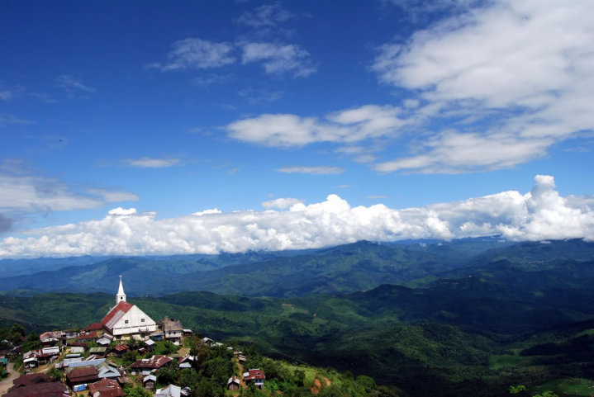
A Baptist Church in Alichen, Nagaland

Slide 3
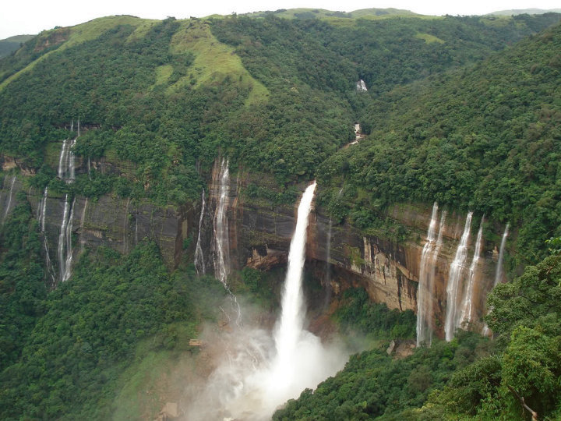
Nohkalikai Falls at Cherapunji, Meghalaya

Slide 4
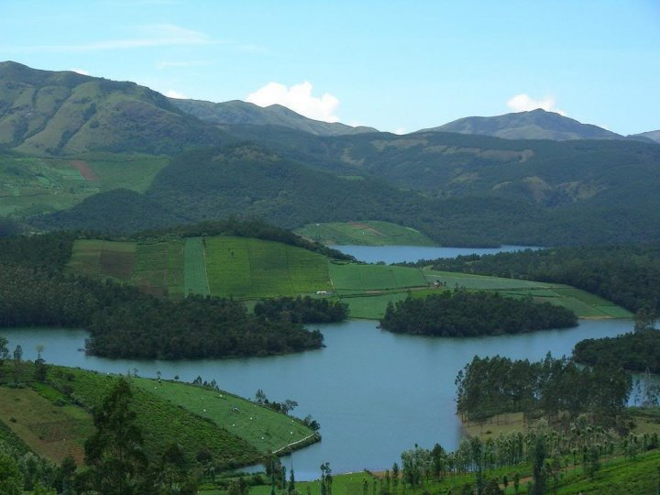
View from Ooty, Tamil Nadu.

Slide 5
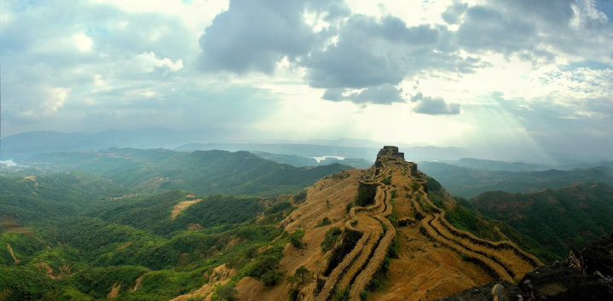
Rajgad Fort, Maharashtra

Slide 6
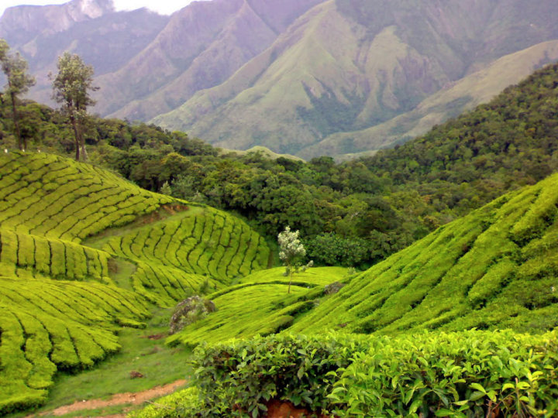
Tea Gardens at Munnar, Kerala

Slide 7
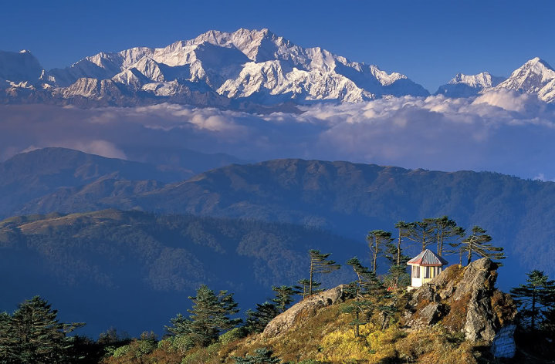
Kanchenjunga (8586m) viewed from Sandakphu, Sikkim

Slide 8
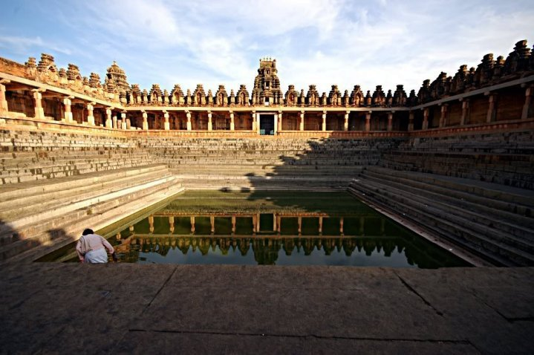
Temple Tank, Bhoga Nandeeshwara temple, Karnataka

Slide 9
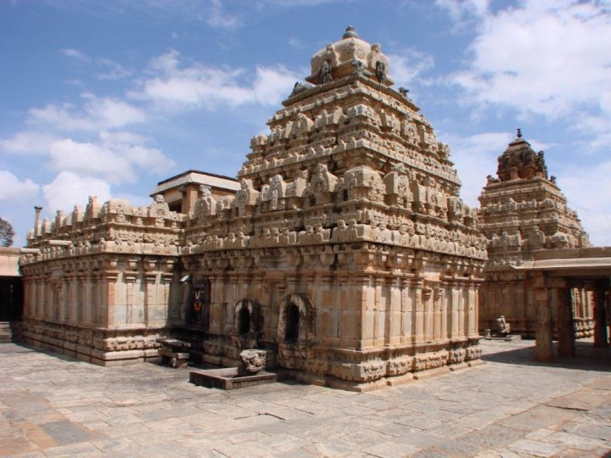
Temple Tank, Bhoga Nandeeshwara temple, Karnataka

Slide 10
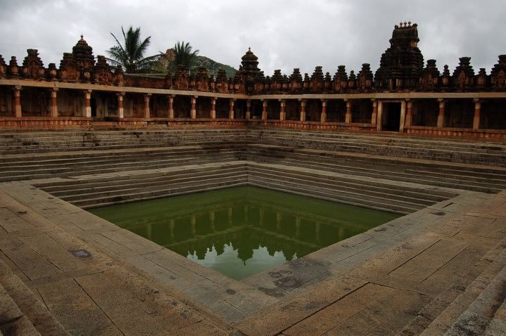
Temple Tank, Bhoga Nandeeshwara temple, Karnataka

Slide 11
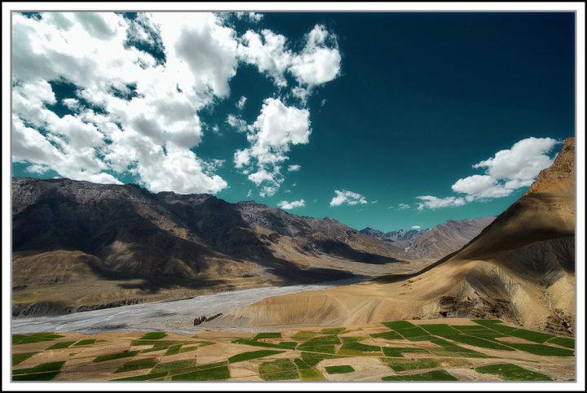
Enroute to Kibber, Himachal Pradesh, India

Slide 12
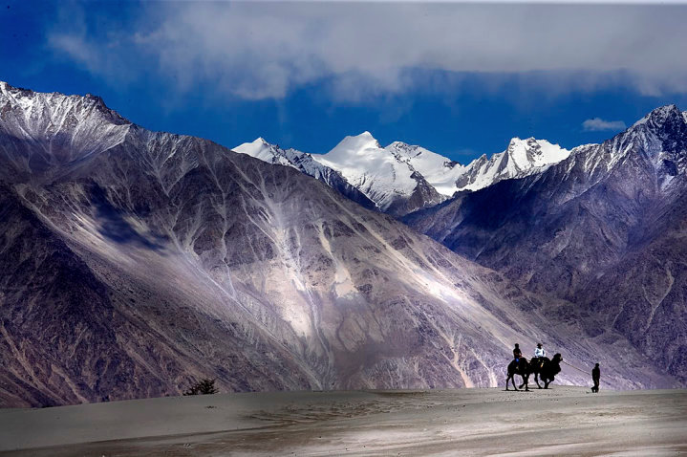
Nubra Valley, Ladakh, Jammu and Kashmir

Slide 13
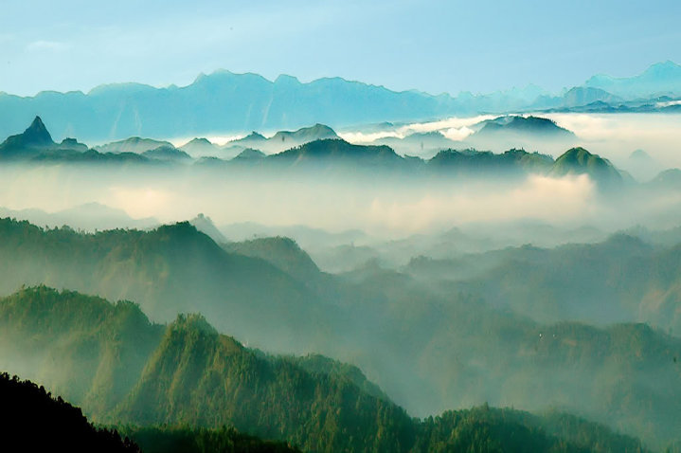
The blue range of mountains that run along the western coast of India.This shot taken in mid May from Palivasal Tea Estate in Munnar in Kerala.

Slide 14
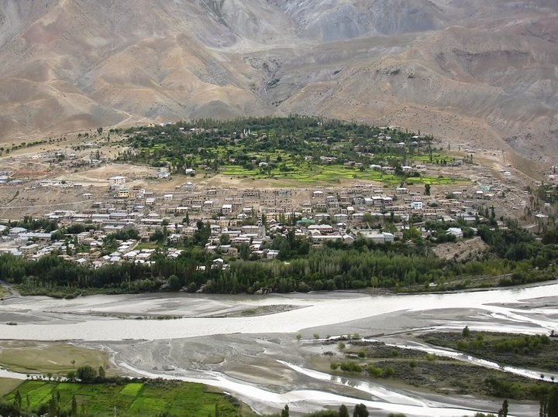
Kargil District, Ladakh, Jammu and Kashmir

Slide 15
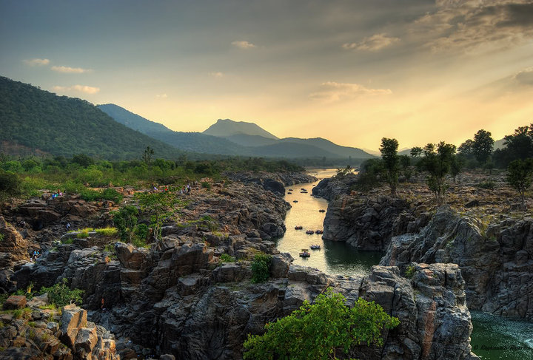
Kaveri river running through Hogenakkal., Tamil Nadu

Slide 16
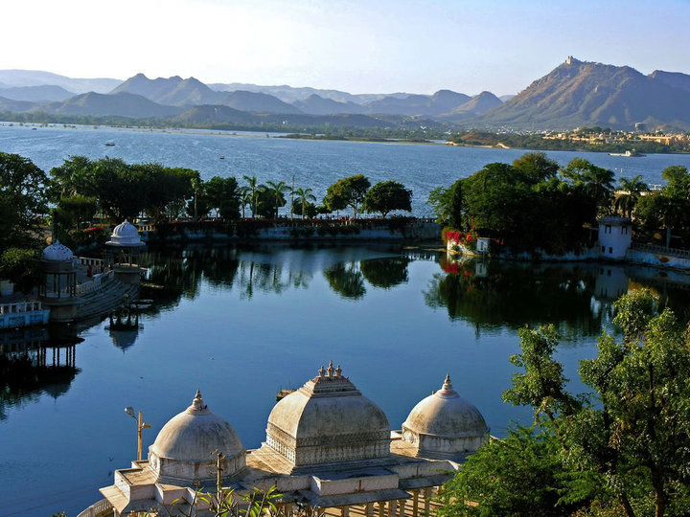
Lake Pichola, Udaipur, Rajasthan

Slide 17
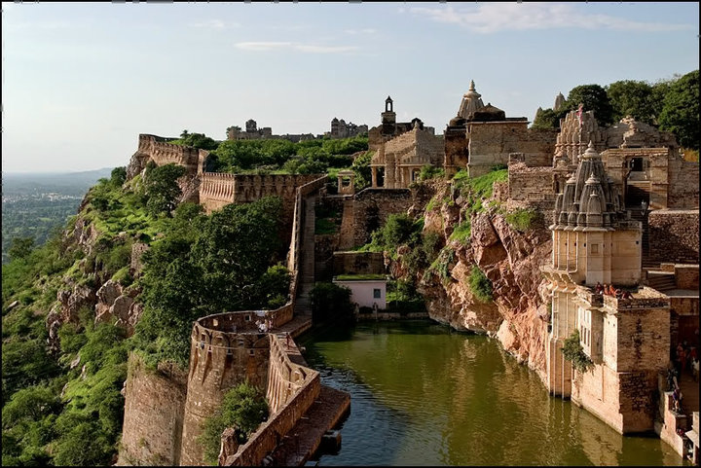
Chittorgarh Fort, Rajasthan

Slide 18
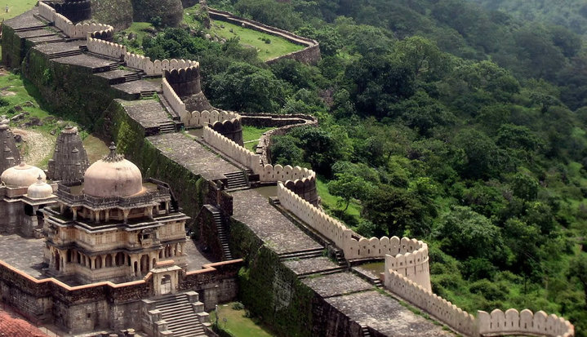
Kumbalgarh Fort, Rajasthan

Slide 19
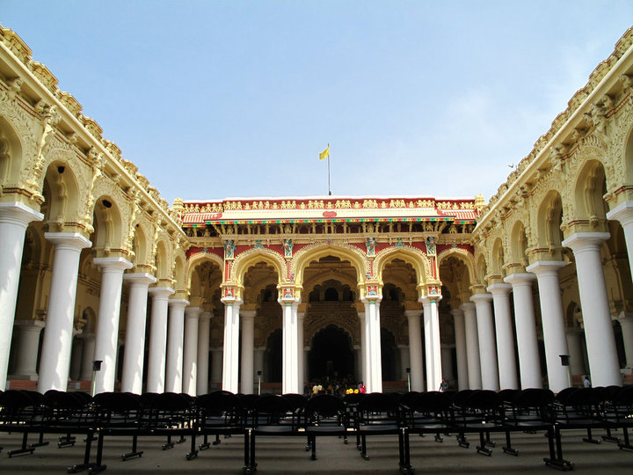
Thirumalai Nayak Palace. Inner courtyard, Madurai,Tamil Nadu

Slide 20
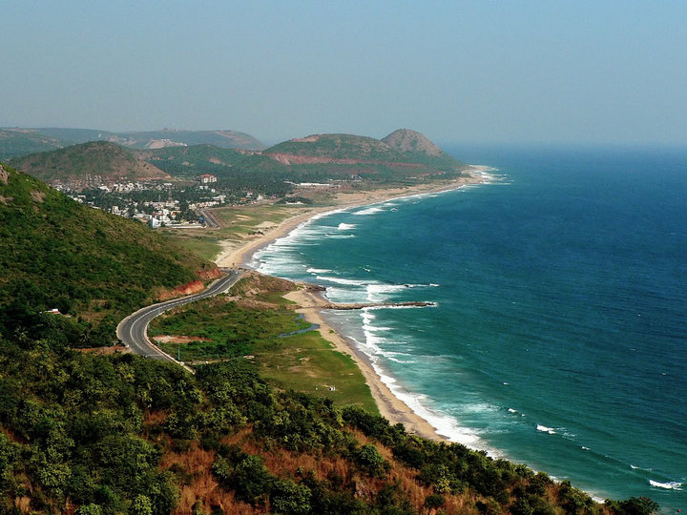
The port city of Vishakhapatnam (Vizag for short), Andhra Pradesh

Slide 21
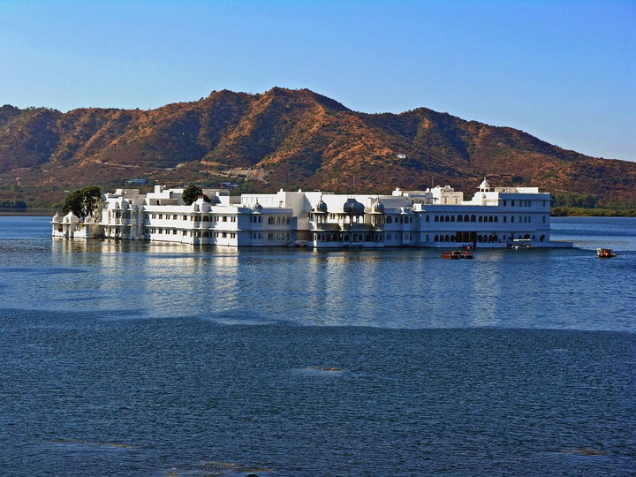
Lake Palace, Udaipur, Rajasthan

Slide 22
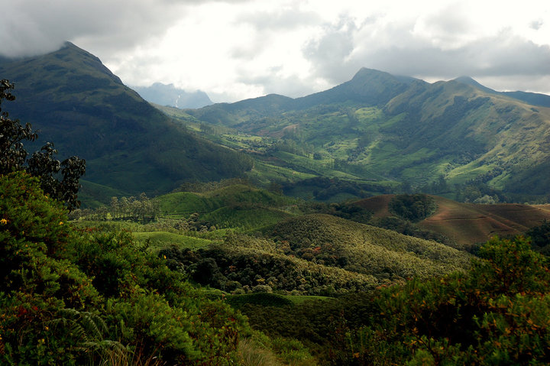
Eravikulam National Park, Kerala

Slide 23
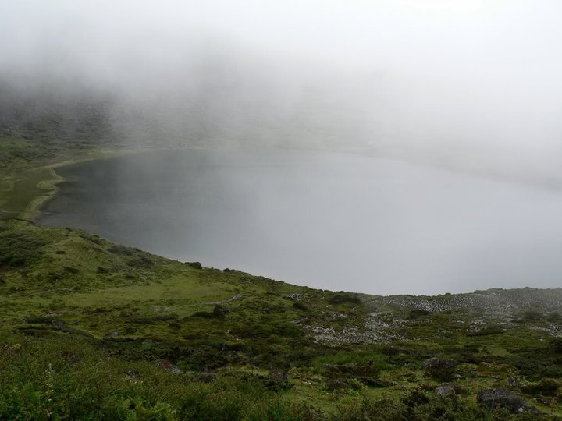
Tso-kyo Lake, Tawang, Arunachal pradesh

Slide 24
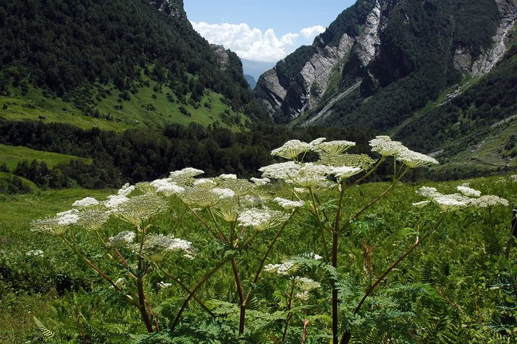
Valley of Flowers National Park, Uttaranchal

Slide 25
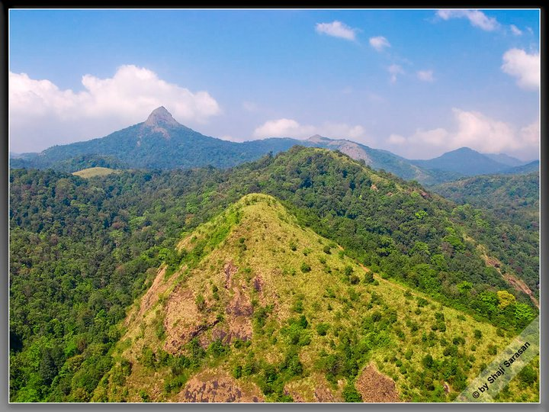
Silent Valley, Palakkad, Kerala

Slide 26
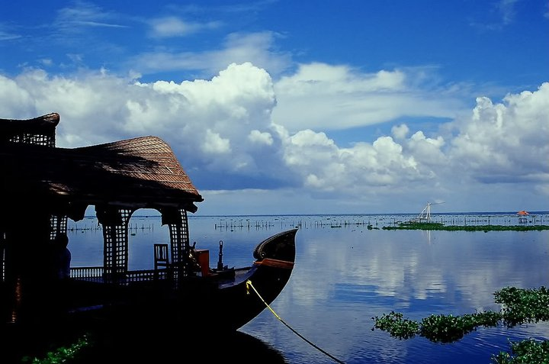
A Boathouse on the placid backwaters of Kumarakom, Kerala

Slide 27
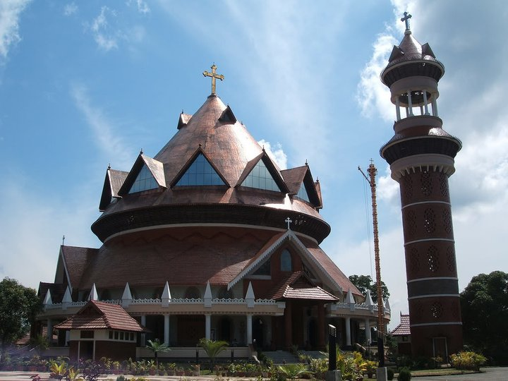
A Cathedral in Thiruvalla, Kerala incorporating the features of a traditional Hindu Temple, a Mosque and Church

Slide 28
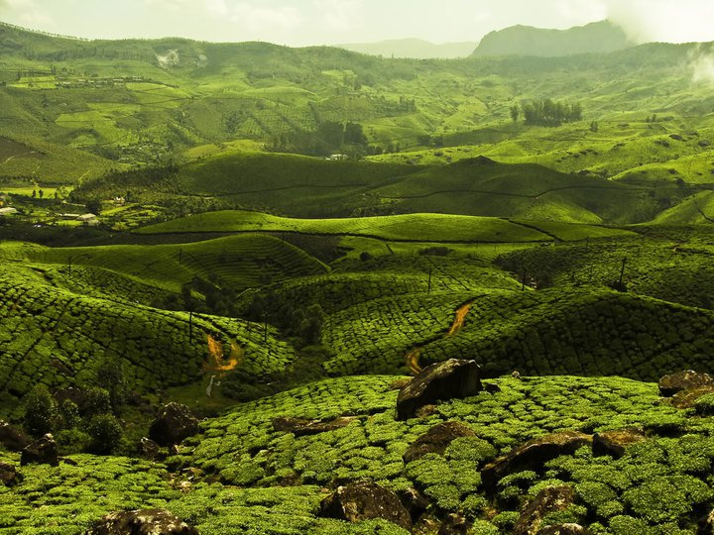
Munnar, Kerala

Slide 29
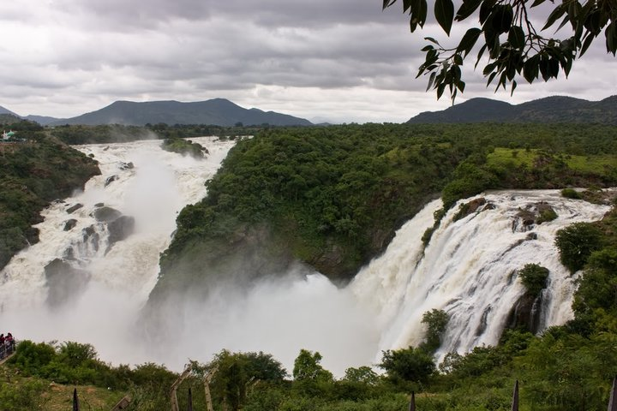
Gaganachukki Falls, Mandya, Karnataka

Slide 30
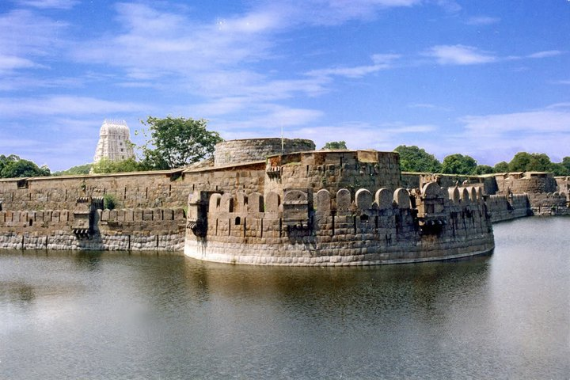
Vellore fort, Tamil Nadu

