Slide 1
INDIA - AJANTA AND ELLORA CAVES

Slide 2
Ellorais an archaeological site, 30 km (19 mi) from the city of Aurangabad in the Indian state of Maharashtra built by the Rashtrakuta rulers. Well-known for its monumental caves, Ellora is a World Heritage Site. Ellora represents the epitome of Indian rock-cut architecture. The 34 "caves" – actually structures excavated out of the vertical face of the Charanandri hills – being Buddhist, Hindu and Jain rock cut temples and monasteries, were built between the 5th century and 10th century. The 12 Buddhist (caves 1–12), 17 Hindu (caves 13–29) and 5 Jain (caves 30–34) caves, built in proximity, demonstrate the religious harmony prevalent during this period of Indian history.

Slide 3
The Ajanta in Maharashtra, India are 31 rock-cut cave monuments which date from the 2nd century BC. The caves include paintings and sculptures considered to be masterpieces of both Buddhist religious art (which depict the Jataka tales) as well as frescos which are reminiscent of the Sigiriya paintings in Sri Lanka. The caves were built in two phases starting around 200 BC, with the second group of caves built around 600 AD. Since 1983, the Ajanta Caves have been a UNESCO World Heritage Site. The caves are located in the Indian state of Maharashtra, just outside the village of Ajinṭhā in Aurangabad district

Slide 4
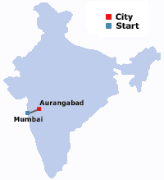
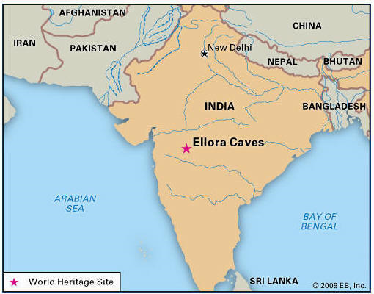
Located near Aurangabad

Slide 5
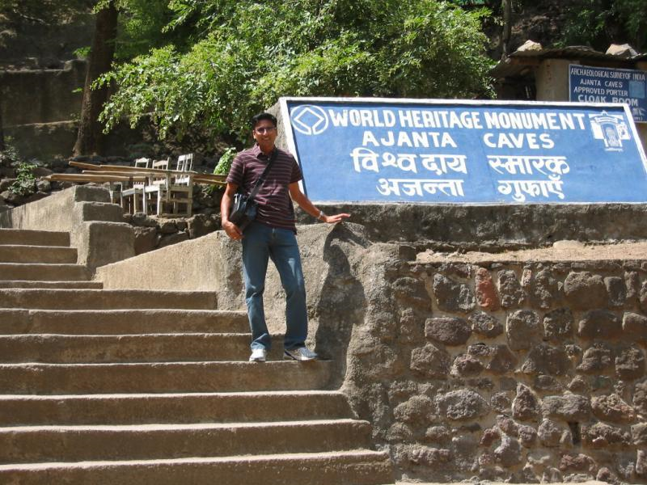

Slide 6
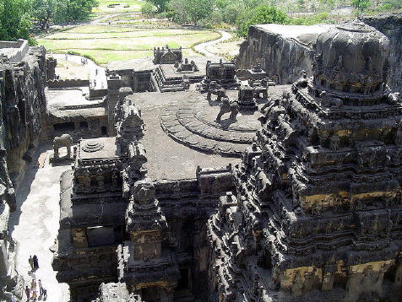
Kailasa Temple – Centerpiece of the Ellora Caves

Slide 7
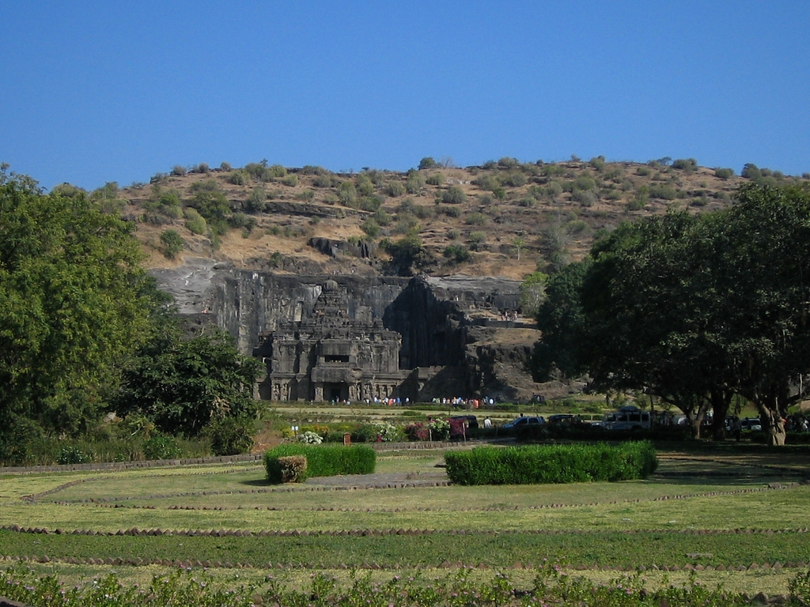
Kailasa Temple

Slide 8
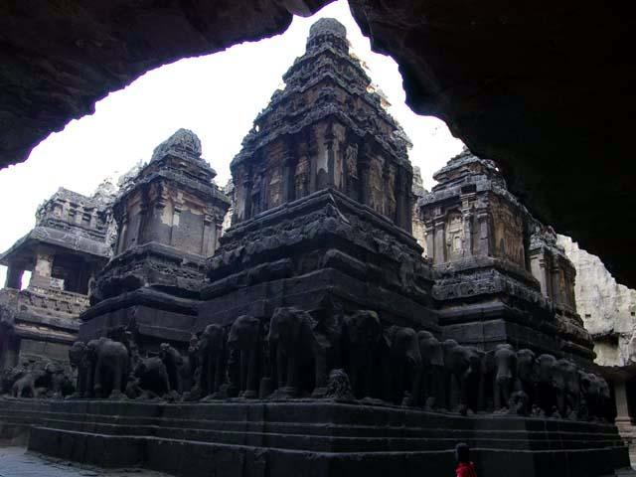

Slide 9
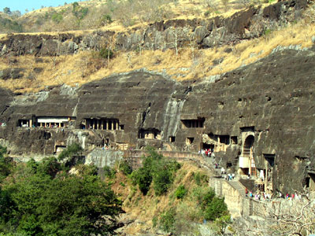

Slide 10
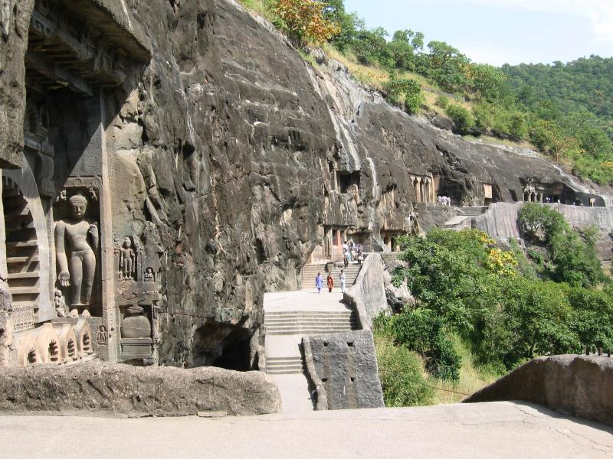

Slide 11
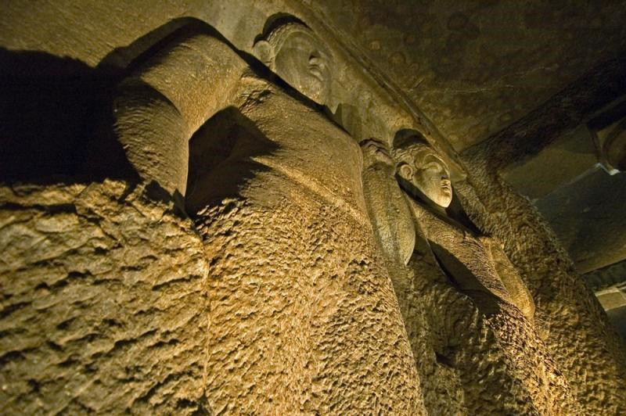

Slide 12
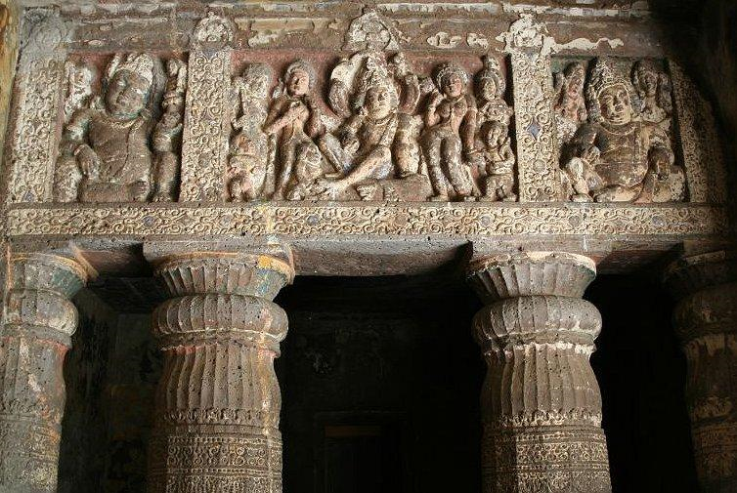

Slide 13
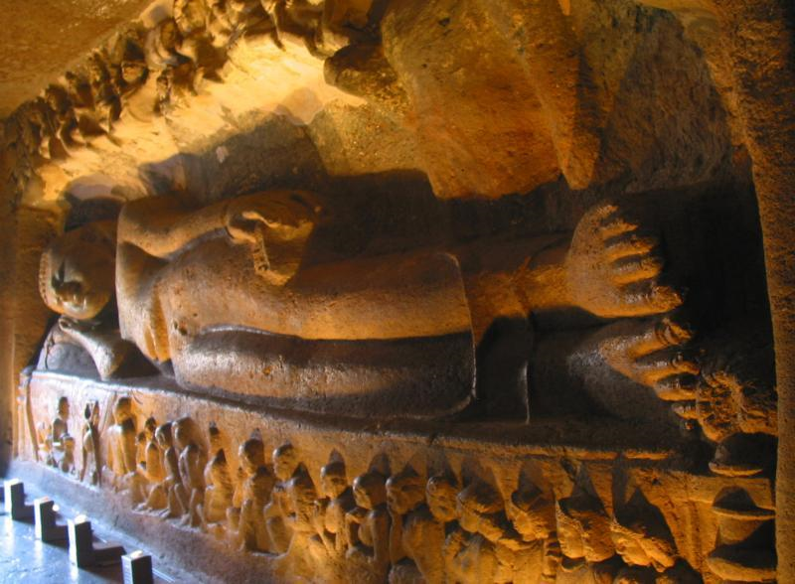

Slide 14
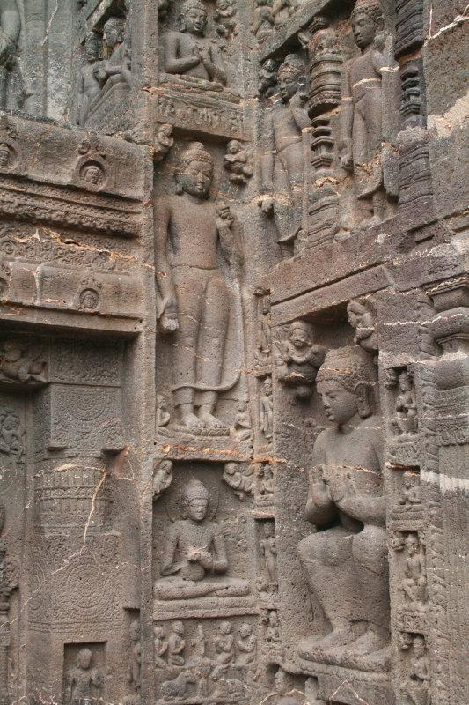

Slide 15
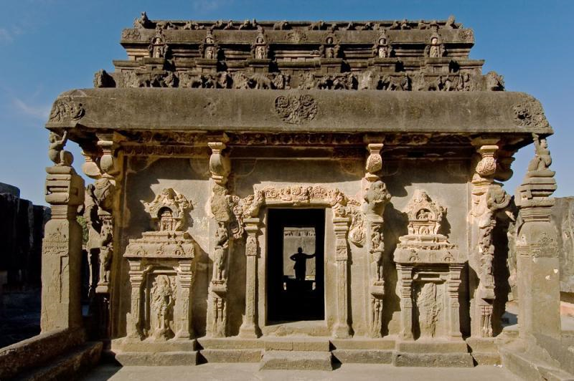

Slide 16
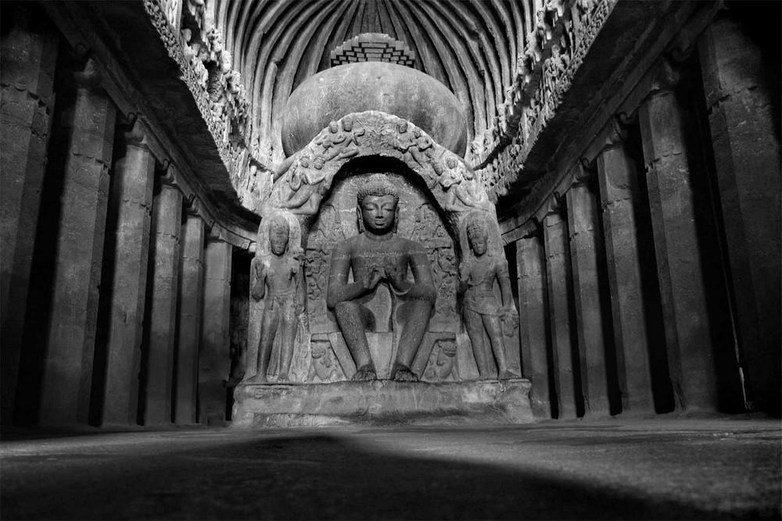

Slide 17
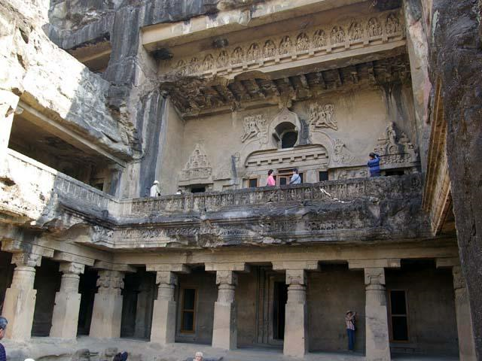

Slide 18
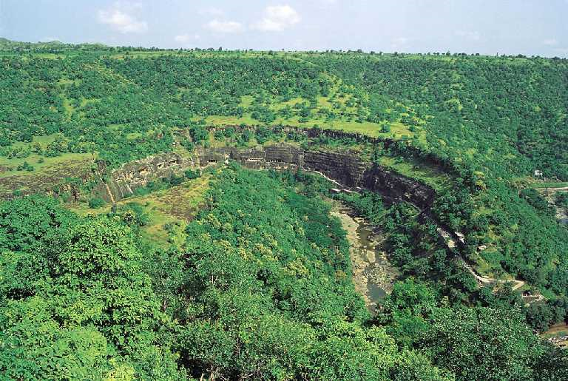

Slide 19
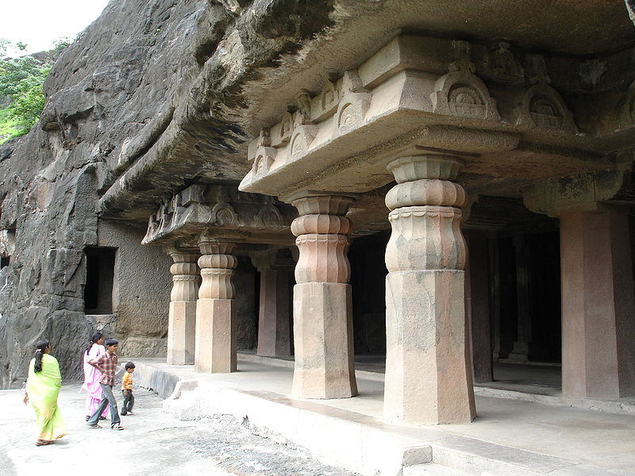

Slide 20
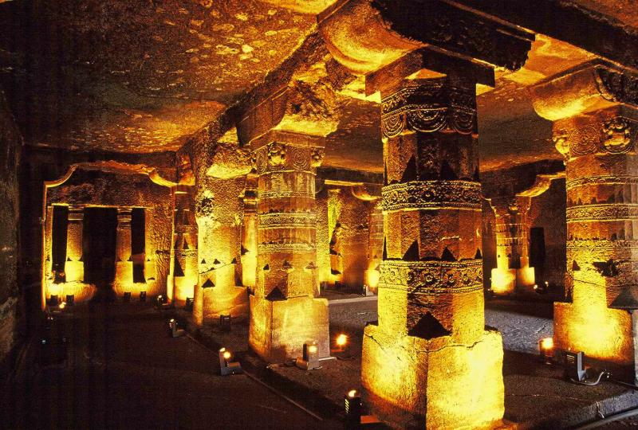

Slide 21
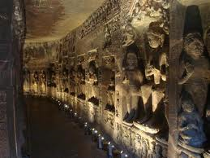

Slide 22
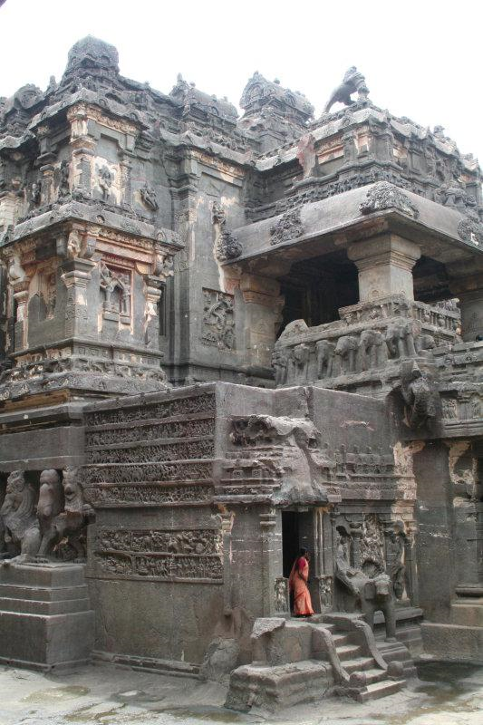

Slide 23
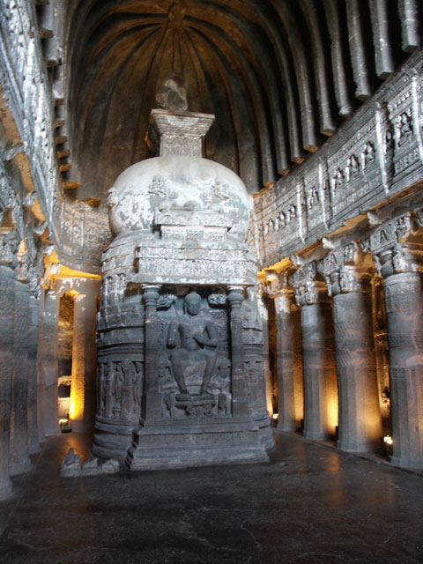

Slide 24
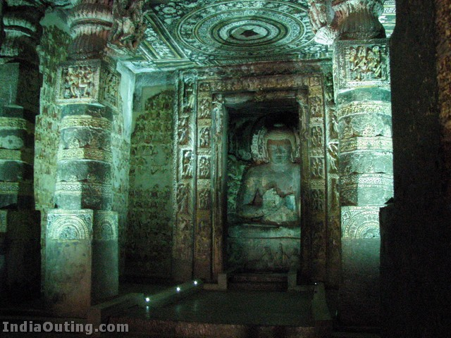

Slide 25
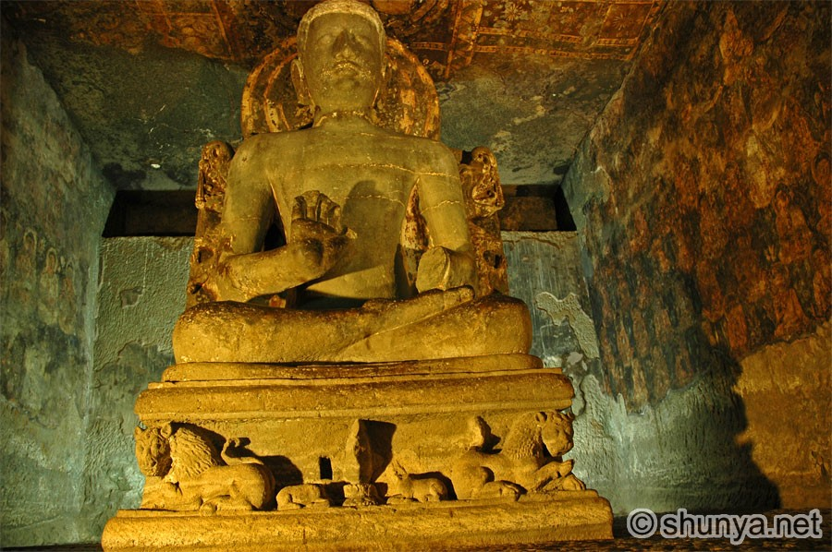

Slide 26
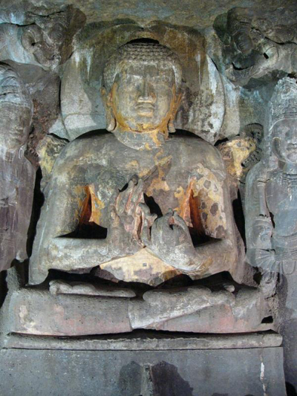

Slide 27
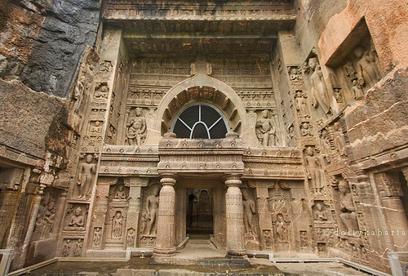

Slide 28
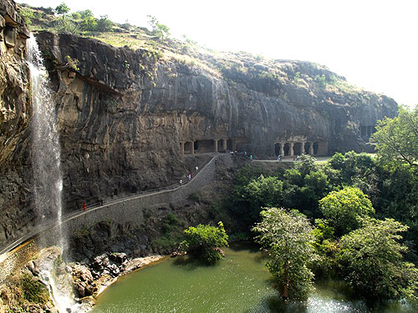

Slide 30
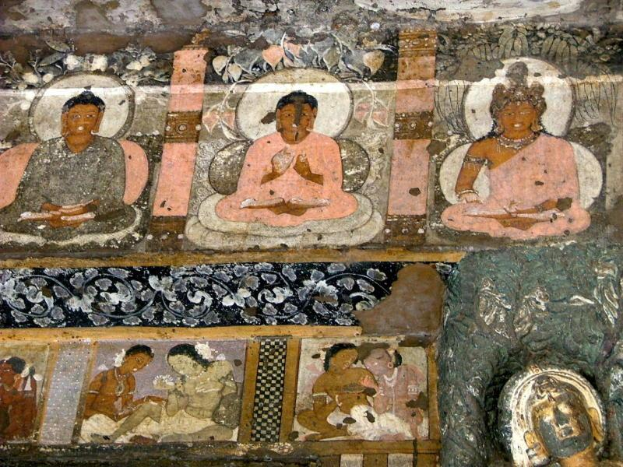

Slide 31
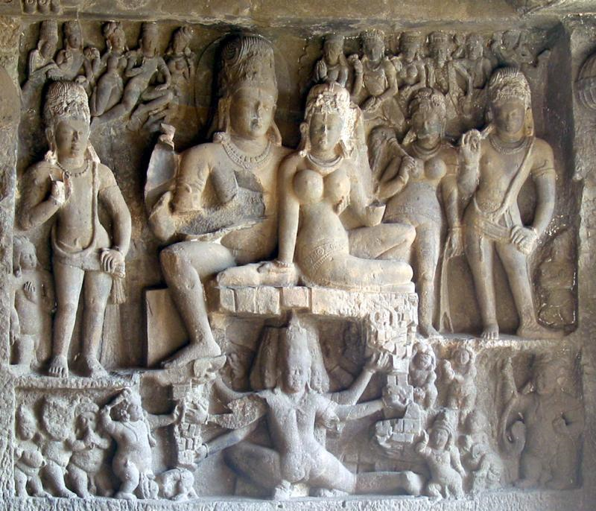

Slide 32
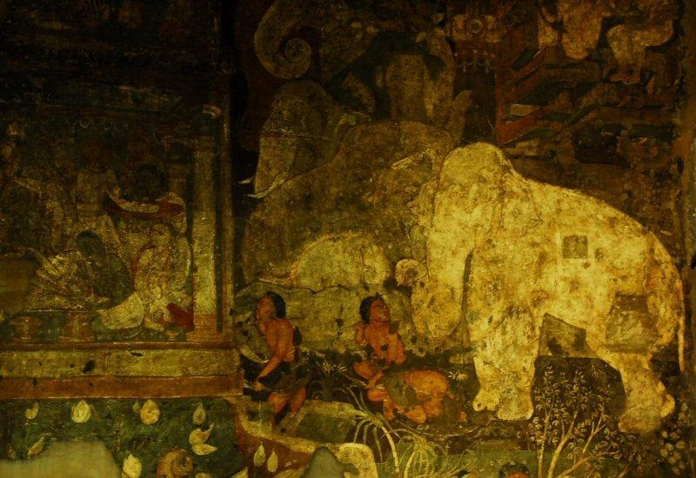

Slide 33
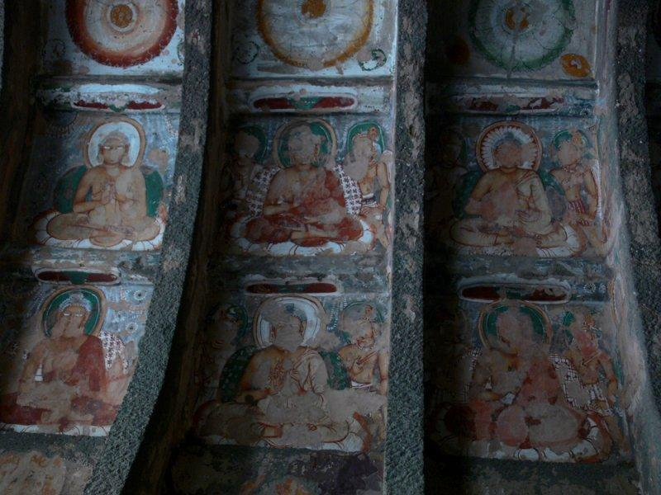

Slide 34
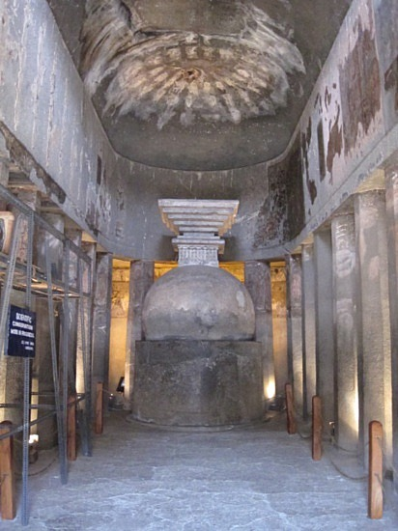

Slide 35
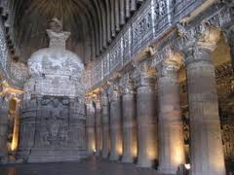

Slide 36
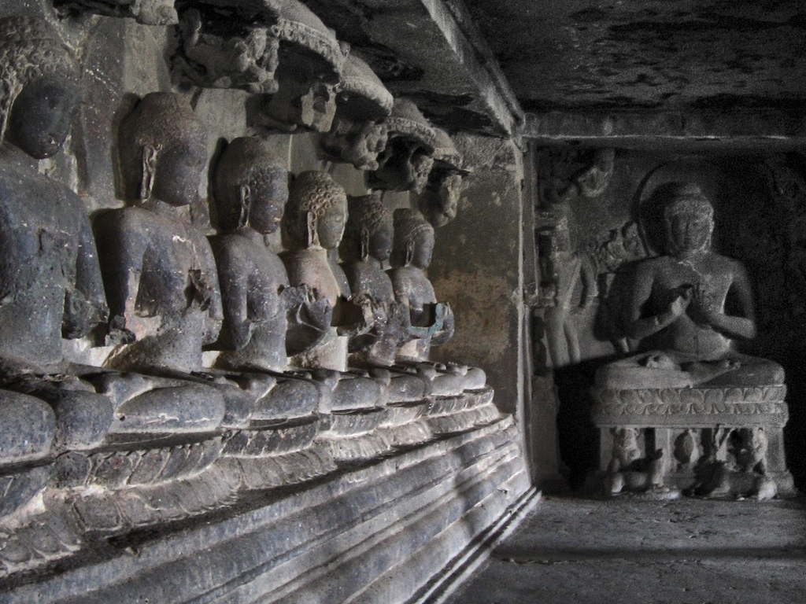

Slide 37
