Slide 1
Earthquake & Tsunami – Japan Worst in 140 years – 3-11-2011
8.9 to 9.1 estimated
23 foot Tsunami waves hit the Japanese coast

Slide 2
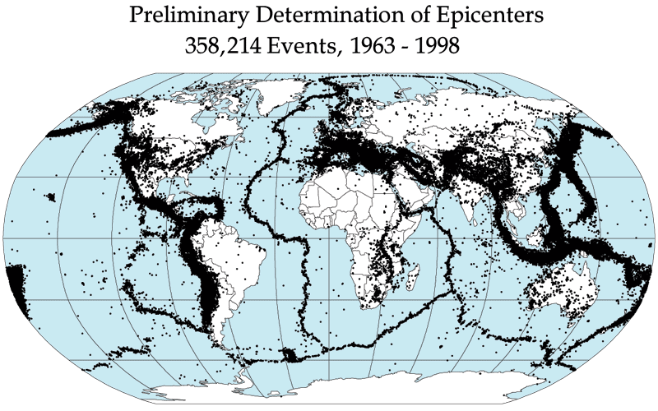

Slide 3
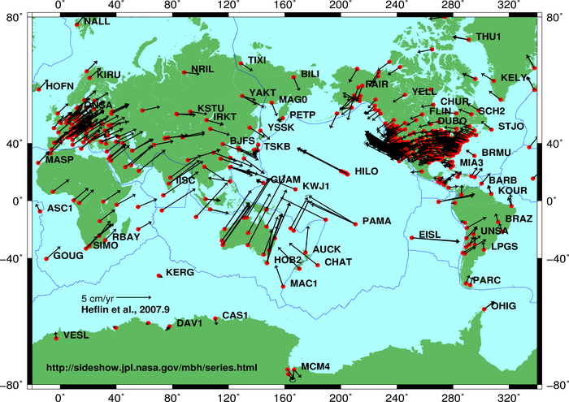
Global plate tectonic movement

Slide 4
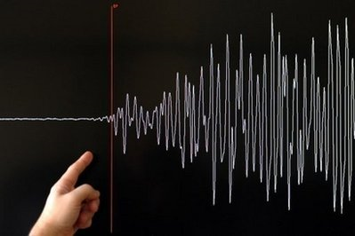

Slide 5
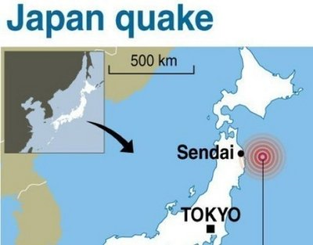

Slide 6
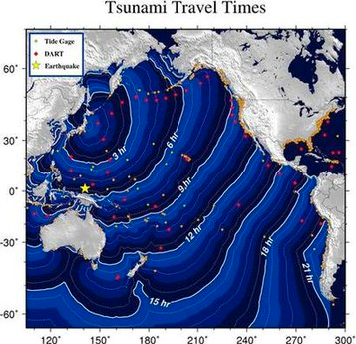

Slide 7
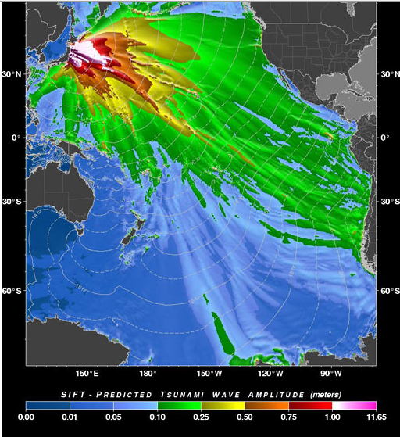

Slide 8
It ranked as the fifth-largest earthquake in the world since 1900 and was nearly 8,000 times stronger than one that devastated Christchurch, New Zealand, last month, scientists said.

Slide 9
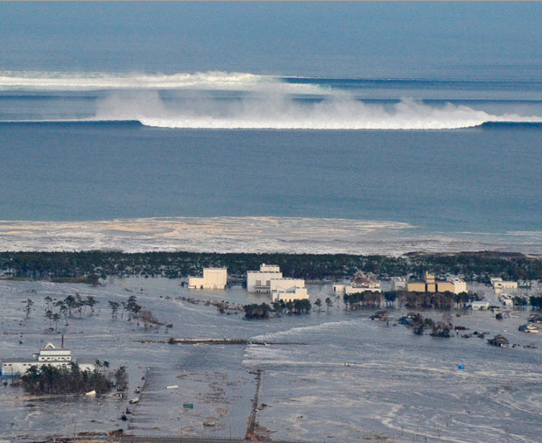

Slide 10
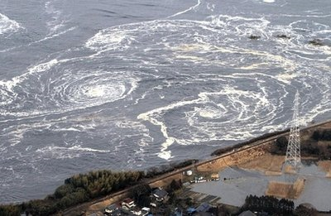

Slide 11
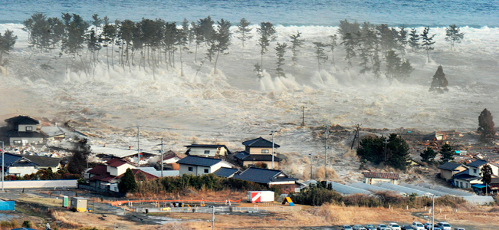
Tsunami

Slide 12
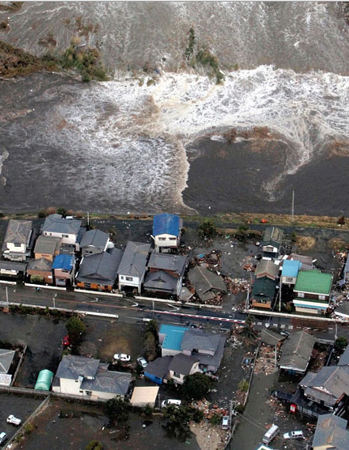

Slide 13
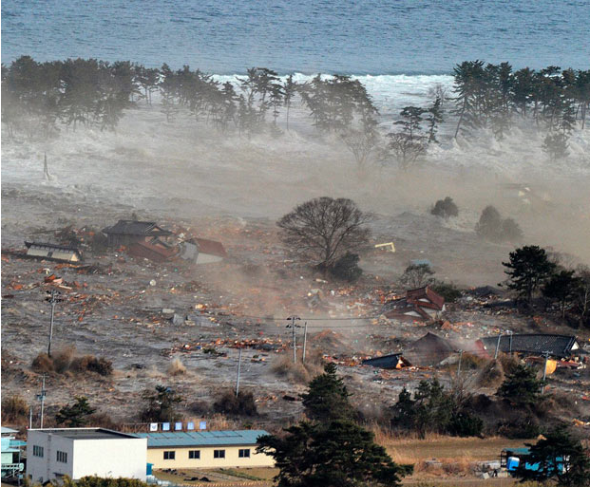

Slide 14
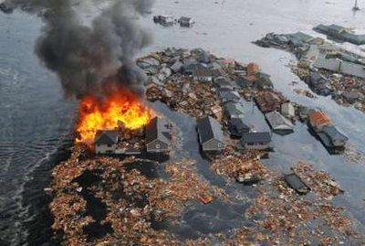
Fires from ruptured gas lines

Slide 15
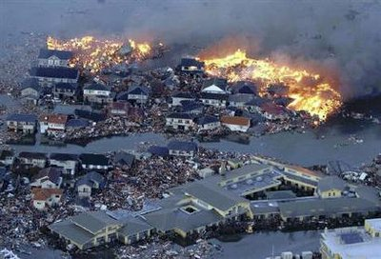

Slide 16
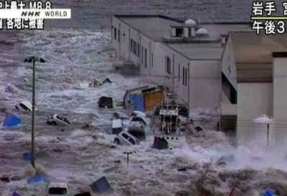

Slide 17
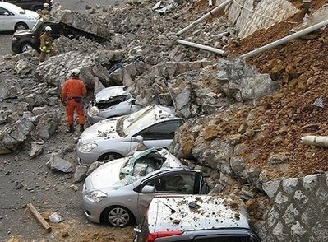
Earthquake – collapsed garage

Slide 18
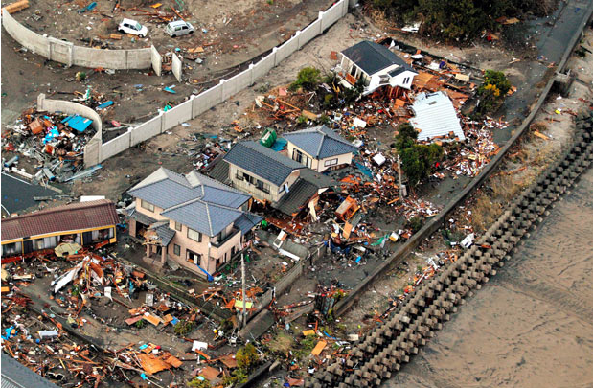

Slide 19
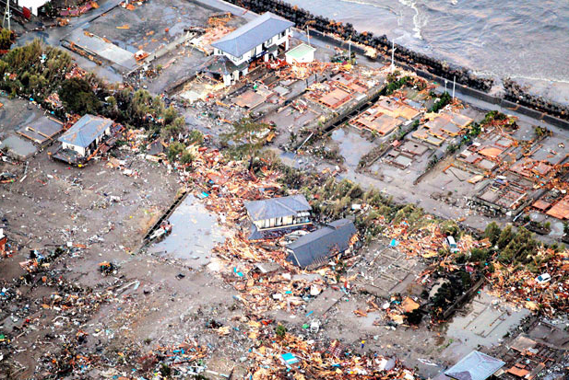

Slide 20
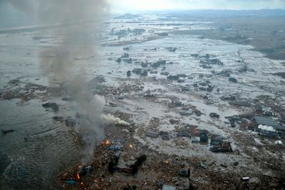
Shores are submerged in Natori city

Slide 21
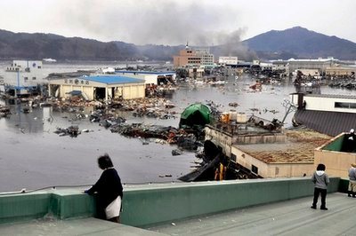
Warehouse washed away

Slide 22
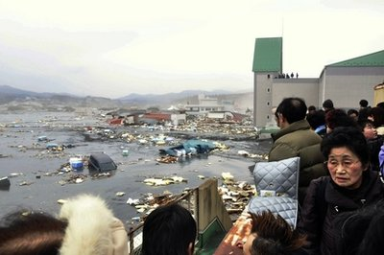
Watching the disaster & its aftermath

Slide 23
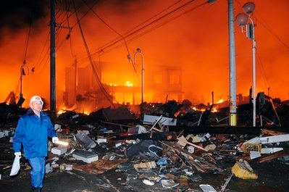
Fires from ruptured gas lines

Slide 24
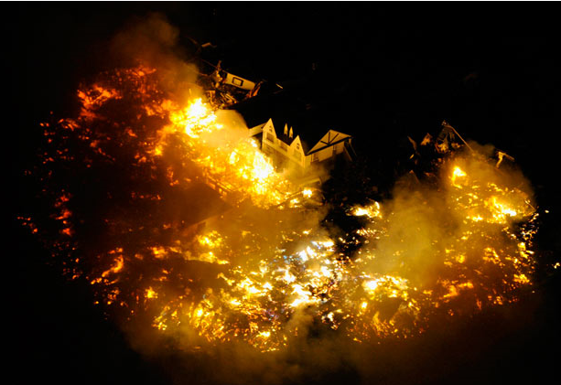
Buildings burn near Sendai Airport in Japan

Slide 25
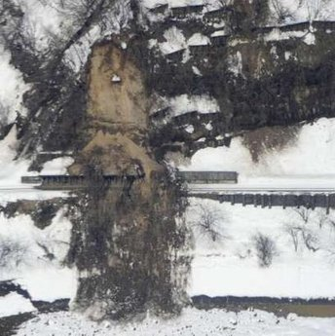
Mudslide triggered by the earthquake

Slide 26
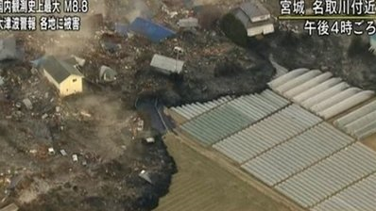

Slide 27
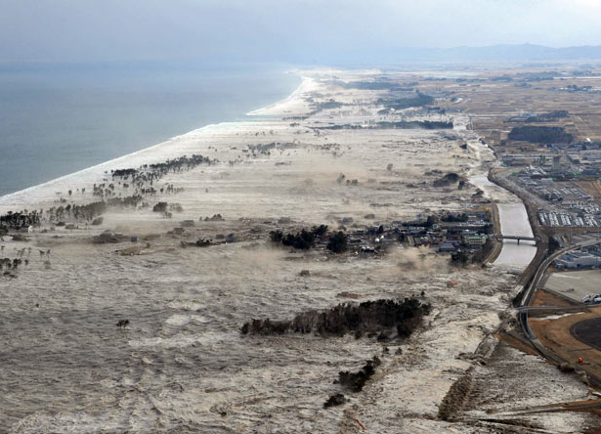

Slide 28
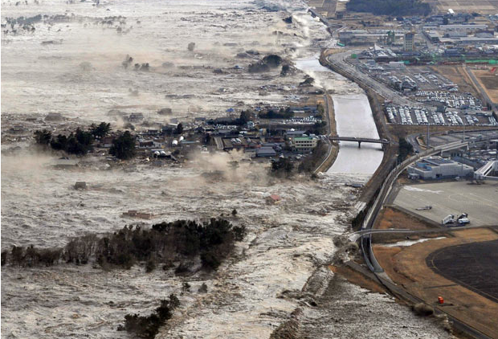

Slide 29
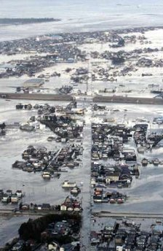

Slide 30
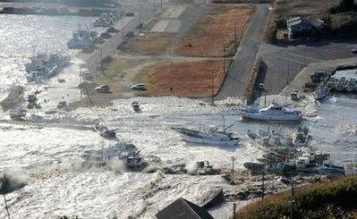
Ships washed ashore

Slide 31
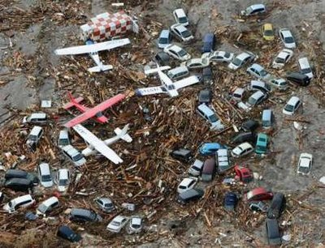

Slide 32
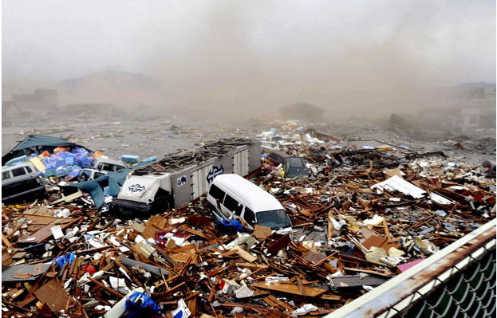

Slide 33
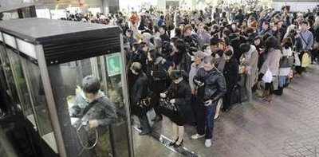
Tokyo public transit was shut down – people stranded

Slide 34
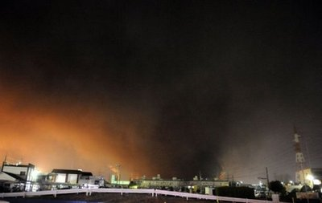

Slide 35
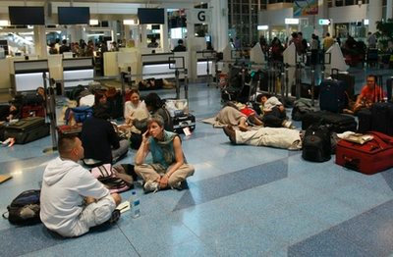

Slide 36
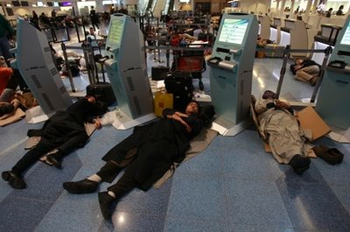

Slide 37
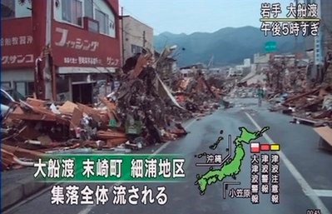

Slide 38
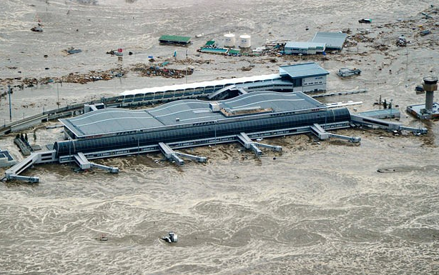
Sendai Airport is flooded after tsunami

Slide 39
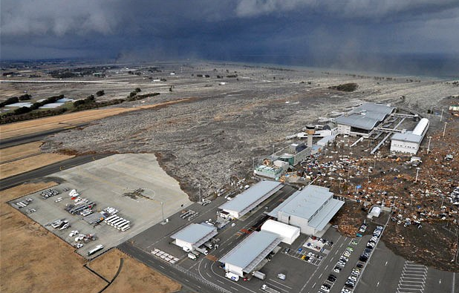
Sendai Airport

Slide 40
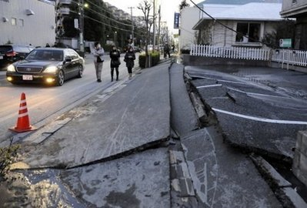

Slide 41
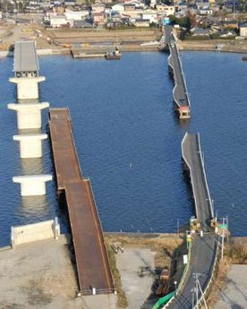

Slide 42
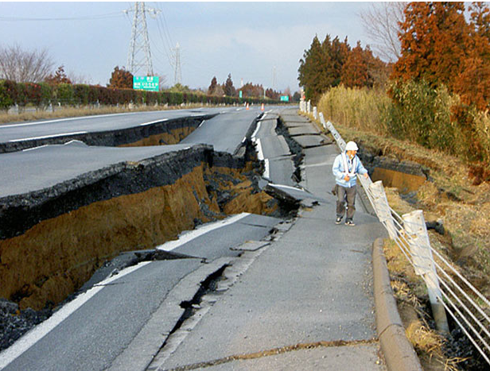

Slide 43
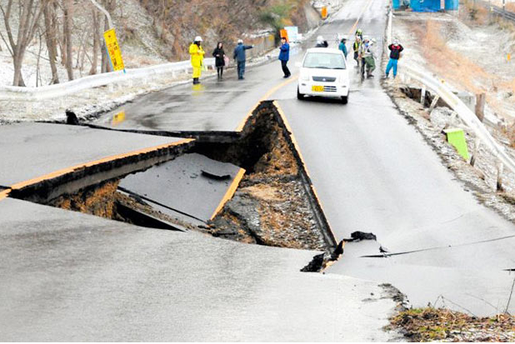

Slide 44
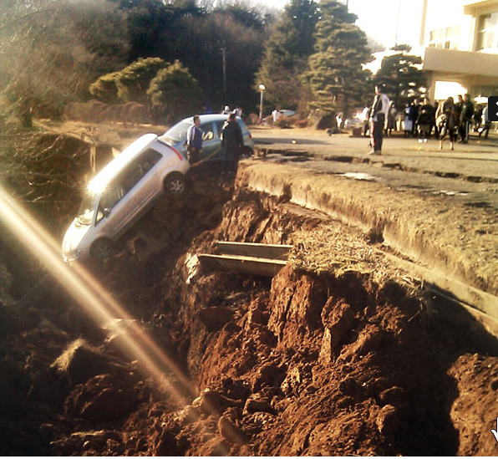

Slide 45
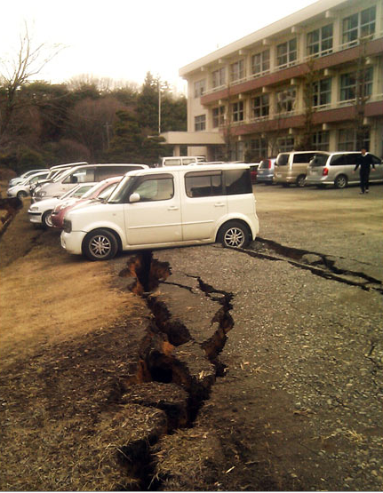

Slide 46
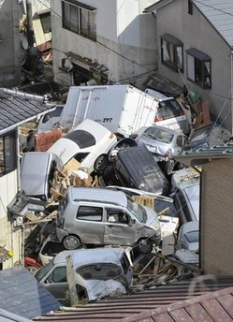

Slide 47
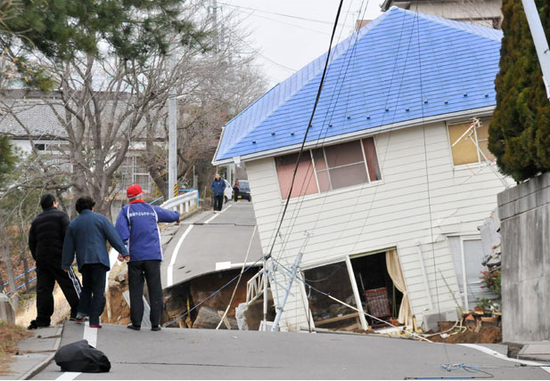

Slide 48
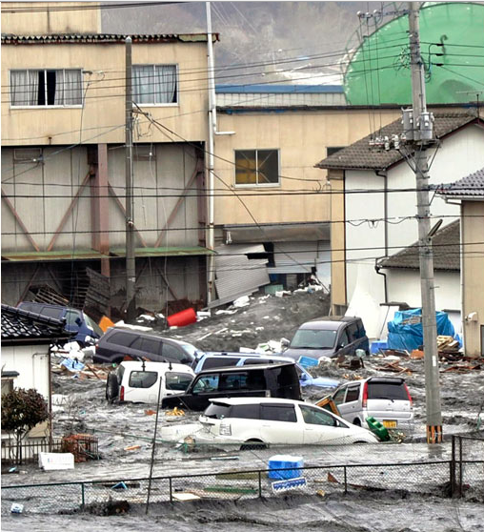

Slide 49
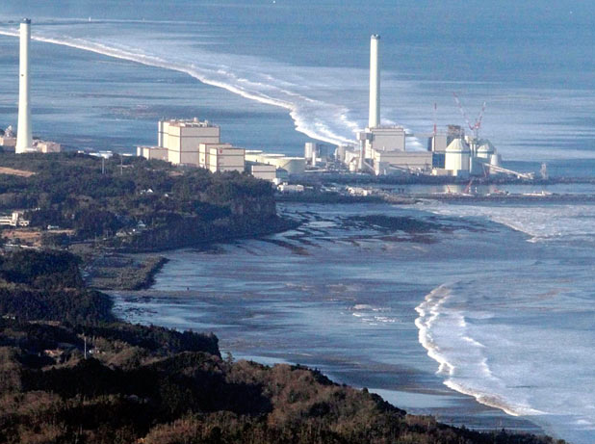
Concern about nuclear power plants

Slide 50
FUKUSHIMA, Japan (Reuters) – Japan scrambled on Saturday to reduce pressure in two nuclear plants damaged after a massive earthquake and tsunami struck its northeast coast probably killing at least 1,300 people.
The government warned of a possible radiation leak as authorities began trying to reduce pressure at damaged two nuclear plants, sending tens of thousands of residents out of the area to avoid possible contamination.

Slide 51
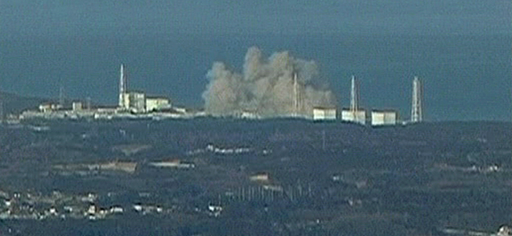
An explosion at a nuclear power station Saturday destroyed a building housing the reactor amid fears that it could melt down

Slide 52
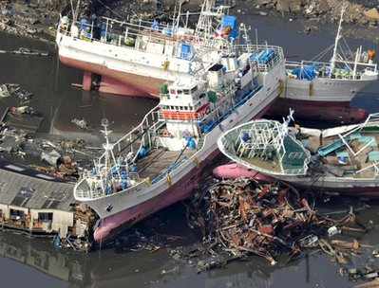

Slide 53
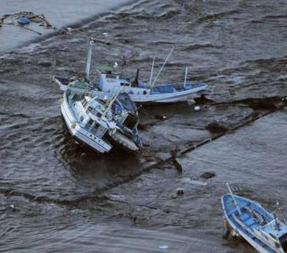

Slide 57
A fireball rise from an oil refinery

Slide 59
Putting out the fires at oil refinery

Slide 60
Swiss Rescue Workers

Slide 61
Korean Rescue Team

Slide 63
Searching for survivors

Slide 69
Evacuees take shelter during blackout

Slide 71
Aftershock Quakes
Saturday, 3/12/2011 – 6.8 on the Richter scale
Saturday's magnitude 6.8 quake was followed by a series of temblors originating from the same area, the USGS said. It was not immediately known whether the new quakes caused any more damage. All were part of the more than 125 aftershocks since Friday's massive quake, the strongest to hit Japan since officials began keeping records in the late 1800s.

Slide 72
Quake, Tsunami Deal Blow to Japanese Automakers
The massive earthquake that rocked northern Japan has dealt a hammer blow to the Japanese auto industry, which is still piecing together the impact of what is now believed to have been the worst temblor in recorded Japanese history – and the tsunami it spawned — on the country’s industrial base. With numerous injuries and at least one death, as well as substantial physical damage, automakers large and small say they will be forced to curb production at more than a dozen plants.

Slide 73
Death toll will exceed 10,000
TAGAJO, Japan – The death toll in Japan's earthquake and tsunami will likely exceed 10,000 in one state alone, an official said Sunday, as millions of survivors were left without drinking water, electricity and proper food along the pulverized northeastern coast.
"This is Japan's most severe crisis since the war ended 65 years ago," Prime Minister Naoto Kan told reporters, adding that Japan's future would be decided by the response to this crisis.

Slide 74
Japan Faces Potential Nuclear Disaster as Radiation Levels Rise
Explosions at 3 reactors by 3/15/2011

Slide 75
In a brief address to the nation at 11 a.m. Tokyo time, Prime Minister Naoto Kan pleaded for calm, but warned that radiation had already spread from the crippled reactors and there was “a very high risk” of further leakage. Fortunately, the prevailing winds were sweeping most of the plume of radioactivity out into the Pacific Ocean, rather than over populated areas.
It diminished hopes earlier in the day that engineers at the plant, working at tremendous personal risk, might yet succeed in cooling down the most damaged of the reactors, No. 2, by pumping in sea water.

