Slide 1
Christinia - The Free Town of Copenhagen
A Unique Settlement

Slide 2
Background
The Freetown of Christiania is a self-governing neighborhood in Copenhagen, Denmark’s capital city, where the people actually live freely.
Chritiania was created in 1971, and consists of the old Bådsmandsstræde Barracks and parts of the city ramparts. After the barracks were abandoned by the military, the area was simply taken over by the locals in the surrounding neighborhoods, as a playground for their children. This was actually a protest against the Danish government of that time, started by the article of one Jacob Ludvigsen. He was a popular journalist who wrote for a magazine addressed mostly to the young and the restless, and his piece, entitled Civilians conquered the forbidden city of the military eventually led to the proclamation of the free town.

Slide 3
It became a small state within a state, governed by its own laws, where people were free to express themselves any way they liked. The inhabitants of Christiania practice meditation and Yoga, but are also passionate about doing light drugs like marijuana or skunk weed. They’ve developed their own set of rules, independent from the Danish law. These rules forbid violence, stealing, knives, guns, bikers’ colors and the use of hard drugs. Other than this, pretty much anything else is allowed.
Often referred to as ‘losers paradise’, because of the number of homeless,vagabonds and jobless people who find a sanctuary here, not to mention the young people who come here to buy and do drugs,

Slide 4
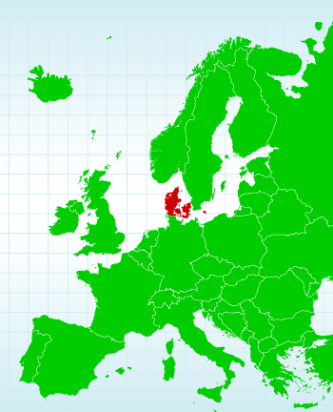
Christiania is truly a unique place. Until 2004, the commerce of marijuana and other light frugs was permitted, but since then, the Danish government has taken action and tried to forbid it. That led to a series of protests and riots, leaving the situation in a sort of limbo. Surrounded by controversy, due to its set of permissive laws, Christiania is unique in the world, and many Danish take their foreign guests here to show them something they can’t see anywhere outside Copenhagen.

Slide 5
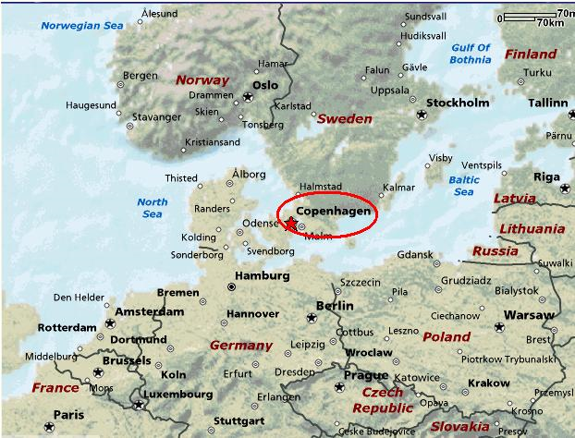

Slide 6
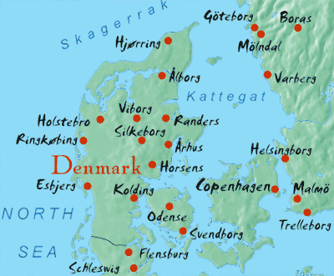

Slide 7
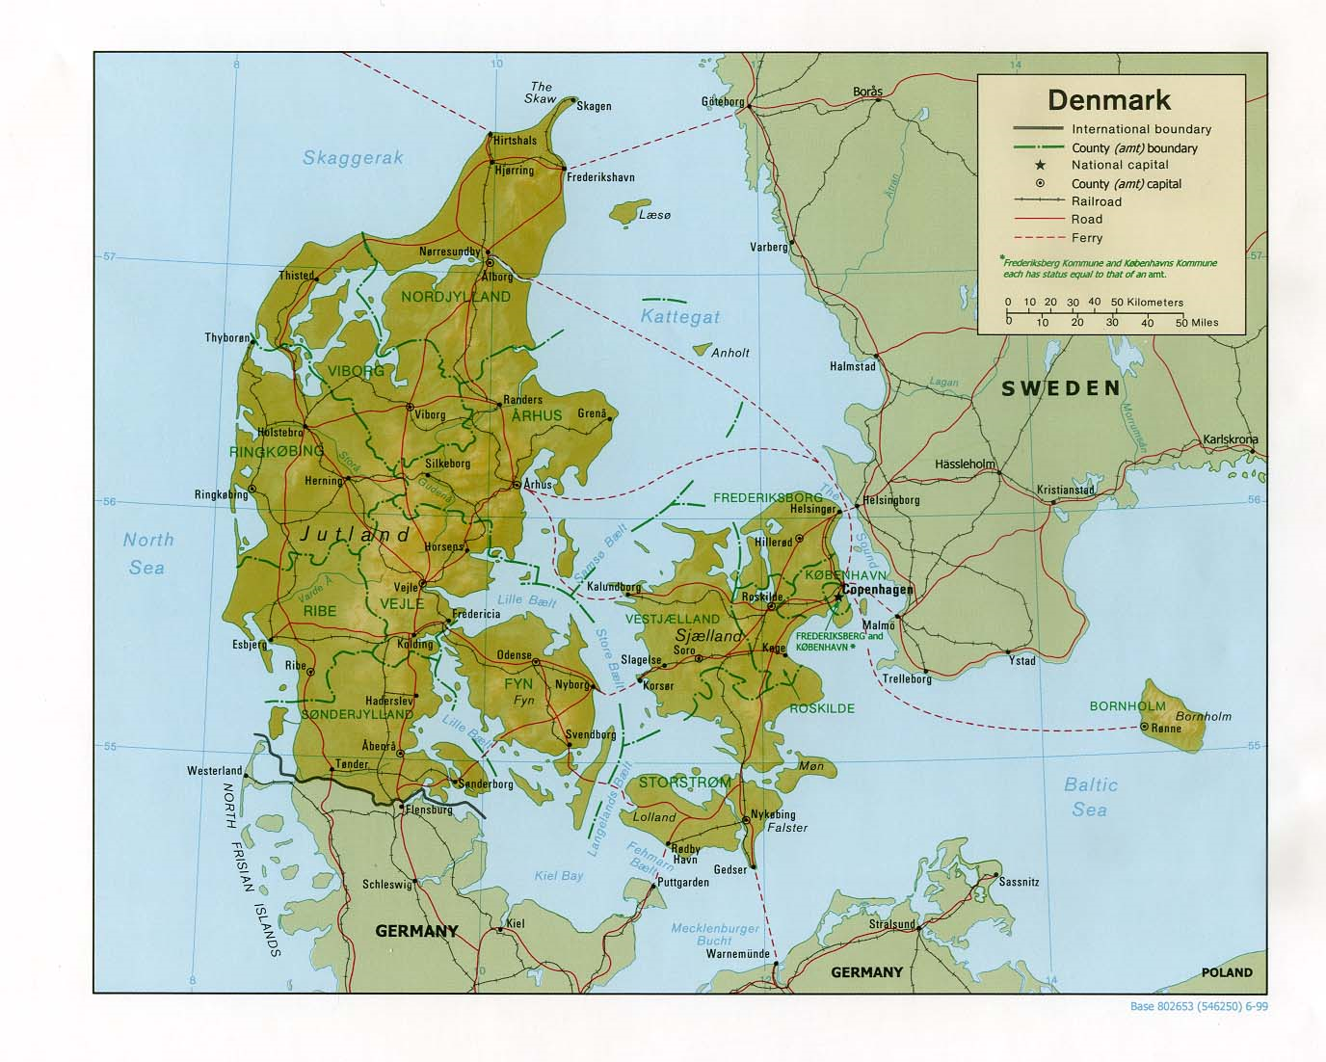

Slide 8
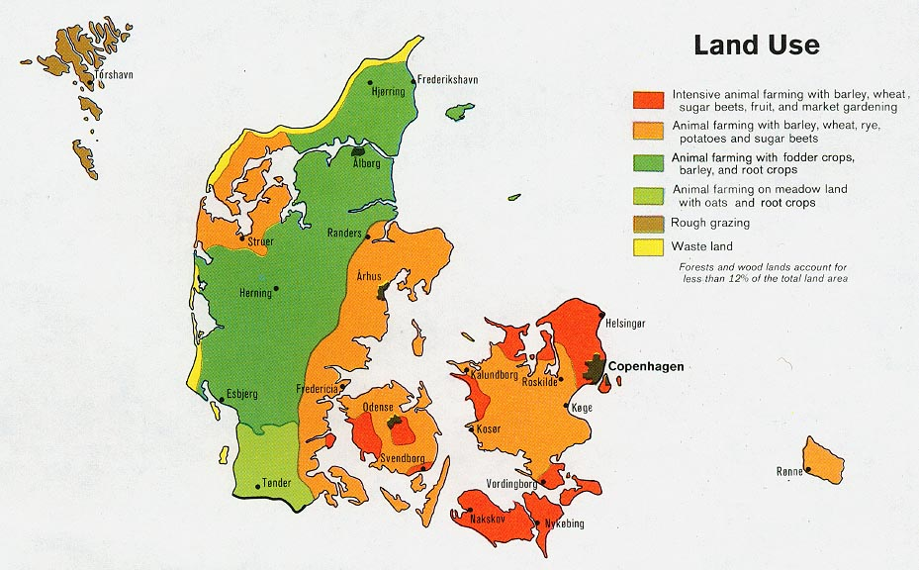

Slide 9
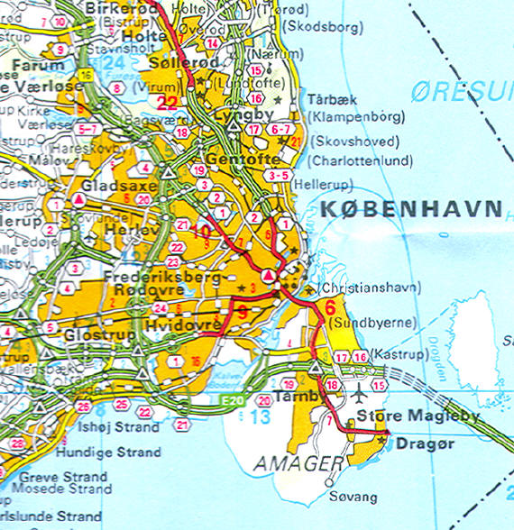

Slide 10
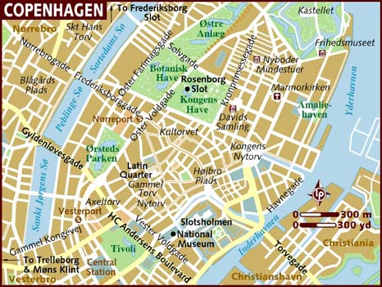

Slide 11
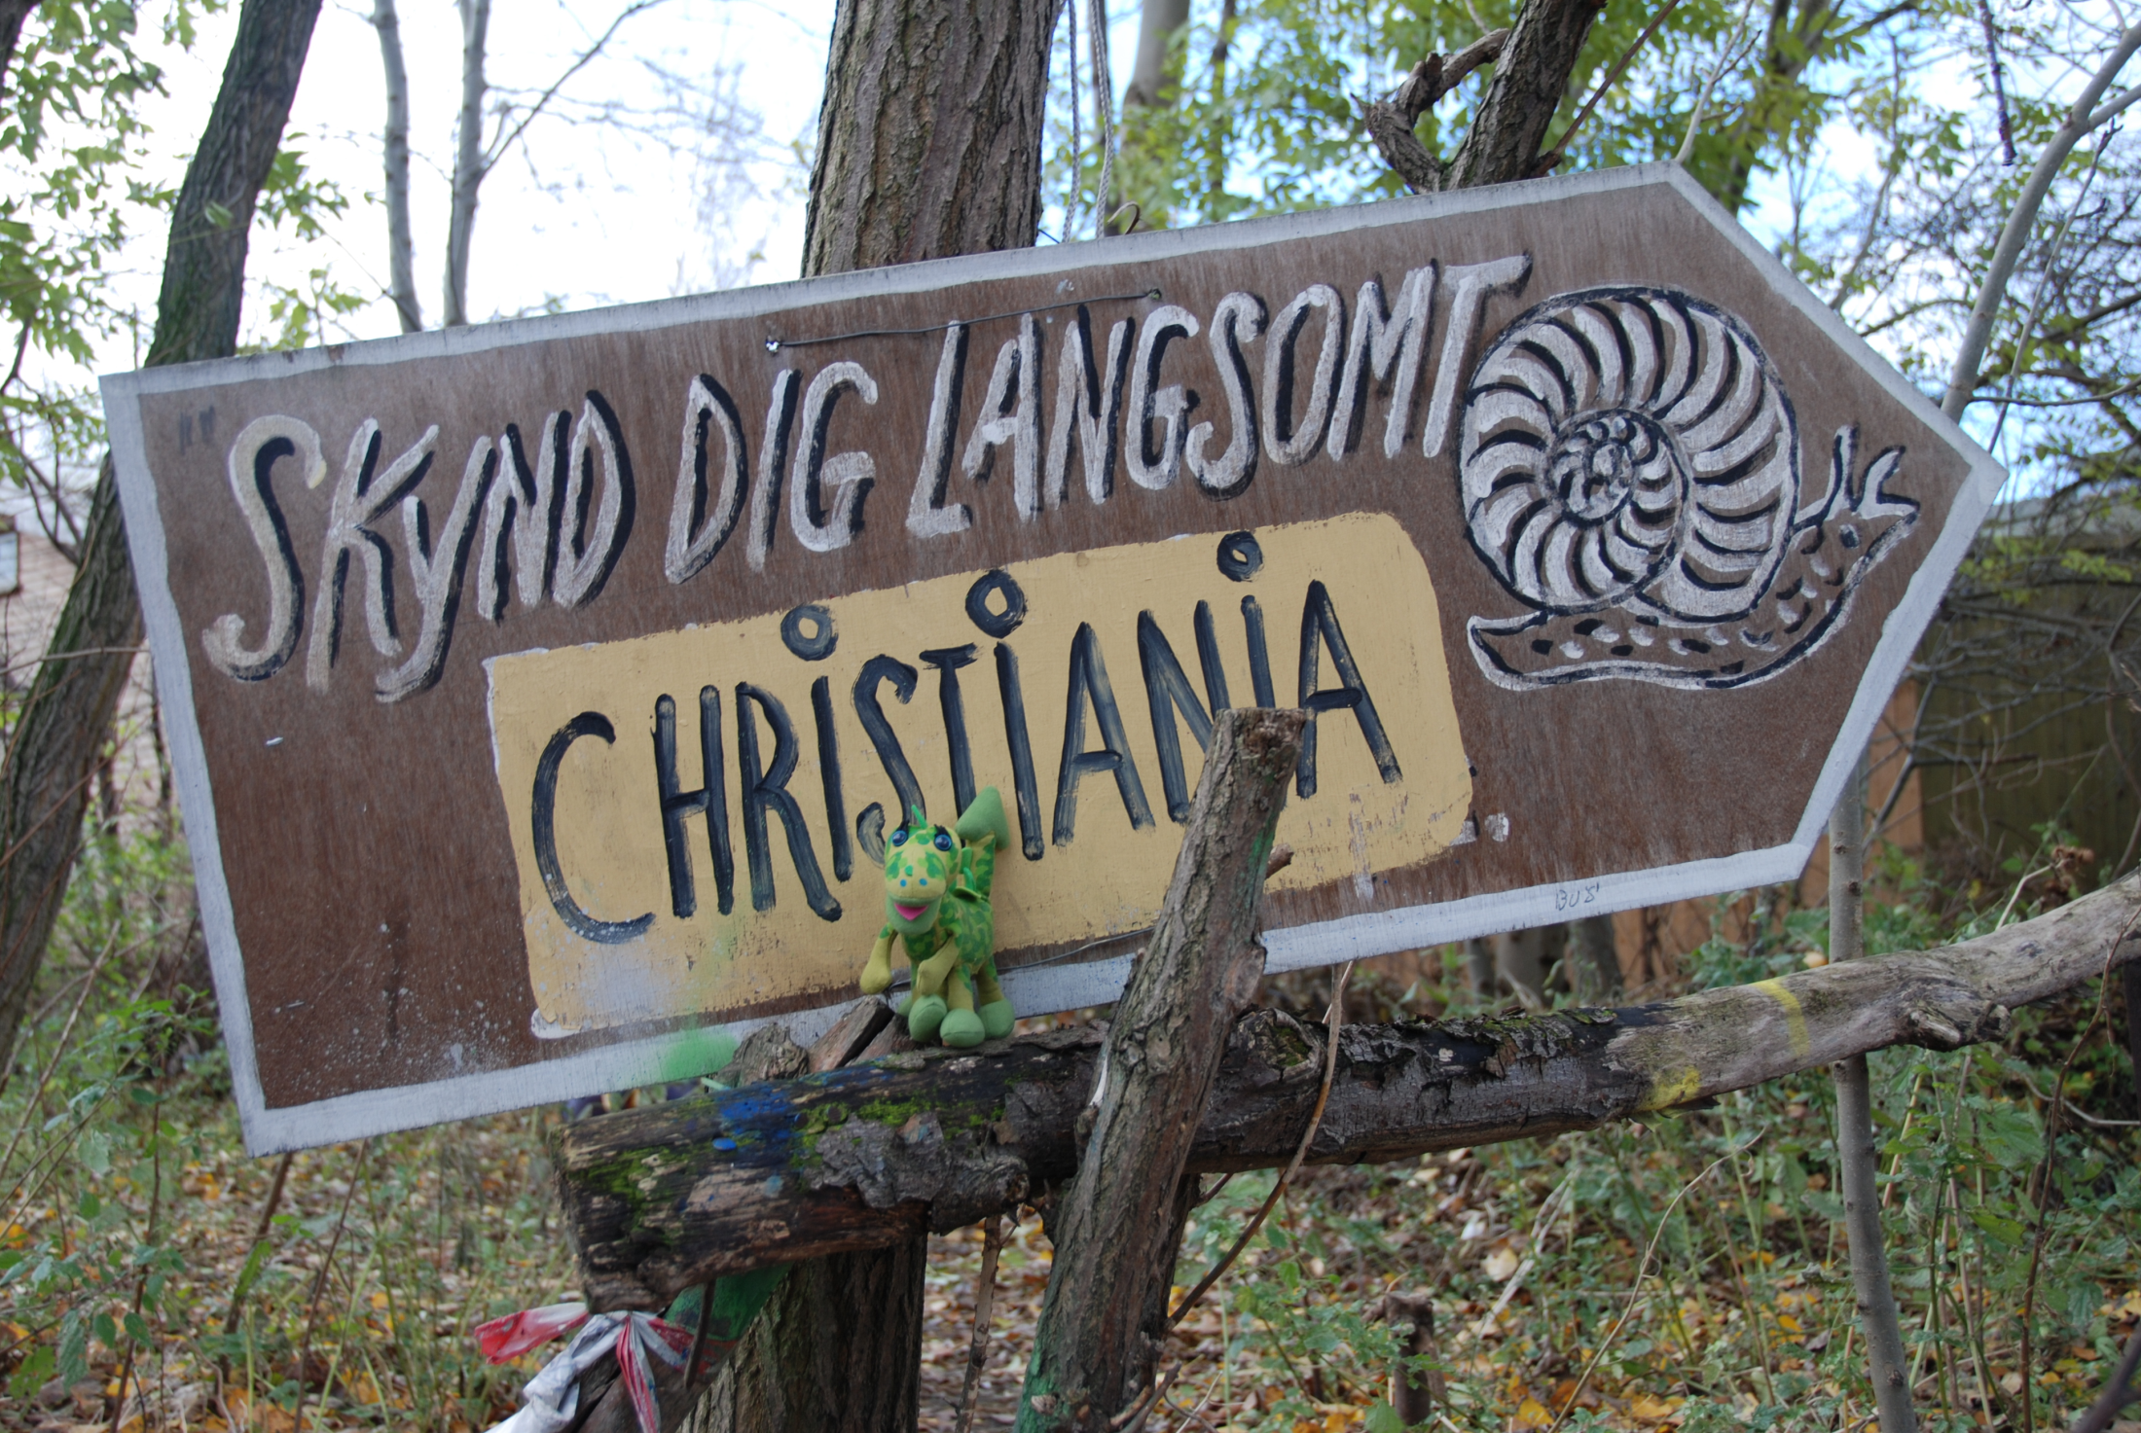

Slide 12
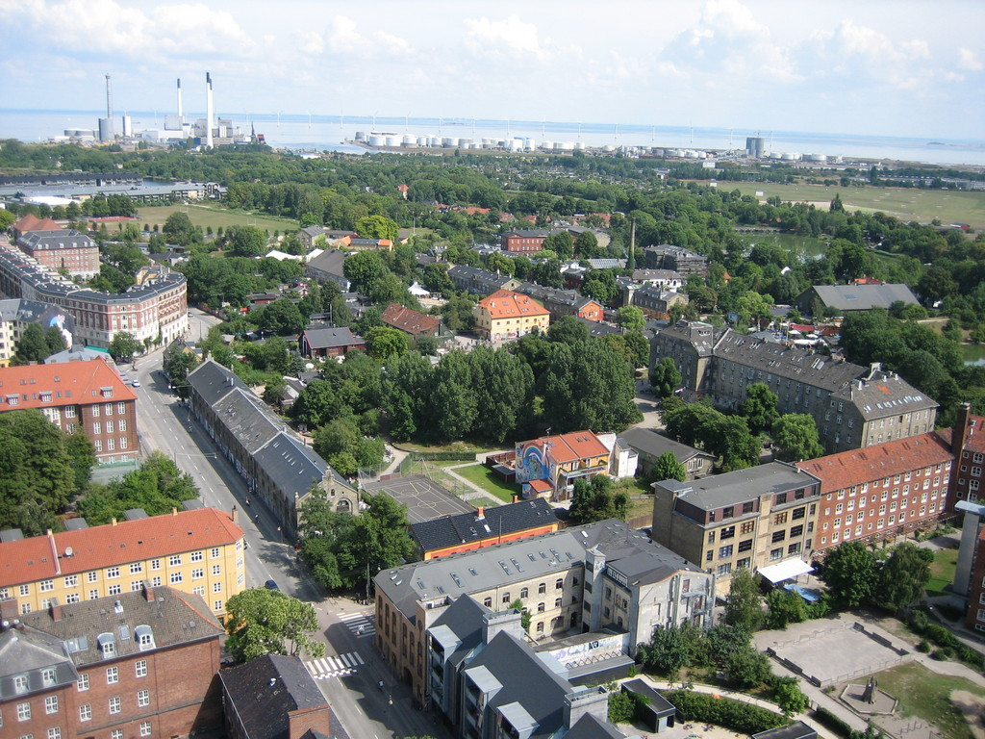

Slide 13
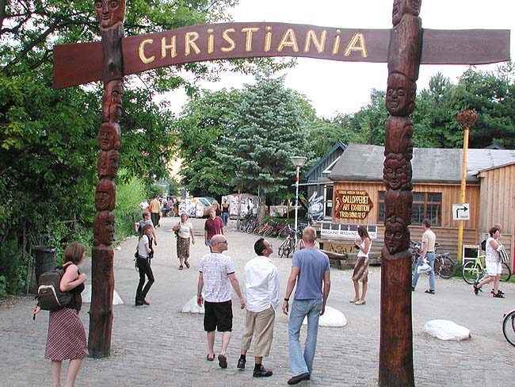

Slide 14
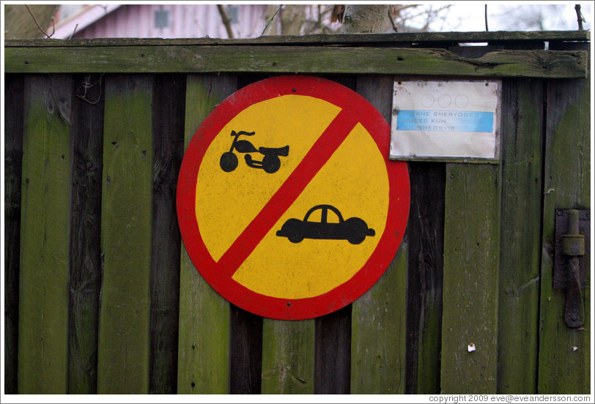

Slide 15
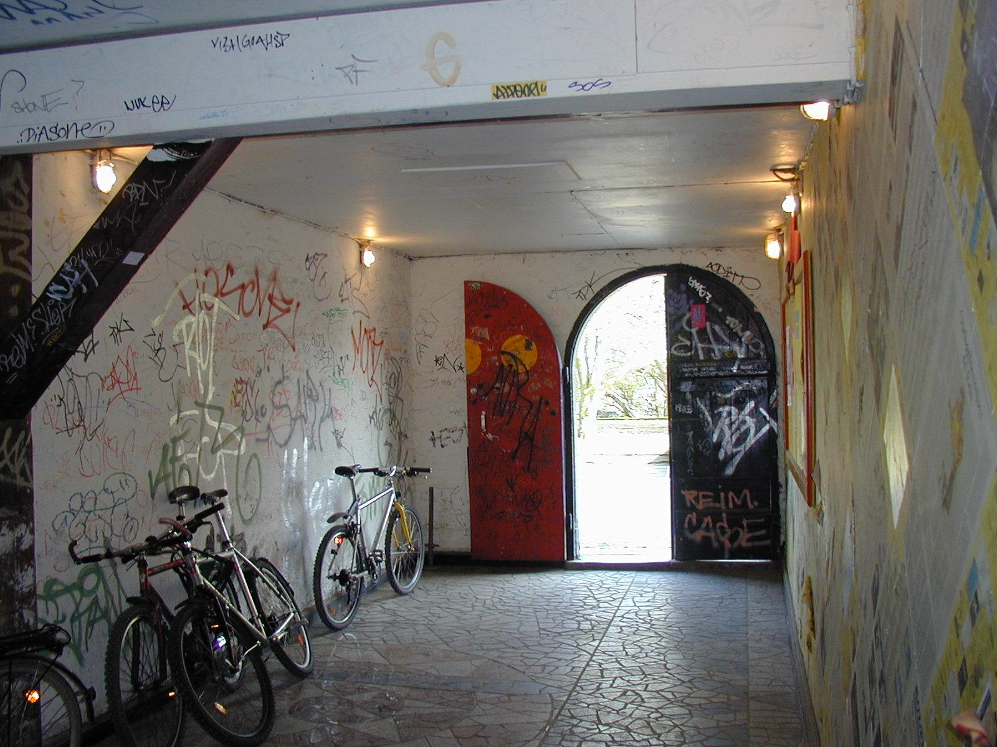

Slide 16
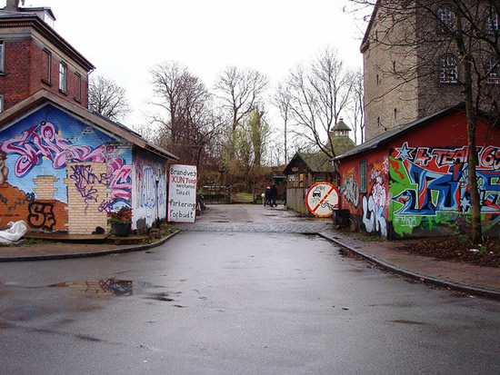

Slide 17
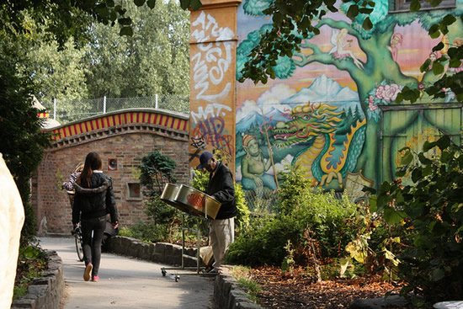

Slide 18
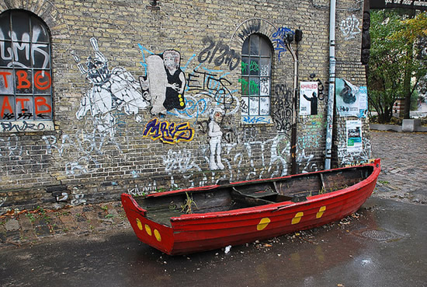

Slide 19
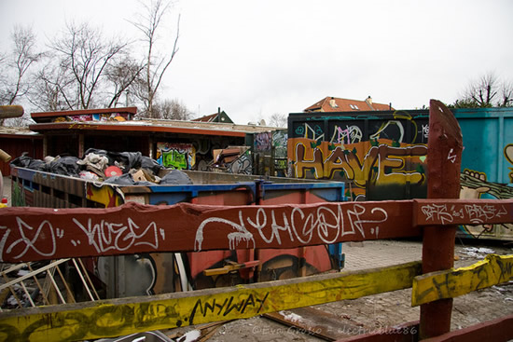

Slide 20
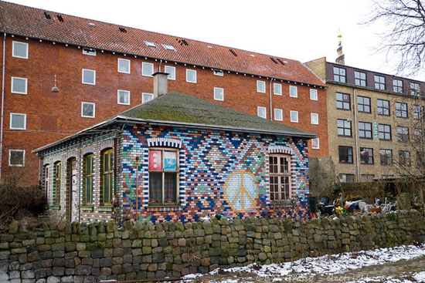

Slide 21
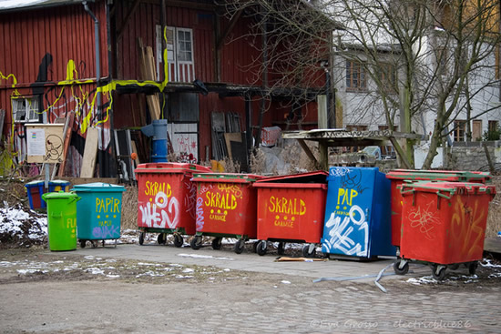

Slide 22
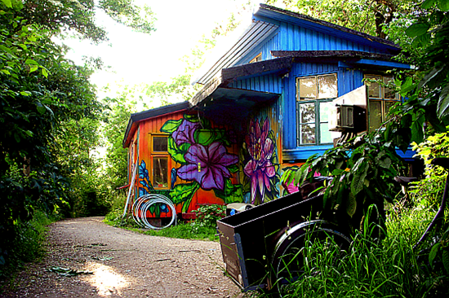

Slide 23
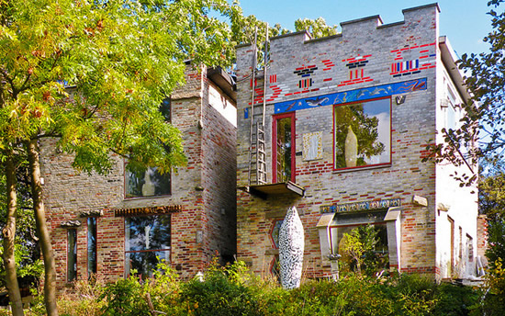

Slide 24
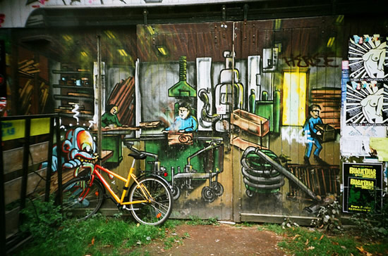

Slide 25
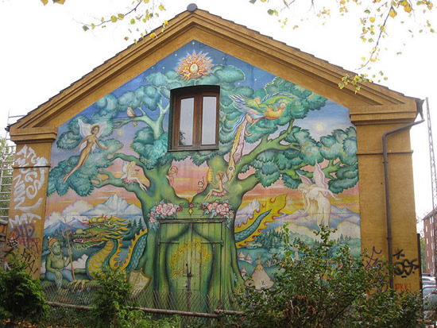

Slide 26
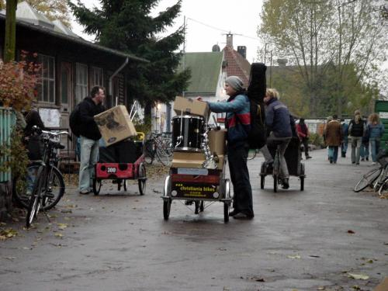

Slide 27
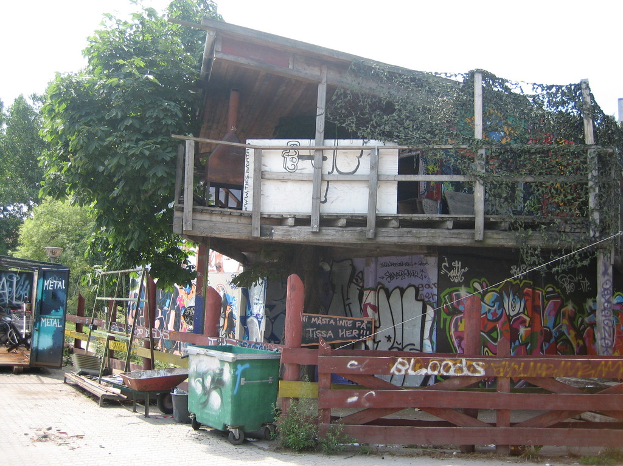

Slide 28
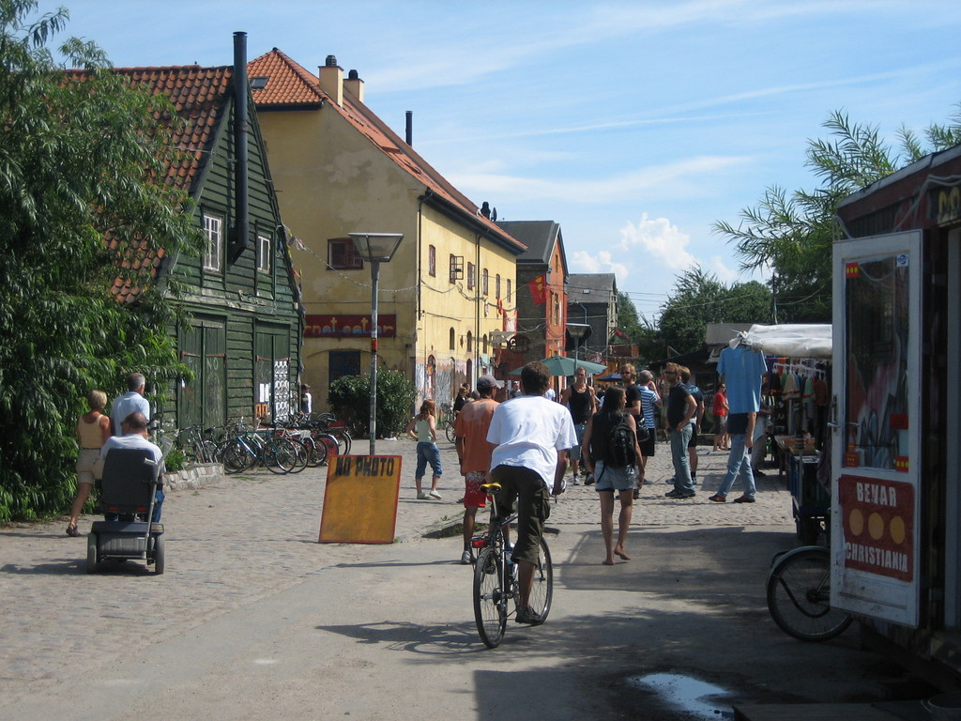

Slide 29
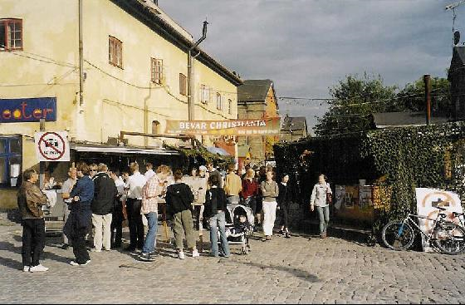

Slide 30
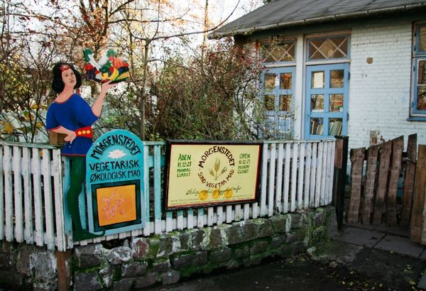

Slide 31
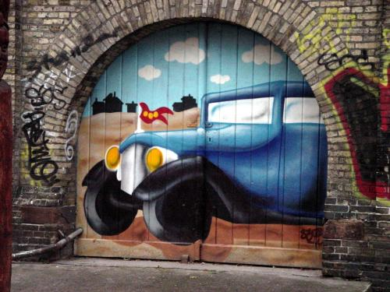

Slide 32
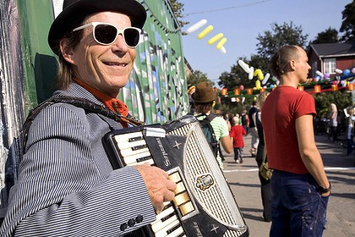

Slide 33
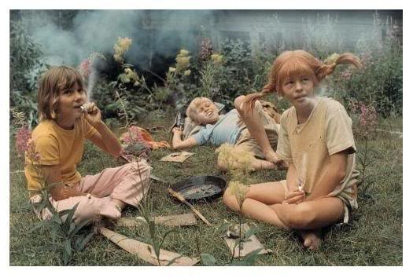

Slide 34
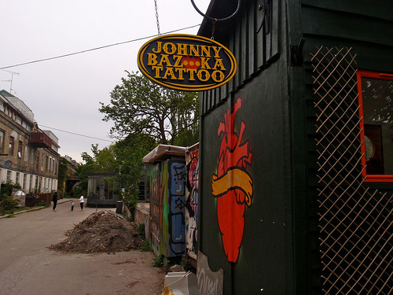

Slide 35
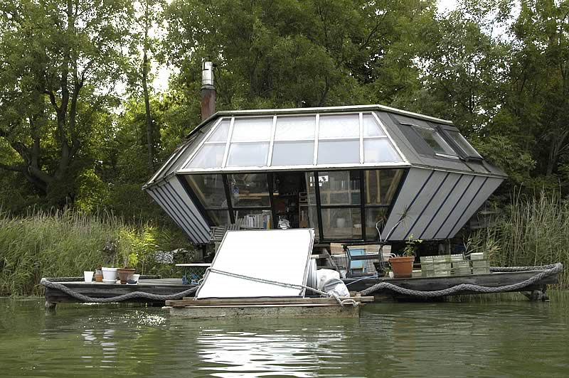

Slide 36
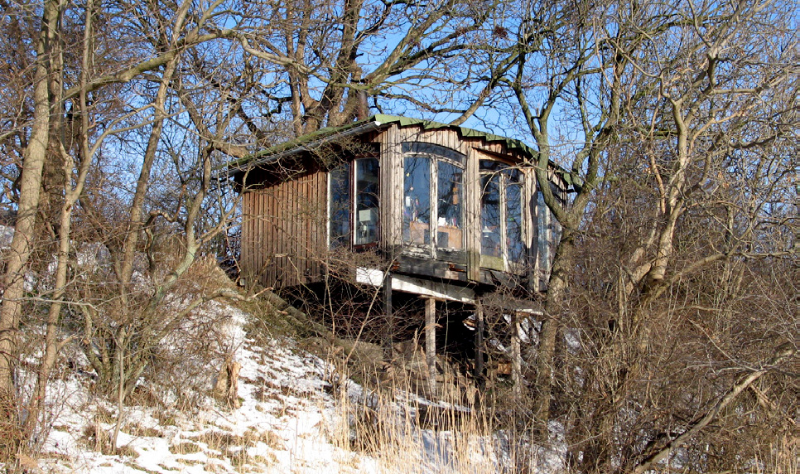

Slide 37
