Slide 1
Winter at St. Joseph’s Indian School: South Dakota
Severe Winter 2011 in Chamberlain, SD

Slide 2
Winter in a Dfb climate
The Humid Continental, Short Summer climate has a short, hot summer and a long cold winter.
Just when we think the sun will peak out from under the clouds, another blizzard whirls in, temperatures drop below zero or the ferocious wind starts blowing again!

Slide 3
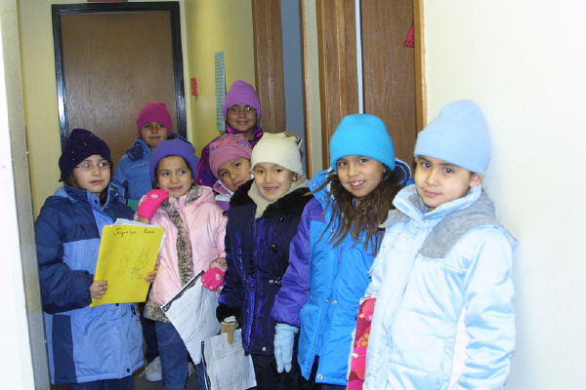
All bundled up and ready for class!

Slide 4
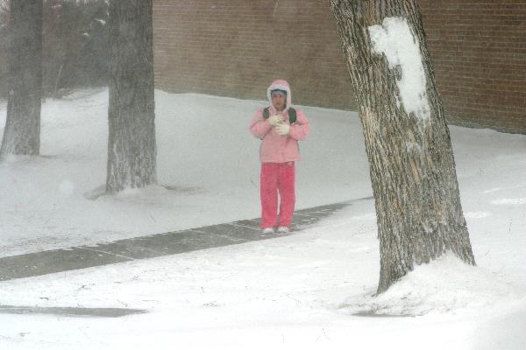
Brrr! A typical day for us this winter!

Slide 5
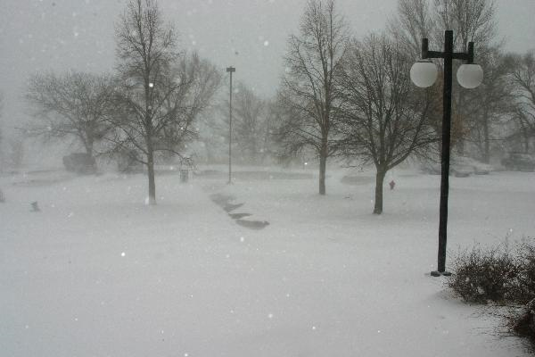
Sub-zero keeps the children inside

Slide 6
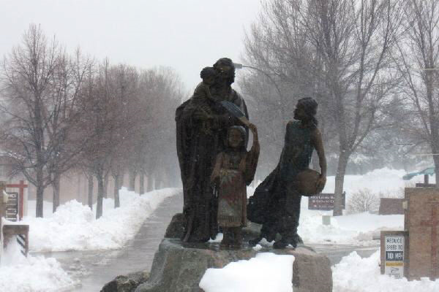
unsafe travel: Harsh winds and freezing temp.

Slide 7
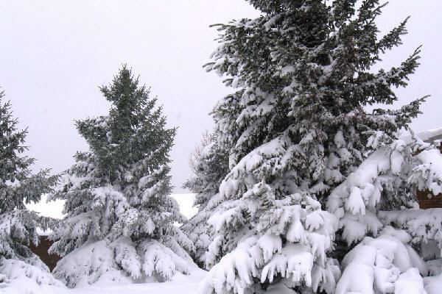
more than usual blizzard conditions

Slide 8
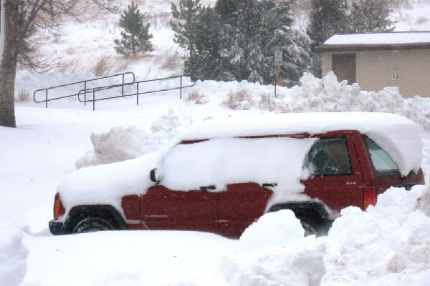
St. Joseph's had to issue late starts.

Slide 9
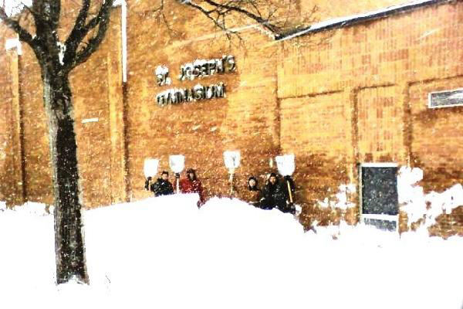
Rec Center staff is building muscle

Slide 10
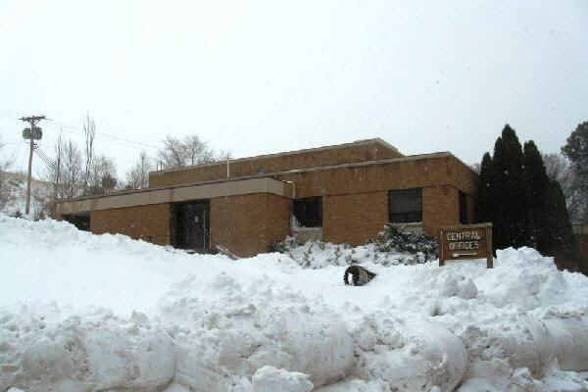
Mounds of snow around our campus!

Slide 11
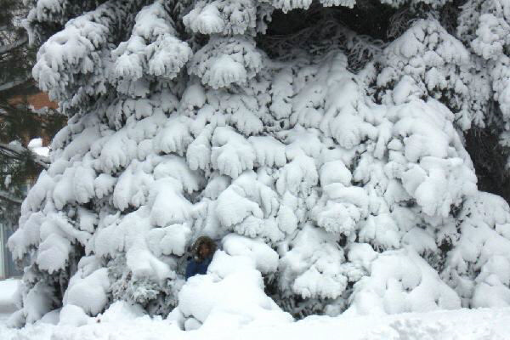
Colorado Spruce stands about 50 ft.

Slide 12
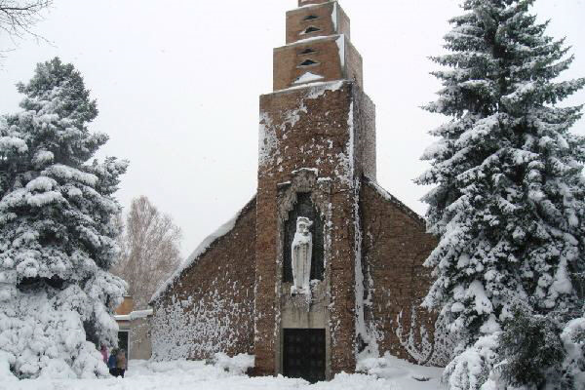
snow around Our Lady of the Sioux Chapel

Slide 13
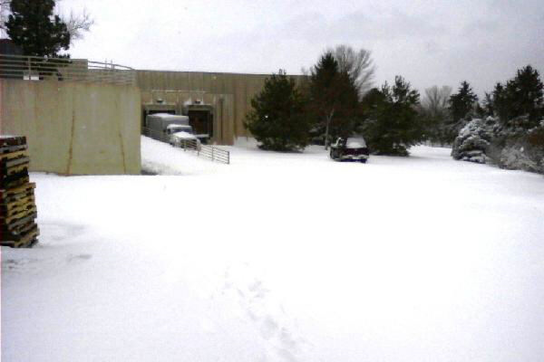
Difficult delivery for our mailroom

Slide 14
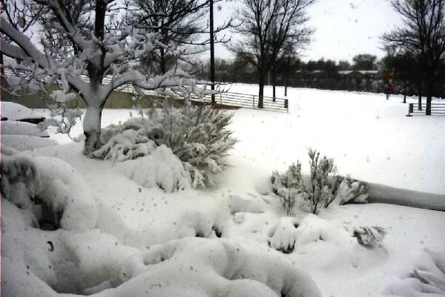
The beautiful landscape

Slide 15
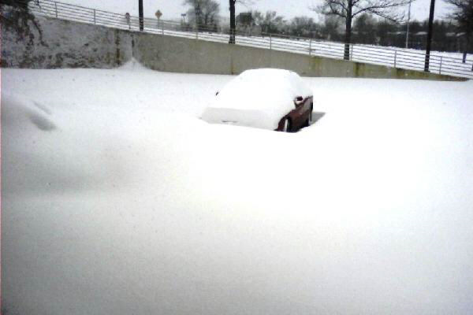

Slide 16
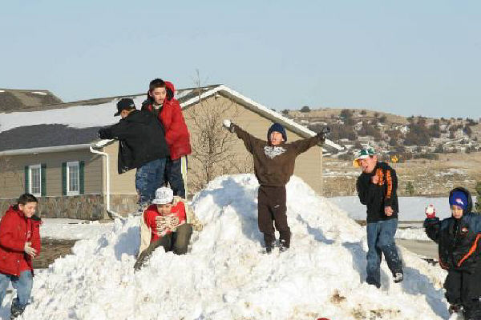
Time to play!

Slide 17
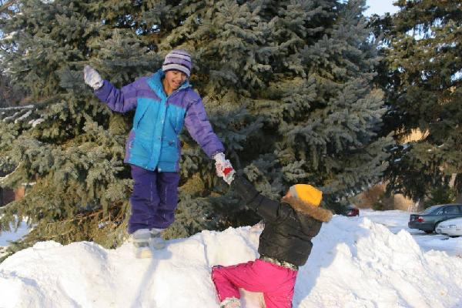

Slide 18
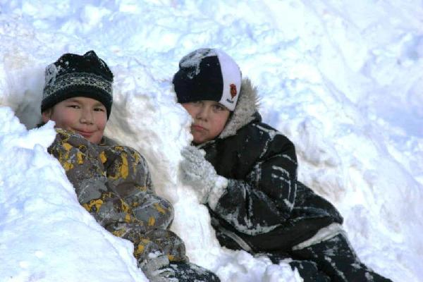
resting in the comfort of a snow chair.

Slide 19
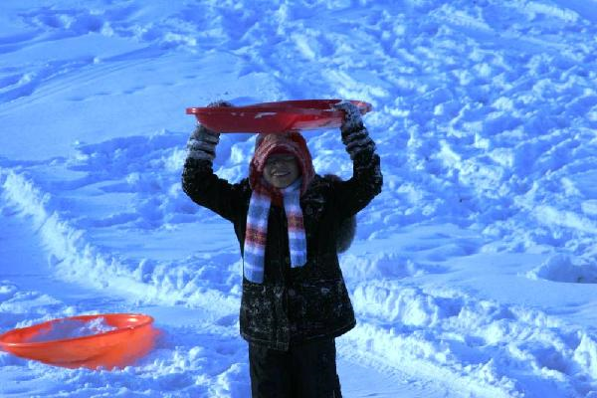

Slide 20
