Slide 1
Images from the end of the world

Slide 2
Joyce Ferder Rankin travelled from the Arctic to Antarctica and back again over a four-year period from 2011 to 2015, capturing stunning polar images. She decided to showcase "the beauty of what we are losing" rather than the ugly effects of human destruction. The trip brought her up close and personal with polar bears - getting within 7ft (2.1m) of the fierce creatures to record their fight for survival on a shrinking hunting ground that is melting into the sea.

Slide 3
What we are in danger of losing . . .

Slide 4
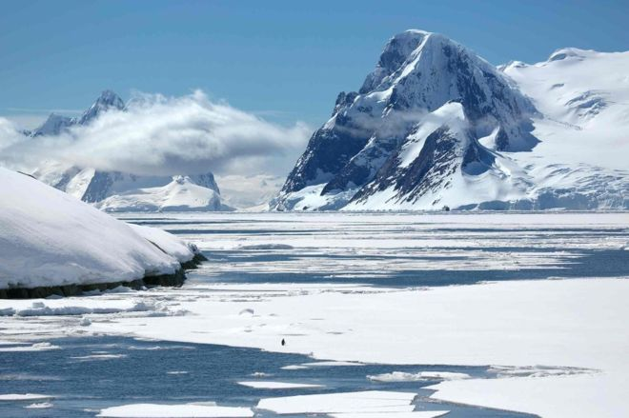

Slide 5
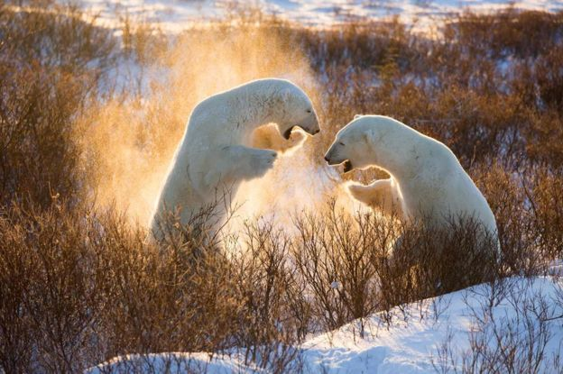

Slide 6
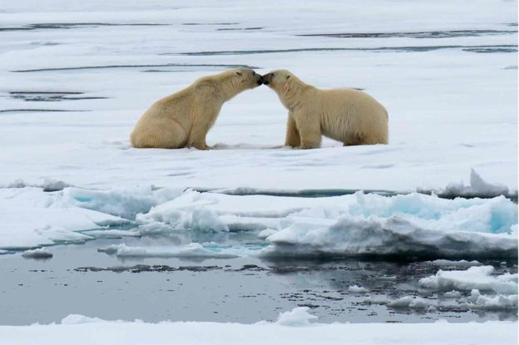

Slide 7
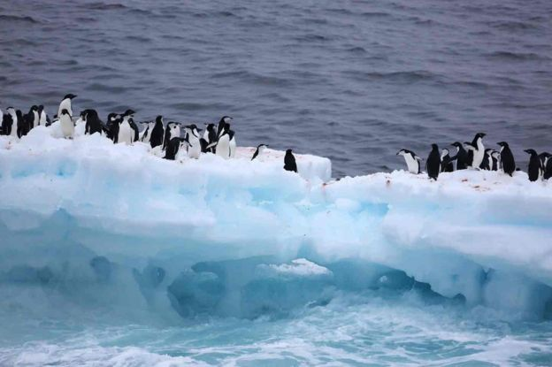

Slide 8
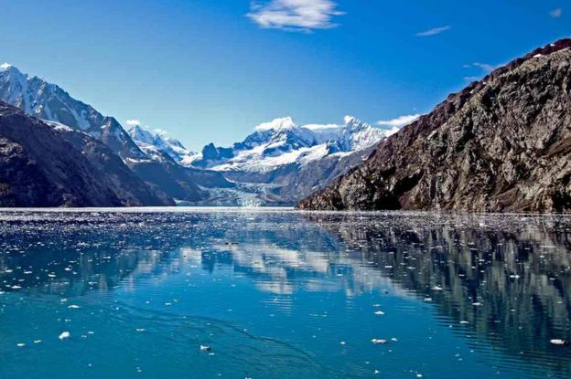
Joyce photographed Columbia glacier in Prince William Sound, Alaska, in September 2011 and said it is "melting so fast that it will be gone completely by 2020"

Slide 9
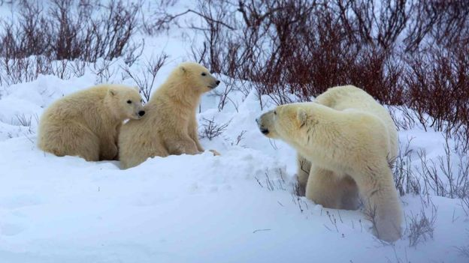

Slide 10
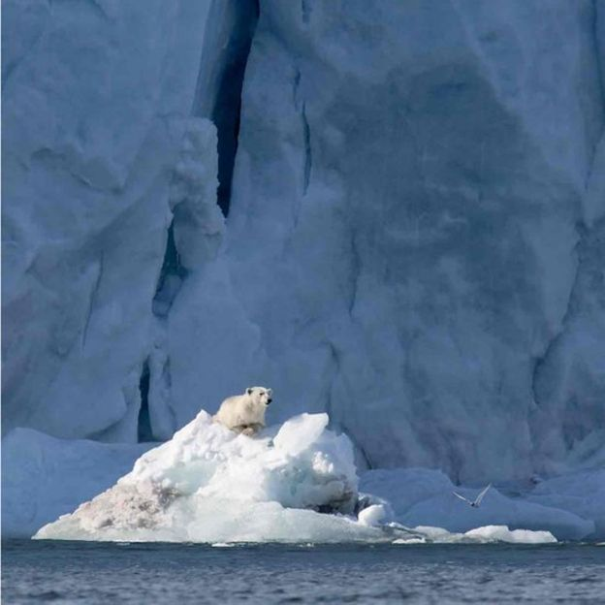
Joyce expressed fear that polar bears will die out in Svalbard because their hunting ground is melting

Slide 11
Joyce is also concerned that rising ocean temperatures and melting Arctic sea-ice will result in the total loss of hunting grounds for polar bears in the Svalbard islands. "This year, it was the first time in history that there was no ice on the western part of Svalbard at all this winter - none," she said. "We're going to lose a generation of (cub) bears and we don't know how many of the adults we're going to lose as well."

