Slide 1
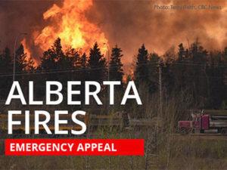
FIRE GIANT IN CANADA

Slide 2
Evacuate more than 80,000 people in Canada because of huge fire
The city of Fort McMurray, Alberta, is on high alert due to a major fire that threatens to raze thousands of homes

Slide 3
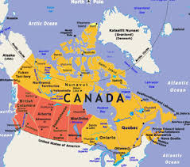

Slide 5
Firefighters prepare to be deployed

Slide 6
Evacuation traffic

Slide 10
Talk about scary!

Slide 11
Many homes were destroyed

Slide 12
As far as the eye could see . . .

Slide 19
Fire fighter Hoffman stands among the ruins of his childhood home at 433 Beacon Hill Drive.

Slide 20
Fire Department captain Damian Asher stands among the remains of his 3700-square foot bungalow that he built himself over the past four years

