Slide 1
Drone Footage Of Greenland's Melting Ice Sheet Is Stunning, Terrifying
It's beautiful and depressing, all at once.

Slide 2
Climate change is one of the biggest problems facing humanity, but it's not always the easiest to visualize. A dreadfully skinny polar bear is a powerful symbol that might shock you in the moment, though it's hard to understand what it might say about our changing planet overall.
The New York Times on Tuesday presented an innovative new approach: Footage shot via drone that shows the melting Greenland ice sheet.

Slide 3
"During the flight, I was mesmerized as I watched the live video from the camera on a tablet attached to my controller. I thought: This is what birds must feel as they fly up Alpine streams, skimming the surface of the water," Josh Haner, a Pulitzer-winning photographer for the Times, wrote in an article about the process.

Slide 4
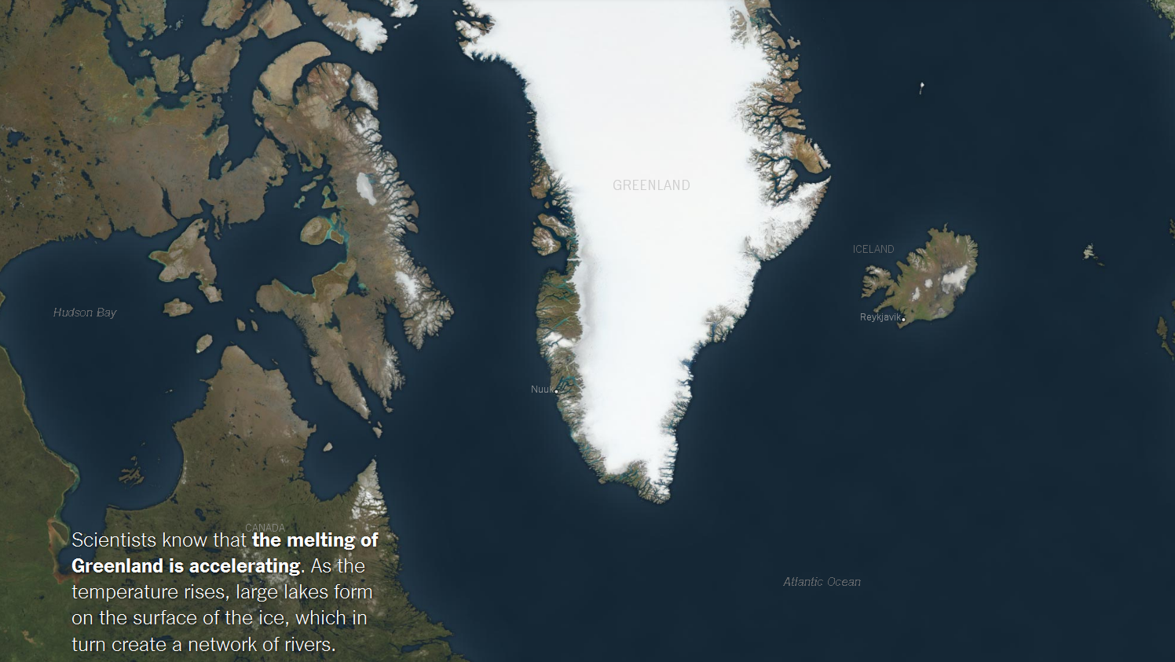

Slide 5
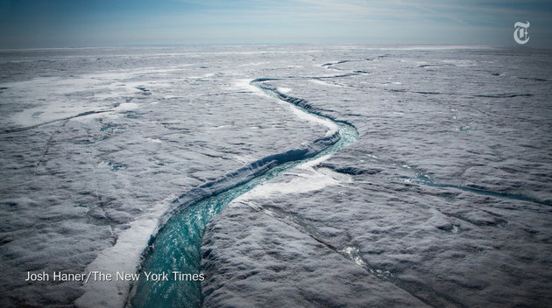

Slide 6
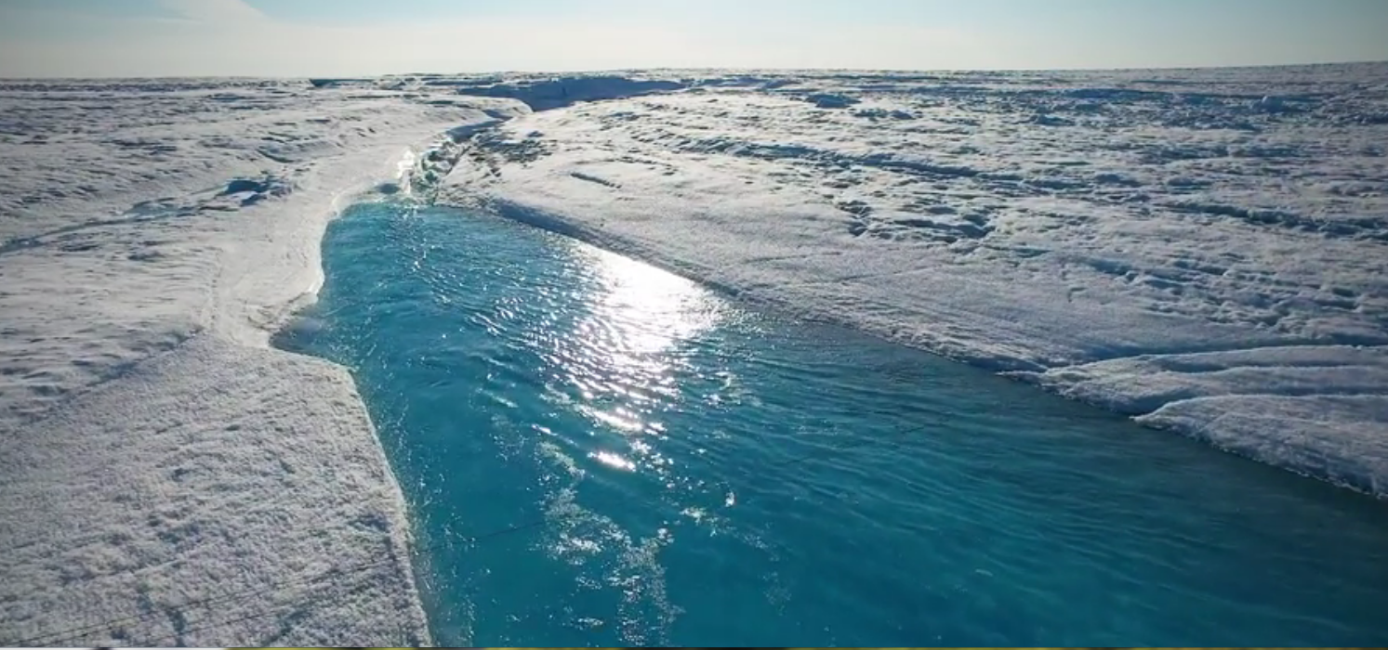

Slide 7
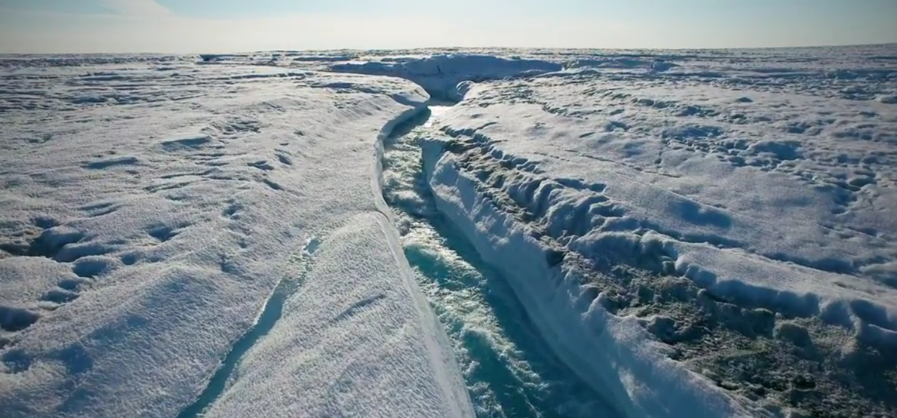

Slide 8
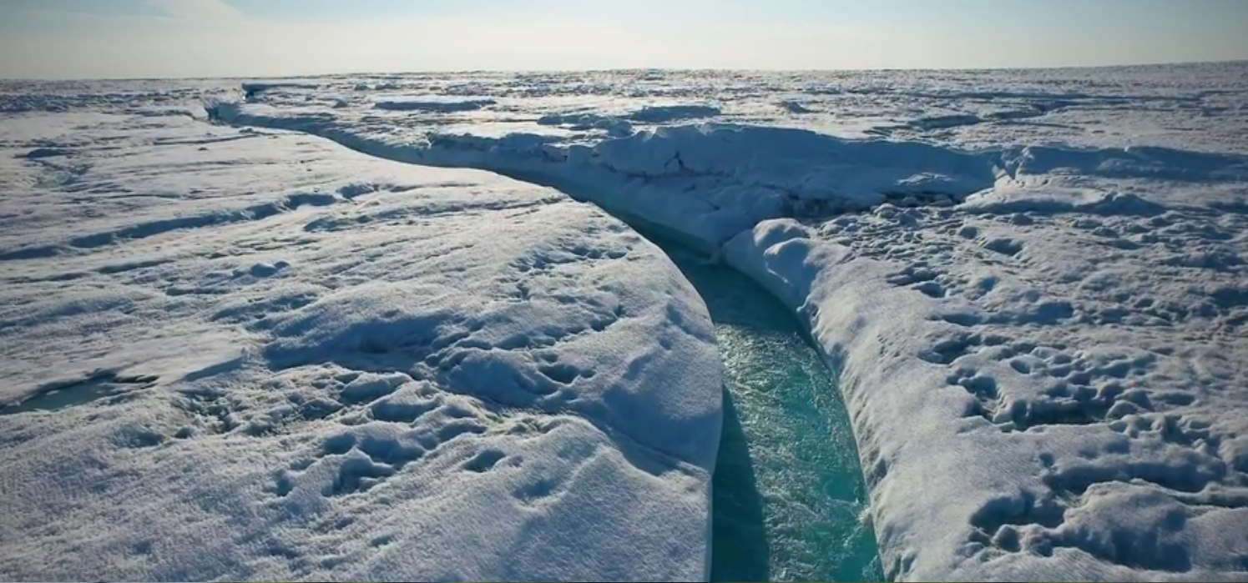

Slide 9
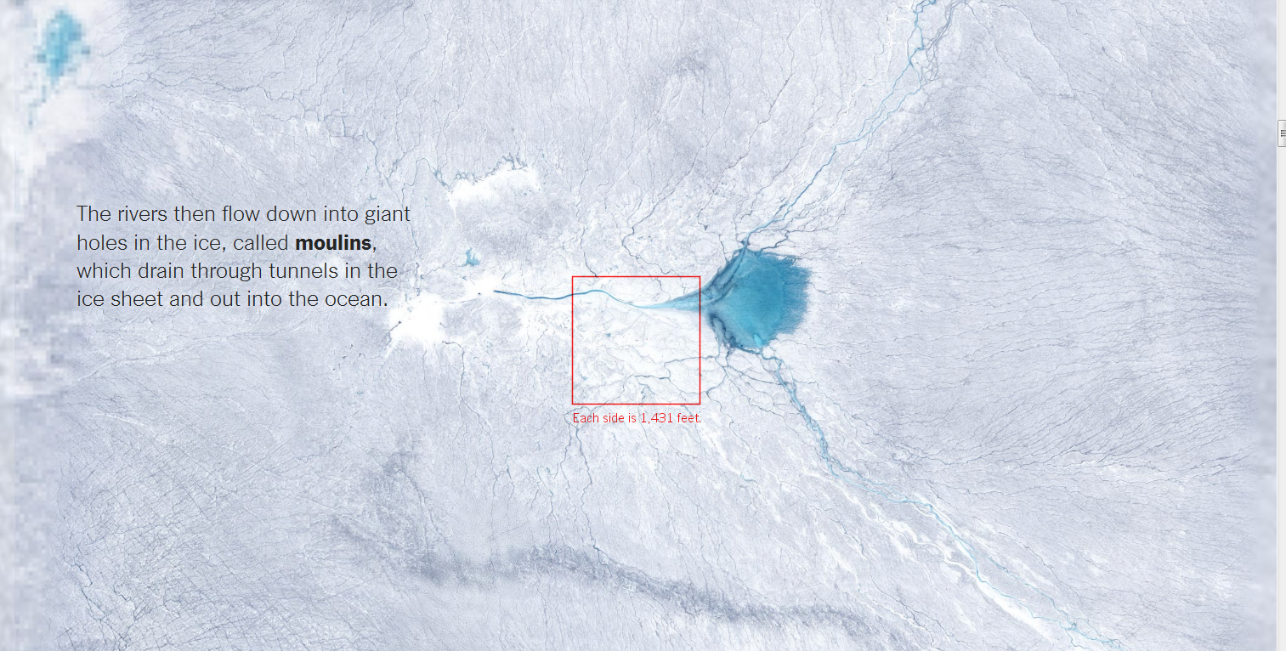

Slide 10
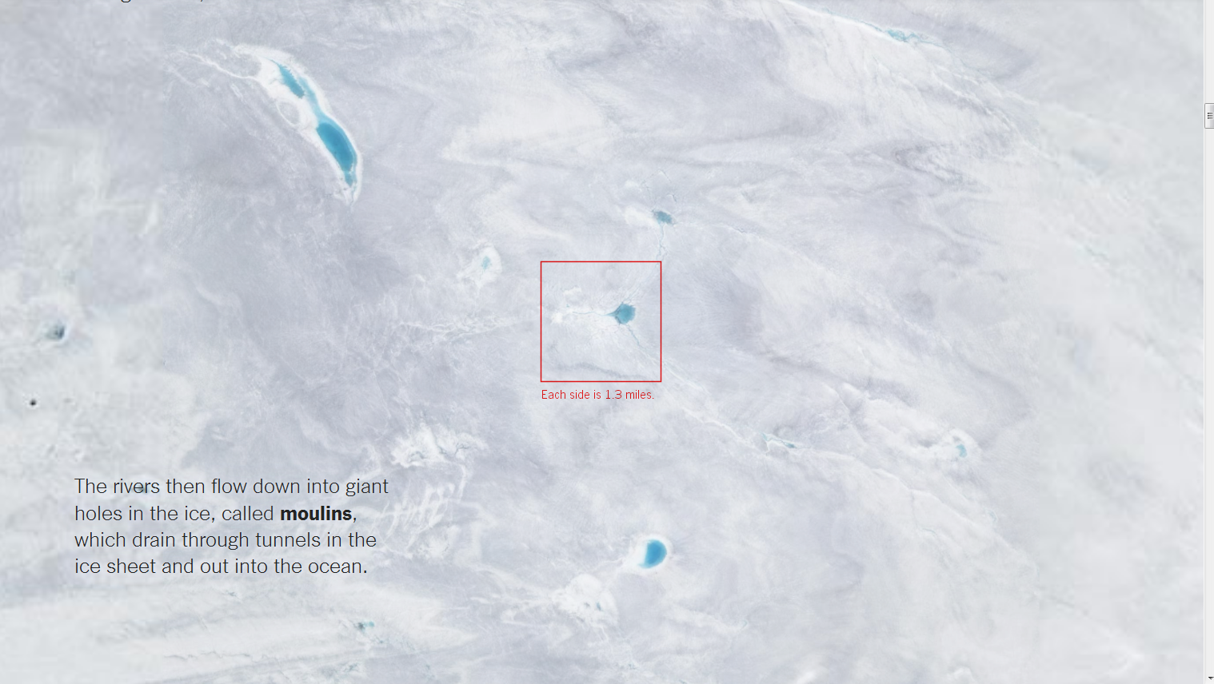

Slide 11
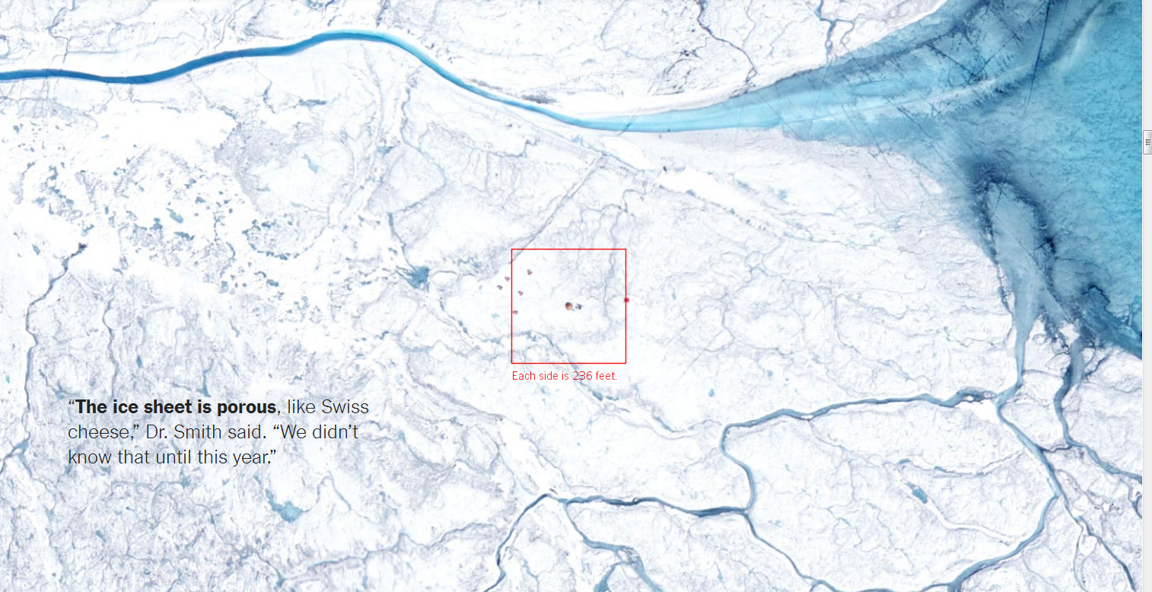

Slide 12
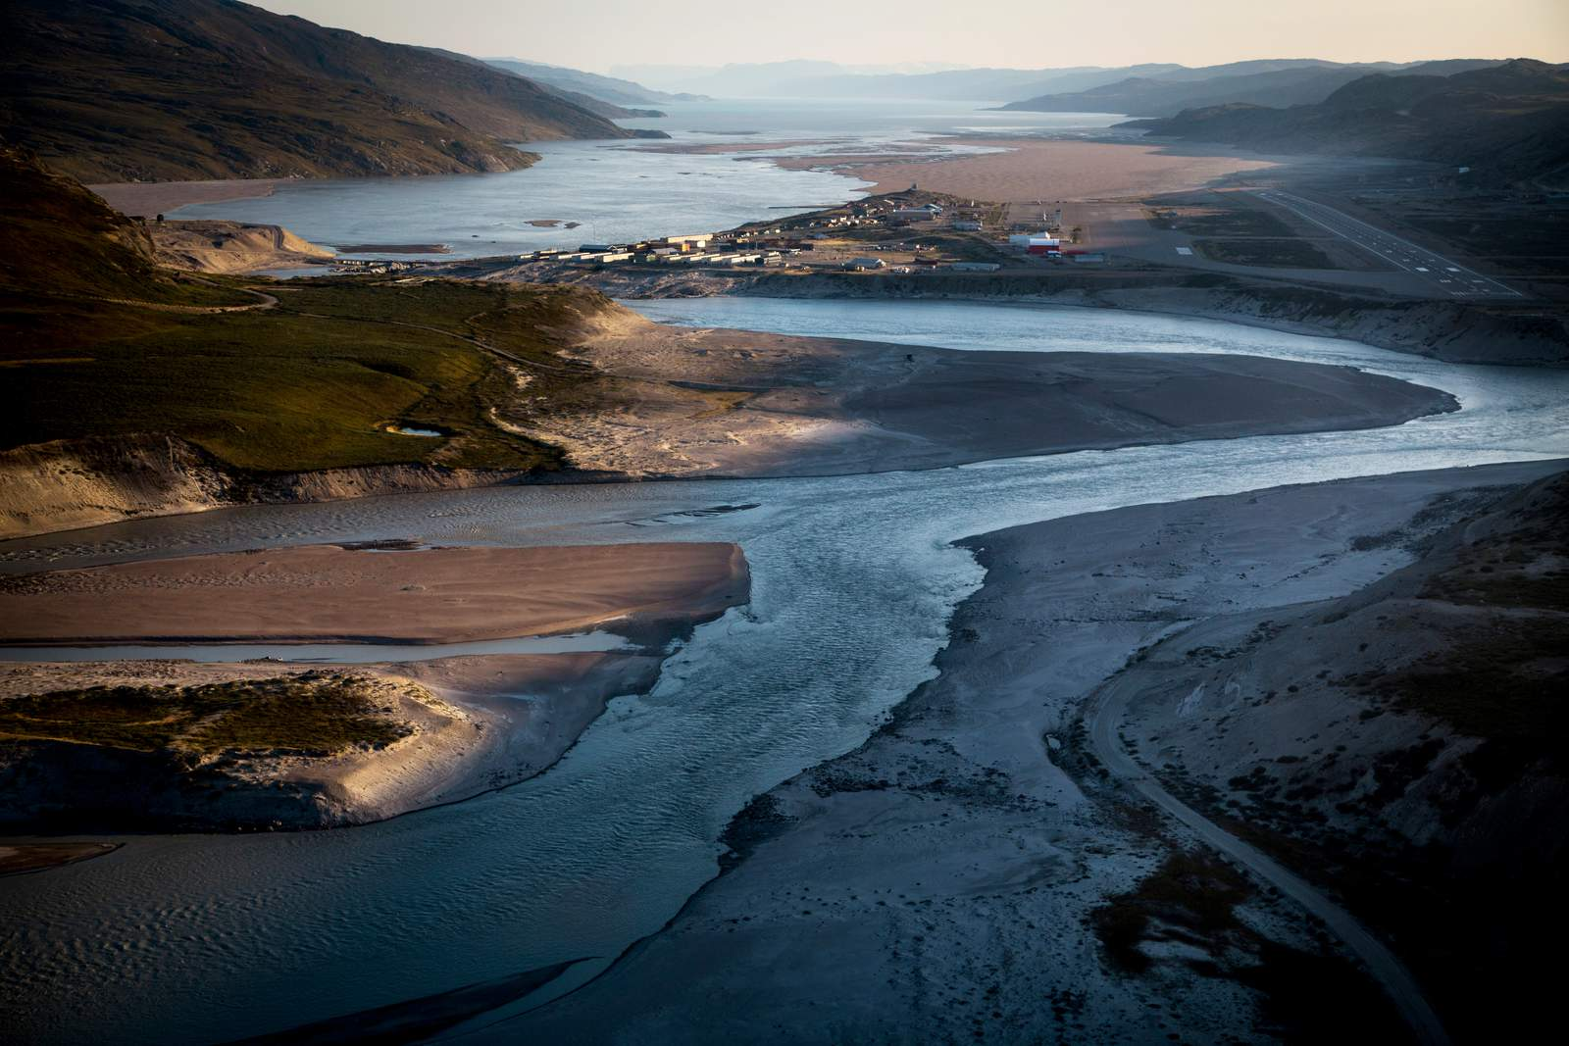

Slide 13
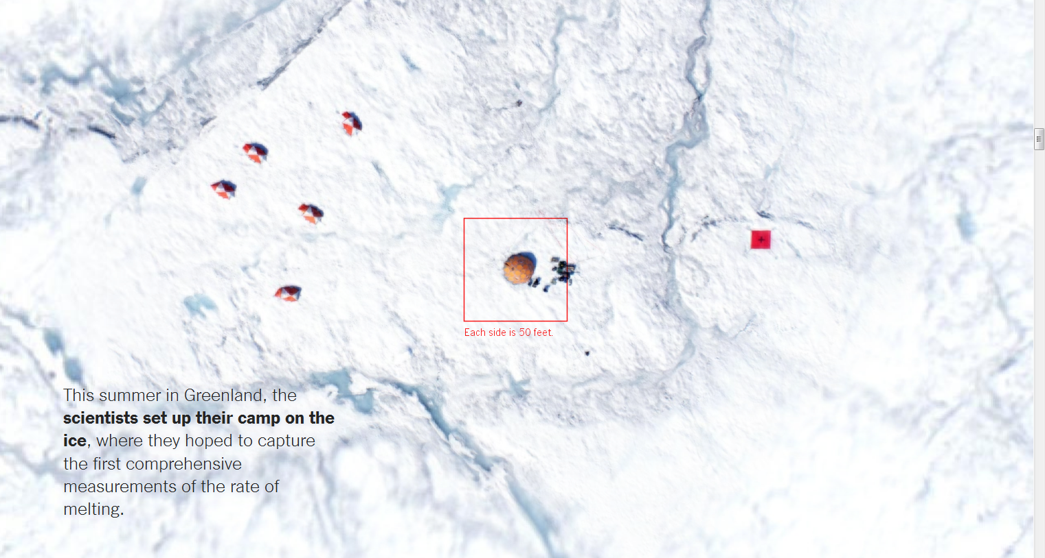

Slide 14
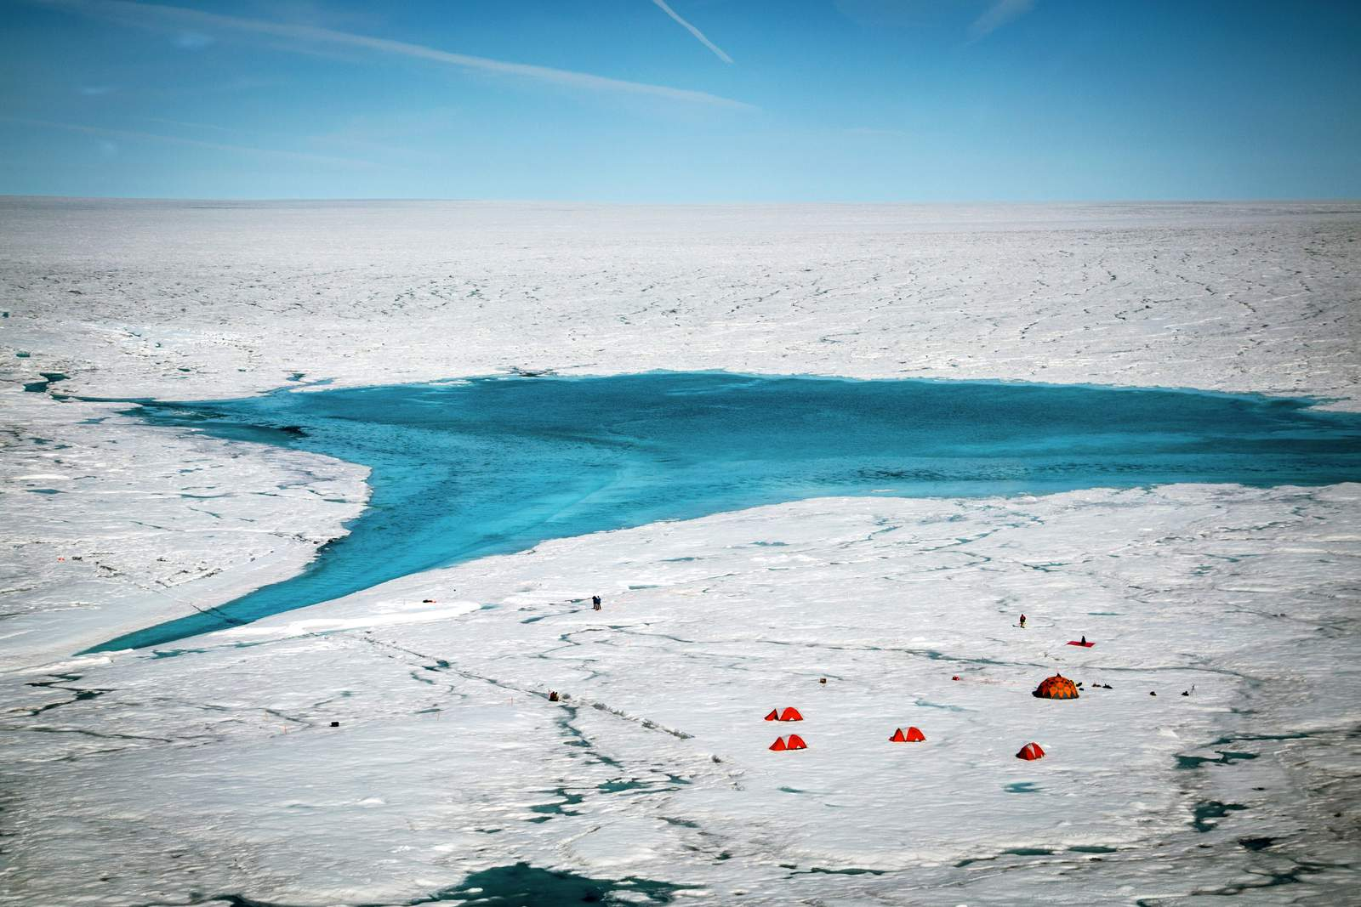

Slide 15
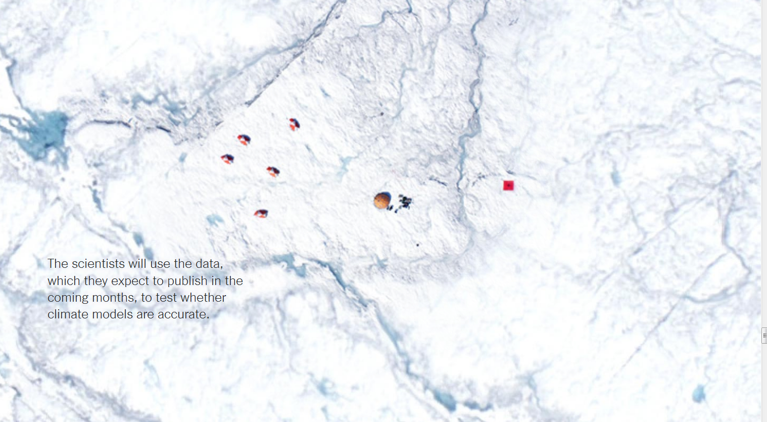

Slide 16
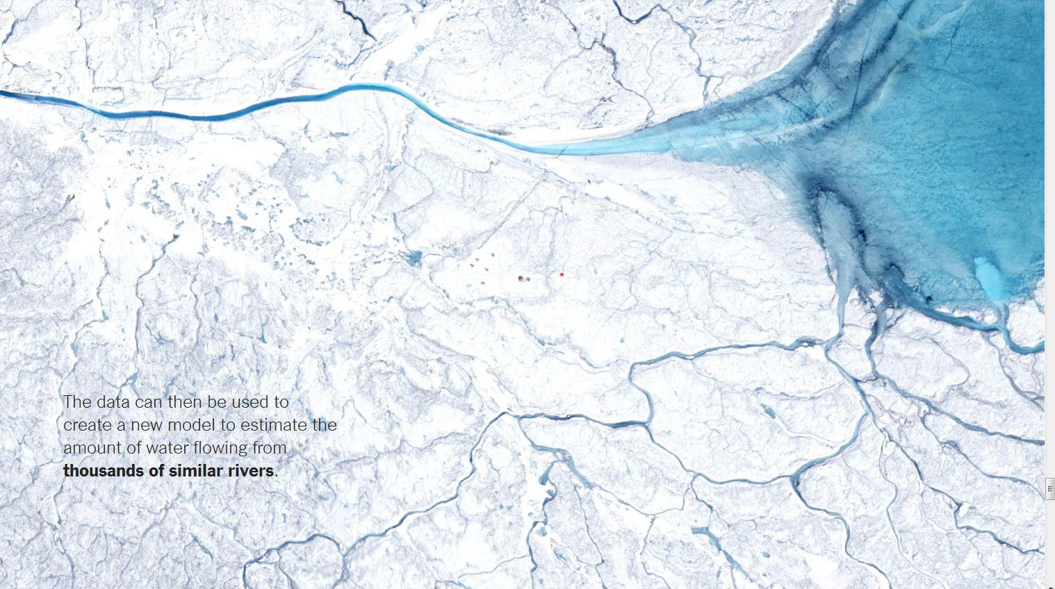

Slide 17
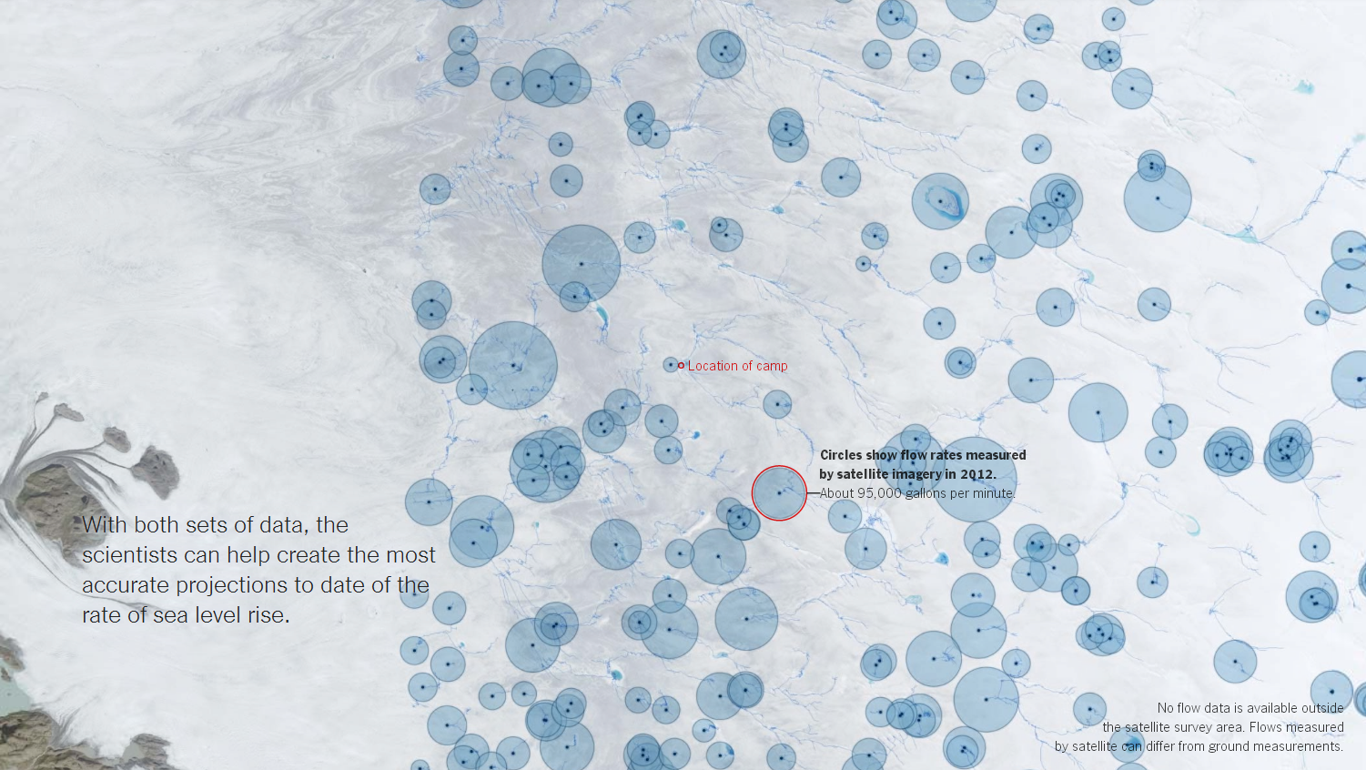

Slide 18
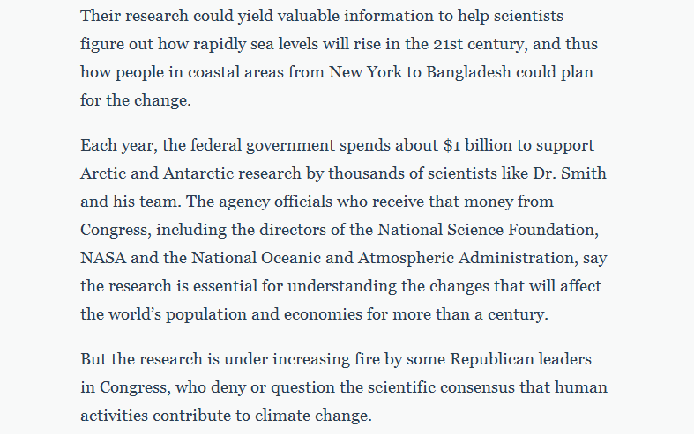

Slide 19
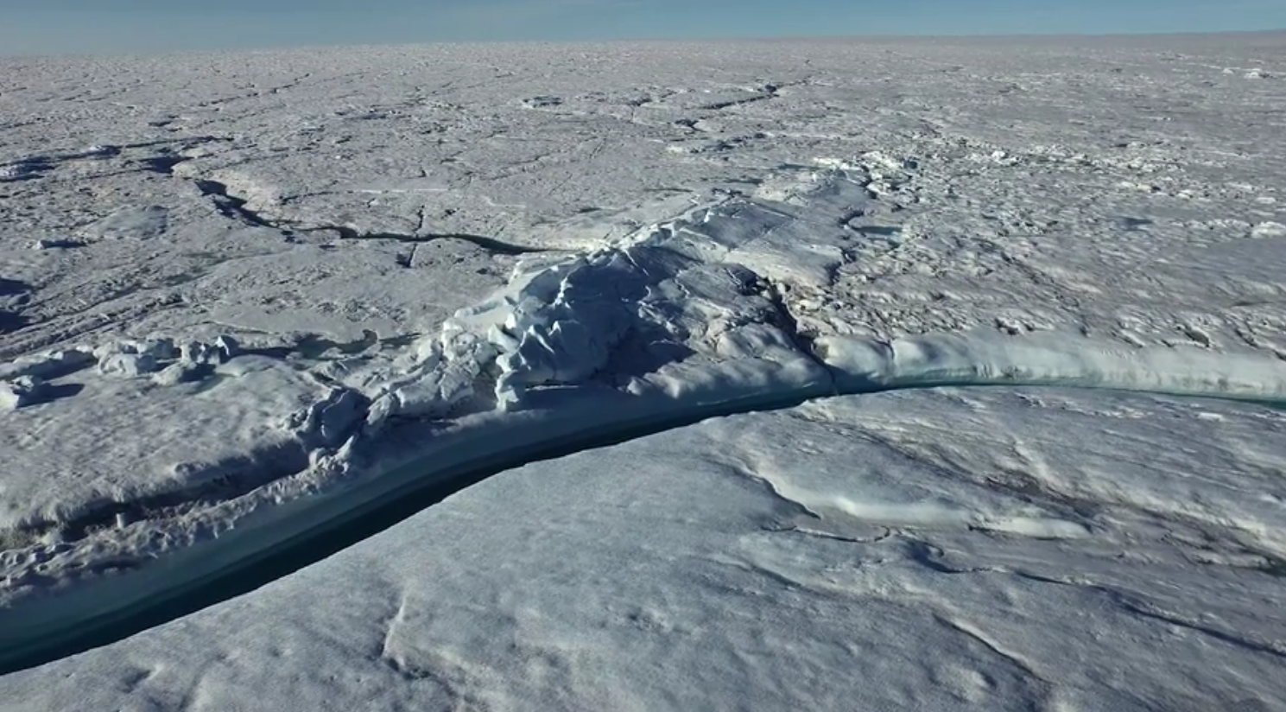

Slide 20
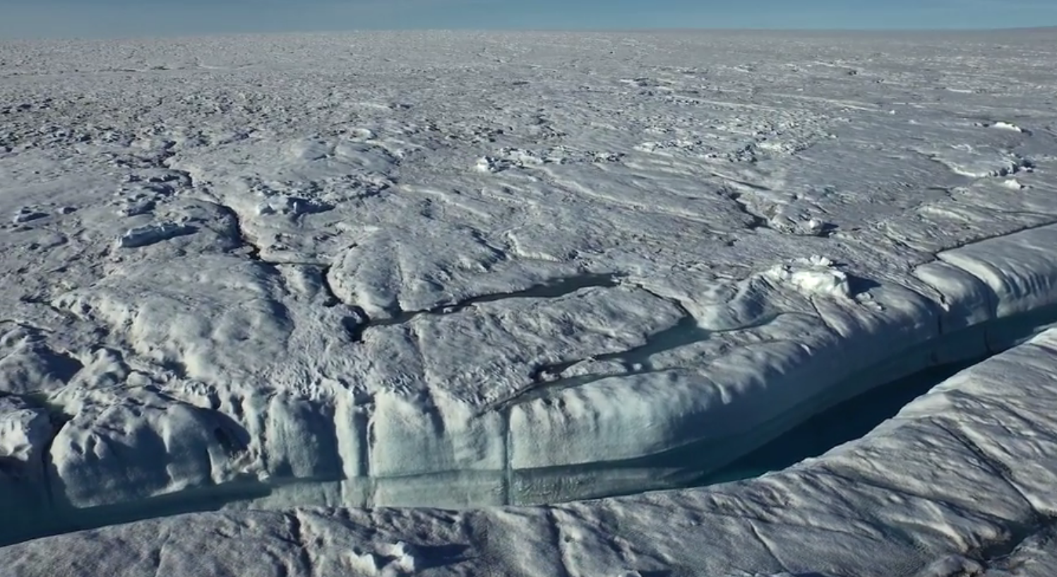

Slide 21
