Slide 1
7 reasons why Arctic sea ice matters
The vanishing veneer of frozen ocean isn't just important for polar bears.
By: Russell McLendon

Slide 2
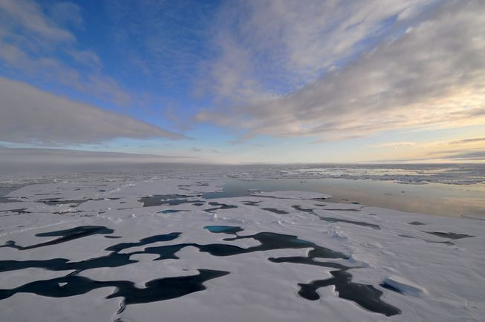
The Arctic hasn't been itself lately. Temperatures there are rising at twice the global rate, sparking an array of changes unlike anything in recorded history. One of the most striking examples is the region's sea ice, whose dramatic decline over the past decade has led to forecasts of an ice-free Arctic Ocean as early as the 2030s.

Slide 3
Arctic sea ice always waxes and wanes with the seasons, but its average late-summer minimum is now shrinking by about 13 percent per decade, according to the U.S. National Oceanic and Atmospheric Administration. 2015 saw the fourth-lowest level on record, and the nine smallest Septembers have all been in the last nine years. Scientists widely agree the main catalyst is man-made climate change, boosted by a feedback loop known as Arctic amplification. (Antarctic sea ice, meanwhile, is more buffered against warming.) The basic problem has become well-known even among laypeople, thanks largely to its compelling effect on polar bears.

Slide 4
1. It reflects sunlight

Slide 5
Earth's poles are cold mainly because they get less direct sunlight than lower latitudes do. But there's also another reason: Sea ice is white, so it reflects most sunlight back to space. This reflectivity, known as "albedo," helps keep the poles cold by limiting their heat absorption. As shrinking sea ice exposes more seawater to sunlight, the ocean absorbs more heat, which in turn melts more ice and curbs albedo even further. This creates a positive feedback loop, one of several ways warming begets more warming.

Slide 6
2. It influences ocean currents
By regulating polar heat, sea ice also affects weather worldwide. That's because the oceans and air act as heat engines, moving heat to the poles in a constant quest for balance. One way is atmospheric circulation, or the large-scale movement of air. Another, slower method occurs underwater, where ocean currents move heat along a "global conveyor belt" in a process called thermohaline circulation. Fueled by local variations in warmth and salinity, this drives weather patterns at sea and on land.

Slide 7
The global conveyor belt of ocean currents, aka "thermohaline circulation."

Slide 8
Declining sea ice has two main effects on this process. First, warming up the poles disrupts Earth's overall heat flow by tweaking its temperature gradient. Second, altered wind patterns push more sea ice toward the Atlantic, where it melts into cold freshwater. (Seawater expels salt as it freezes.) Since less salinity means the water is less dense, melted sea ice floats rather than sinking like cold saltwater. And since thermohaline circulation needs cold, sinking water at high latitudes, this can halt the flow of warm, rising water from the tropics.

Slide 9
3. It insulates the air
As cold as the Arctic Ocean is, it's still warmer than the air in winter. Sea ice acts as insulation between the two, limiting how much warmth radiates up. Along with albedo, this is another way sea ice helps maintain the Arctic's chilly climate. But as sea ice melts and cracks, it becomes dotted with gaps that let heat escape. "Roughly half of the total exchange of heat between the Arctic Ocean and the atmosphere occurs through openings in the ice," according to the National Snow & Ice Data Center.

Slide 10
Older, multiyear sea ice can grow much thicker and sturdier than first-year ice. (Illustration: NASA)

Slide 11
4. It keeps methane at bay
Heat isn't all that seeps through weak sea ice. Scientists have long known Arctic tundra and marine sediments contain large, frozen deposits of methane, posing a climate risk if they thaw and release the potent greenhouse gas. But in 2012, researchers from NASA's Jet Propulsion Laboratory discovered "a surprising and potentially important" new source of Arctic methane: the Arctic Ocean itself. Flying north of the Chukchi and Beaufort seas, the researchers found mysterious methane fumes that couldn't be explained by typical sources like wetlands, geologic reservoirs or industrial facilities. Noticing the gas was absent over solid sea ice, they finally traced its source to surface waters exposed by broken ice. They still aren't sure why there's methane in Arctic seawater, but microbes and seabed sediments are likely suspects.

Slide 12
Gaps in sea ice can release methane into the atmosphere, scientists have discovered. (Photo: NOAA)

Slide 13
"While the methane levels we detected weren't particularly large, the potential source region, the Arctic Ocean, is vast, so our finding could represent a noticeable new global source of methane," NASA's Eric Kort said in a statement. "As Arctic sea ice cover continues to decline in a warming climate, this source of methane may well increase."

Slide 14
5. It limits severe weather
It's well-established that global warming boosts severe weather in general, but according to the NSIDC, sea-ice loss also favors bigger storms in the Arctic itself. Unbroken swaths of sea ice normally limit how much moisture moves from the ocean to the atmosphere, making it harder for strong storms to develop. As sea ice dwindles, storm formation is easier and ocean waves can grow larger. "[W]ith the recent decline in summer sea ice extent," the NSIDC reports, "these storms and waves are more common, and coastal erosion is threatening some communities."

Slide 15
Satellites spotted this unusually strong storm in the Arctic Ocean on Aug. 5, 2012. (Photo: NASA)

Slide 16
In Shishmaref, Alaska, for example, years of fading ice have let waves eat a shoreline already softened by permafrost thaw. The sea is now invading the town's drinking water, threatening its coastal fuel stores and even forcing its residents to consider relocation. At the same time, a swell in Arctic storms and waves could also create yet another feedback loop, damaging current ice and impeding new growth as it agitates the ocean.

Slide 17
6. It supports native people
Shishmaref is an extreme case, but its residents aren't alone in watching their home crumble. Nearly 180 Alaskan native communities have been identified as vulnerable to erosion, Smithsonian anthropologist Igor Krupnik said at a 2011 summit on Arctic climate change, and at least 12 have already decided to relocate to higher ground. Many Arctic people rely on seals and other native animals for food, yet the deterioration of sea ice can make it increasingly difficult and dangerous to pursue certain prey. Hunters must not only wait longer for ice to form, but must travel farther over mushier terrain. "Everywhere we asked people, they talked about increasing uncertainty," Krupnik said. "They talked about irregular changes in weather and weather patterns, they talked about flooding and storms, they talked about new risks of going out on thin ice."

Slide 18
Inuit and other indigenous Arctic people often travel across sea ice by snowmobile. (Photo: NOAA)

Slide 19
Farther offshore, the retreating ice is often deemed good news for the oil, gas and shipping industries, which are already jockeying for drilling rights and shipping routes in newly ice-free waters. Such activity could pose risks on its own — from whales killed by ship strikes to shores fouled by oil spills — yet may also be hindered by stronger storms and waves, thanks to the same declining sea ice that enabled it in the first place.

Slide 20
7. It supports native wildlife
Sea-ice loss has made polar bears into poster children for climate change, and the shoe unfortunately fits. Like people, they sit atop the Arctic food web, so their plight reflects an array of ecological woes. Not only are they directly hurt by warming, which melts the ice rafts they use to hunt seals, but they also indirectly suffer the effects on their prey. Arctic seals, for instance, use sea ice as everything from a maternity ward and pup nursery to a cover for stalking fish and fleeing predators. Walruses also use it as a place to rest and congregate, so its absence may force them to overcrowd beaches and swim farther to find food. Caribou have reportedly fallen through thin sea ice while migrating, one of many threats the hardy herbivores face from climate change.

Slide 21
Polar bears and other animals are struggling to adapt to less sea ice. (Photo: Continentalshelf.gov)

Slide 22
Not all wildlife likes Arctic sea ice, though. Warm, open seas let migratory whales stay later in summer; bowheads from Alaska and Greenland have even begun mingling in the Northwest Passage. And less ice means more sunlight for phytoplankton, the base of the marine food web. Arctic algae productivity rose 20 percent from 1998 to 2009, according to NOAA, especially in giant blooms near "skylights" in the ice. Less sea ice also helps the Arctic Ocean absorb more carbon dioxide from the air, removing at least some of the heat-trapping gas from the atmosphere. But like most apparent perks of climate change, this silver lining has a cloud: Excess CO2 is making parts of the Arctic Ocean more acidic, NOAA reports, a problem that's potentially fatal to marine life like shellfish, coral and some types of plankton.

