Slide 1
Electrifying Moments
Electrifying pictures of lightning and thunderstorms

Slide 2
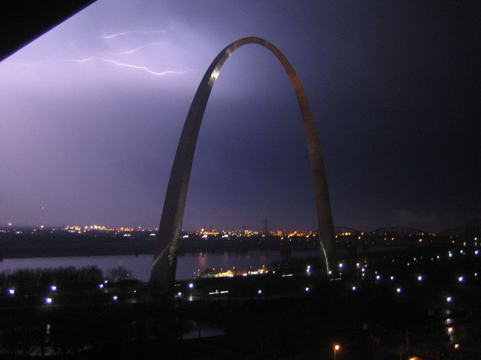

Slide 3
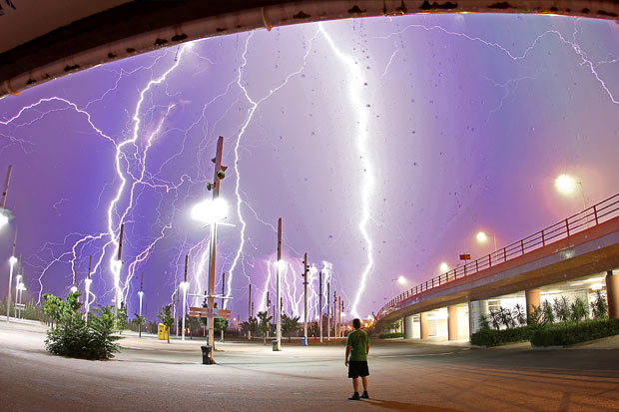
This composite shot was taken as a summer electrical storm hit Athens, Greece. Photographer Chris Kotsiopoulos dashed from his home to the Olympic Stadium when he heard the thunder and lightning and came back with this awesome shot.

Slide 4
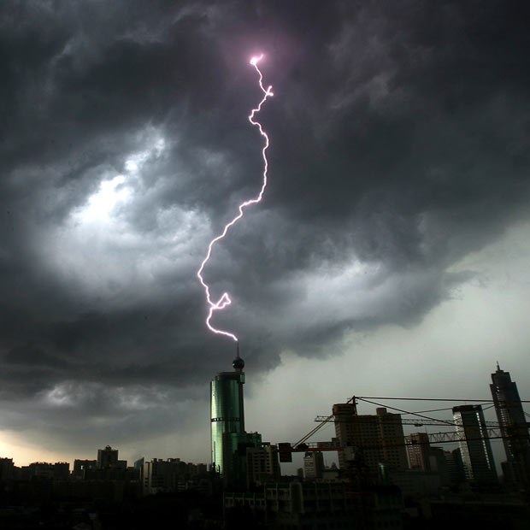
Lightning strikes the top of a building in Foshan in south China's Guangdong province

Slide 5
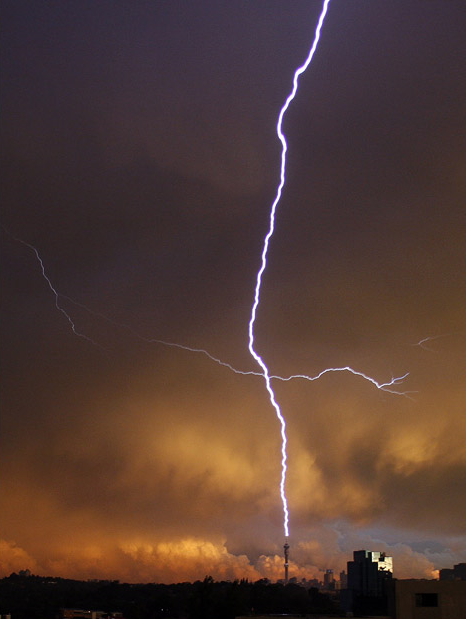
Lightning strikes the Hillbrow Telkom Tower in Johannesburg, South Africa

Slide 6
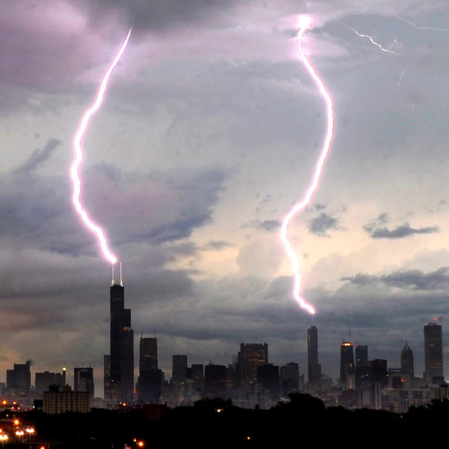
Lightning bolts appear to strike both the Willis Tower and the Trump Tower in downtown Chicago

Slide 7
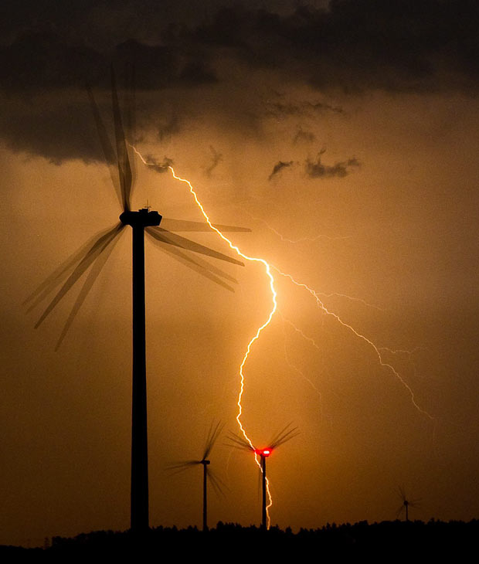
Wind turbines are silhouetted by lightning in Jacobsdorf, in Brandenburg, Germany

Slide 8
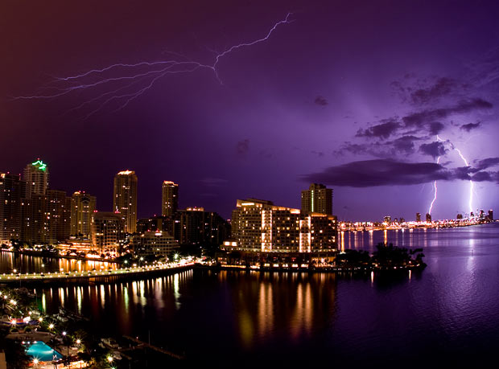
Lightning illuminates the night sky and strikes two buildings over South Beach, Miami

Slide 9
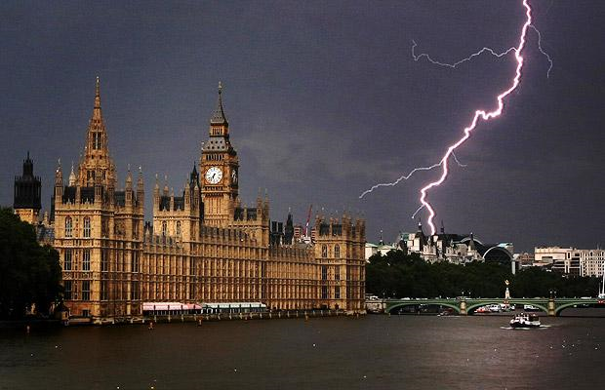
Lightning striking near the Houses of Parliament, in London

Slide 10
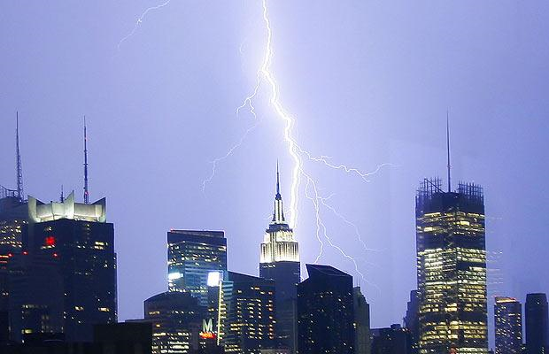
Lightning strikes near the Empire State Building during a severe thunderstorm in a sweltering New York

Slide 11
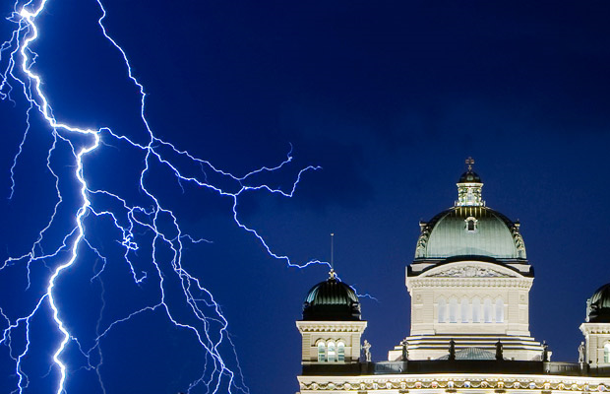
Lightning illuminates the sky during a thunderstorm over the Swiss Federal Palace in Bern

Slide 12
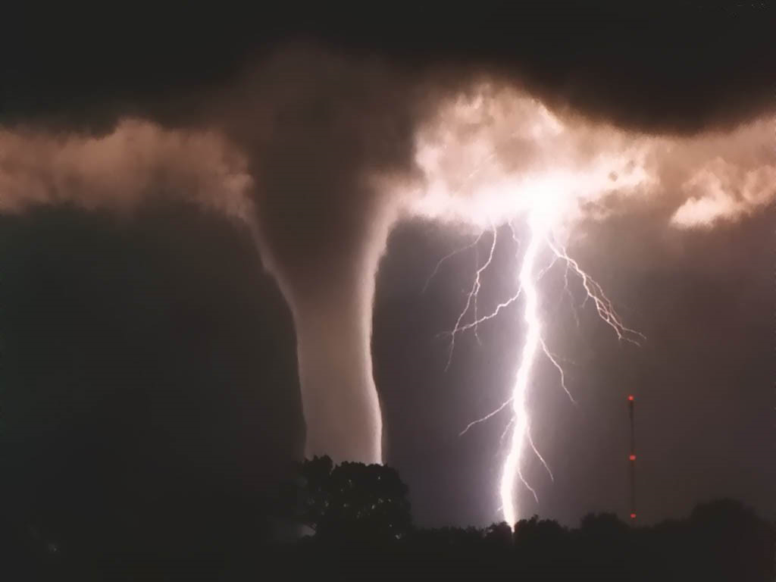
Tornado and lightening

Slide 13
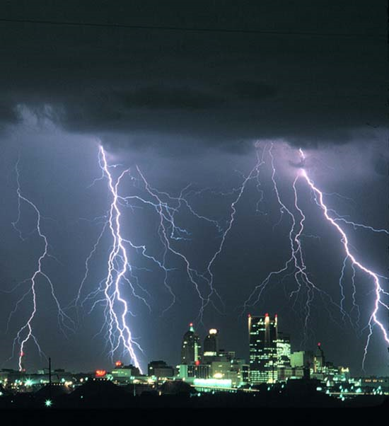

Slide 14
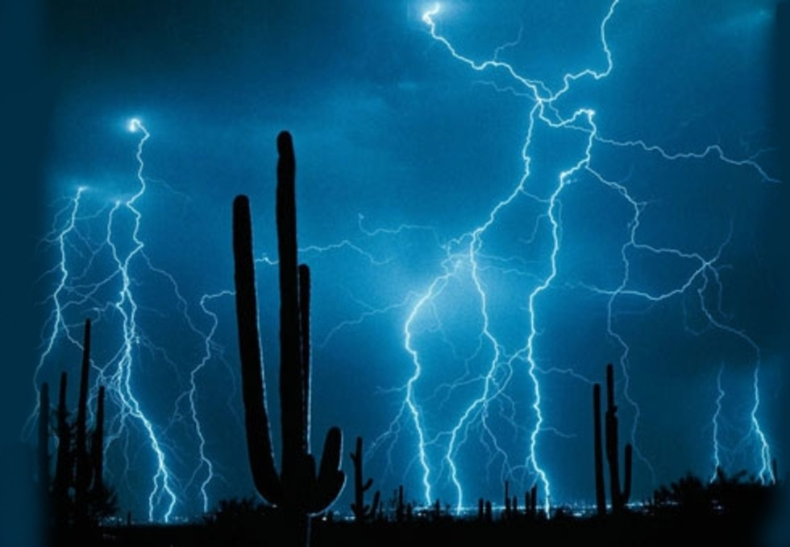
Arizona Desert

Slide 15
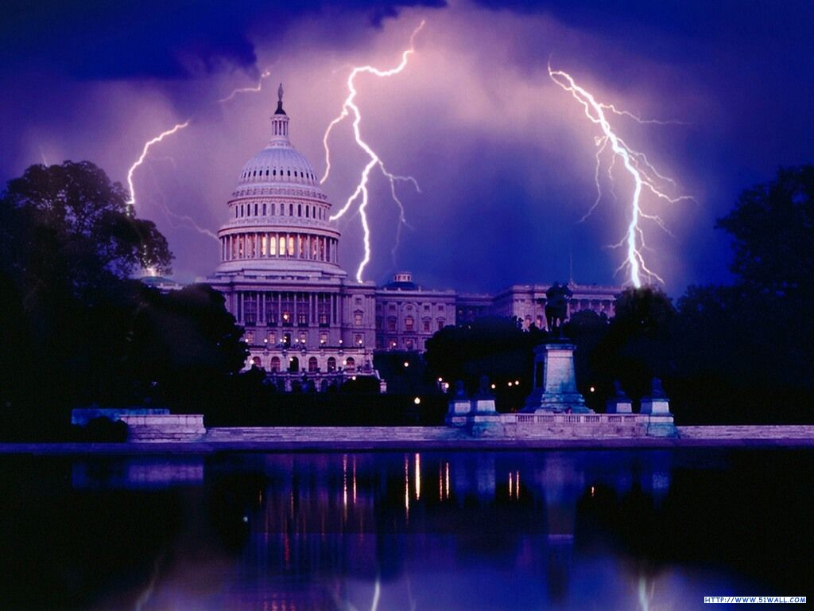
Lightening around the Capital Building, D.C.

Slide 16
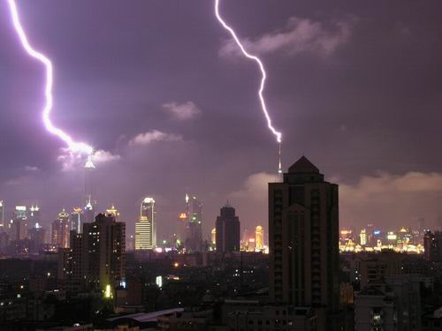
Shanghai, China

Slide 17
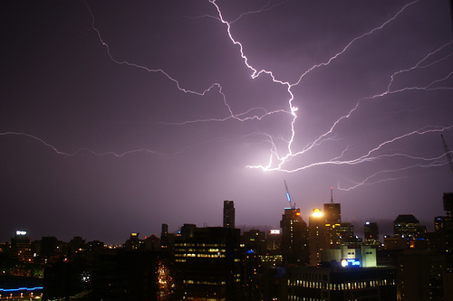
Brisbane, Australia

Slide 18
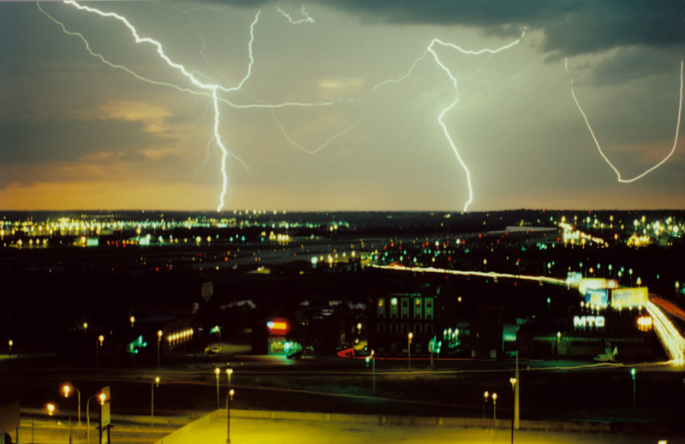
Kansas City, MO

Slide 19
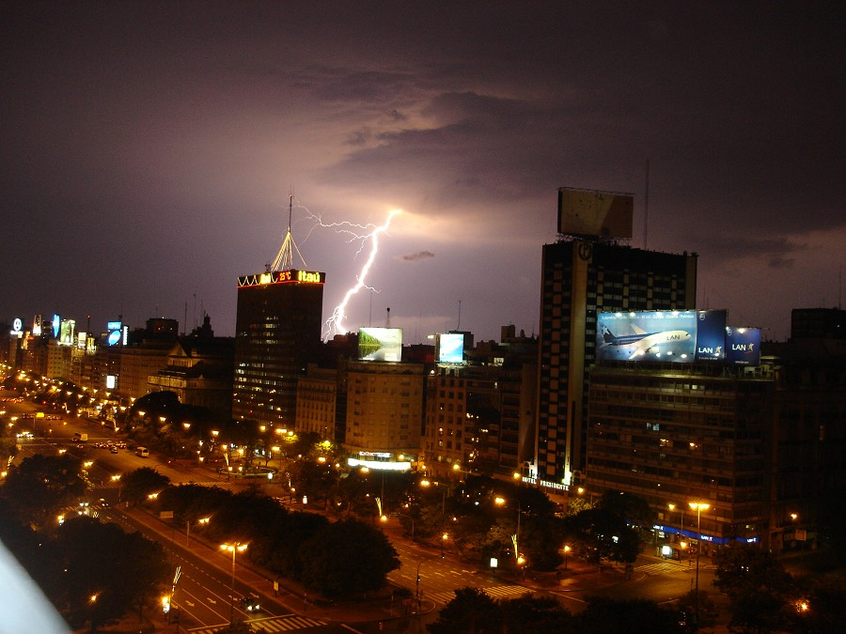

Slide 20
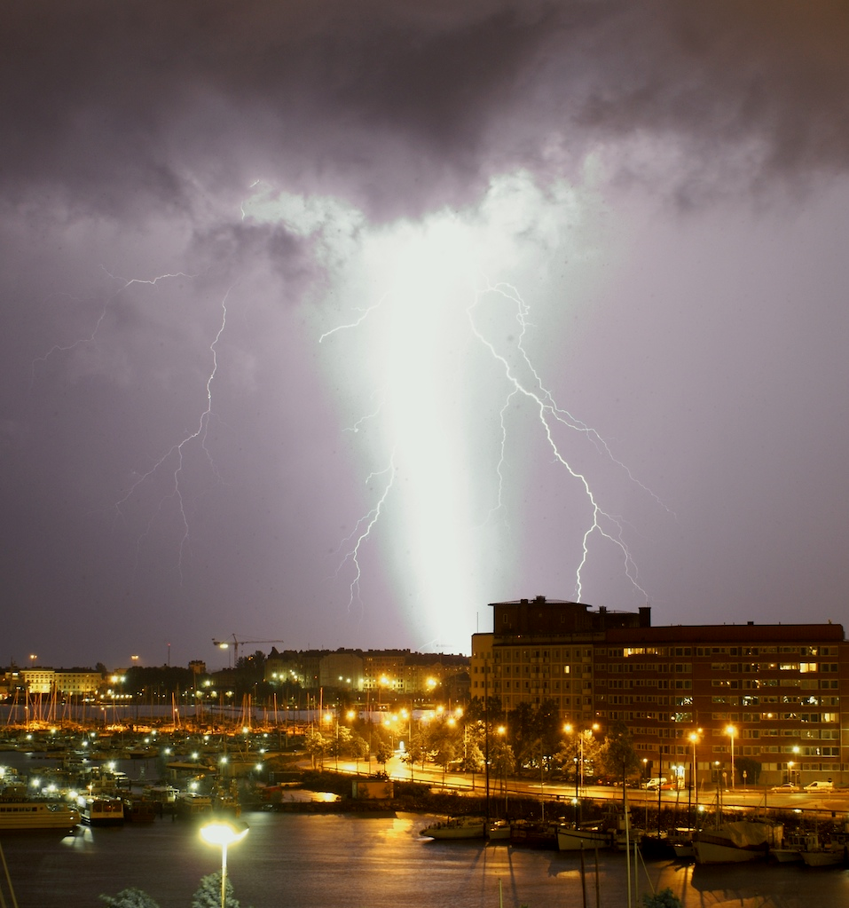
Helsinki, Finland

Slide 21
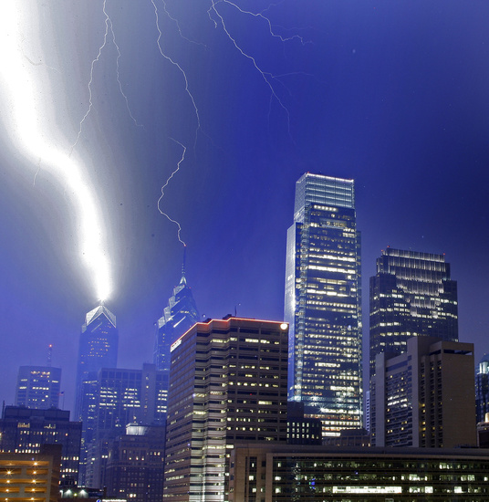
Philadelphia, Pennsylvania

Slide 22
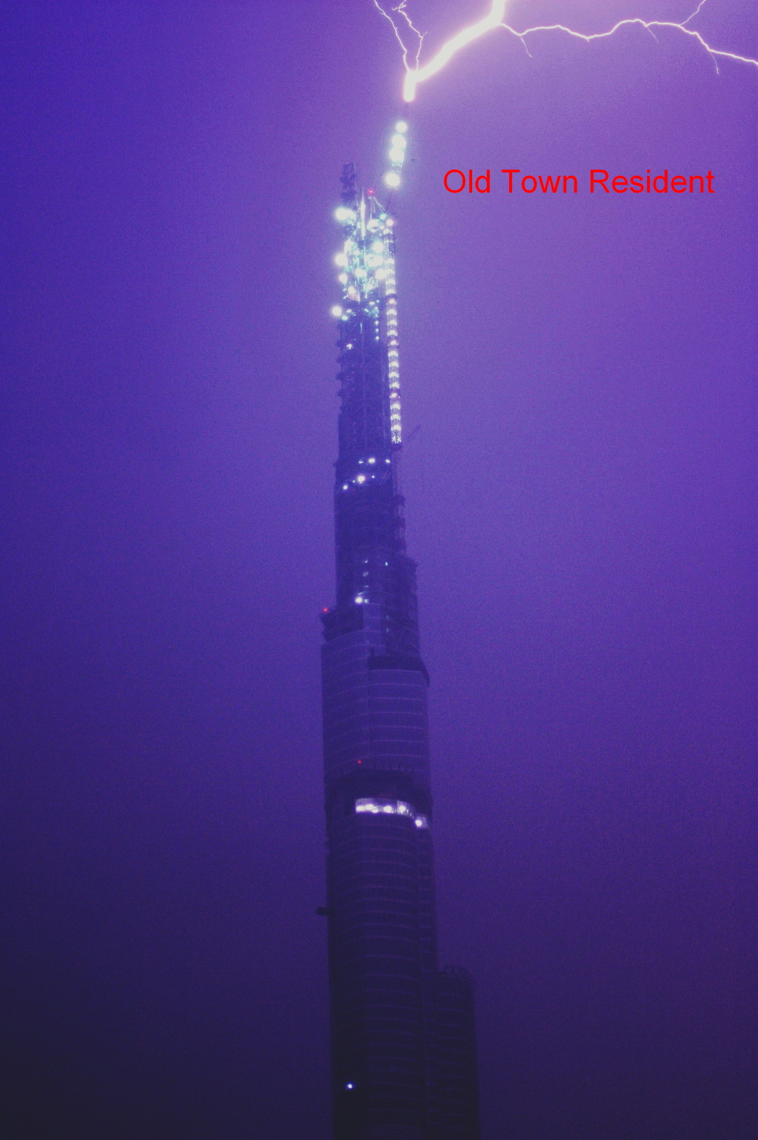
Dubai – the world’s tallest building

Slide 23
Lightning damage

Slide 25
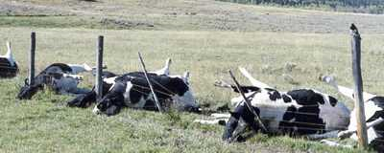
Cows killed by lightning striking the barbed wire fence they were huddled against.

Slide 26
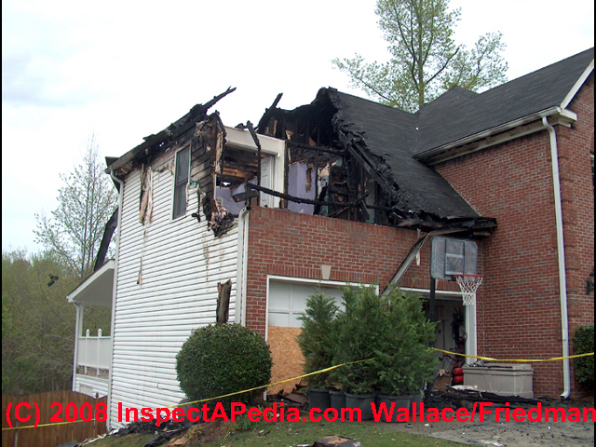

Slide 27
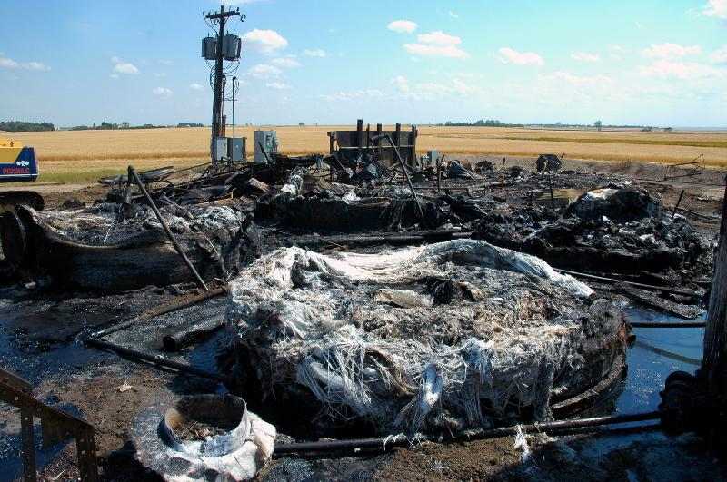
Crude Oil Tank

Slide 28
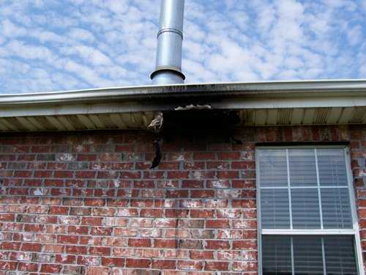

Slide 29
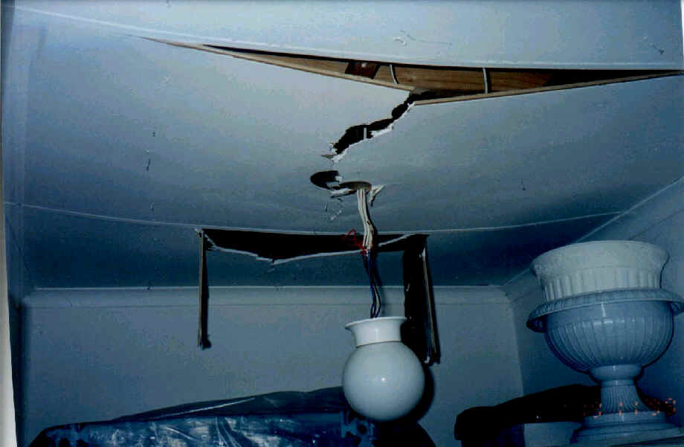

Slide 30
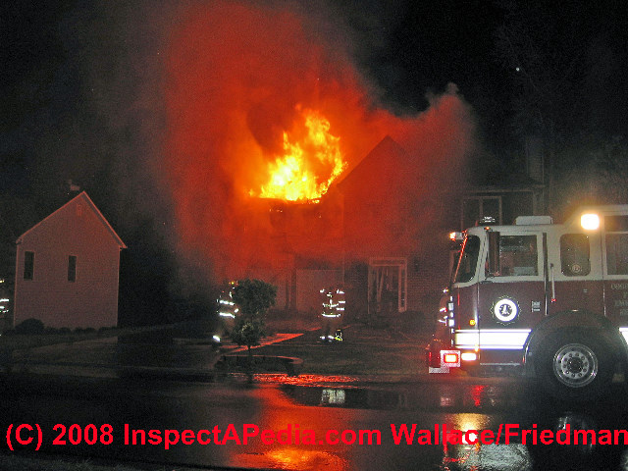

Slide 31
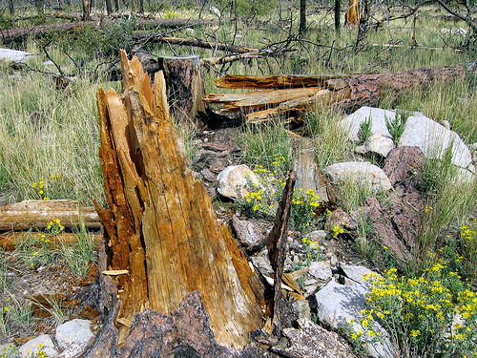

Slide 32
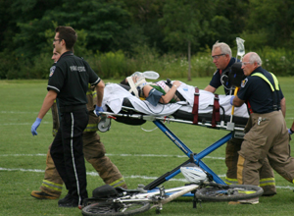

Slide 33
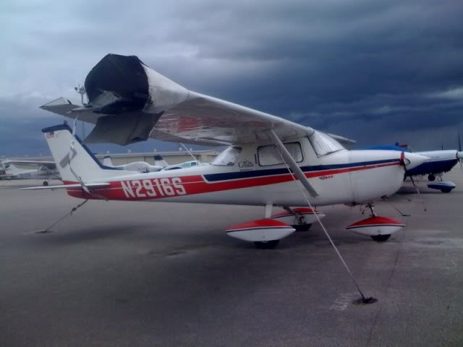

Slide 34
