Slide 1
TOO, TOO, TOO MUCH SNOW !!
Global Warming = Greater Extremes and Less Predictability in Weather

Slide 2
These pictures were taken in Lead, South Dakota , on January 5, 2011.

Slide 3
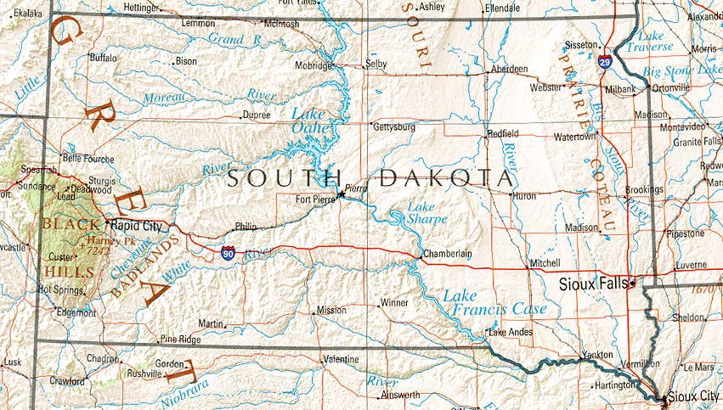

Slide 4
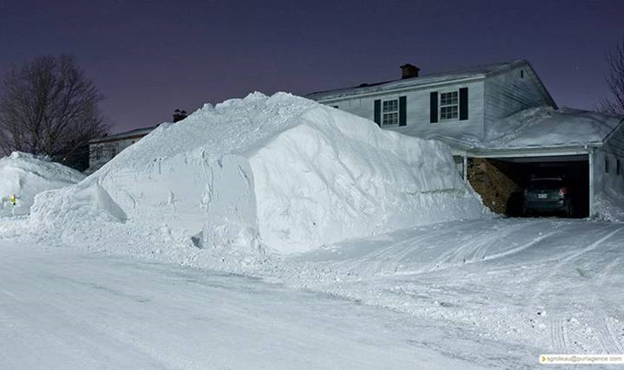

Slide 5
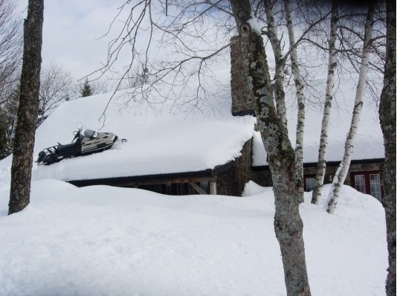

Slide 6
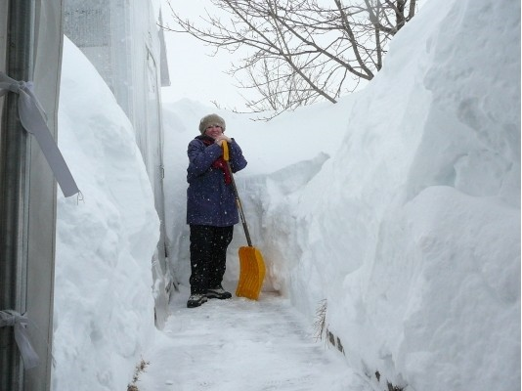

Slide 7
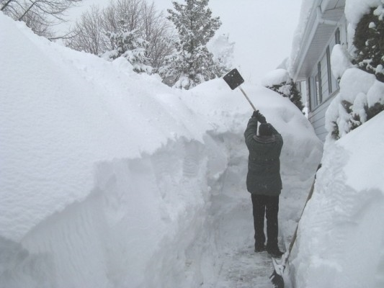

Slide 8
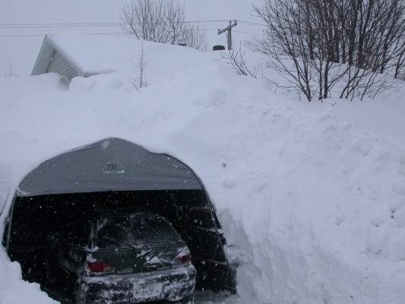

Slide 9
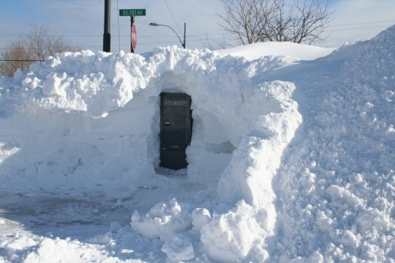

Slide 10
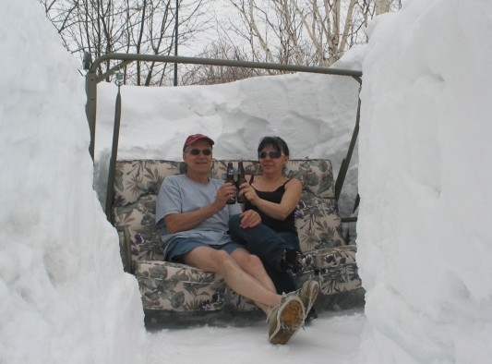

Slide 11
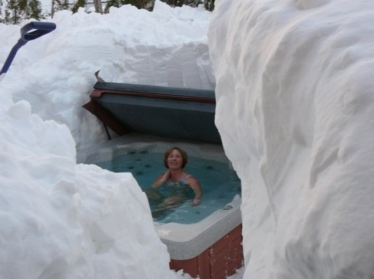

Slide 12
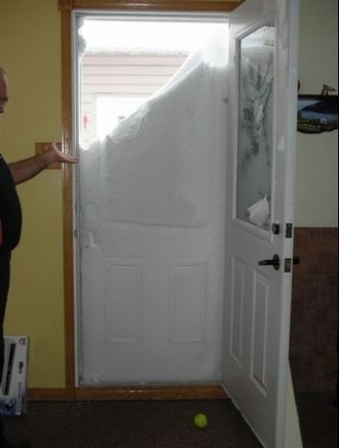

Slide 13
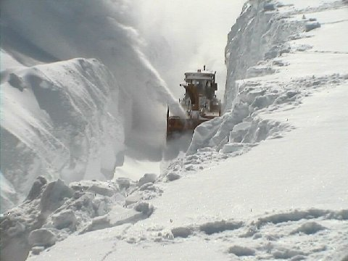

Slide 14
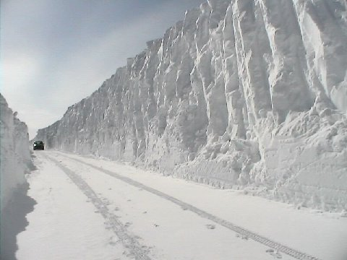

Slide 15
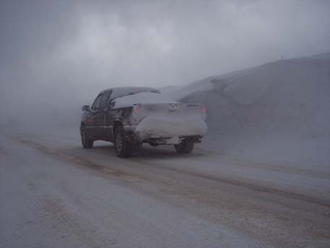

Slide 16
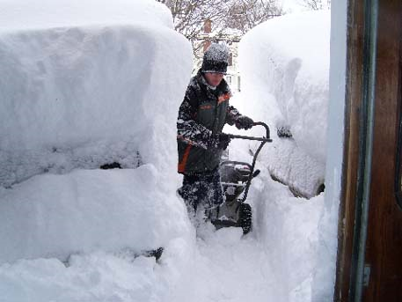

Slide 17
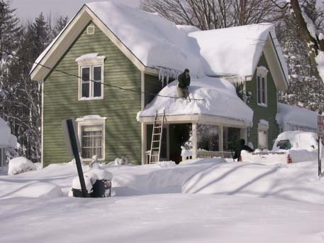

Slide 18
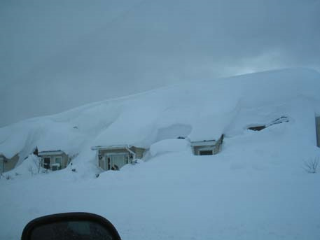

Slide 19
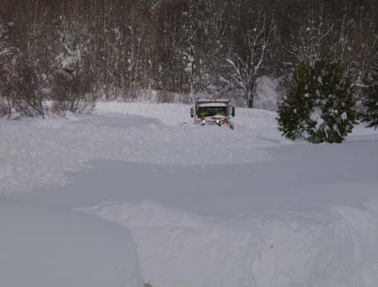

Slide 20
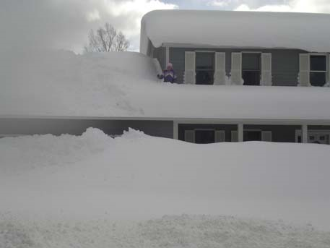

Slide 21
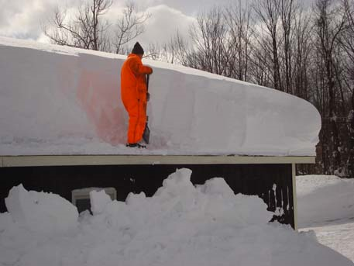

Slide 22
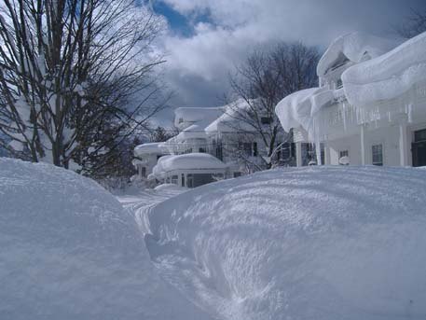

Slide 23
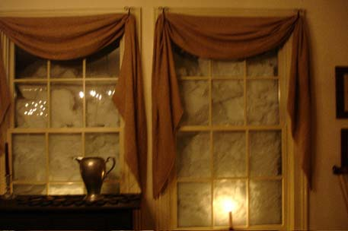

Slide 24
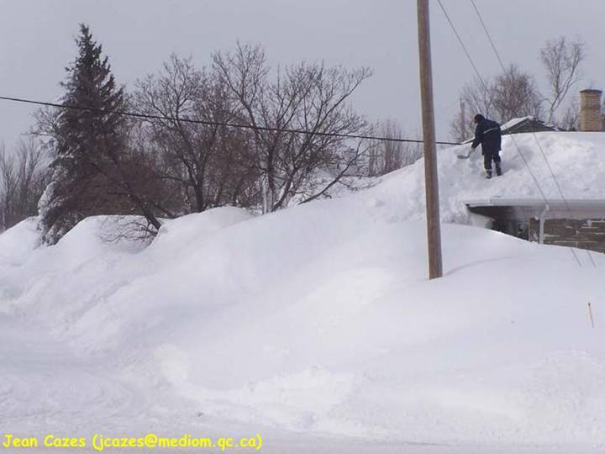

Slide 25
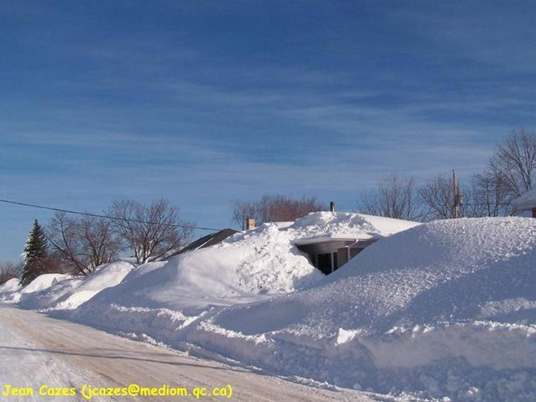

Slide 26
Other 2011 Extremes
Areas around New York got 30 inches of snow in January.
Areas around New York had a low temperature of -25 degrees Fahrenheit.
Feb 2 in St. Louis, it had received 11 inches of snow more than the average for that date & for the first time, Hwy 70 had been closed from Wentzville to Kansas City because of ice/sleet/snow.

