Slide 1
Psychedelic wonder of galaxies at night
Incredible images taken by amateur astronomer using a camera and home-made telescope

Slide 2
Georgiy Suturin
These spectacular images of galaxies thousands of light years away would appear to have been taken using state-of-the-art equipment.
In fact, they were captured by amateur astronomer Georgiy Suturin using just a camera and a home-made telescope.
The extraordinary photos include the twinkling beauty of the Orion Nebula, and the Rosette Nebula - an object so massive it would take 130 years travelling at the speed of light to go from one side to the other.

Slide 3
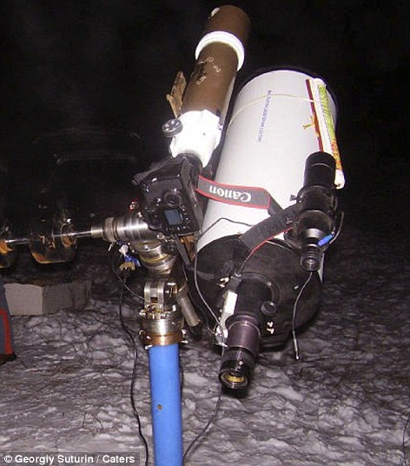
Current Equipment
'I first started making telescopes together with my friend. We made them out of standard glasses you wear if you have bad eyesight. 'We inserted the lenses to tubes made of hard cardboard and discovered we could take pictures of Venus.” The picture is of his current equipment.

Slide 4
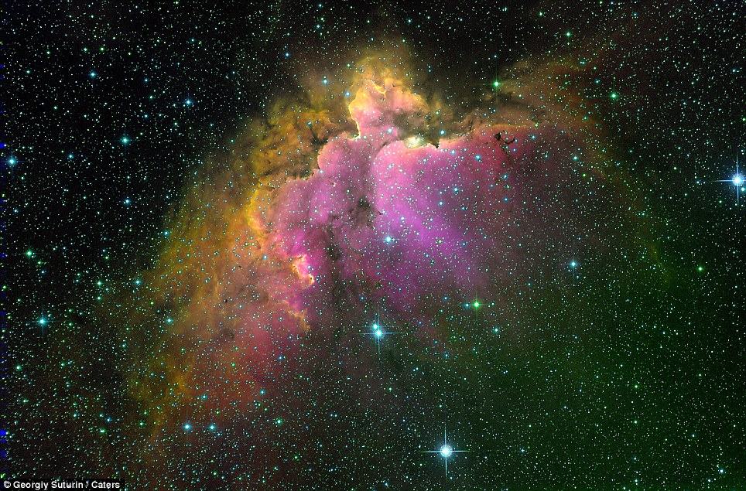
stunning image of an open cluster

Slide 5
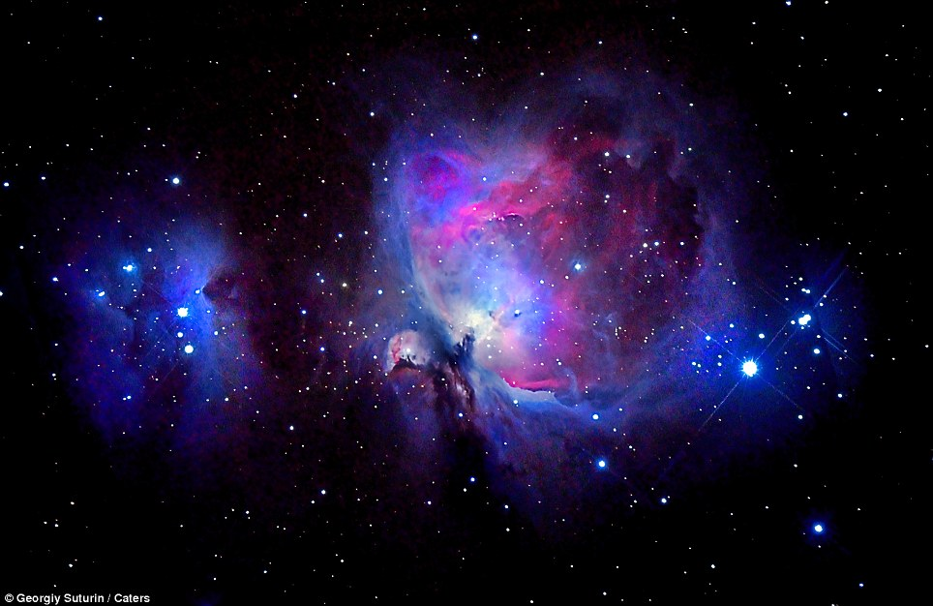
Orion Nebula

Slide 6
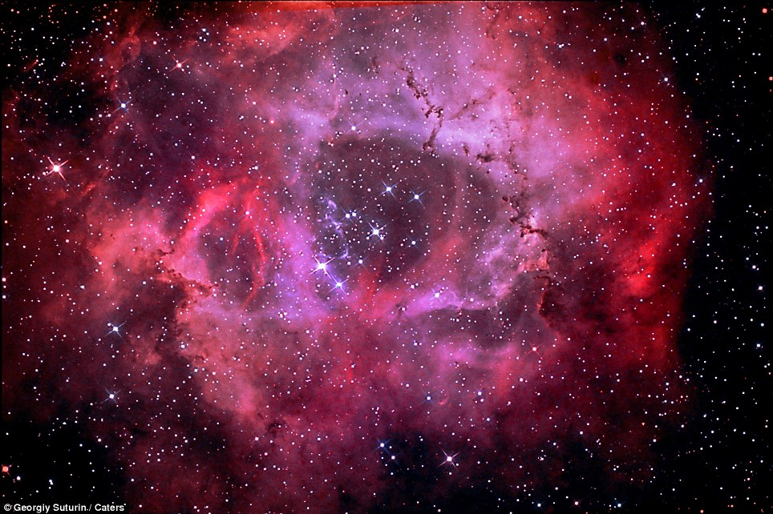
The Rosette Nebula

Slide 7
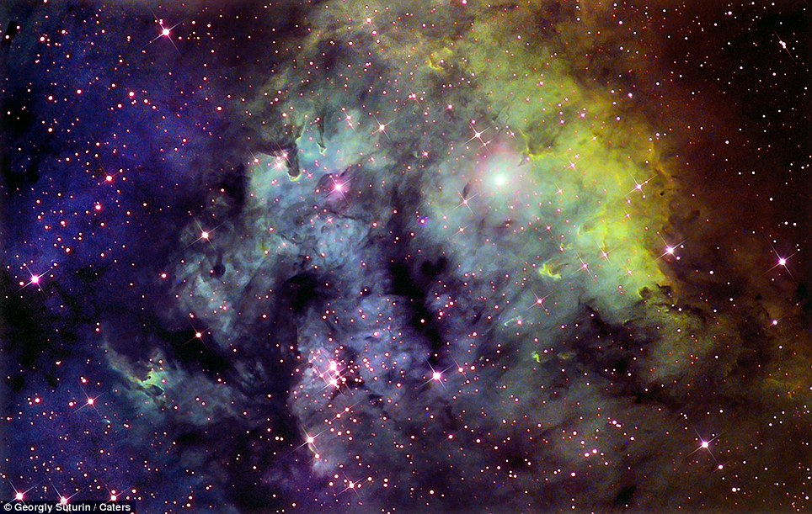
the Cepheus constellation

Slide 8
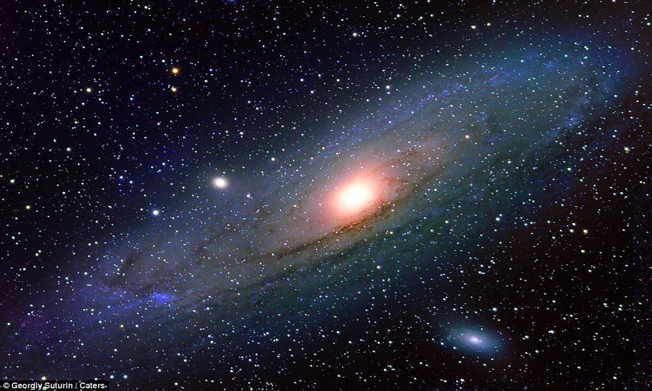
the Andromeda Galaxy

Slide 9
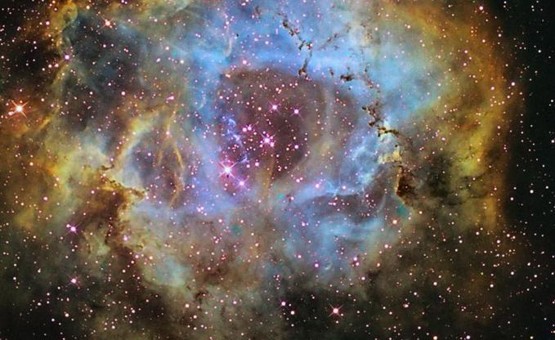
NGC 2237

Slide 10
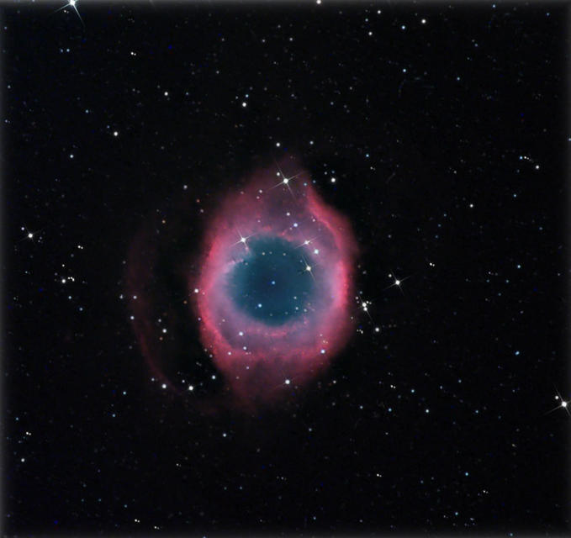
Helix nebula

Slide 11
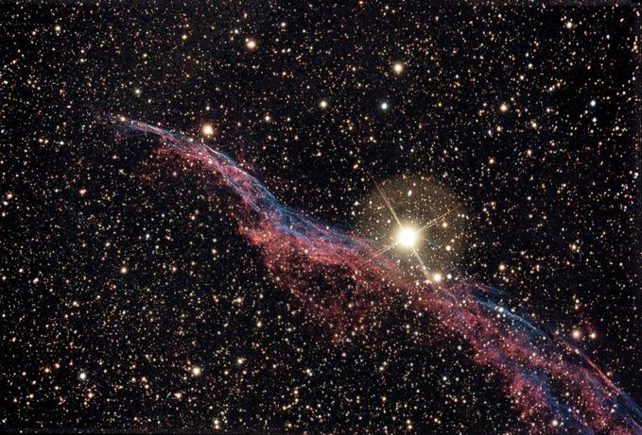
Veil Nebula

Slide 12
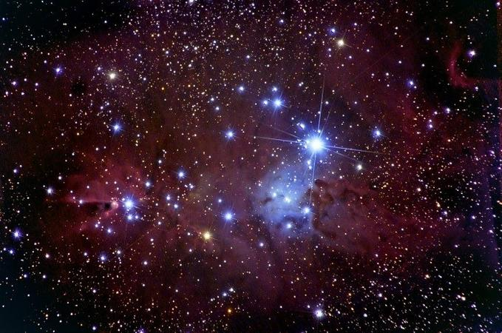
Cone Nebula

Slide 13
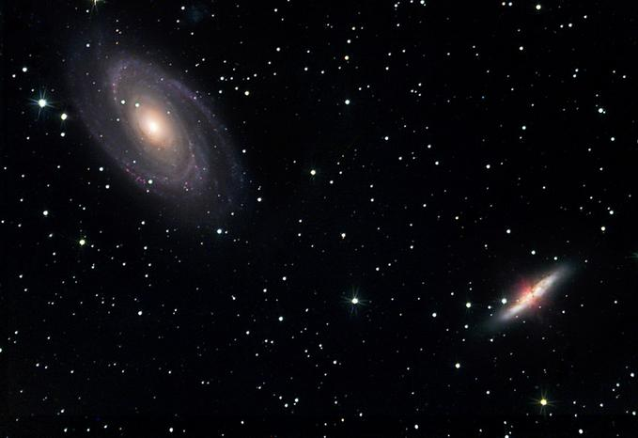
Two Galaxies in Ursa Major

Slide 14
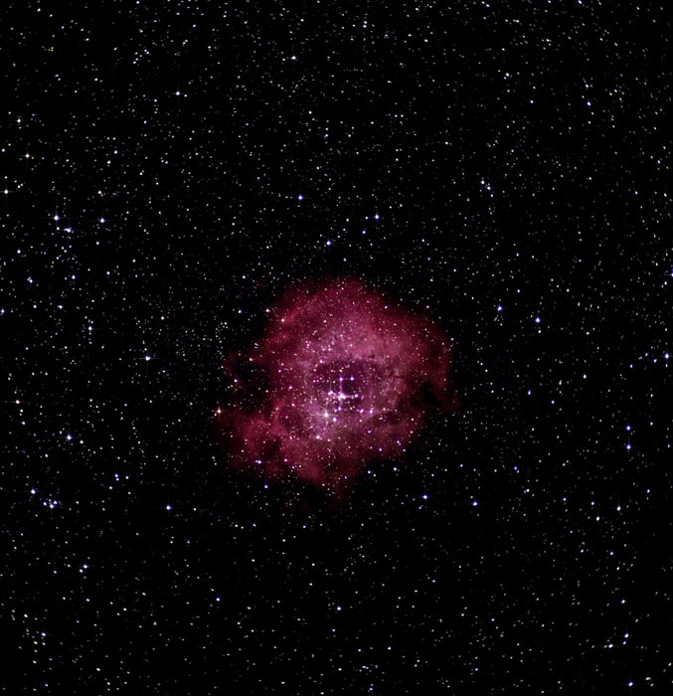
NGC 2244

Slide 15
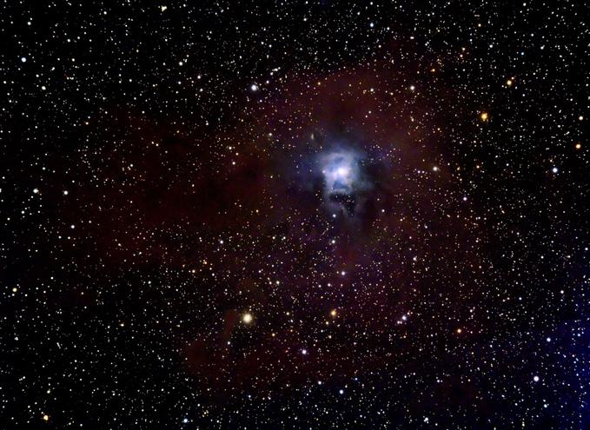
"Iris" nebula, NGC 7023

Slide 16
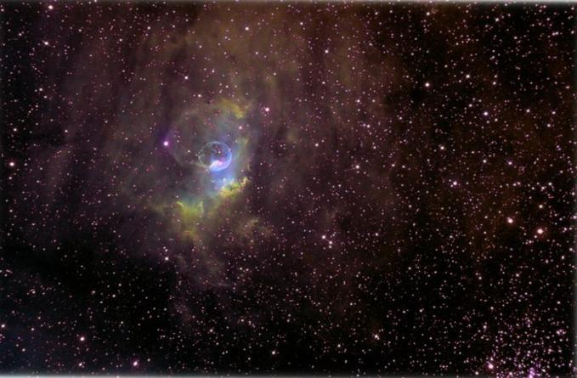
Bubble Nebula

Slide 17
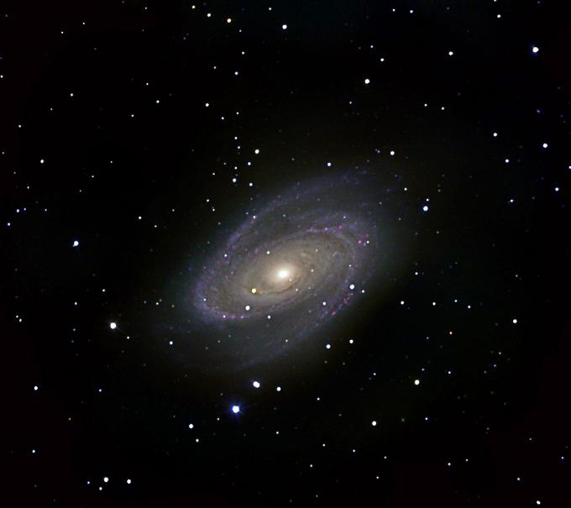
M-81 Galaxy

