Slide 1
Massive Solar Storm Causes Aurora Lights in United States and Canada.
Beautiful but Problematic?

Slide 2
As scientists have already warned us, huge solar storm hit Earth’s atmosphere today. A few of extraordinary massive eruptions of the plasma on Sun’s surface have reached Earth today and thanks to that increased solar activity, residents in some areas of North America were able to see aurora lights in the sky.
NASA has announced that there were four strong eruptions on Sun which were directed straight to Earth. Luckily, our atmosphere as well as magnetic field has played well its role and absorbed the radiation.

Slide 3
Problem ahead?
Scientists have been predicting for a while that solar storms like this one could cause significant damage to satellites. Scientists are predicting that increased solar activity in next few years will be followed with a number of similar solar storms.

Slide 4
The Cause

Slide 5
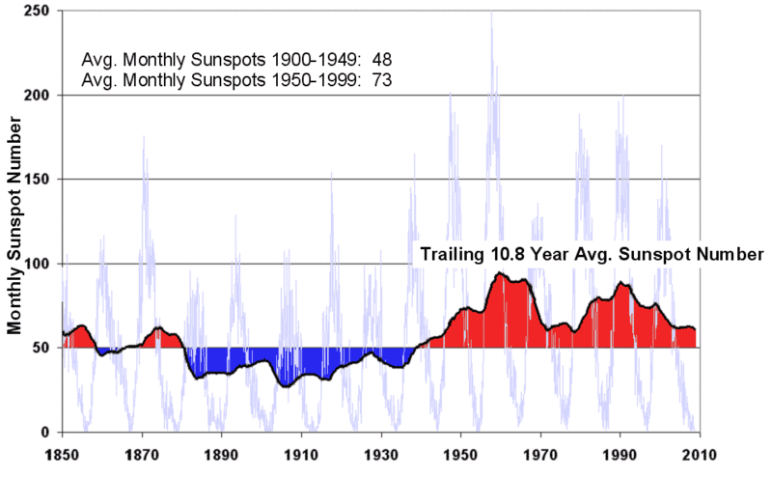

Slide 6
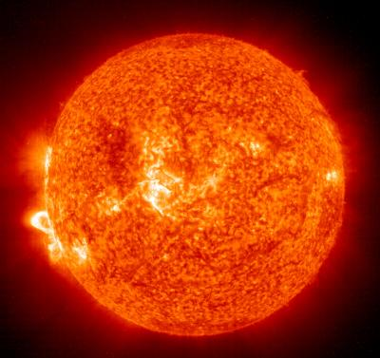

Slide 7
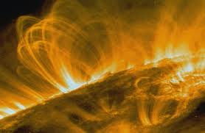
2010
Increased solar storm and solar flare activity has been reported.

Slide 8
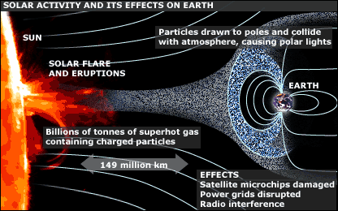

Slide 9
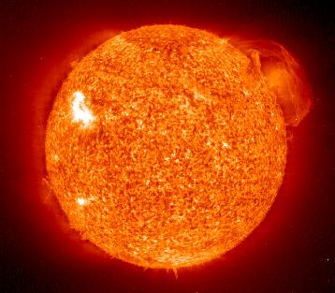

Slide 10
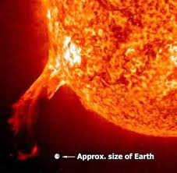
2010

Slide 11
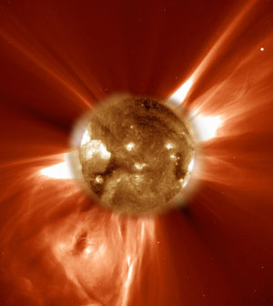
Computer Model for 2012 Storms
Long scorned as “mysticism” and “parascience,” concern about the year 2012 has now surfaced in a mainstream NASA report on the potential impacts on human society of solar flares anticipated to peak in 2012.

Slide 12
The Visible Results

Slide 13
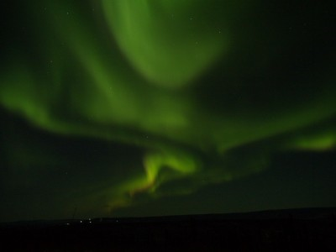

Slide 14
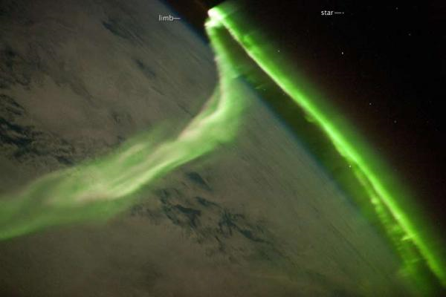

Slide 15
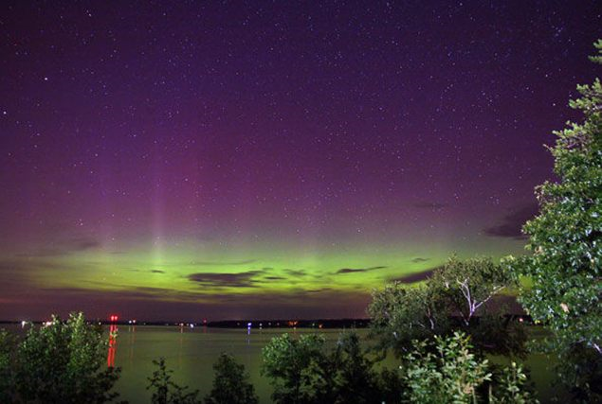

Slide 16
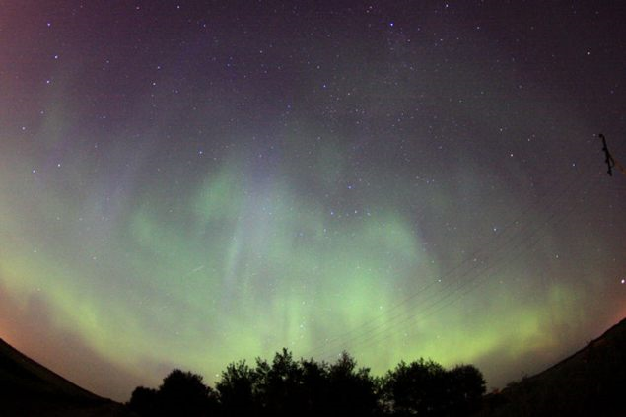

Slide 17
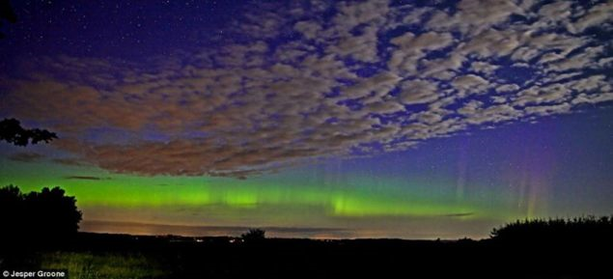

Slide 18
