Slide 1
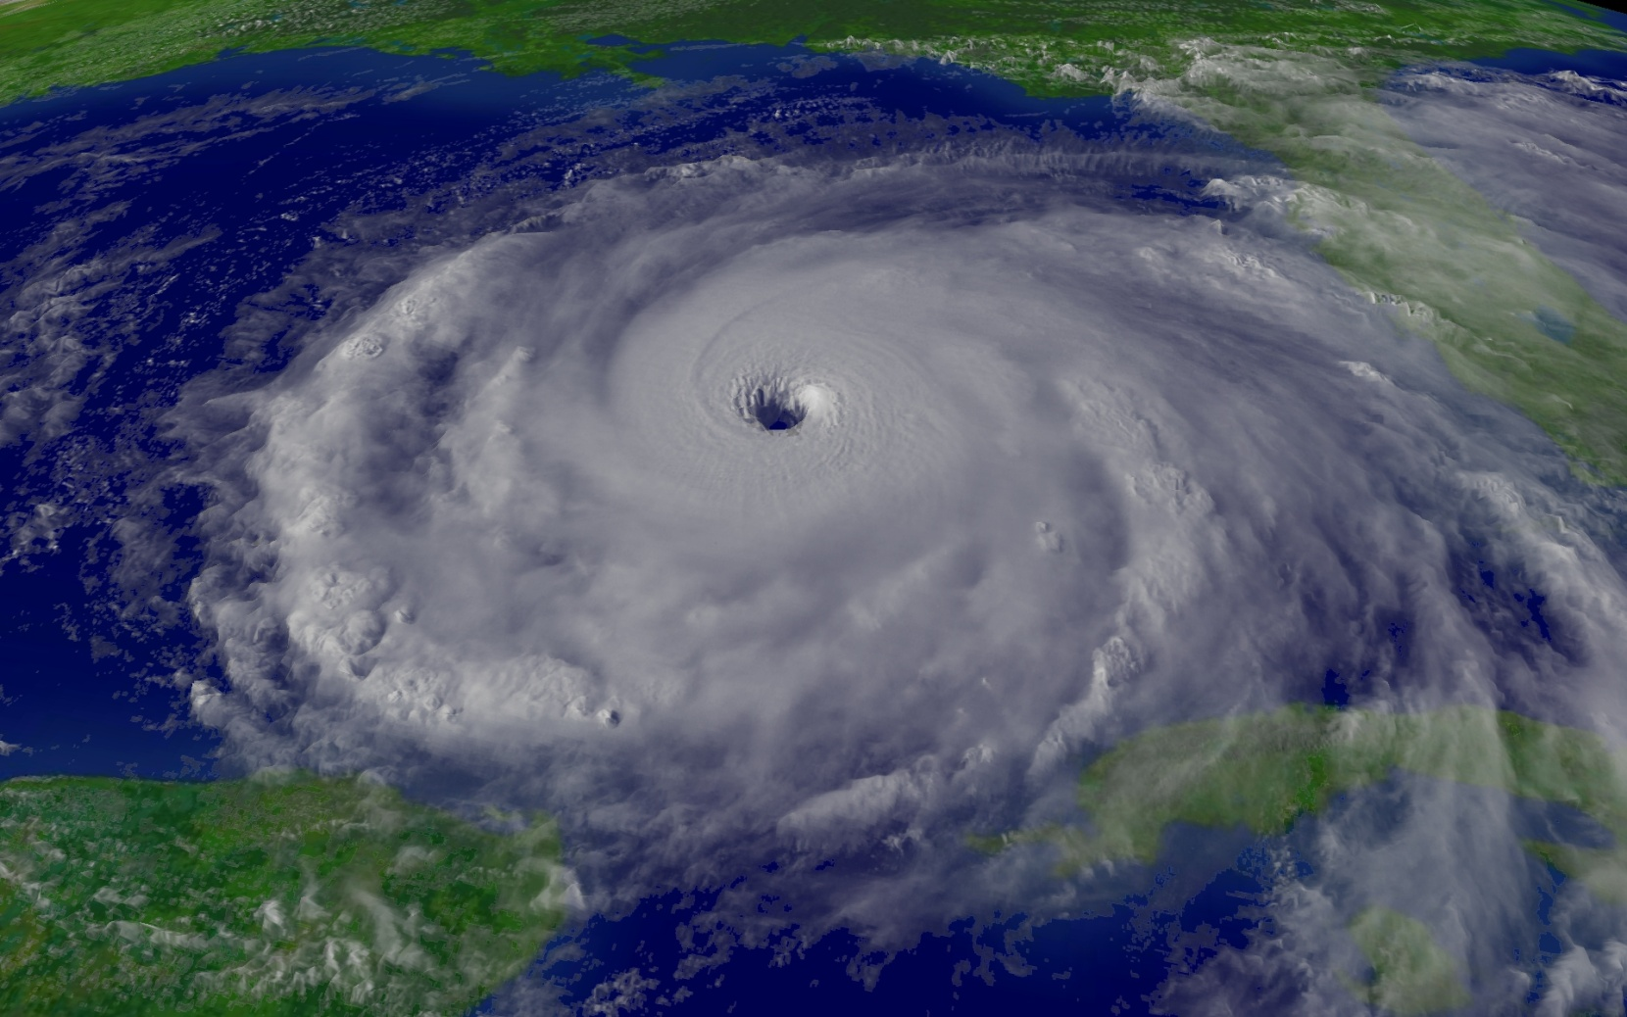
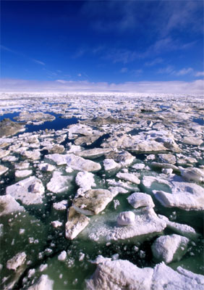
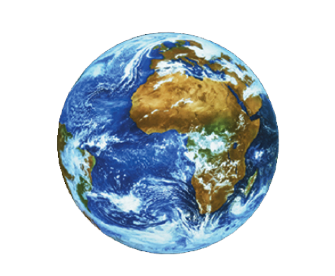
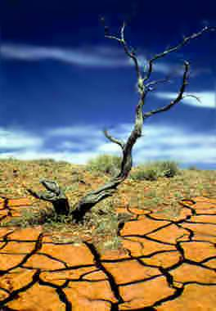
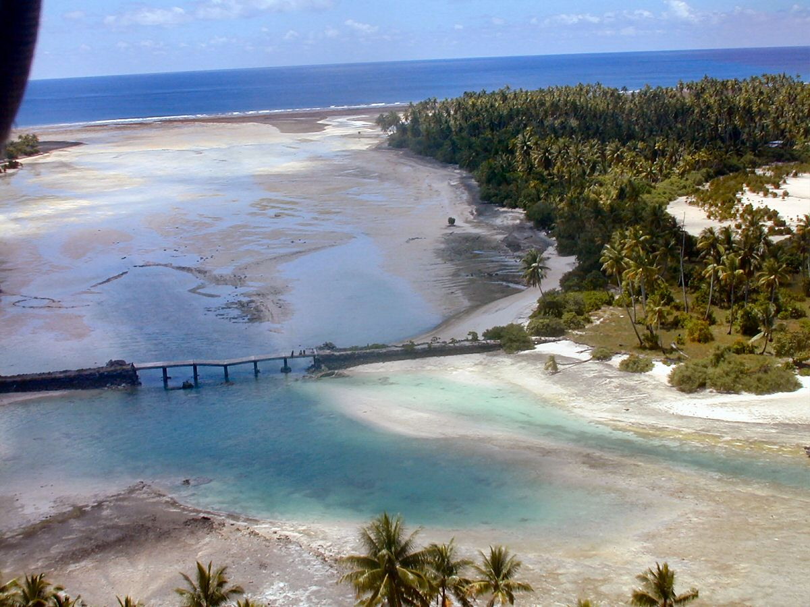
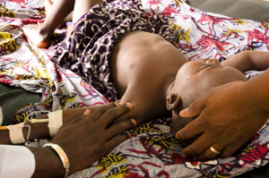
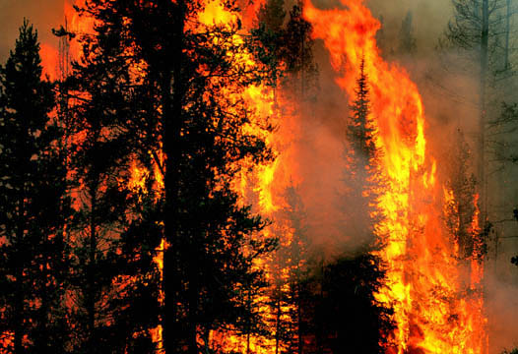
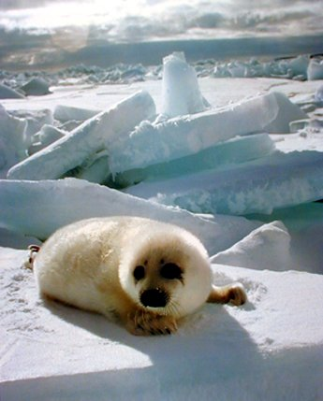
Spreading
disease
Endangered Species
Sea level rise
Lets start at the beginning of the story....
Melting Polar Ice
Do they live happily ever after?
It all starts with a greenhouse...
With looming threats
Once upon a time...
Drought
Wildfires
You decide...
Increasingly severe storms
There was a planet

Slide 2
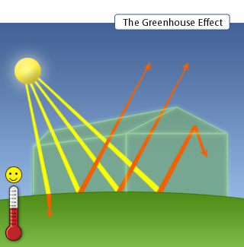
Greenhouses trap heat from the sun
The glass panels let in light but keep heat from escaping.
This causes the greenhouse to heat up

Slide 3
Much like the inside of a car parked in sunlight

Slide 4
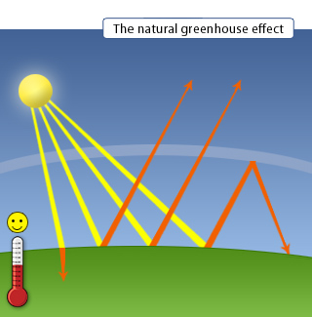
Atmospheric gases allow sunshine to pass through but absorb infrared radiation (heat) that is radiated back from the warmed surface of the Earth
Our planet's atmosphere traps energy just like a greenhouse or car windshield
Resulting in increased temperatures

Slide 5
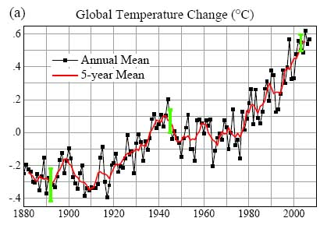
As you can see...
Global temperatures are rising!

Slide 6
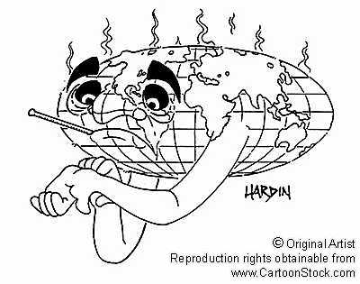
The rise in
temperature
that the Earth
experiences
when solar
radiation is trapped by the atmosphere is called
THE GREENHOUSE EFFECT

Slide 7
Many gases exhibit “greenhouse” properties
Water vapour
(H₂0)
Methane
(CH₄)
Ozone
(O₃)
Nitrous oxide
(N₂O)
Carbon dioxide
(C0₂)

Slide 8
But where do these Greenhouse gases
come from???

Slide 9
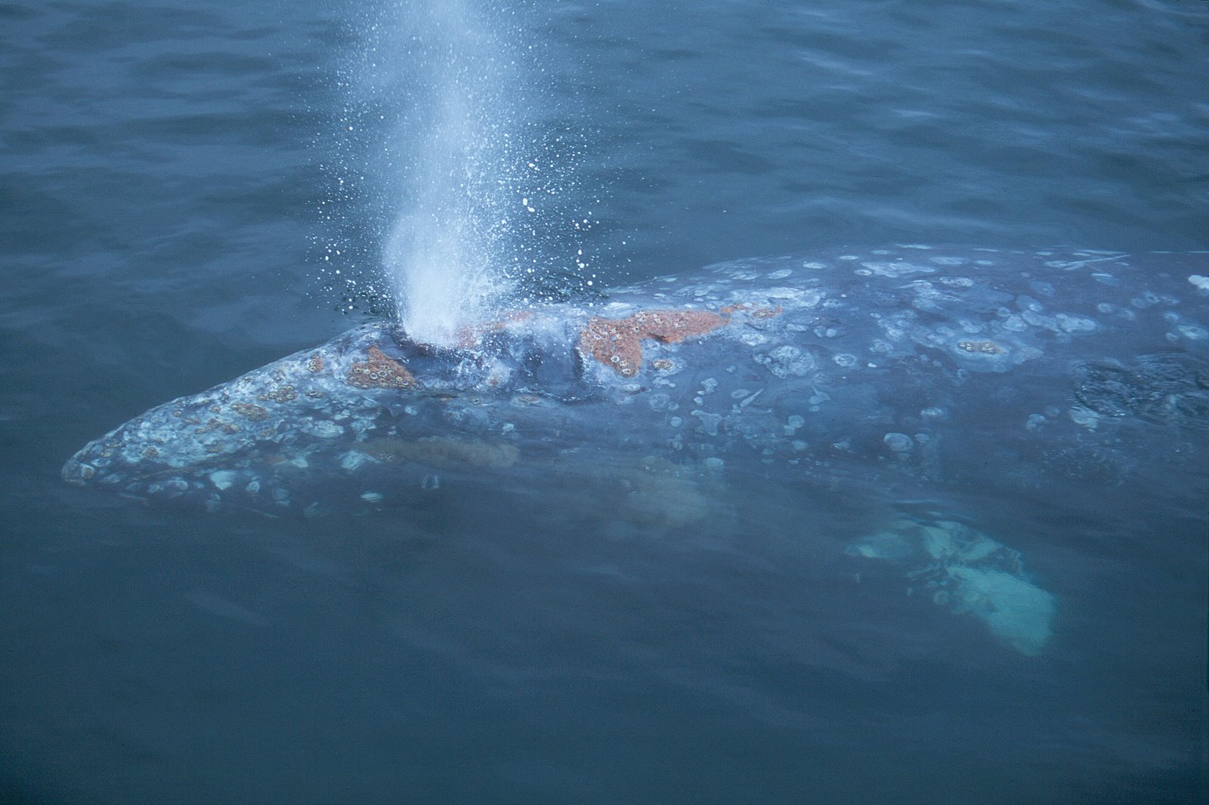
Carbon Dioxide Occurs Naturally
Eg. as gas produced by living organisms through respiration and fermentation
Eg. released during volcanic eruptions

Slide 10
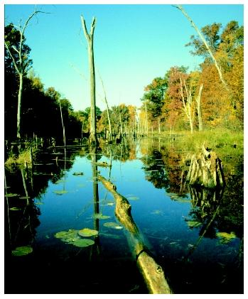
Methane Occurs Naturally
Eg. geological coal formations
Eg. decomposition of organic matter (especially in wetlands)

Slide 11
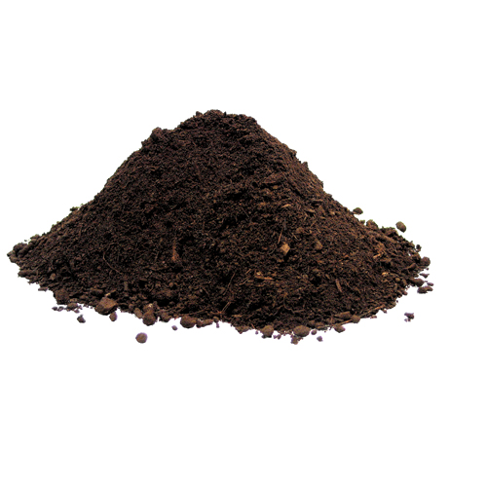
Nitrous Oxide Occurs Naturally
Eg. from microbial action in soil

Slide 12
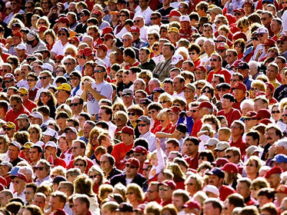
Human activities also contribute to greenhouse gases
Anthropogenic = caused by human activity

Slide 13
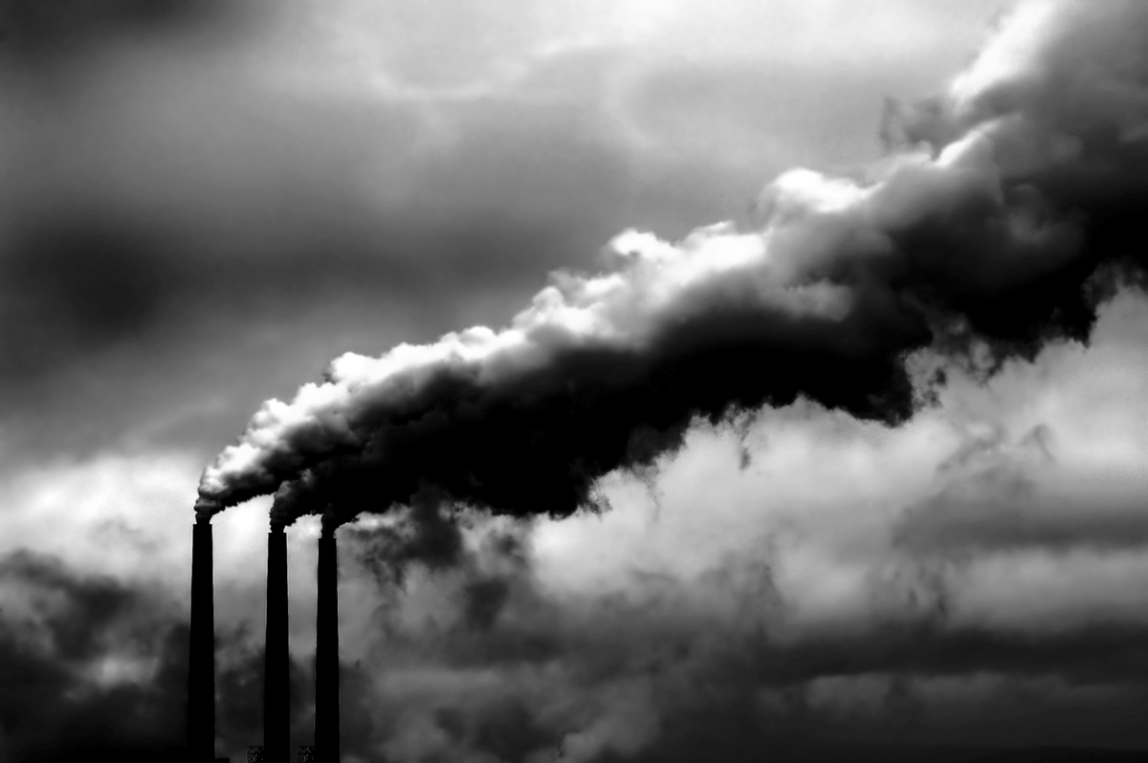
Anthropogenic Sources of Nitrous Oxide
Eg. agricultural and industrial processes
Eg. burning of solid waste or fossil fuels

Slide 14
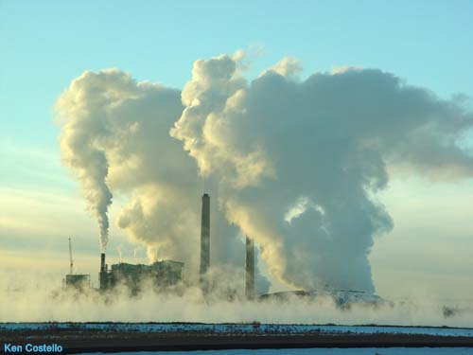
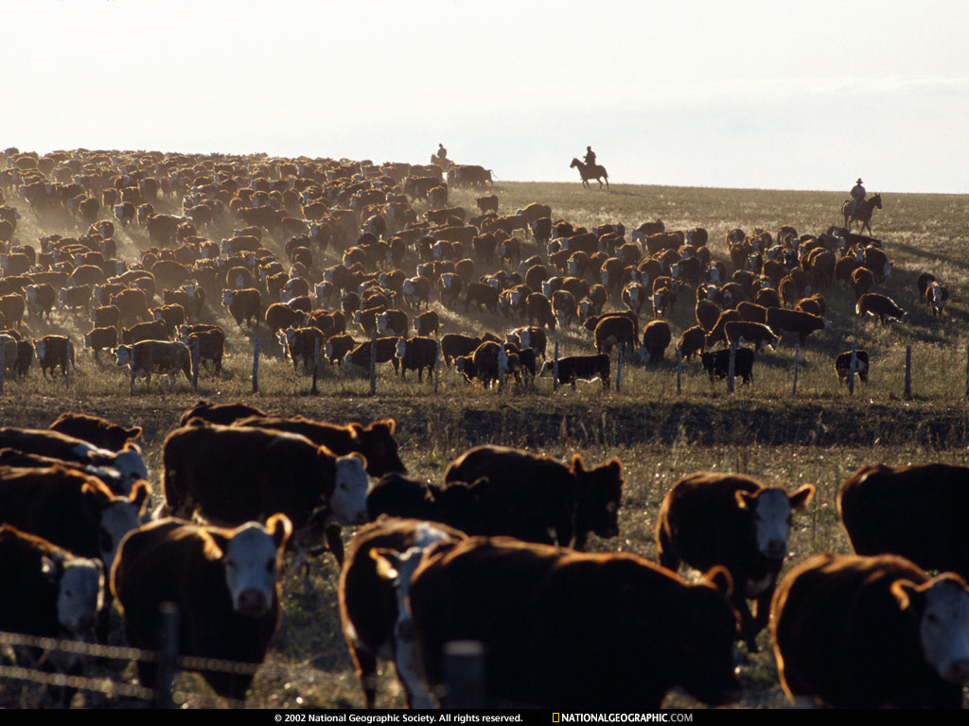
Anthropogenic Sources of Methane
Eg. production and transport of fossil fuels
Eg. decomposition of organic waste (landfills/livestock farming)
DID YOU KNOW...Ruminants belch tremendous amounts of methane (and other greenhouse gases)
BURP
‘CH₄’
BURP
‘CH₄’
BURP
‘CH₄’
BURP
‘CH₄’
BURP
‘CH₄’
BURP
‘CH₄’
BURP
‘CH₄’
BURP
‘CH₄’
BURP
‘CH₄’
BURP
‘CH₄’
BURP
‘CH₄’
BURP
‘CH₄’
BURP
‘CH₄’
BURP
‘CH₄’
BURP
‘CH₄’
BURP
‘CH₄’
BURP
‘CH₄’

Slide 15
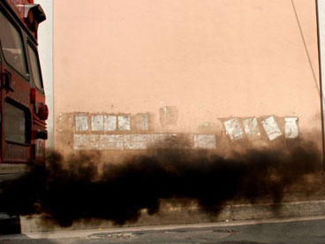
Anthropogenic Sources of Carbon Dioxide
Eg. burning of solid waste, wood, and fossil fuels (oil, natural gas, and coal)

Slide 16
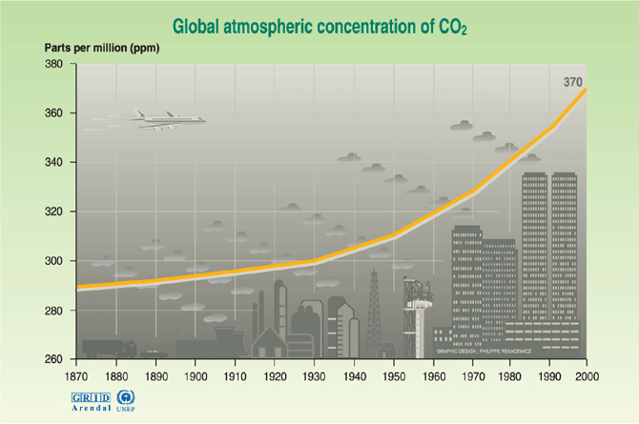
Carbon dioxide concentrations have been on the rise since the industrial revolution
Year

Slide 17
Did you know...

Slide 18
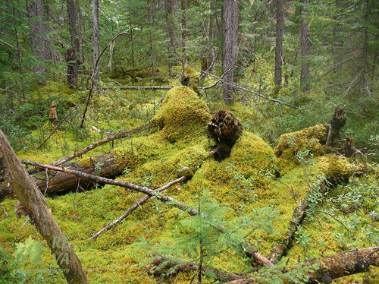
The natural decay of organic material in forests and grasslands results in the release of about 220 billion tons of CO₂ every year

Slide 19
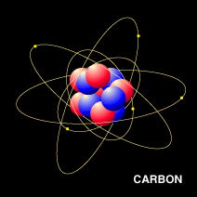
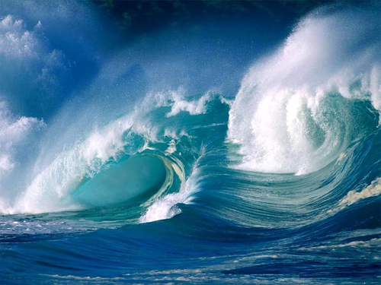
The Carbon Cycle
Natural sources are nearly balanced by physical and biological processes, called natural sinks, which remove carbon dioxide from the atmosphere
For example...
Some carbon dioxide dissolves in sea water, and some is removed by plants as they grow
CO₂ is released into the atmosphere by a variety of sources

Slide 20
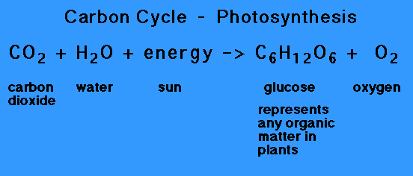
Photosynthesis
Carbon dioxide is a reactant in photosynthesis
Photosynthesis is thus a mechanism for removing carbon dioxide from the atmosphere (carbon sink)
Carbon dioxide becomes fixed into organic biomass

Slide 21
Cellular Respiration
Carbon dioxide is a product of cellular respiration
Cellular respiration is thus a mechanism for adding carbon dioxide from the atmosphere

Slide 22
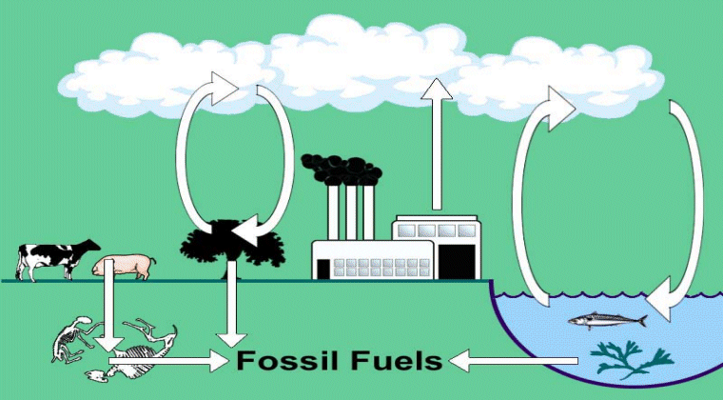
Simplified carbon cycle

Slide 23
Did you know...

Slide 24
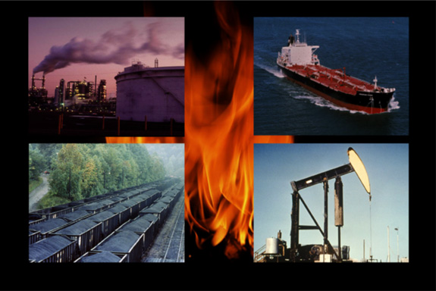
Burning fossil fuels is releasing all of that carbon that had originally been fixed and removed from the carbon cycle

Slide 25
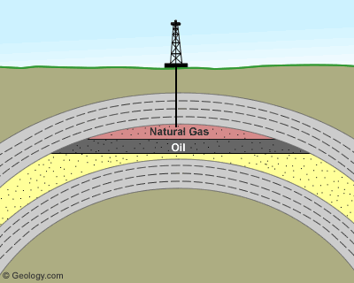
Fossil fuels come from the biological material of organisms that died millions of years ago.
High pressure and temperatures, over millions of years, converted the biomass (fixed carbon) into concentrated forms of energy (mainly charcoal (C) and alkanes) which we call fossil fuels.

Slide 26
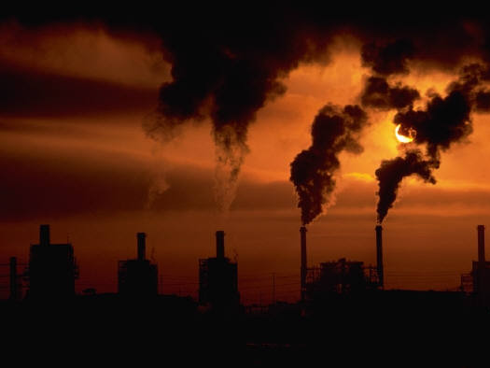
Heptane (C₇H₁₆) is an alkane found in fuel The combustion of heptane releases carbon dioxide into the atmosphere C₇H₁₆+11O₂ → 7CO₂+8H₂O Heptane + Oxygen → Carbon Dioxide + Water
Humankind is taking ‘fixed’ carbon and releasing it into the atmosphere

Slide 27
Did you know...

Slide 28
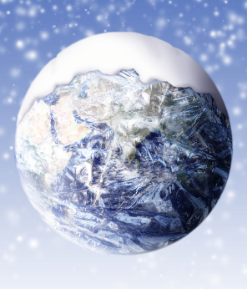
Without greenhouse gases,
heat would escape back into space and Earth’s average temperature would be about 16ºC colder...

Slide 29
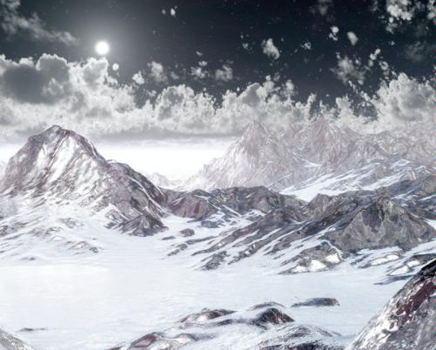
...and the Earth would not be warm enough for humans to live.

Slide 30
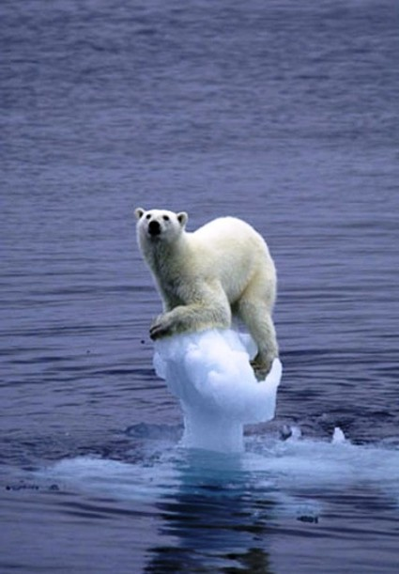
If the greenhouse effect becomes stronger, it could make the Earth warmer than usual.
Even a little extra warming may cause problems for humans, plants, and animals.
On the other hand...

Slide 31
What if the Earth heats up?
Sea levels around the world could rise. Cities on coasts would flood.
Temperate places that now receive frequent rain and snowfall might become hotter and drier.
Inland lakes and rivers could shrink.
Forest fires could occur more often.
Frequent periods of drought would make it hard to raise crops for food.
Less water would available for drinking, showers, irrigation, even swimming pools!
Plants and animals unable to take the heat may go extinct, and be replaced by heat-tolerant species.
Hurricanes, tornadoes and other storms caused by changes in heat and water evaporation might occur more frequently and be more intense.

Slide 32
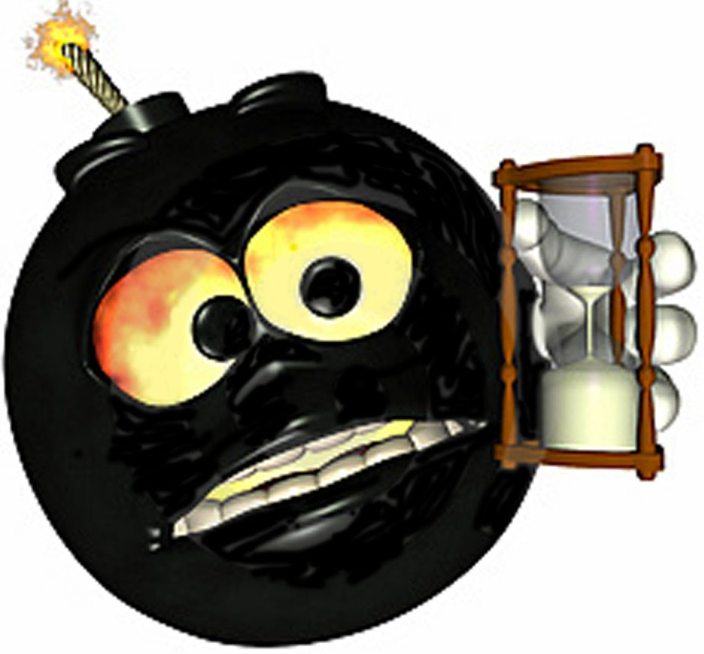
Now come fears of a methane time bomb, part two…
…this one a result of melting of the sub-sea layer of permafrost which will release methane deposits formed before the last ice age.
Climate scientists have been concerned about a so-called “methane time bomb”…
…set off when warming Arctic temperatures melt permafrost and cause
frozen vegetation in peat bogs
and other areas to decay,
releasing methane
and carbon dioxide.

Slide 33
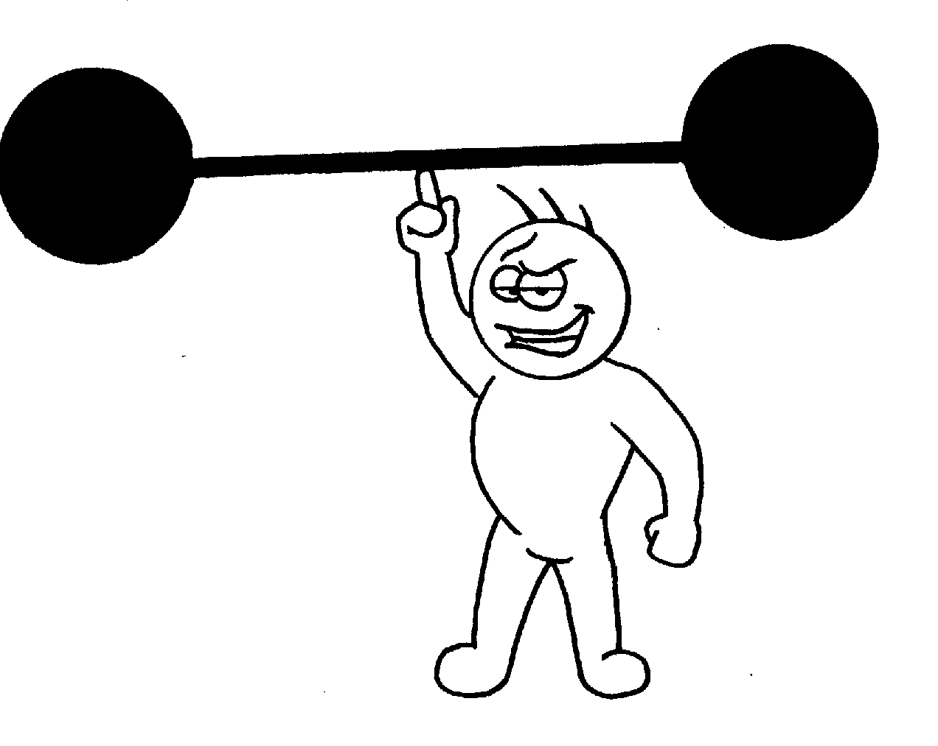
CH₄
More atmospheric methane
Causes higher temperatures
Leading to further permafrost melting
And the release of yet more methane
And it keeps going, and going…
Methane is about 20 times more powerful as a greenhouse gas than carbon dioxide.
Scientists fear that its release could accelerate global warming in a giant positive feedback.

Slide 34
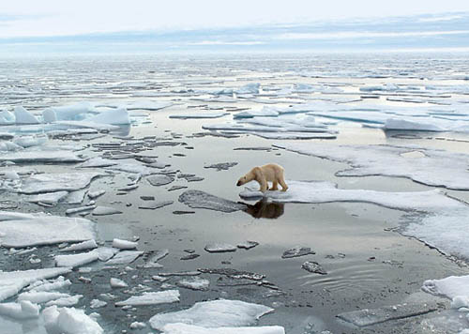
What is happening in the Arctic is a "tipping point”
Scientists worry that climate change is progressing so rapidly that, within decades, humans may be helpless to slow or reverse the trend.
There is a threshold where a slight rise in the Earth's temperature can cause a dramatic change in the environment that itself triggers a far greater increase in global temperatures.
This is the ‘tipping point’ beyond which really dangerous climate change is likely to be unstoppable.

Slide 35
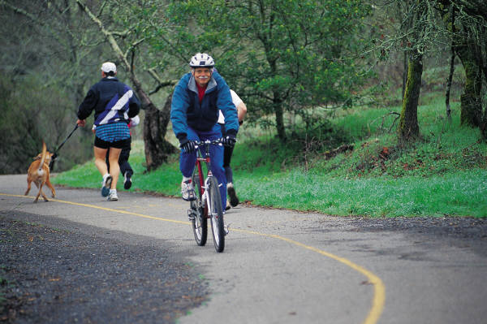
You can help!
Walk,
ride a bike,
or take a bus

Slide 36
You can help!
Don’t waste electricity (turn off the lights, the radio, the TV and the computer when you're not using them)

Slide 37
You can help!
Reduce, Reuse and Recycle
It saves energy and raw materials

Slide 38
You can help!
Plant trees
They absorb excess CO2
And provide shade/windbreaks to keep buildings at more even temperatures
so they will require less energy for heating or cooling

Slide 39
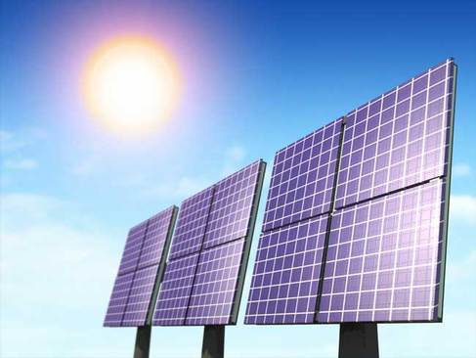
You can help!
Do you use alternate sources of energy?

Slide 40
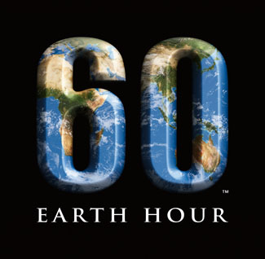
You can help!
Earth Hour is an annual international event created by WWF held on the last Saturday of March
The next Earth Hour will next take place on Saturday, March 28 2009 at 8:30pm, local time
They ask households and businesses to turn off their non-essential lights and electrical appliances for one hour
Did you participate?

Slide 41
Did you know...

Slide 42
There is also an international and legally binding agreement to reduce greenhouse gas emissions worldwide

Slide 43
The Kyoto Protocol

Slide 44
The Kyoto Protocol
entered into force in 2005
to reduce the emission of carbon dioxide and other greenhouse gases to below 1990 levels by the year 2012.

Slide 45
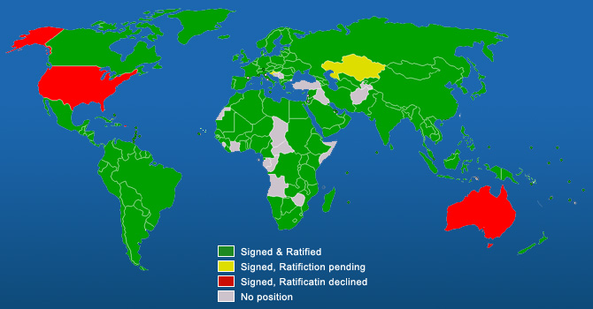
Countries Ratifying the Kyoto Accord

Slide 46
The Canada-Kyoto Timeline
1997
Dec. 11: More than 160 nations gather in Kyoto to negotiate an agreement (the Kyoto Protocol)
calls for a reduction of 5% of greenhouse gas emissions from 1990 levels by the 2008-2012 period.
1998
April 29: Canada signs Kyoto Protocol, pledging to reduce greenhouse gas emissions by 6% from 1990 levels by the commitment period ending in 2012.
2001
U.S. President George W. Bush says the U.S. will not ratify Kyoto, calling it economically irresponsible.

Slide 47
The Canada-Kyoto Timeline
2005
Feb. 16: Kyoto Protocol formally goes into force.
2007
Feb. 1: Liberal Leader Stéphane Dion tables a motion to make the Harper government reaffirm Canada's commitment to Kyoto, referring to "overwhelming scientific evidence" that climate change is the result of human activity.
Feb. 2: The United Nations releases a 21-page report that pinpoints human activity as a "very likely" cause of global warming.
Feb. 8: Environment Minister John Baird announces Canada will not attempt to meet Kyoto's greenhouse gas targets.

Slide 48
The Canada-Kyoto Timeline
2008
Canada is in contravention of international and domestic law because of its failure to take effective measures to reduce greenhouse gases
There are many inspiring examples of leadership on climate change (ranging from local to provincial (BC and Quebec) to global
Sadly, Canada’s federal government does not figure among them.

Slide 49
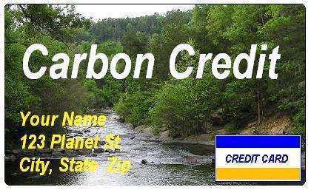
Kyoto introduced Carbon Credits
This is a trading system for countries to help them meet the goal of reducing the world's greenhouse gas emissions

Slide 50
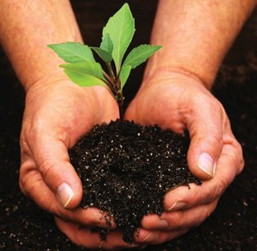
As each country produces CO₂, it must be able to contain that CO2 by tree-planting or other processes that can absorb it
OR…
It can reduce the CO₂ it produces in the first place

Slide 51
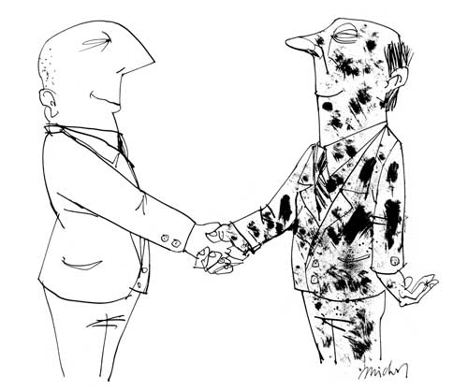
If a country produces more CO2 than it can absorb, according to the Kyoto agreement, it must purchase an ‘absorption ability’ (or Carbon Credit) from another nation that has earned credits by exceeding their target.

Slide 52
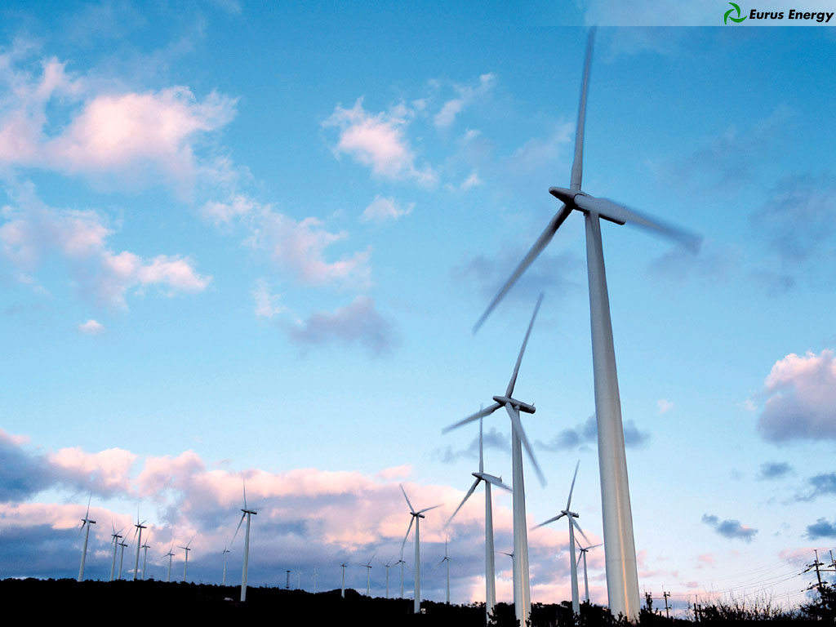
The money that purchases carbon credits will ultimately be used to give grants to further carbon saving schemes

Slide 53
Currently, there is no federally approved carbon credit market in Canada

Slide 54
Does it even matter?

Slide 55
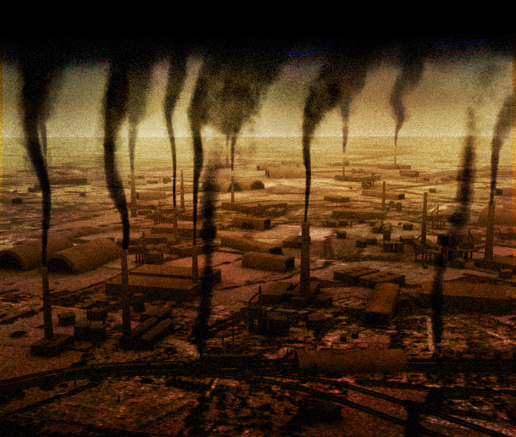
Will cleaning up greenhouse emissions really put a stop to global warming?
...and in turn stop global climate change?

Slide 56
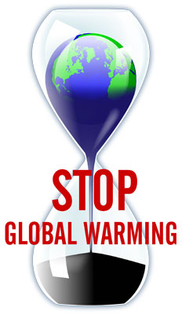
Are we already past the tipping point?
Have we run out of time?

Slide 57
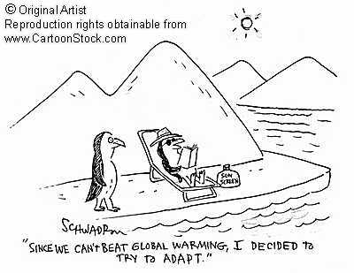
`

Slide 58
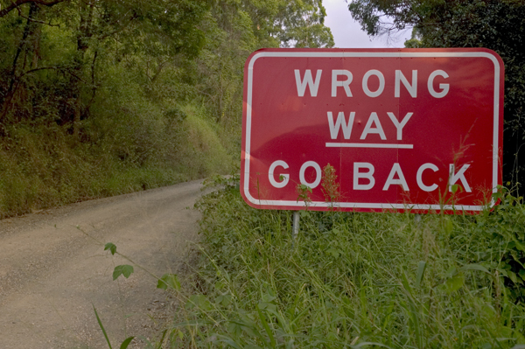
Or perhaps we have it all wrong

Slide 59
Have we considered all perspectives?

Slide 60
Did you know...

Slide 61
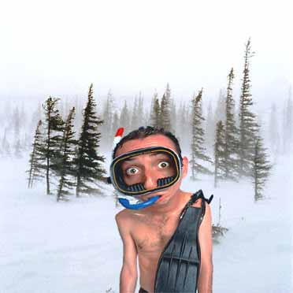
Some scientist believe global warming will actually
DECREASE
not increase

Slide 62
What if we examine a longer period of time—say, the past 450,000 years?

Slide 63
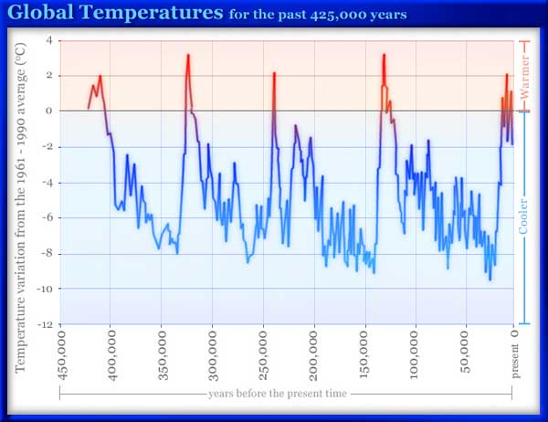
Hmm... Looks kind of cyclic

Slide 64
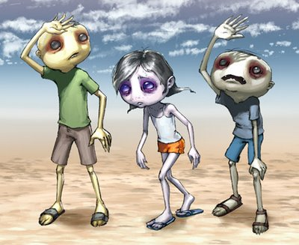
Have modern day temperatures reached a peak?

Slide 65
Are we now on the down slope towards the next an Ice Age?

Slide 66
Did you know...

Slide 67
Carbon dioxide follows a cycle similar to that of temperature

Slide 68
CO2 increases seem to lag about 800 years behind the temperature increases
Something seems strange here!

Slide 69
Hmm...

Slide 70
So if carbon dioxide causes global warming...

Slide 71
Wouldn’t CO₂ levels increase
BEFORE
the temperature increase?

Slide 72
Maybe the CO₂ increase isn’t to blame for global warming?

Slide 73
Did you know...

Slide 74
There are other global warming theories

Slide 75
Some scientists
believe that
increasing
global temperature
is a result of changes in the suns activity

Slide 76
Henrik Svensmark is a cosmoclimatologist.
This is his theory...

Slide 77
It all starts with cosmic rays

Slide 78
Cosmic rays are energetic particles coming from interstellar matter
(mainly from remnants of supernova explosions)

Slide 79
When the sun and the solar wind are very active (like they are now)...

Slide 80
Less cosmic rays reach Earth

Slide 81
When there are fewer cosmic rays
fewer clouds will form
This is because the ionization from cosmic rays help produce cloud condensation nuclei

Slide 82
Because more energy can reach the surface of the Earth
Fewer clouds lead to a warmer Earth

Slide 83
Does that mean we are off the hook?

Slide 84
There are other theories too...

Slide 85
William M. Gray, a meteorologist,
believes the rising
temperatures are a
result of natural
alterations in global
ocean currents
(which are driven by ocean salinity variation)

Slide 86
“But this warming trend is not going to keep on going.”
“My belief is that three, four years from now, the globe will start to cool again, as it did from the middle '40s to the middle '70s”
“[H]umans might have caused a very slight amount of this warming.
Very slight.”

Slide 88
Did you know...

Slide 89
Many scientists believe the whole concept of global warming is a hoax.

Slide 91
Robert M. Carter,
a geologist,
believes there is no evidence of ground-based warming since 1998 ...

Slide 92
“[T]here is every doubt whether any global warming at all is occurring at the moment, let alone human-caused warming.”

Slide 93
Still think cleaning up greenhouse emissions will put a stop to global warming?
...and in turn stop global climate change?

Slide 94
‘Que Sera Sera’
Right?
We might as well give up!
Wash our hands of the whole situation
Just throw in the towel?

Slide 95
There is an abundance of good reasons to conserve our resources
...and find a more economical way of using energy
Even if the argumentation is not necessarily linked to climate!
On the other hand...

Slide 96
Air Pollution

Slide 97
Water Pollution

Slide 98
Depletion of Natural Resources

Slide 99
Overconsumption
Where do we put it all?

Slide 100
Global Water Crisis

Slide 101
Peak Oil

Slide 102
Litter

Slide 103
Illegal Dumping of Waste

Slide 104
Habitat Destruction

Slide 106
Have we forgotten about acid rain?

Slide 107
We did not inherit it from our Ancestors
Treat the Earth well
We borrow it from our children
`Ancient Indian Proverb

Slide 108
So have you decided how the story ends?

Slide 109
Warming or cooling?

Slide 110
Minor inconveniences?

Slide 111
Major catastrophes?

Slide 112
Complete annihilation?

Slide 113
Thousands of years from now?

Slide 114
Billions?

Slide 115
In our lifetime?

Slide 116
Next year?

Slide 117
You decide!

Slide 118
WEBSITES REFERENCED:
alternet.org/environment/100067/
britain4kiwikids.org.nz/news/images/globalw2.jpg
carbonoptions.com/images/Kyoto_Protocol_participation_map_2005.png
cartoonstock.com/lowres/hsc4603l.jpg
cbc.ca/news/background/kyoto/carbon-trading.html
cbc.ca/news/background/kyoto/timeline.html
chemistryland.com/CHM107/GlobalWarming/GlobalWarming.html
climatephilanthropists.org/basics
cpc-ccp.com/newsroom/pdf/Carbon_Credit_Bulletin_ July_2006_e.pdf

Slide 119
WEBSITES REFERENCED:
dictionary.die.net/greenhouse%20effect
discovermagazine.com/2007/jul/the-discover-interview-henrik-svensmark/article_view?b_start:int=0&-C=
dnr.state.wi.us/org/caer/ce/eek/earth/air/global.htm
e360.yale.edu/content/feature.msp?id=2081
epa.gov/climatechange/kids/gw.htmlgo-green.com/files/CO2pollution.jpg
gcrio.org/ipcc/qa/05.htmlgdrc.org/uem/waste/waste-gases.html
members.iinet.net.au/~glrmc/

Slide 120
WEBSITES REFERENCED:
myclimatechange.net/UserImage/3/Definition/GreenhouseEffect.jpg
nasa.gov/centers/goddard/images/content/208488main_global_temp_change.jpg
nydailynews.com/news/us_world/2008/08/28/2008-08-28_global_warming_tipping_point_arctic_ sea_.html
oneearth-onechance.com/images/greenhouse(1).jpg
savetheplanet.co.nz/carbon-wave-power.html
seed.slb.com/en/scictr/watch/climate_change/images/global_temp2.jpg
sierraclub.ca/national/kyoto/

Slide 121
WEBSITES REFERENCED:
terranature.org/methaneSiberia.htm
thesisterswindfarm.com/images/greenhouse.GIF
troy.k12.ny.us/thsbiology/images/oxcacyc.jpg
water-research.net/images/phosyn.GIF
whrc.org/resources/online_publications/warming_earth/images/Car-Greenhouse.gif

