Slide 1
A World Endangered . . . .
Joe Naumann – UMSL Geography

Slide 2
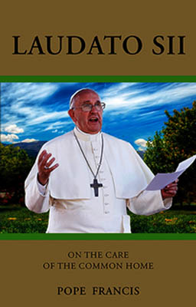
Recommendation
Take some time to read the encyclical on the environment issued by Pope Francis in June, 2015. The following slides show what will be endangered if people don’t take this issue seriously. Leaving Christian tought out of the document still presents a sound argument for taking better care of the environment. Free or very inexpensive copies are available online. Download a copy http://w2.vatican.va/content/francesco/en/encyclicals/documents/papa-francesco_20150524_enciclica-laudato-si.html

Slide 3
The Four Laws of Ecology
Presented by Barry Commoner in The Closing Circle in 1971. Download a copy at http://icternodisola.it/public/uploaded/manuale%20della%20qual/lim%20Scuola%20Secondaria/percorso%20economico-soc/letter/The%20closing%20circle%20Commoner.pdf
Commoner was a prophet ahead of his time – was a professor at Washington University in St. Louis, MO.

Slide 4
The Four Laws of Ecology
Pope Francis certainly understands these laws in relation to our only home, Earth.
Everything is connected
Everyone with open eyes and mind can see this around them
Everything goes somewhere –
eg. When a tree is burned, every atom goes somewhere: the ashes or gasses that went into the atmosphere
Nature knows best –
nature can disassemble molecules that nature has made but cannot disassemble some molecules made by humans
There is no such thing as a “free lunch.” – Every action or change in an ecosystem has consequences.
Adding an new component to a system
Removing a component from a system

Slide 5
View the following slides
This Beauty is Endangered . . .

Slide 24
No one is exempt from responsibility to preserve our home

