Slide 1
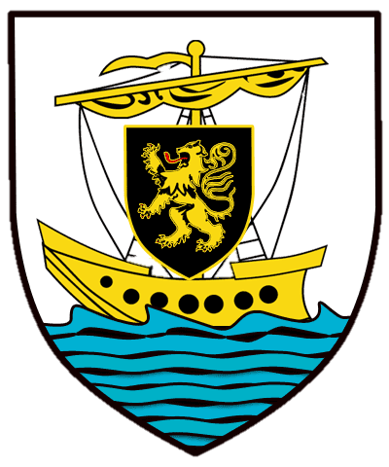
Galway, Ireland

Slide 2
Galway is a city in the West of Ireland in the province of Connacht. Galway lies on the River Corrib and Lough Corriband Galway Bay and is surrounded by Counry Galway. It's is the 4th most populous urban area in Ireland.

Slide 3
Galway is known as Ireland's Cultural Heart and is renowned for its vibrant lifestyle and numerous festivals, celebrations and events. Every November, Galway hosts the Tulca Festival of Visual Arts as well as numerous festivals. On 1 December 2014, the Director General of UNESCO announced the official designation of Galway as a UNESCO City of Film. In 2004, there were three dance organizations, ten festival companies, two film organizations, two Irish language organizations, 23 musical organisations, twelve theatre companies, two visual arts groups, and four writers' groups based in the city. Furthermore, there were 51 venues for events, most of which were specialized for a certain field (e.g. concert venues or visual arts galleries), though ten were described as being 'multiple event' venues. The main squares in the city are Eyre Square in the centre of the city, and Spanish Parade next to the Spanish Arch.

Slide 11
National University of Ireland, Galway

Slide 22
Eyre Square
Eyre Square
Eyre Square
Eyre uareq

Slide 23
Galway Arts Festival Parade 2007

Slide 24
Galway Christmas market 2016

Slide 26
Ballyknow Quay, Claddagh

Slide 29
The Galway train.

