Slide 1
Turku, Finland

Slide 2
Turku is a city on the southwest coast of Finland at the mouth of the Aura River in the region of Southwest Finland.

Slide 3
Turku is a city on the southwest coast of Finland at the mouth of the Aura River, in the region of Southwest Finland. Turku, as a town, was settled during the 13th century and founded most likely at the end of the 13th century, making it the oldest city in Finland. It quickly became the most important city in Finland, a status it retained for hundreds of years. After Finland became part of the Russian Empire (1809) and the capital of the Grand Duchy of Finland was moved to Helsinki (1812), Turku continued to be the most populous city in Finland until the end of the 1840s, and it remains a regional capital and an important business and cultural center.
Due to its location, Turku is a notable commercial and passenger seaport with over three million passengers traveling through the Port of Turku each year to Stockholm and Mariehamn.

Slide 6
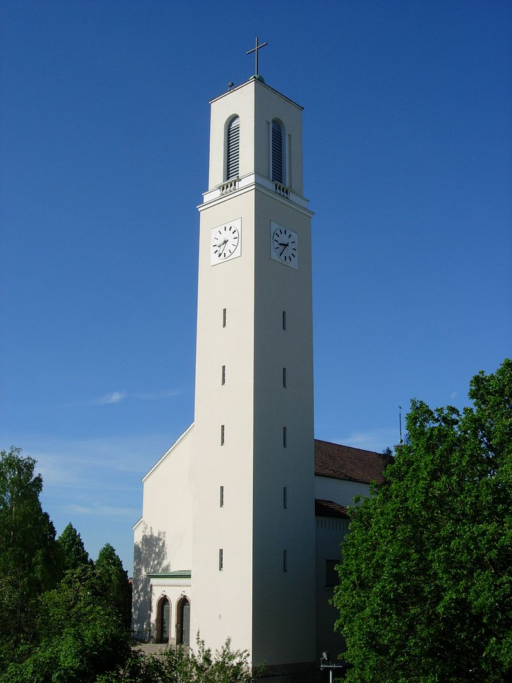
Michael's Church (left) Martin’s Church (right)

Slide 18
Winter

Slide 22
Brinkhall Manor in Kakskerta island.

Slide 23
Old Mill in Samppalinna.

Slide 25
People celebrating Vappu in central Turku

Slide 26
Paavo Nurmi Marathon is run every summer.

Slide 27
Locomotives at Turku Central railway station

Slide 28
Main library of Turku

Slide 29
MS Oasis of the Seas, the world's largest passenger ship was built in Turku.

