Slide 1
Sendai, Japan!

Slide 2
Sendai is the capital city of Miyagi Prefecture, Japan, and the
largest city in the Tohoku region, and the second largest city north of Tokyo.

Slide 3
Sendai is a city in Japan’s Tohoku Region, northeast of Tokyo on Honshu island. The remains of 17th-century Sendai Castle, built for samurai lord Date Masamune on Aoba Hill, overlook the city and include a museum of historic artifacts. The Sendai City Museum focuses on the history and culture of Japan’s Edo period and displays Masamune’s samurai armour.
Sendai is the capital city of Miyagi Prefecture, Japan, and the largest city in the Tōhoku region, and the second largest city north of Tokyo. In 2010, the city had a population of one million, and was one of Japan's 20 designated cities. The city was founded in 1600 by the daimyō Date Masamune, and is nicknamed the City of Trees: there are about 60 zelkova trees on Jōzenji Street
In the summer, the Sendai Tanabata Festival, the largest Tanabata festival in Japan, is held. In winter, the trees are decorated with thousands of lights for the Pageant of Starlight
On March 11, 2011, coastal areas of the city suffered catastrophic damage from a magnitude 9.0 offshore earthquake which triggered a destructive tsunami.

Slide 4
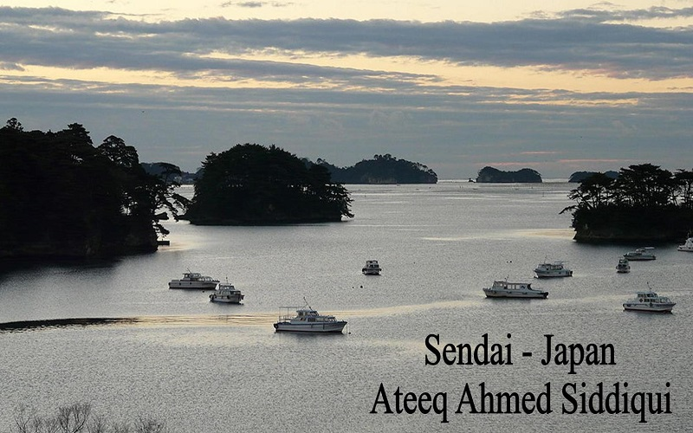

Slide 7
An aerial view of Sendai harbour after the earthquake, 12 March 2011

Slide 11
The Miyagi Museum of Art

Slide 12
Zuihōden

Slide 13
Sendai Castle

Slide 19
City Hall

Slide 20
Jozenji-Dori promenade

Slide 21
Tohoku University, Aobayama Campus

Slide 27
Matsushima

Slide 29
Sendai Tanabata Festival

Slide 30
Sendai Pageant of Starlights

