Slide 1
Sapporo, Japan!

Slide 2
Sapporo is the fourth largest city in Japan by population, and the largest city on the northern Japanese island of Hokkaido.

Slide 3
Sapporo is the fourth largest city in Japan by population, and the largest city on the northern Japanese island of Hokkaido. Located in Ishikari Subprefecture, it is the capital of Hokkaido Prefecture, and an ordinance-designated city of Japan.
Sapporo is known outside Japan for having hosted the 1972 Winter Olympics, the first ever held in Asia, and for the city's annual Yuki Matsuri, internationally referred to as the Sapporo Snow Festival, which draws more than 2 million tourists from around the world. The city is also home to Sapporo Brewery and the white chocolate biscuits called shiroi koibito ("white sweetheart").

Slide 4
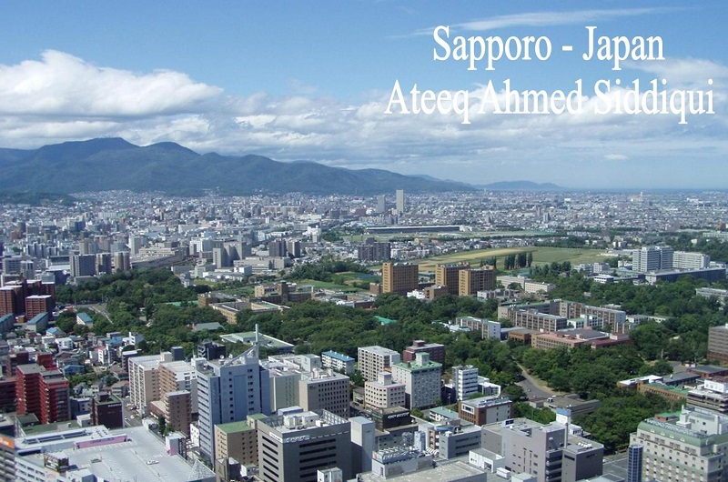

Slide 12
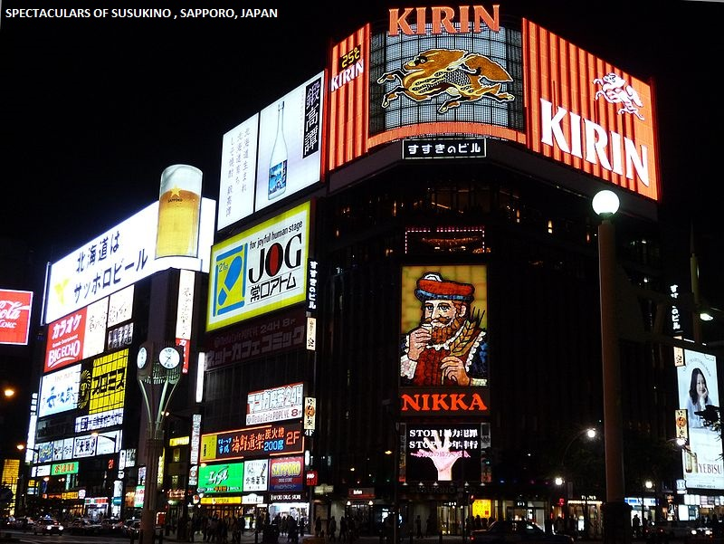

Slide 15
Sapporo Odori High School

Slide 16
Sapporo Station

Slide 22
Summer

Slide 24
Winter

Slide 26
Deep winter snow

Slide 28
The Sapporo Dome in winter

Slide 30
Sapporo City Hall (June 2007)

Slide 34
The 34th G8 summit protest march in 2008

Slide 35
Dancers in the Yosakoi Sōran Festival

