Slide 1
Paris in the 1920s

Slide 2
A boat on the Seine River in 1926, with a view of the Eiffel Tower in the background.

Slide 3
A horticulture exhibition at the Grand Palais in 1922.

Slide 4
The Jardin de Tuileries taken by the little-known photographer, Yvon.

Slide 5
Street cleaners clear slushy snow off the sidewalk, 1922.

Slide 6
The queen of the Mi-Carême parade on her float, 1921.

Slide 7
The Place De L'Opera, 1926.

Slide 8
A man gets his shoes shined, 1929.

Slide 9
A busy train station, 1929.

Slide 10
Josephine Baker – big star in Paris

Slide 11
Josephine Baker dancing the Charleston at the Folies-Bergere in Paris - 'Negro Dance Revue (1926).

Slide 12
Modigliani, Picasso and André Salmon to Rotunda in Paris in 1916

Slide 13
Paris Montmartre in 1925

Slide 14
1920, a triporteurs race

Slide 15
women enjoy an afternoon cup of coffee, circa 1925

Slide 16
Here, cycling up the Champs Elysees are the nearly 160 competitors of the Tour de France in June, 1926

Slide 17
An ice-cream vendor selling sodas and sweets to children on the city streets, 1925.

Slide 18
American publisher Sylvia Beach stands in the doorway of her bookshop “Shakespeare & Company”, during the 1920s. The shop gained recognition for being run by the only person willing to publish James Joyce’s Ulysses in the English language and was regarded as a haven for American expatriates during the 1920s and 1930s.

Slide 19
Harry Pilcer and Gaby Deslys perform an exotic dance at the Casino de Paris, in the revue ‘Paris Qui Jazz’, circa 1920

Slide 20
La Boule Blanche, a much-frequented Paris nightclub of the era

Slide 21
have a drink and take a swim at the Champs Elysees Lido 1925

Slide 22
Members of the “Friday The Thirteenth Club” walk under a ladder in single file line at a meeting in a Paris bar. The club met every Friday 13th to do everything that superstitious people traditionally avoid

Slide 23
The Moulin Rouge cabaret, January 1929.

Slide 24
Gardeners taking care of a tulip field in front of the Carrousel du Louvre, in spring 1929.

Slide 25
A little girl hands a posy of lilies to a police officer on duty at the Porte Saint-Denis in Paris, circa 1920.

Slide 26
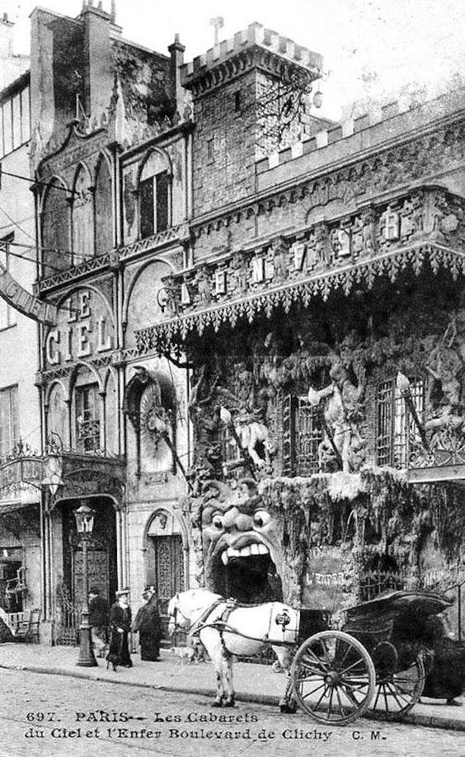

Slide 27
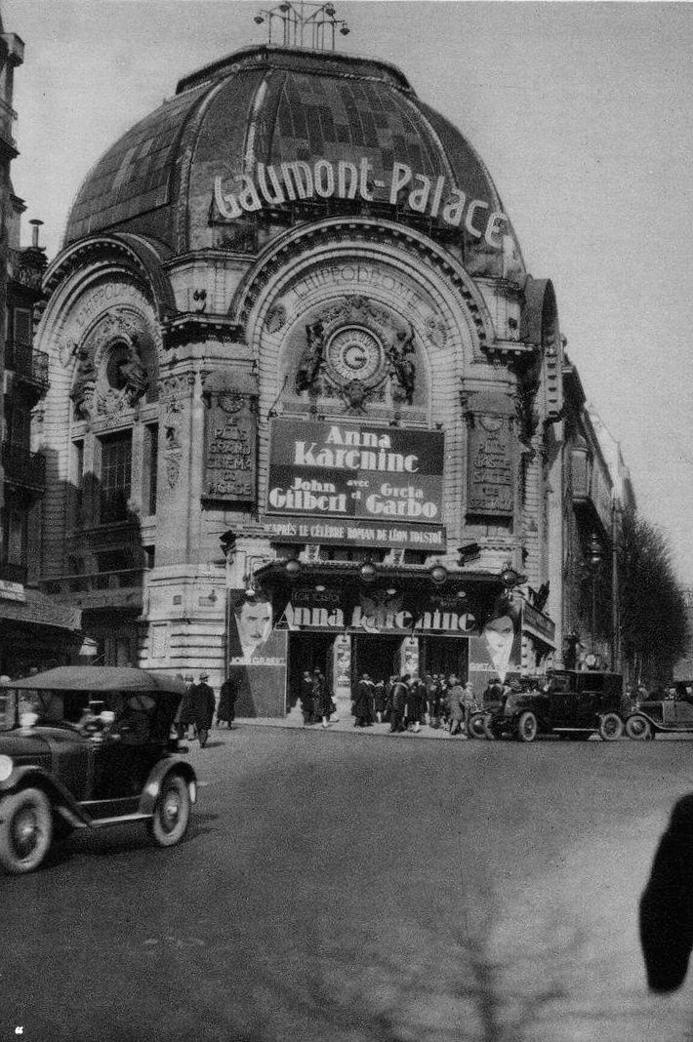

Slide 29
A Paris street market in 1920

