Slide 1
Osaka, Japan!

Slide 2
Osaka is a designated city in the Kansai region of Japan. It is the capital city of Osaka Prefecture and the second largest metropolitan area in Japan.

Slide 3
Osaka is a designated city in the Kansai region of Japan. It is the capital city of Osaka Prefecture and the largest component of the Keihanshin Metropolitan Area, the second largest metropolitan area in Japan and among the largest in the world with over 19 million inhabitants. Situated at the mouth of the Yodo River on Osaka Bay, Osaka is the second largest city in Japan by daytime population after Tokyo's 23 wards and the third largest city by nighttime population after Tokyo's 23 wards and Yokohama, serving as a major economic hub for the country.
Historically a merchant city, Osaka has also been known as the "nation's kitchen" and served as a center for the rice trade during the Edo period.

Slide 4
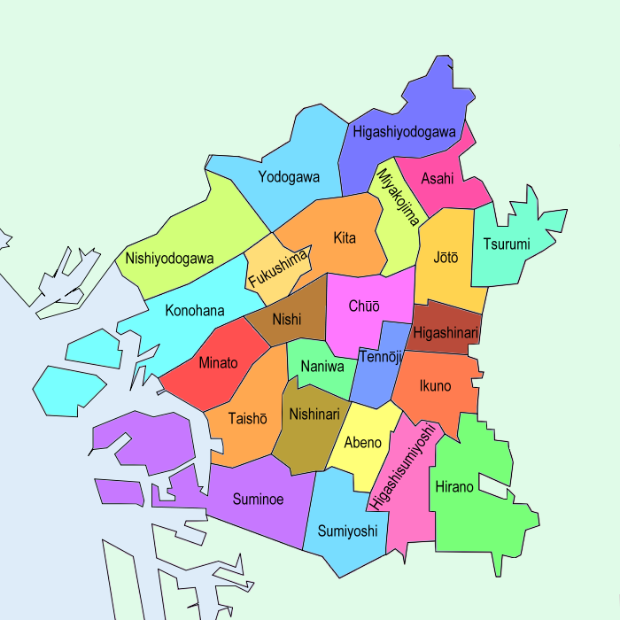
A map of Osaka's Wards

Slide 16
Soemoncho in Minami

Slide 21
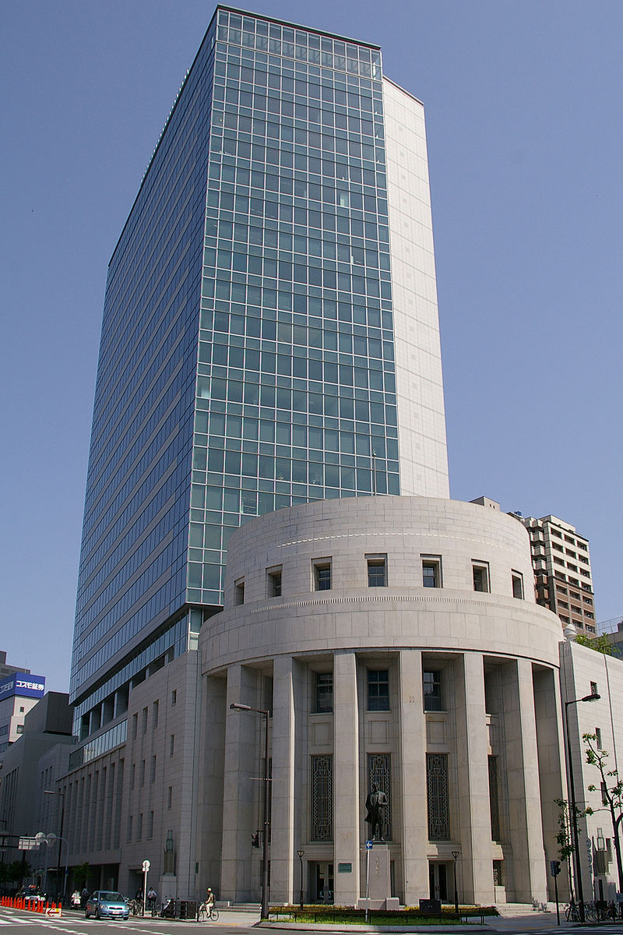
Osaka Securities Exchange in the Kitahama district of Osaka
Greater Osaka Area

Slide 23
A chef prepares for the evening rush in Umeda

Slide 26
Osaka City University

Slide 30
Shitennō-ji with Abeno Harukas in the background

Slide 31
The National Museum of Art, a subterranean museum for Japanese and international arts

Slide 32
Osaka Aquarium Kaiyukan
Osaka Aquarium Kaiyukan

Slide 38
Illuminated main building of Osaka city hall.

Slide 40
Tsūtenkaku, a symbol of Osaka's post-WWII rebuilding

