Slide 1
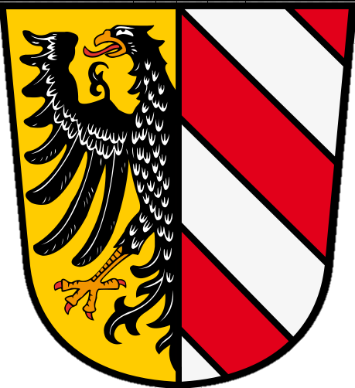
Nuremberg, Germany

Slide 2
Nuremberg is a city on the river Pegnitz and the Rhine-Main-Danube Canal in the German state of Bavaria. It's Germany's fourteenth largest city.

Slide 5
19th Century

Slide 6
1945

Slide 10
museum of modern art and design

Slide 13
Subway Station

Slide 14
U-Bahn train

Slide 15
Football Stadium

Slide 17
Nürnberger Bratwurst

Slide 26
Old Fortifications

Slide 29
Christkindlesmarkt , Nuernberg

Slide 30
Old City Hall

