Slide 1
Malacca (Melaka), Malaysia!

Slide 2
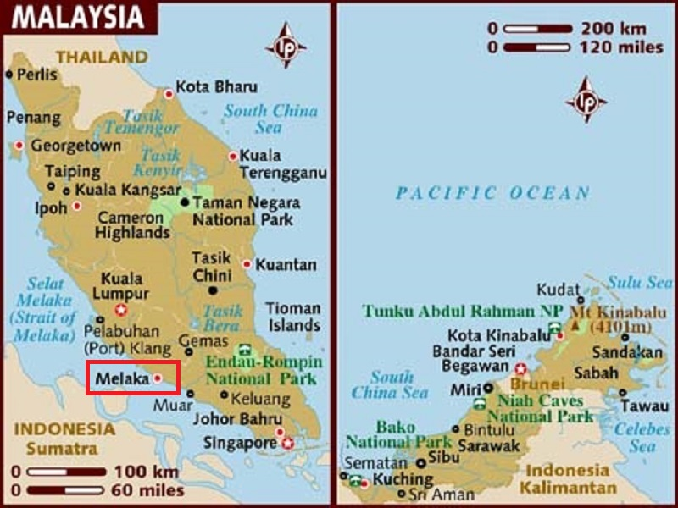
Malacca (Melaka), dubbed "The Historic State", is a state in Malaysia and located in the southern region of the Malay Peninsula, next to the Straits of Malacca.

Slide 3
Malacca City, is the capital city of the Malaysian state of Malacca. As of 2010 it has a population of 484,885. It is the oldest Malaysian city in the Straits of Malacca, having become a successful entrepôt in the era of the Malacca Sultanate. The present-day city was founded by Parameswara, a Sumatran prince who escaped to the Malay Peninsula when Srivijaya fell to the Majapahit. Following the establishment of the Malacca Sultanate, the city drew the attention of traders from the Middle East, South Asia, and East Asia, as well as the Portuguese, who intended to dominate the trade route in Asia. After Malacca was conquered by Portugal, the city became an area of conflict when the sultanates of Aceh and Johor attempted to take control from the Portuguese.
The economy of the city of Malacca is largely based on tourism. As the economic centre of the state of Malacca, it also hosts several international conferences and trade fairs. The city is located along the Maritime Silk Road, proposed by China in 2013. Among the tourist attractions in and nearby the Malacca city are: A Famosa, Jonker Walk, Little India, Portuguese Settlement, Stadthuys, Maritime Museum, Christ Church, Malacca Sultanate Palace Museum, Malacca Zoo, and Taming Sari Tower.

Slide 4
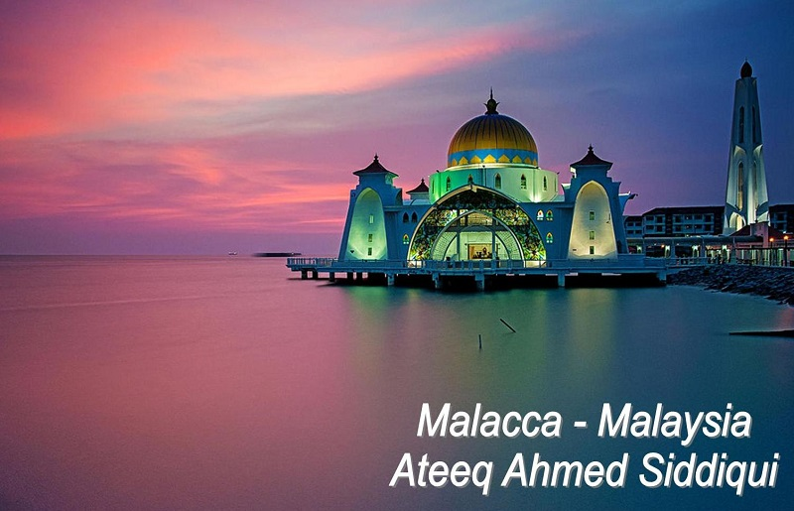

Slide 5
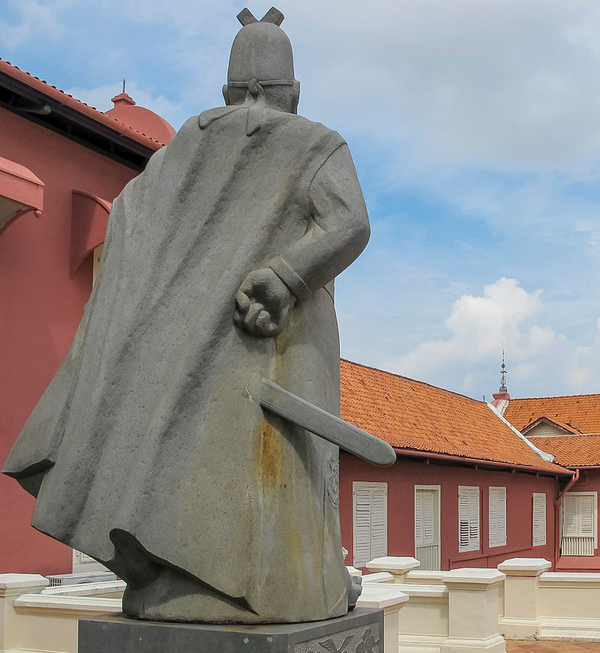
The Zheng He monument today (seen from the backside), marking his stopover at the city

Slide 6
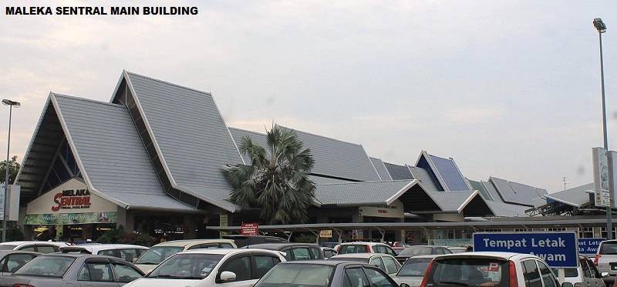

Slide 7
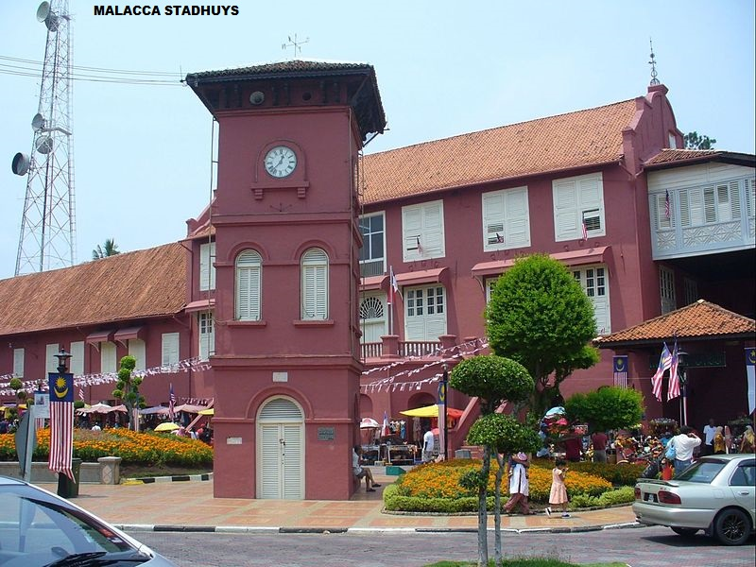

Slide 8
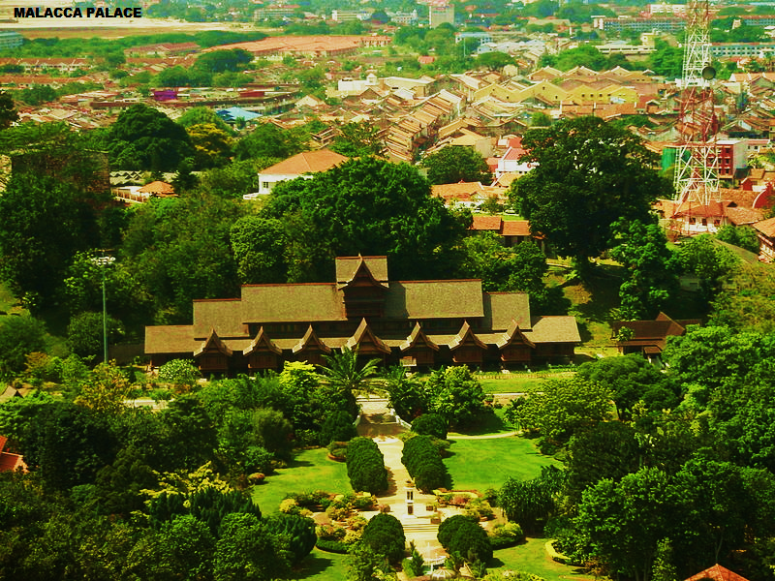

Slide 9
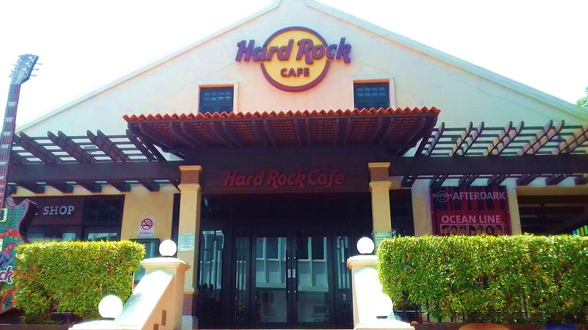

Slide 10
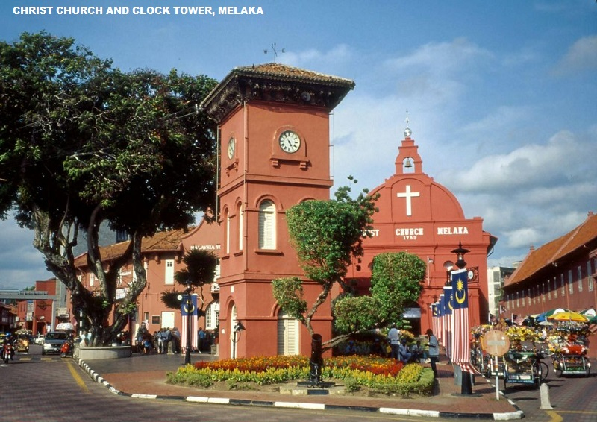

Slide 11
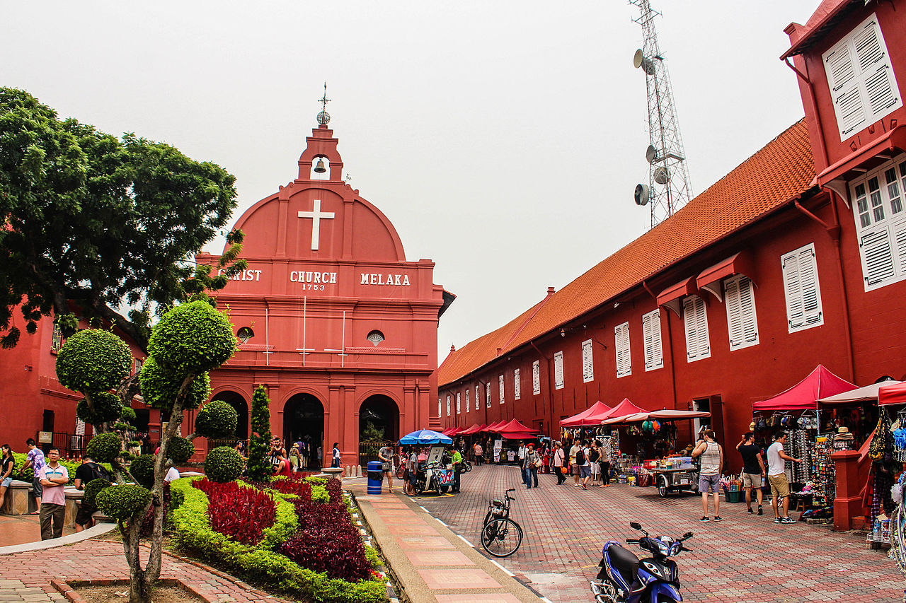

Slide 12
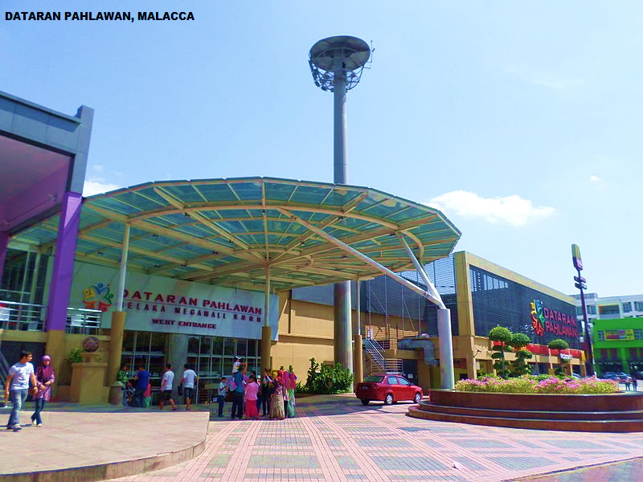

Slide 13
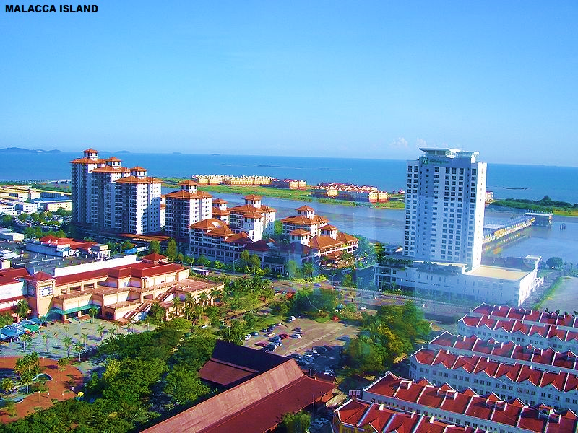

Slide 14
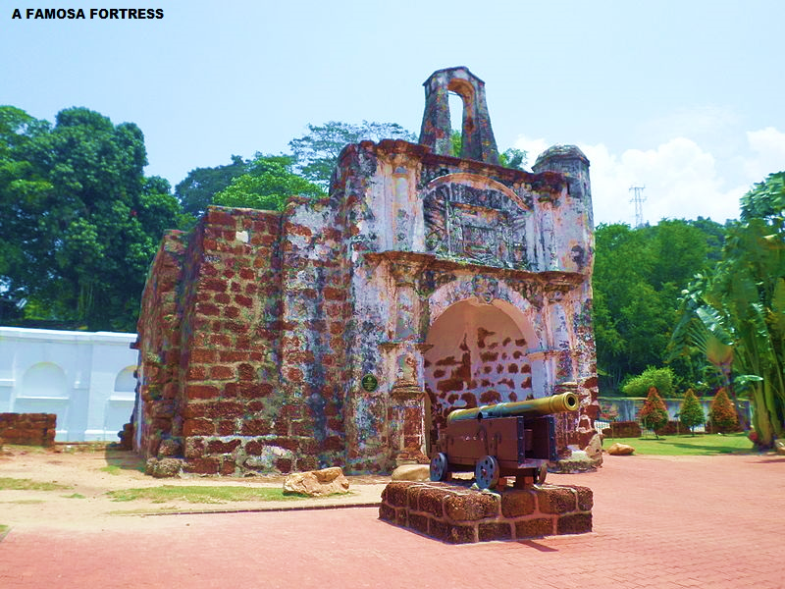

Slide 15
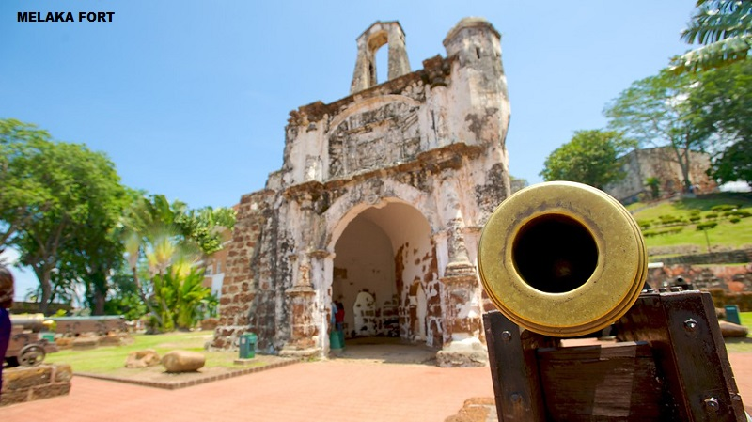

Slide 16
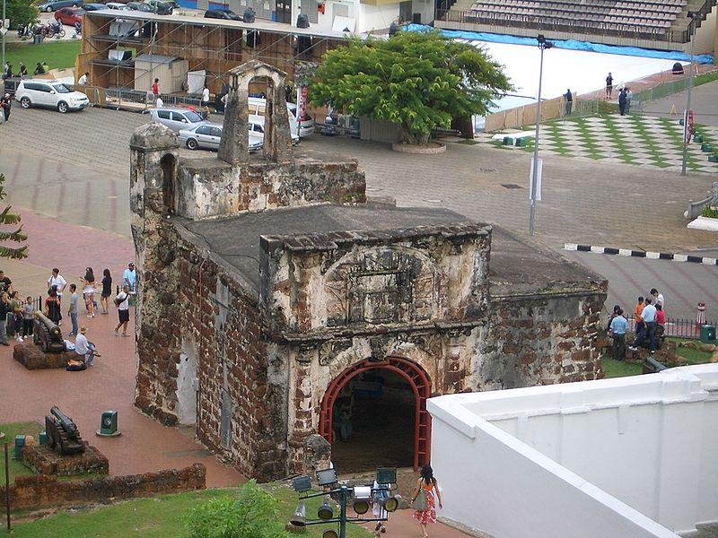
The backside

Slide 17
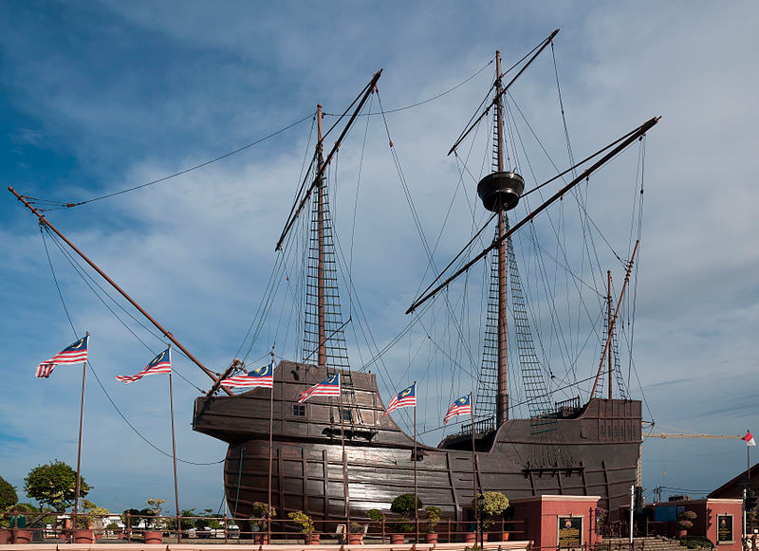
The replica of a 1502 Portuguese ship, the Flor de la Mar

Slide 18
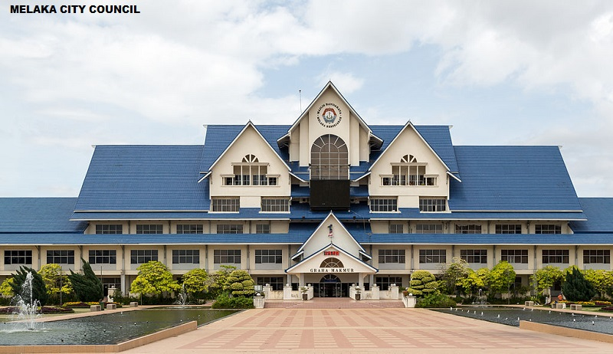

Slide 19
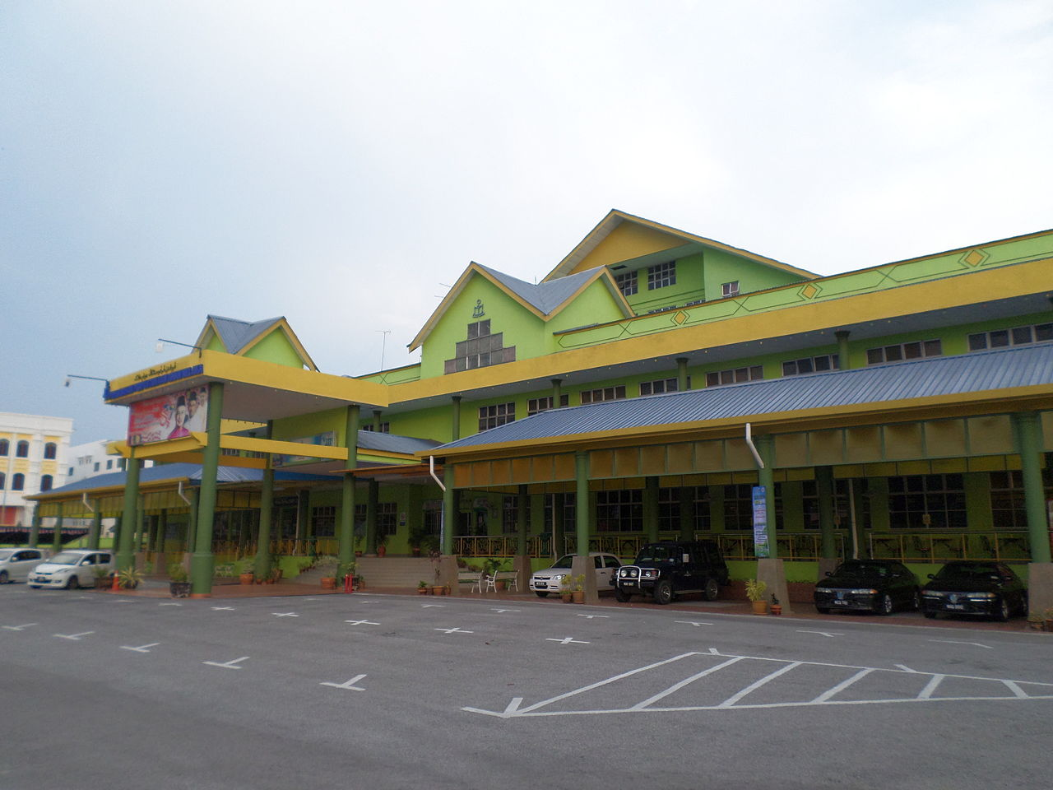
The Malacca Public Library

Slide 20
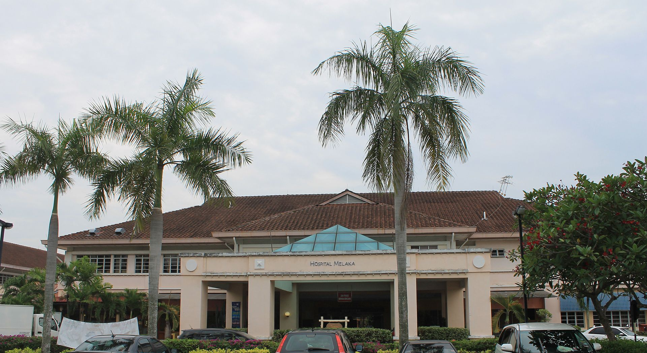
Malacca General Hospital main building

Slide 21
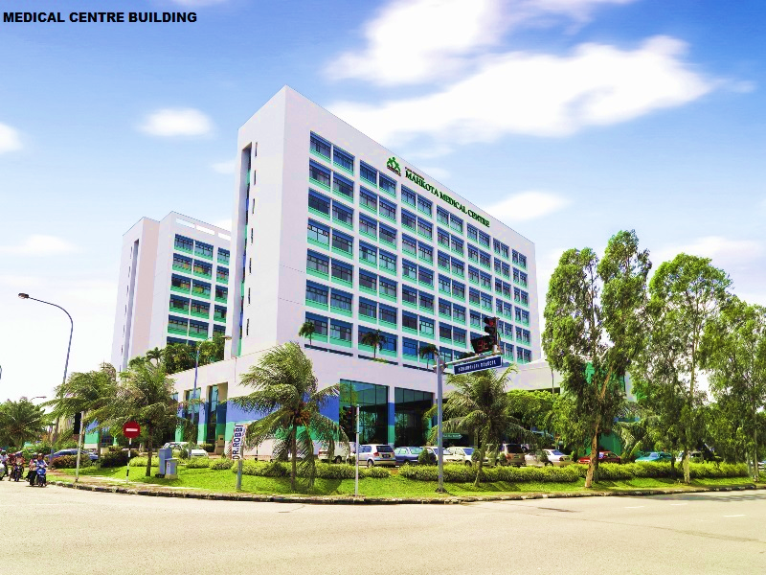

Slide 22
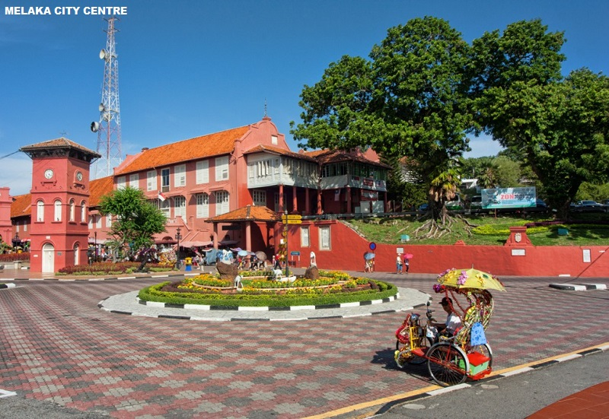

Slide 23
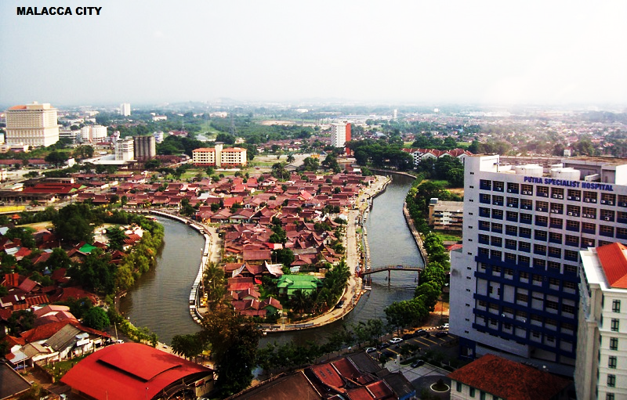

Slide 24
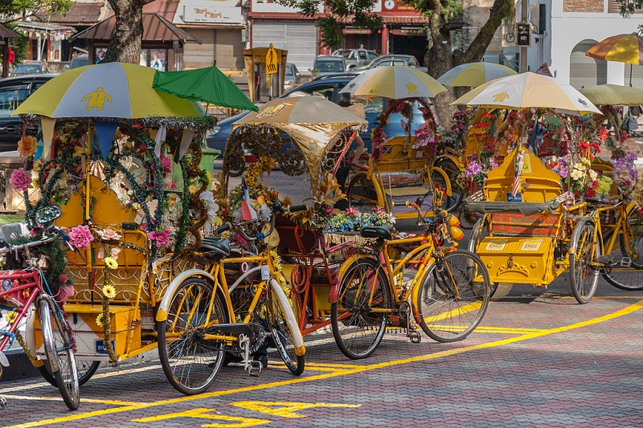

Slide 25
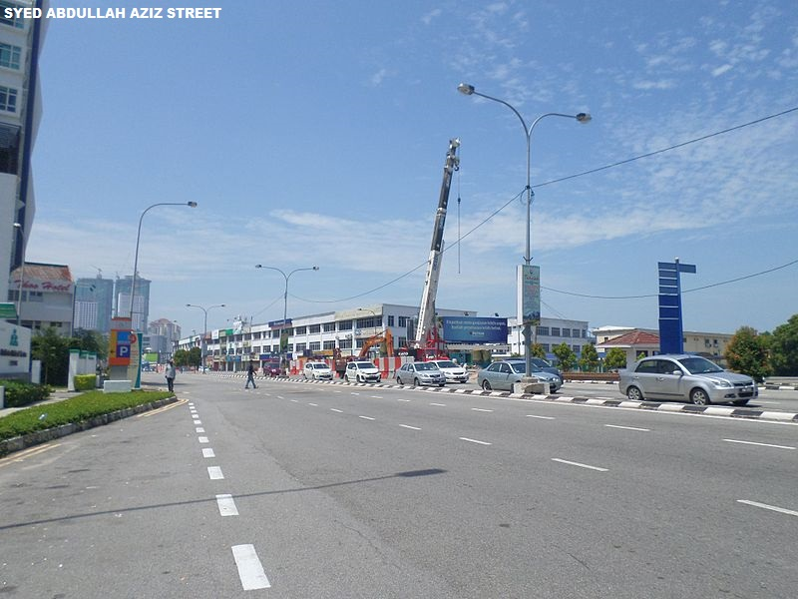

Slide 26
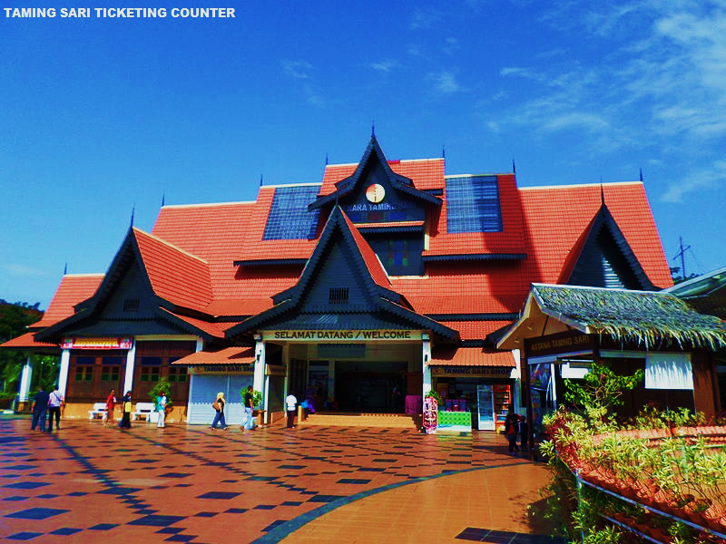

Slide 27
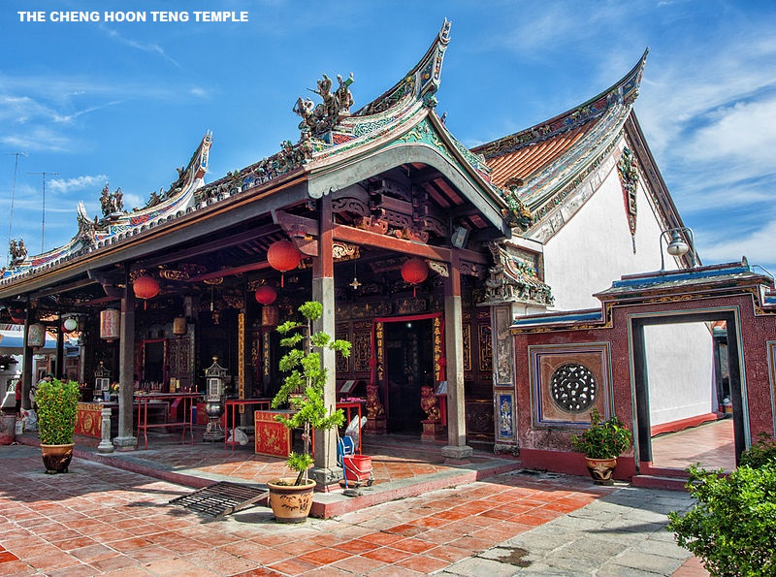

Slide 28
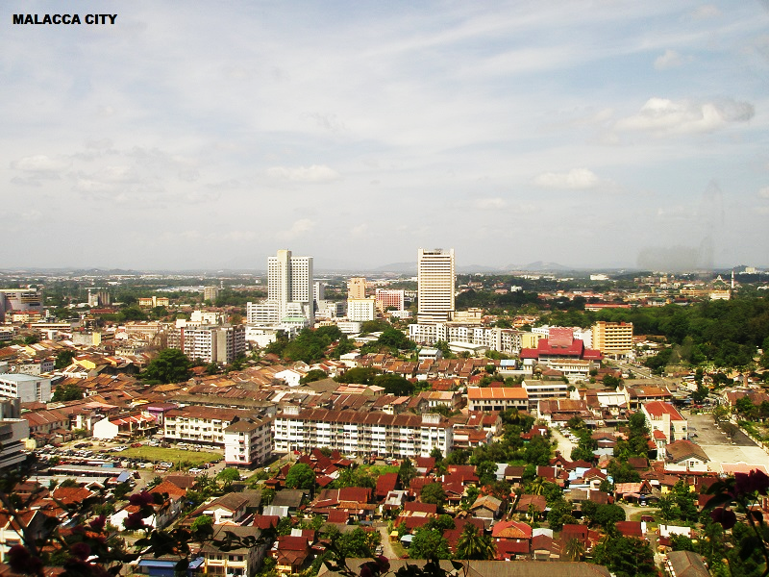

Slide 29
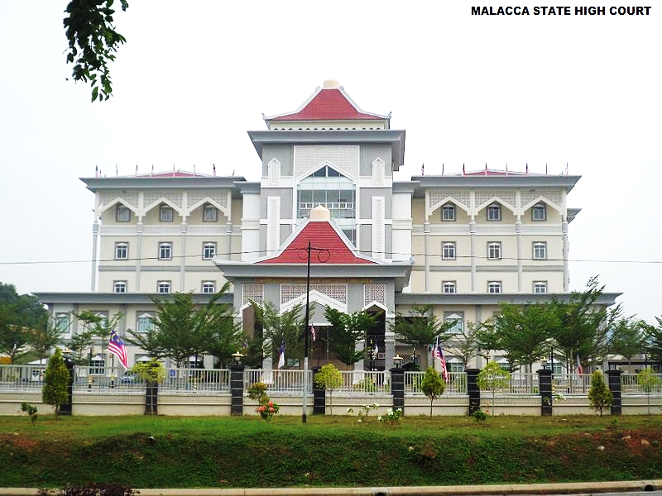

Slide 30
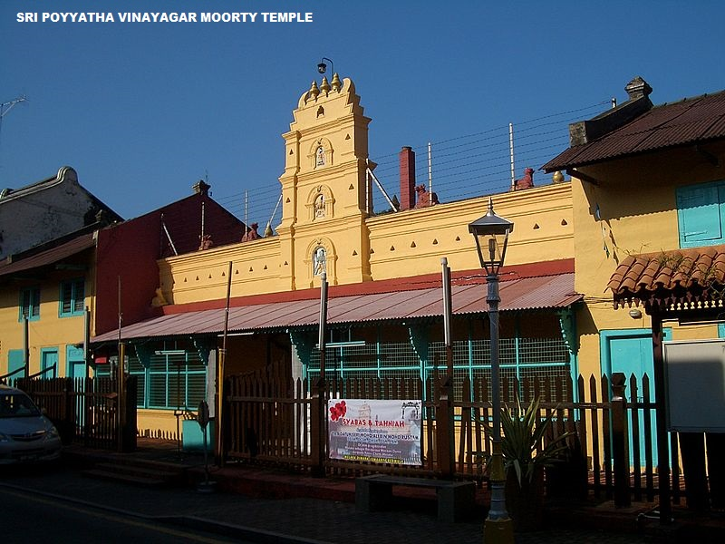

Slide 31
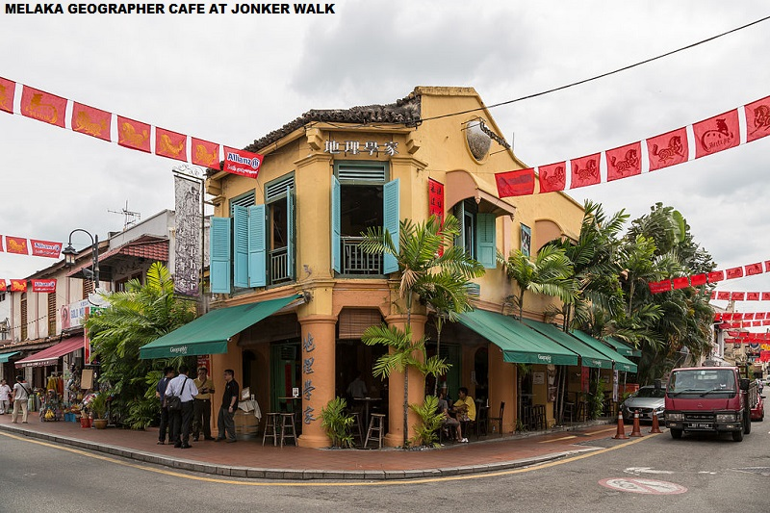

Slide 32
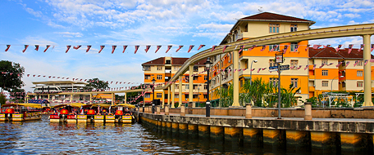
malacca hotels

Slide 33
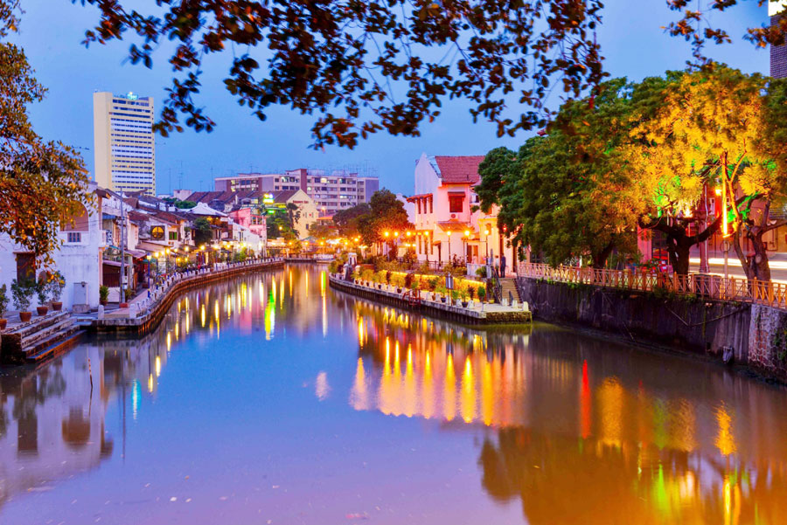

Slide 34
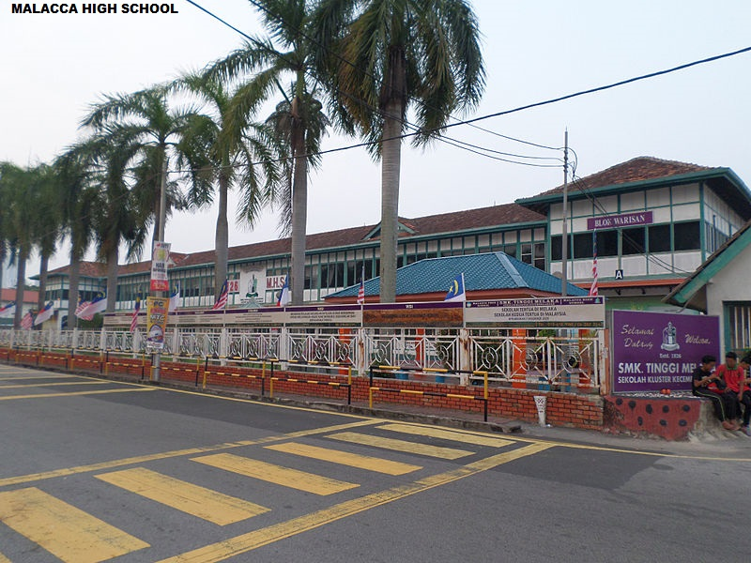

Slide 35
