Slide 1
Magdeburg, Germany

Slide 2
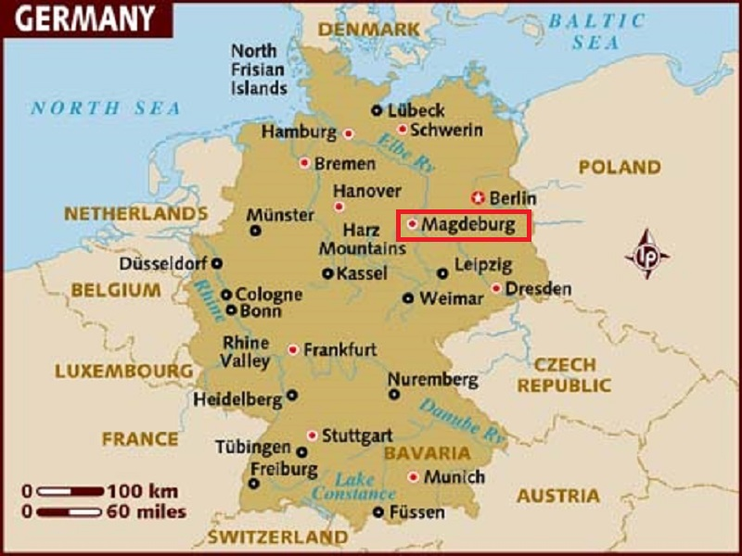
The Magdeburg Water Bridge is a large navigable aqueductin Central Germany, located near Magdeburg.
The largest canal underbridge in Europe, it spans the river Elbe and directly connects the Mittellandkanal to the west and Elbe-Havel Canal to the east of the river, allowing large commercial ships to pass between the Rhineland and Berlin.

Slide 3
Magdeburg is the site of two universities, the Otto-von-Guericke University and the Magdeburg-Stendal University of Applied Sciences.
Nowadays Magdeburg is a traffic junction as well as an industrial and trading centre. The production of chemical products, steel, paper and textiles are of particular economic significance, along with mechanical engineering and plant engineering, ecotechnology and life-cycle management, health management and logistics.
In 2005 Magdeburg celebrated its 1200th anniversary. In June 2013 Magdeburg was hit by record breaking flooding.

Slide 4
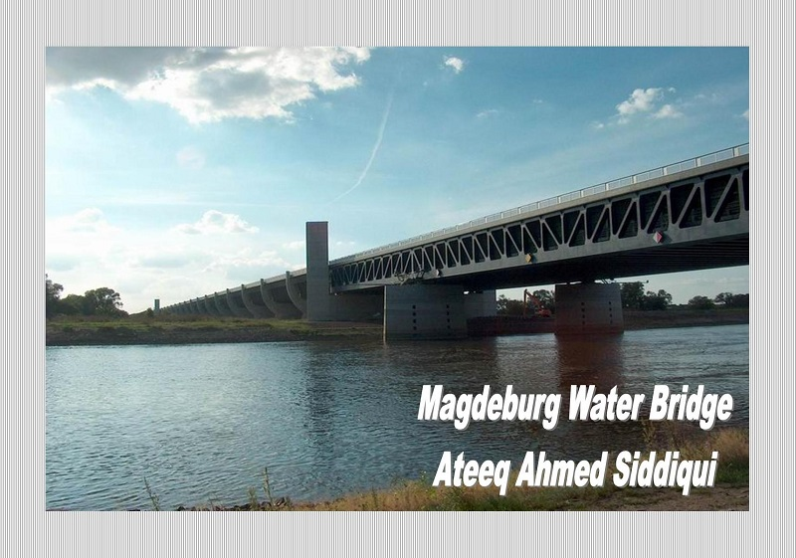

Slide 5
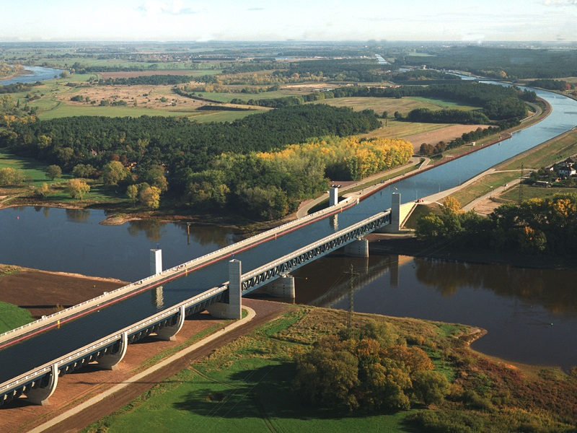

Slide 6
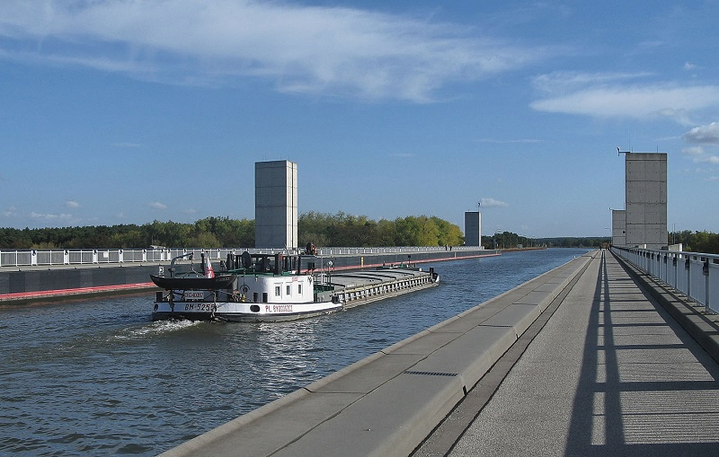

Slide 7
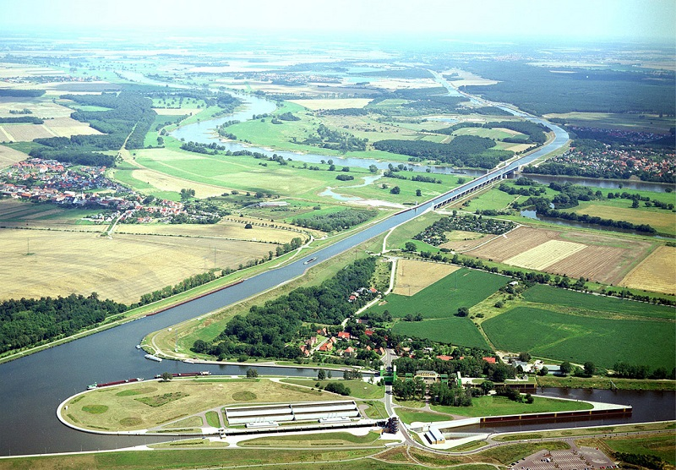

Slide 8
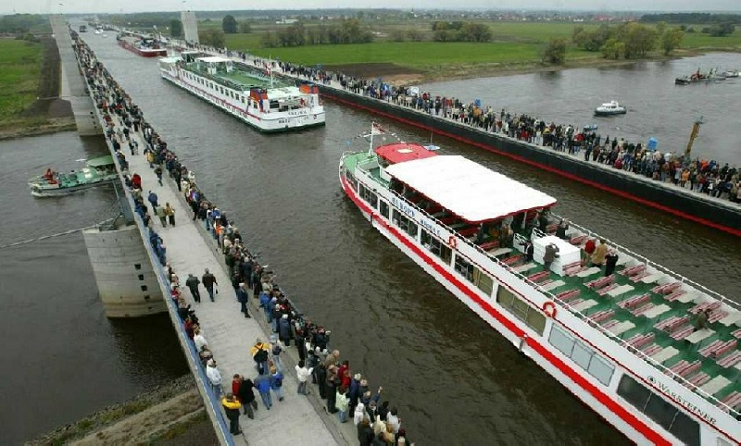

Slide 9
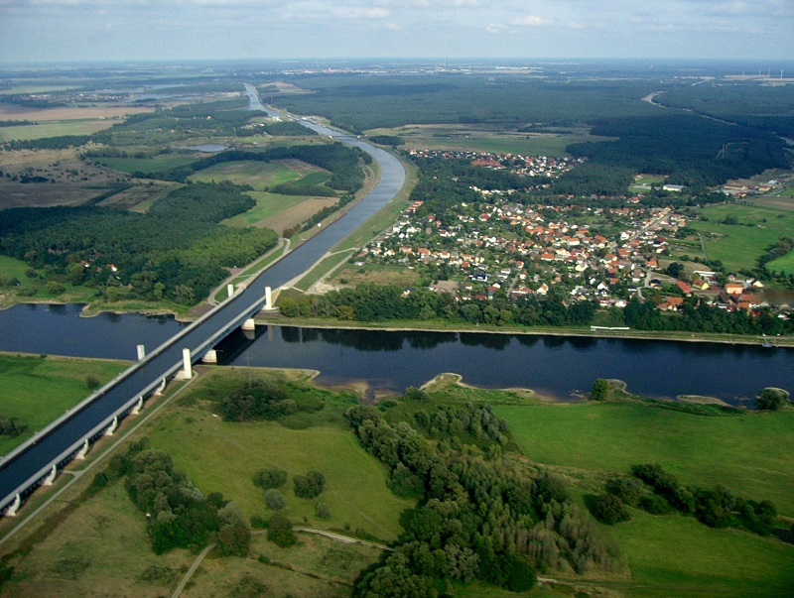

Slide 10
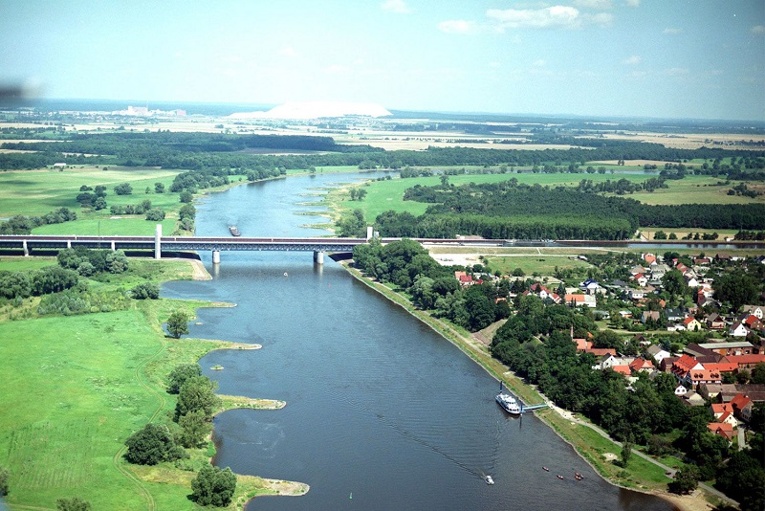

Slide 11
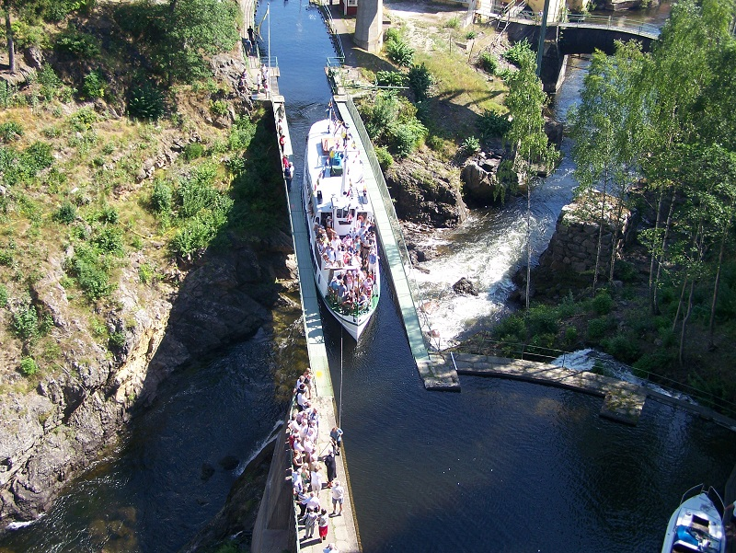

Slide 12
There’s more than the canal bridge

Slide 13
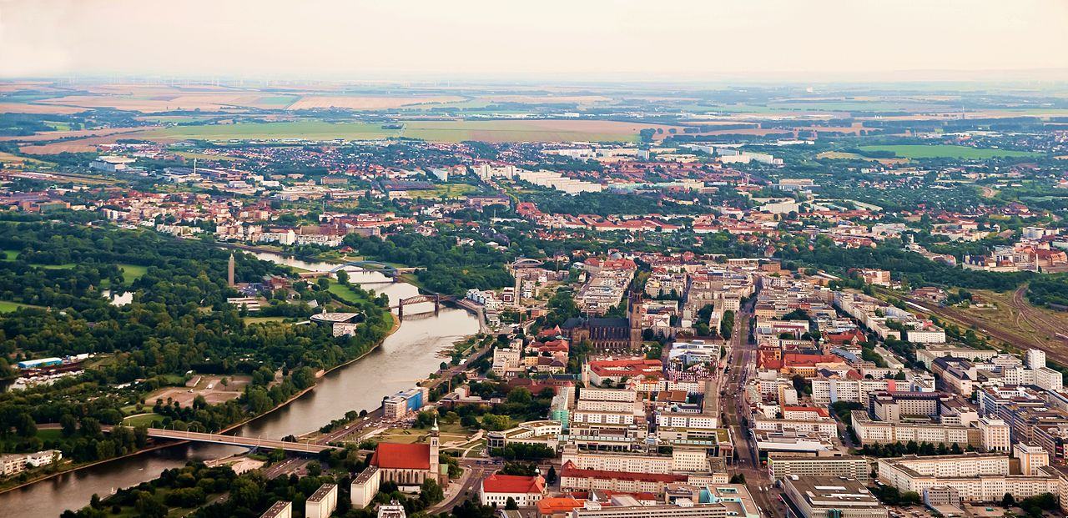

Slide 14
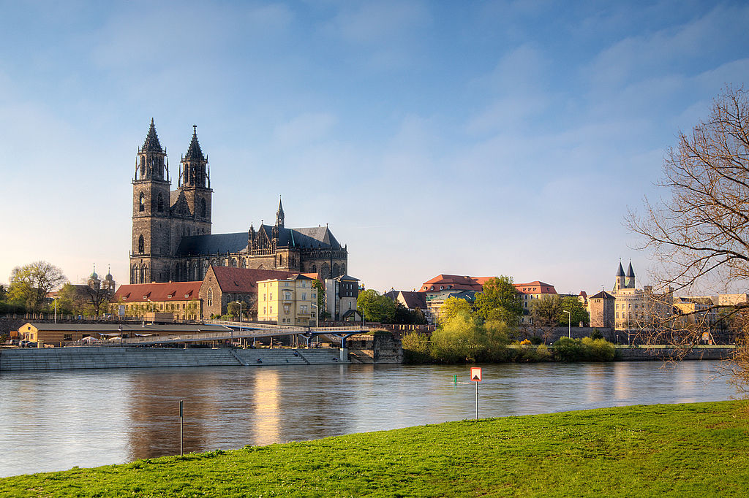

Slide 15
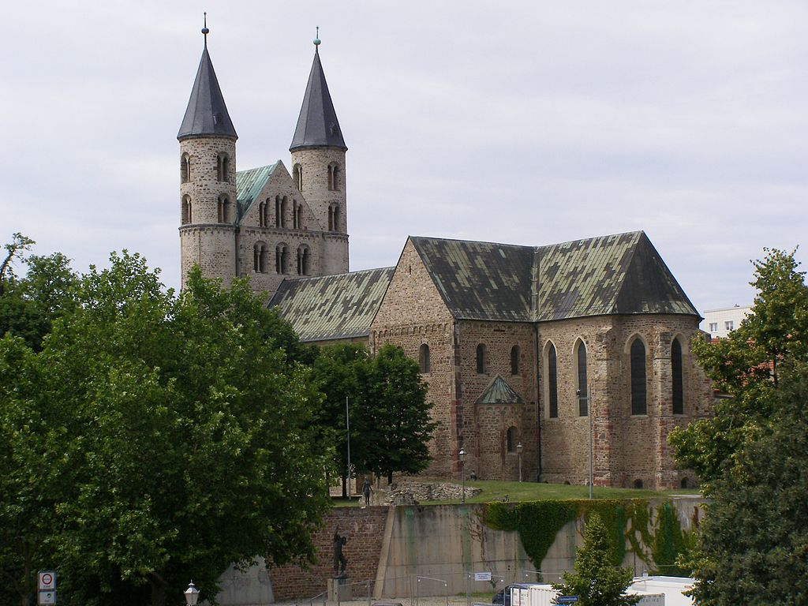
monastery of Our Lady

Slide 16
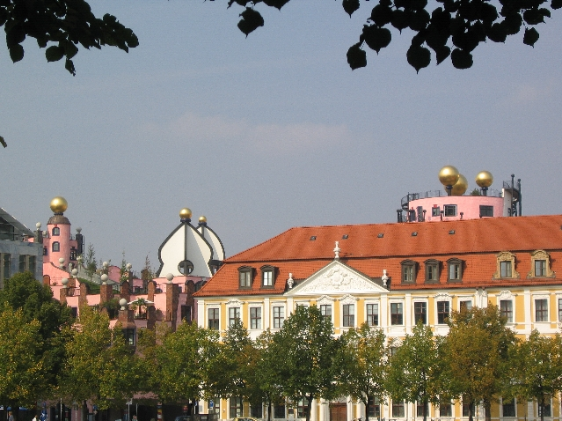

Slide 17
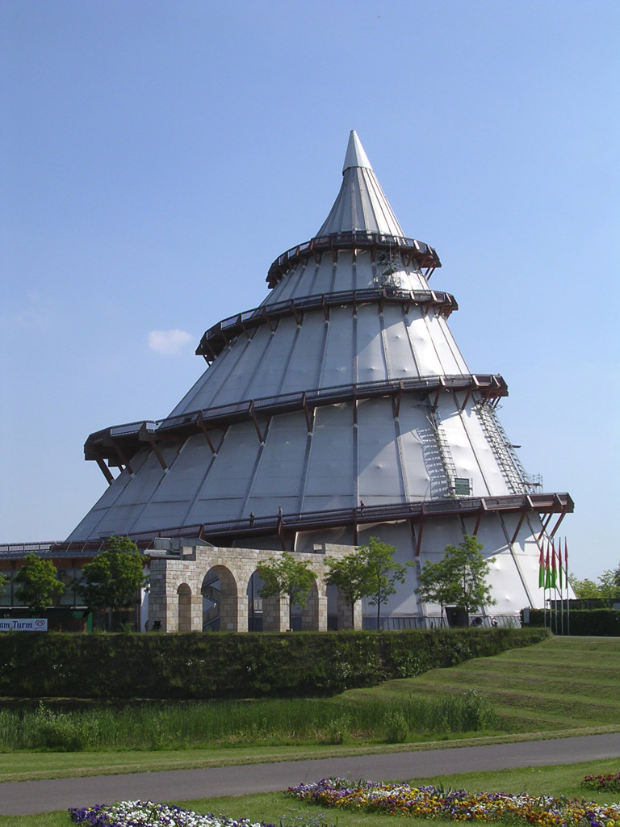
millennium tower

Slide 18
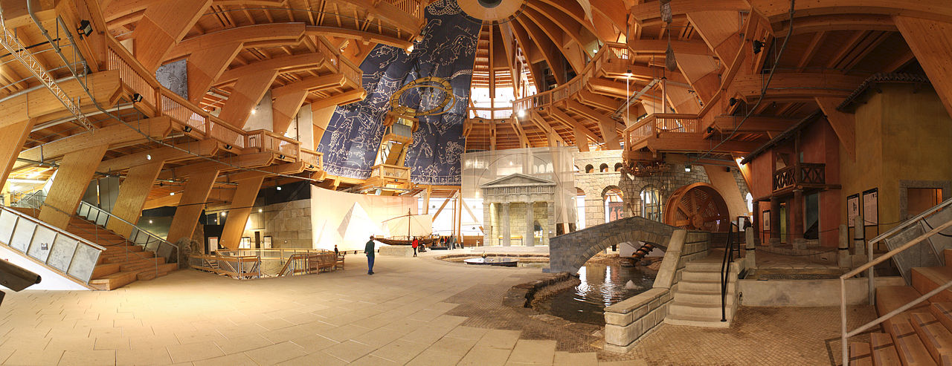
interior from the millennium tower (Jahrtausendturm)

Slide 19
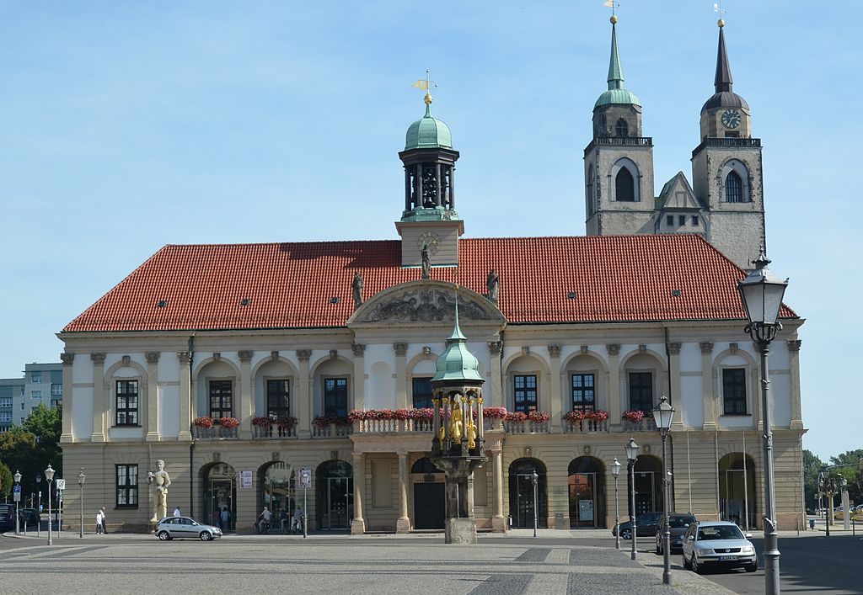
City Hall

Slide 20
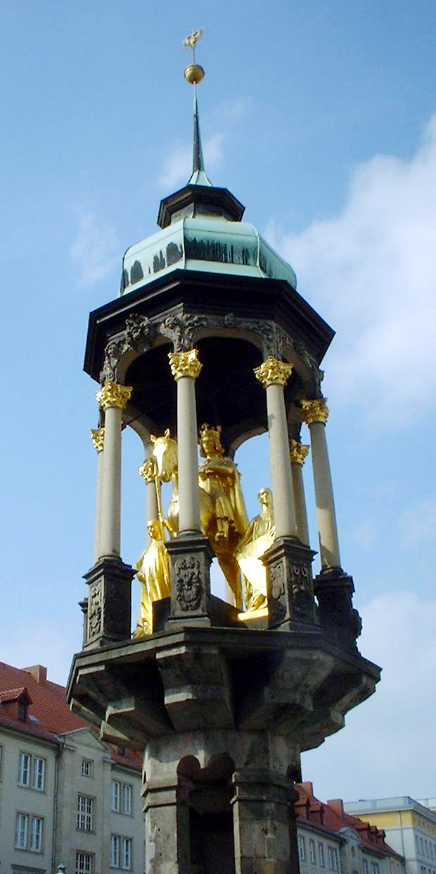
Magdeburger Reiter, 1240, the first equestrian statue north of the Alps

Slide 21
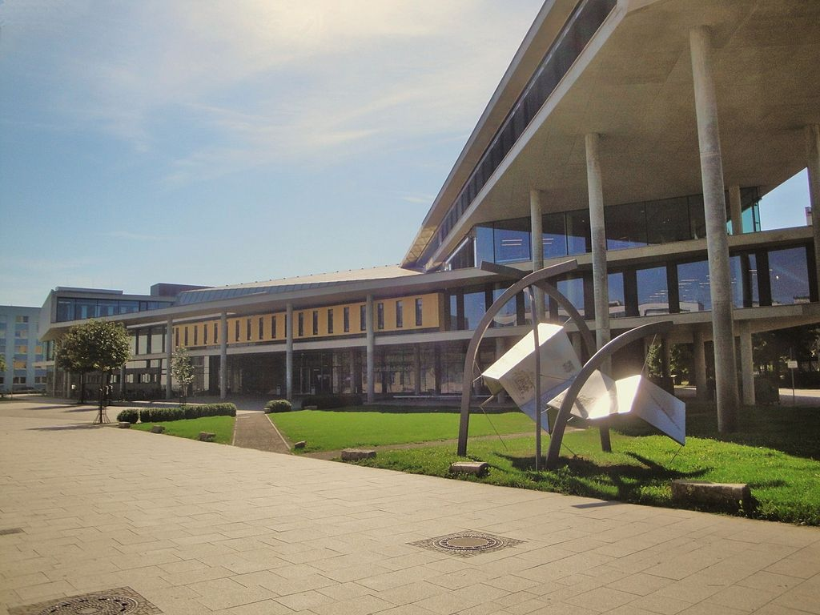
Otto-von-Guericke University Magdeburg was created in 1993

Slide 22
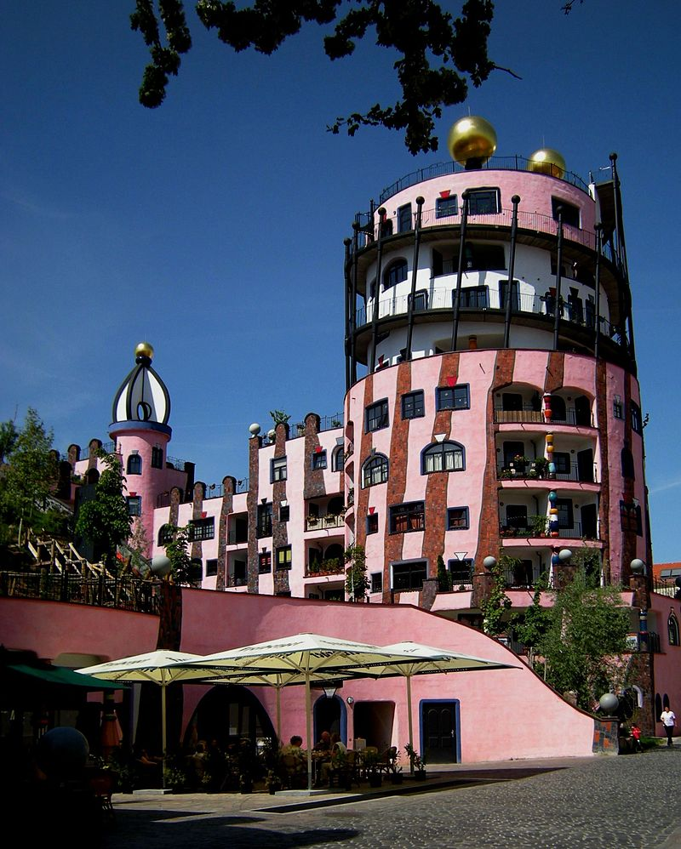
The Green Citadel of Magdeburg, built in 2005

Slide 23
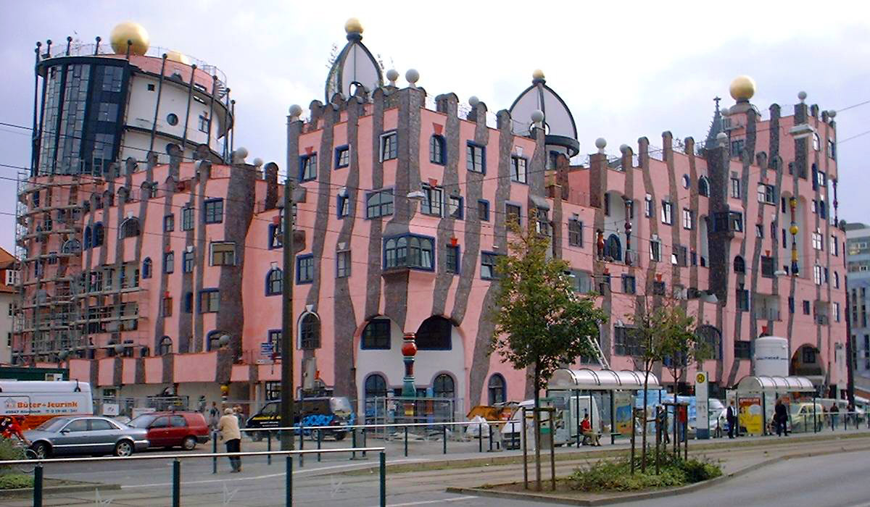

Slide 24
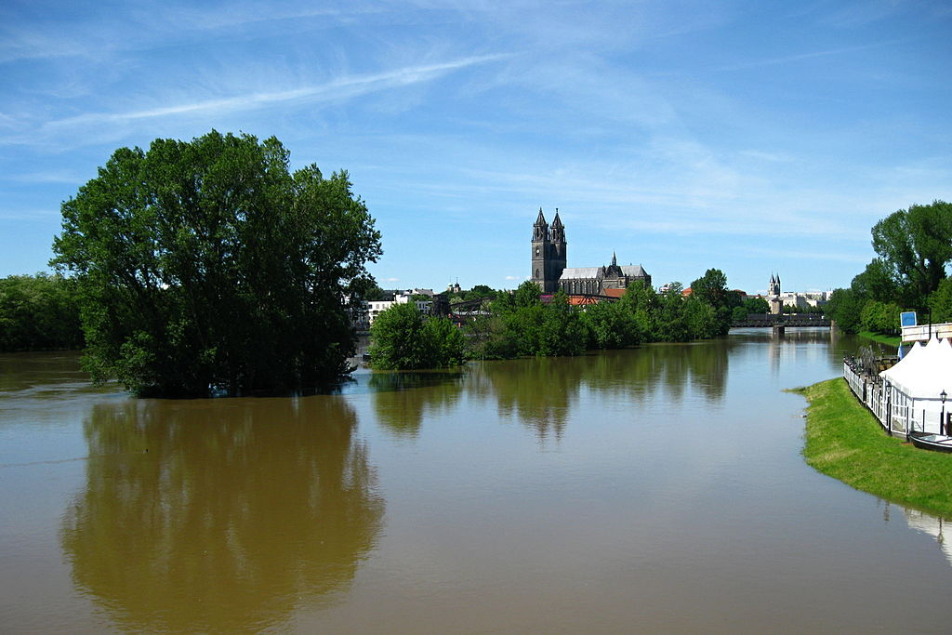
Magdeburg during the 2013 Elbe flood

Slide 25
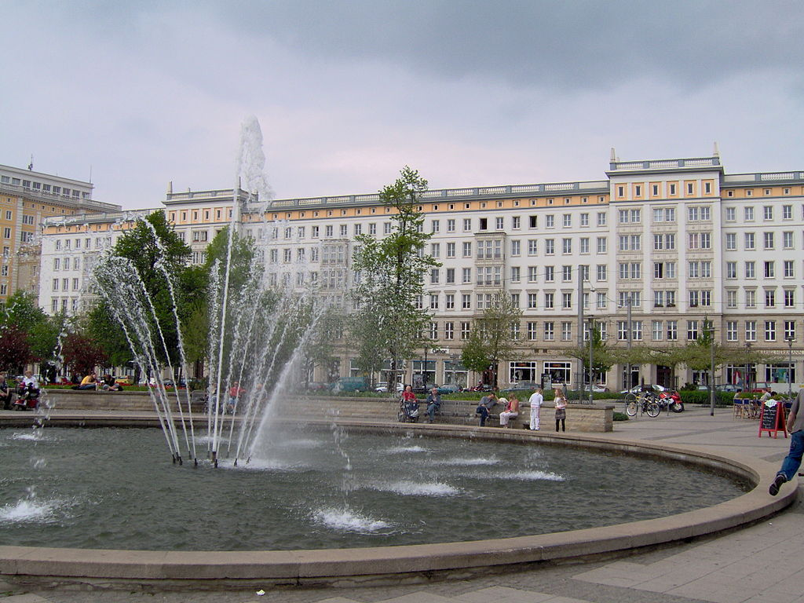
Magdeburg's centre has a number of Stalinist buildings from the 1950s.

Slide 26
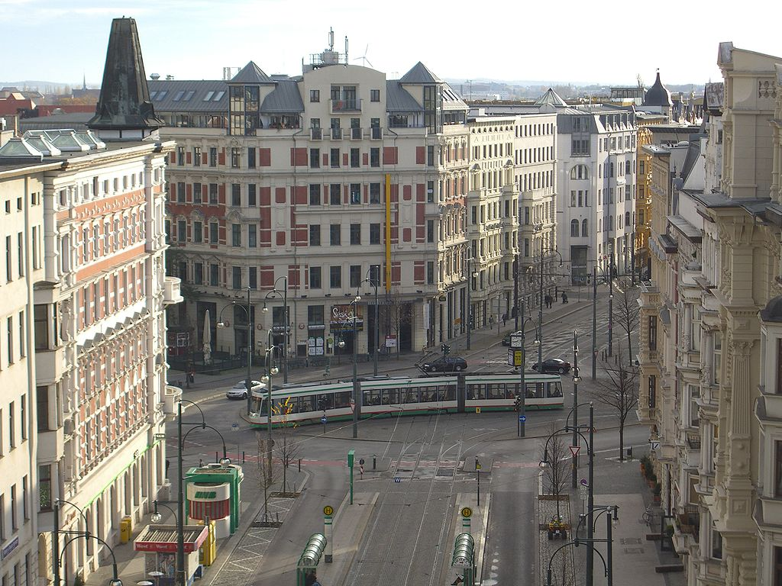

Slide 27
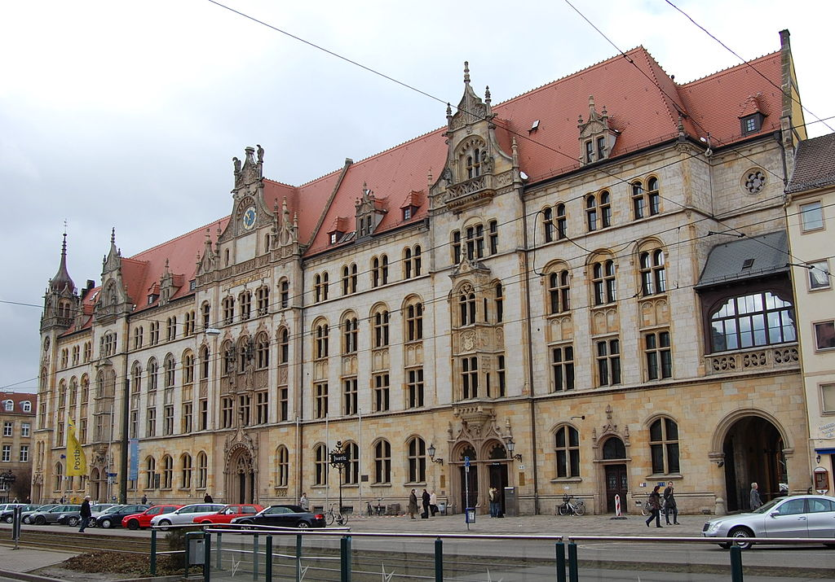
Justizzentrum

Slide 28
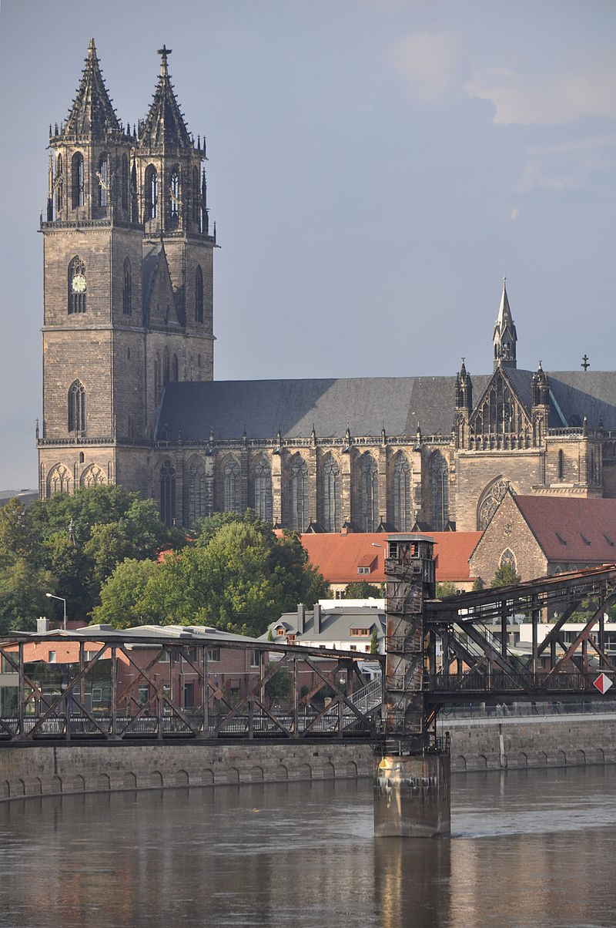
Cathedral of Magdeburg, seen from the other side of the Elbe river

Slide 29
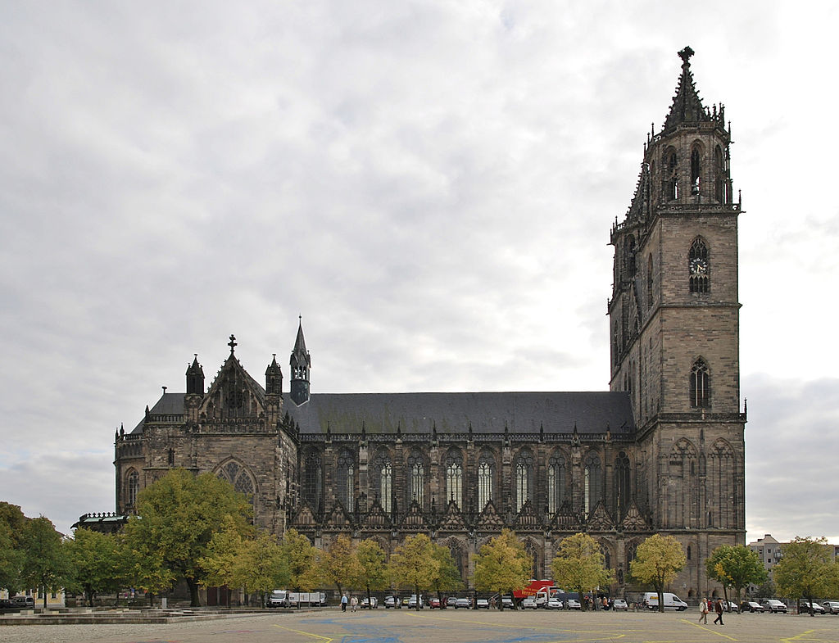
The Cathedral

Slide 30
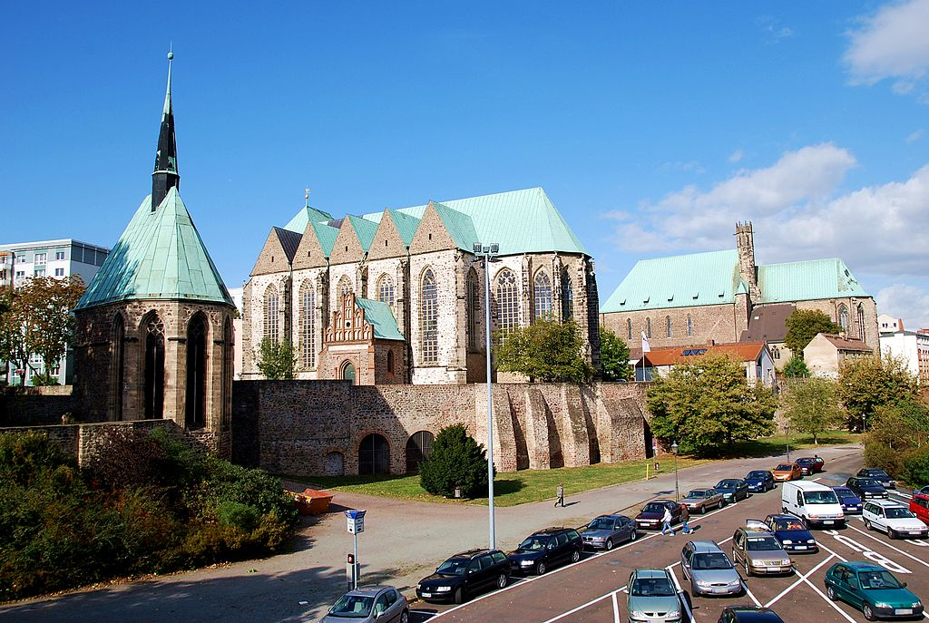
The three churches on the banks of the Elbe river

Slide 31
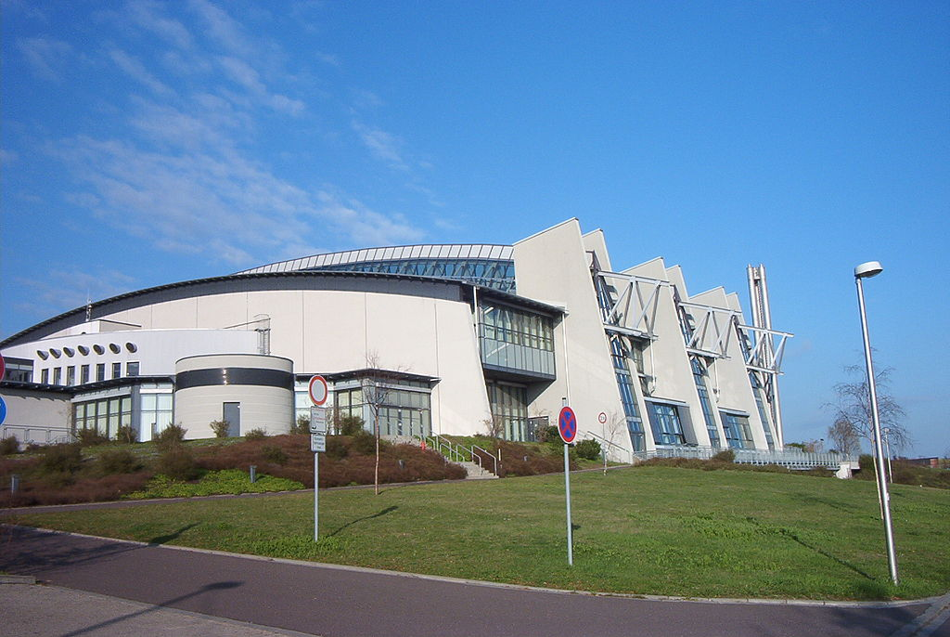
The GETEC Arena

Slide 32
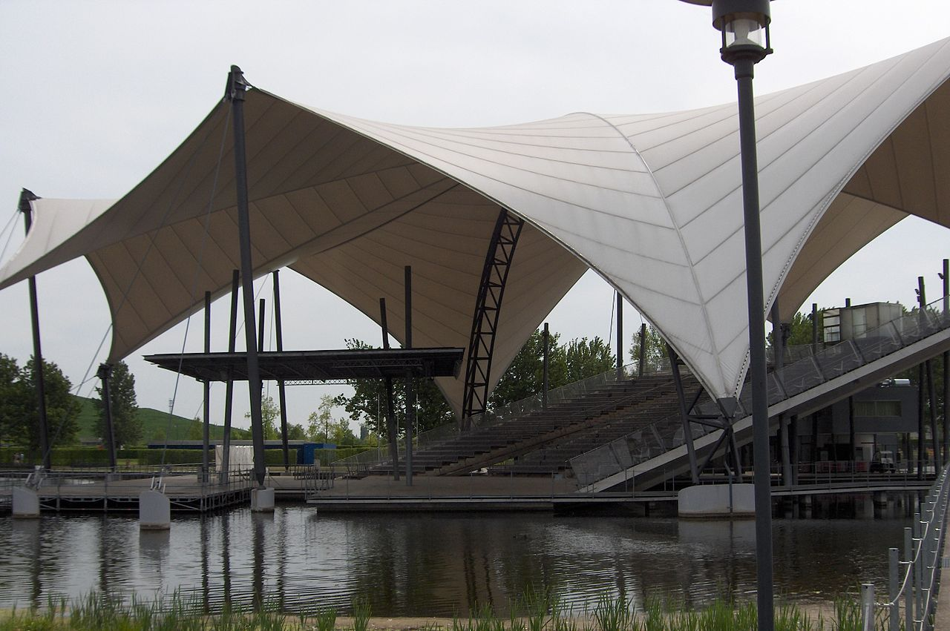
Lake-Stage at Elbauenpark

Slide 33
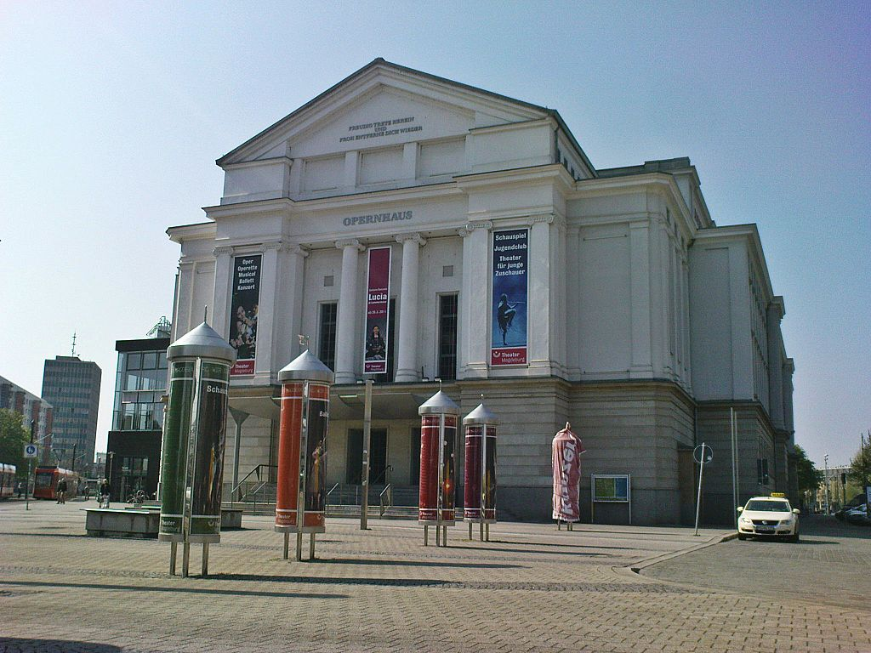
Magdeburg opera

Slide 34
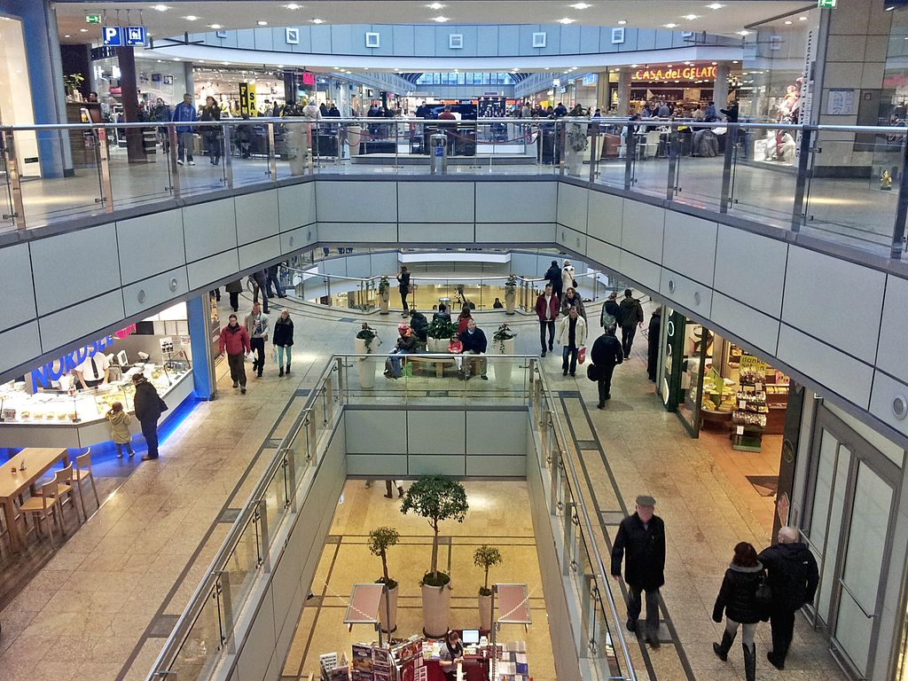
Allee-shopping-centre is one of seven shopping centres

Slide 35
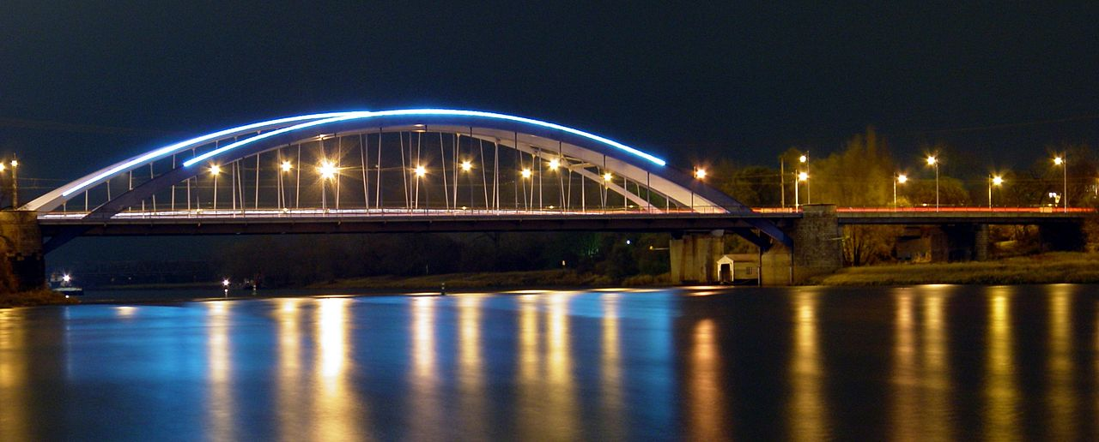
Jerusalem Bridges

Slide 36
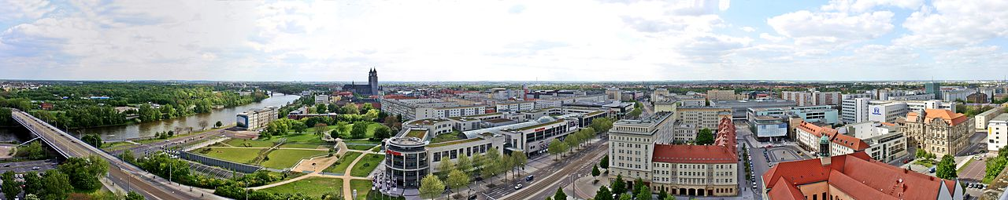
View of Magdeburg, from the tower of the Johanniskirche

