Slide 1
Leipzig, Germany

Slide 2
Leipzig is the largest city in the federal state of Saxony, Germany. Leipzig is located southwest of Berlin at the confluence of the White Elster, Pleisse and Parthe rivers.

Slide 3
Leipzig (/ˈlaɪpsɪɡ/; German: [ˈlaɪptsɪç] ( listen)) is the largest city in the federal state of Saxony, Germany. With a population of 570,087 inhabitants (1,001,220 residents in the larger urban zone) it is Germany's tenth most populous city. Leipzig is located about 160 kilometres (99 mi) southwest of Berlin at the confluence of the White Elster, Pleisse and Parthe rivers at the southern end of the North German Plain.
Leipzig has been a trade city since at least the time of the Holy Roman Empire. The city sits at the intersection of the Via Regia and Via Imperii, two important Medieval trade routes. Leipzig was once one of the major European centers of learning and culture in fields such as music and publishing. Leipzig became a major urban center within the German Democratic Republic (East Germany) after the Second World War, but its cultural and economic importance declined.

Slide 4
17th Century

Slide 7
Monument to the Battle of the Nations

Slide 12
New Town Hall

Slide 13
New City Hall

Slide 14
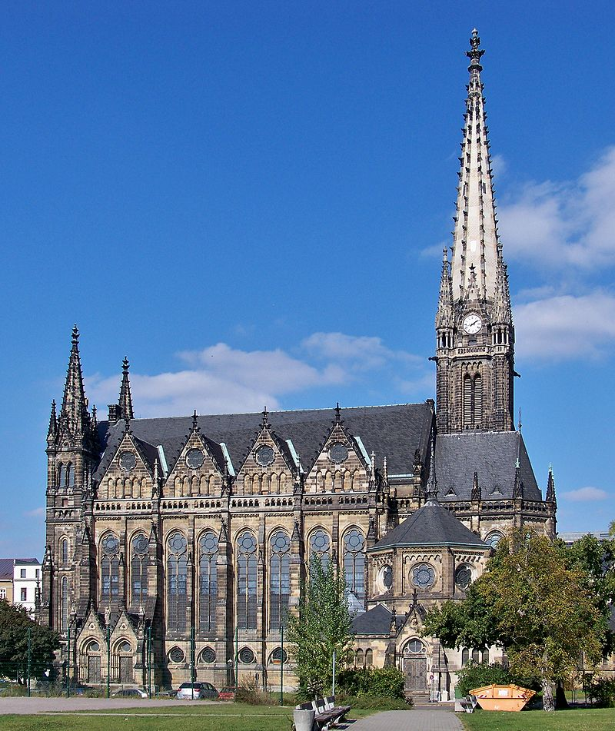

Slide 15
Russian Orthodox

Slide 16
Leipzig Christmas market entrance

Slide 31
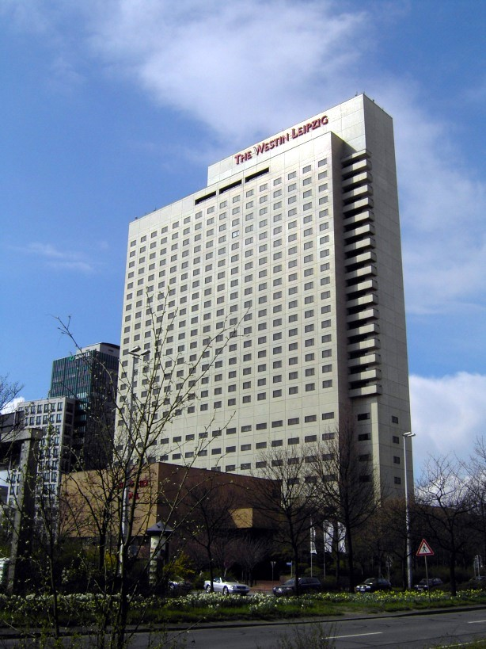

Slide 35
German Museum of Books and Writing

Slide 36
Exhibits of the Egyptian Museum

Slide 37
Grassi Museum

Slide 38
Museum in der Runden Ecke

Slide 39
Museum of Fine Art

Slide 40
Inside Gondwanaland at Leipzig Zoological Garden

Slide 42
New Augusteum of the University of Leipzig

Slide 47
BMW Plant

