Slide 1
Kyoto, Japan!

Slide 2
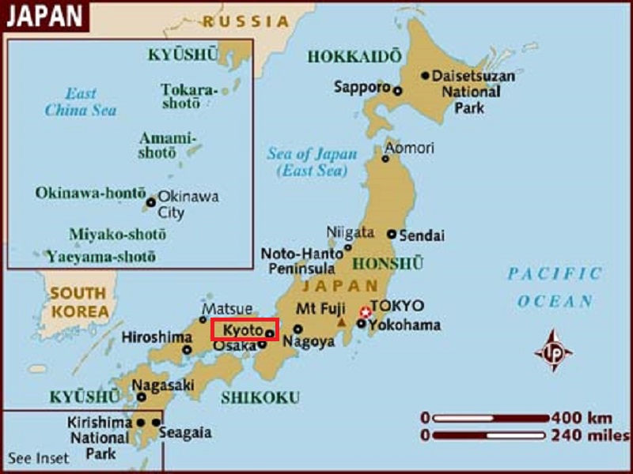
Kyoto is a city located in the central part of the island of Honshu, Japan. Formerly, the Imperial capital of Japan, it is now the capital of Kyoto Prefecture.

Slide 3
There was some consideration by the United States of targeting Kyoto with an atomic bomb at the end of World War II because, as an intellectual center of Japan, it had a population "better able to appreciate the significance of the weapon" In the end, at the insistence of Henry L. Stimson, Secretary of War in the Roosevelt and Truman administrations, the city was removed from the list of targets and replaced by Nagasaki. The city was largely spared from conventional bombing as well, although small-scale air raids did result in casualties.
As a result, the Imperial City (Emeritus) of Kyoto is one of the few Japanese cities that still have an abundance of prewar buildings, such as the traditional townhouses known as machiya. However, modernization is continually breaking down the traditional Kyoto in favor of newer architecture, such as the Kyōto Station complex.
Kyoto became a city designated by government ordinance on September 1, 1956. In 1997, Kyoto hosted the conference that resulted in the protocol on greenhouse gas emissions that bears the city's name.

Slide 4
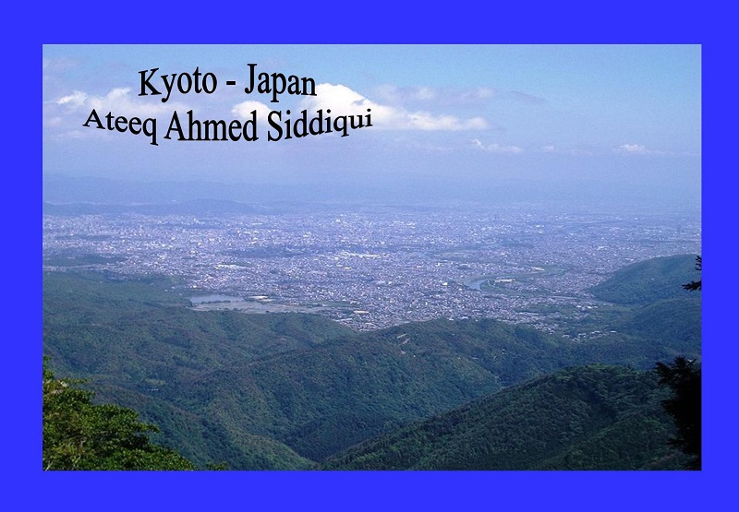

Slide 5
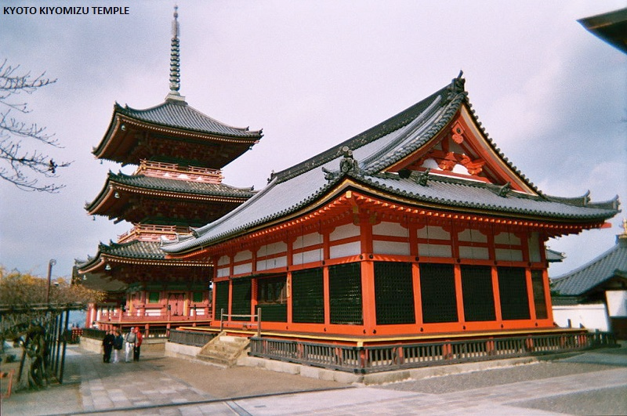

Slide 6
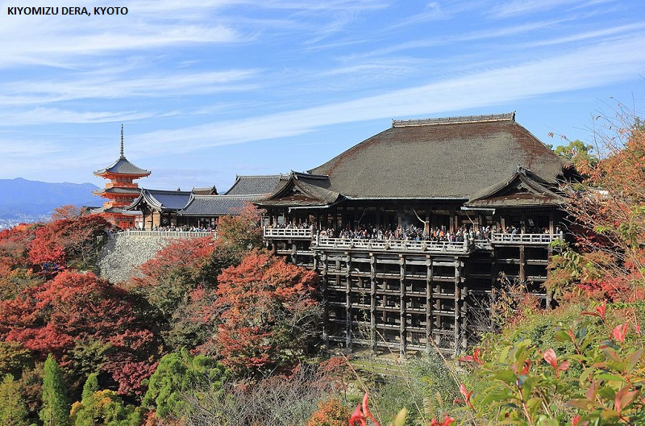

Slide 7
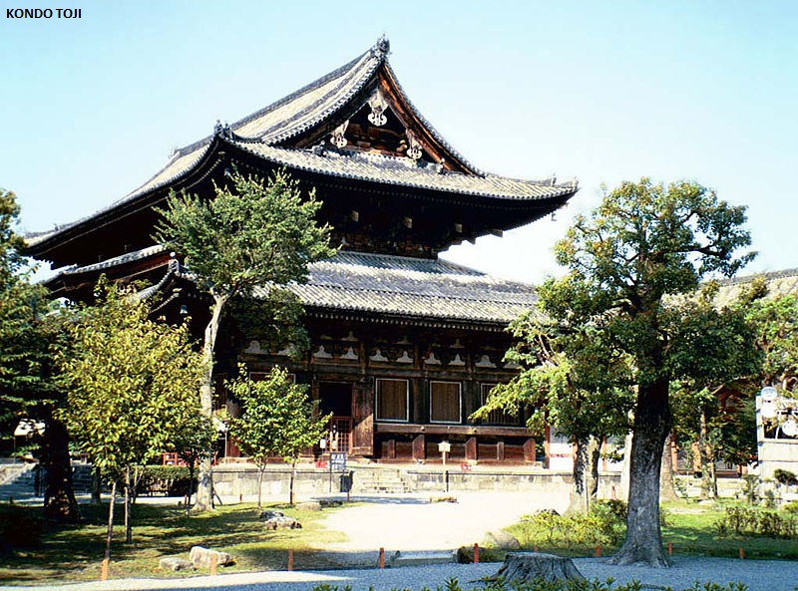

Slide 8
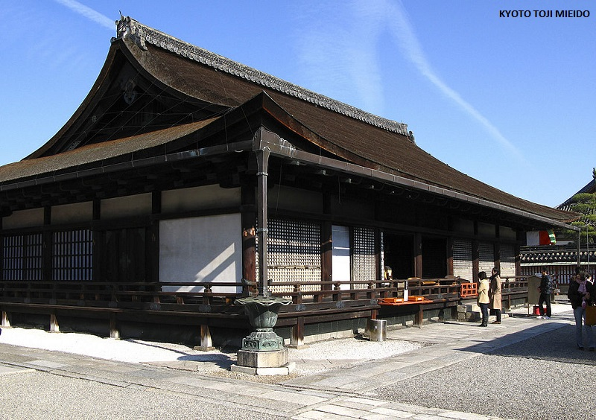

Slide 9
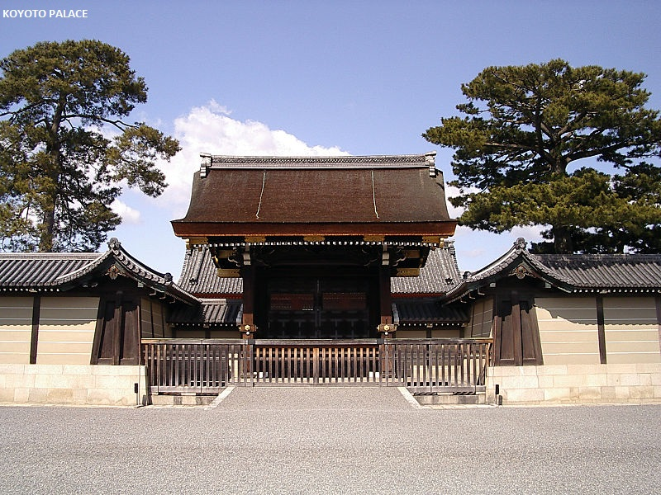

Slide 10
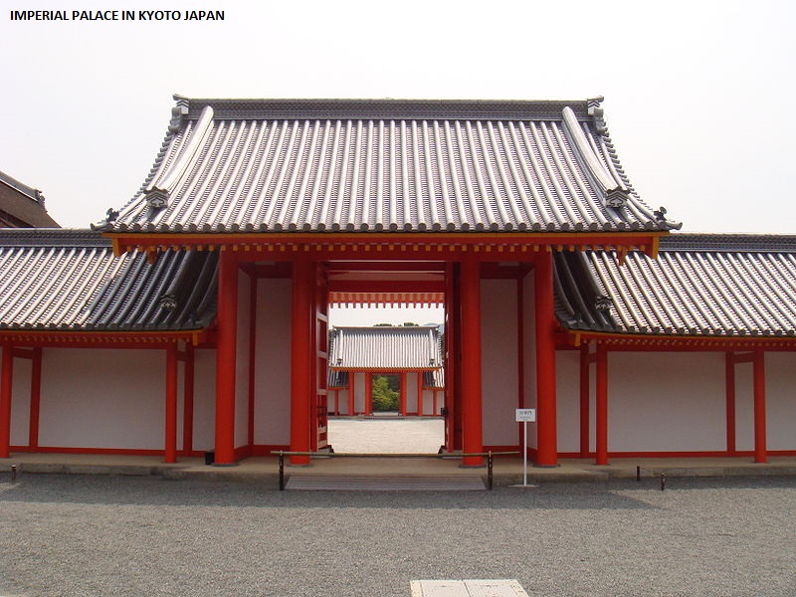

Slide 11
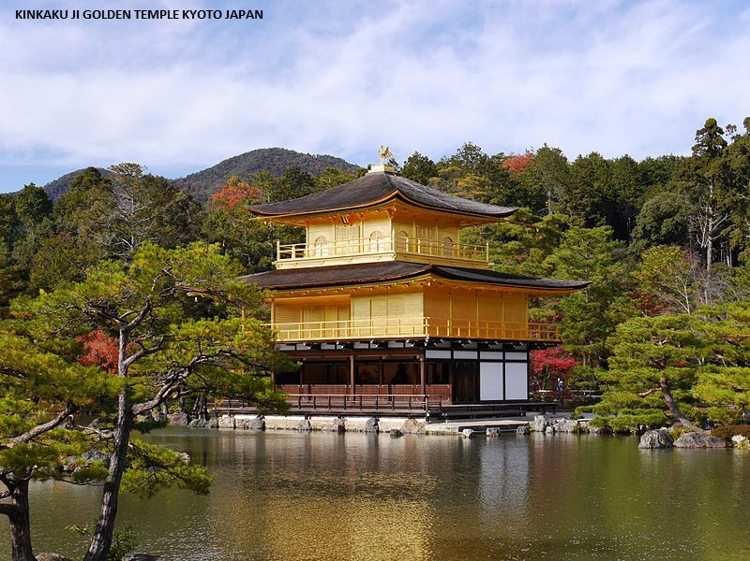

Slide 12
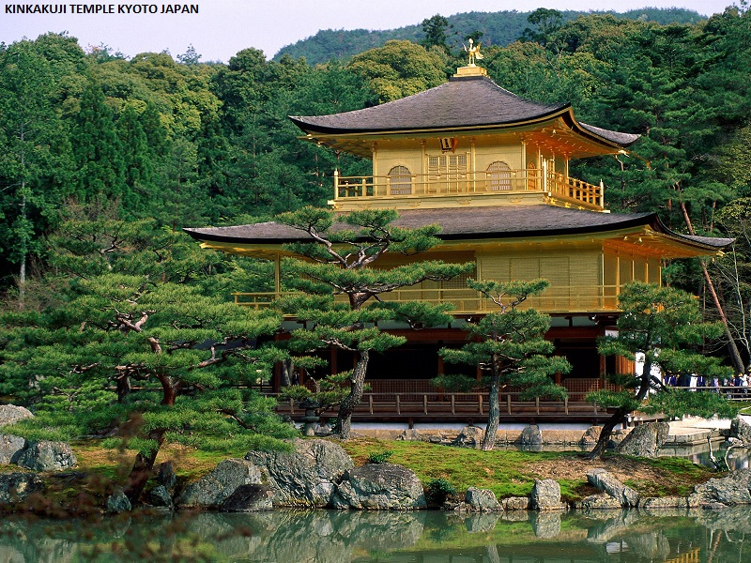

Slide 13
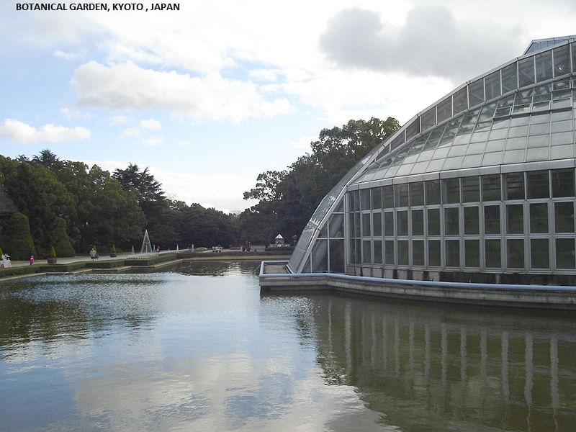

Slide 14
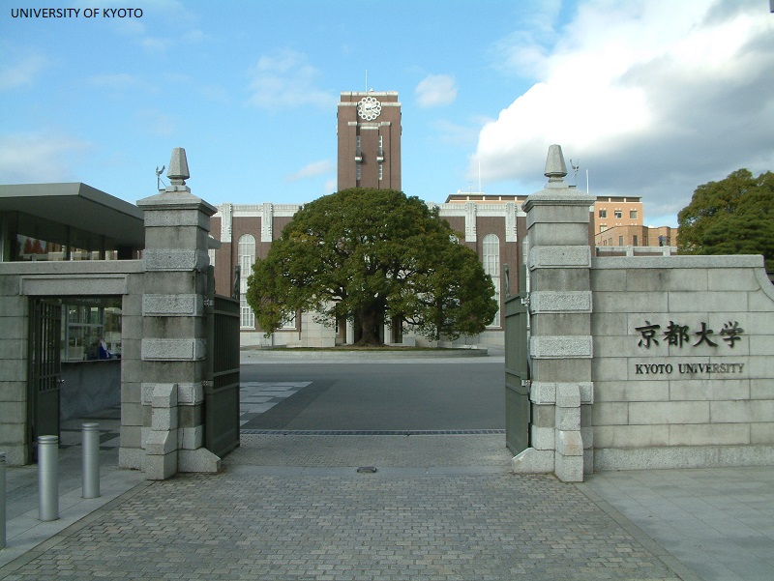

Slide 15
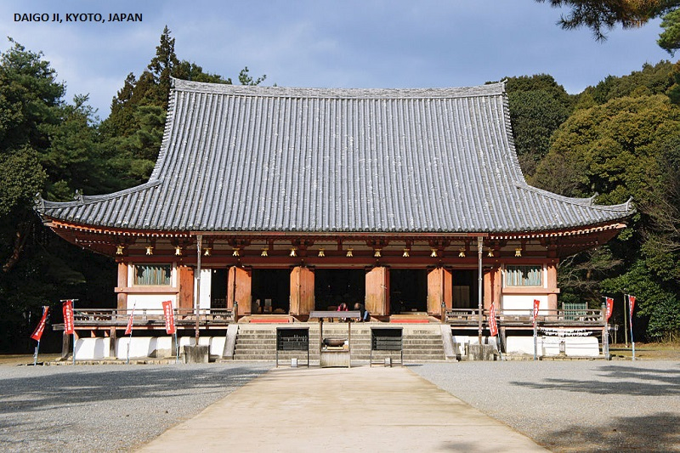

Slide 16
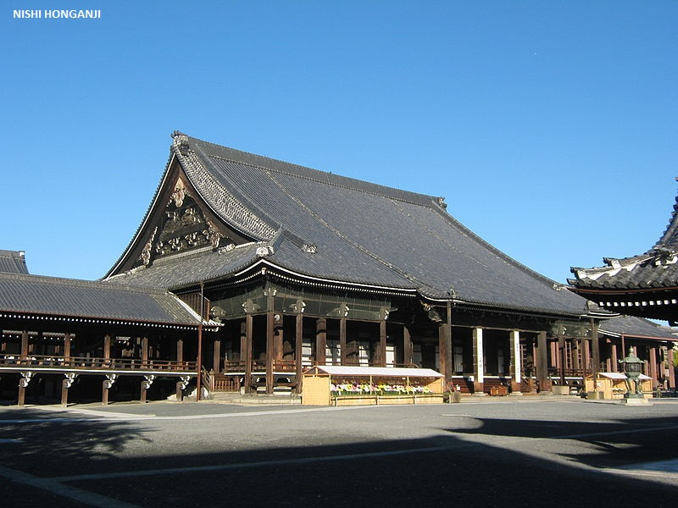

Slide 17
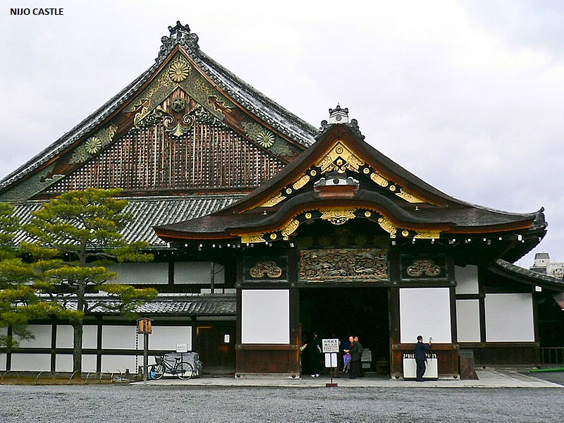

Slide 18
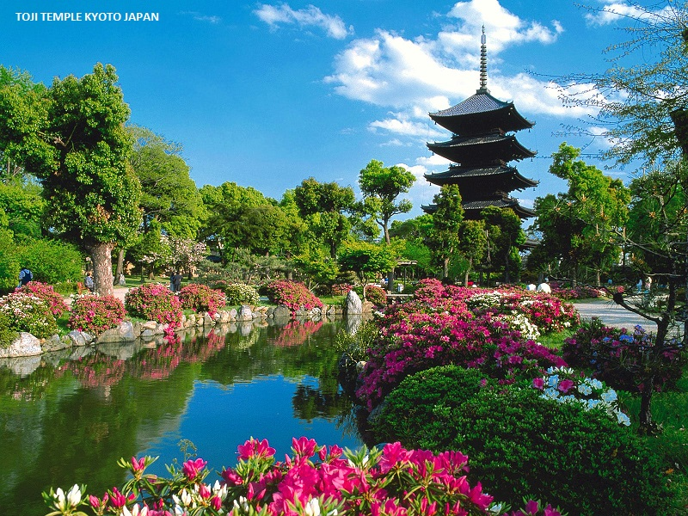

Slide 19
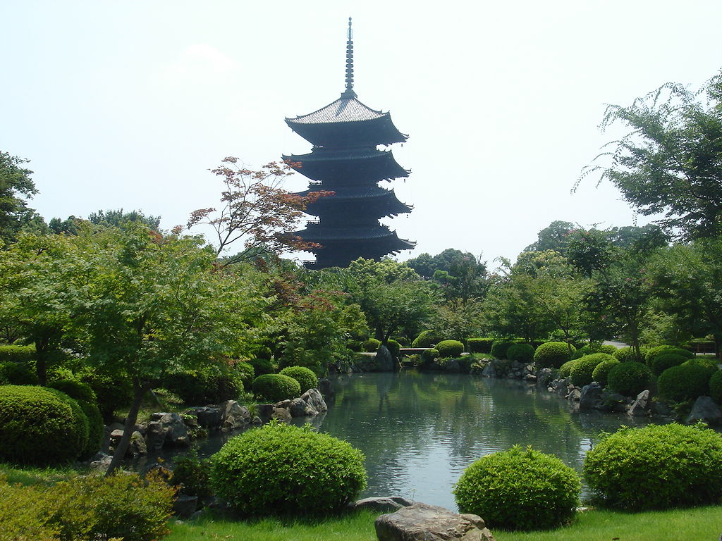
Tō-ji

Slide 20
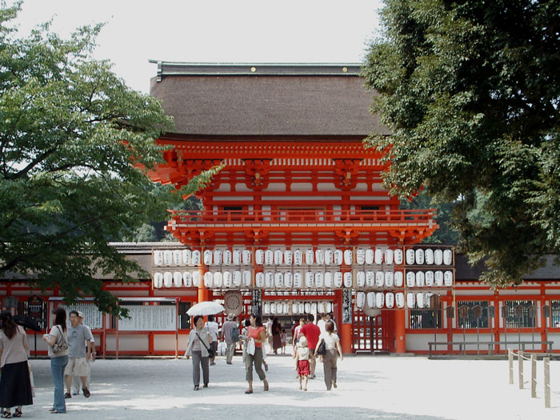
Shimogamo Shrine

Slide 21
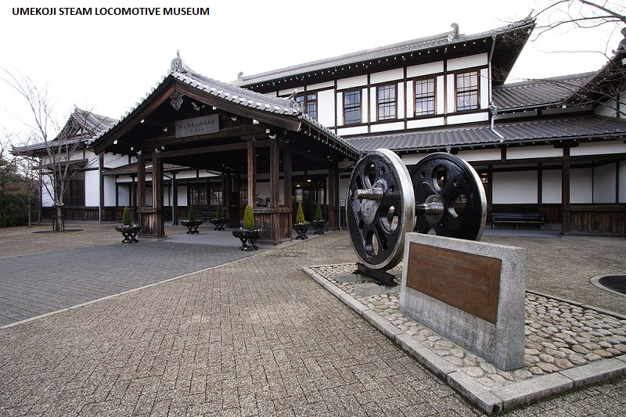

Slide 22
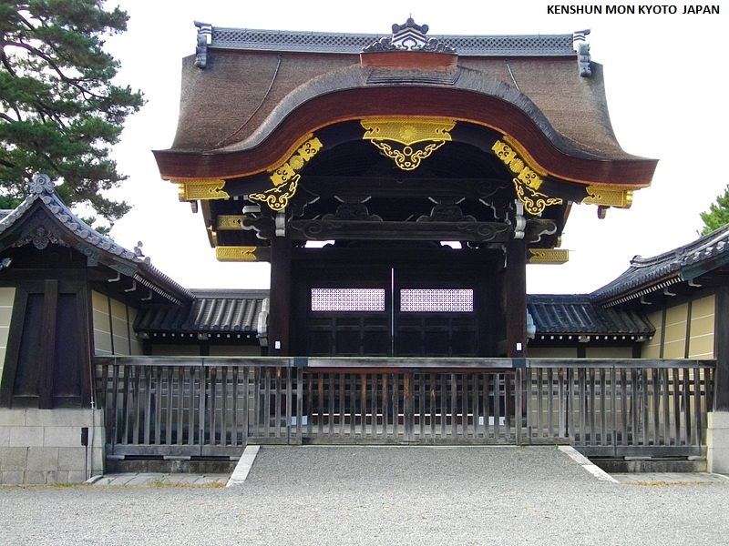

Slide 23
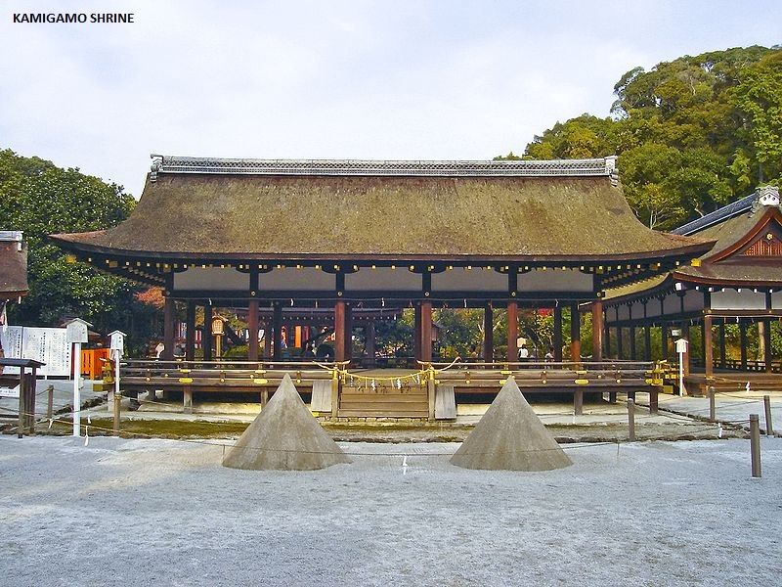

Slide 24
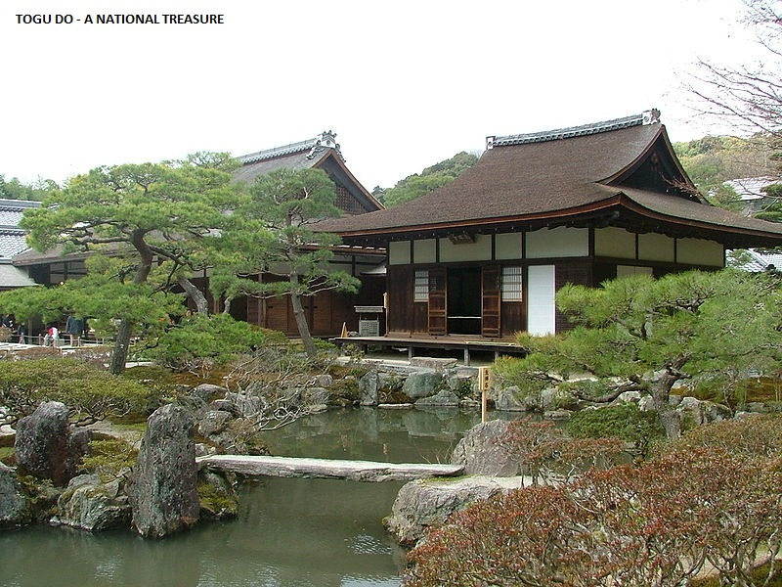

Slide 25
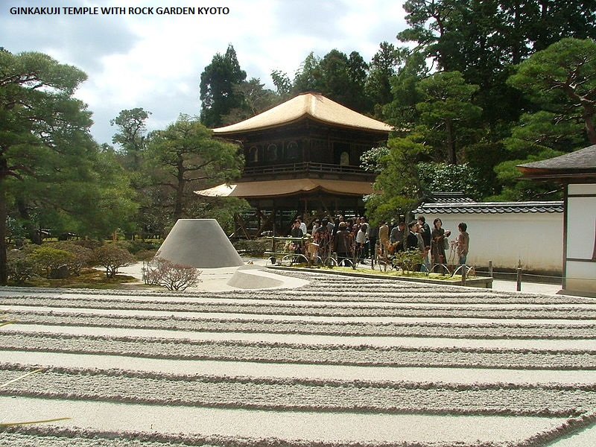

Slide 26
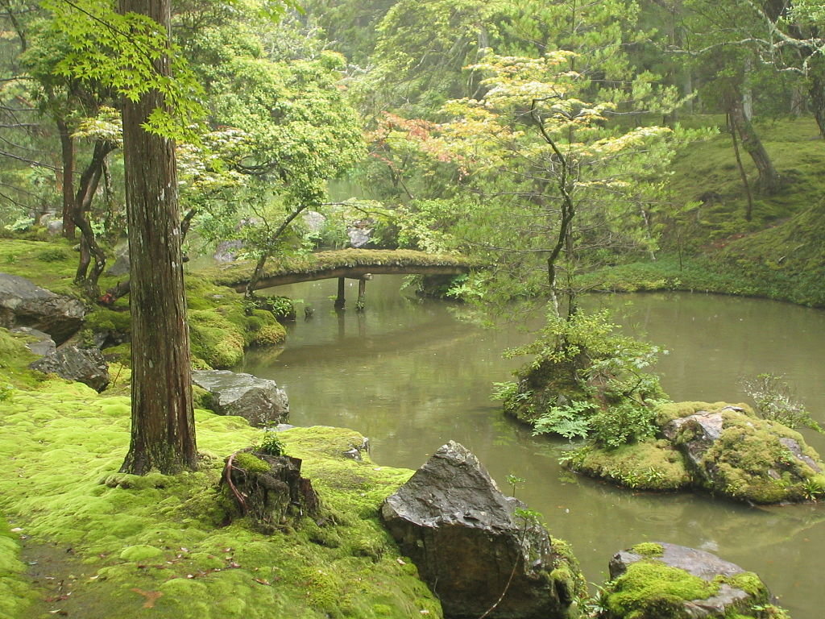
Saihō-ji

Slide 27
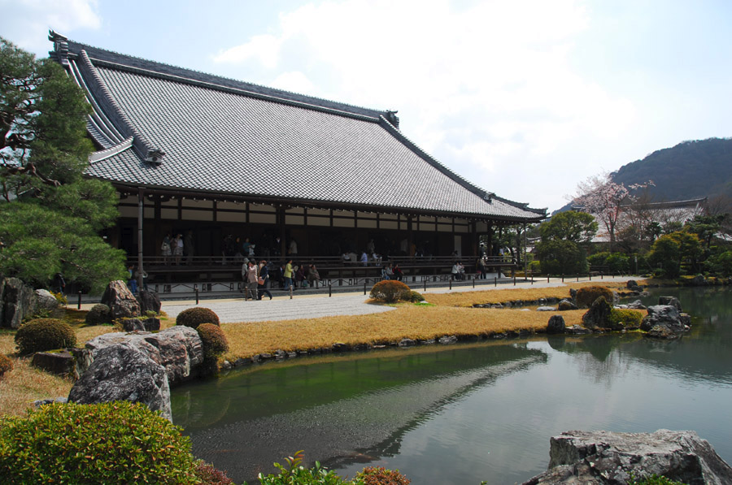
Tenryū-ji

Slide 28
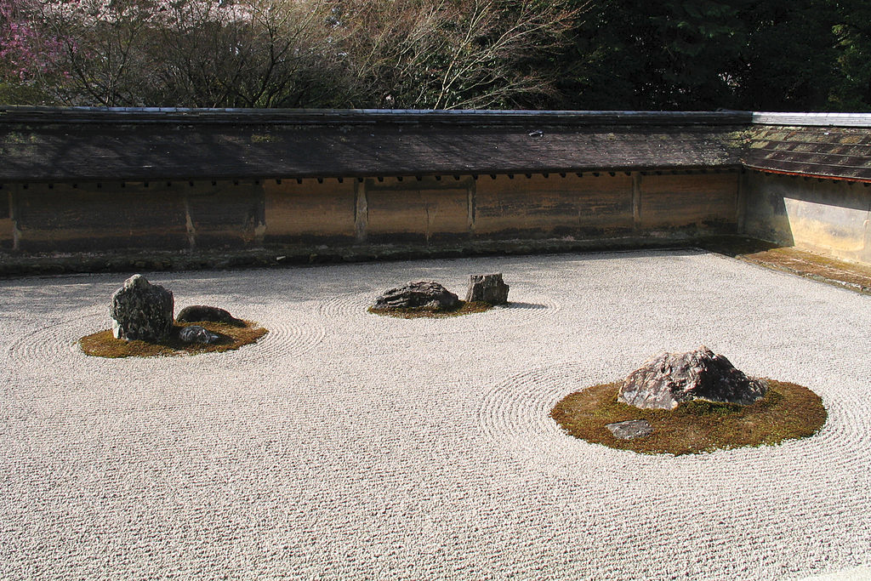
Rock garden

Slide 29
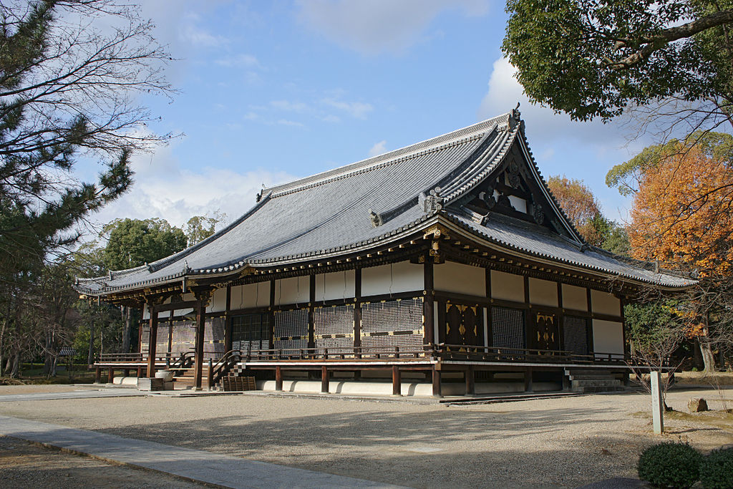
Ninna-ji

Slide 30
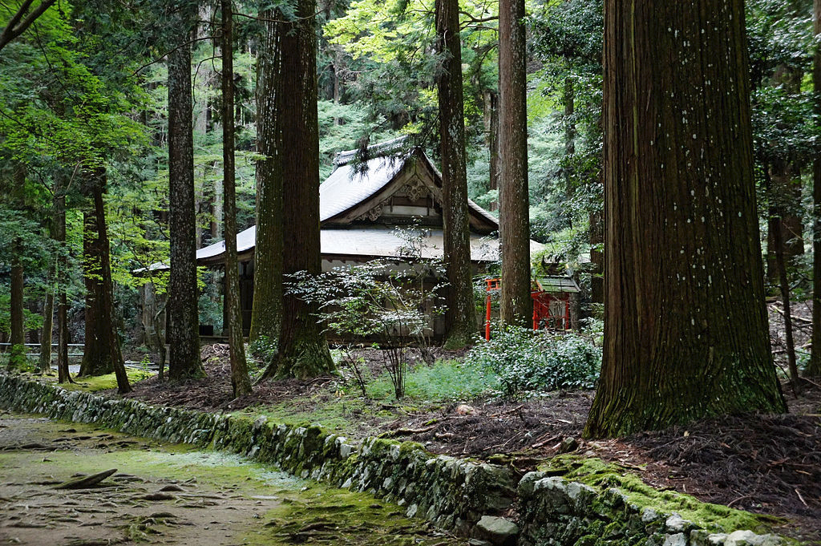
Kōzan-ji

Slide 31
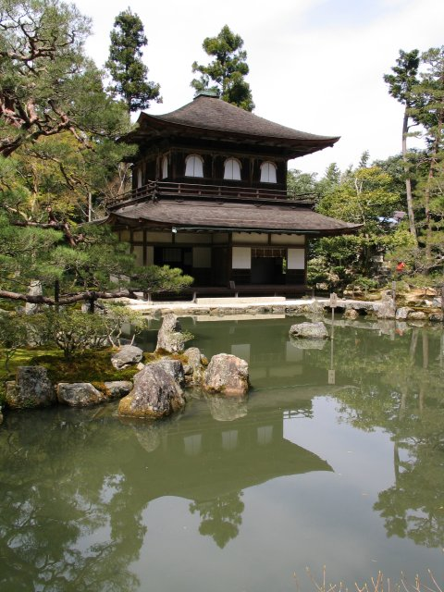
Ginkaku-ji

Slide 32
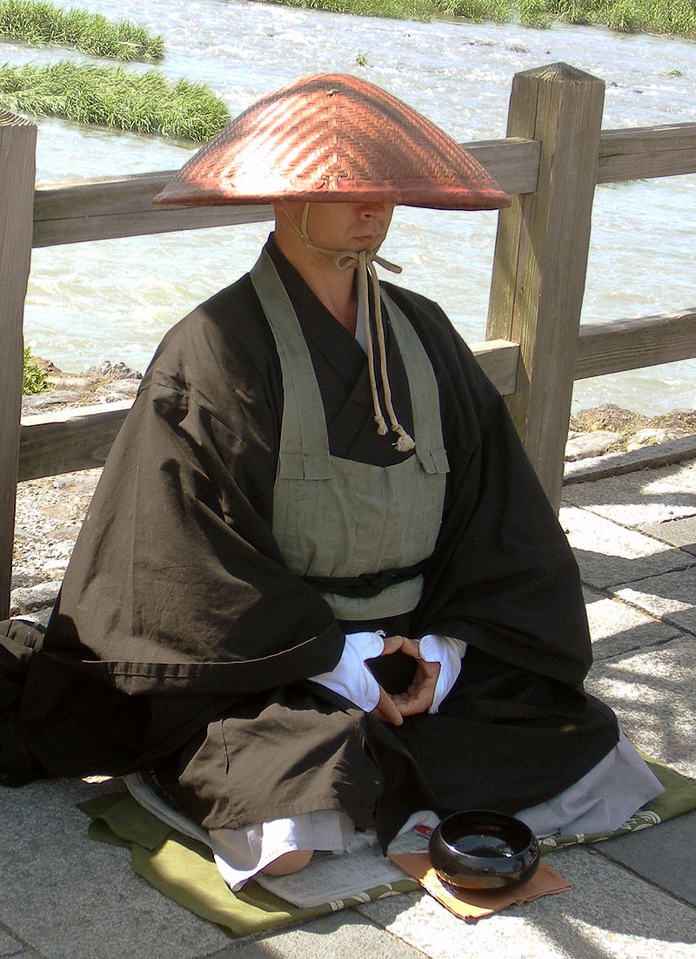
A monk by the Katsura River in Arashiyama

Slide 33
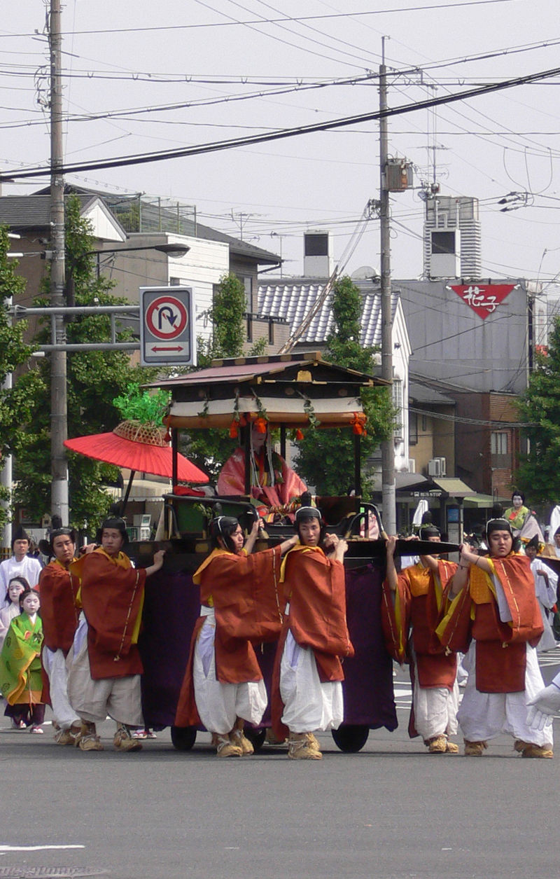
Aoi Matsuri

Slide 34
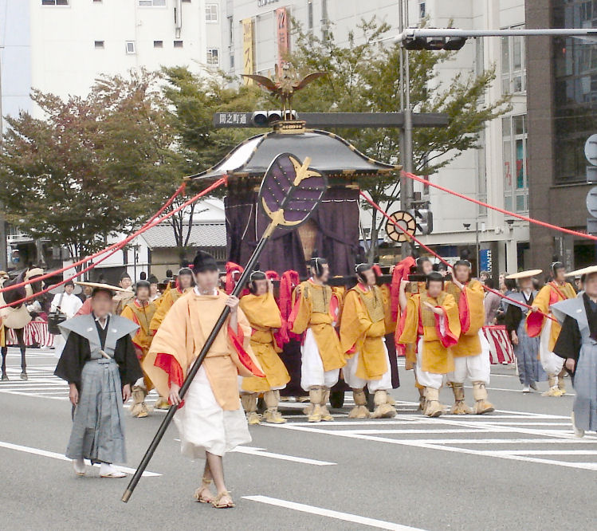
Jidai Matsuri

Slide 35
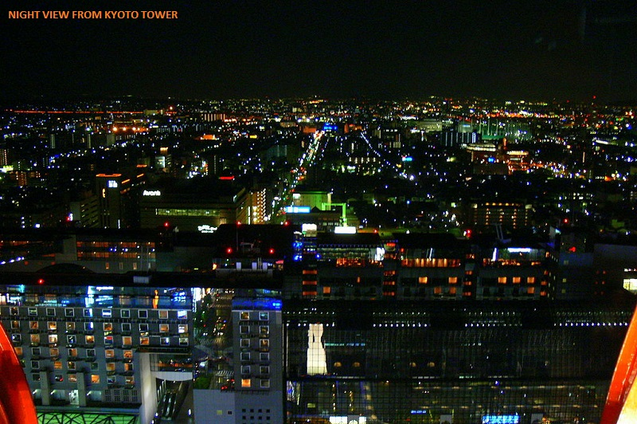

Slide 36
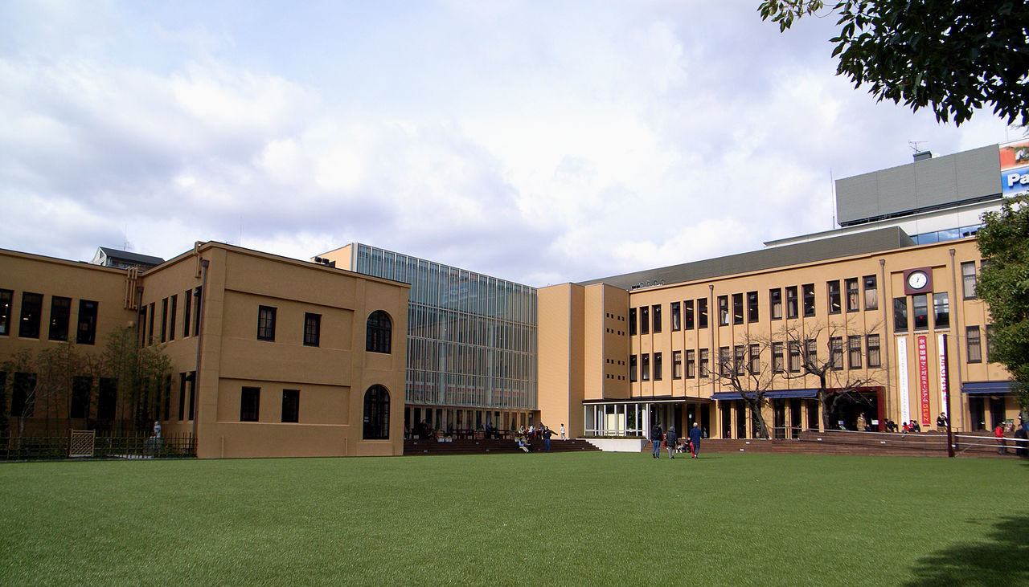
Kyoto International Manga Museum

Slide 37
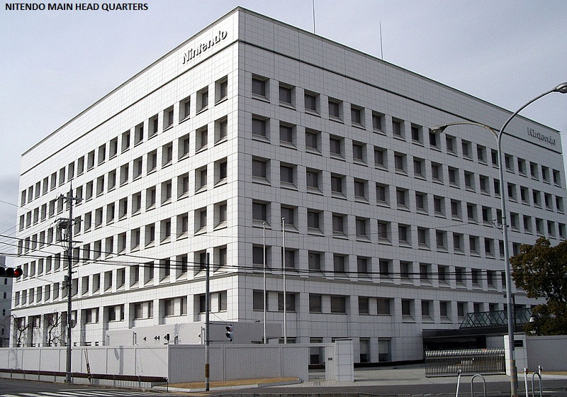

Slide 38
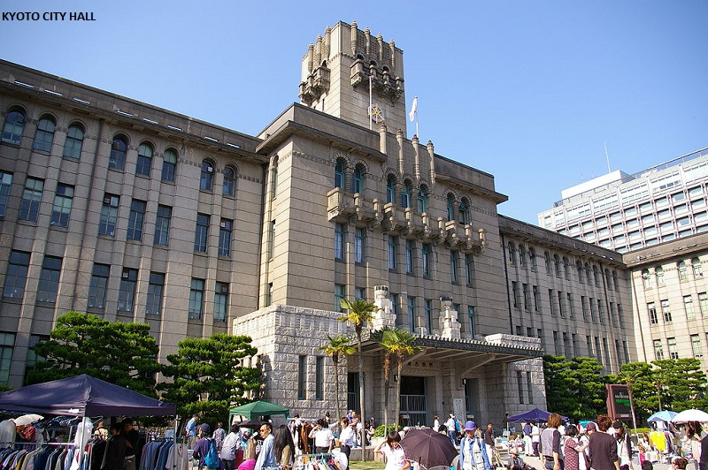

Slide 39
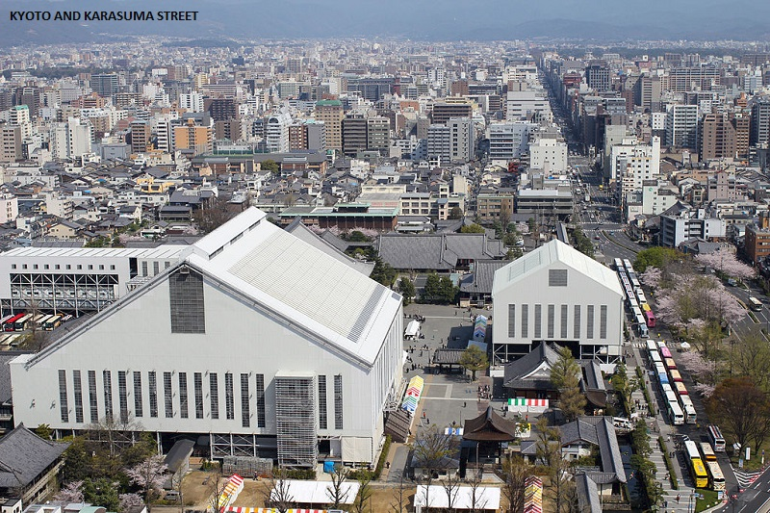

Slide 40
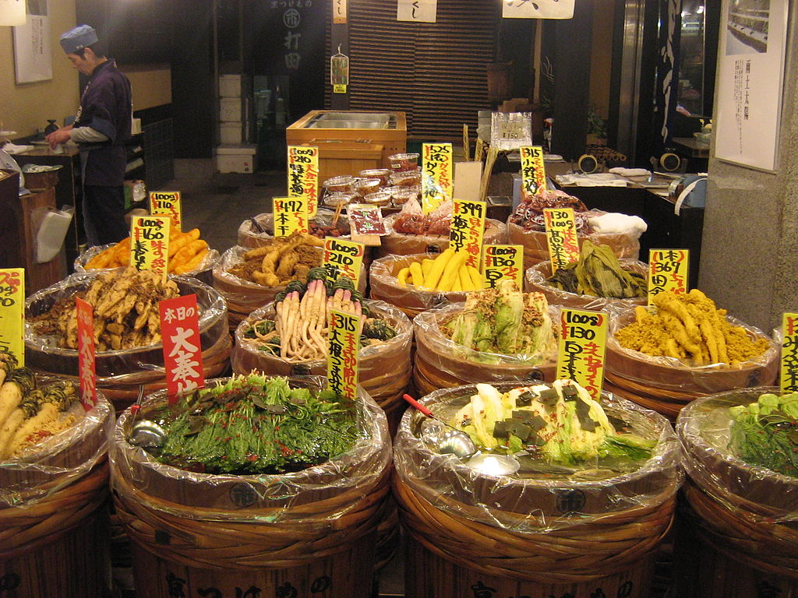
A tsukemono shop on Nishiki Street

Slide 41
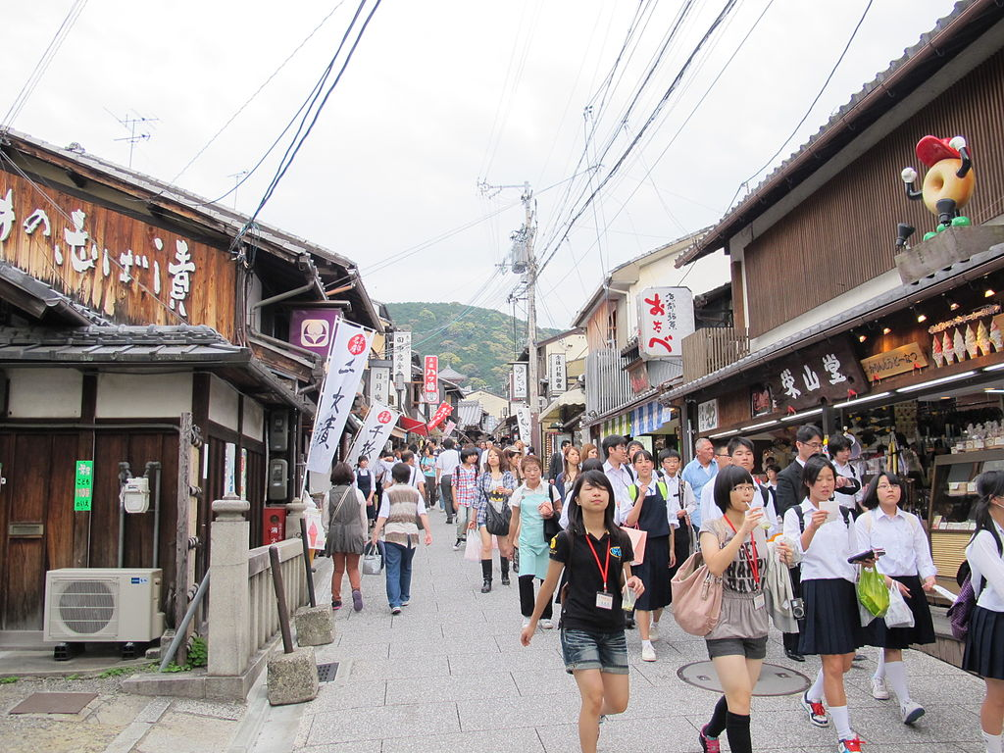
Tourists on street near Kiyomizu-dera

Slide 42
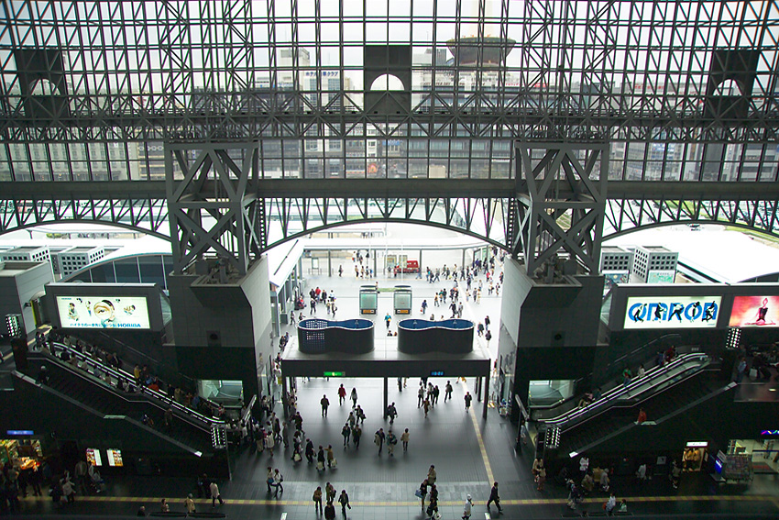
Inside Kyoto Station

Slide 43
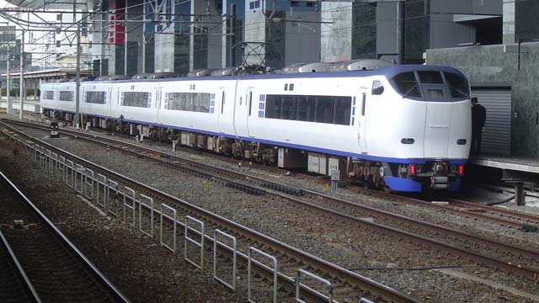
Kansai Airport express Haruka at Kyoto Station

Slide 44
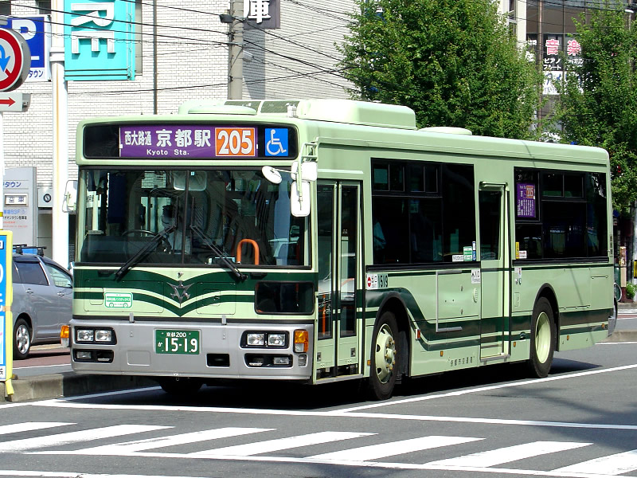
A typical Kyoto Municipal Bus

Slide 45
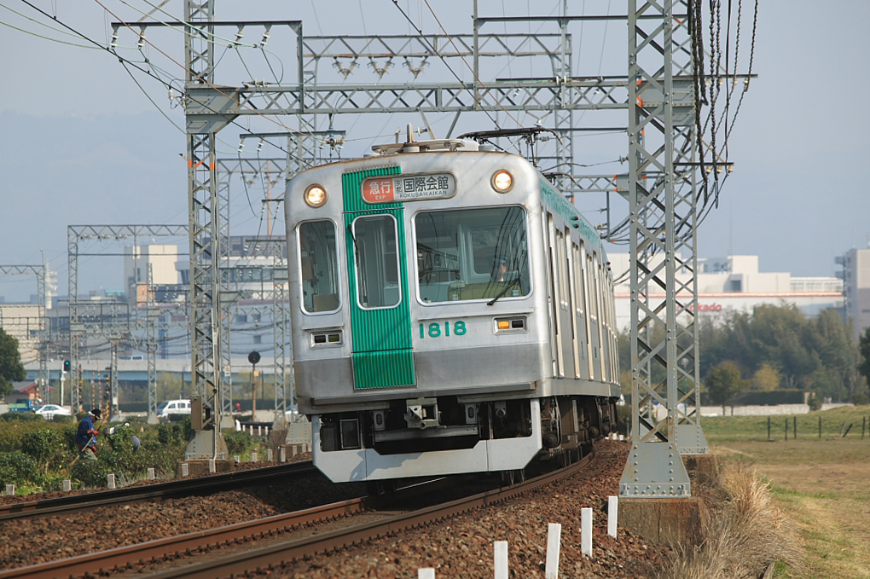
An express service bound for Kokusaikaikan Station

Slide 46
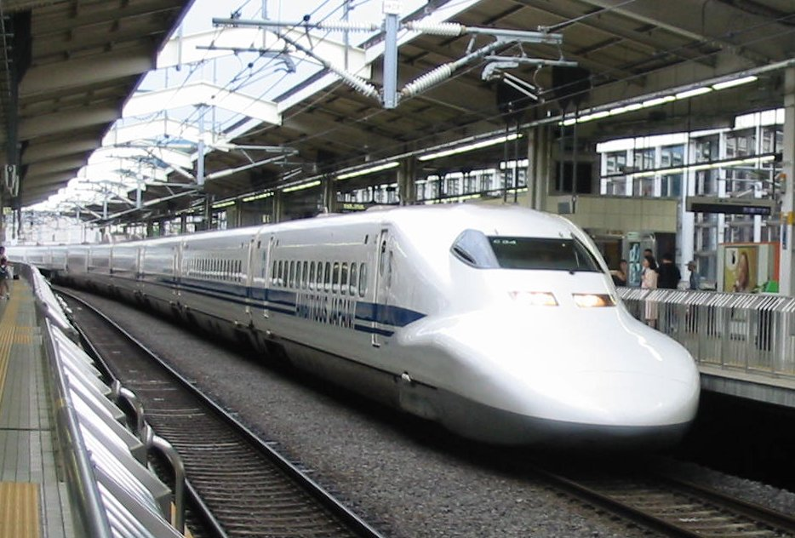
Shinkansen at Kyoto Station

Slide 47
Truly a treasure house for anyone studying traditional Japanese architecture

