Slide 1
CITIES

Slide 2
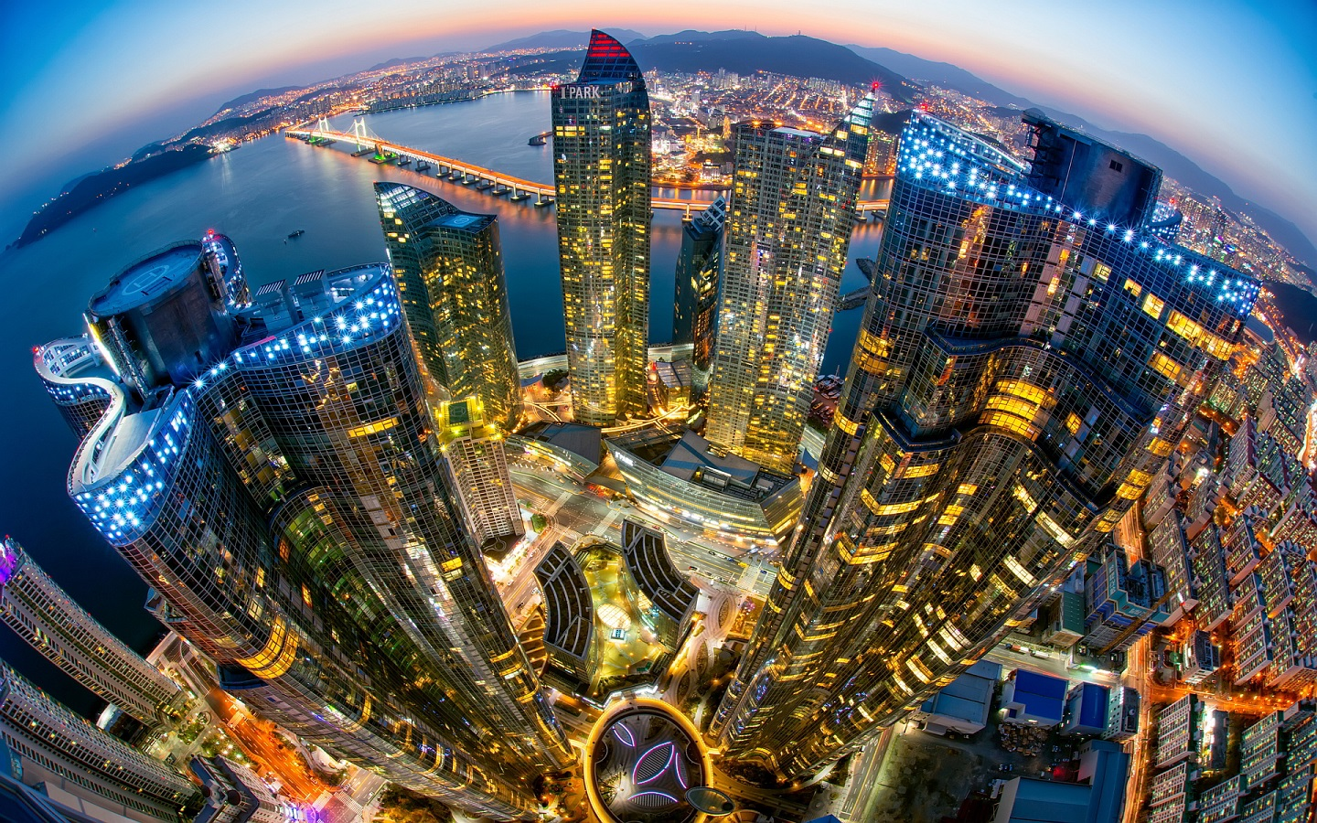
Seoul, South Korea

Slide 3
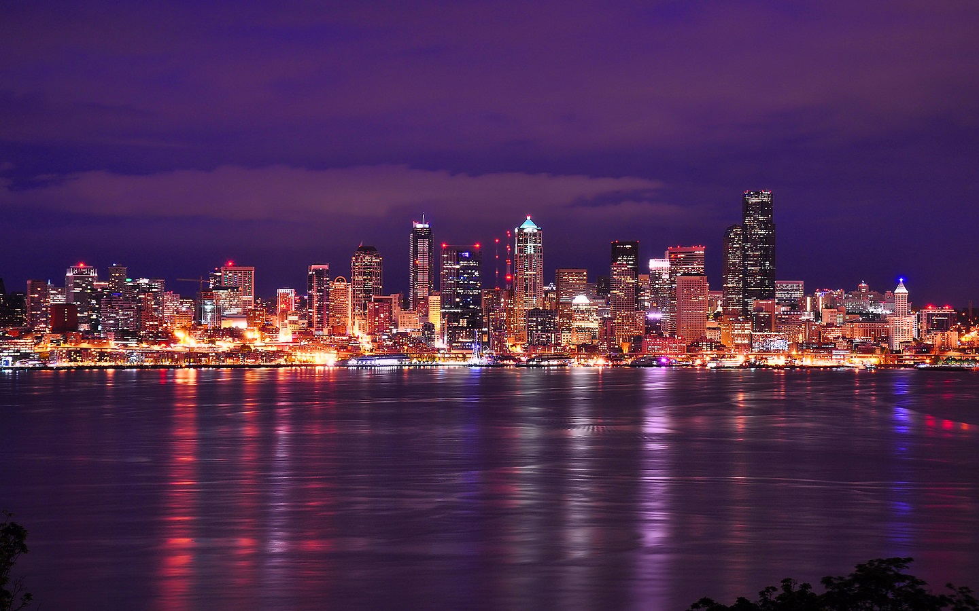
​Seattle - USA

Slide 4
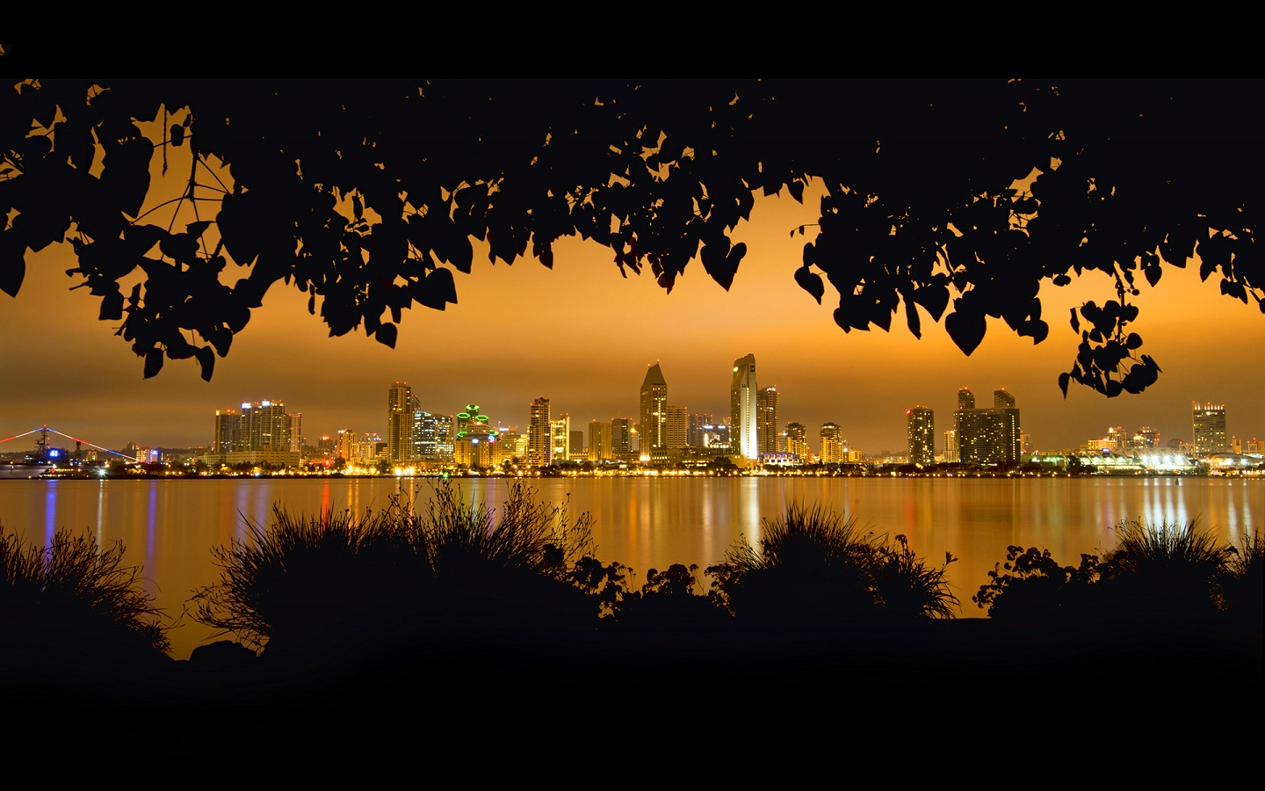
​San Diego - USA

Slide 5
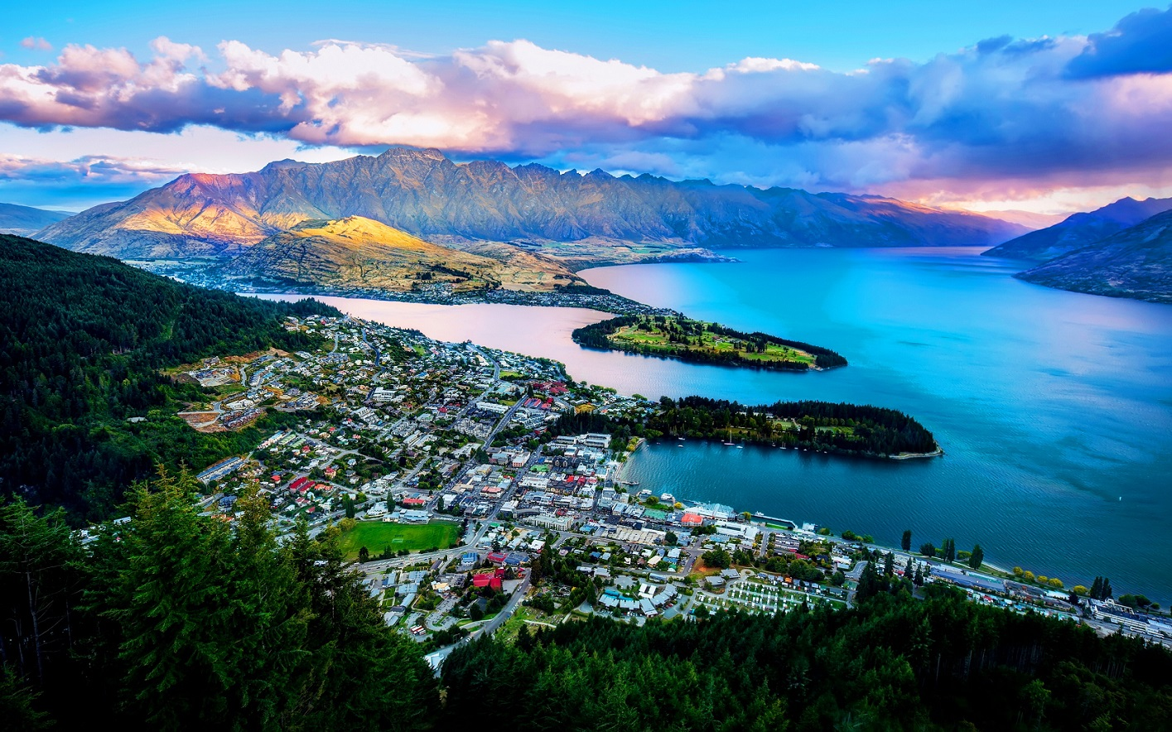
​Queenstown - Wakatipu lake - New Zealand

Slide 6
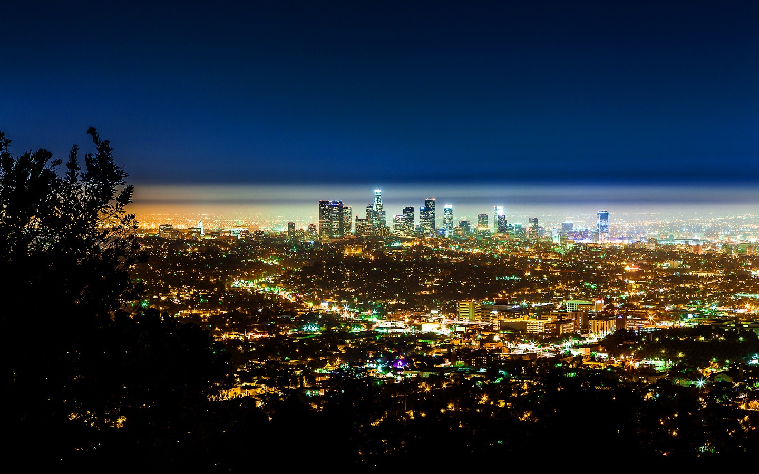
​Los Angeles - USA

Slide 7
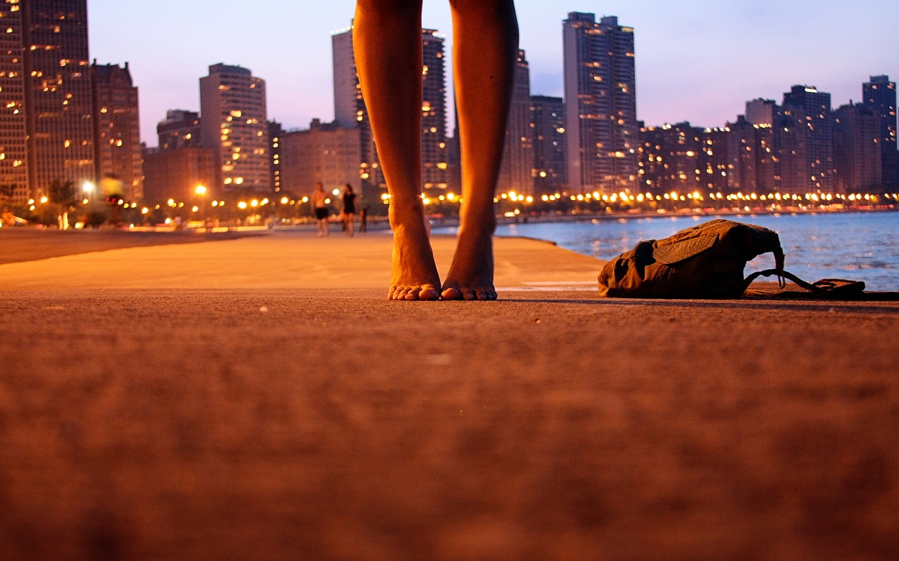
City shore​

Slide 8
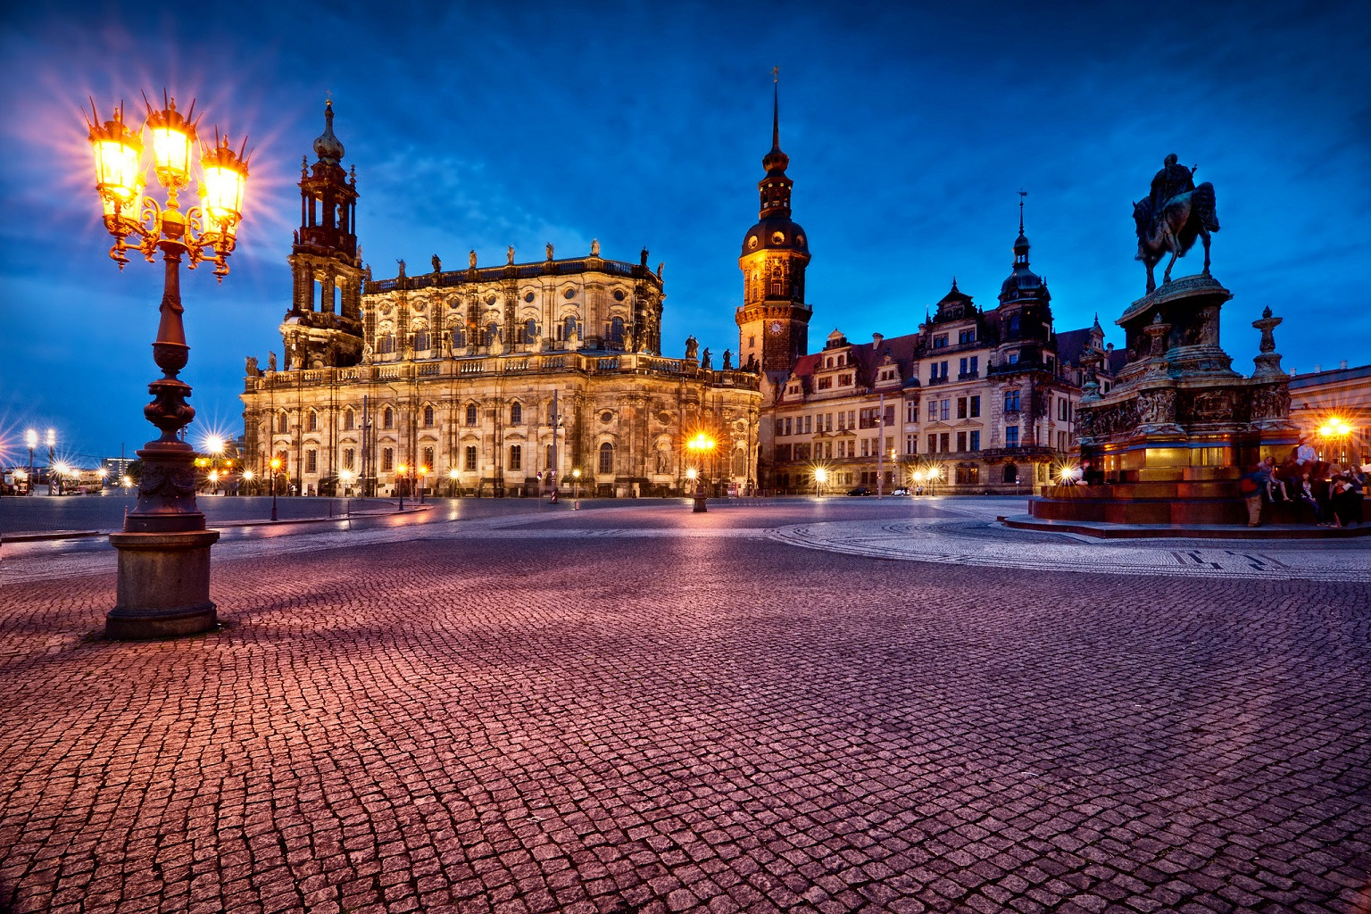
​Dresden - Germany

Slide 9
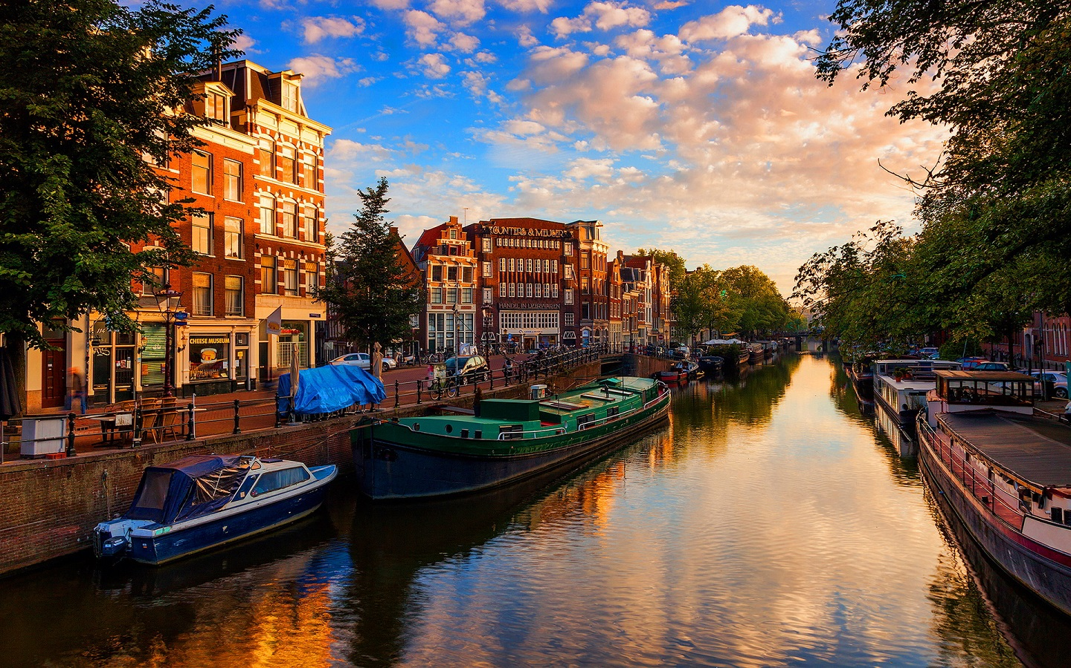
​Amsterdam - Netherlands

Slide 10
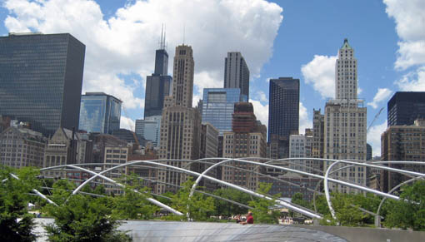
Chicago, USA

Slide 11
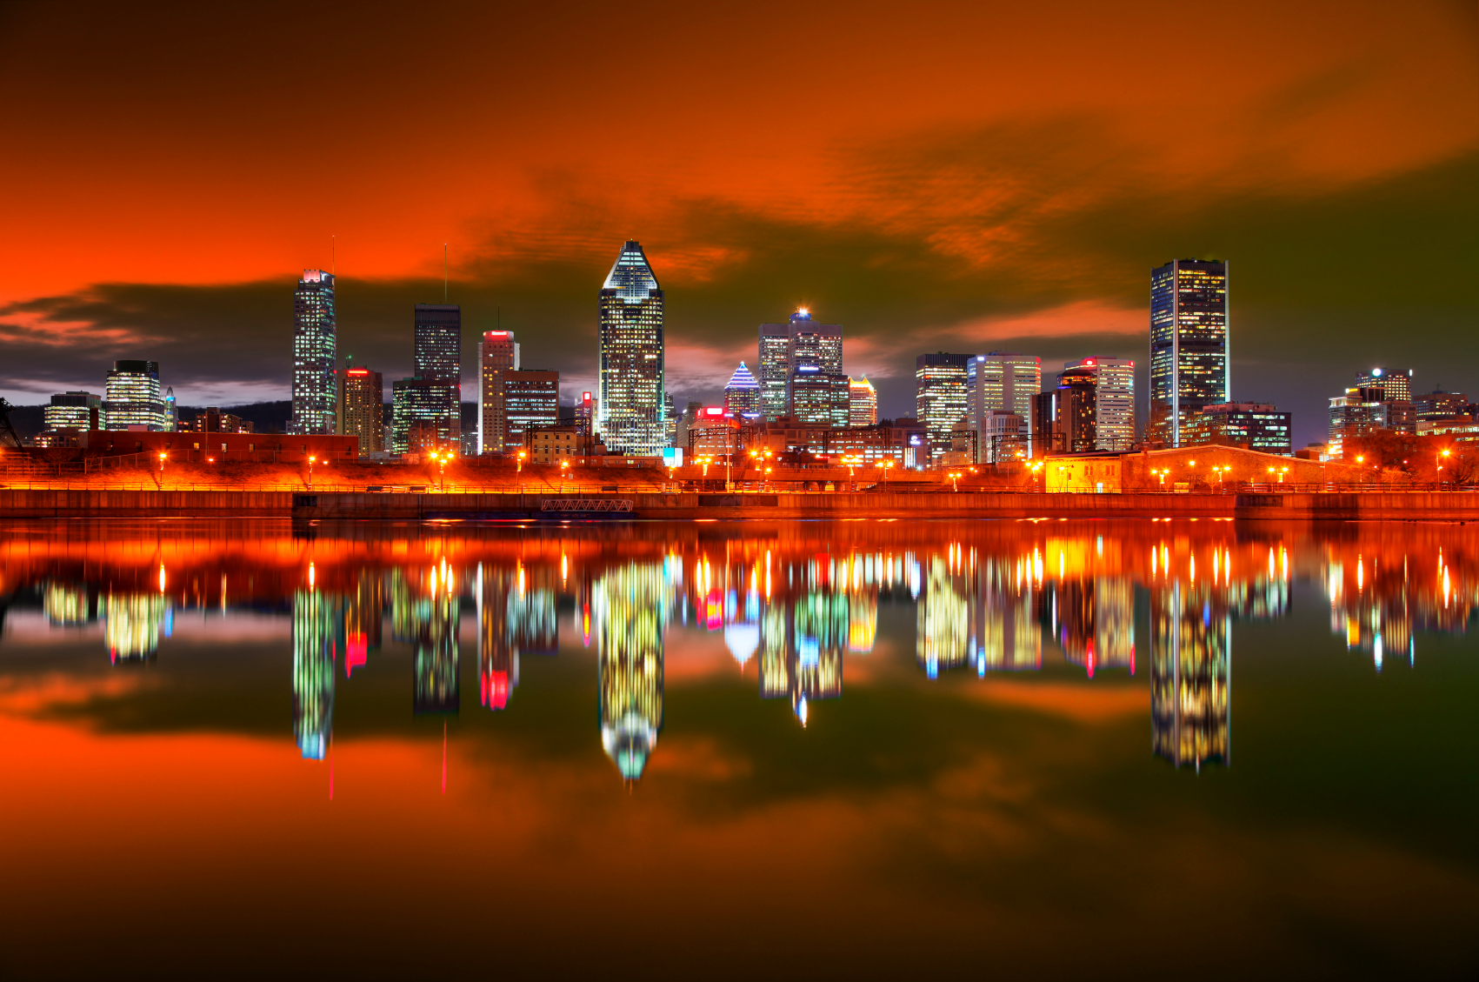
Montreal, Canada

Slide 12
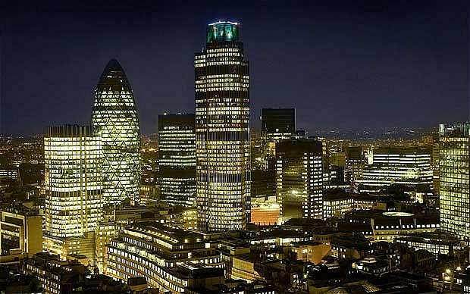
London, UK

Slide 13
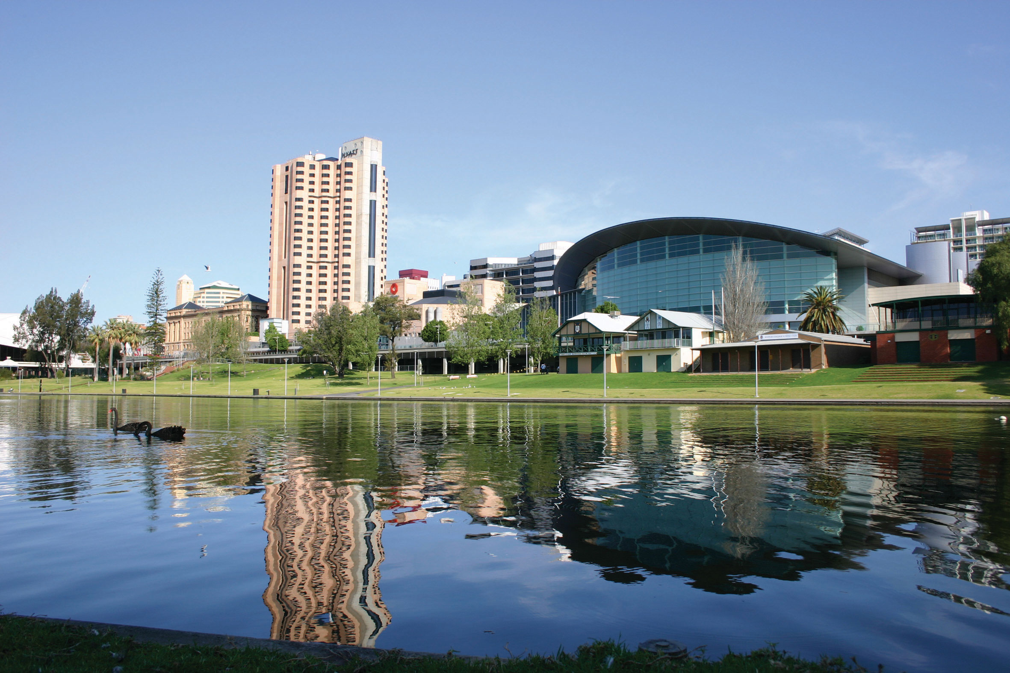
Adelaide, Australia

Slide 14
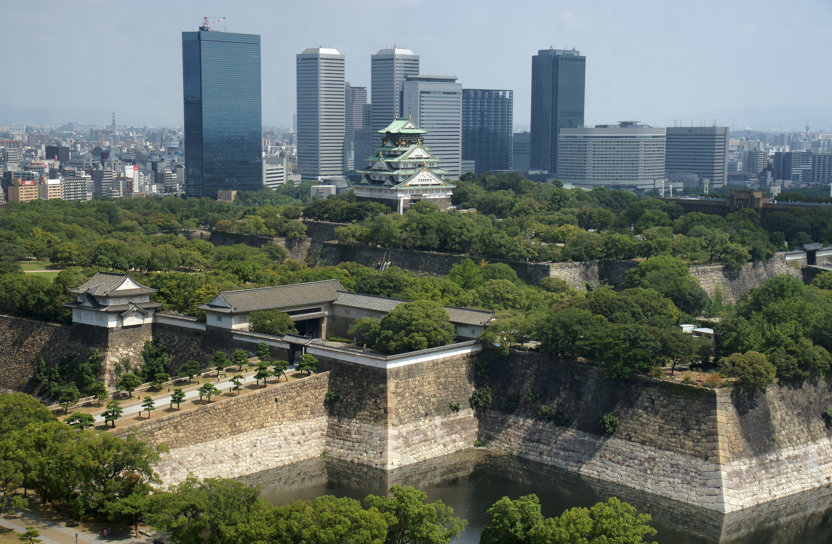
Osaka, Japan

Slide 15
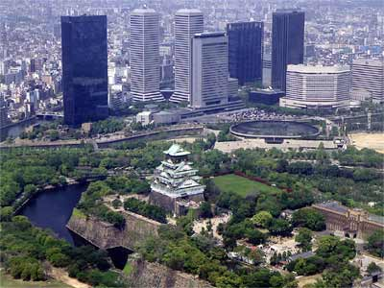
Kyoto, Japan

Slide 16
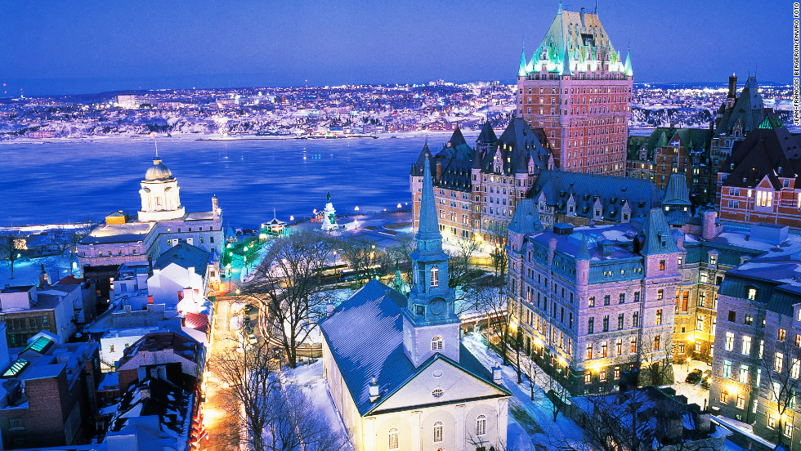
Quebec, Canada

Slide 17
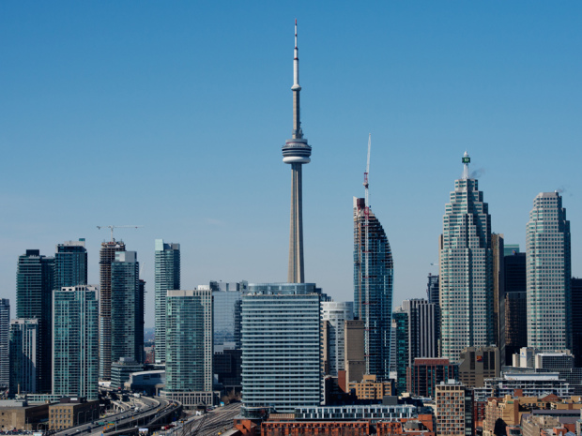
Toronto, Canada

Slide 18
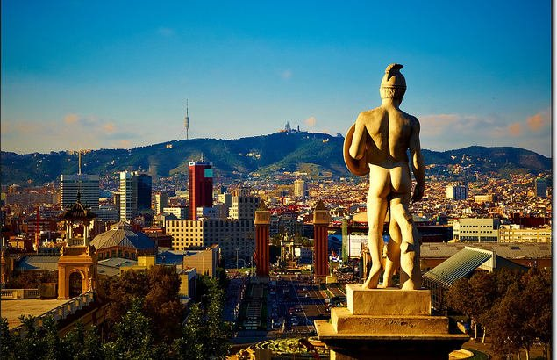
Barcelona, Spain

Slide 19
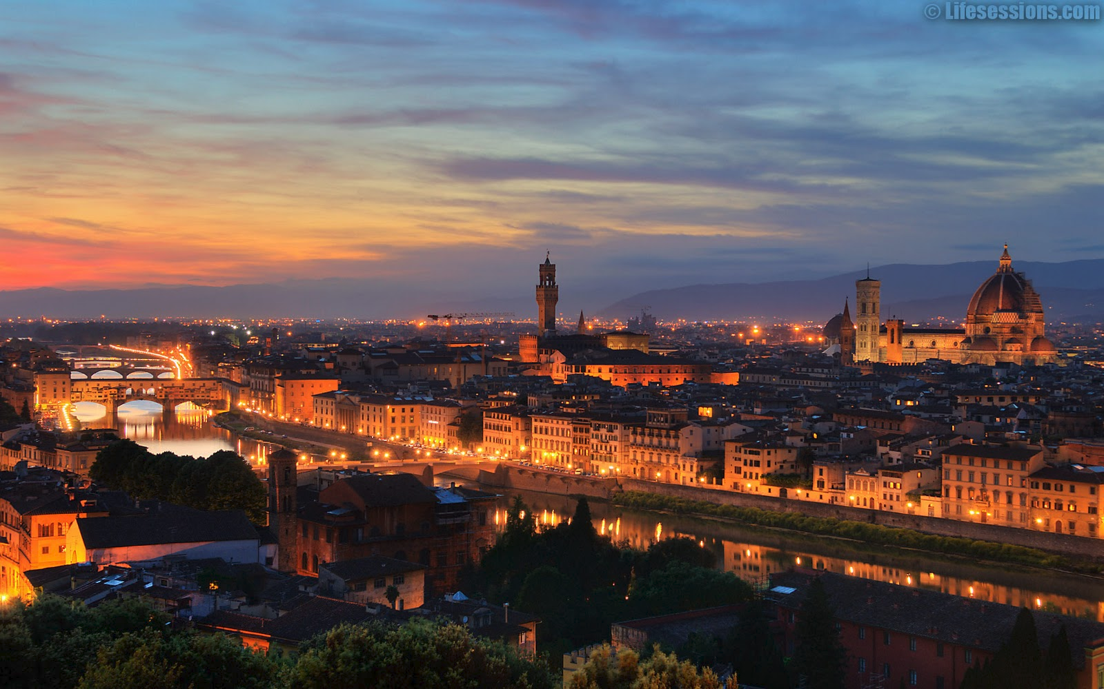
Florence, Italy

Slide 20
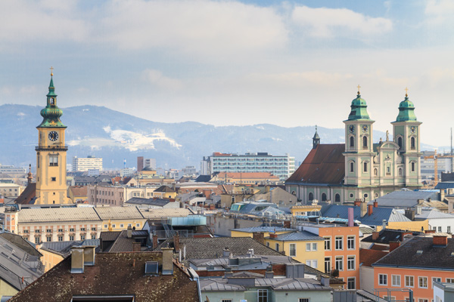
Linz, Austria

Slide 21
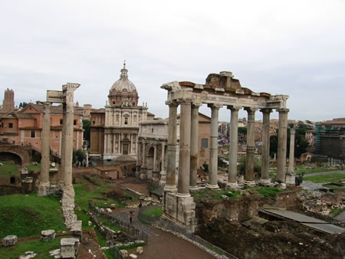
Rome, Italy

Slide 22
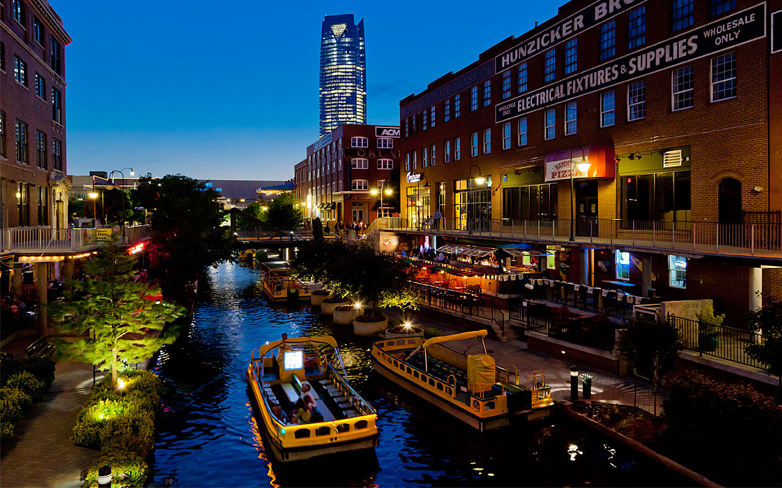
Oklahoma City, USA

Slide 23
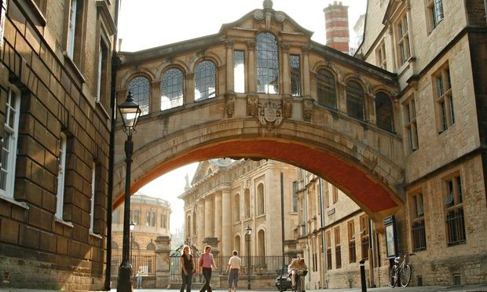
Oxford, UK

Slide 24
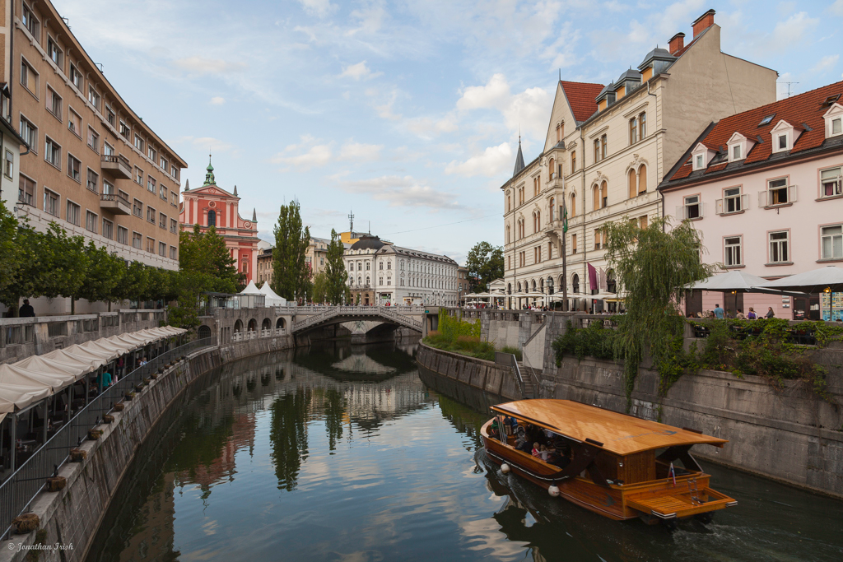
Ljubljana, Slovenia

Slide 25
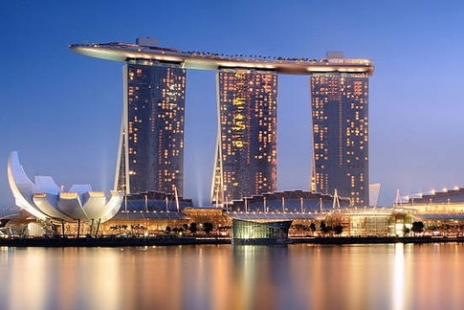
Singapore

Slide 26
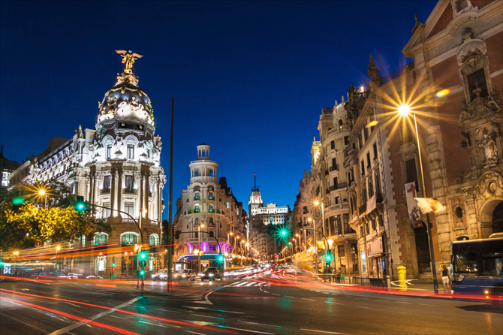
Madrid, Spain

Slide 27
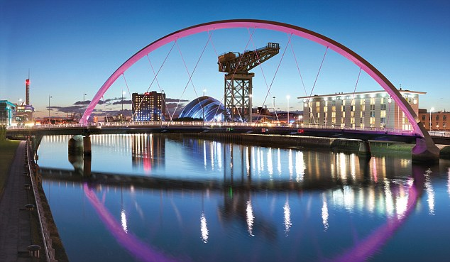
Glasgow, UK

Slide 28
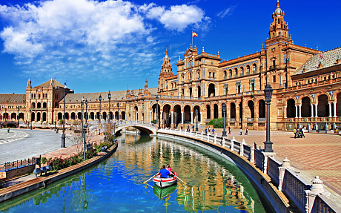
Seville, Spain

Slide 29
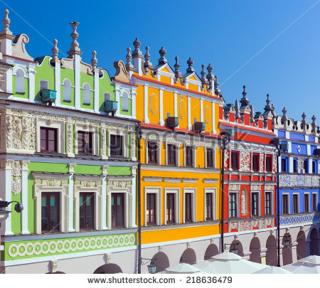
Warsaw, Poland

Slide 30
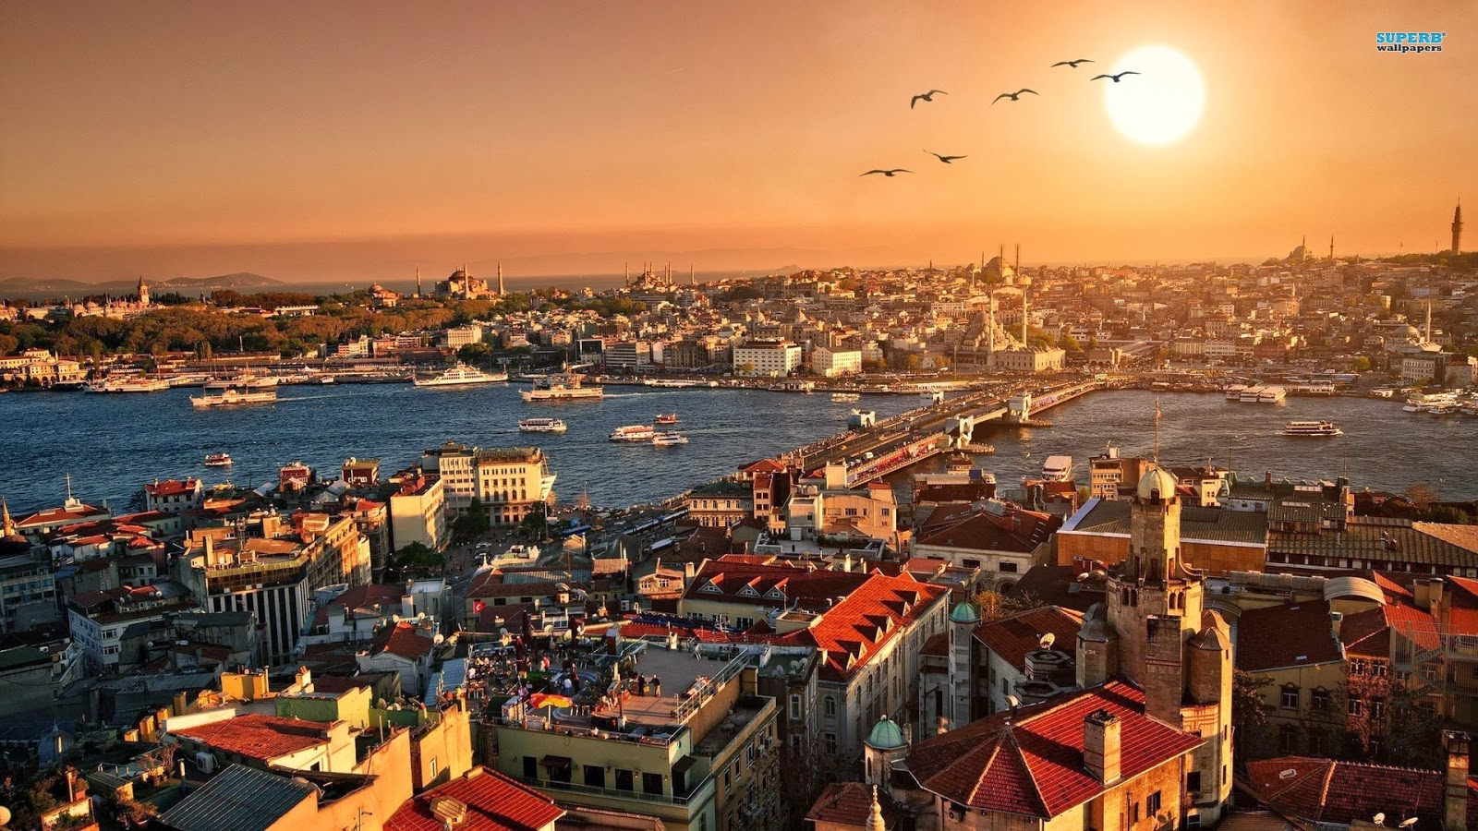
Istanbul, Turkey

Slide 31
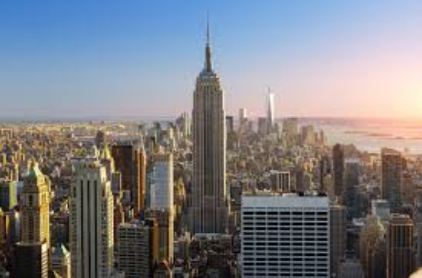
New York, USA

