Slide 1
15 Of The Most Unfriendly Cities In The World

Slide 2
Readers of Travel + Leisure were asked to rate 266 world cities on a range of factors, including the friendliness of local people.
The results show that even cities that are best known for their cultural attractions and amazing foods are still lacking when it comes to welcoming tourists with open arms.

Slide 3
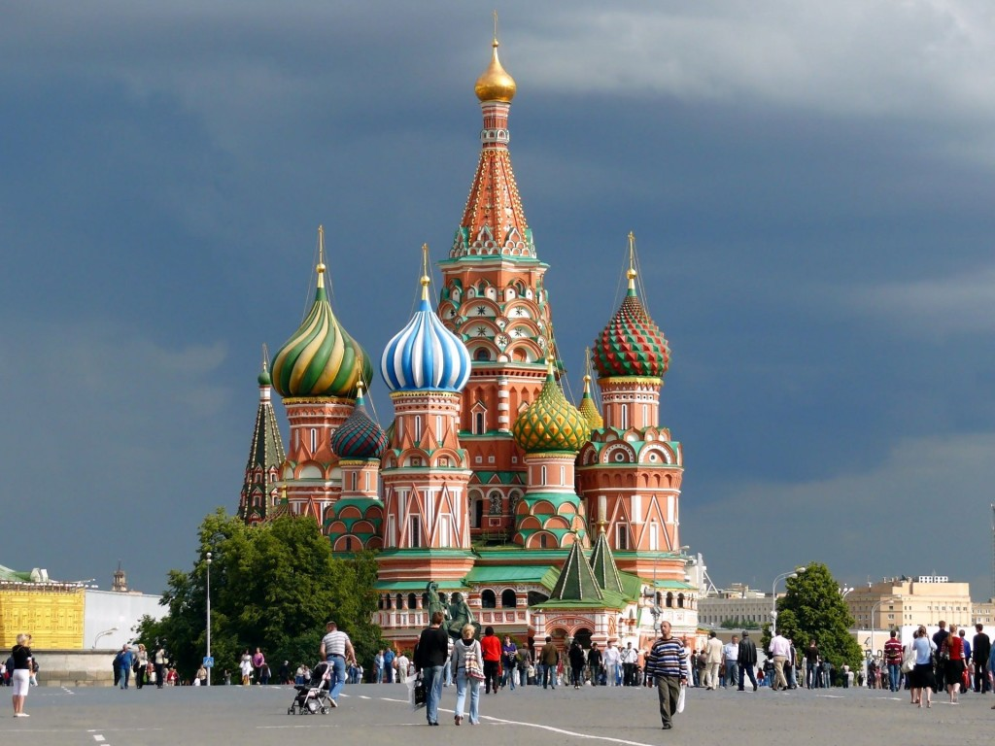
1) Moscow, Russia

Slide 4
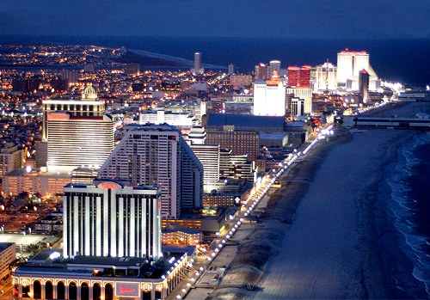
2) Atlantic City, New Jersey, USA

Slide 5
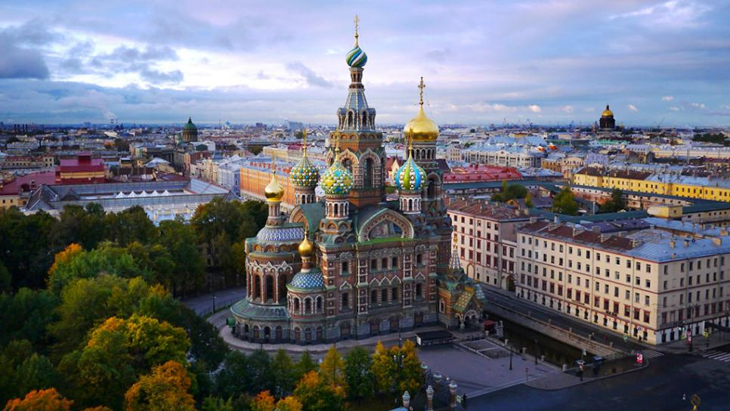
3) St Petersburg, Russia

Slide 6
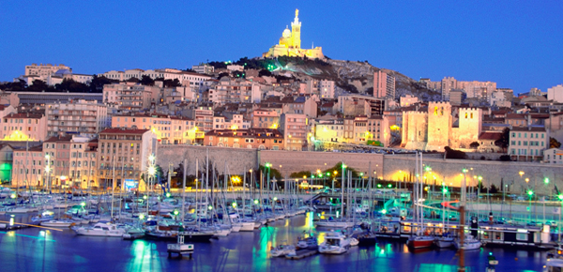
4) Marseille, France

Slide 7
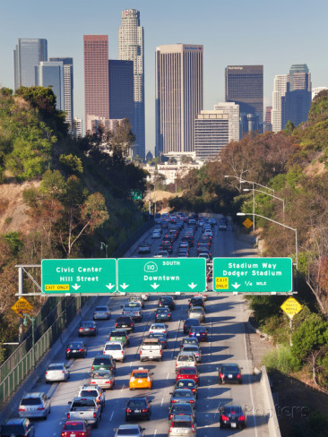
5) Los Angeles, California, USA

Slide 8
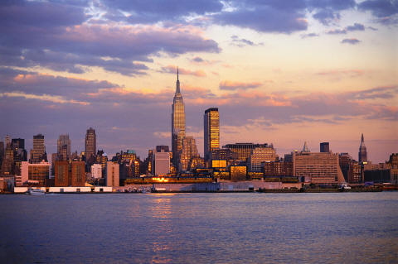
6) New York, New York, USA

Slide 9
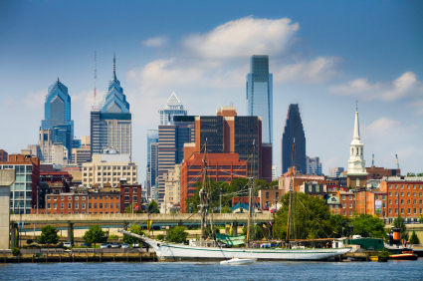
7) Philadelphia, Pennsylvania, USA

Slide 10
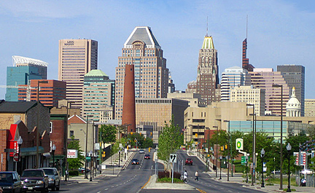
8) Baltimore, Maryland, USA

Slide 11

9) Las Vegas, Nevada, USA

Slide 12

10) Cannes, France

Slide 13
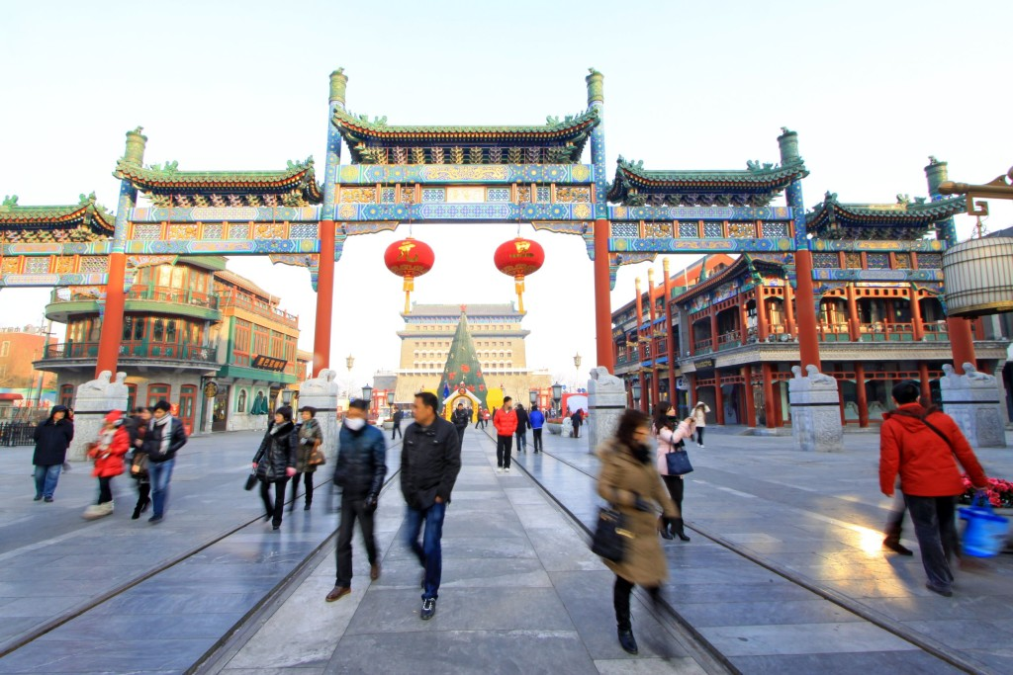
11) Beijing, China

Slide 14
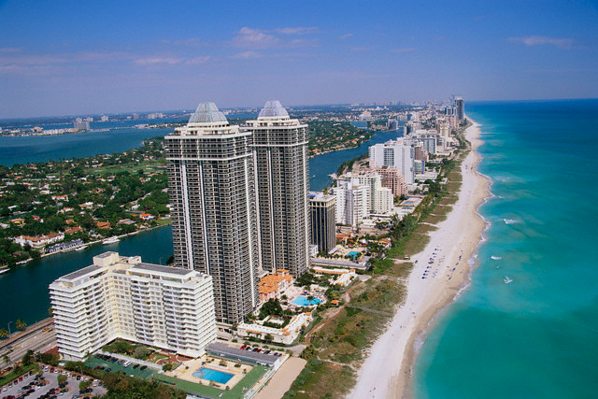
12) Miami, Florida, USA

Slide 15
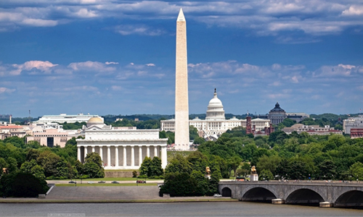
13) Washington D.C., USA

Slide 16
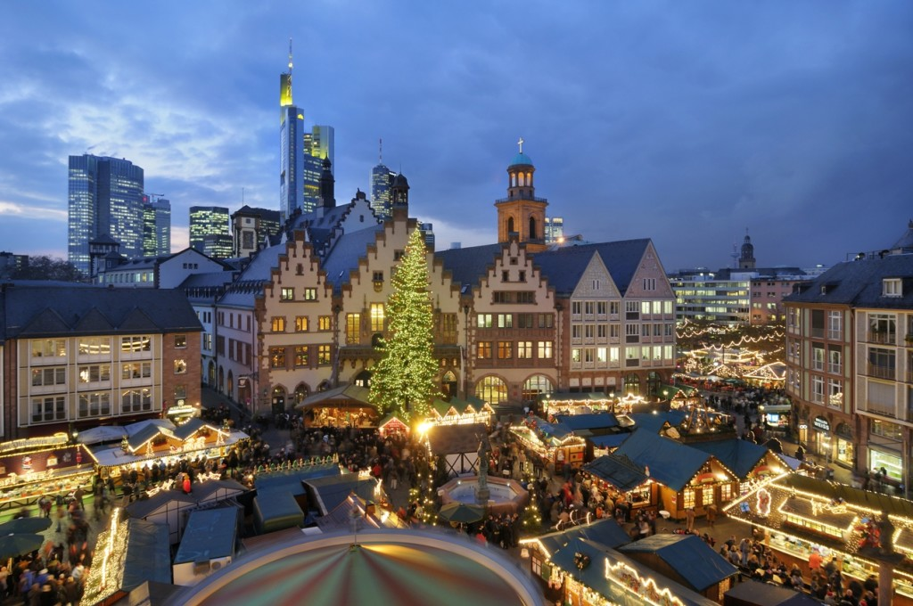
14) Frankfurt, Germany

Slide 17
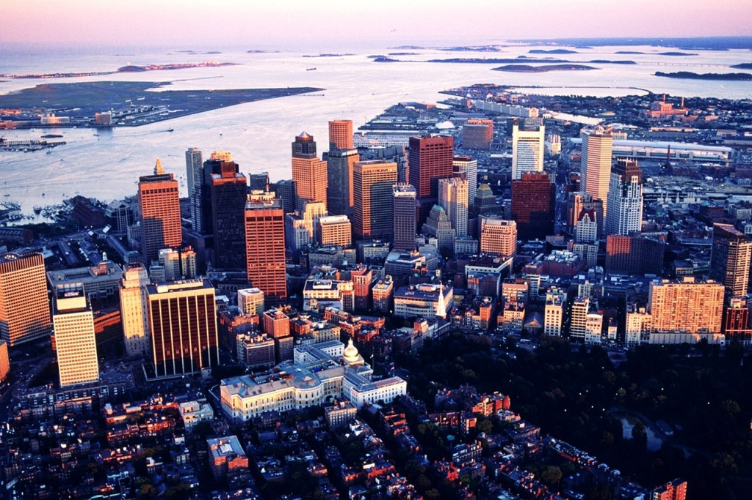
15) Boston, Massachusetts, USA

