Slide 1
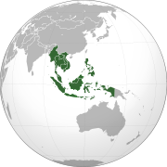
Atlas of Southeast Asia

Slide 2
Current configuration

Slide 3
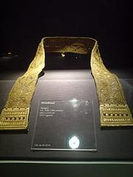
History
A golden vestment similar to those worn by the Hindu Brahmin Caste.
1st Century AD – traders from India and China were vying for a foothold in the region, drawn there by its rich abundance of minerals, spices, and forest products.
For the next 13th or 14th centuries – India’s influence dominated, except in what is now Vietnam.
Although there is some small Indian influence seen in the cuisine, China maintained a political foothold in Vietnam for a thousand years.
Notes:
This artifact shows the influence of Indian culture in Southeast Asia, also through trade. Found in Butuan, Philippines.
=Even after it lost control over the area during the 900s , Chinese migrants and merchants continued to make a strong impact on the region.

Slide 4
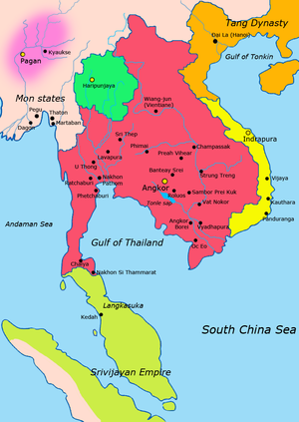
900 CE

Slide 5
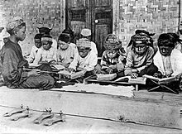
History
Throughout this long period, local kingdoms, such as Khmer empire, rose and fell, but the peoples of the region were never unified culturally.
In the late 15th century Islamic
influences grew strong but were
overshadowed by the arrival of
Europeans, who established their
power throughout Southeast Asia.
Only Thailand remained free of colonial occupation.
Notes:
Even today, ung war sa bawat region at yung legacy of distrust among groups andun pa rin.

Slide 6
Imperialist Colonial Period

Slide 8
History
Southeast Asia became the scene of battles between Allied and Japanese forces during World War II.
Since the war of the countries of Southeast Asia have reemerged as independent nations. They have been plagued by political turmoil, weak economies, ethnic strife, and social inequities, although the situation for most Southeast Asian nations improved in the 1980’s and 1990’s.
Notes:
=Ito ay naging scene of battle dahil sa Southeast Asia’s strategic location between Japan and India and dahil sa importance ng shipping routes that traverse dun lugar.

Slide 9
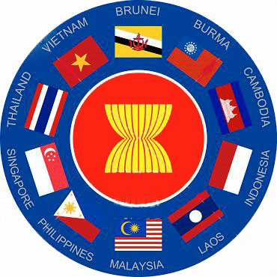
History
Throughout the 1960’s and early 1970’s,however, there were open conflicts between communist and non-Communist factions, especially in Vietnam, Laos, and Cambodia. At one point, the U.S. had 500,000 troops in South Vietnam.
1967 – Indonesia, Malaysia, Philippines, Singapore, and Thailand created the Association of Southeast Asian Nations (ASEAN).
Since then Brunei, Vietnam, Laos, Myanmar and Cambodia have joined ASEAN.

Slide 10
Tet Offensive This was a surprise setback for the U.S. and South Vietnamese forces.

Slide 11
History
1997 – A monetary collapse in Thailand sparked a general economic crisis in several nations in the region; the results were most severe in Indonesia, which underwent economic, political, and social turmoil in the late1990’s.
Religions, ethnicity, and language are diverse throughout Southeast Asia. There are dozens of religions, including Buddhism, Confucianism, Hinduism, Islam, and Roman Catholicism. Hundreds of languages are spoken throughout.

Slide 12
Singapore

Slide 14
Tectonic Plate Boundaries

Slide 16
Petroleum
Natural Gas
Minor Basins

Slide 18
Zone of Conflicting Claims: the South China Sea
China, the Philippines, and Vietnam have overlapping claims to parts of the South China Sea. It is believed that large oil deposits may be found beneath the ocean floor. China has constructed artificial islands in the South China Sea and claimed control of the surrounding waters. In 2015, the U.S. navy has sent ships through the waters claimed by China because the U.S. does not recognize Chinese sovereignty over those waters. China has protested those actions.

Slide 21
Coral Reefs: Very important in the ocean ecosystem.

Slide 22
Mineral Resources

Slide 23
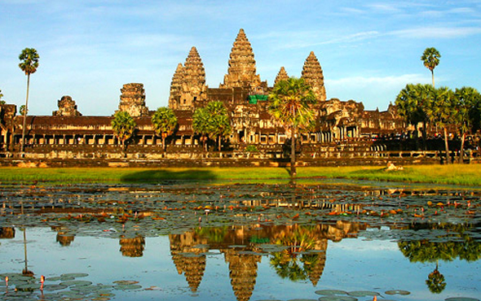
Southeast Asian Cultures

Slide 24
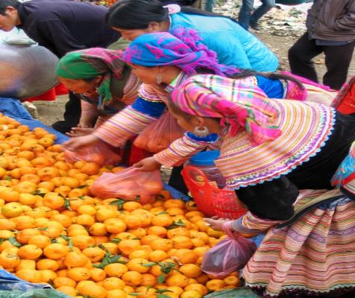
The People
Southeast Asia is one of the world’s great melting pots.
Its diverse peoples moved into the region in search of a better life and greater security.

Slide 25
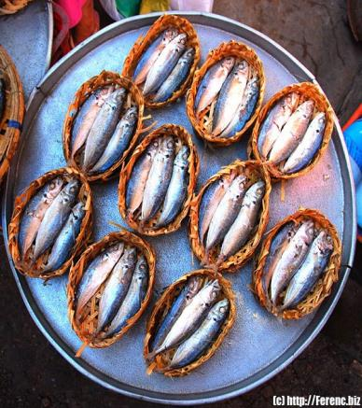
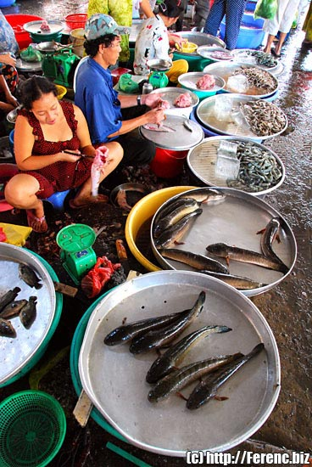
More than three-quarters of Southeast Asia population is agriculture-based.
Much fish is consumed in this region, reflecting the long coastlines and river environments of Southeast Asia.

Slide 29
The staple food throughout the region is RICE, which has been cultivated for thousands of years.

Slide 30
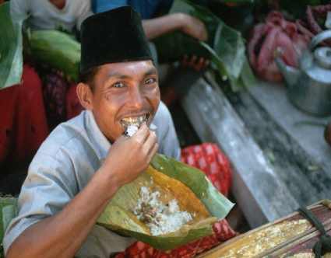
In Asia, there are different styles of eating food. In India and the Middle East, as well as Southeast Asia, people typically eat with their hands.
It is a very direct way to experience the texture of the food, and people wash their hands before and after each meal.

Slide 31
Normally, only the right hand is used, so that one knows to keep it especially clean.
Generally, the foods to be eaten are placed on plates in the center of the mat or table, and people take food in small portions as they eat.
The exception to this pattern is Vietnam, where the influence of China was much stronger than anywhere else in Southeast Asia.

Slide 32
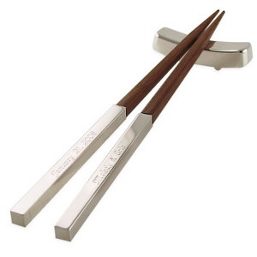
Chopsticks are the utensils of choice, and food is served onto individual plates or into individual bowls.

Slide 33
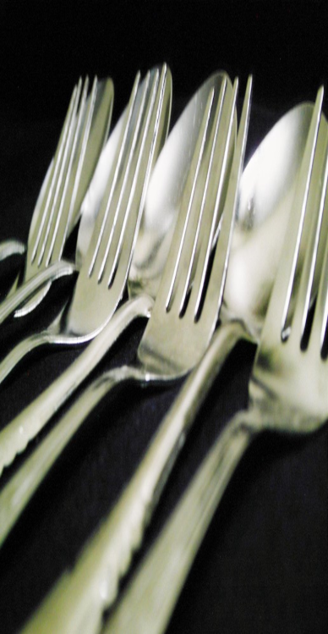
Today, the influence of Western cultures is found not only in the use of tables and chairs in many modern Southeast Asian households, but also in the use of SPOONS and FORKS.

Slide 34
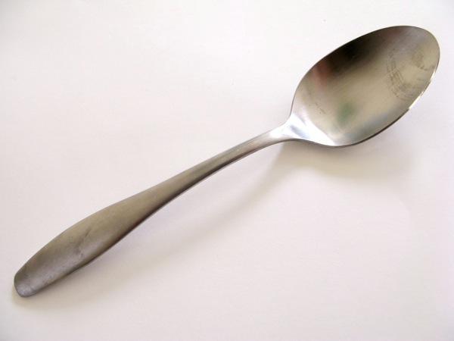
Knives are not necessary, since meat and vegetables are chopped into smaller portions before cooking or serving.
A large spoon is held in the right hand, while the left hand is used to scoop food into the spoon.

Slide 35
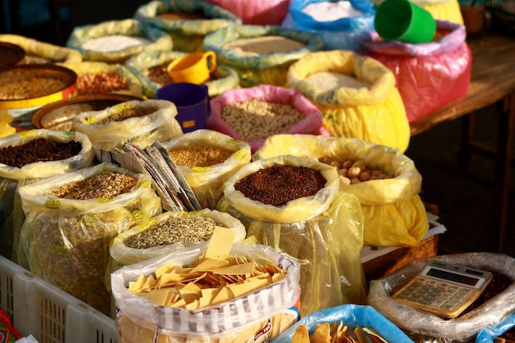
The Food
The rich culture of South East Asia lies at the tastiest food in the world and once known as the
“land of the spices”
the food of the Thais, Filipinos, Vietnamese, and Indonesians are among the most famous exotic creations.
Much of the identity of South East Asia lies on the different food that come from unique, yet common backgrounds following the influences of Indian, Chinese, and the European colonizers along with the local flavor.

Slide 36
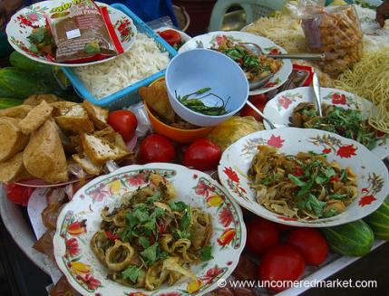
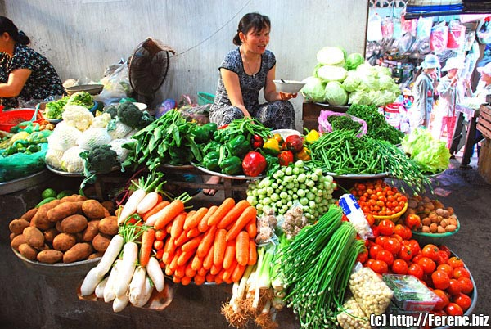
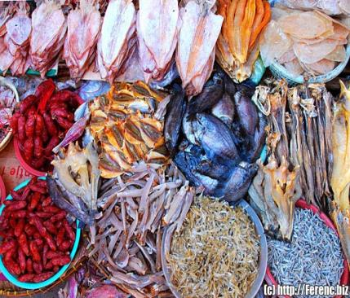
The Food
Popular meals in Southeast Asia consists of:
rice
fish
vegetables
fruits
spices

Slide 37
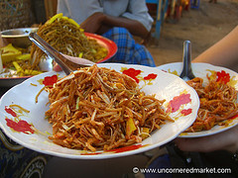
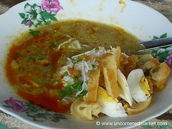
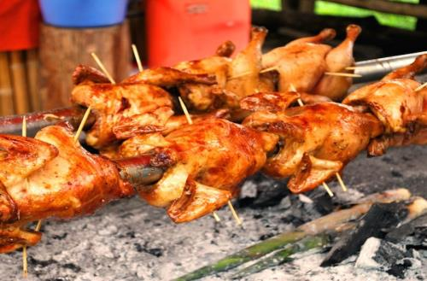
The Food
Popular Products:
Curry
Satay (spiced or marinated meat on a stick that is barbequed)
Sour fish soup
Noodles
Soy products

Slide 38
The Food
Common flavorings:
Ginger
Pepper
Chile pepper
Onions
Garlic
Soy sauce
Fish sauce
Fermented fish paste
Turmeric
Candlenut
Lemongrass
Cloves
Nutmeg
cinnamon
Tamarind and lime

Slide 39
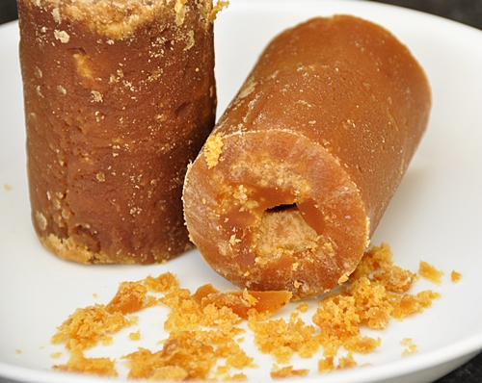
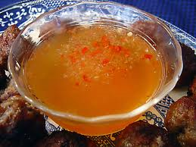
The Food
Coconut milk is often used to bind sharp flavors.
Palm sugar is used to balance the spices
Fish sauce is used in almost all Southeast Asian curries as well as in various forms of cooking fish and pork.
Unique combinations of sweet and sour, hot and sour, or hot and sweet are common in various regions.

Slide 40
The Food
Popular vegetables are:
Sweet potatoes
maize
Taro
Tapioca
Legumes
Blossoms
Leaves of many green plants
Popular Fruits are:
Pineapple
Coconut
Star fruit
Jackfruit
Papaya
Bananas
Rambutan
Mangosteen
durian

Slide 41
The Food
Tea and coffee are abundant throughout the region, although the popular drink with a meal is water.

Slide 46
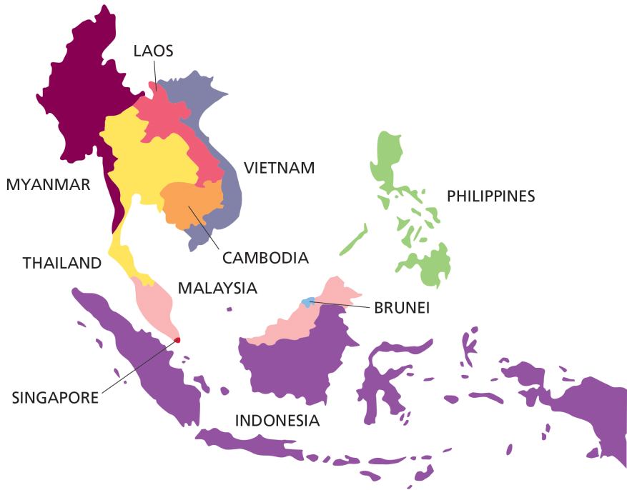
Individual Countries

Slide 47
Indonesia
4th most populous nation in the world.
A population that is 90 percent Muslim, with hundreds of tribes, subcultures, and languages.
Language- Bahasa Indonesia
Capital- Jakarta
Religion
Islam

Slide 49
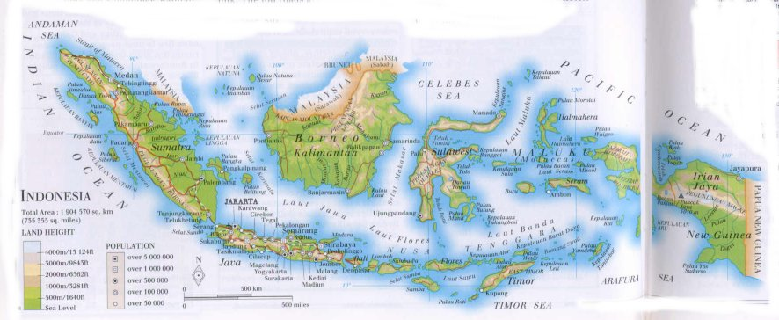

Slide 51
Population Density

Slide 53
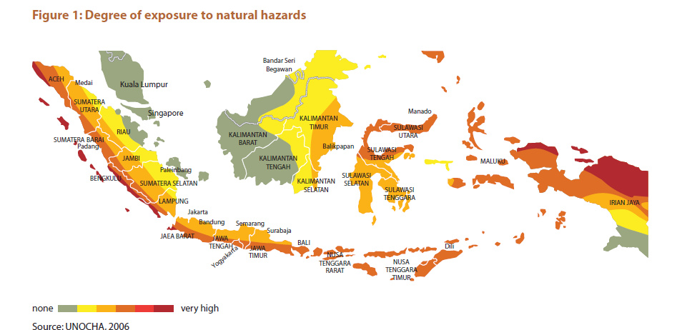

Slide 55
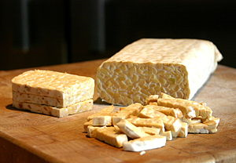
Indonesia
Satay – a piece of grilled meat, poultry, or seafood served with spicy peanut sauce and an Indonesia’s best-known dish.
One of the region’s most unique foods is the vegetarian tempeh or tempe- made from soybeans and was oroginally produced to be a food similar to China’s tofu.

Slide 56
Population Transmigration Policy
The transmigration program was an initiative of the Dutch colonial government, and later continued by Indonesian government to move landless people from densely populated areas of Indonesia to less populous areas of the country. This involved moving people permanently from the island of Java, but also to a lesser extent from Bali and Madura, to less densely populated areas including Papua (ended in 2015 by president Joko Widodo), Kalimantan, Sumatra, and Sulawesi. The stated purpose of this program was to reduce the considerable poverty and overpopulation on Java, to provide opportunities for hard-working poor people, and to provide a workforce to better utilize the natural resources of the outer islands. The program, however, has been controversial as fears from native populations of "Javanization" and "Islamization" have strengthened separatist movements and communal violence.

Slide 58
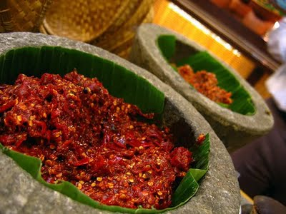
Indonesia
Gado-gado – a dish of mixed vegetables and salad with both tofu and tempeh, topped with a spicy peanut sauce, is one of the typical ways in which it is used.
Sambal- a spicy sauce made from chiles, shrimp paste, and tomatoes, is available everywhere and is eaten with main dishes and snacks.

Slide 59
Dining Etiquette
Wait to be shown to your place - as a guest you will have a specific position.
Food is often taken from a shared dish in the middle. You will be served the food and it would not be considered rude if you helped yourself after that.
If food is served buffet style then the guest is generally asked to help themselves first. It is considered polite that the guest insist others go before him/her but this would never happen.
In formal situations, men are served before women.
Wait to be invited to eat before you start.
A fork and spoon are often the only utensils at the place setting. Depending on the situation some people may use their hands.
Eat or pass food with your right hand only.

Slide 60
Malaysia
Malaysia has been influenced by Chinese, Indian, and Arabic roots.
Language- Malay
Capital- Kuala Lumpur
Religion
Islam

Slide 63
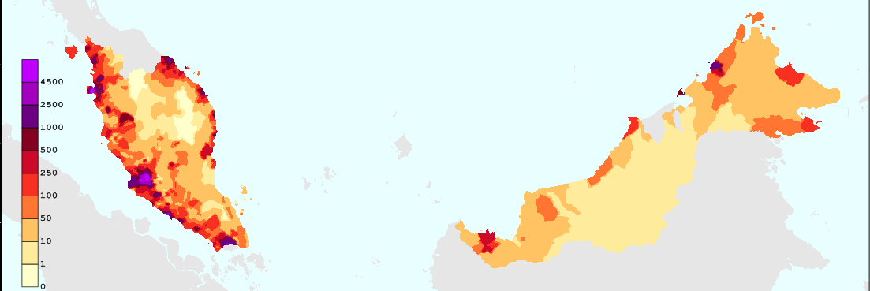
Population Density

Slide 68
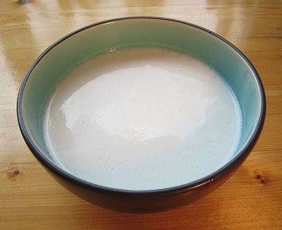
Malaysia
Majority of Malays are Muslims who consume rice, but not pork or alcohol.
However, similar to its Thai neighbors in the north, Malay cooking extensively uses chile peppers and thick coconut milk.

Slide 69
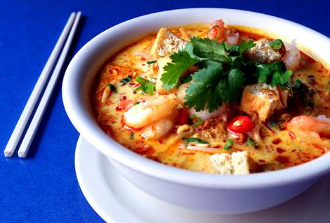
Malaysia
East Asian spices contribute flavor to many of the sauces.
Malaysian dishes are typically seasoned with curry, shallots, garlic, shrimp paste, tamarind, lemongrass, or coconut milk.

Slide 70
Dining Etiquette
Each grain of rice is sacred, you must clean your place. Hence, you only scoop enough rice for your own consumption and not too much.
Do not chew and talk at the same time. Take each morsel in small bites and do not swallow in big bites.
If there were two guests suddenly reaching out for the same dish, the elder would be given the honor to go first.
If you tasted something and did not like it, do not place it back in the communal dish. Put it aside your own plate.

Slide 71
Bones, shells and inedible residue may be placed on a special platter provided. Failing which, you put on the side of your plate.
Food cannot be placed on its own on the floor as a sign of respect for the provision that God provides. Also, you must never point at the food (or anyone) using your foot.
Even though the drinks are offered simultaneously, it is better to drink only after you clean your plate.
Burping or belching is okay for men (they must cover their mouths while doing so) but farting is a big no-no.
You may arrive between fifteen to thirty minutes ahead. It is nice to bring an extra dish as a contribution to the feast (like a potluck party). You must also ensure that the food you bring is halal.

Slide 72
Singapore
Cooking- known as Straits Chinese, Baba, or Peranakan cuisine, or Nonya cooking – is a mixture of Chinese and Malay traditions.
Language-Chinese Malay
Capital-Singapore City
Religion
Buddhism

Slide 77
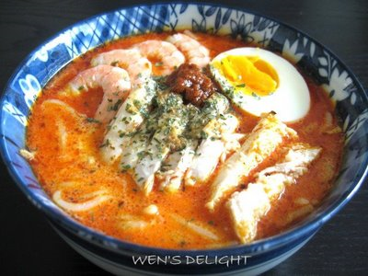
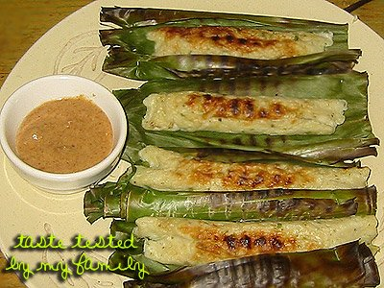
Singapore
Nonya cooking tends to be spicier and tangier than Chinese food but, unlike indigenous Malay cuisines, features the use of pork and noodles.
Laksa – the rich coconut soup-noodle dish, is one of the best-known Nonya dishes.
Otak otak – is mashed fish with coconut milk and chile, wrapped in banana leaf and grilled over coals.

Slide 78
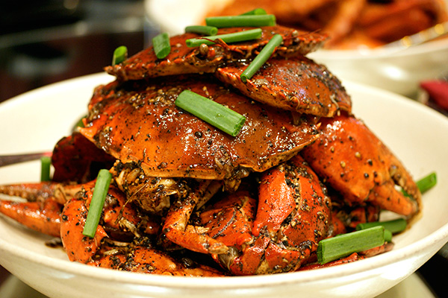
Singapore
Singapore is particularly famous for its crab dishes.
Chile crab features pieces of shellfish smothered in tangy chile and tomato sauce.
Black pepper crabs are seasoned in a thick black pepper and soy sauce.

Slide 79
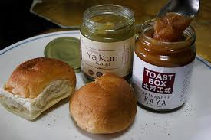
Singapore
The European influence can be seen in curry puffs (pastry parcels filled with curried potato and chicken or lamb),which are similar to England’s pastries.
Kaya – which is a sweet preserve most likely based on Europe’s imported jams, but made of coconut and egg. It is usually served with bread.

Slide 80
Dining Etiquette
1. Singaporeans don’t usually get appetizers or anything to drink.
2. Singaporeans have their meal set on the table along with all of their other dishes with food.
3. When you have finished eating your meal with any acquaintances, it would be polite in showing that you recognize their kindness by leaving some of your meal in the plate.

Slide 81
4. Apart from other Asian culture, in Singapore it is not favored to tip after the meal, which tries to impress other people around.
5. When at a social dinner it is inappropriate to share your food with anyone. Also the plate you have shouldn’t be touching the eating utensils.
6. It is kind and friendly for the host to get food from the main dishes available to everyone and put it in the guests’ dish.
7. Singaporeans eat with chopsticks. They specifically use the thin end of the chopsticks though. So when getting food from the big dish that is available to everyone they use the thick side of the chopsticks

Slide 82
Thailand
“ Land of Smiles”
Language-Thai
Capital- Bangkok
Religion
Buddhism

Slide 83
Thailand
Thailand can be broken into four regions :
The influences of neighboring Laos are reflected strongly in the northeastern region food,
With glutinous rice being the staple food,
Eaten both as a base for a meal and also as a dessert,
Steamed with coconut milk and black beans.

Slide 86
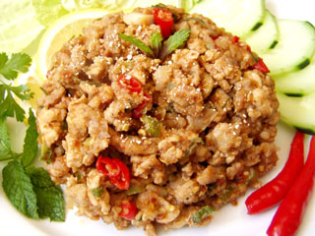
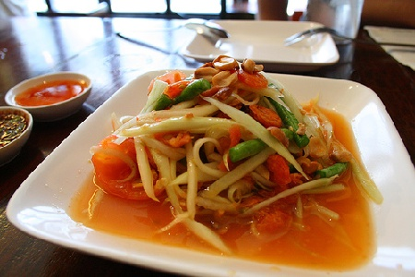
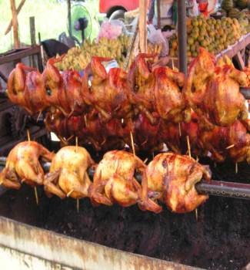
Thailand
Khanom Buang – popular regional dish, a thin crispy egg omelette stuffed with shrimp and bean sprouts.
Northeastern food is highly spiced, with regional specialties like lap, spicy minced meat or chicken
Som tam (papaya salad) and kai yang (barbequed chicken).

Slide 87
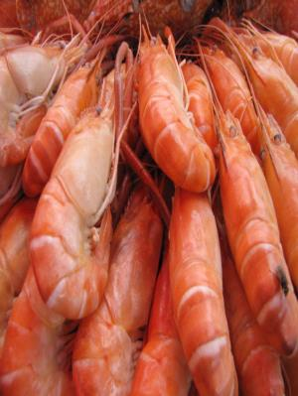
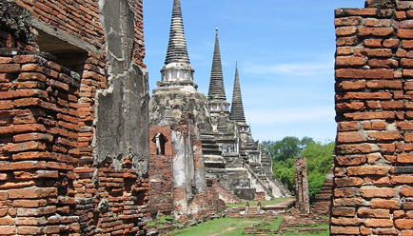
Thailand
Freshwater fish and shrimp are the main sources of protein in Northeastern dishes, as meat is a scarce commodity.
The central plains area is to be the cultural and economic heart of Thailand due to the fertility of the land.

Slide 88
Land Use

Slide 89
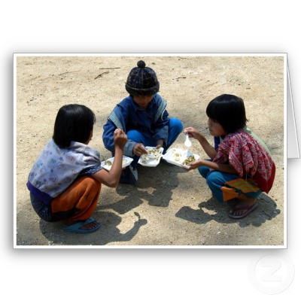
Thailand
Kin khao – Thai expression means “to eat” which literally translates as “to eat rice”
Traditional Thai cuisine
Rice
Fish
Vegetables flavored with garlic
Fish sauce
Black pepper
Abundance of fresh fruits

Slide 92
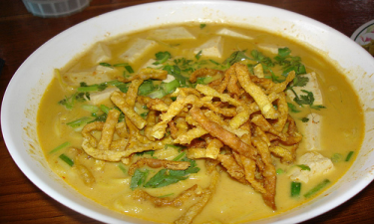
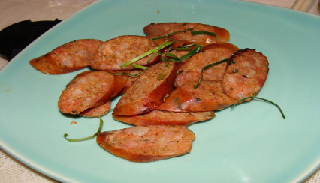
Thailand
Northern curries are generally milder than elsewhere in Thailand, with the influence of neighboring countries such as Myanmar evident in dishes such as:
Kaeng hang le – a pork curry with ginger, tamarind, and turmeric,
Khao soi – a curry broth with egg noodles.
Name – spicy pork sausage.

Slide 93
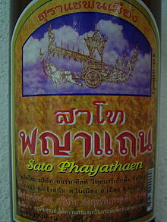
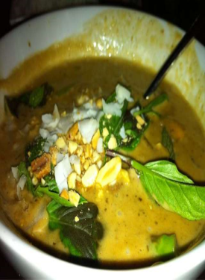
Thailand
Southern food is characterized by local produce.
Coconut has a prominent role in most dishes.
Sato – bitter flavor provided by the pungent flat bean.
Kaeng massaman – is a mild Indian-style curry with cardamom, cloves, and cinnamon

Slide 94
Dining Etiquette
A fork and spoon are the usual eating utensils. However, noodles are often eaten with chopsticks.
The spoon is held in the right hand and the fork in the left. The fork is used to guide food on to the spoon. Sticky rice, a northern Thai delicacy, is often eaten with the fingers of the right hand.
Most meals are served as buffets or with serving platters in the centre of the table family- style.
You may begin eating as soon as you are served.

Slide 95
Leave a little food on your plate after you have eaten to show that you are full. Finishing everything indicates that you are still hungry.
Never leave rice on your plate as it is considered wasteful. The words for food and rice are the same. Rice has an almost mystical significance in addition to its humdrum 'daily bread' function.
Never take the last bite from the serving bowl.
Wait to be asked before taking a second helping.
Do not lick your fingers.

Slide 96
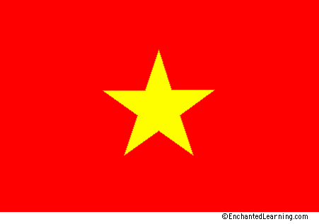
Vietnam
Vietnamese cuisine can be divided into three regional varieties. In a cool, mountainous north, in the city of Hanoi, a history of Chinese rule is evident in Cantonese-style stir-fries and simple, brothy soups.
Language-Vietnamese
Capital-Hanoi
Religion
Buddhism

Slide 98
Vietnam
In the hot, steamy south, including the city of Ho Chi Minh City (formerly Saigon), tropical abundance is the rule: Seafood, Pork, and numerous fruits and vegetables are found in bold and spicy dishes, including curries influenced from nearby India.

Slide 102
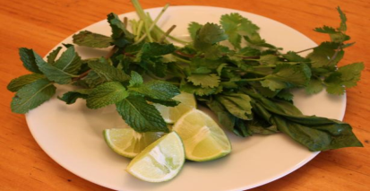
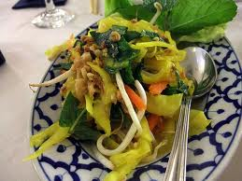
Vietnam
Banh mi (a kind of Vietnamese po’boy with meat, pate, hot peppers, and pickled vegetables) and strong, sweet coffee serve as reminders of Vietnam’s French colonial past.
Rau thom – fresh herbs
Rau song – a table salad includes a plateful of herbs, along with lettuces, cucumbers, mung bean sprouts, and sometimes pickled vegetables; it is served at every meal.

Slide 103
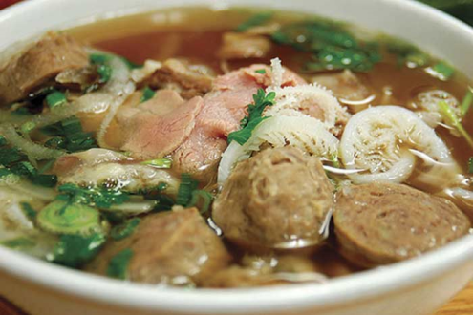
Vietnam
Vietnamese cooking uses little fat or oil for frying similar to Chinese cooking
Instead of using soy sauce for seasoning, nuoc mam (fish sauce) is used as the main flavoring in almost every dish.
Pho – is a type of soup in which noodles, beef, chicken, or pork are added, and the soup is then garnished with basil, bean sprouts, and other seasonings.

Slide 104
Gemstones

Slide 105
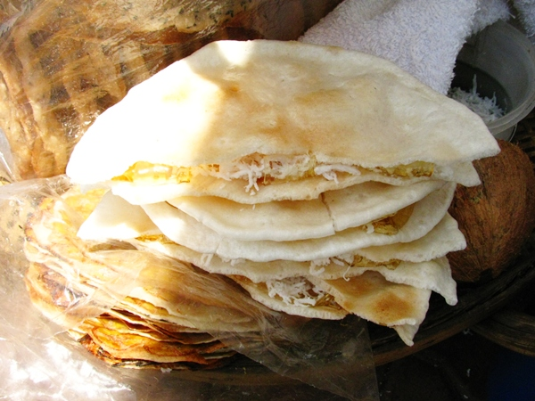
Vietnam
Vietnamese spring rolls are an alternative to Chinese egg rolls.
Bahn trang are paper-thin, white crepes that have a criss-cross pattern from the trays on which they are dried.

Slide 106
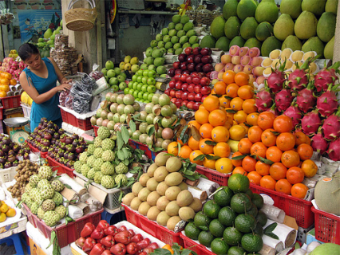
Vietnam
Rice flour is a crucial item in a Vietnamese kitchen.
The flour is the main element of a Vietnamese pancake/crepe, banh Xeo.
Fruits are an integral part of each meal – bananas, mangoes, papayas, oranges, coconuts, and pineapple are all popular.

Slide 108
Vietnam
Vietnamese coffee is made with condensed milk to make the drink sweet.
Hot green tea is very popular as well.

Slide 109
Dining Etiquette
You should wait until you are showed your seat at the table.
The elderly usually sit before the others.
The Vietnamese use chopsticks and rice bowls as their eating utensils.
The Chopsticks must be kept on the table or a chopstick rest after taking a few mouthfuls and at the end of the meal.
The rice bowls should be held up closer to the mouth otherwise it is considered idleness.
Vietnamese etiquette demands that spoons should be held with the left hand while eating soup.
It is polite to finish every food item on the platter.
Toothpicks should be used with the mouth covered.

Slide 110
Myanmar (Burma)

Slide 111
Myanmar (Burma)

Slide 115
Cambodia

Slide 123
Laos

Slide 128
Brunei

Slide 132
Population Density

Slide 134
Thank you =)
Prepared by:
Analiza Amandy
Merry Grace B. Cariño
Candice Dale
Donagift Reyes
☺ ☺ ☺
Map additions by Joe Naumann, UMSL

