Slide 1
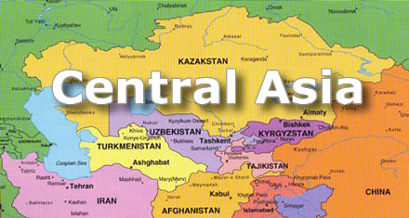

Slide 2
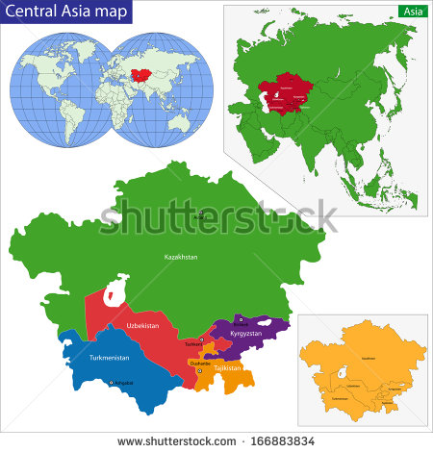

Slide 3
Central Asia atlas – Historical, physical, and human
An Introduction to
by Kathy Pham - Fall 2014
Modified by Joe Naumann – Spring 2016 (largely map additions)

Slide 4
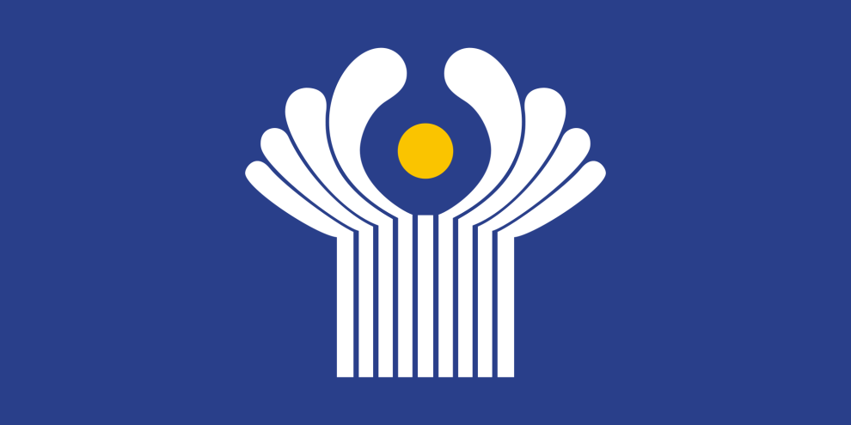
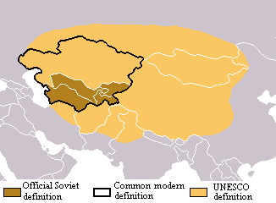
Defining terms
Commonwealth of Independent States (CIS):
formed when the former Soviet Union dissolved in 1991. At its conception it consisted of ten former Soviet Republics: Armenia, Belarus, Kazakhstan, Kyrgyzstan, Moldova, Russia, Tajikistan, Turkmenistan, Ukraine, and Uzbekistan.
Cultural-Linguistic Note:
Russians use two separate terms:
Средняя Азия, five CIS republics
Центральная Азия, a wider definition that includes lands outside the former Soviet Union

Slide 5
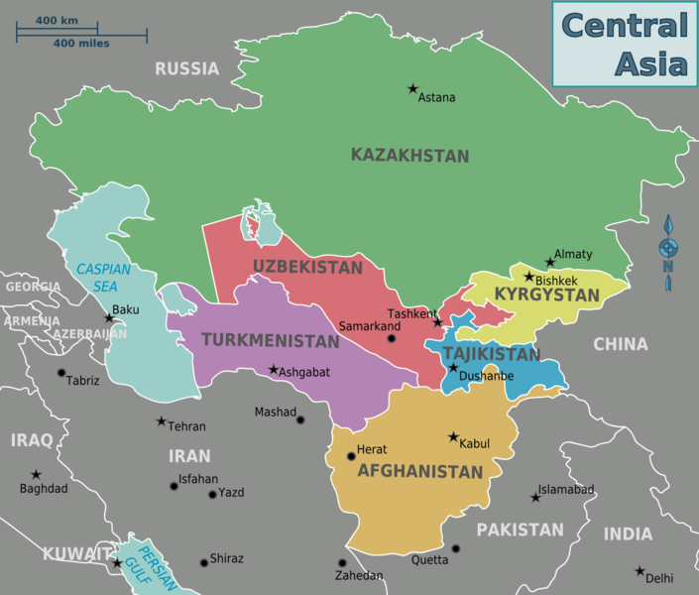
WhEre is Central Asia?
During this presentation, we will focus on five CIS republics:
Turkmenistan
Uzbekistan
Tajikistan
Kyrgyzstan
Kazakhstan
Some Geographers add:
Afghanistan
Azerbaijan
Also are landlocked, Muslim countries in the “neighborhood.” .
9
Not much prior involvement until 1979 Soviet Invasion

Slide 6
No clear-cut definition of the realm, as the following maps illustrate

Slide 7
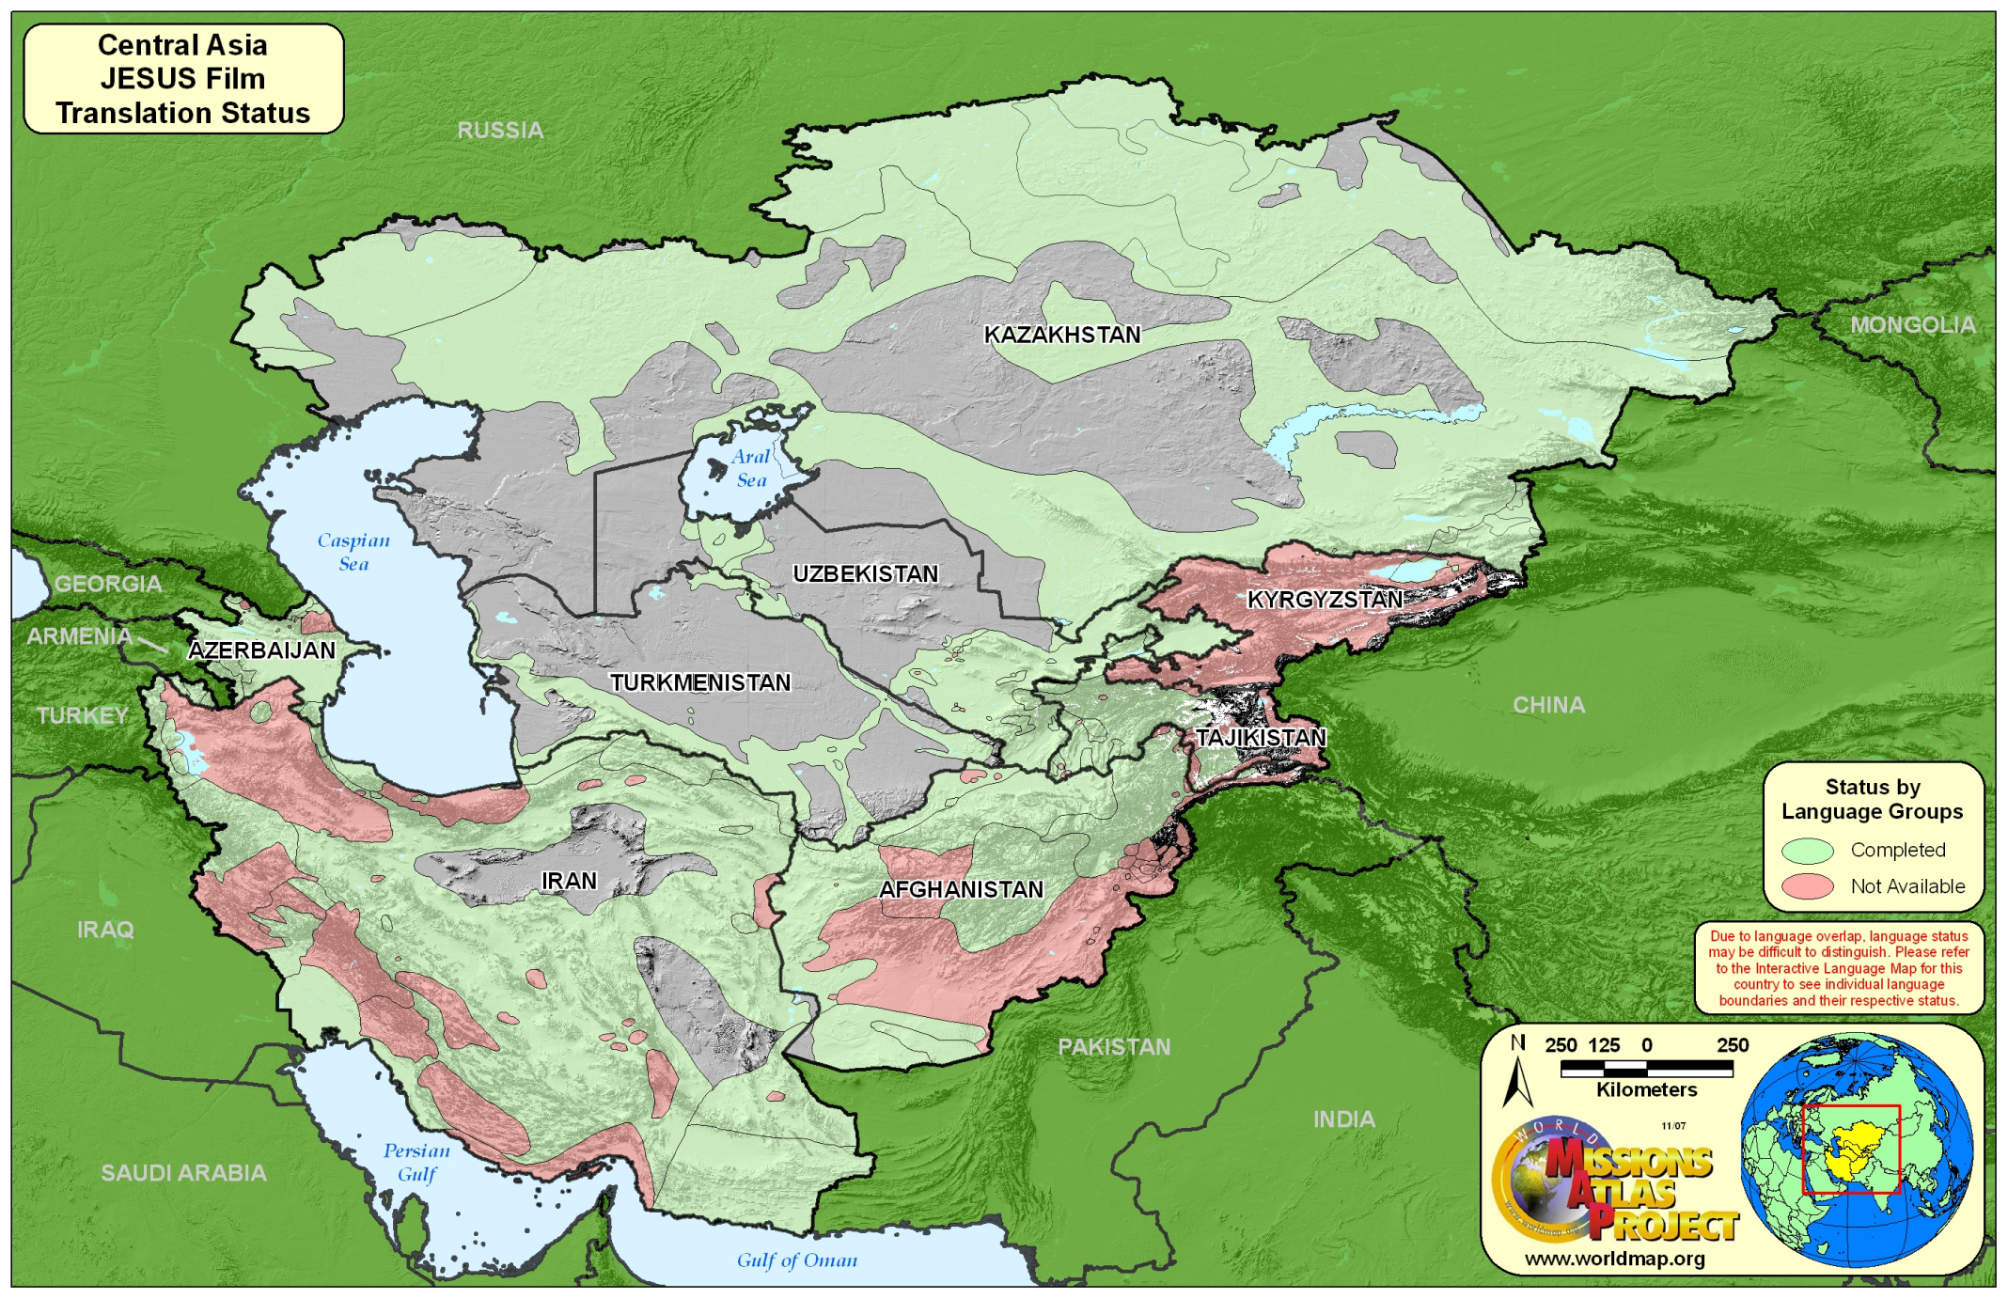

Slide 8
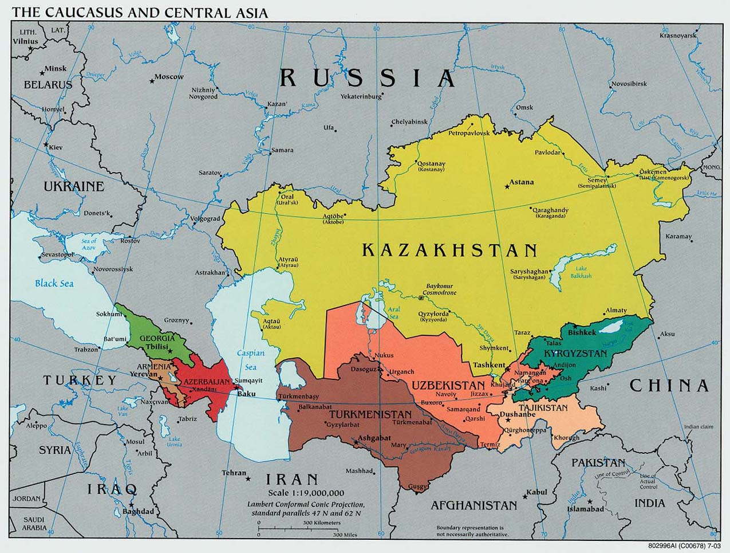

Slide 9
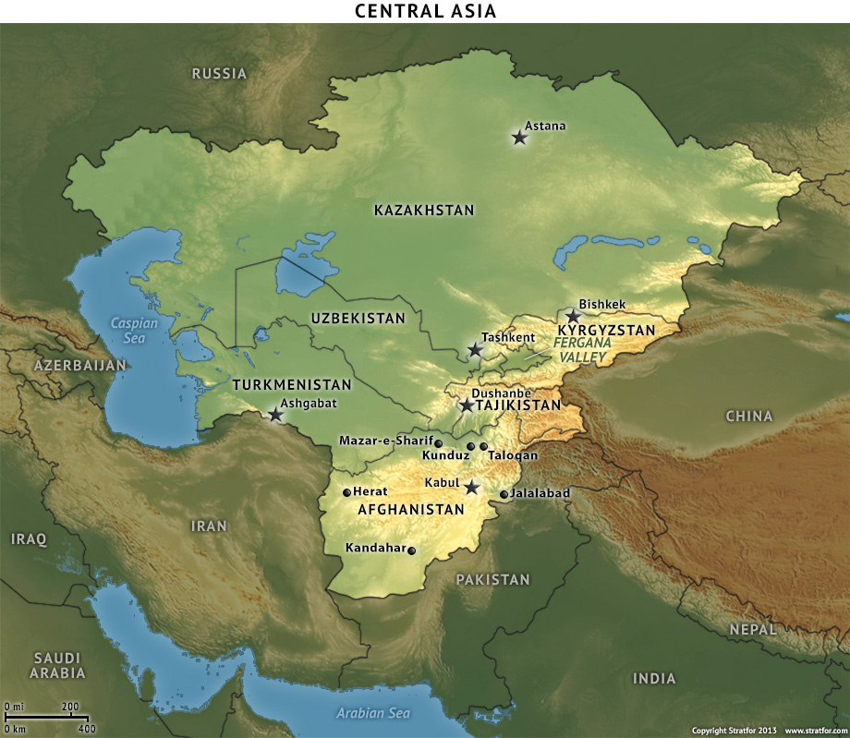

Slide 10
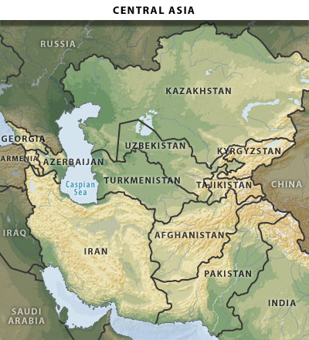

Slide 11
Background & History

Slide 12
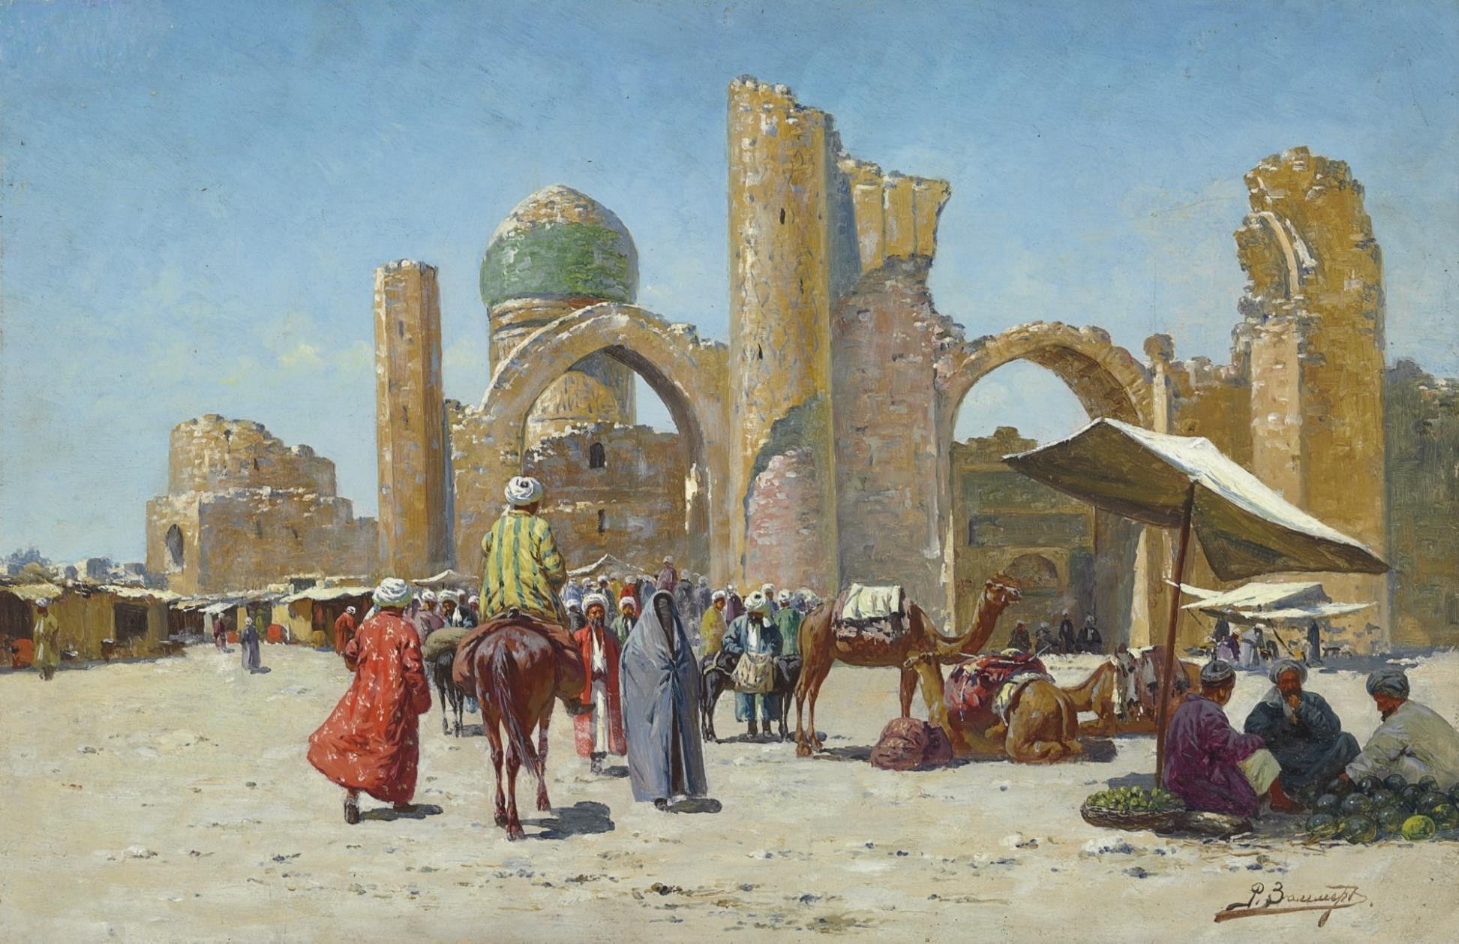
Nomads - Silk Road - Steppes
Рихард-Карл Карлович Зоммер “Самарканд, Узбекистан” (1866—1939). Trained in St. Petersburg.
On the trade route between China and the Mediterranean

Slide 13
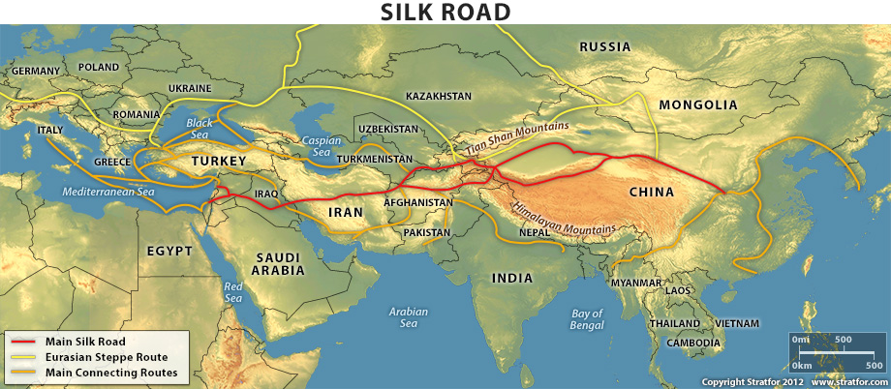

Slide 14
Russia & Central Asia?
Russians interacted with the Central Asians since the 19th century
Каразин Николай Николаевич “Переправа Туркестанского отряда у Шейх-арыка.” 1869.

Slide 15
“'Now I shall go far and far into the North, playing the Great Game...”
–Rudyard Kipling, Kim, 1901

Slide 16
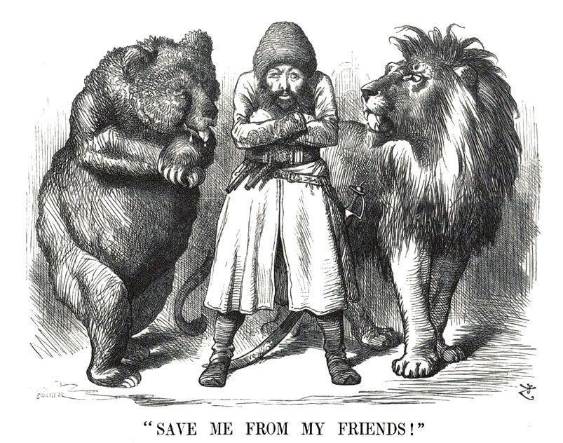
“The Great Game”
Great Britain v. Soviet Union
Fought for dominance over Central Asia
Key events 1813-1907:
1813 Russo-Persian Treaty
1865 Russia conquers Turkestan
1887 Both Russia and Britain reach the north-west border of Afghanistan
1907 the Anglo-Russian Convention
Sir John Tenniel. Political cartoon depicting the Afghan Emir Sher Ali with his "friends" the Russian Bear and British Lion (1878)

Slide 17
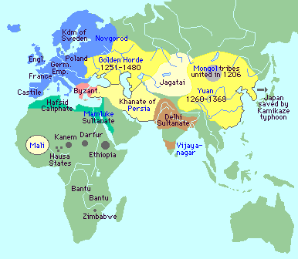
The Extent of Mongol rule in Eurasia
From the 15th century to the 20th century, the Russians were engaged in reclaiming land from and taking land from the Mongols. This explains why Russia was only marginally influenced by such things as the Renaissance and the Enlightenment which deeply affected Europe.

Slide 18
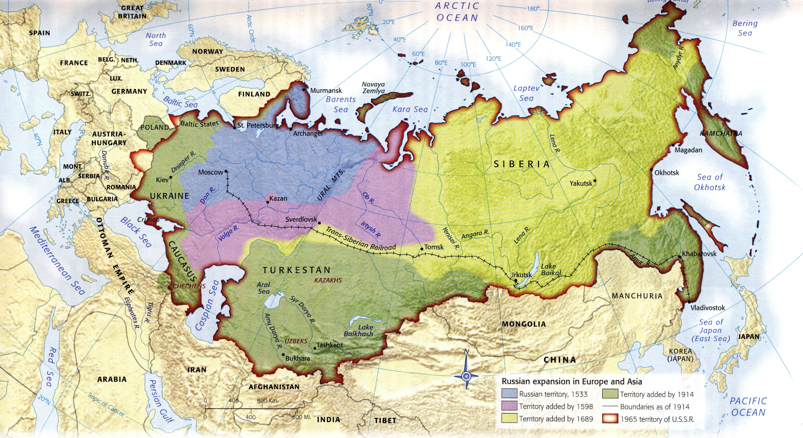
Russian Expansion: Central Asia added between 1689 and 1914.

Slide 19
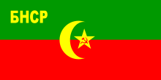
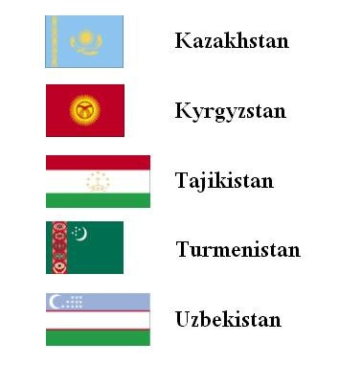
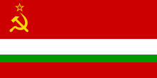
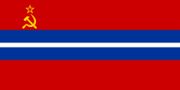
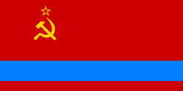
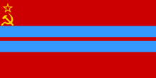
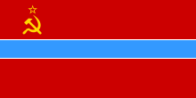
Central Asia in the Soviet Era
Time: 1918-1991
Again, the five CIS republics:
Flags of Former Soviet Republics:
Bukharan People's Soviet Republic (1918), Khorezm People's Soviet Republic and SSR (1920), Tajik SSR (1925), Kirghiz SSR (1925), Turkmen SSR (1925), on top: Kazakh SSR (1936)
In 1924, Turkestan was split into Tajik ASSR (now Tajikistan), Turkmen SSR (now Turkmenistan), Uzbek SSR (now Uzbekistan), Kara-Kirghiz Autonomous Oblast (now Kyrgyzstan).
Kazakh SSR was established on December 5, 1936.

Slide 20
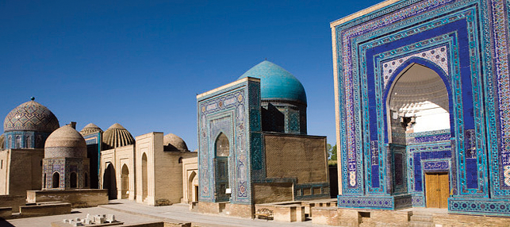
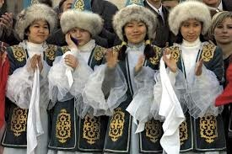
Central Asia in the Soviet Era
Time: 1918-1991
Population Demographic Shift: Stalin expelled Volga Germans, Koreans, Turks outside Russia; encouraged ethnic Russians to settle in Kazakhstan and other Central Asian territories.
Ban on Religion: Primarily Sunni Muslim pre-Soviet times. Starting in the 1930s, the Soviets shut down churches and mosques. By the 1980s, ban ceased.
Nationalist Revolts: Short-lived wins, majority crushed.

Slide 21
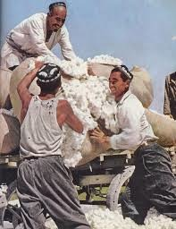
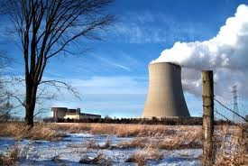
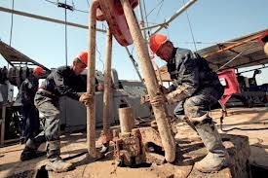
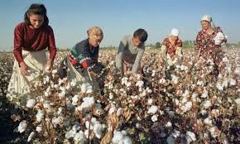
Central Asia in the Soviet Era
Time: 1918-1991
Cotton Farming: Large industry in Uzbekistan, later a large cause for the Aral Sea shrinkage…
Natural Resources & Industrialization: After World War II, the Soviets rapidly industrialized Kazakhstan, and started prospecting for oil in Central Asia. Oil was found in Uzbekistan, both oil and gas - in Turkmenistan
Metallurgy —> Nuclear Development: Uranium produced in Uzbekistan. Nuclear testing sites open.

Slide 22
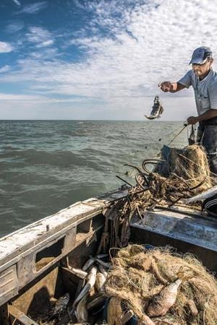
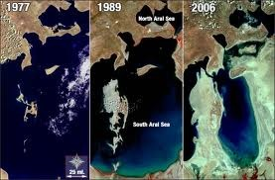
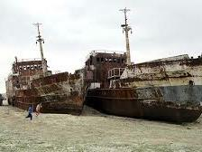
NonSustainable Practices
=
Aral Sea Shrinkage

Slide 23
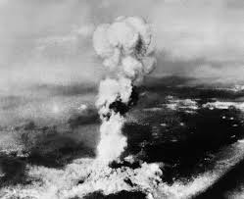
"Atomic Meltdown"
While the Ukraine isn’t part of Central Asia, it isn’t located too far away. Once the radioactive materials entered the atmosphere in 1957 the wind could carry them to nearby areas.
Chernobyl was a good example of Soviet carelessness in handling toxic materials. By building cheaply and “cutting corners,” the double and triple back-up safety systems built into American and European nuclear reactors were absent. This is part of the legacy of the Soviet Years.
ChernobYl, Kyshtym/Mayak,
…Countless Nuclear Disasters in the USSR…

Slide 24
…Today

Slide 25
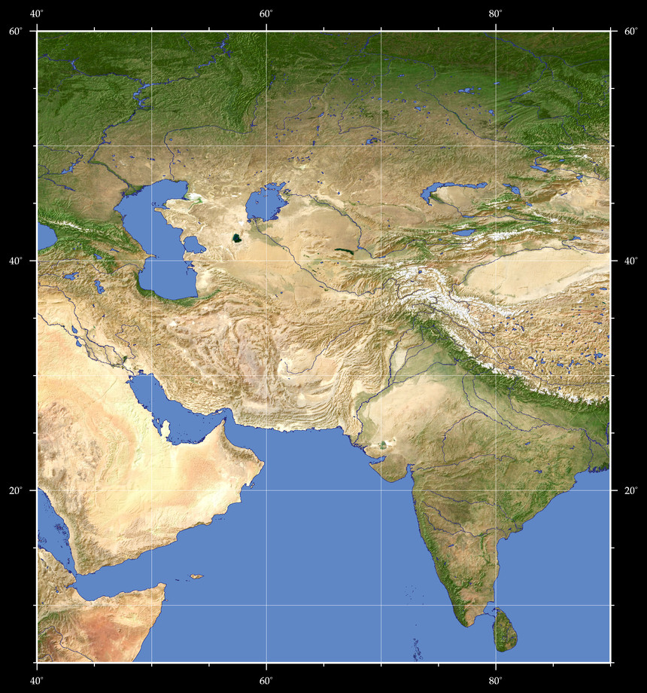
Topography

Slide 26
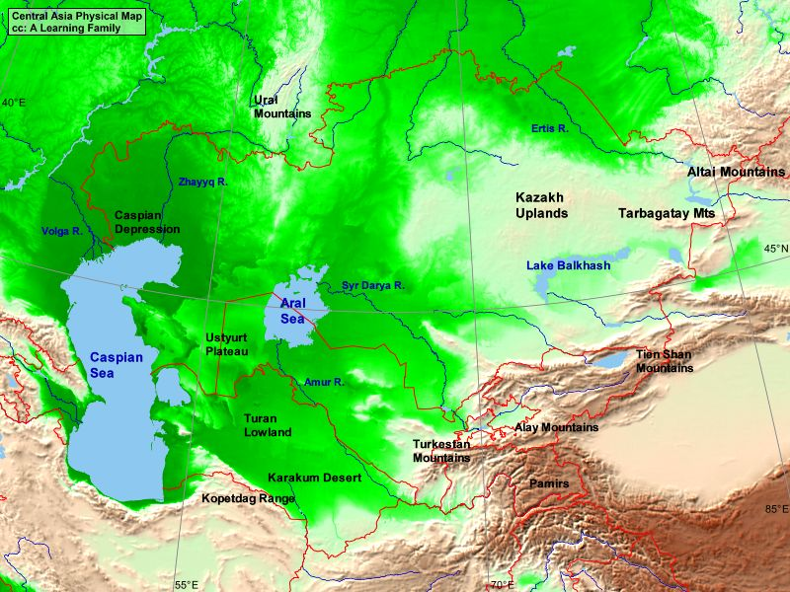

Slide 27
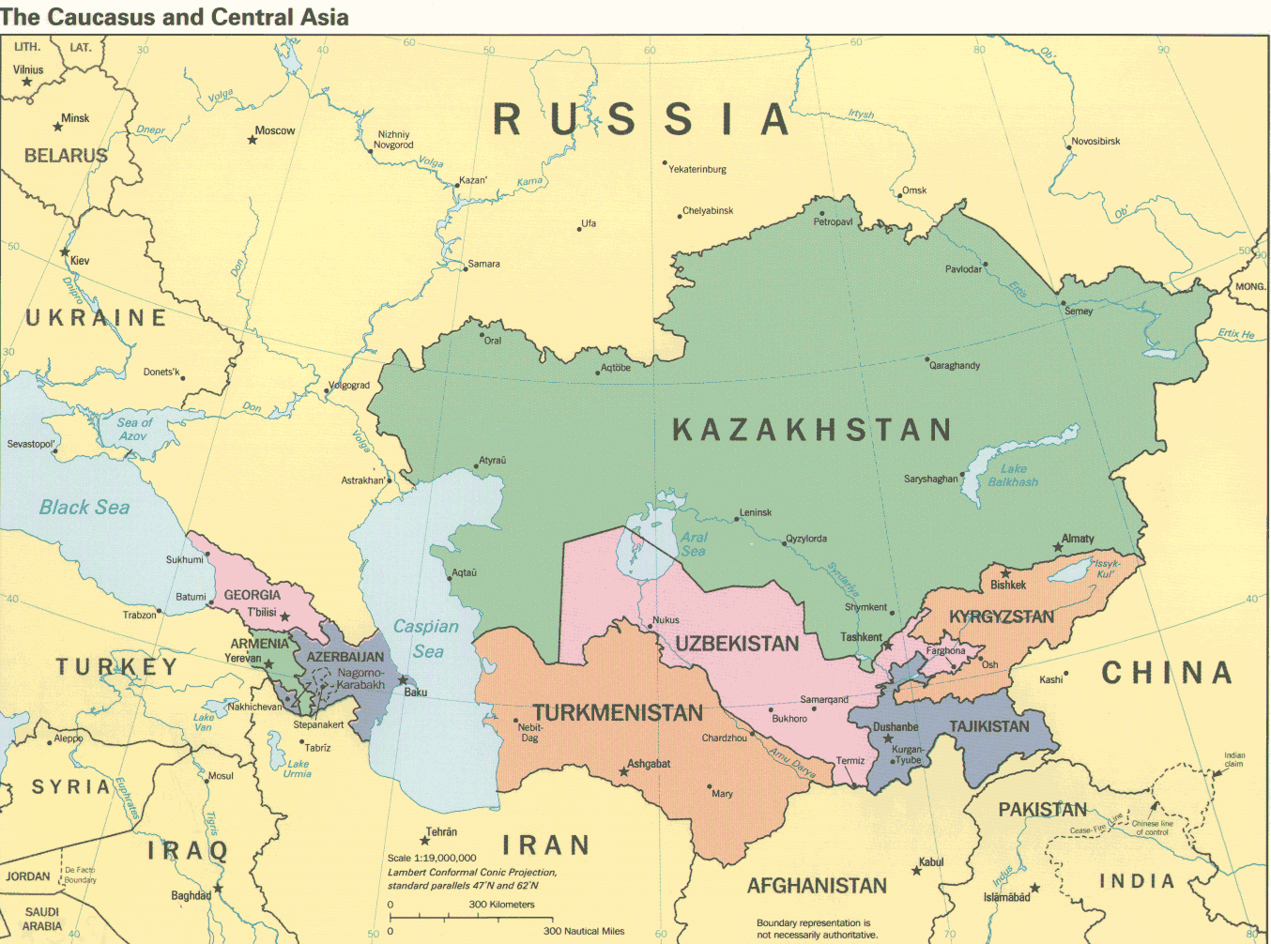
Political

Slide 28
General – physical/political Map

Slide 29
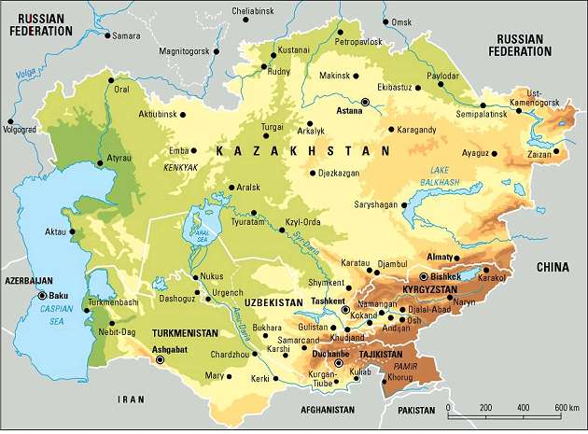

Slide 30
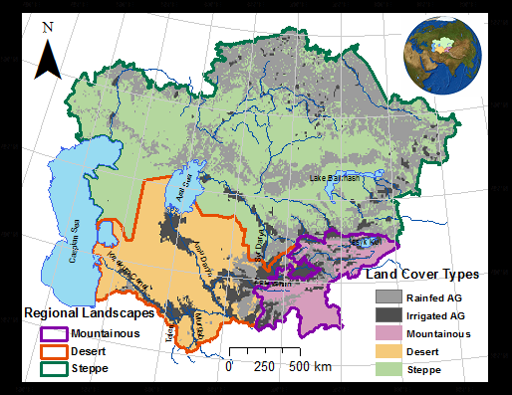

Slide 31
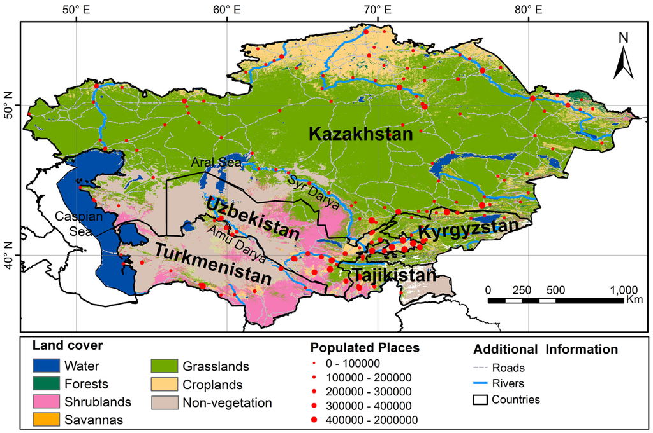

Slide 32
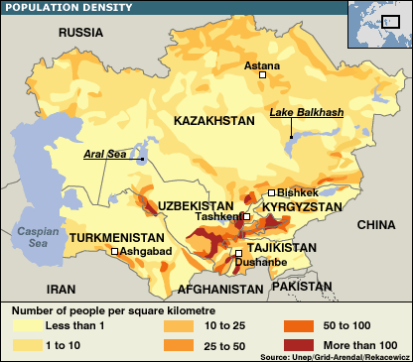

Slide 33
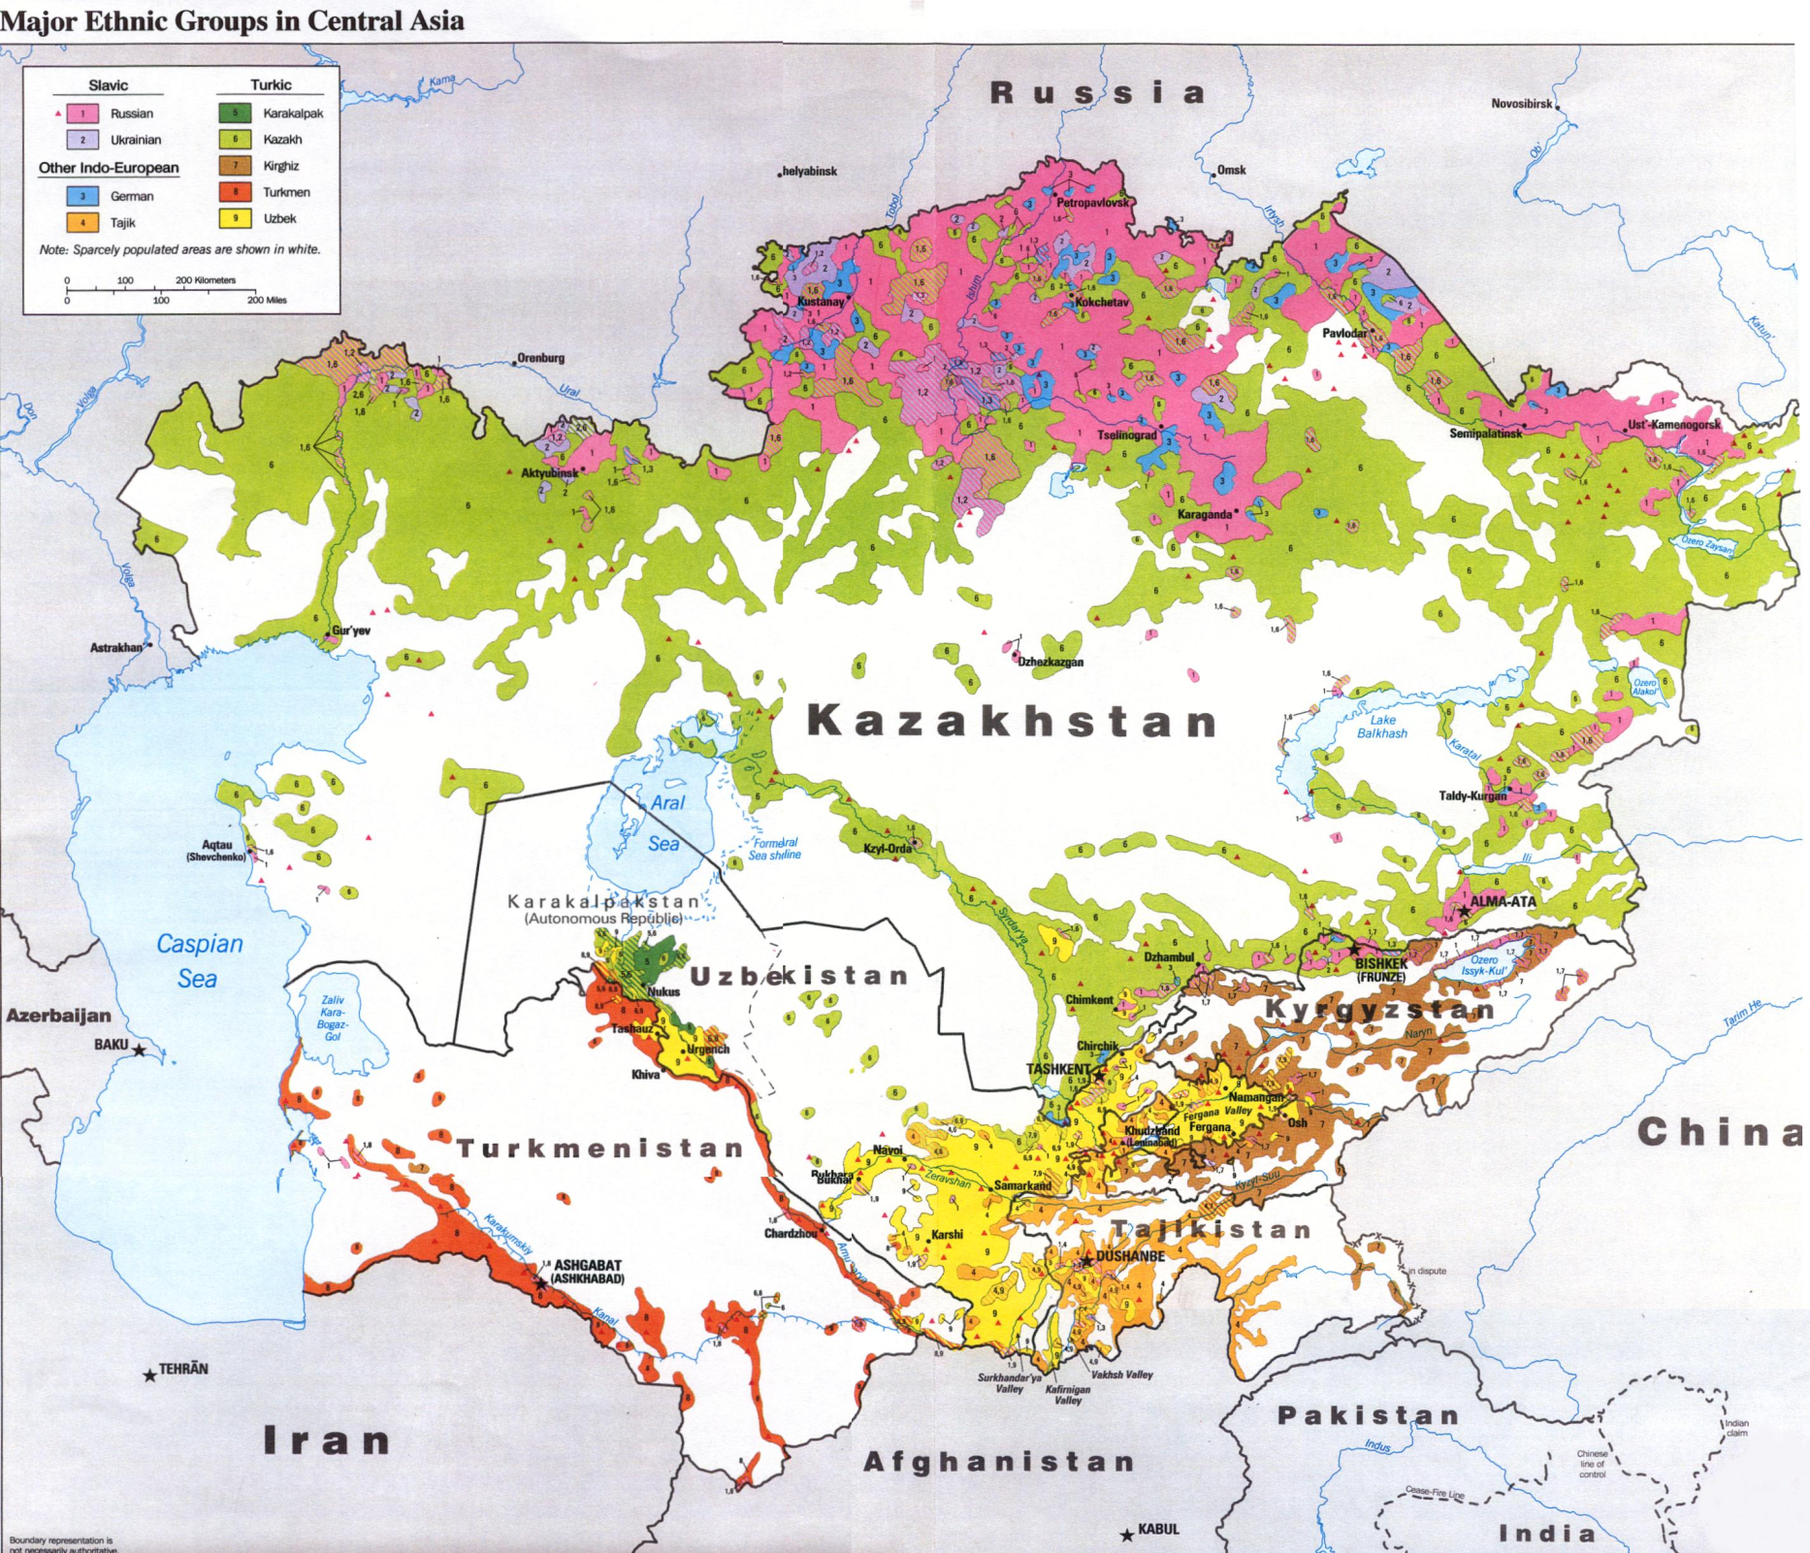

Slide 34
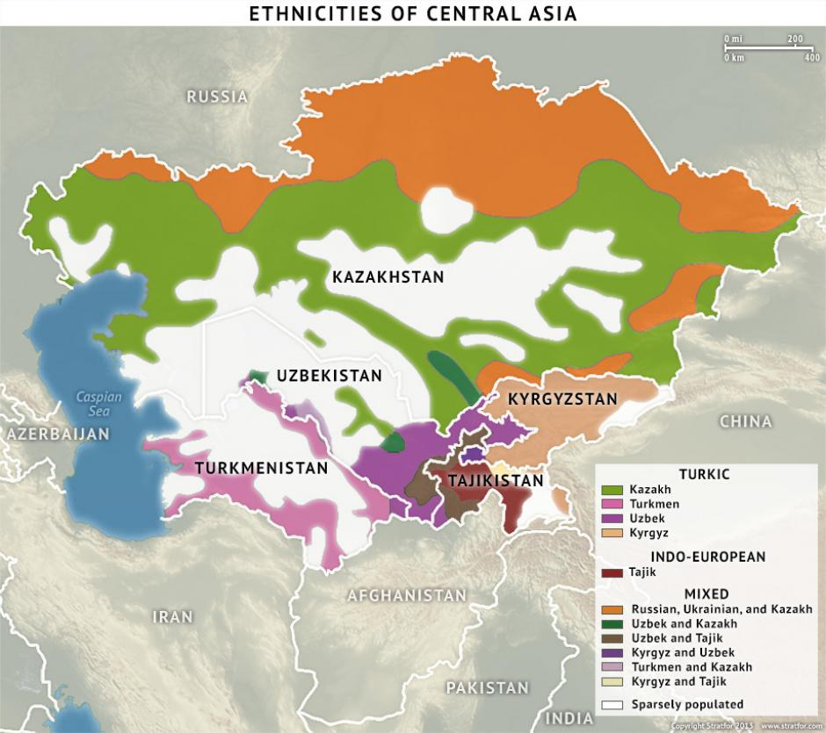

Slide 35
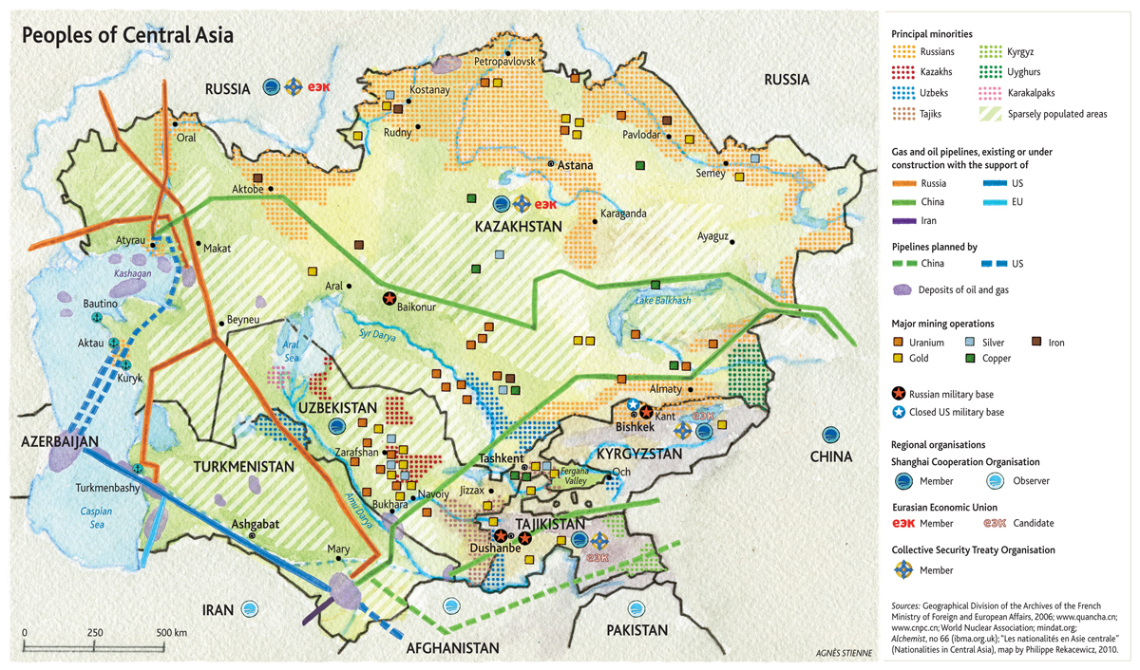

Slide 36
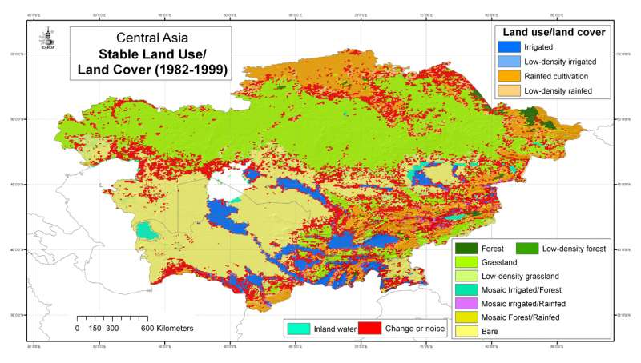

Slide 37
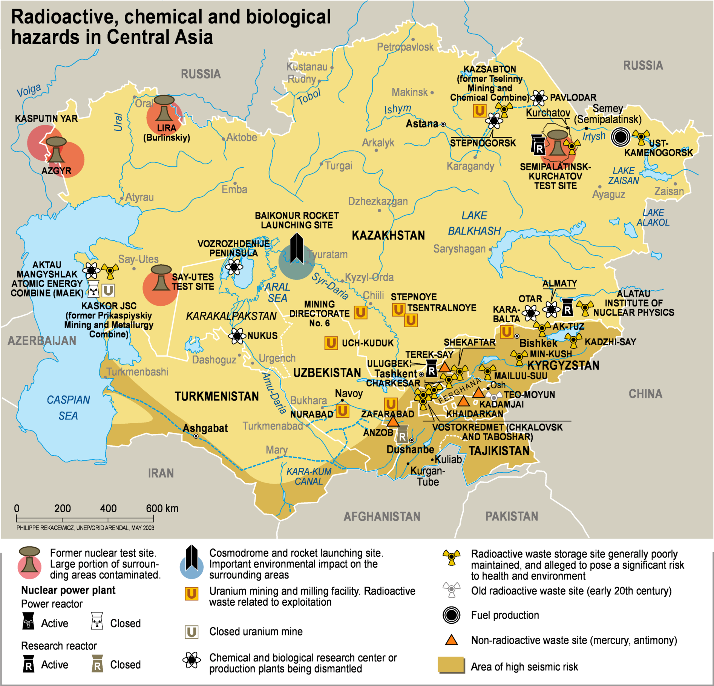

Slide 38
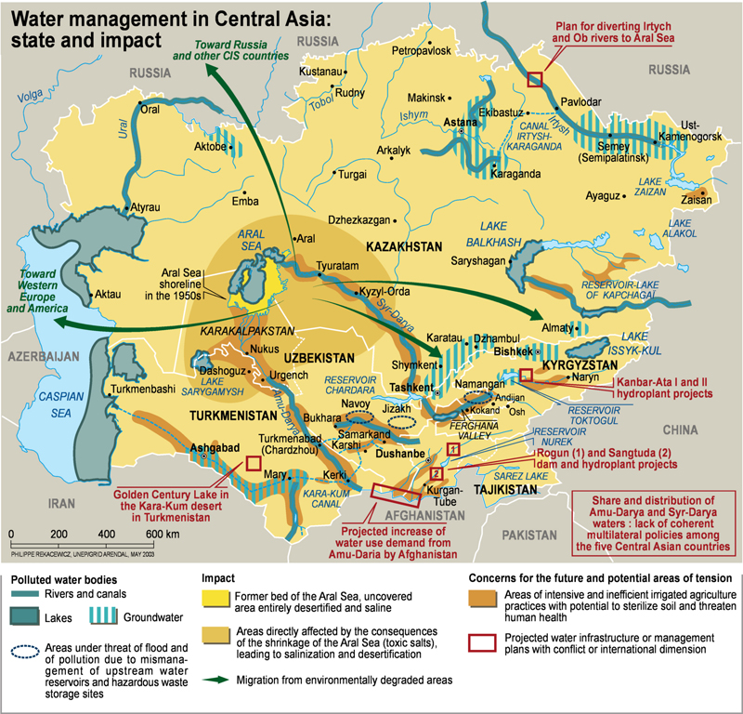

Slide 39
Economics By CoUntry - Push Factor for Migrant Workers
National GDPs from highest to lowest: Kazakhstan ($149.06 billion) vs. Tajikistan ($5.64 billion) - World Bank data 2010
National Trade from highest to lowest: Kazakhstan ($55 billion) vs. Tajikistan ($1.06 billion) - Harvard Center for International Development 2010
According to Carnegie Endowment article (reading),
Tajikistan greatly depends on migrant labor “as many as 1.5 million of its 6.9 million people work abroad, the vast majority of them in Russia.”
Remittances from migrant labor equal to around 49% of Tajikistan’s GDP, super high ratio
Why Tajikistan? Let’s look at some charts ahead.

Slide 40
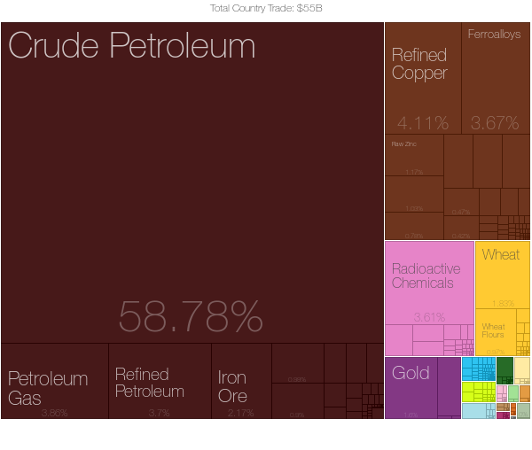
Main Kazakhstan Exports
Economic Complexity Observatory, MIT Media Lab and the Center for International Development at Harvard University. (TC) http://atlas.media.mit.edu/

Slide 41
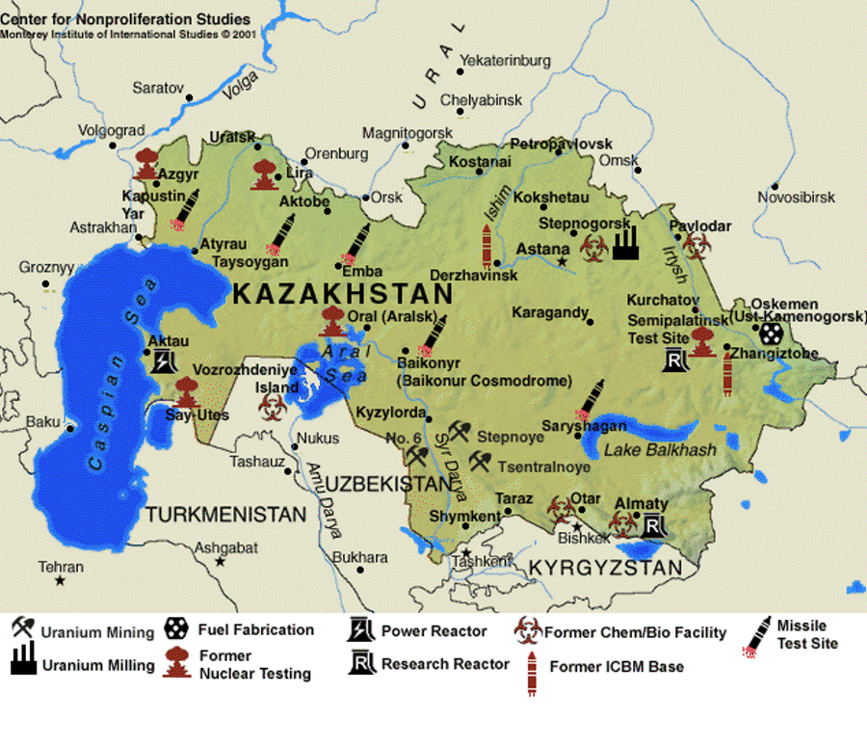

Slide 42
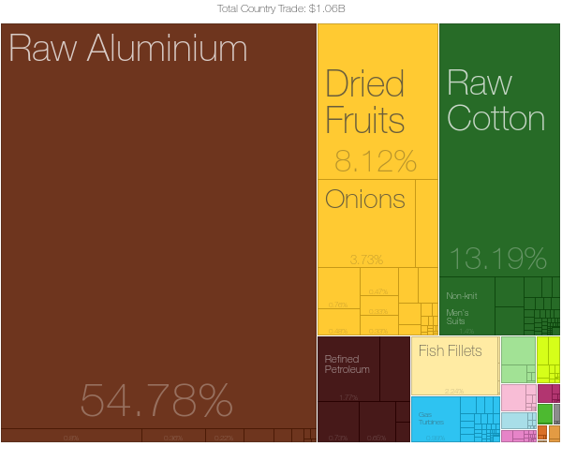
Main Tajikistan Exports
Economic Complexity Observatory, MIT Media Lab and the Center for International Development at Harvard University. (TC) http://atlas.media.mit.edu/

Slide 43
Tajikistan & Kazakhstan
* POPULATION (2010): 6.9 MILLION
GDP (2010): $5.64 B
* INFANT MORTALITY Rate (PER 1k LIVE BIRTHS): 52.2
LIFE EXPECTANCY (2009): 66.97 YEARS
Religions: Sunni Muslim 85%, Shia Muslim 5%,
LITERACY RATE (2009): 99.7%
* POPULATION (2010): 16.3 MILLION
GDP (2010): $149.06 B
* INFANT MORTALITY RATE (PER 1k LIVE BIRTHS): 29.1
LIFE EXPECTANCY (2009) 68.43 YEARS
Religions: Muslim 70.2%, Christian 26.2% (mainly Russian Orthodox
* LITERACY RATE (2009): 99.7%
CIA World Fact Book, Transparency International Country Profile,World Bank Data

Slide 44
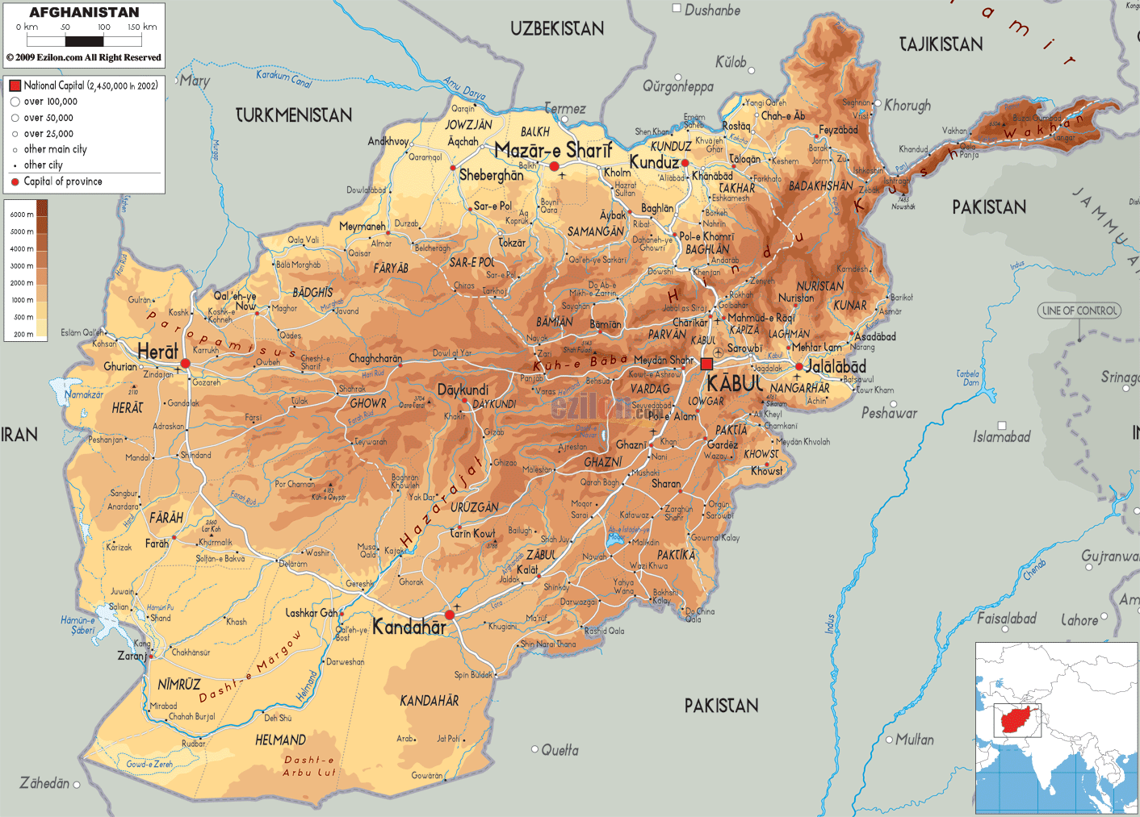

Slide 45
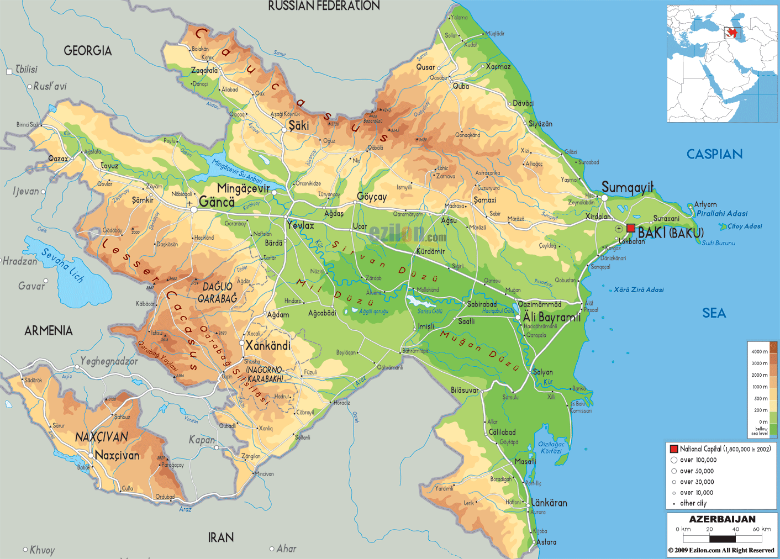

Slide 46
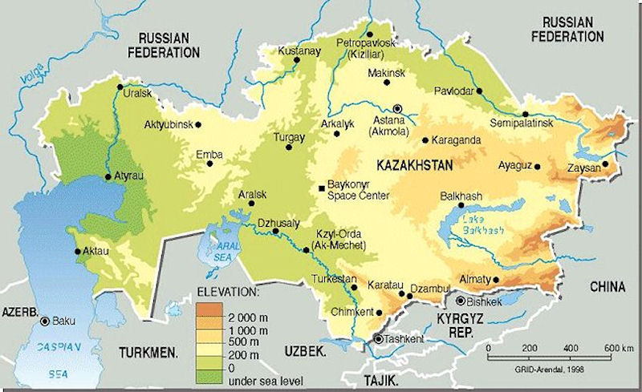

Slide 49
Turkmenistan

Slide 51
Corruption,
Wealth Distribution
Let’s compare….
http://www.transparency.org/country/#KAZ
http://www.transparency.org/country/#TJK

Slide 52
The Corruption Perceptions Index ranks countries/territories based on how corrupt a country’s public sector is perceived to be. It is a composite index, drawing on corruption-related data from expert and business surveys carried out by a variety of independent and reputable institutions. Scores range from 0 (highly corrupt) to 100 (very clean).
Country | CPI
Azerbaijan | 29
Afghanistan | 11
Kazakhstan | 28
Kyrgyzstan | 28
Tajikistan | 26
Turkmenistan | 18
Uzbekistan | 19

Slide 53
corruption
Corruption in the region is endemic. The 2012 “Corruption Index” from Transparency International (www.transparency.org) lists 176 countries in order of corruption. Turkmenistan and Uzbekistan are ranked jointly at 170 out of 176 countries in the world – i.e. very nearly the most corrupt places on earth. Afghanistan actually is bottom of the list; sharing the title of “most corrupt” with North Korea and Somalia. Tajikistan and Kyrgyzstan look comparatively clean at 154 but still only score 22 and 24/100 respectively (anything below 50 means the country is considered “significantly corrupt”). Kazakhstan is listed at rank 133, scoring 28/100.

Slide 54
Special Thanks to:
Marina Ingman
Yulduz Ismatullaeva
Other Sources:
UCLA Central Asian Institute Lecture Series
Transparency International
LA Natural History Museum
wikipedia.Org

Slide 55
Immigration Issues
Immigration into these countries is an extremely challenging process. The political situation in the area is unstable. Kyrgyzstan’s political regime was toppled in 2010 amid unrest that very nearly led to full-scale civil war. War is ongoing in Afghanistan with tens of thousands of deaths so far, both military and civilian. Turkmenistan is a one party state which was run by a dictator with a personality cult (“Turkmenbashi”, or “Father of the Turkmen”) until 2006. The BBC country profile on Uzbekistan reports that, “There is no legal political opposition and the media is tightly controlled by the state. A UN report has described the use of torture as "systematic".”

Slide 56
Guiding Quotes
In December 2008, the government blocked foreign workers from working as salespeople in retail and in marketplaces, which employ over 30 percent of Russia’s migrant workers.
Russia also introduced quotas limiting the number of available work permits and introduced tougher regulations on employers. These initiatives appear to have been mostly politically motivated—there is scant proof that migrants compete for jobs with locals.
How does this sentiment compare to one in the USA? Europe?

Slide 57
Guiding Quotes
On June 13, 2014, President Vladimir Putin signed a revised State Migration Policy, which requires foreign workers to pass Russian language and history exams to obtain work permits and, in effect, pushes more migrants to work illegally.

Slide 58
Guiding Quotes
According to the Russian Federal State Statistics Service’s middle­ scenario projection from 2008, Russia’s working­ age population may shrink by 14 million by 2025.
The UNDP reports that this decrease will result in a labor shortage that will significantly hamper Russia’s economic growth potential, even if labor productivity increases.
To cover this shortage, the country will need to attract foreign workers. In this respect, persisting anti­ immigrant sentiment and the current quota system are counterproductive.
Agree/Disagree?

Slide 59
Further Reading
Central Asian Labor Migrants in Russia: The "Diasporization" of the Central Asian States? http://www.silkroadstudies.org/new/docs/CEF/Quarterly/August_2007/Laruelle.pdf
Possible academic sources, books to check out later:
Naomi Caffee from UCLA, Central Asian Studies at UCLA
Marat, Erica. Labor migration in Central Asia: Implications of the global economic crisis. Silk Road Studies Program, Institute for Security and Development Policy, 2009.
Rywkin, Michael. Moscow's Muslim Challenge: Soviet Central Asia. ME Sharpe, 1990.

Slide 60
Study Maps

