Slide 1
The
Geography
of the
Indian subcontinent
Ms. Susan M. Pojer - Chappaqua, NY
Additions by Joe Naumann - UMSL

Slide 2
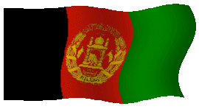
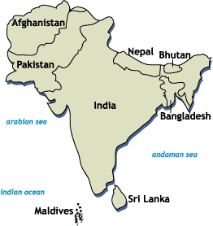
South Asia

Slide 3
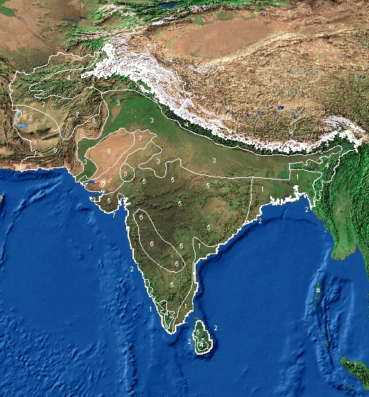
Satellite View of South Asia

Slide 4
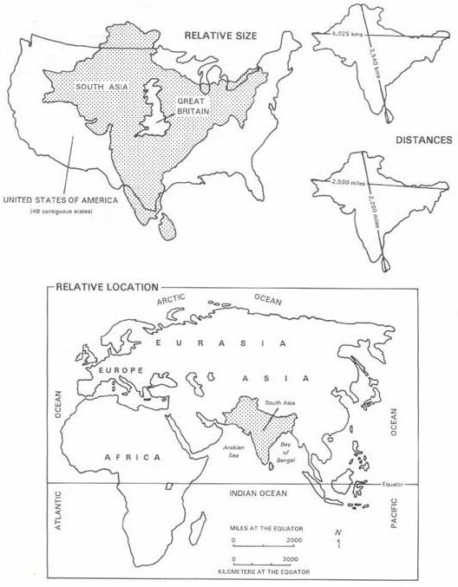
The Size of South Asia

Slide 5
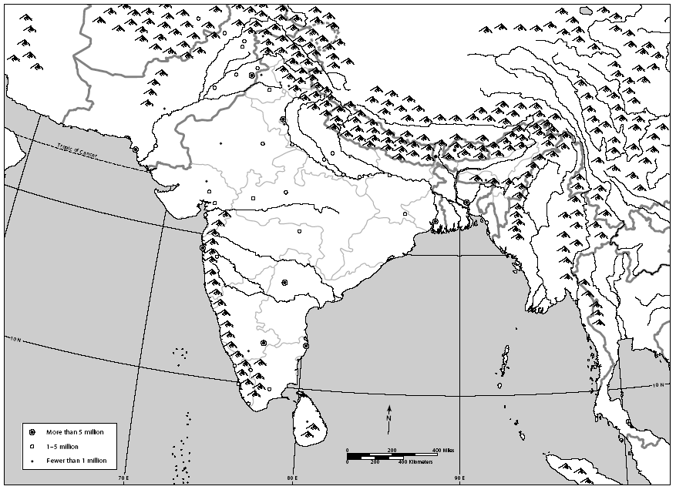
Countries
Afghanistan
China
Iran
Nepal
Bhutan
Pakistan
Myanmar
India
Bangladesh
Sri Lanka

Slide 6
cities
Kabul
Islamabad
Lahore
Kathmandu
New Delhi
Karachi
Benares
Thimbu
Dacca
Bombay
Calcutta
Madras
Colombo

Slide 7
Topography
of
South Asia

Slide 8
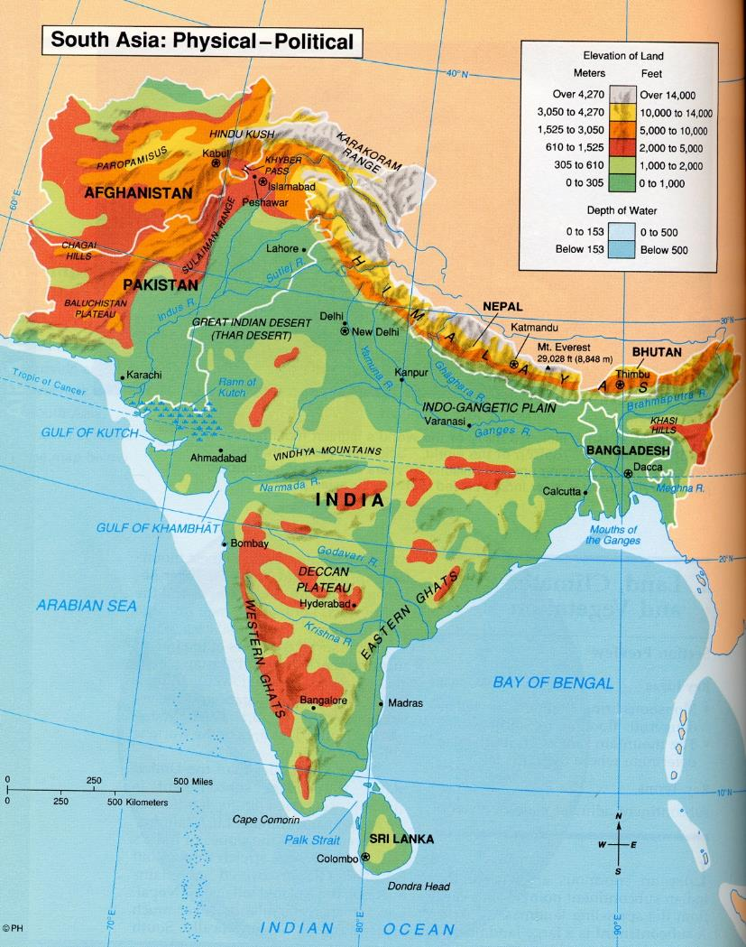
South Asia: Physical Map

Slide 9
Bodies of Water
Indus R.
Brahmaputra R.
Ganges R.
Bay of Bengal
Arabian Sea
Indian Ocean

Slide 10
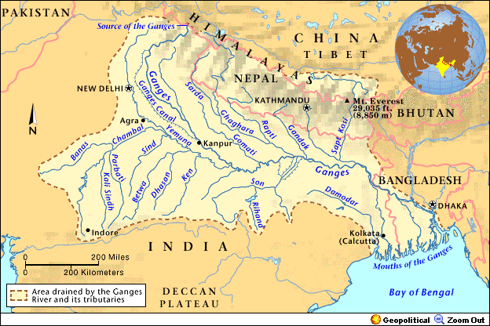
The Ganges River System
1,560 miles long

Slide 11
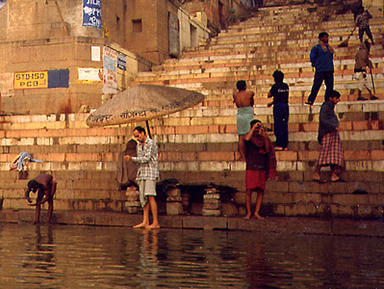
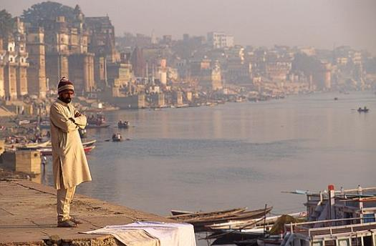
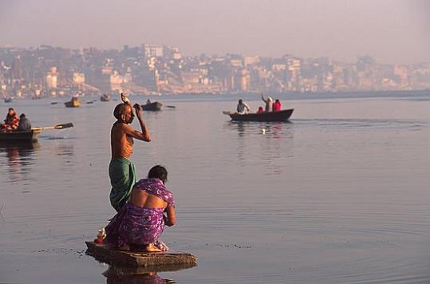
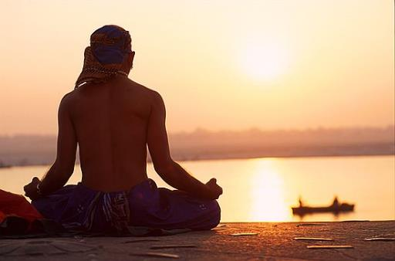
“Mata Ganga” (Mother Ganges)

Slide 12
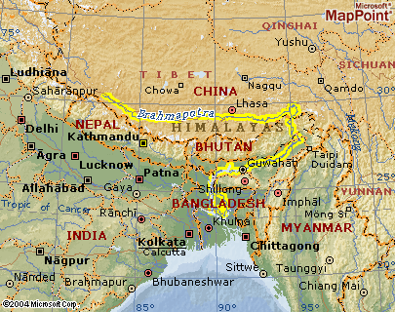
The Brahmaputra River System
1,800 miles long

Slide 13
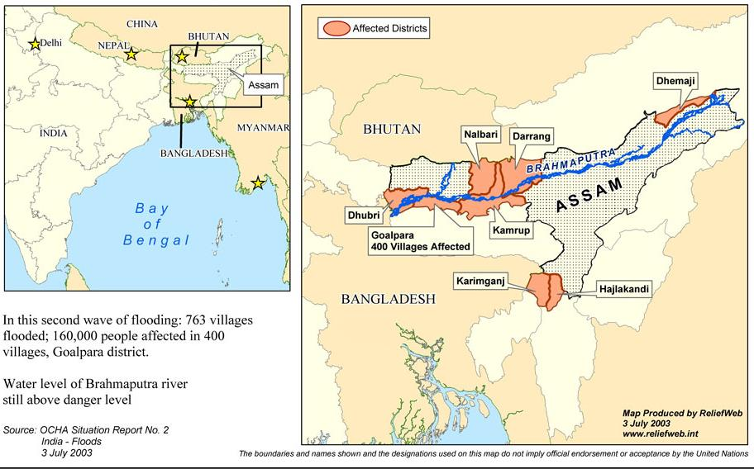
Floods on the Brahmaputra: 2003

Slide 14
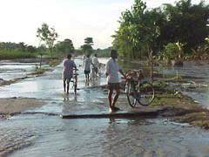
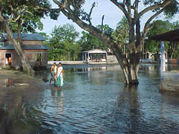
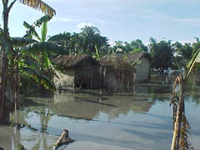
Flooding on the Brahmaputra

Slide 15
Valleys / Plains
Indo-Gangetic Plain

Slide 16
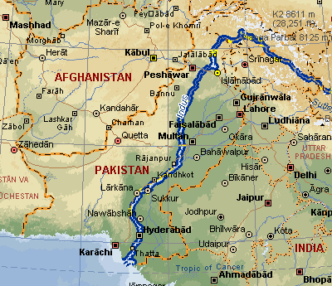
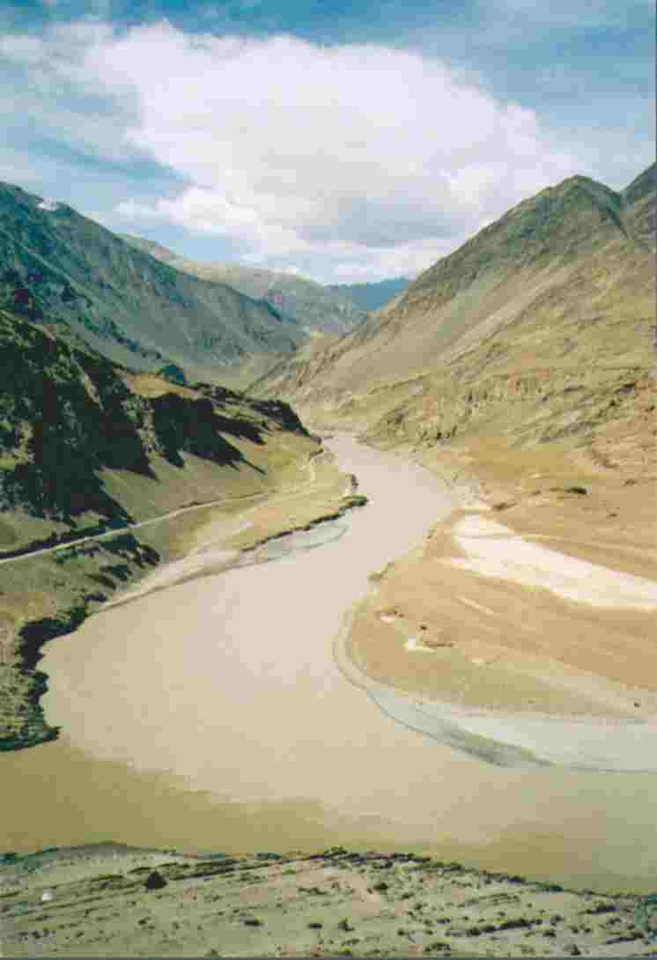
The Indus River System
1,975 miles long

Slide 17
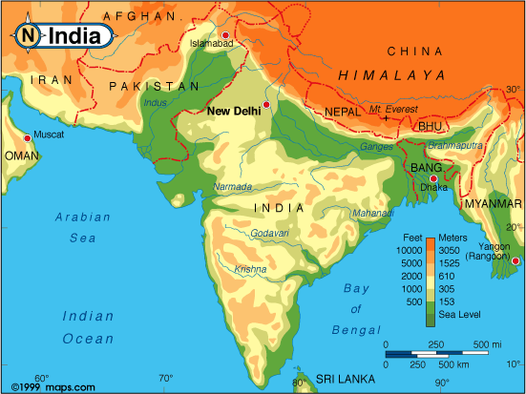
Elevation Levels

Slide 18
Mountains & Peaks
Hindu Kush
Khyber Pass I I
Karakoran Mts.
Mt. Everest ▲
Himalayas
Vindhya Hills
Eastern Ghats
Western Ghats

Slide 19
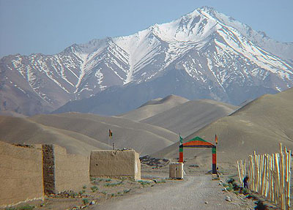
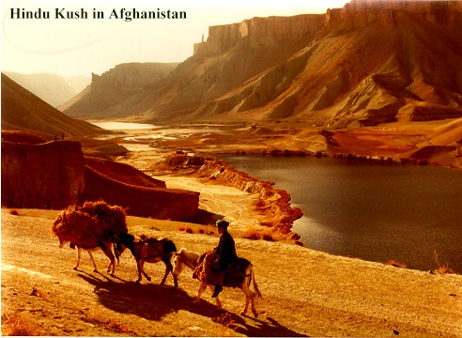
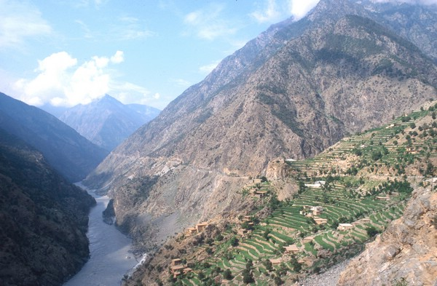
Hindu Kush

Slide 20
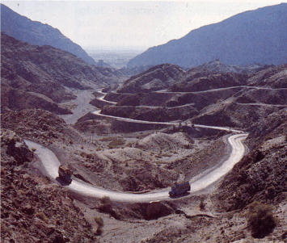
The Khyber Pass

Slide 21
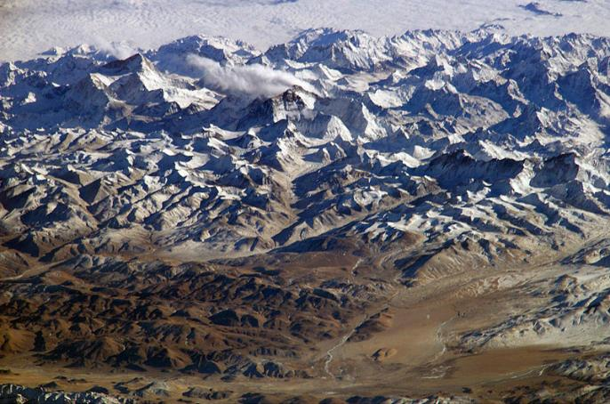
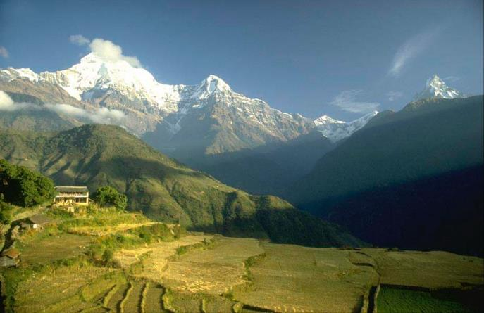
The Himalayas
“him” [snow]
“aalaya” [home]
Mt. Everest is 29,035 feet. It is the highest mt. peak in the world.

Slide 22
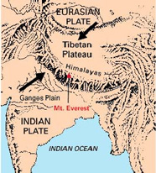
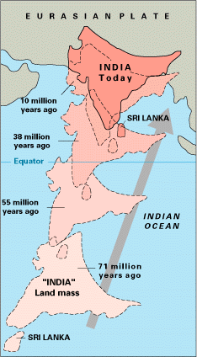
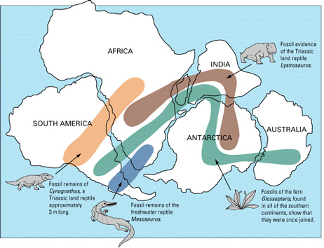
The Himalayas

Slide 23
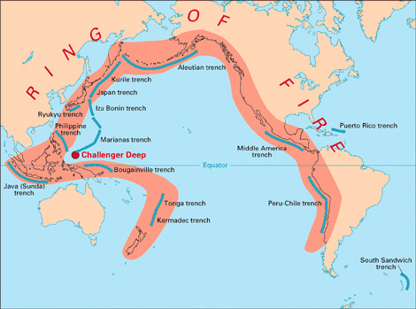
“Fire Rim of the Pacific”

Slide 24
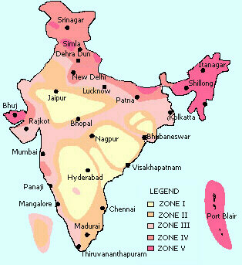
Earthquake Zones in India

Slide 25
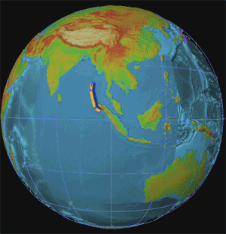
2004 Earthquake In Indonesia: Tsunami Devastates Indian Ocean Coastlines!

Slide 26
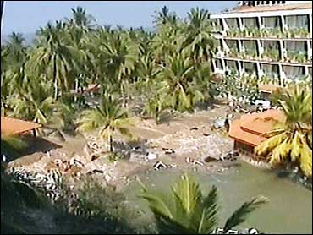
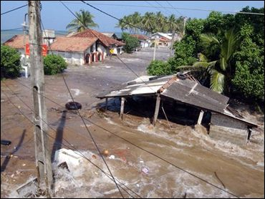
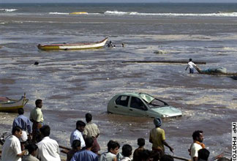
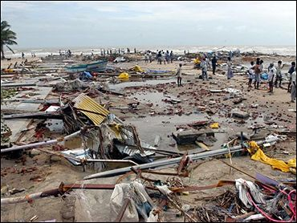
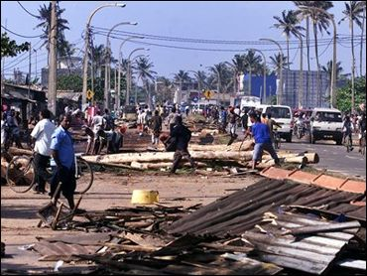
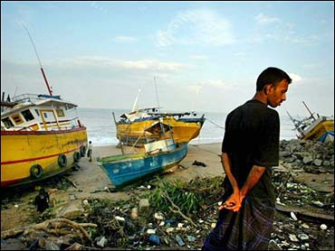
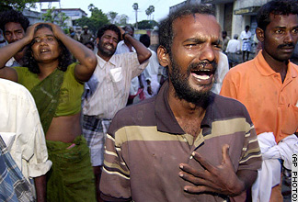
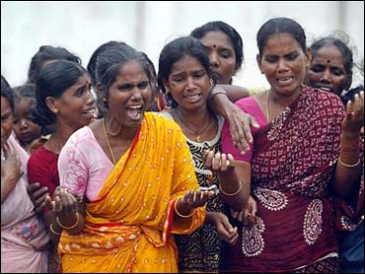
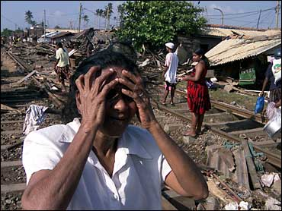
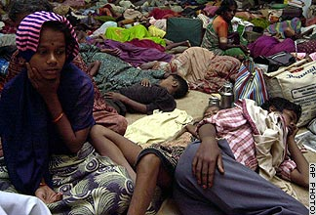
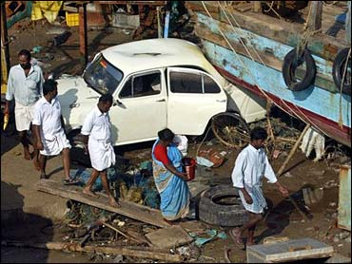
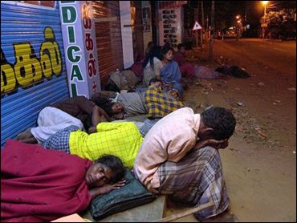
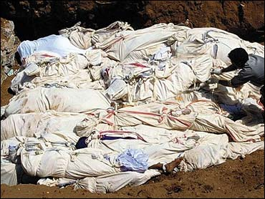
the Tsunami’s Devastation
100,000s dead!

Slide 27
Deserts / Plateaus
Tibetan Plateau
Thar Desert
Deccan Plateau

Slide 28
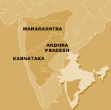
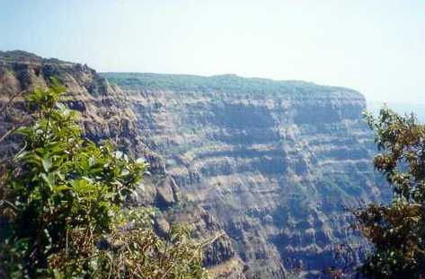
The Deccan Plateau
31,800 square miles in size.
Elevation range: 2,000 – 8,000 feet high.
From the Sanskrit word, “dakshina” [“the south”].

Slide 29
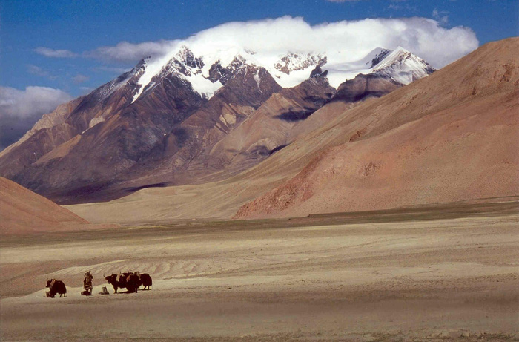
The tibetan Plateau
The “Roof of the World.”
average elevation is 16,400 feet.

Slide 30
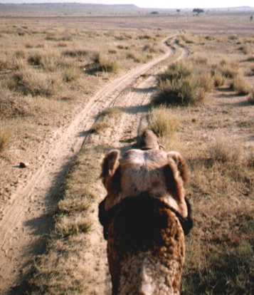
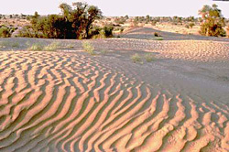
The Thar Desert
The Great Indian Desert
200 - 1500 feet in elevation.
up to 127ºF in July.

Slide 31
Other
Kashmir
Punjab

Slide 32
Completed Map
Hindu Kush
Khyber Pass I I
Karakoran Mts.
Tibetan Plateau
Kashmir
Punjab
Mt. Everest ▲
Indus R.
Brahmaputra R.
Himalayas
Indo-Gangetic Plain
Thar Desert
Ganges R.
Vindhya Hills
Bay of Bengal
Deccan Plateau
Eastern Ghats
Western Ghats
Arabian Sea
Indian Ocean

Slide 33
Climate
of
South Asia

Slide 34
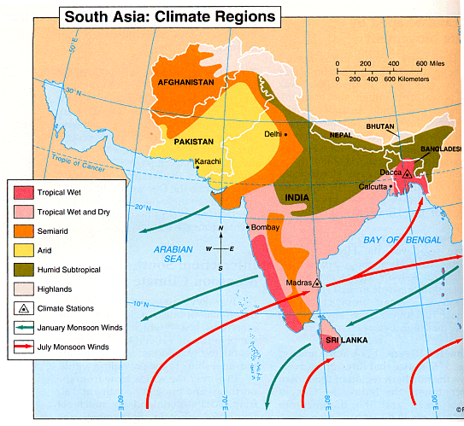
Climate Regions of South Asia

Slide 35
Winter Monsoons: Nov.-April

Slide 36
Summer Monsoons: May-Oct.

Slide 37
Temperature

Slide 38
Global Areas of Malaria

Slide 39
Vegetation
of
South Asia

Slide 40
Major Farming Systems of South Asia

Slide 41
Economic Activities & Resources

Slide 42
Silk Cultivation

Slide 43
Tiger regions

Slide 44
Demographic
Data
for
South Asia

Slide 45
Indian States & Union Territories

Slide 46
Population Density

Slide 47
Population Density

Slide 48
Language Families in South Asia

Slide 49
Per Capita Income in India

Slide 50
Language in India alone

Slide 51
Religions

Slide 52
Literacy Rate in India

Slide 53
Pakistan
True peace does not exist between Pakistan and India – the dispute over Jammu and Kashmir has never been settled. UN peace-keeping troops have supervised the transition zone between Pakistan and India for more than 60 years.

Slide 69
Bangladesh
The Ganges and Brahmaputra River Deltas make up more than half of the country; therefore, yearly flooding is a major hazard and problem.

Slide 80
Sri Lanka
Sri Lanka (formerly Ceylon), a tiny island nation south of India in the Indian Ocean, is a rugged land of rainforest, diverse wildlife and endless beaches. It’s famed for its ancient Buddhist ruins, including the 5th-century citadel Sigiriya, with its palace and frescoes, and the sacred city of Anuradhapura. Its flavorful cuisine reflects its history as a maritime hub and cultural melting pot.

Slide 82
Climate

Slide 88
Exports to USA

Slide 90
Cultural Triangle of Sri Lanka encompasses World Heritages sites of Anuradhapura, Polonnaruwa, Sigiriya, Dambulla & Kandy.

Slide 91
Sri Lankan Civil War
The Sri Lankan Civil War was an armed conflict fought on the island of Sri Lanka. Beginning on 23 July 1983, there was an intermittent insurgency against the government by the Liberation Tigers of Tamil Eelam (the LTTE, known as the Tamil Tigers), an independent militant organization which fought to create an independent Tamil state in the north and the east of the island. After 26 years, the Sri Lankan military defeated the Tamil Tigers in May 2009, ending the civil war.

Slide 93
Tamil Controlled Land 2005 2007

Slide 94
Nepal and Bhutan Mountain Kingdoms
Bhutan–Nepal relations refer to the bilateral relations between the Bhutan and Nepal. Relations were formally established in 1983.[citation needed] The two Himalayan countries are both landlocked, separated only by the Indian state of Sikkim. Both countries are bordered by India and the People's Republic of China.

Slide 95
Sandwiched between two giants

