Slide 1
The Dome: Timeless Architectural Form
From Ancient Rome to the Present

Slide 2
Background
A dome is a structural element of architecture that resembles the hollow upper half of a sphere. Dome structures made of various materials have a long architectural lineage extending into prehistory. Corbel domes have been found in the ancient Middle East in modest buildings and tombs.

Slide 3
The construction of technically advanced large-scale true domes began in the Roman Architectural Revolution, when they were frequently used by the Romans to shape large interior spaces of temples and public buildings, such as the Pantheon. This tradition continued unabated after the adoption of Christianity in the Byzantine (East Roman) religious and secular architecture, culminating in the revolutionary pendentive dome of the 6th century church Hagia Sophia.

Slide 4
Pantheon, Rome

Slide 5
Pantheon dome interior

Slide 6
Hagia Sophia, Istanbul

Slide 7
Hagia Sophia dome interior

Slide 8
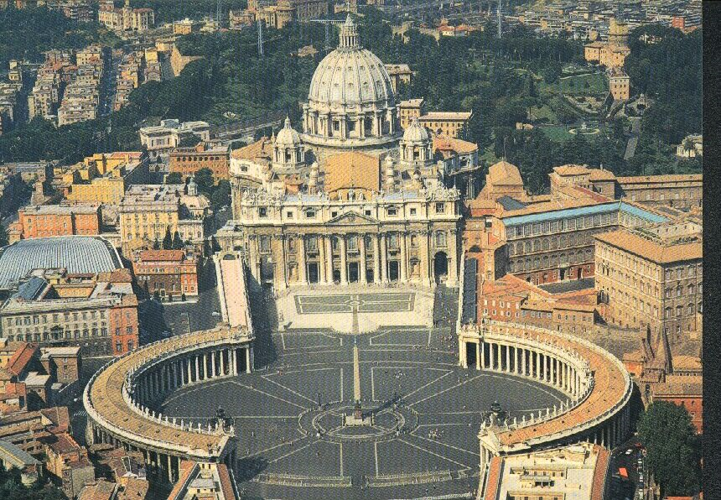
St. Peter’s, Rome

Slide 9
St. Peter’s dome interior

Slide 10
Cathedral Basilica of St. Louis, MO

Slide 11
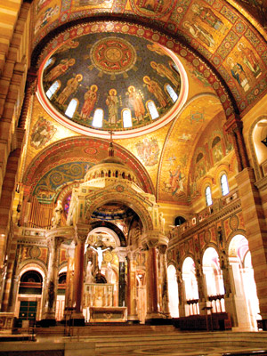
St. Louis dome interior
The dome, ceiling, and arches are covered with more mosaics than any other building in the world.

Slide 12
Climatron at Missouri Botanical Garden (geodesic dome)
The Climatron is a world famous greenhouse at the Missouri Botanical Garden in St. Louis, Missouri incorporating the principles of R. Buckminster Fuller, inventor of the geodesic system. It won the 1961 Reynolds Award, an award for architectural excellence in a structure using aluminum. In 1976 it was named one of the 100 most significant architectural achievements in United States history.

Slide 13
Climatron dome interior

Slide 14
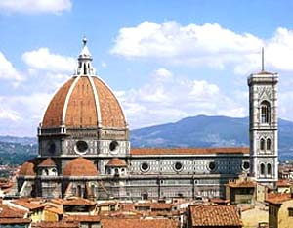
Duomo (cathedral) of Florence, Italy

Slide 15
Duomo of Florence dome interior

Slide 16
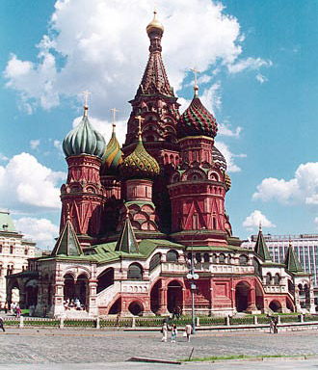
St. Basil’s Cathedral, Moscow

Slide 17
Onion Dome
An onion dome is a dome whose shape resembles the onion, after which they are named. Such domes are often larger in diameter than the drum upon which they are set, and their height usually exceeds their width. These bulbous structures taper smoothly to a point. It is the predominant form for church domes in Russia and Bavaria, Germany, but can also be found regularly across Austria, Eastern Europe, Mughal India, the Middle East and Central Asia.

Slide 18
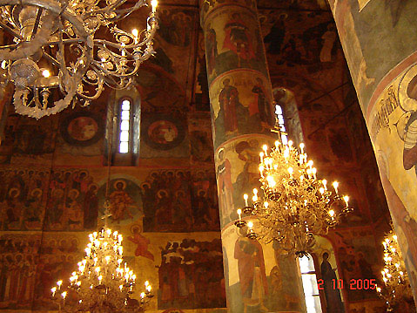
St. Basil’s dome interior

Slide 19
Taj Mahal, India

Slide 20
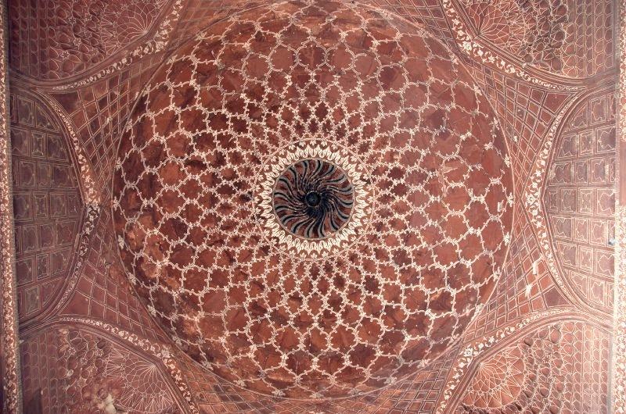
Taj Mahal Dome interior

Slide 21
Royal Mosque, India

Slide 22
Royal Mosque dome interior

Slide 23
Typical on Greek islands.

Slide 24
U.S. Capital Building Dome

Slide 25
U.S. Capital Building dome interior

Slide 26
Duomo in Palermo, Sicily

Slide 27
Duomo di Palermo, Sicily - interior

Slide 28
Other decorative domes

Slide 36
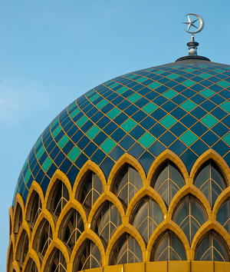
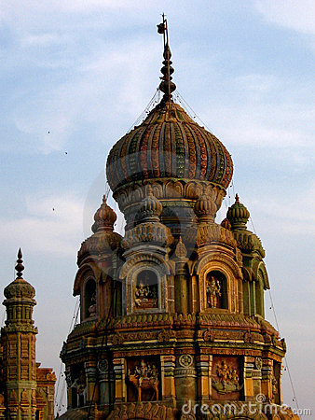
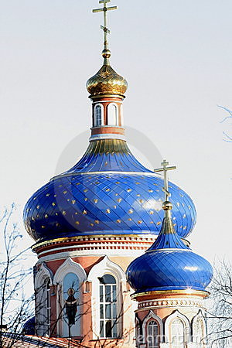
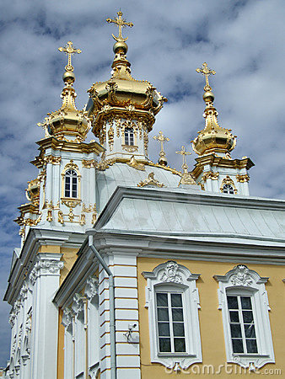
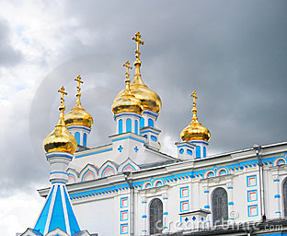

Slide 37
