Slide 1
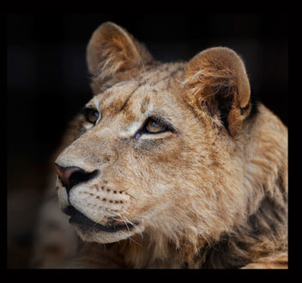
Up Close and Personal with a Lion and a Tiger
Double amputee, John Reinke

Slide 2
Lions and tigers aren’t usually the sort of animals you’d want to get close to, but that’s exactly what double amputee John Reinke likes to do. In fact, he’s discovered an incredible ability to get so close to such animals that he can cuddle them. He only released his sensitive skill after a bungee jump accident caused him to lose both legs. The dad-of-two has a particularly special bond with Bonedigger, a seven-foot male lion, who like John also suffers from a disability due to brittle bones.

Slide 3
John with a young Bonedigger

Slide 5
John, 43, first came into contact with the big cat through his work at the G.W Exotic Animal Park in Wynnewood, Oklahoma. He bottle-fed Bonedigger, now 18 months old, from birth, and the pair are now the closest of pals.
Speaking about this special bond John added, ‘He’s like a dog and when he hasn't seen me for ages he gets all excited and runs up to me.’
Nothing about the relationship between the pair is normal; Bonedigger was hand-reared by John along with a tiger named Tony.

Slide 7
‘They used to live with me in the house. I raised them both with bottled formula and raw meat until they grew too big for the house,’ said John.
And even though they’ve moved out Tony and Bonedigger aren’t far from John - the cats share an enclosure next to the house John usually lives in with the other keepers.
‘Tony is perfectly healthy, but is a bit too playful. When Bonedigger senses that I am losing control of the play, he snarls at Tony and you can tell he is being protective and telling him to stop.’

Slide 12
Three's no crowd: When Bonedigger senses John is losing control of the play, he protectively snarls at Tony and tells him to stop

