Slide 1
Aggressive or “Kung Fu” Birds
Some great action pictures

Slide 2
Urs Schmidli
Bird watcher Urs Schmidli spent hours crouched in his garden trying to capture the perfect picture, but could not believe how the male bird managed to stop the squawking of his flighty friend.

Slide 3
Postman Schmidli, 55, from Switzerland said he studied the sparrows in his garden for a month before he began taking pictures.
'Sparrows mainly have little squabbles over food.

Slide 4
'But in this one shot it really looked like the darker male had just had enough of a nearby female's cheeping and decided to try and quieten the din down.'

Slide 5
This incredible picture shows how a lovers tiff between two sparrows ended abruptly when the male bird rudely took matters into his own claws and clamped his female friend's beak shut.

Slide 6
I said, “Quit your squawking!”

Slide 7
Let’s look at some other “aggressive” or “Kung Fu” birds.

Slide 8
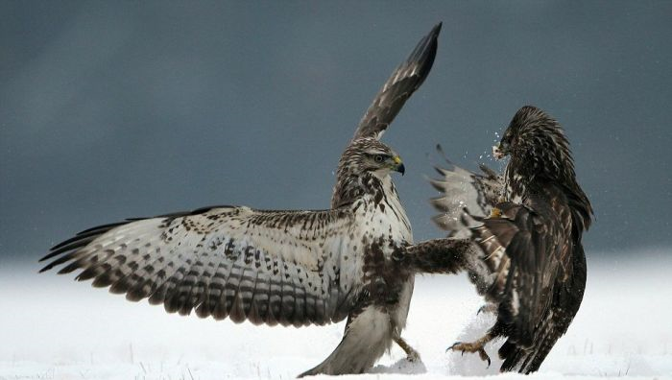

Slide 9
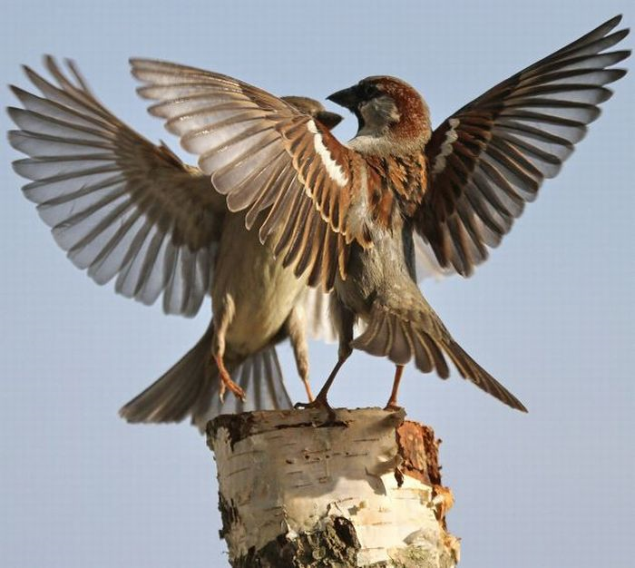

Slide 10
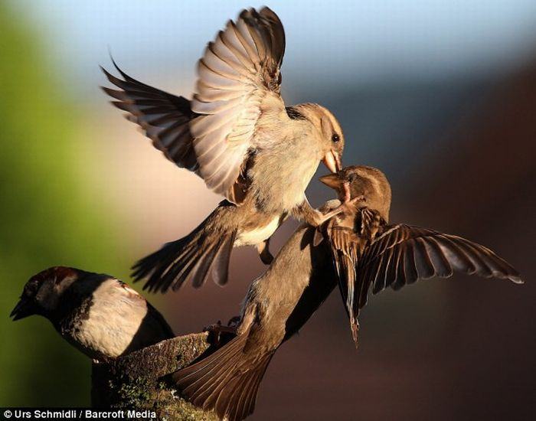

Slide 11
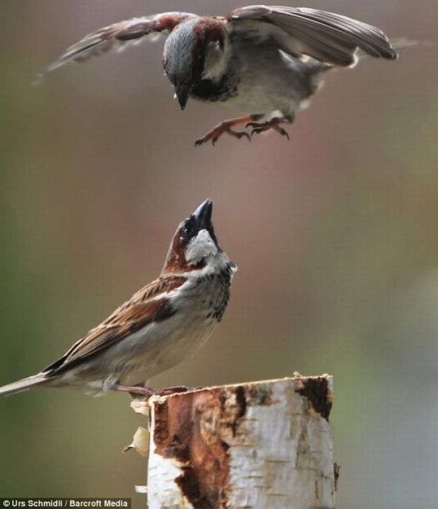

Slide 12
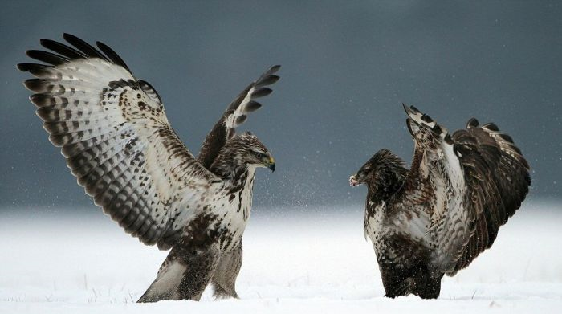

Slide 13
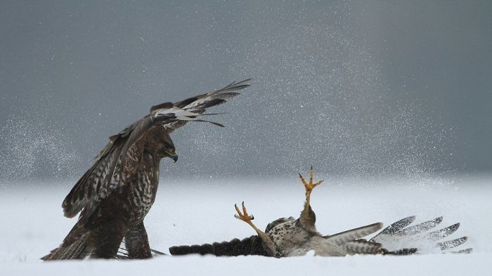

Slide 14
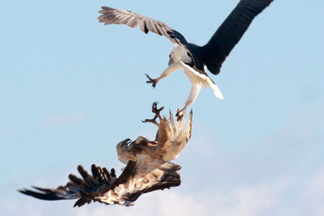

Slide 15
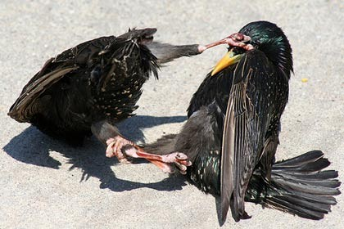

Slide 16
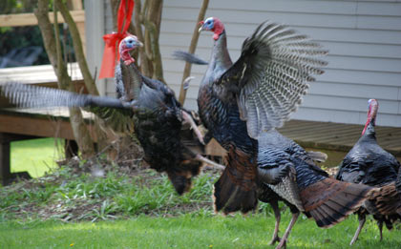

Slide 17
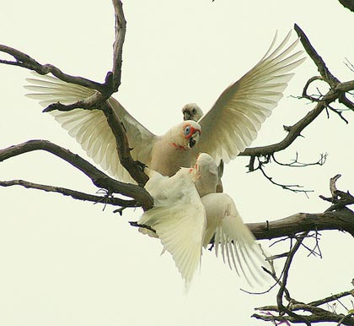

Slide 18
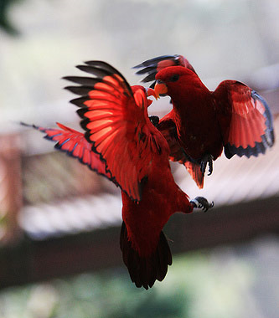

Slide 19
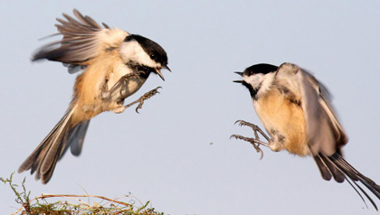

Slide 20
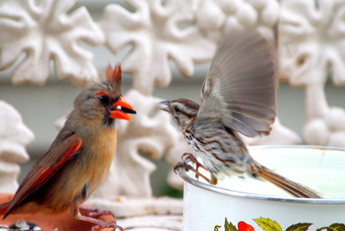

Slide 21
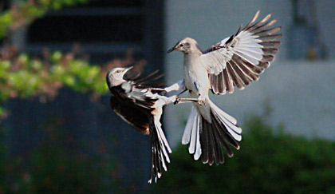

Slide 22
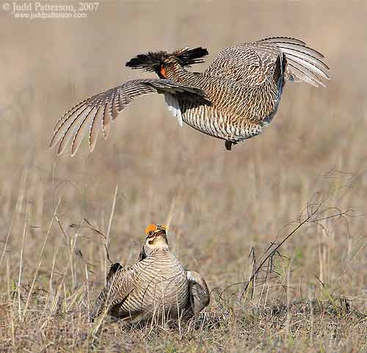

Slide 23
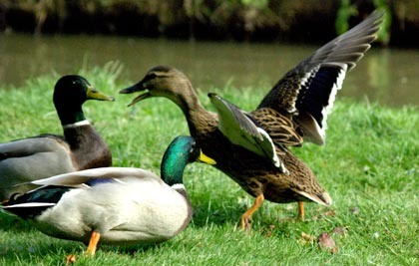

Slide 24
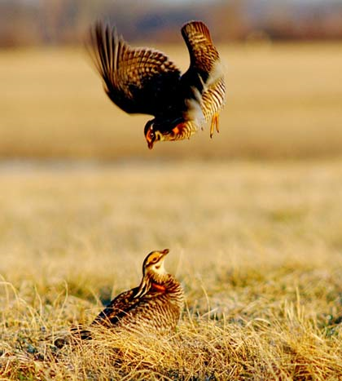

Slide 25
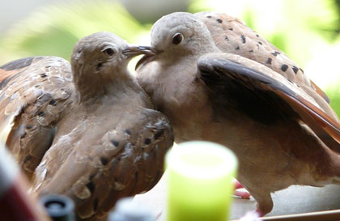

Slide 26
