Slide 1
Agriculture in Developing Nations
A Sampling

Slide 2
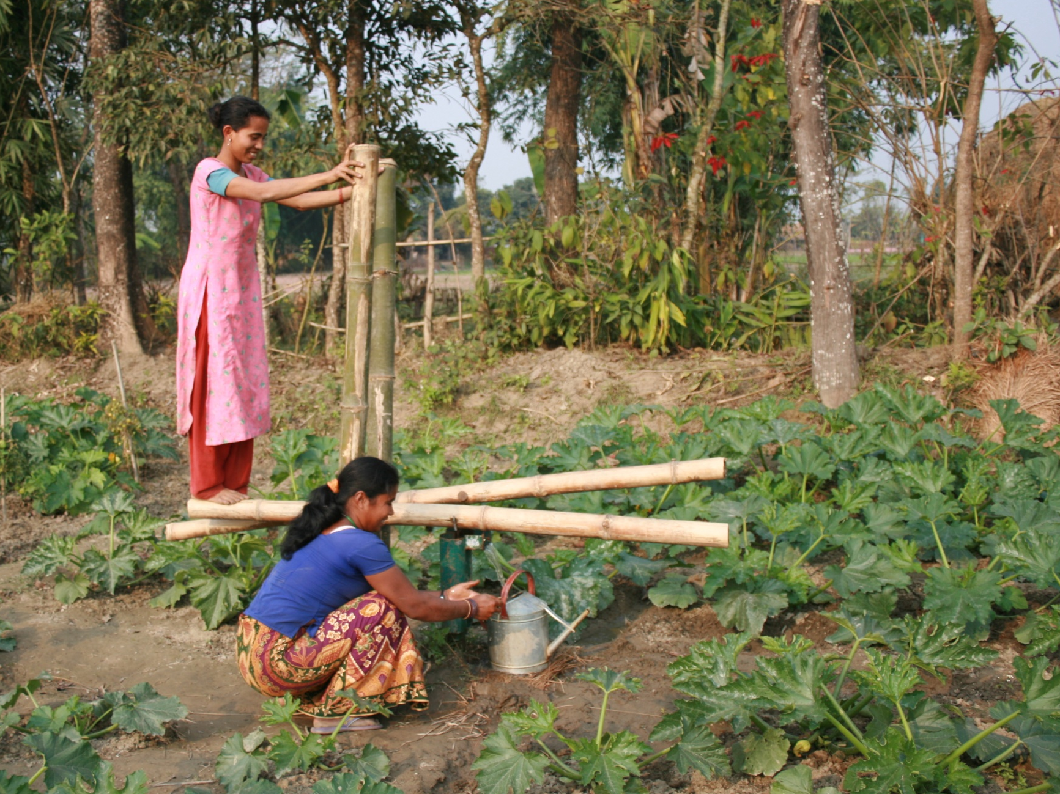
A treadle pump is used to irrigate crops in Nepal. Water is pumped up from under the ground using pistons and directed into irrigation channels. It can also be collected in watering cans to water plants further afield as is the case in this picture.

Slide 3
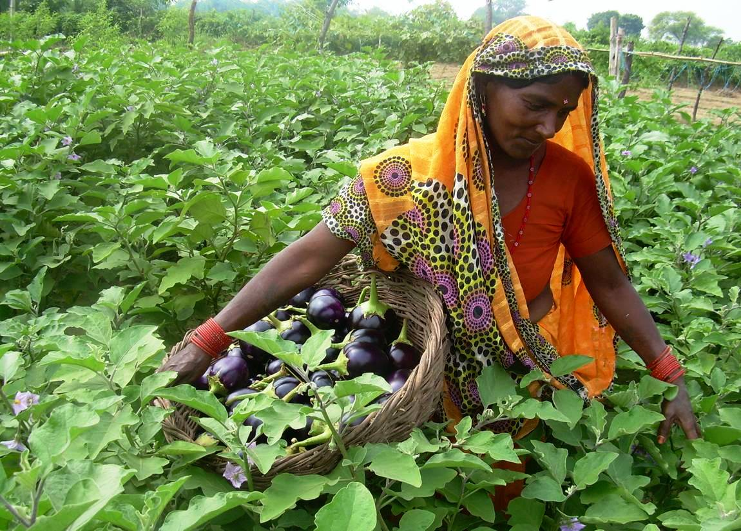
A Farmer harvesting aubergines in Nepal. Farmers started growing aubergines as a result of a project introduced by Practical Action that enabled them to get together and produce a wide variety of different crops.

Slide 4
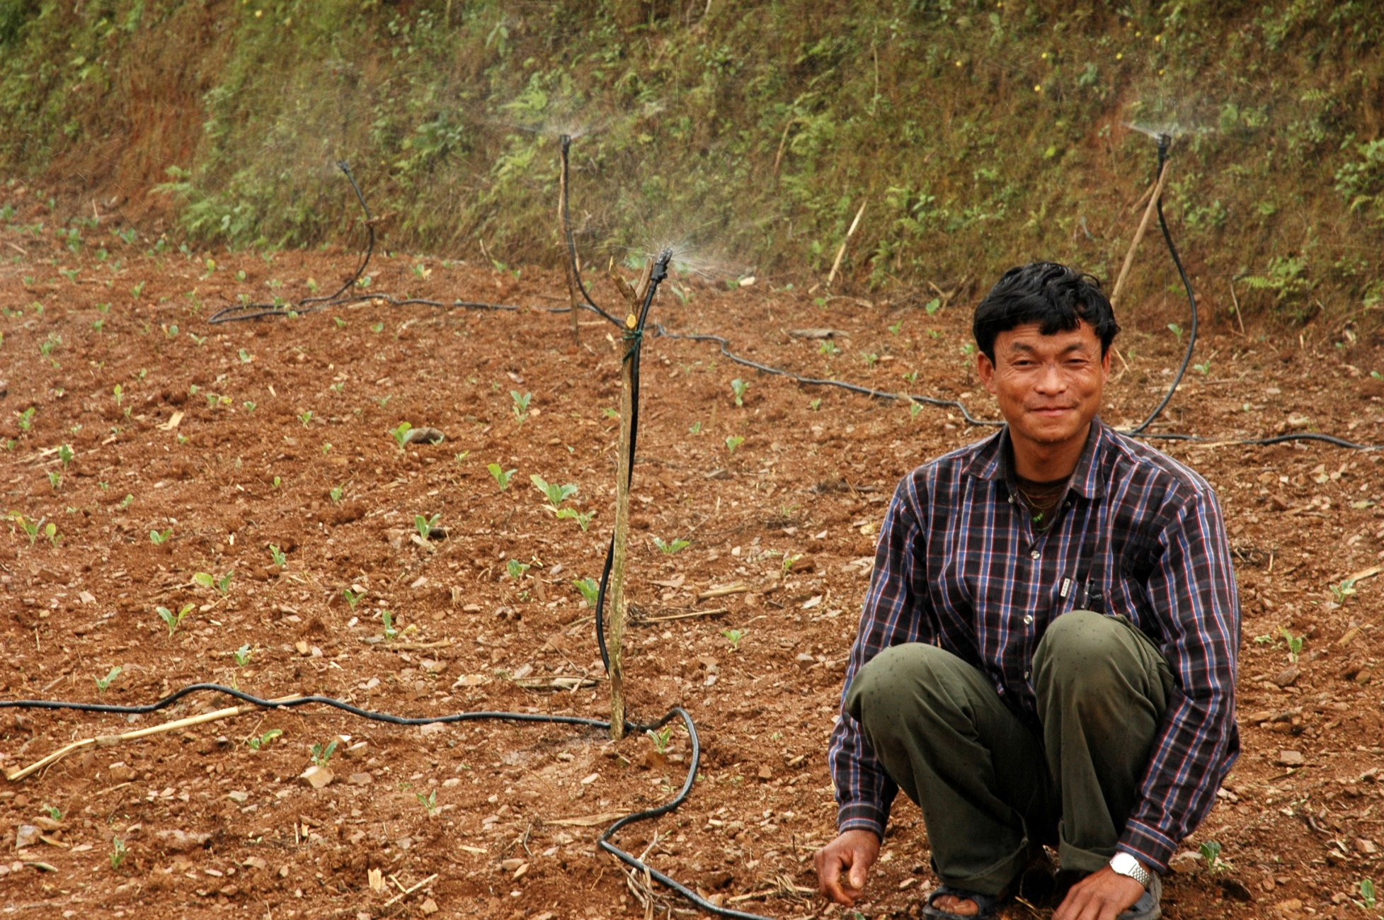
A farmer in Nepal has installed a sprinkler irrigation system to water his crops.

Slide 5
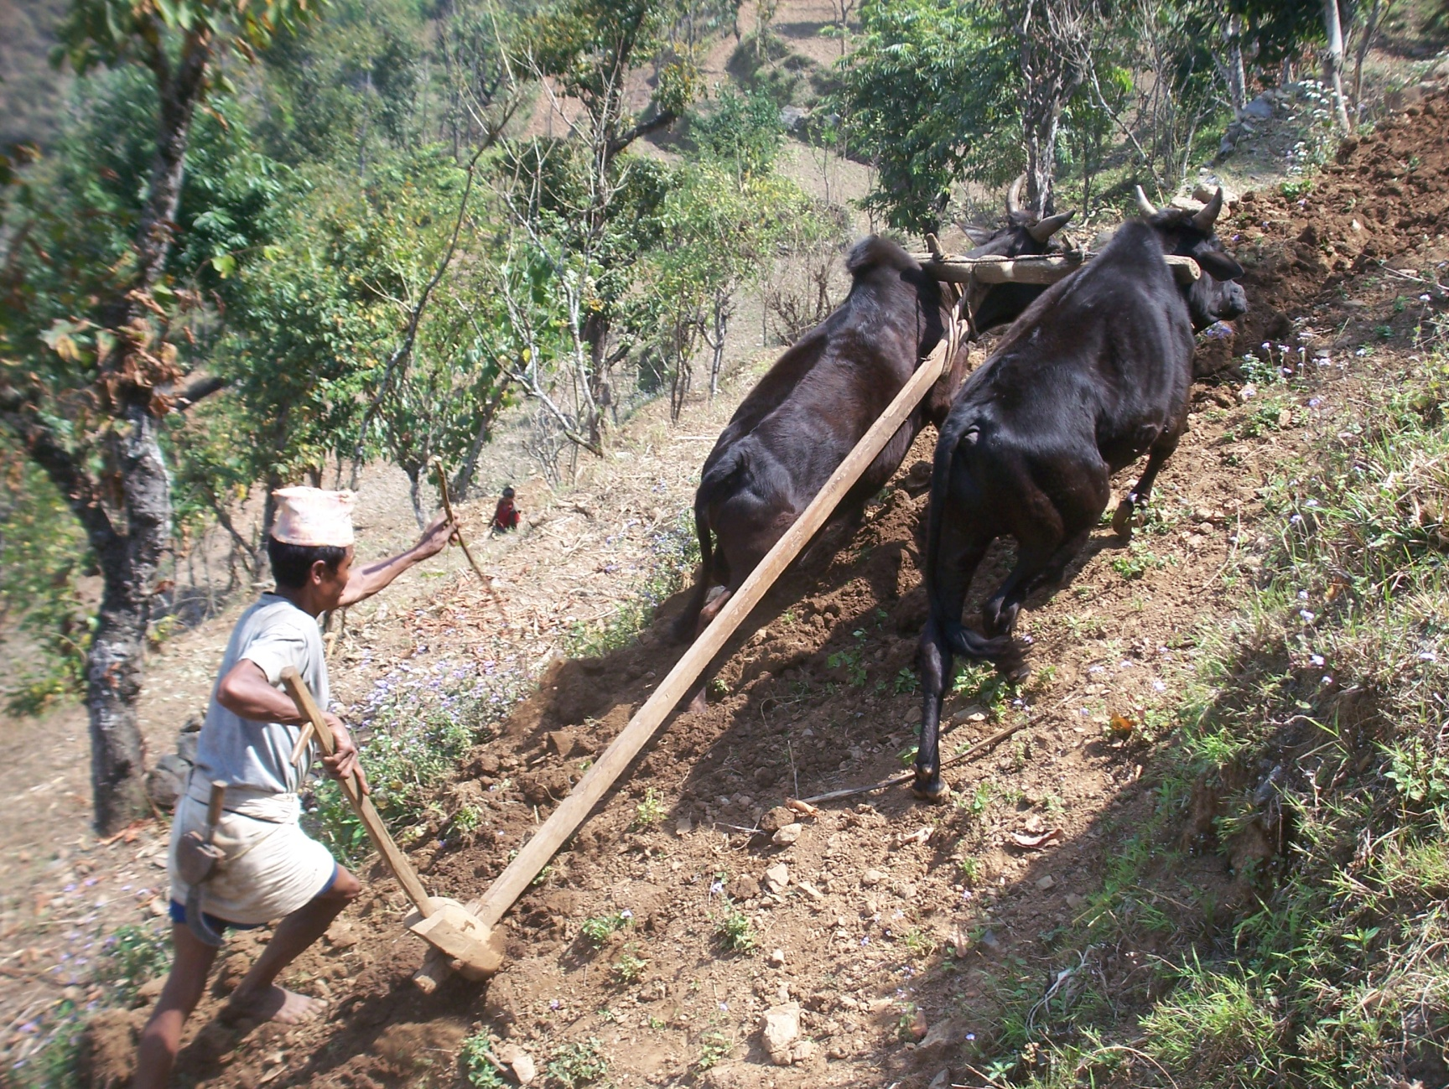
This farmer in Nepal is using oxen to plough his land which is on an extremely steep mountainside

Slide 6
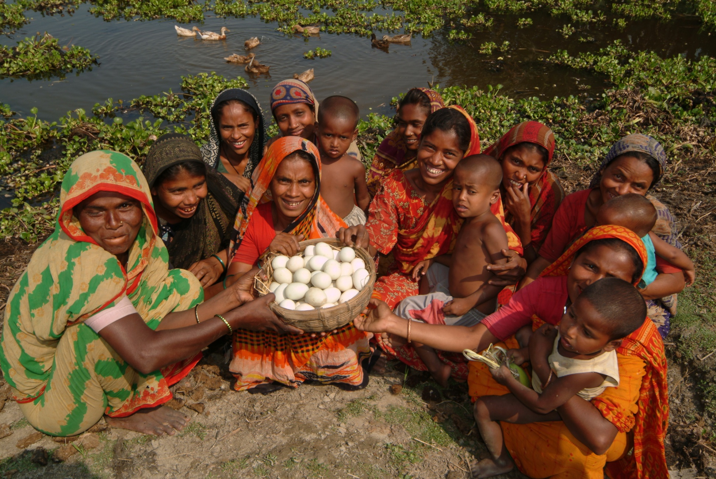
In Bangladesh Practical Action has trained women to keep ducks instead of goats to provide food for their families and to sell. Unlike goats ducks are not affected when it floods.

Slide 7
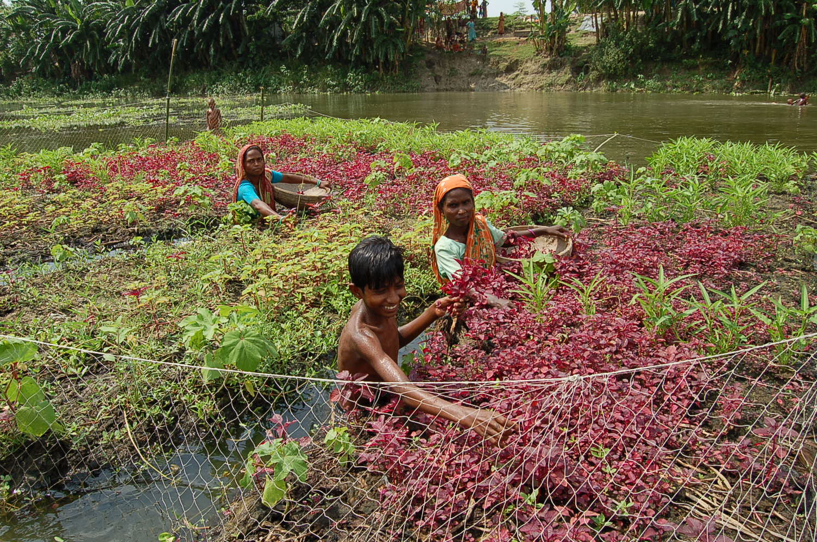
Climate change increases the risk of flooding in Bangladesh. Practical Action shows communities how to grow crops on a raft made of hyacinth roots. This means when their land floods the crops will not be ruined. They also breed ducks rather than goats.

Slide 8
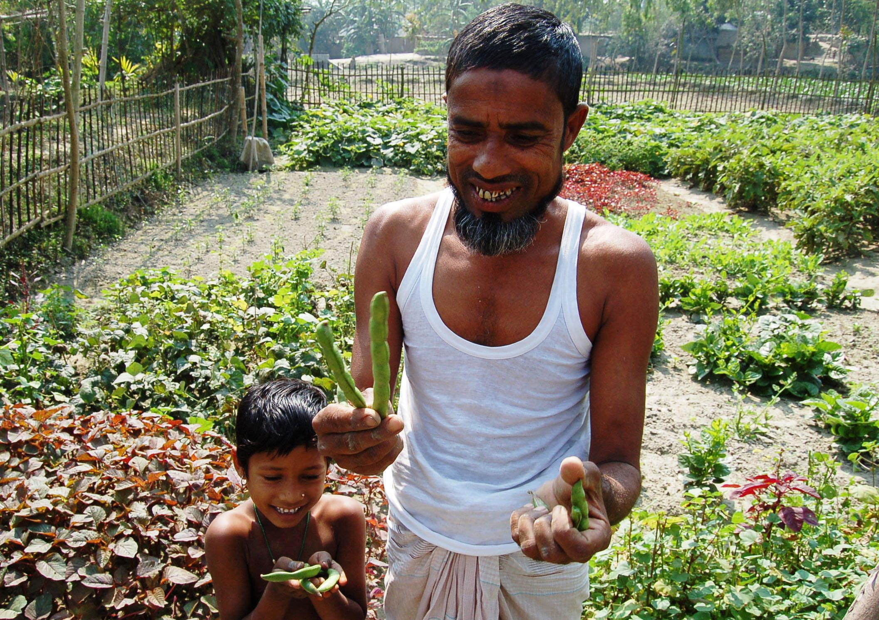
A man and his son showing broad beans they have grown in their homestead garden in Bangladesh. The garden is not the man’s main livelihood but provides food for his family.

Slide 9
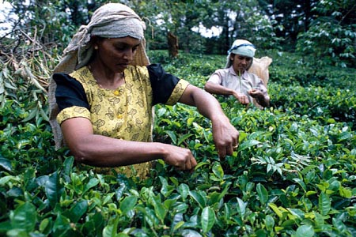
These women in Sri Lanka are picking tea

Slide 10
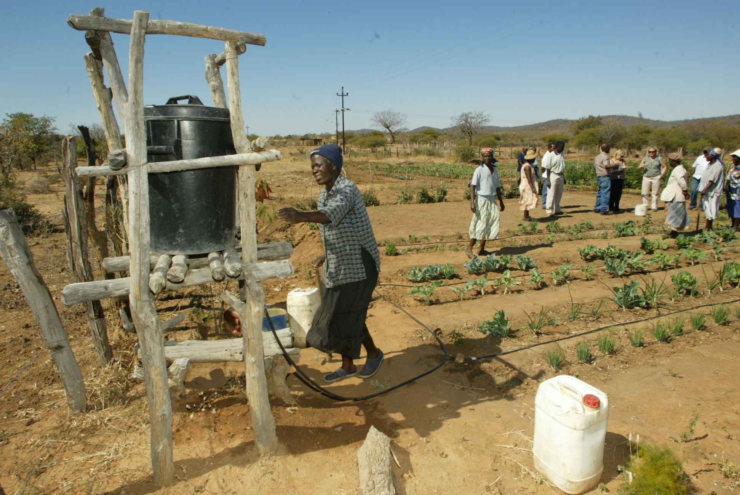
This drip irrigation system in Zimbabwe shows how an elevated water reservoir tank and a system of pipes is used to water plants. The pipes have holes in at regular intervals so the plants are individually watered.

Slide 11
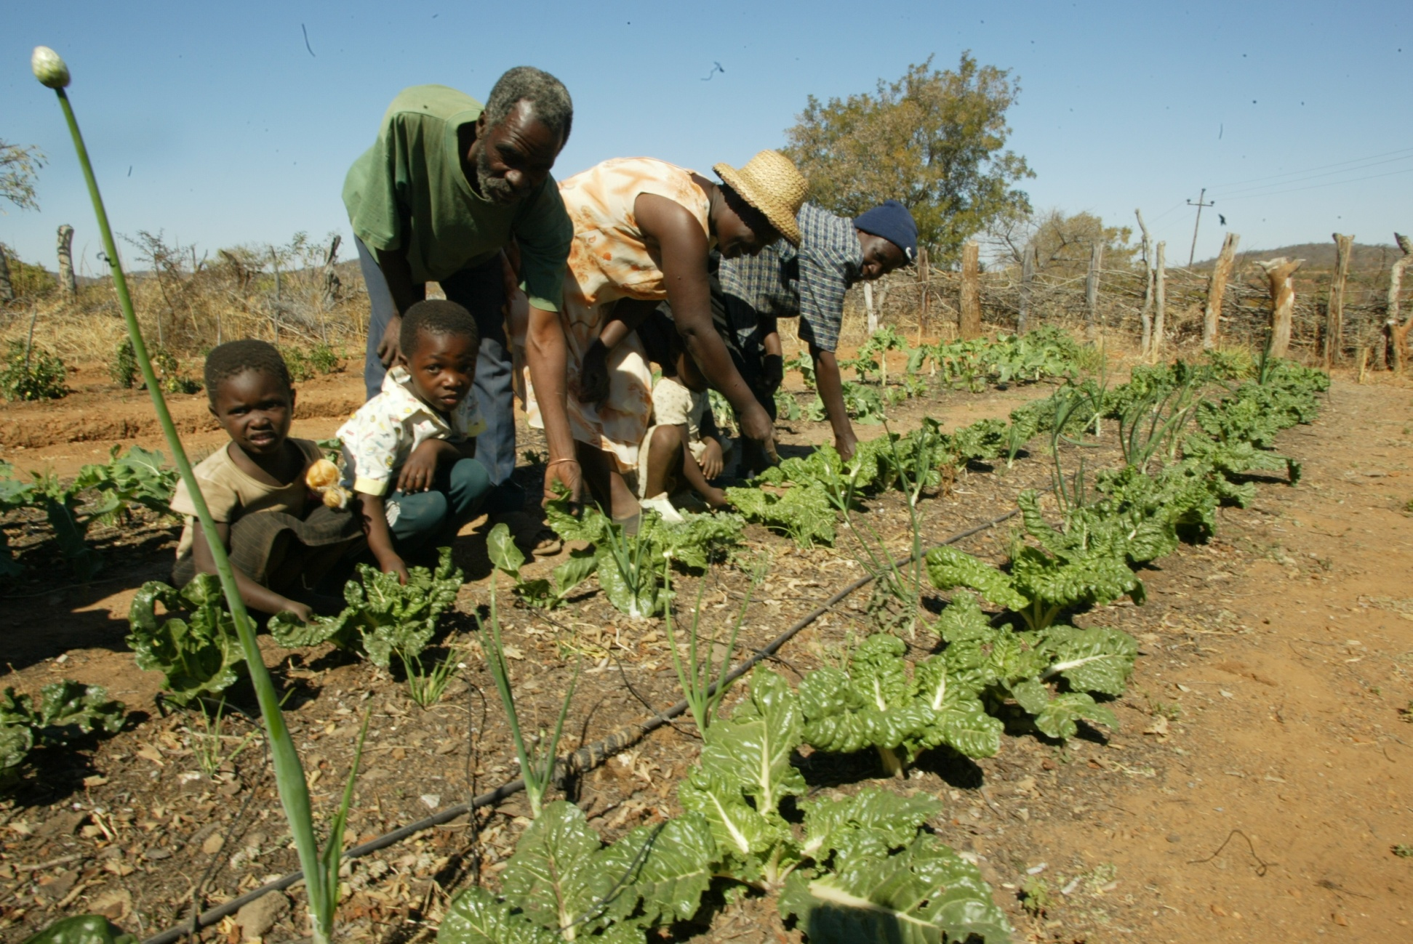
Practical Action works with communities in Zimbabwe to help them install drip irrigation systems. These make efficient use of any water which is harvested.

