Slide 1
Iceland's Grimsvotn Volcano Erupts
May 2011

Slide 2
The world didn’t end on May 21, 2011 as predicted
As "apocalypse", "end of world 2011", "rapture 2011" and more lead the most tweeted about and searched about topics, there seems to be an ironic turn of events as Iceland's most active volcano Grimsvotn has just started erupting.

Slide 3
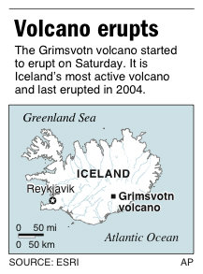

Slide 4
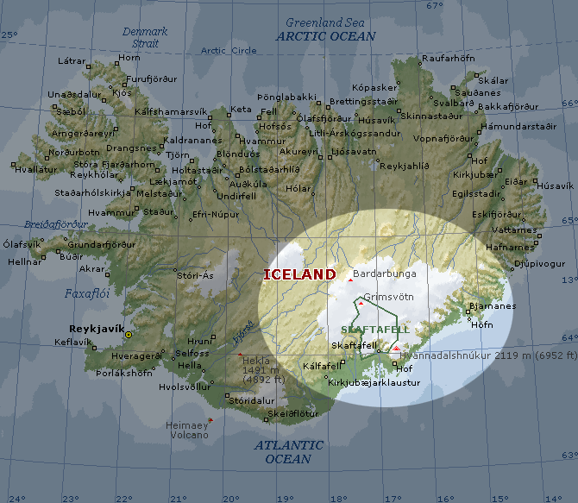

Slide 5
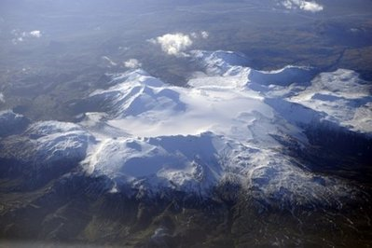
An aerial view taken from a plane shows a glacier in Iceland in 2008. An eruption began at the Grimsvoetn volcano under Iceland's largest glacier Saturday, May 21, 2011

Slide 6
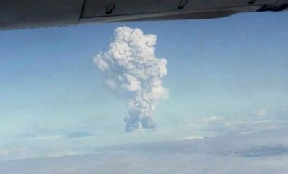

Slide 7
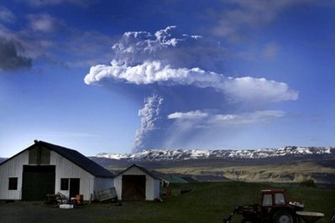

Slide 8
The Grimsvotn volcano last erupted in 2004. Here is one of the most recent twitpic's of the volcano from Hjortur Smarason, who seems to have taken it from Hotel Nupur in Isafjordur, Iceland.

Slide 9
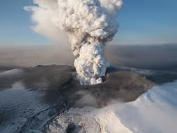

Slide 12
Sunset beyond the rising ash cloud of erupting Grímsvötn volcano, seen from nearby Sprengisandur, on May 22, 2011

Slide 14
Erupting steam and ash interact with clouds above Grímsvötn volcano.

Slide 17
The Sun obscured by volcanic ash in the air.

Slide 18
A tractor is seen through a cloud of ash at the Geirland farm near Kirkjubaejarklaustur

Slide 19
Tire tracks are pressed into a layer of volcanic ash, outside a gas station in Kirkjubaejarklaustur, Reykjavik

Slide 20
A car travels down a highway, immersed in total darkness due to an ash fallout

Slide 21
A dead bird lies in volcanic ash on Highway One

Slide 22
A farm beneath an ash colud in Thorvaldsstadir, southeast Iceland

Slide 23
Sheep standing on an ash-covered field

Slide 24
Ash Plume from Grímsvötn Volcano, Iceland, seen on May 23, 2011

Slide 25
The volcanic eruption cloud of Grímsvötn, apparent on the very edge of NASA's GOES-13 imagery.

