Slide 1
Halong Bay, Vietnam
A Natural Wonder of the World?

Slide 2
A Natural Wonder
watching the world's interest in Halong Bay. In the Official New 7 Wonders of Nature Halong Bay is one of 28 finalists in a global vote on the seven most spectacular natural spaces in the world. We won't know until Nov. 11, 2011 (11.11.11) whether the world thinks Halong Bay is one of the world's most stunning natural landscapes, or seascapes.

Slide 3
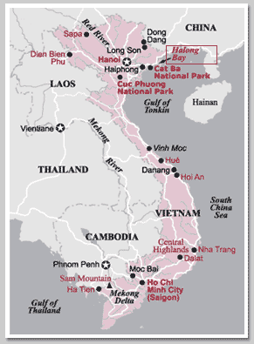

Slide 4
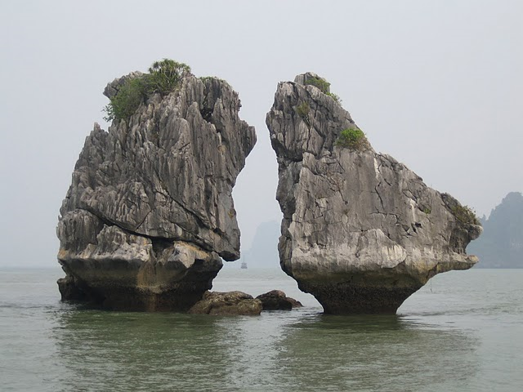

Slide 5
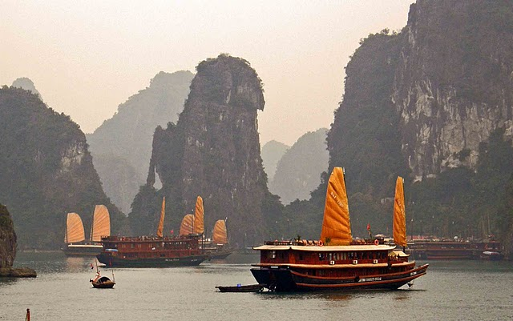

Slide 6
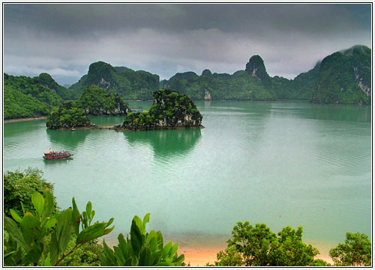

Slide 7
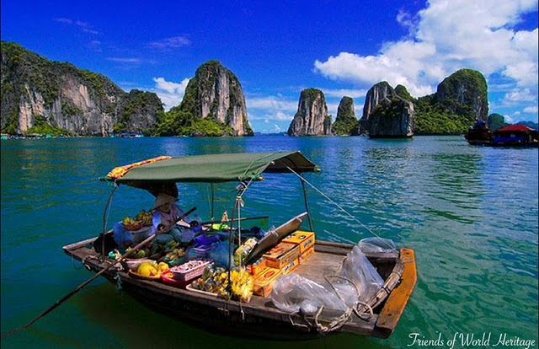

Slide 8
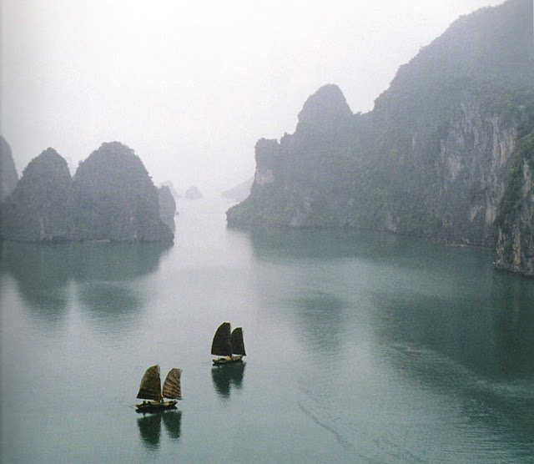

Slide 9
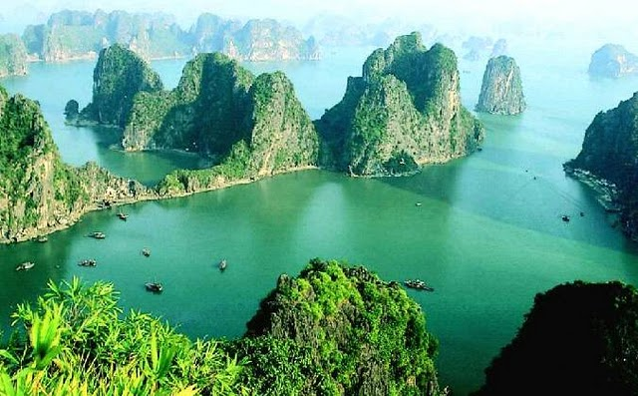

Slide 10
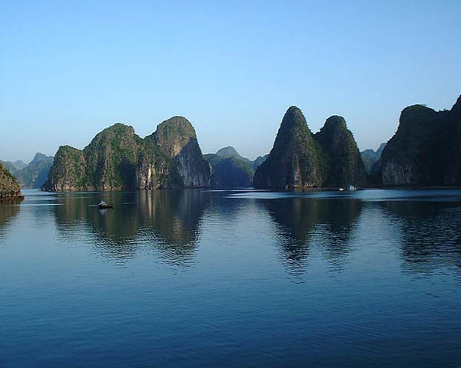

Slide 11
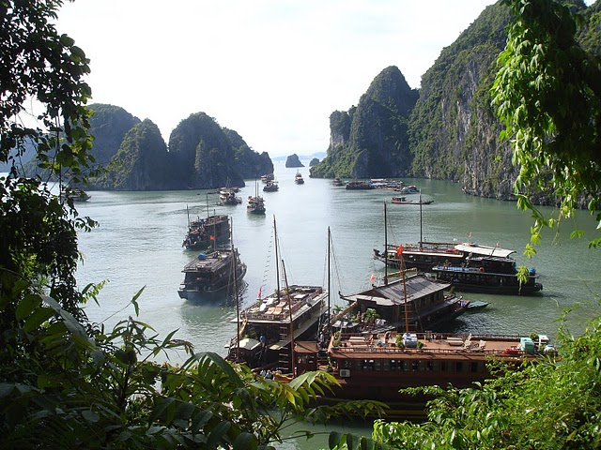

Slide 12
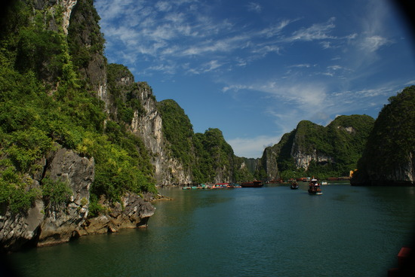

Slide 13
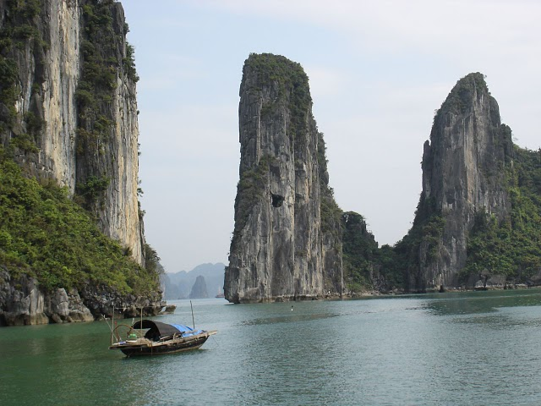

Slide 14
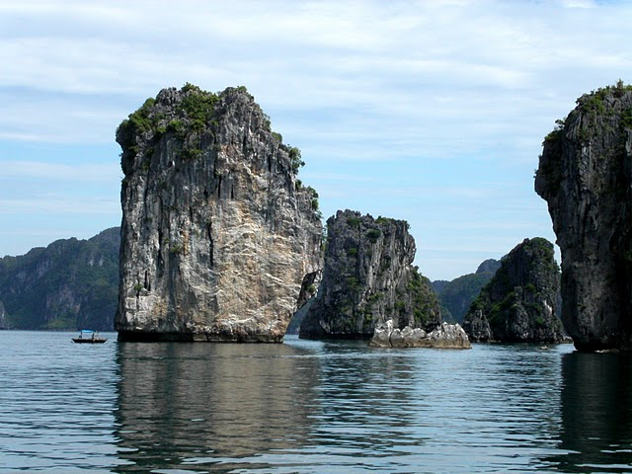

Slide 15
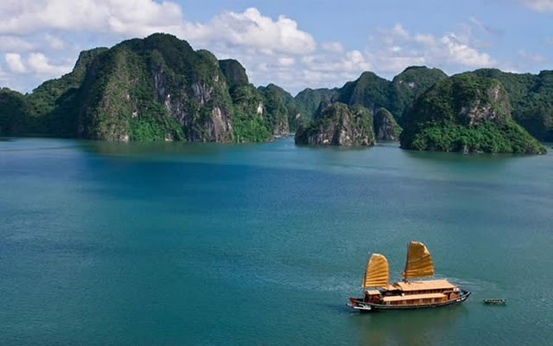

Slide 16
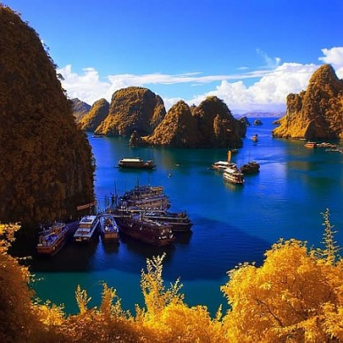

Slide 17
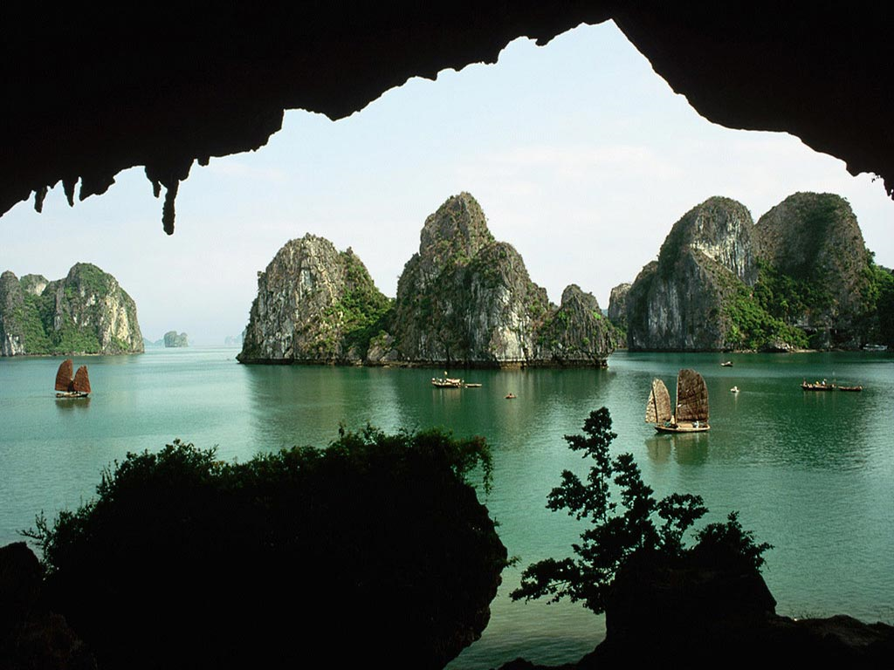

Slide 18
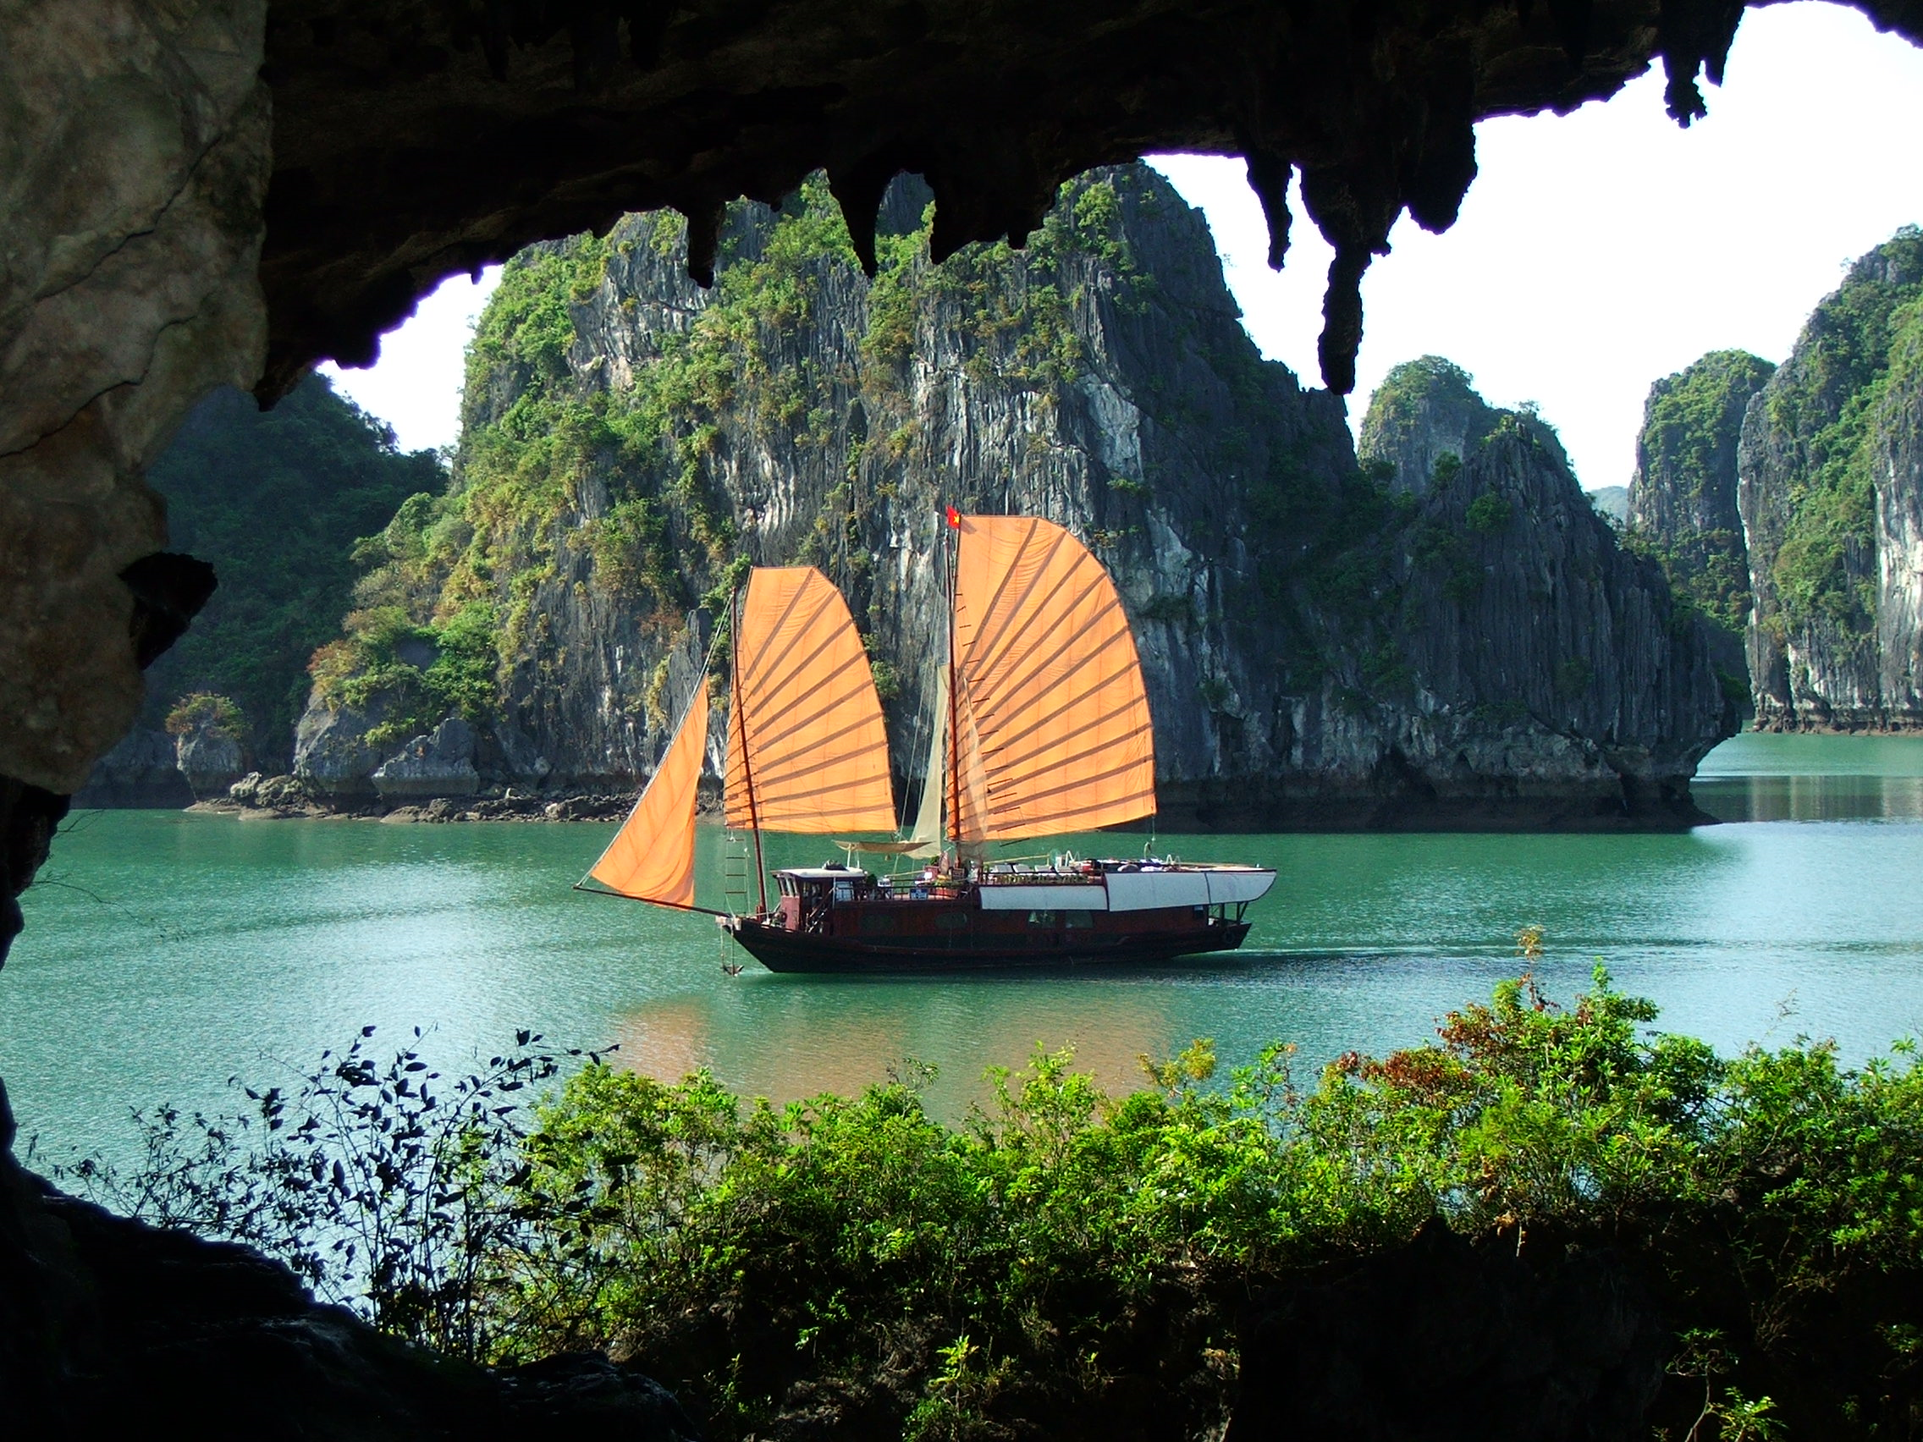

Slide 19
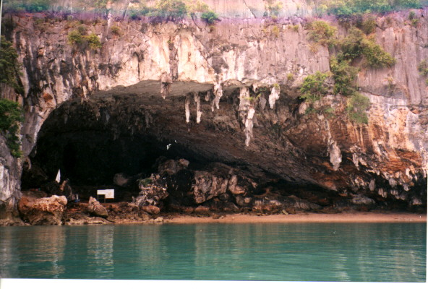

Slide 20
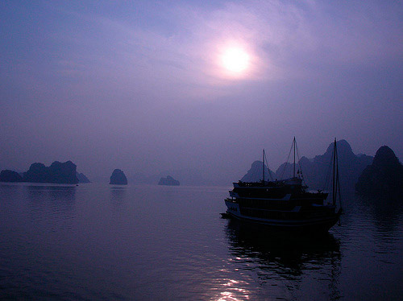

Slide 21
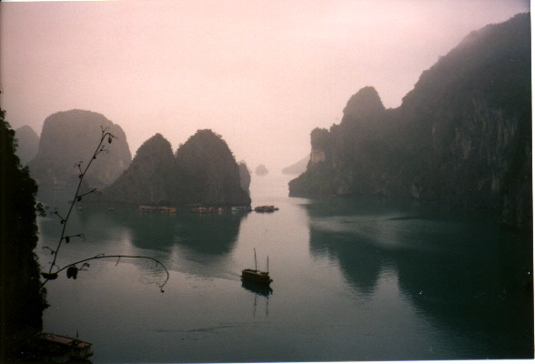

Slide 22
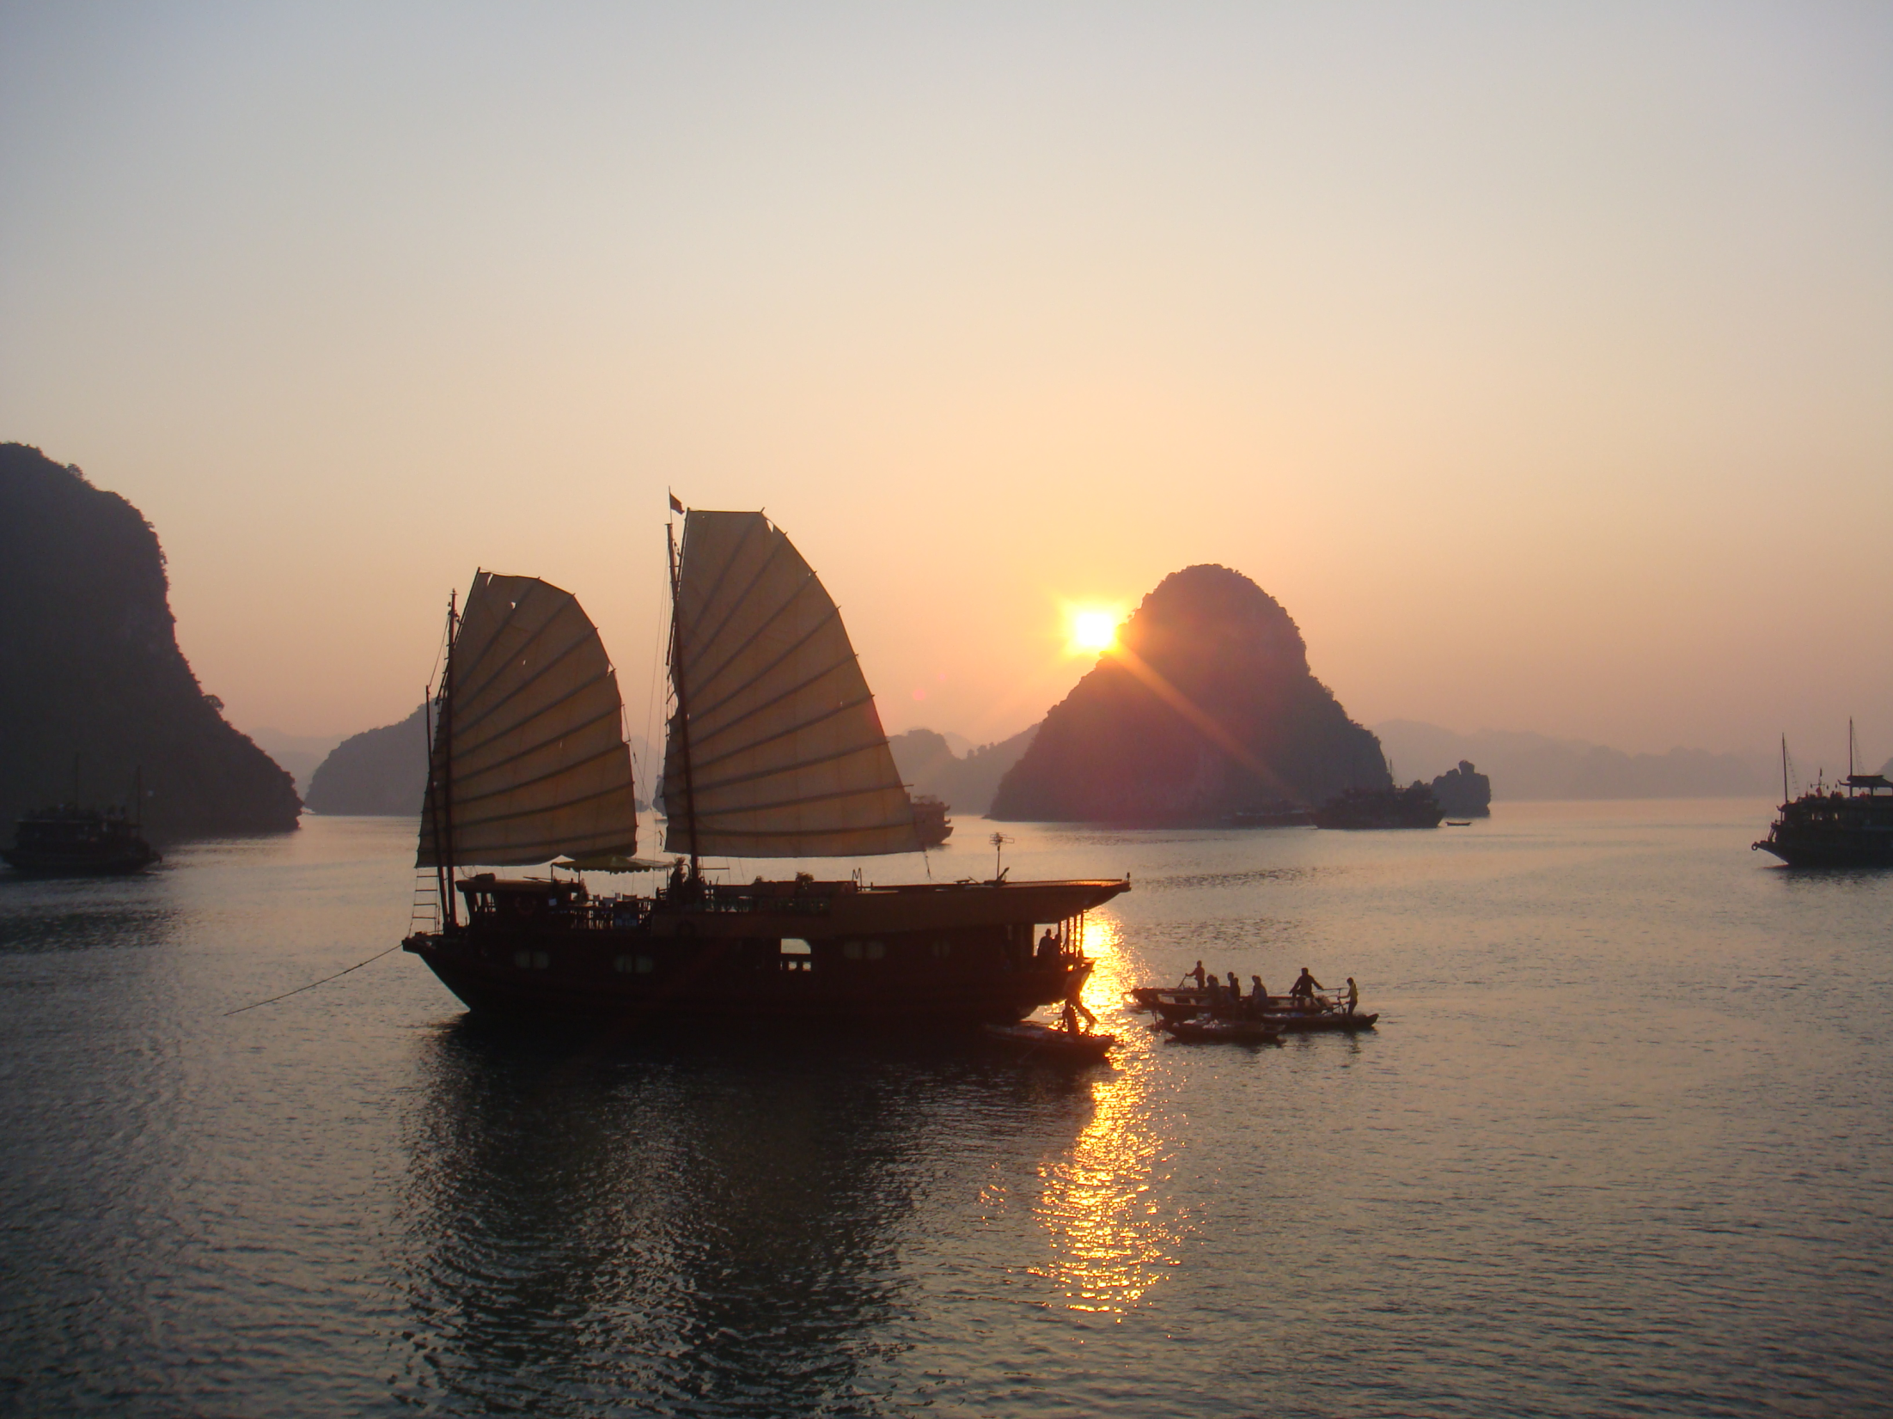

Slide 23
