Slide 1
The Five Themes of Geography
modified by Mrs. Jones – FMMS FURTHER MODIFIED by Joe Naumann UMSL

Slide 2
Let’s Review!
What are the SEVEN CONTINENTS??
Asia
Europe
Africa
Australia
Antarctica
North America
South America
What are the FOUR OCEANS??
Pacific Ocean
Atlantic Ocean
Arctic Ocean
Indian Ocean

Slide 3
Why Study Geography?
It affects where people live.
It affects how people live.
It affects the outcome of major events.

Slide 4
The 5 Themes of Geography
Location
Movement
Region
Place
Human/ Environment Interaction

Slide 5

Theme # 1: Location
Where is it??

Slide 6
Location:
There are two types of LOCATION!!
Absolute
Relative

Slide 7
Absolute Location:
Absolute Location is found by using…
Two specific line types
  Latitude (parallels)
  Longitude (meridians)
Together, the form a GRID

Slide 8

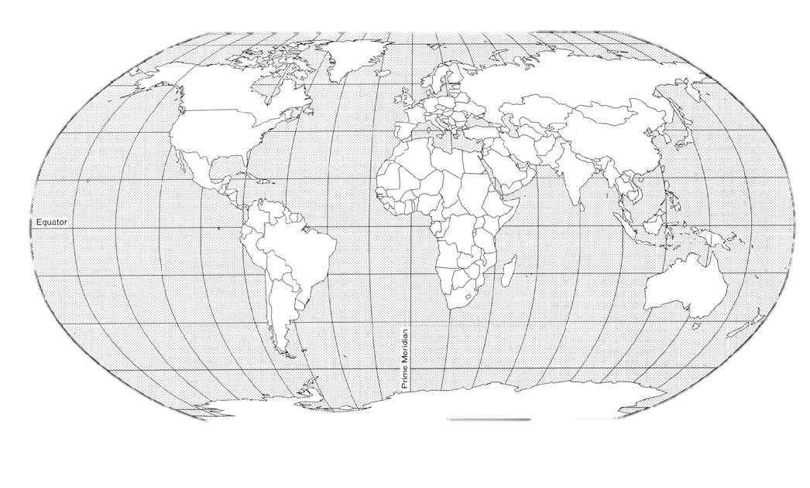
Absolute Location:
Latitude Lines
AKA Parallels
Latitude lines are drawn from:
East to West
Latitude lines measure:
North to South (angular distance
between the parallels)

Slide 9
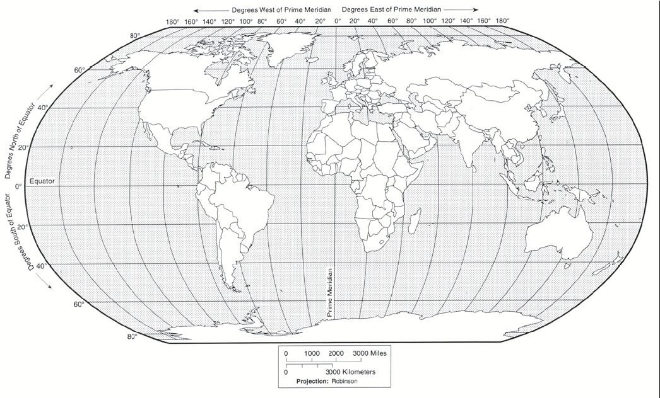
Absolute Location:
The Major Line of LATITUDE is the:
Equator
It splits the Earth into:
the Northern and
Southern Hemispheres

Slide 10
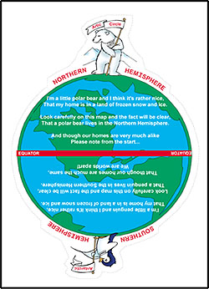

Define Hemisphere:
Half of a globe
(in our case the Earth)
There can be an infinite
number of hemispheres.

Slide 11
Absolute Location:
Longitude Lines
AKA Meridians
Longitude lines are drawn from:
North to South
Longitude lines measure:
East to West (the angular distance between meredians which gets smaller as one moves north or south of the Equator toward the poles.) Meredians are not parallel to each other like the parallels are.

Slide 12
Absolute Location:
The Major Line of LONGITUDE is the:
Prime Meridian
It splits the Earth into:
the Eastern and
Western Hemispheres

Slide 13
Absolute Location:
Can you find an
ABSOLUTE LOCATION???
Using
Latitude & Longitude
Go to an atlas or a map on the internet and estimate the latidude and longitude of St. Louis, Missouri.

Slide 14

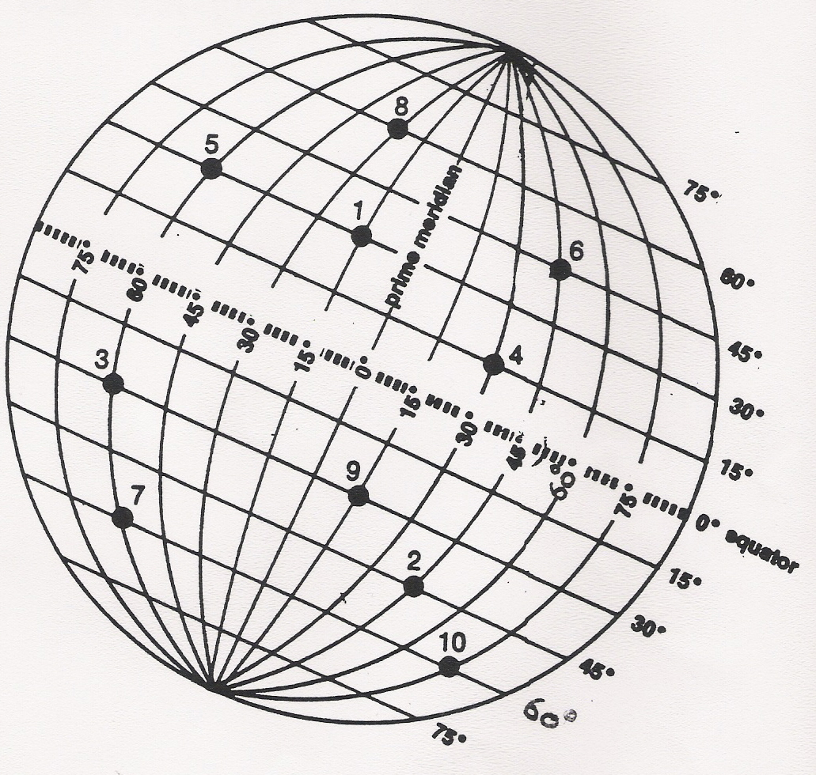
Absolute Location:
1 30*N 15*W
2 45*S 45*E
3 30*S 60*W
4 15*N 30*E
5 30*N 60*W
6 45*N 45*E
7 60*S 60*W
8 60*N 30*W
9 30*S 15*E
10 60*S 75*E

Slide 15
Relative Location:
Where an area is depending on where another area is! It is a description using compass directions and/or terms like “turn left” in relationship to distinctive features or landmarks.
Figure out where the teacher’s desk is in relation to something else in the room!

Slide 16
Theme # 2: Movement
How are people linked together?
The transfer of people, animals, objects, ideas, energy or information from one location to another.

Slide 17
Movement:
Movement has two forms of transference:
  Material movement – you may be aboe to see, touch, taste, smell, and/or hear what is being transferred.
  Non-material movement – you cannot see, touch, etc. what is being transferred, but you can be affected by that transfer.

Slide 18
Movement: What can move??
Material things
GOODS
PEOPLE AND THEIR PERSONAL STUFF
MONEY sent by mail or hand carried.
IDEAS

Slide 19



Material Movement requires a form of conveyance to hold the material or channel its movement (pipeline):
Forms of transportation

Slide 20

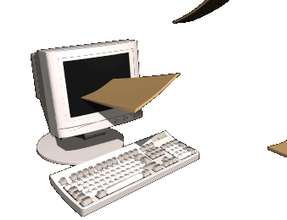


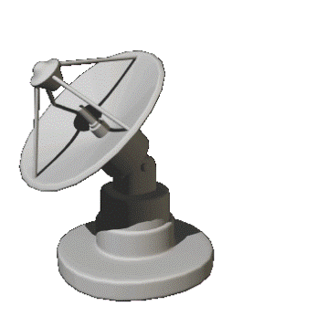
Movement: What can move??
Non-Material things (ideas, fads, information, energy, etc.) need some means of conveyance too.
COMPUTERS
TELEPHONES
SATELLITES
WORD OF MOUTH

Slide 21
Movement:
Through movement we connect all of our world together. This is promotes globalization (Concepts, practices, ideas, products becoming rather universlized among the world’s people)!
In the 21st century, we are interdependent on each other for our economy, culture, politics, socialization, and technology.

Slide 22
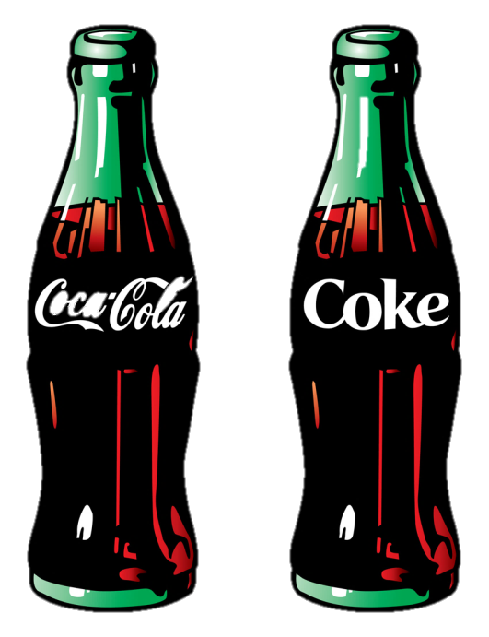
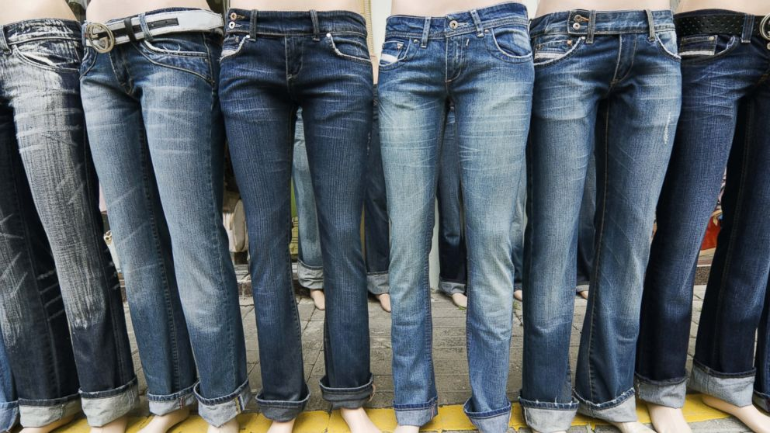
Globalization . . . .
It’s everywhere . . . It’s everywhere . . . It’s everywhere . . . It’s everywhere . . . It’s everywhere . . . It’s everywhere . . .

Slide 23
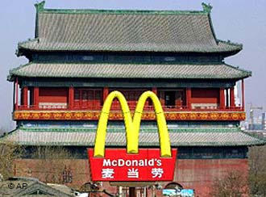




Slide 24
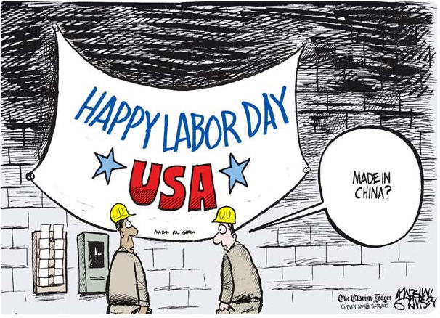

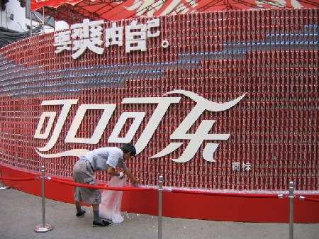
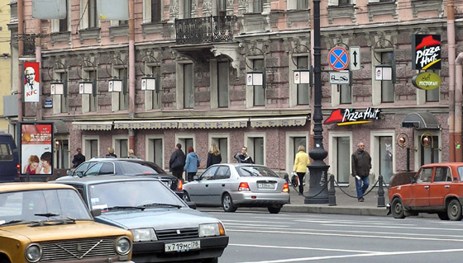

Slide 25
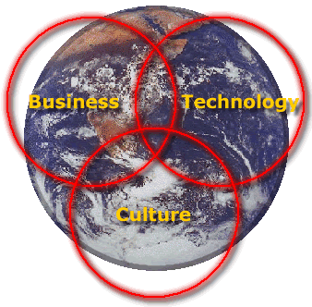
Actually, business methods and technology are part of a particular culture and as they evolve, so does the culture. Other elements of culture are social mores, religion, gender roles, language, family structure, etc. Outside factors (globalization) can produce changesw in some of these cultural factors.

Slide 26
Theme # 3: Region
What does this part of the earth’s surface and its people have in common?
Upon what, and where, does this part of the earth’s surface and its people focus.

Slide 27
Region:
A region describes:
A part of the Earth’s surface and its people that has one or more things in common or has a common focus.
Regions can be: BIG or small

Slide 28
Region:
There are two types of Regions
  Formal – sharing a common feature or several features in common
  Functional – focused on a particular location because of a relationship.

Slide 29
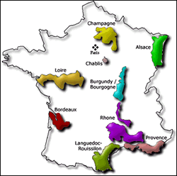
Region:
A Formal Region is an. . . Area in which a certain characteristic or characteristics are generally found throughout the area
    Example: City, State, Country, Continent, agricultural area, cultural area, etc.

Slide 30
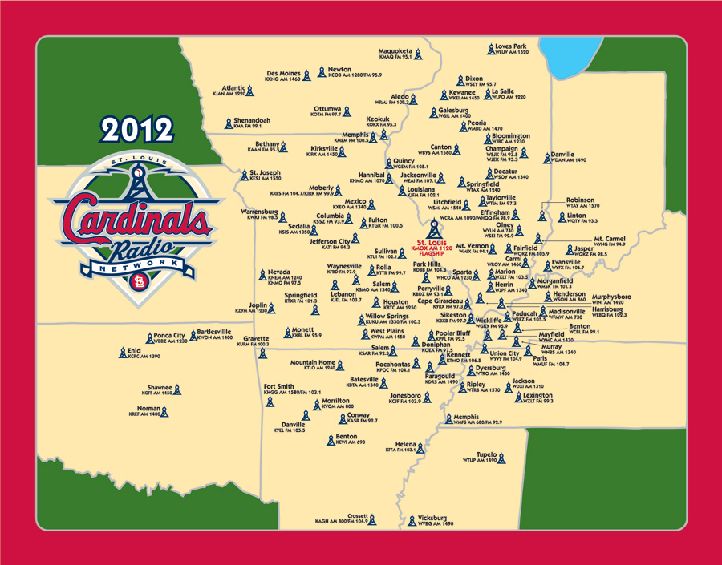
Region:
Functional Regions
Have one central place and is surrounded by the areas it affects
St. Louis Cardinals – listening area

Slide 31
Theme # 4: Place
What is it like?
What sets it apart from other locations?
What is distinctive?
TWO CATEGORIES:
    Physical – what nature put there
    Cultural or Human – how humans have altered the location in some distinctive ways.

Slide 32
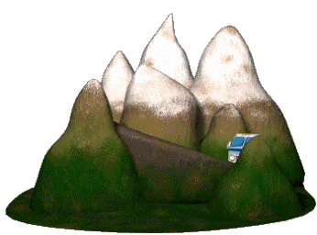
Physical Place:
Physical Features include the landforms and bodies of water found on the earth

Slide 33
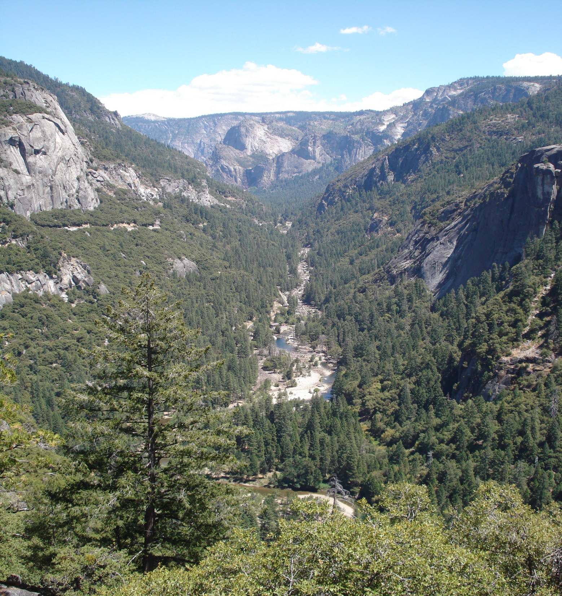
Physical Place:
What is it like?

Slide 34
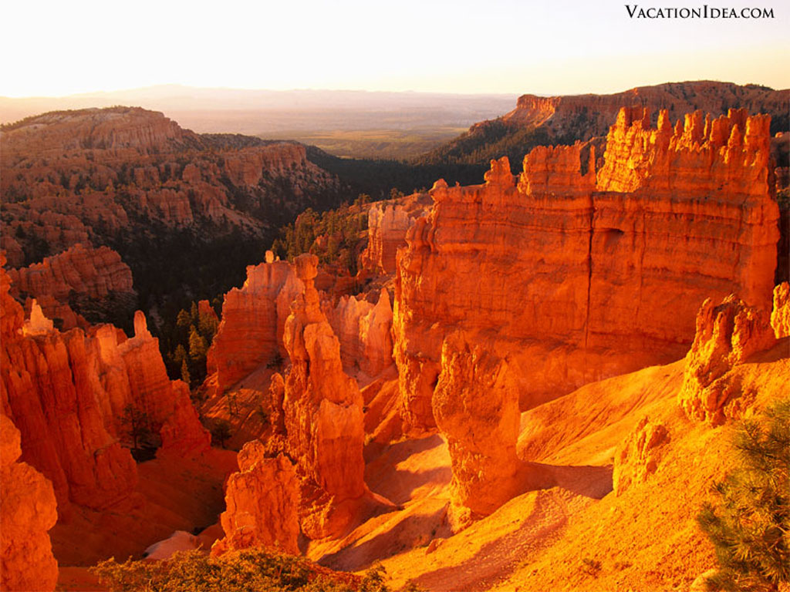
Physical Place:
What is it like?

Slide 35
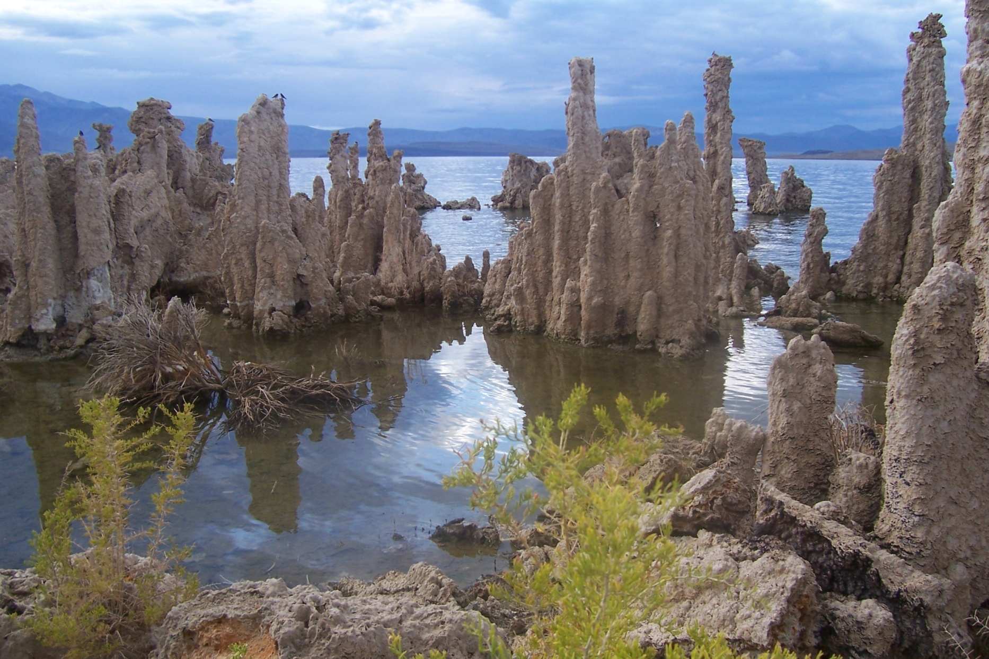
Physical Place:
What is it like?

Slide 36
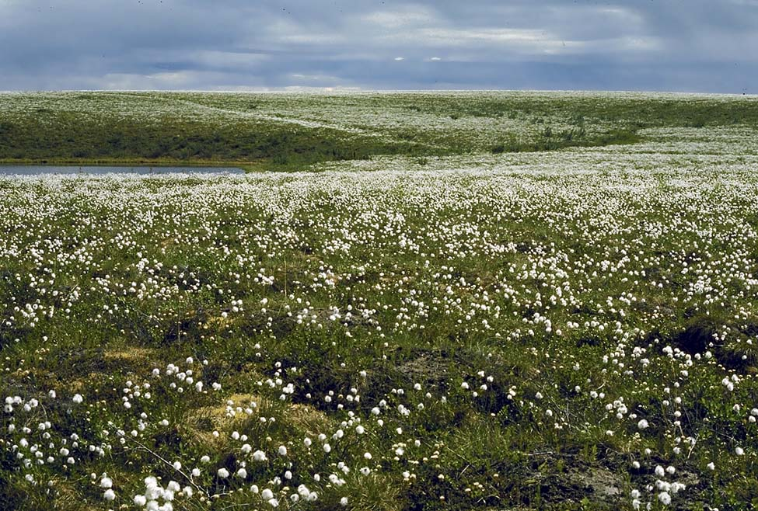
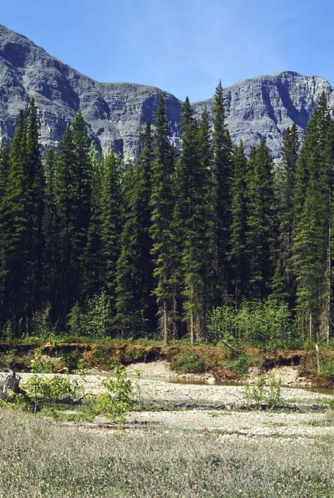
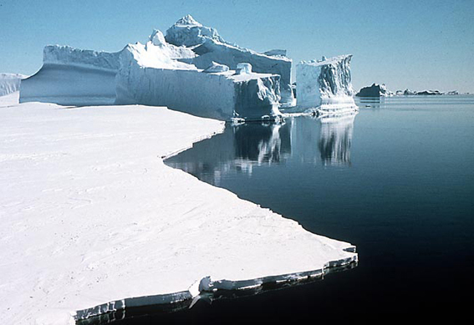

Slide 37
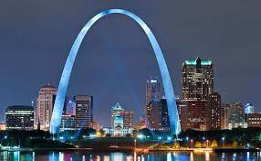
‘’Cultural or Human Place:
Related to interaction (alteration)
How have humans changed the location in some distinctive way?
  Removing things nature put there
  Adding plands and animals that nature hadn’t put in that location
  Constructing distinctive structures
  Creating very identifiable landmarks

Slide 38
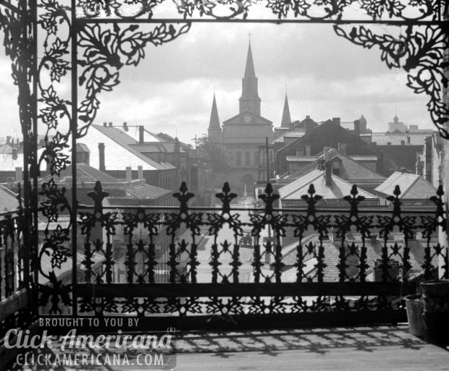
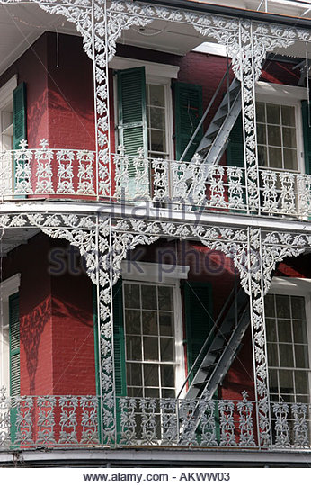
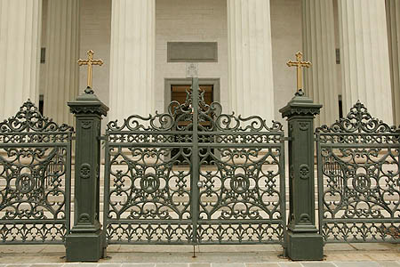
Human Place
Distinctive wrought iron work in New Orleans

Slide 39
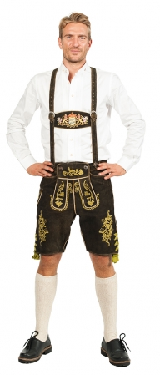
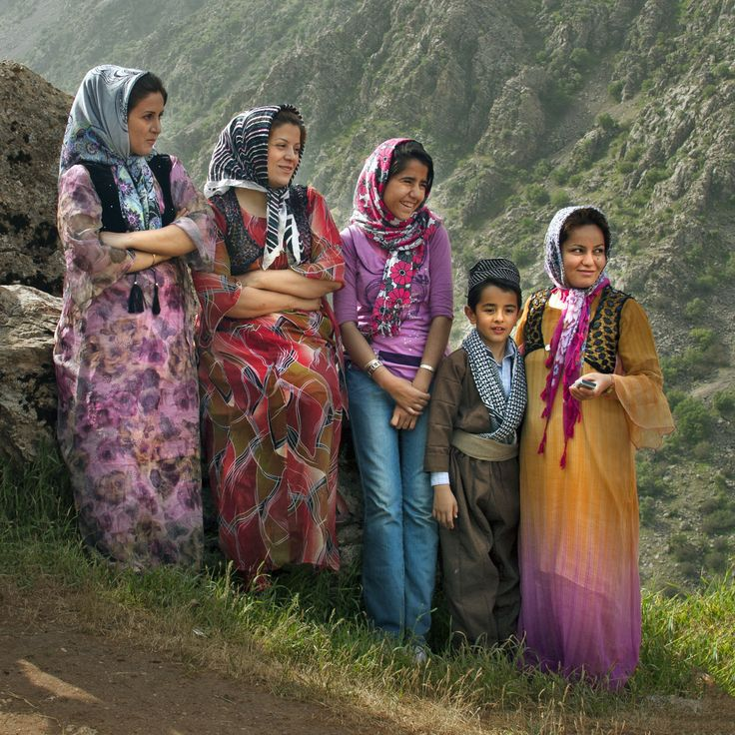
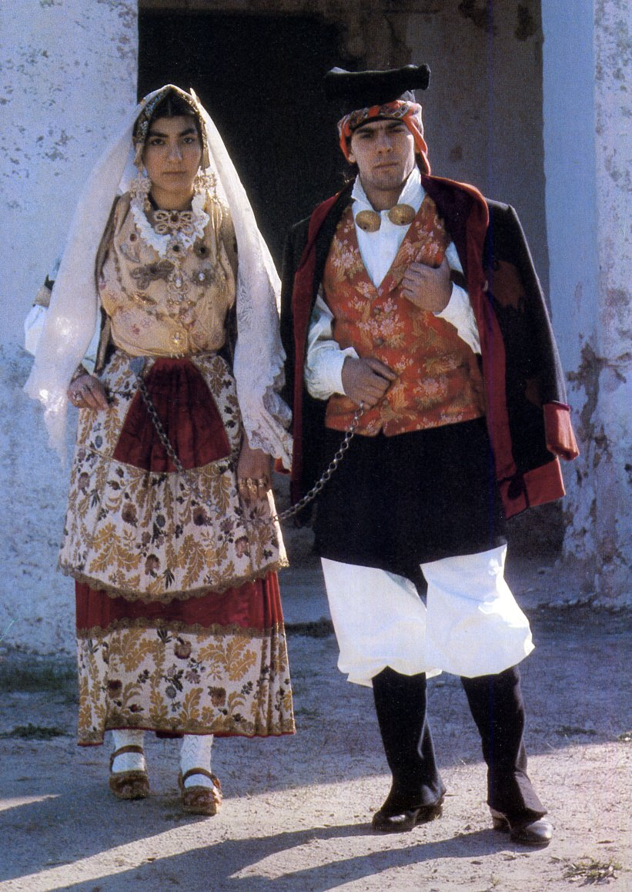

Human or Cultural Place:
Distinctive dress

Slide 40
????????????????????????????????
What is the difference between
Location & Place?

Slide 41
What is the difference between
Location & Place?
Location: 5* S , 68 * W
Where is it? How do I find it?

Slide 42
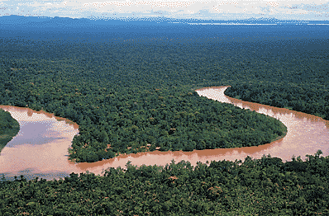
What is the difference between
Location & Place?
Place: Describe
What is it like there? How is it different from “here?”

Slide 43
Theme #5: Human/Environment Interaction:
How do we interact with our environment?
Do we ALTAR it?
Do we ADAPT to it?

Slide 44
HEI:
Human/Environment Interaction explains how people use (fit in) or change their environment.

Slide 45
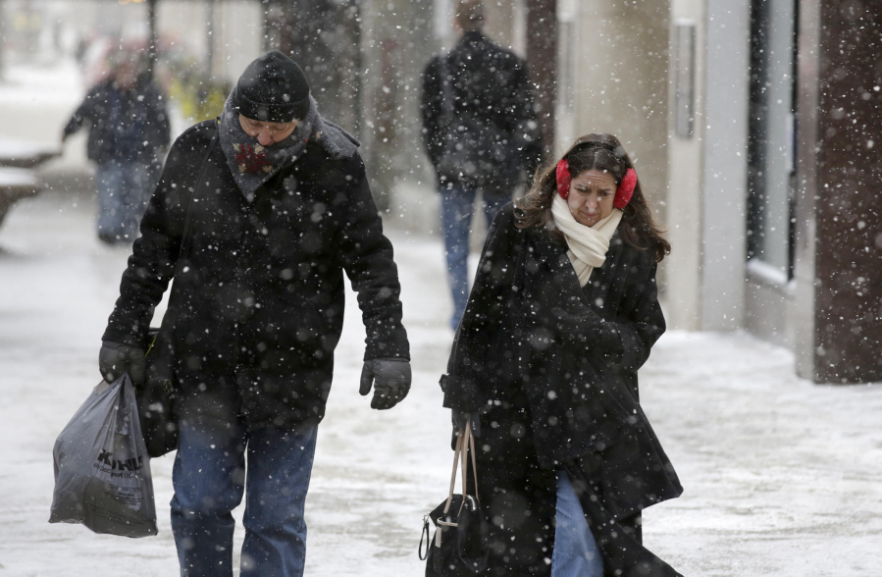

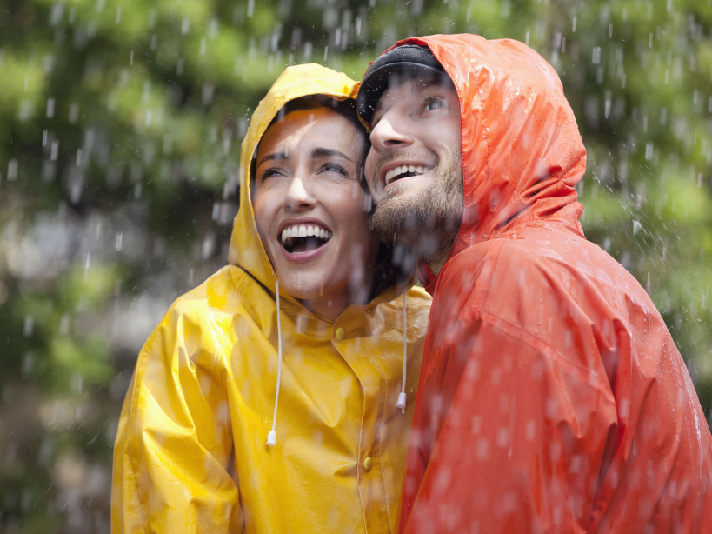
Adaptation
We cannot change the weather outside in an instant to suit us, so we adapt to the outside conditions.

Slide 46
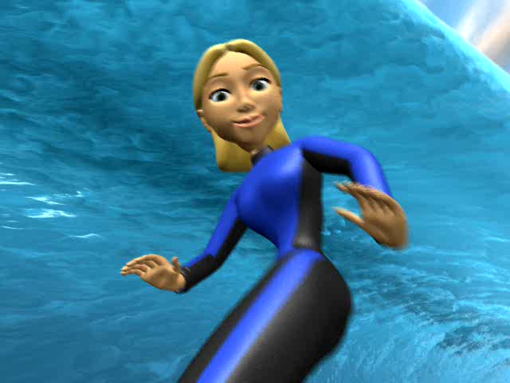
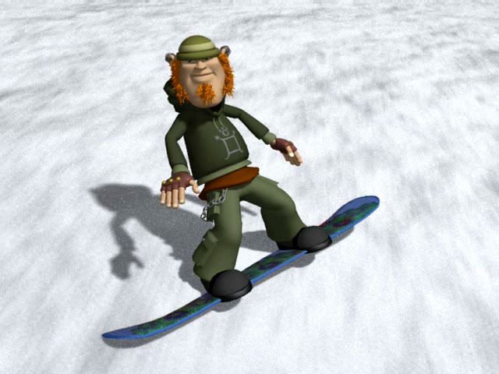
Does the environment affect where we do these activities?

Slide 47
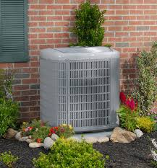
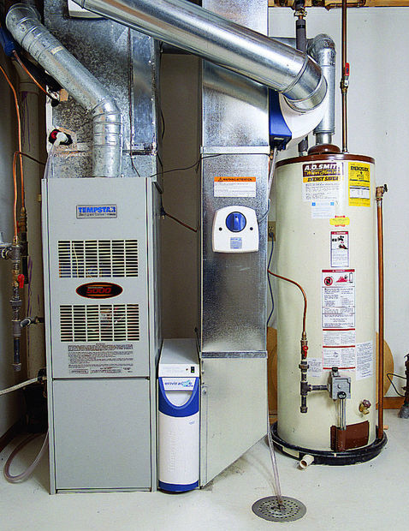
Alteration
If we don’t like what nature gives us to work with, sometimes we can change it to fit our desired.

Slide 48
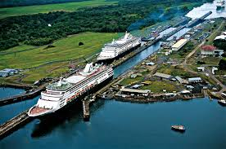
Alteration – build a canal to connect oceans.

Slide 49
:Changes to the environment can be:
        Good
        Bad, or
      Both! (usually they have both positive and negative consequences)
THINK CAREFULY BEFOREHAND

Slide 50
Remembering the Five Themes
Use the term below (MEMORY HELP)
MR. HELP
M = Movement R = Region HE = Human Environment (Interaction) L = Location P = Place

Slide 51
Can you place the geographic term with the correct theme of geography!?!?
Location:
Place:
Location:
A
I
Q
Can you place the geographic term with the correct geographic theme!?!?
Location:
A
I
Q
Location:
A
I
Q
Location:
A
I
Q
Location:
A
I
Q
Location:
A
I
Q
Place:
E
G
O
P
Place:
E
G
O
P
Place:
E
G
O
P
Five
Themes of Geography
Geographic
Themes
Region:
Geographic
Themes
Geographic
Themes
Geographic
Themes
Geographic
Themes
Movement:
Geographic
Themes
Movement:
D
L
M
Region:
C
F
K
Region:
C
F
K
Region:
C
F
K
Region:
C
F
K
Region:
C
F
K
Human/Environment Interaction:
Equator
Building roads
Southwest Asia
Visiting another country
On an island
The Western US
Planting crops
Latitude/longitude coordinates
Cutting down forests
Your neighborhood
Changing your address
Handwritten letters to a friend
Building new houses
Areas with little rainfall
Swiss chalets & high mountains = Switzerland
Texas is south of Oklahoma
Equator
Building roads
Southwest Asia
Visiting another country
On an island
Western US
A very hot climate
Planting crops
longitude
Equator
Building roads
Southwest Asia
Visiting another country
On an island
Western US
A very hot climate
Planting crops
longitude
Equator
Building roads
Southwest Asia
Visiting another country
On an island
Western US
A very hot climate
Planting crops
longitude
Equator
Building roads
Southwest Asia
Visiting another country
On an island
Western US
A very hot climate
Planting crops
longitude
Equator
Building roads
Southwest Asia
Visiting another country
On an island
Western US
A very hot climate
Planting crops
longitude
Human/Environment Interaction:
B
H
J
N
Human/Environment Interaction:
B
H
J
N
Human/Environment Interaction:
B
H
J
N
Human/Environment Interaction:
B
H
J
N
Cutting down forests
Your neighborhood
Changing your address
Written letters
Building new houses
Areas with little rainfall
Swiss chalets & high mts = Switzerland
Texas is south of Oklahoma
Cutting down forests
Your neighborhood
Changing your address
Written letters
Building new houses
Areas with little rainfall
Swiss chalets & high mts = Switzerland
Texas is south of Oklahoma
Cutting down forests
Your neighborhood
Changing your address
Written letters
Building new houses
Areas with little rainfall
Swiss chalets & high mts = Switzerland
Texas is south of Oklahoma
Cutting down forests
Your neighborhood
Changing your address
Written letters
Building new houses
Areas with little rainfall
Swiss chalets & high mts = Switzerland
Texas is south of Oklahoma
Human/Environment Interaction:
B
H
J
N
Cutting down forests
Your neighborhood
Changing your address
Written letters
Building new houses
Areas with little rainfall
Swiss chalets & high mts = Switzerland
Texas is south of Oklahoma

