Slide 1
FESTIVALS FROM HERE TO THERE
By: Leah Daniels
Geography 1002
Summer 2010

Slide 2
Raksha Bandhan India
Raksha Bandhan occurs in August every year and means “the bond of protection” in many Indian languages. This is a secular type of festival and it celebrates the relationship between brothers and sisters.
The festival is marked by the sister tying a rakhi (holy thread) around the wrist of her brother. In return, the brother offers a gift to his sister and vows to look after her.

Slide 3
Raksha Bandhan (cont.)
The brother and sister traditionally feed one another sweets, called laddu.
The rakhi can be given to any male “adopted” as a brother, not just blood brothers. In Indian history, all women seek the lifelong protection from a male. If the female does not have a blood brother, the “adopted” male could be a cousin or even a friend.

Slide 4
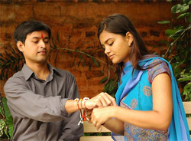
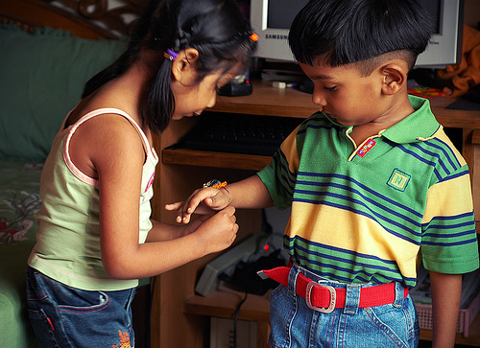
Raksha Bandhan (cont.)

Slide 5
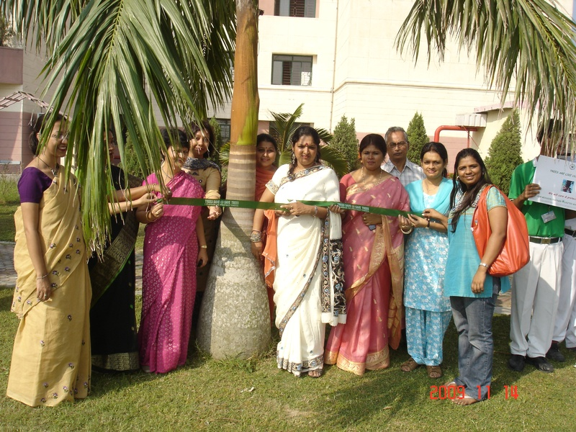
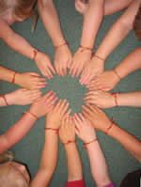
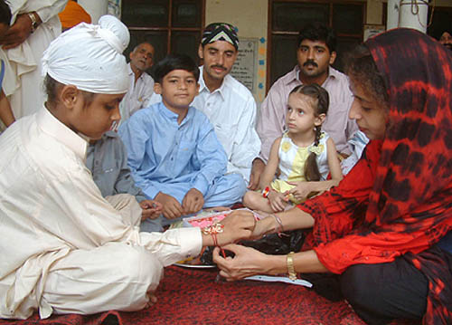
Raksha Bandhan (cont.)

Slide 6
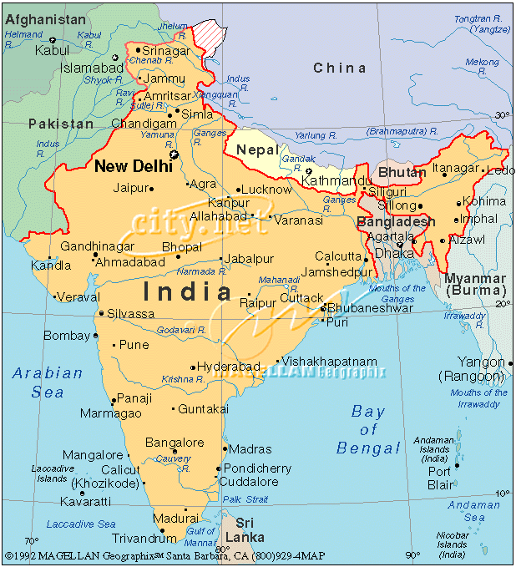
Raksha Bandhan (cont.)

Slide 7
Oktoberfest Germany
Oktoberfest is a 16 day festival held each year, running from late September to early October. It is a huge secular festival that attracks over 6 million people. The festival is held at Theresienwiese (field of Therese). The reasoning for Oktoberfest was to celebrate the marriage of King Ludwig I and Therese of Bavaria. The first Oktoberfest occurred in Munich in October, 1810.

Slide 8
Oktoberfest (cont.)
There is a traditional festival opening. A 12 gun salute and the tapping of the first keg of Oktoberfest beer at 12:00 by the Mayor of Munich with the cry “O’zapft is!” (“It’s tapped”). The first beer is then given to the Minister-President of the State of Bavaria.
Visitors of Oktoberfest indulge in many delicious foods including: Hendi (chicken), steckerlfisch (grilled fish on a stick), Wurstl (sausages), Sauerkraut, and Obatzda (a fatty, spiced cheese-butter concoction).

Slide 9
Oktoberfest (cont.)
During Oktoberfest people wear cowboy shaped hats which contain goat hair. In Germany, goat hair is highly valued. The more goat hair on your hat, the wealthier you are considered to be.
72% of the people who attend Oktoberfest are from Bavaria. 15% come from foreign countries like the surrounding EU-countries and United States and Canada.

Slide 10
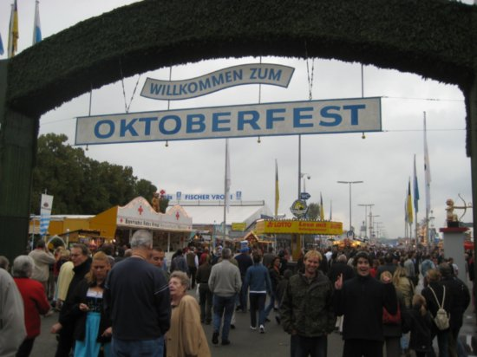
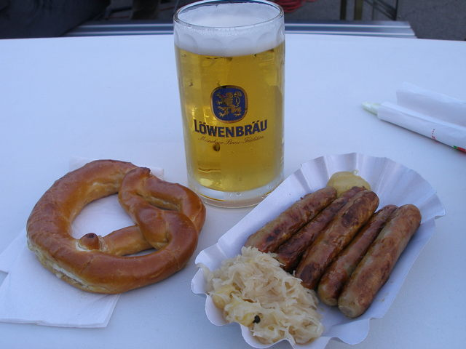
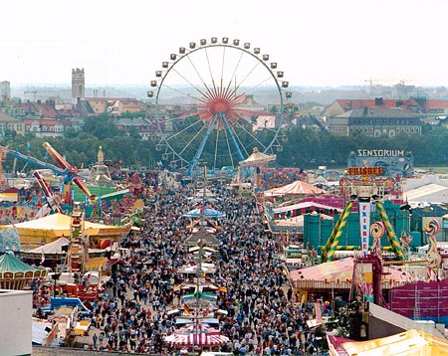
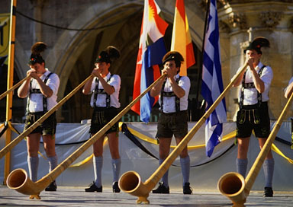
Oktoberfest (cont.)

Slide 11
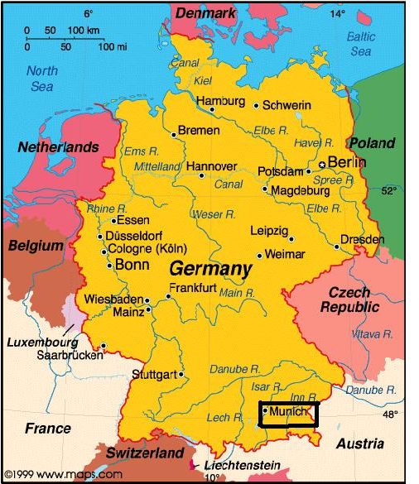
Oktoberfest (cont.)

Slide 12
Hogmanay Scotland
Hogmanay is the Scottish word for “last day of the year” and it coincides with the New Year celebration. It starts December 31 and can go until January 2. It is a secular festival that celebrates the winter solstice among the Norse. The celebration has been celebrated by many, including the Vikings.

Slide 13
Hogmanay (cont.)
In Glasgow and central Scotland a custom to celebrating Hogmanay involves singing, dancing, eating pie or stew, and storytelling.
The most widespread custom that many do while celebrating Hogmanay is first-footing. It starts immediately after midnight and involves being the first person to cross the threshold of a friend or neighbor where the person gives gifts that bring luck to the household. These gifts can include: coal, whisky, shortbread, and a rich fruit cake called black bun. It is supposed to set the luck for the rest of the year.

Slide 14
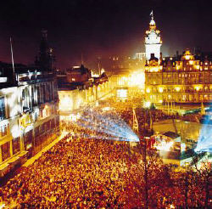
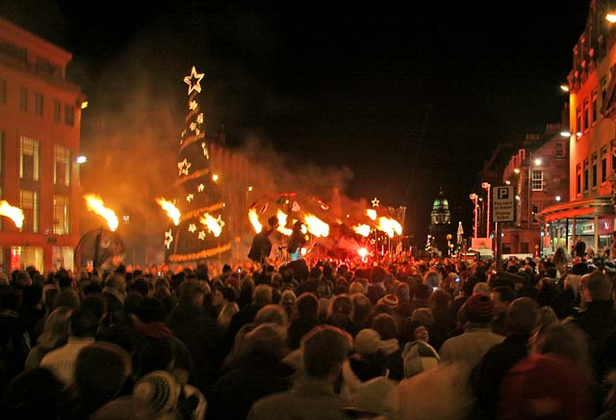
Hogmanay (cont.)

Slide 15
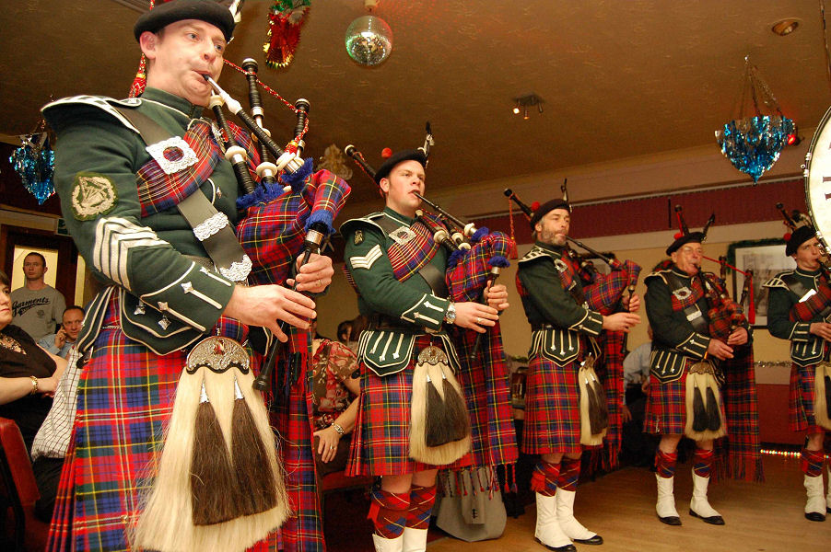
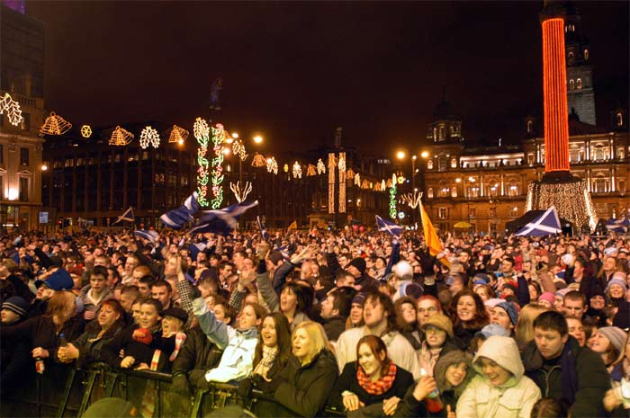
Hogmanay (cont.)

Slide 16
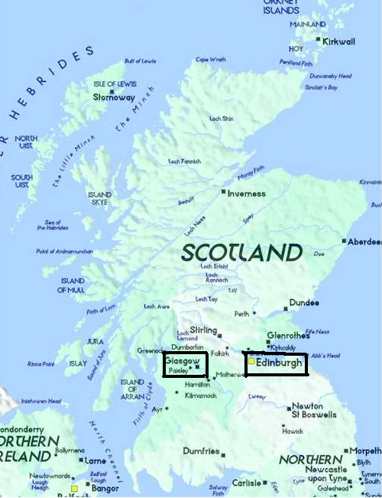
Hogmanay (cont.)
Everyone in Scotland celebrates the festival but Glasgow and Edinburgh are the biggest celebrations

Slide 17
El Colacho Festival Spain
El Colacho is a festival celebrated in Burgos, Spain. It began as a religious festival that has been celebrated since 1620. It is the Catholic festivity of The Corpus Christi.
During the five day festival, El Colacho (or the devil) runs through the town making noise and hitting anyone in his path. At night, these devils run through the town in pursuit of its inhabitants with firecrackers.

Slide 18
El Colacho Festival (cont.)
The most important day of the festival is the jumping over the babies. The babies are placed on mattresses on the street going from the church to the end of town. These babies are born after the last El Colacho festival. Several men dressed as El Colacho will jump over the babies. The idea behind it is that the devil has been driven out of the church and out of town. By jumping over the babies, the devil and his companions take with them bad luck that could be brought on the babies.

Slide 19
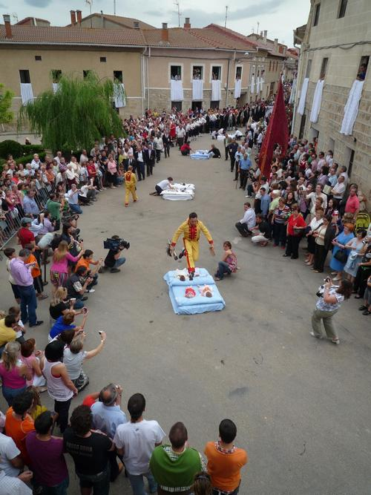
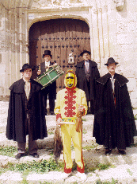
El Colacho Festival (cont.)

Slide 20
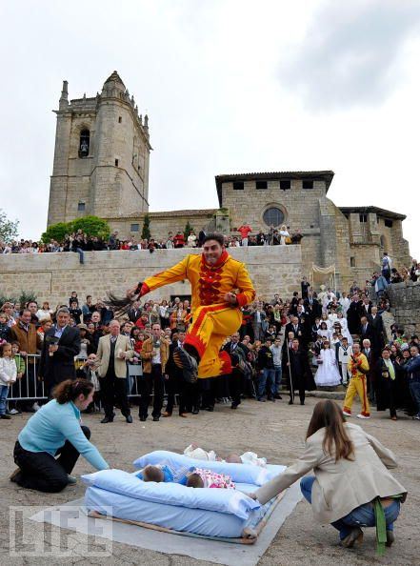
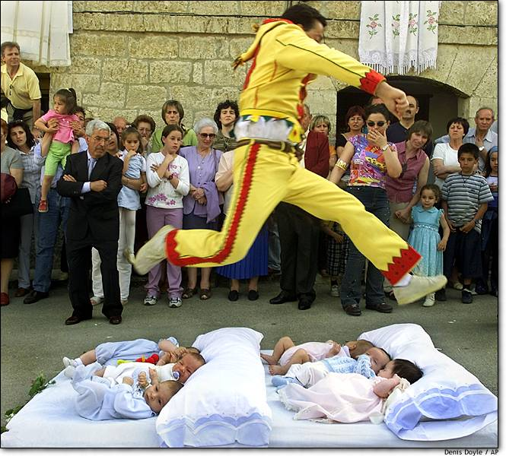
El Colacho Festival (cont.)

Slide 21
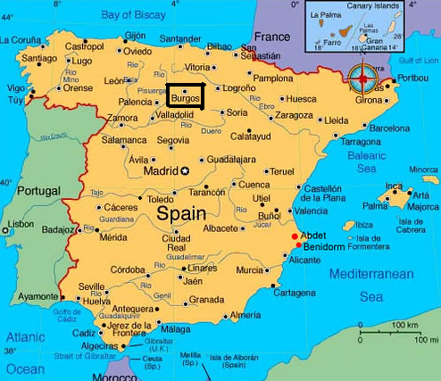
El Colacho Festival (cont.)

Slide 22
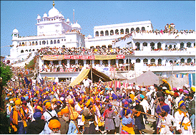
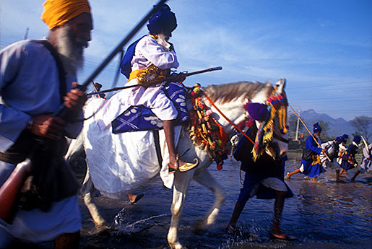
Hola Mohalla Punjab
Hola Mohalla stands for “mock fight”. This is a religious/secular festival that occurs every March. The festival started in February 1701, when Guru Gobind Singh held the first mock fight. It is held at Anandpur Sahib in Punjab and is a gathering of Sikhs for military exercises and mock battles.

Slide 23
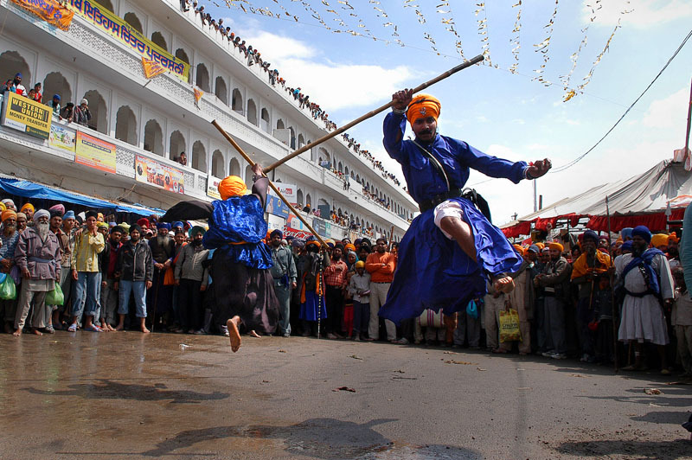
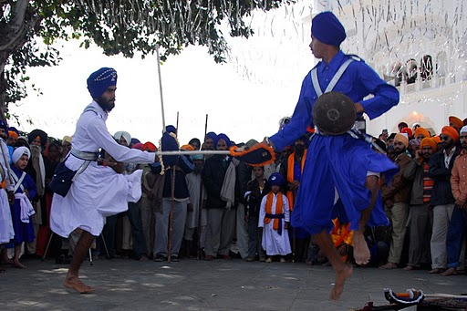
Hola Mohalla (cont.)
This is a 3 day festival that has exhibitions, weapon displays, music, and poetry competitions. Hola Mohalla is a time to celebrate but also a time to rededicate oneself to the community and a time to restore faith.

Slide 24
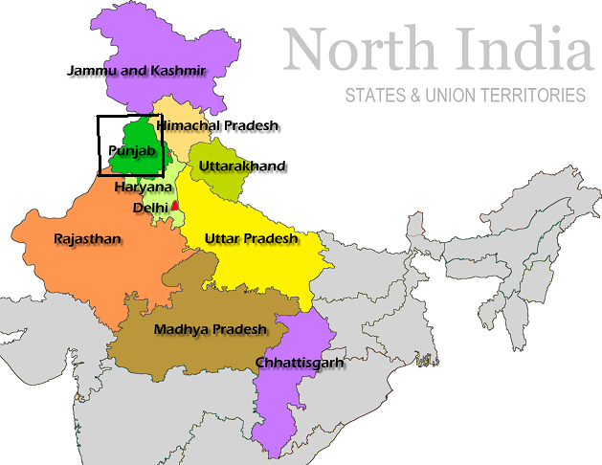
Hola Mohalla (cont.)

Slide 25
N’Cwala Swaziland
This is a religious festival that has been celebrated for hundreds of years. It takes place over three weeks. At the new moon, the Bemanti (or water party) travels to Indian Ocean to collect the foam of the waves, which are believed to have special healing powers. When they return to the village, they hold a special ceremony at the king’s palace, where they sing sacred chants.

Slide 26
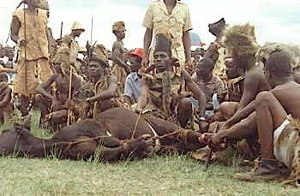
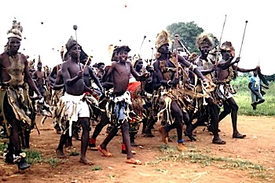
N’Cwala (cont.)
The festival also consists of the men of the village kill a black bull which is fed at the feast. There is also a day dedicated to resting and meditating. They burn clothes to start the beginning of the year. The dates for the festival are kept secret and are only told a few days before by the Swazi elders.

Slide 27
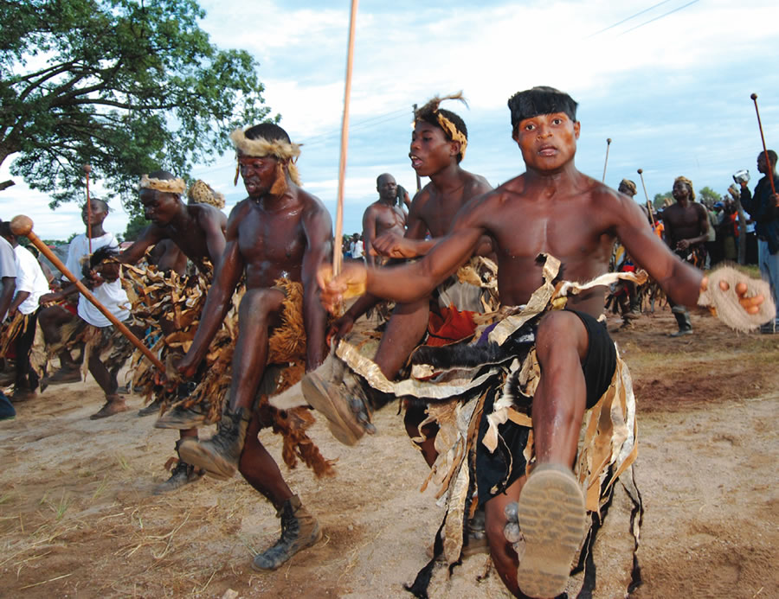
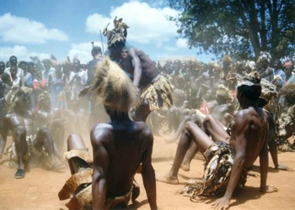
N’Cwala (cont.)

Slide 28
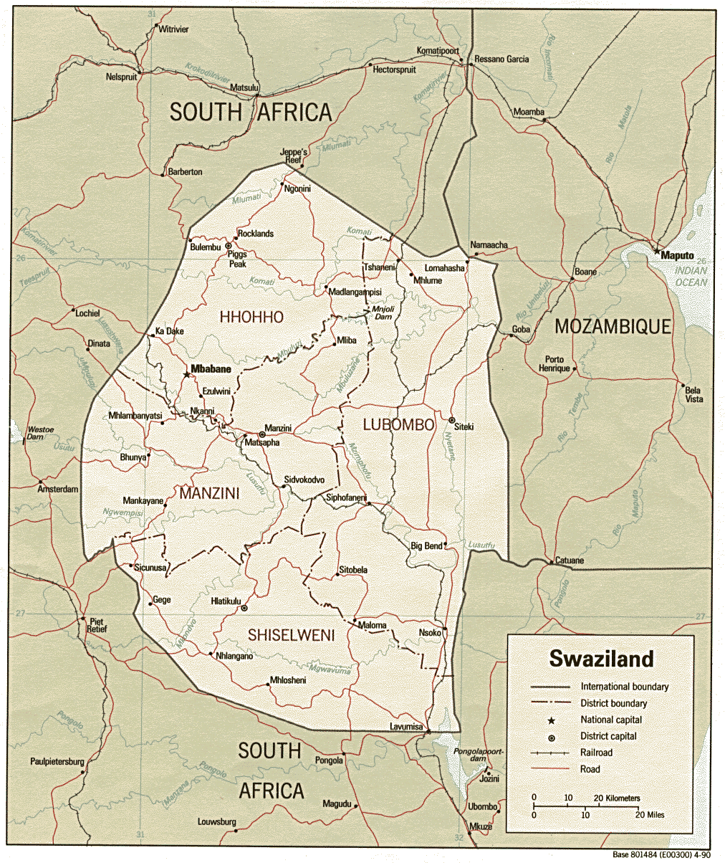
N’Cwala (cont.)

Slide 29
The End

