Slide 1
Amazing Photo Album

Slide 2
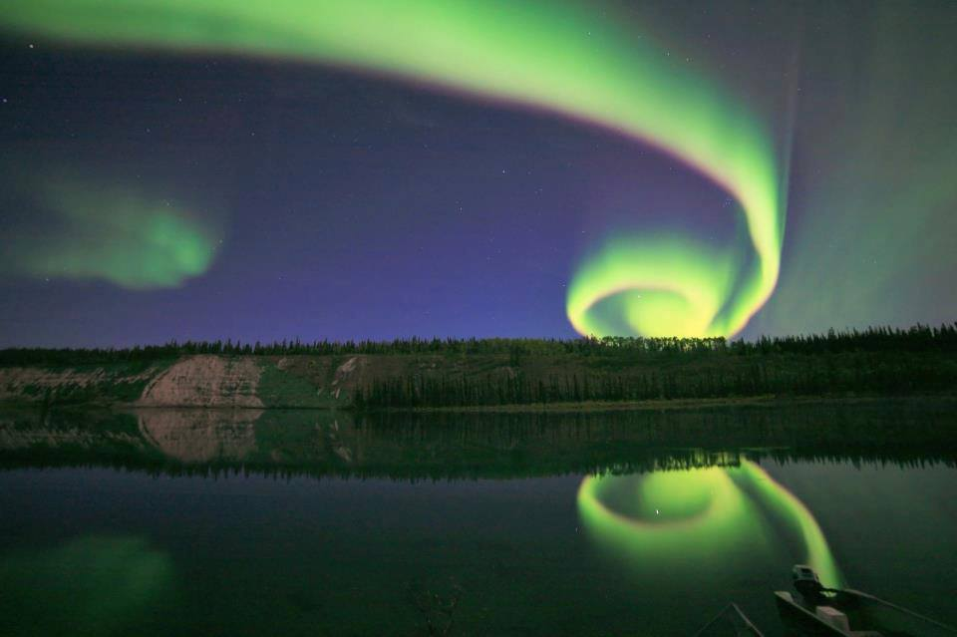
Incredible shot of Spiral Aurora Borealis

Slide 3
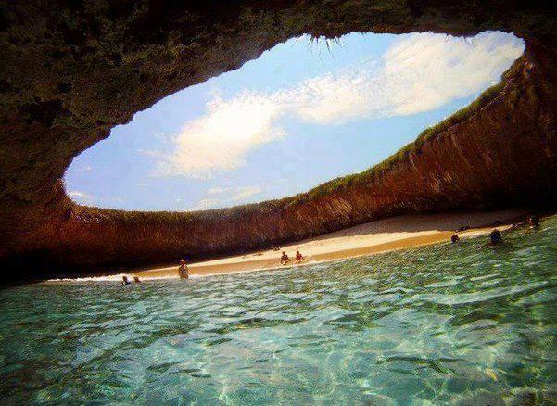
Hidden Beach, Mexico

Slide 4
The Rare and Mysterious Grinning Monkey Orchids

Slide 5
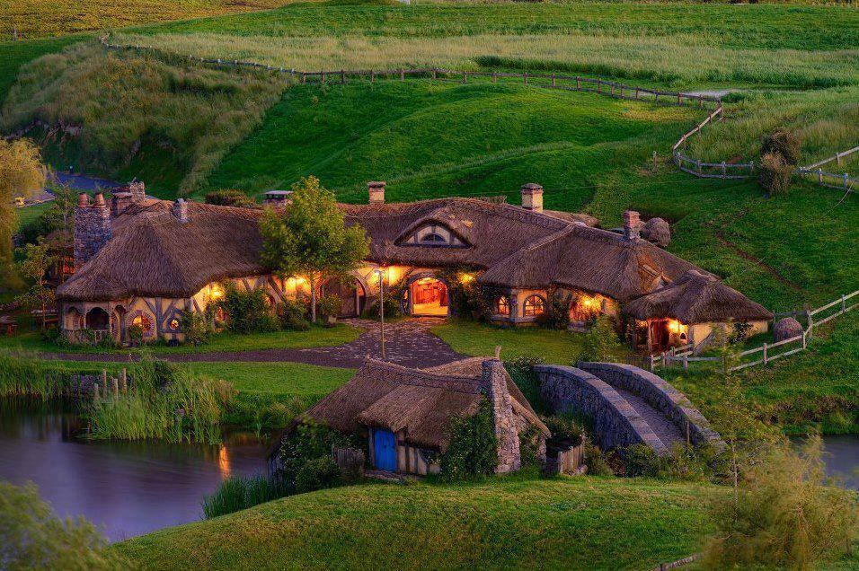
Hobbiton, New Zealand.

Slide 6
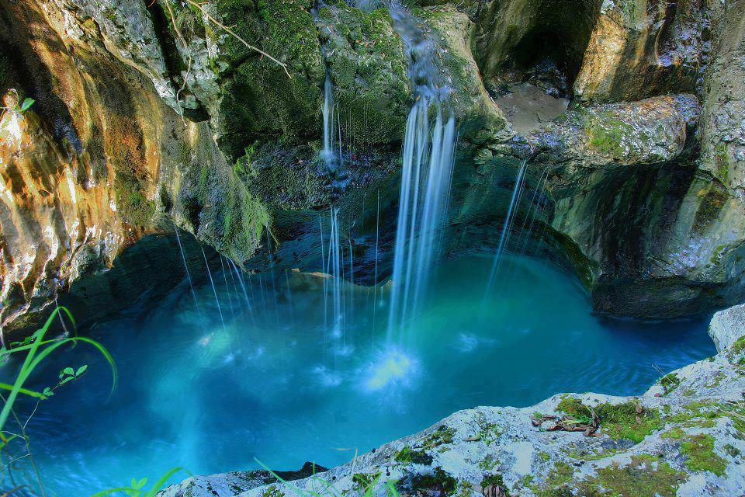
Triglav National Park near the town of Bovec in Slovenia

Slide 7
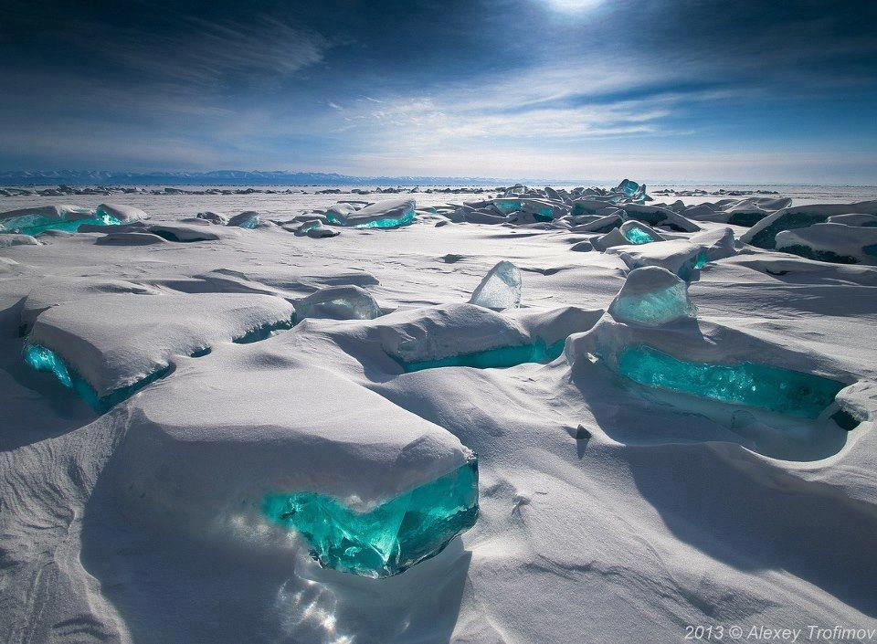
Turquoise Ice at Northern Lake Baikal, Russia

Slide 8
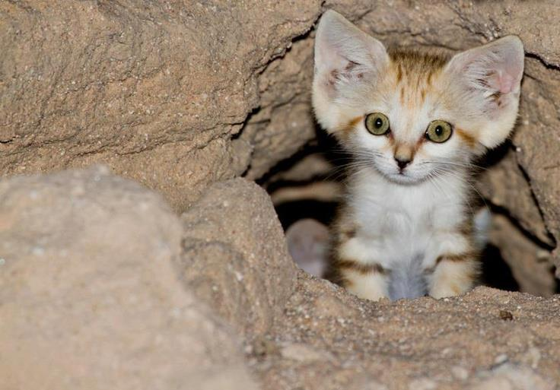
Arabian Sand Cat

Slide 9
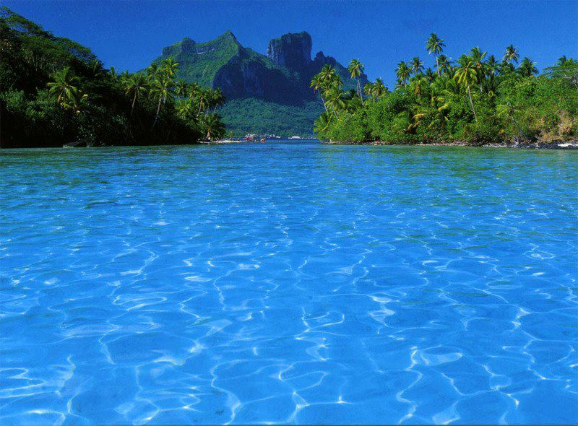
Bora Bora

Slide 10
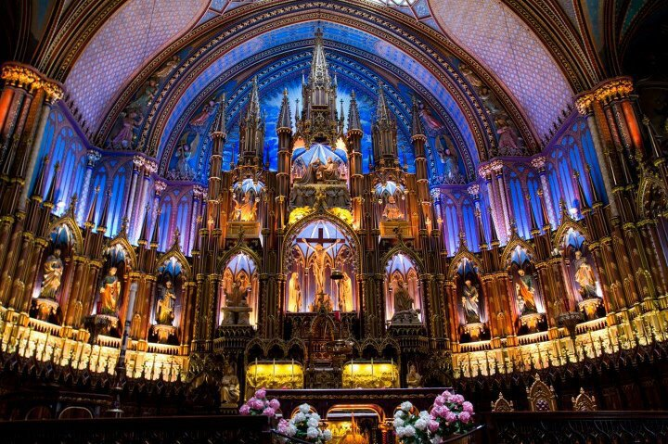
Notre Dame Church - Montréal, Canada

Slide 11
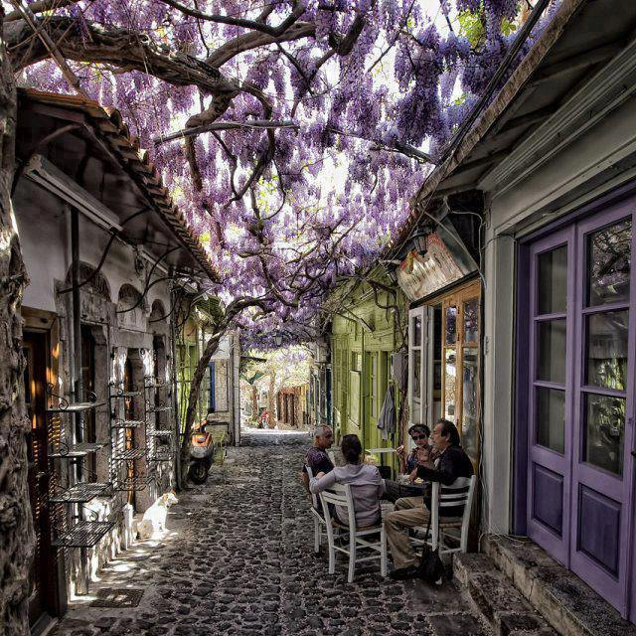
Molyvos village in Lesvos, Greece.

Slide 12
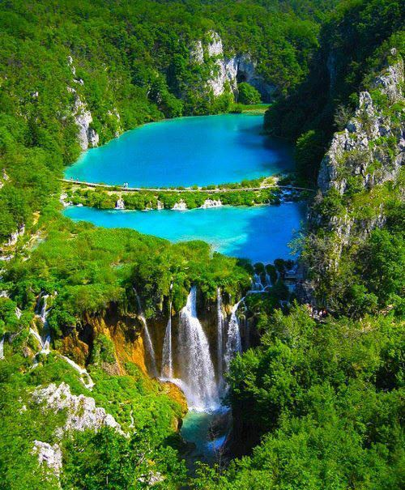
Turquoise, Plitvice Lake, Croatia

Slide 13
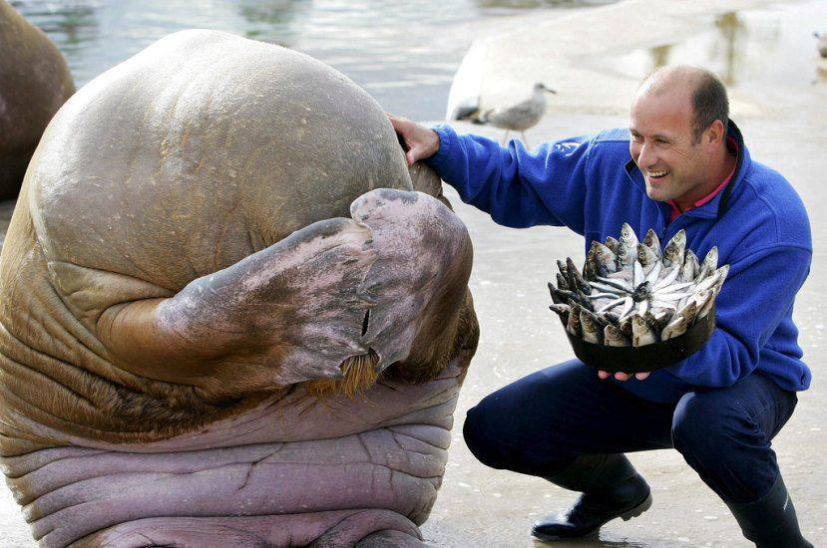
Great picture of A Walrus's reaction after being presented with a fish cake for his birthday

Slide 14
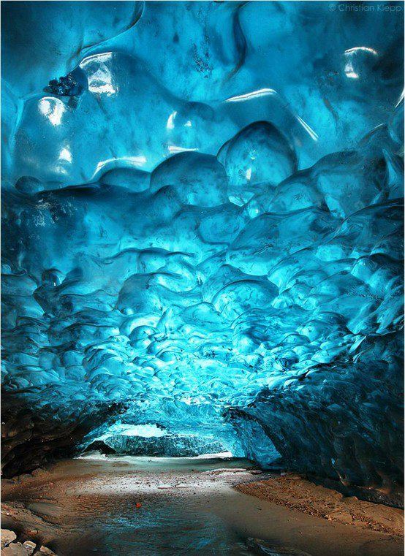
Skaftafell Ice Cave in Iceland

Slide 15
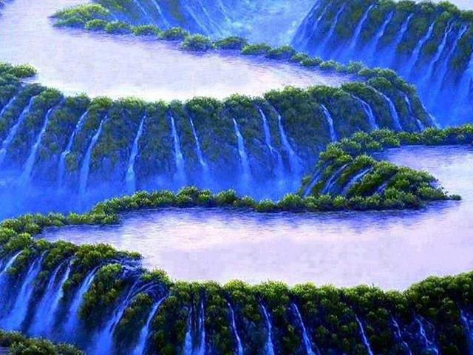
Most beautiful waterfall painting in the world

Slide 16
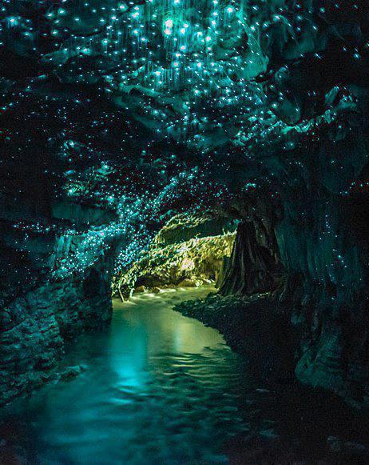
Waitomo Glow worm Caves, New Zealand

Slide 17
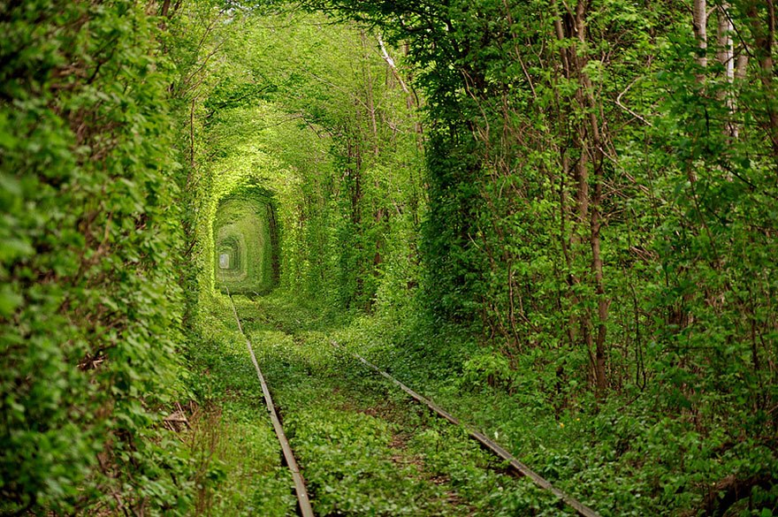
Tunnel of Love, Ukraine

Slide 18
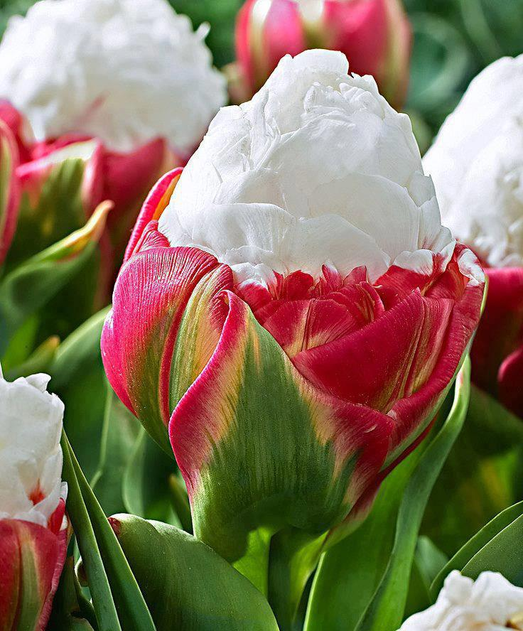
The beautiful Ice Cream Tulips

Slide 19
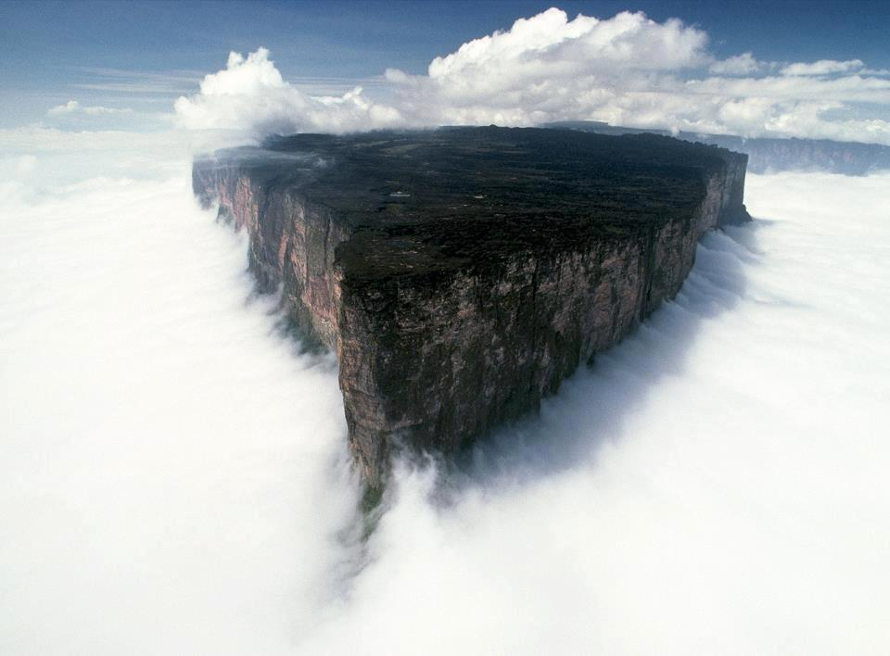
Mount Roraima one of the oldest geological formations

