Slide 1
Where the Missouri River Meets the Mississippi River
Edward "Ted" and Pat Jones-Confluence Point State Park

Slide 2
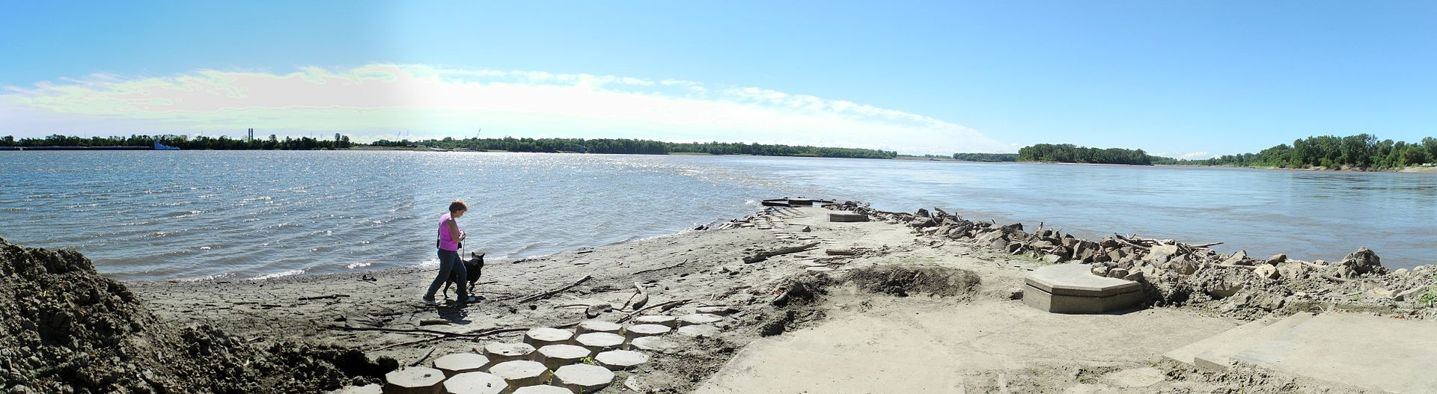
Edward "Ted" and Pat Jones-Confluence Point State Park is a Missouri state park located on the north side of the Missouri River at its confluence with the Mississippi River, approximately 8 miles north of the St. Louis Arch. The park was opened May 9, 2004, and includes 1,118 acres (4.5 km²) of shoreline and bottomland. The Park is part of the Confluence Greenway. The lands within the Park were purchased in 2001 by Western Rivers Conservancy and conveyed to the Missouri Department of Natural Resources and the Metropolitan Parks and Recreation District to be managed as a State Park.

Slide 3
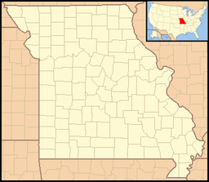

Slide 4
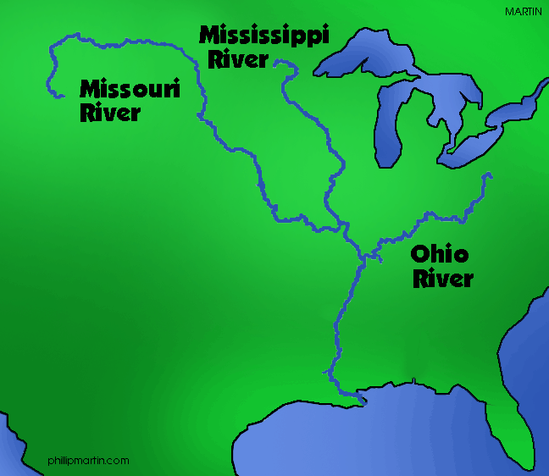

Slide 5
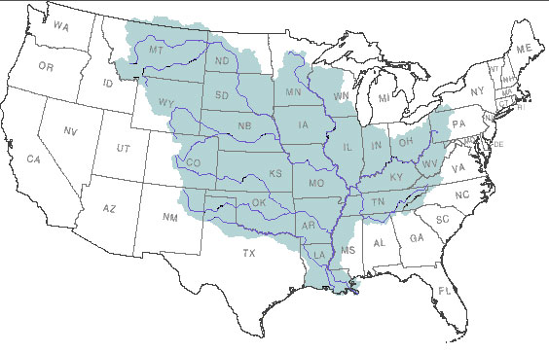
Mississippi River Watershed

Slide 6
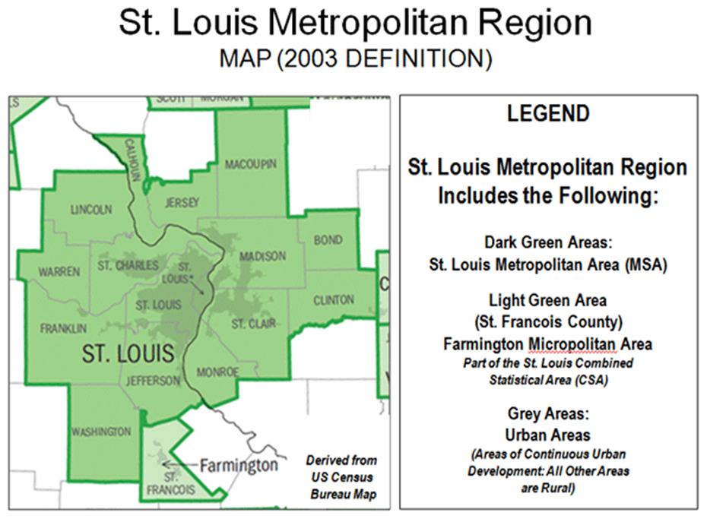

Slide 7
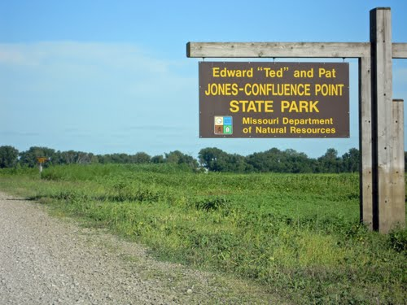

Slide 8
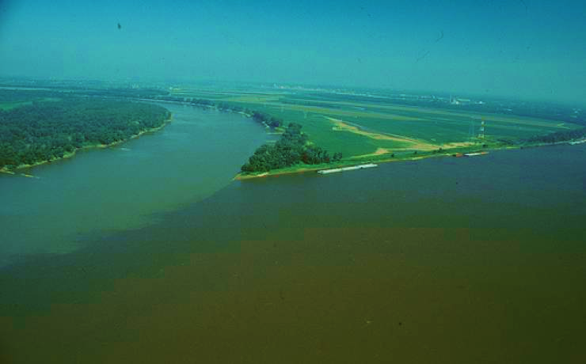

Slide 9
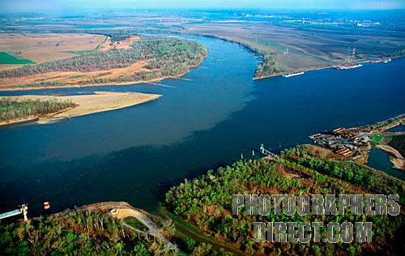

Slide 10
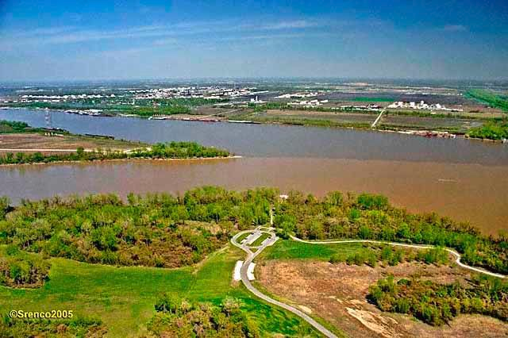

Slide 11
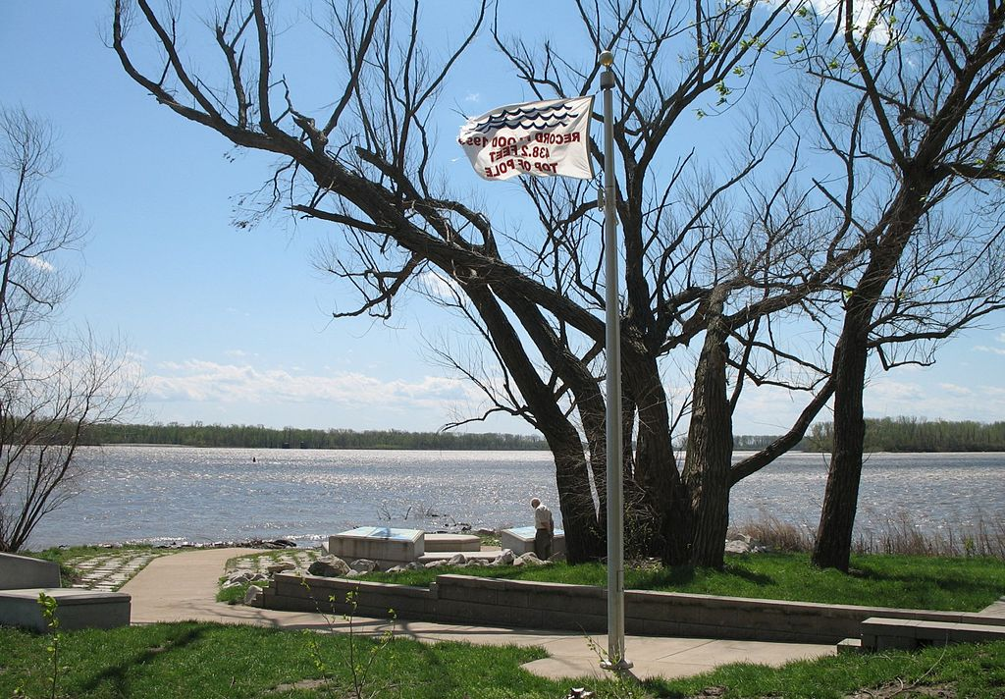
Monument to the Great Flood of 1993 in the park. The flag says the water reached the top of the pole and was 438.2 feet. The confluence site is normally 400 feet above sea level. The Mississippi is on the left and Missouri on the right.

Slide 12
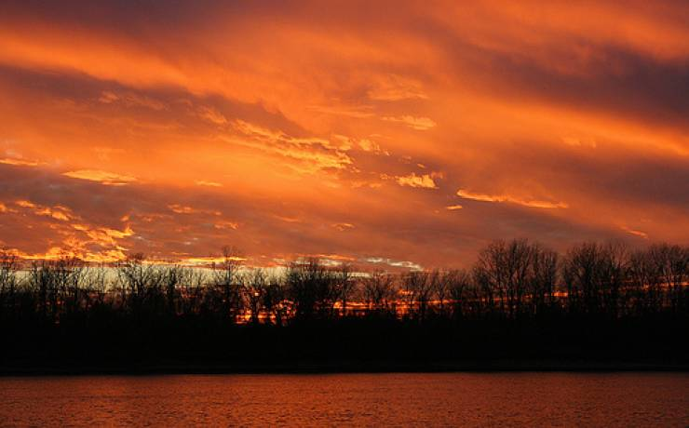

Slide 13
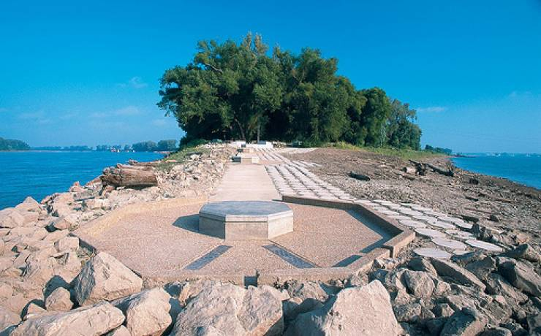

Slide 14
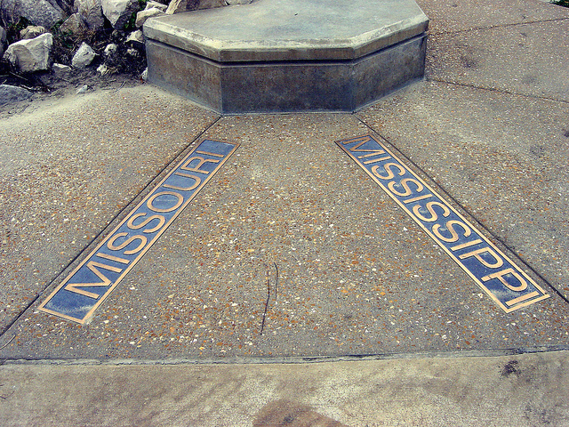

Slide 15
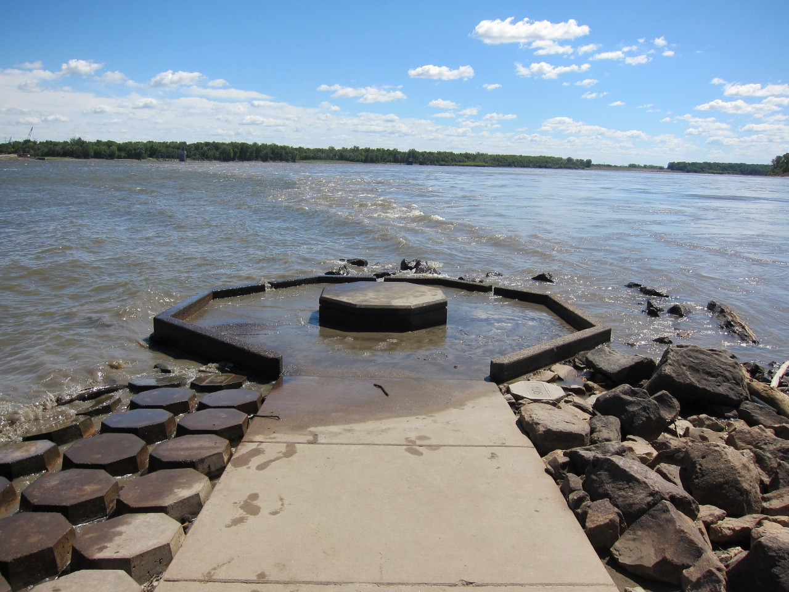
When the water is high

Slide 16
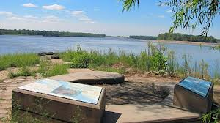

Slide 17
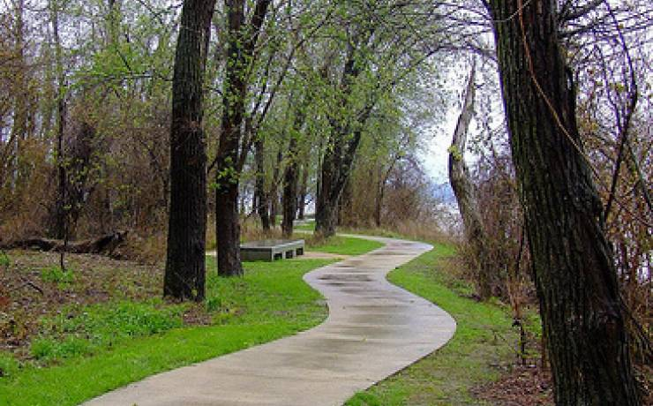

Slide 18
