Slide 1
Transparent animals

Slide 2
Transparent animals
They're some of the most intriguing and complex creatures on the planet but they really do have nothing to hide - because theyre totally see-through. Transparent animals - creatures with clear glass-like skin - can be found all over the world but their very existence is still shrouded in mystery. The fascinating organisms verge on the invisible and their translucent skin often helps them elude predators. These extraordinary images were taken by a whole host of photographers from around the globe. (Caters News)

Slide 3
Thornback Skate. (Ken Lucas/Caters News)

Slide 5
Fleischmanns glass frog. (Thomas Marent/Caters News)

Slide 6
Comb jelly. (Pat Morris/Caters News)

Slide 7
Glasswing butterfly. (Hans Dossenbach/Caters News)

Slide 8
Paper nautilus. (Valerie Taylor/Caters News)

Slide 9
Blind cave tetra. (Brian Bevan/Caters News)

Slide 10
Elegant hydromedusa jellyfish. (Ken Lucas /Caters News)

Slide 11
Glass fish. (Jean Michel Labat/Caters News)

Slide 12
White shrimp. (Ken Lucas/Caters News)

Slide 13
Box jellyfish. (Valerie Taylor/Caters News)

Slide 14
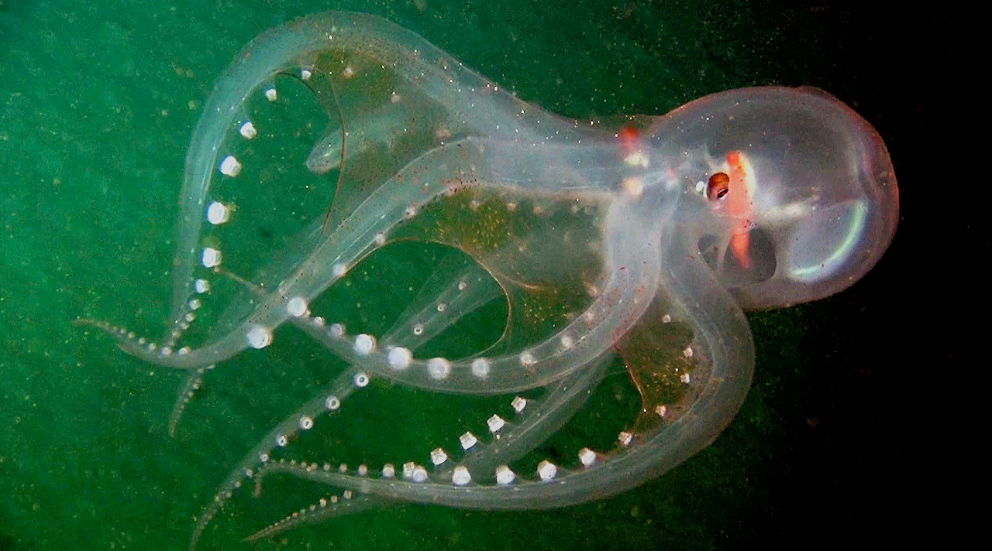
Additional pictures

