Slide 1
Storm Chasing Down Under

Slide 2
A British photographer made the lightning decision to quit the UK to chase storms Down Under and was rewarded with these striking shots. Oliver Kay, 40, left his dead-end IT job in Manchester almost a decade ago with wife Helen in search of a new life in Perth, Western Australia.
He mixes a job with one of Perths biggest mining companies with his weekend passion of photography. And Oliver struck gold after being woken up by thunder at 3.30 in the morning and taking amazing pictures of lightning filling the sky above Hillarys Marina in his adopted home city. (Caters News)

Slide 4
A Beautiful sunset Over Perth Harbor in Australia.

Slide 5
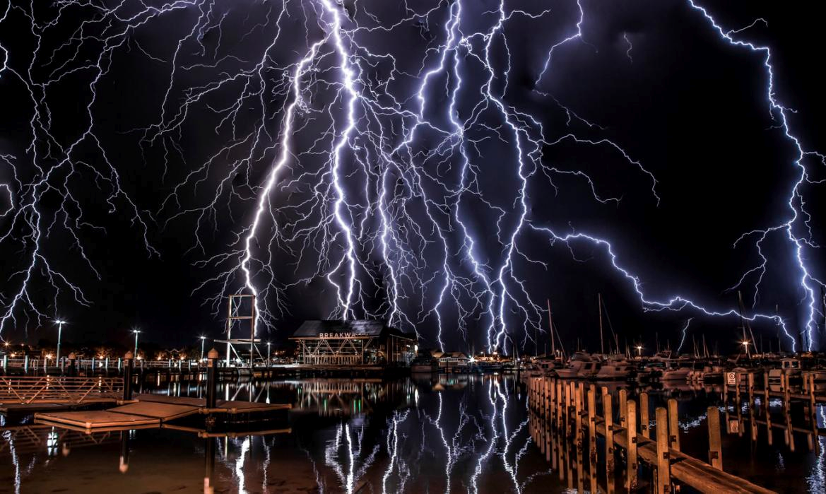
Dramatic lightning strikes over Perth Harbor in Australia.

Slide 6
A beautiful sunset over Perth Harbor in Australia.

Slide 7
The Perth skyline is covered by some beautiful clouds.

Slide 8
Stormy clouds over Perth Harbor in Australia.

Slide 9
Stormy clouds over Perth Harbor in Australia.

Slide 10
Dramatic lightning strikes over Perth Harbor in Australia.

Slide 11
A beautiful sunset over Perth Harbor in Australia.

Slide 12
Dramatic lightning strikes over Perth Harbor in Australia

