Slide 1
South Coast Botanic Garden, Palos Verdes Penninsula, California

Slide 2
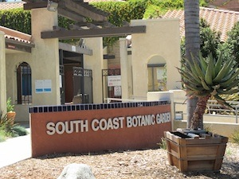
The 87-acre botanic garden and culture center features a lake, a stream, and many different gardens including a Mediterranean Garden, AARS Rose Garden, Water-Wise Garden, Garden of the Senses, Cactus Garden, Children's Garden, Fuchsia Garden, Dahlia Garden, Herb Garden, and Japanese Garden. There are over 2,500 species of plants and trees from around the world. Ornamental trees and shrubs from every continent except Antarctica can be viewed here. An large wildlife and bird population is provided food and shelter by the wide variety of plant life. Over 200 species of birds are sighted annually. Tour the grounds by tram on weekends, or stroll along the meandering parkways. Plant and flower shows are held year-round. An experiment in landfill until 1957, this site has become a model for how to reclaim lands used for refuse dumping. A pinic area is available outside of the gate. Free parking. Admission charge. Open daily, 9 AM to 5 PM, except Christmas.

Slide 3
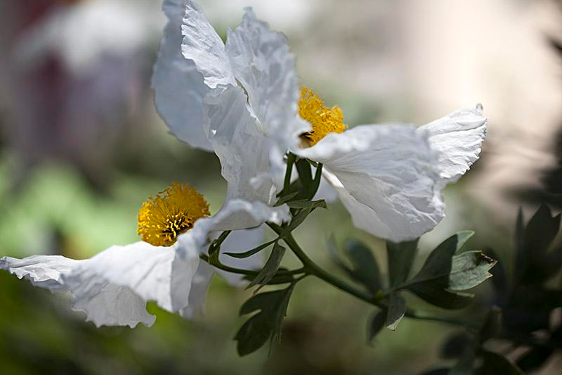

Slide 4
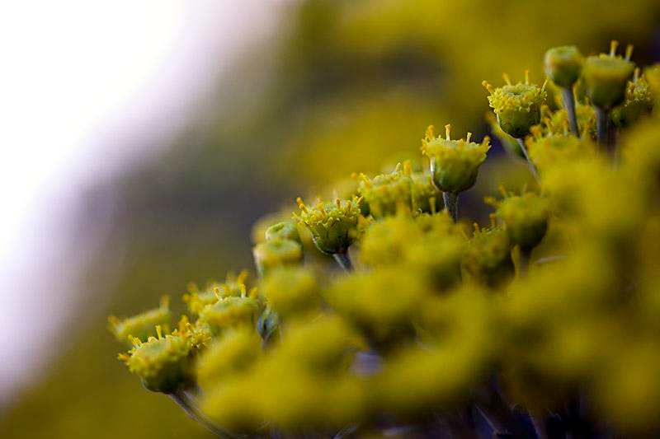

Slide 5
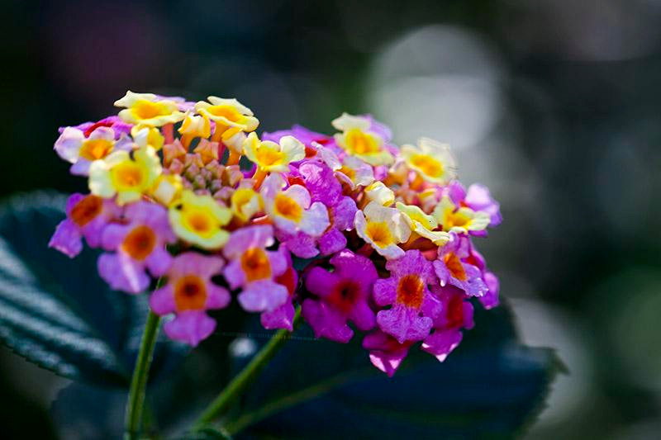

Slide 6
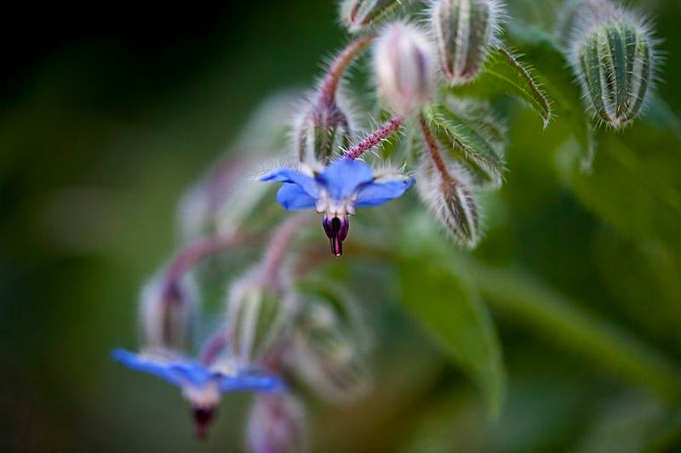

Slide 7
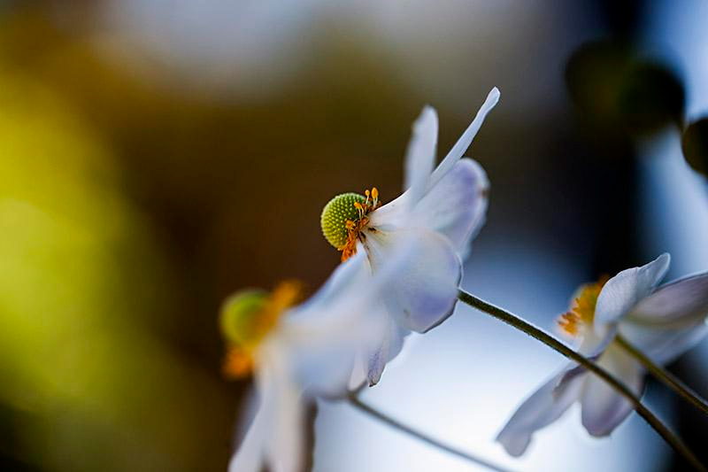

Slide 8
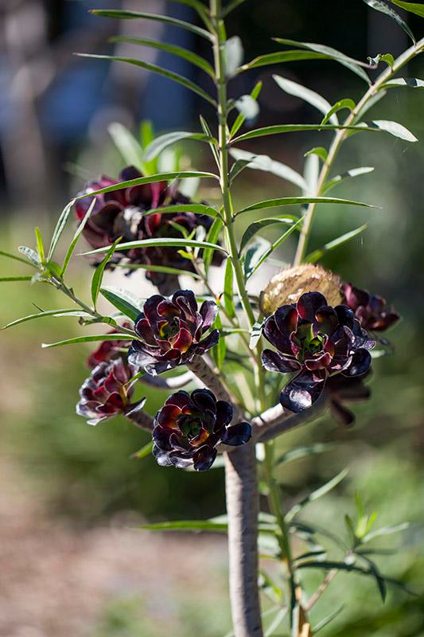
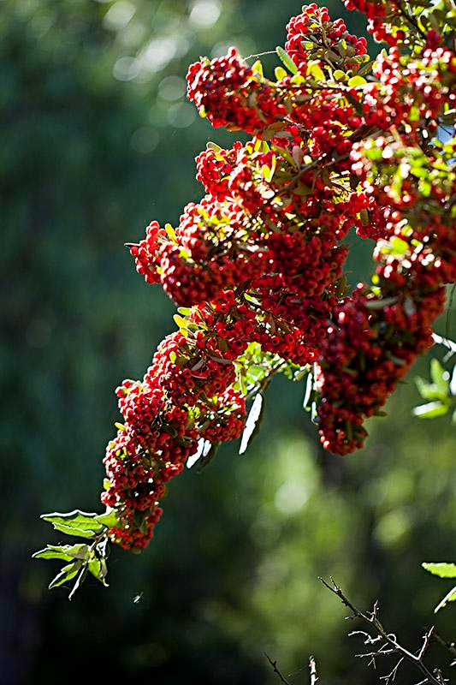

Slide 9
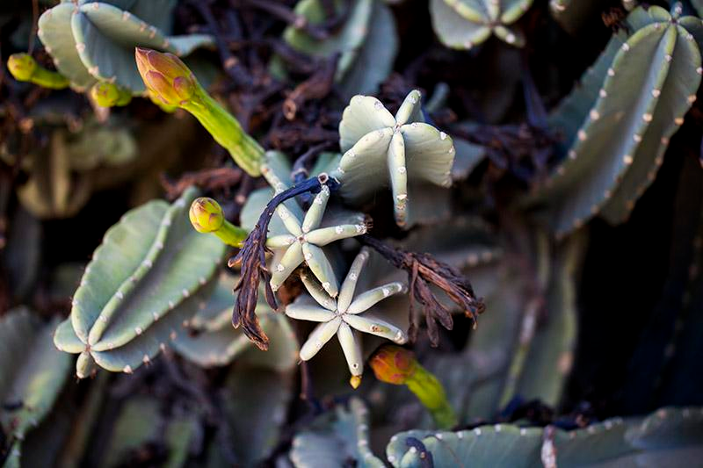

Slide 10
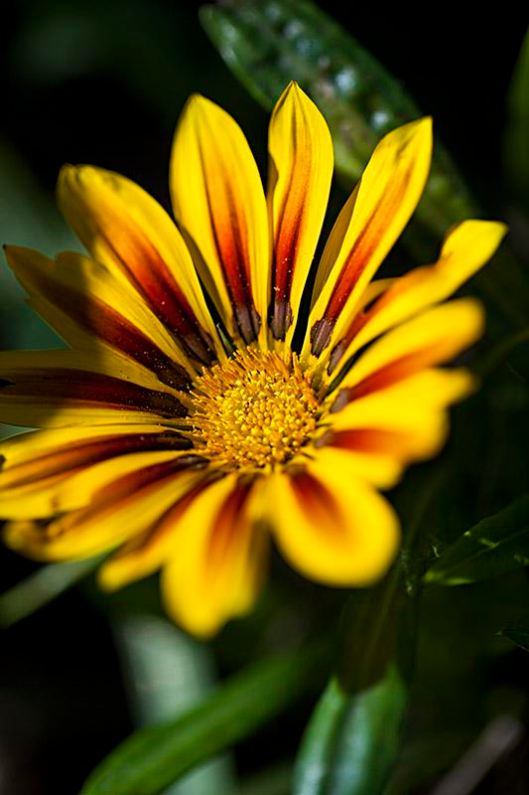
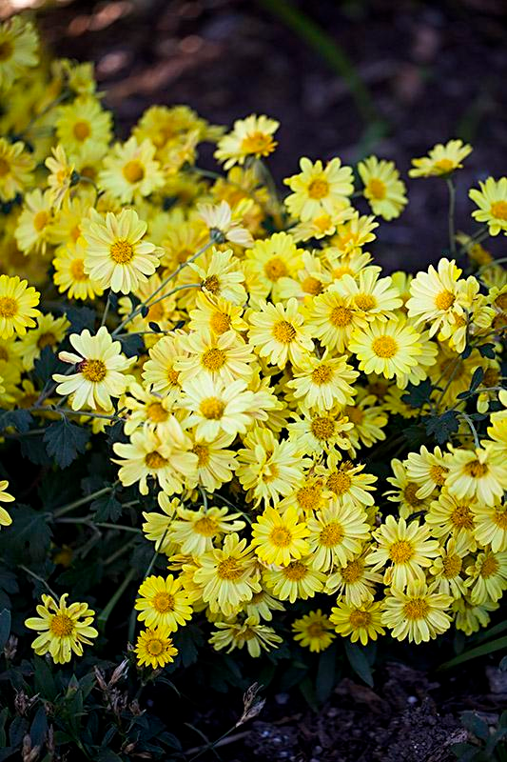

Slide 11
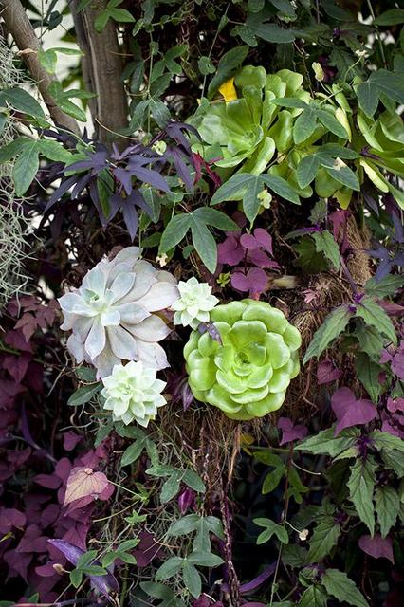
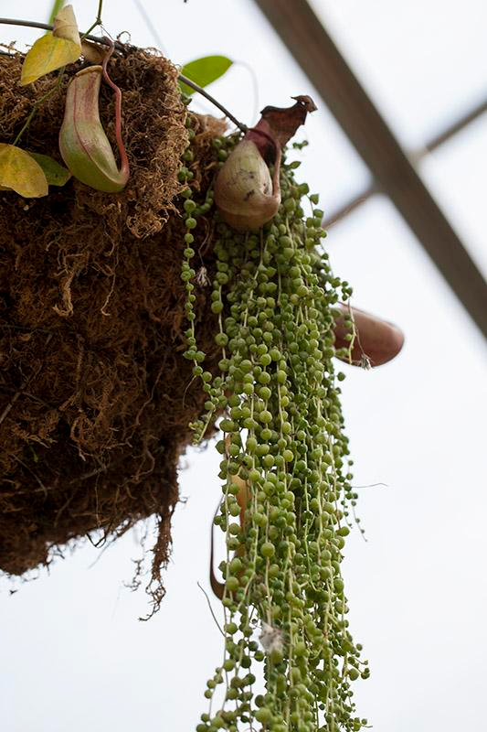

Slide 12
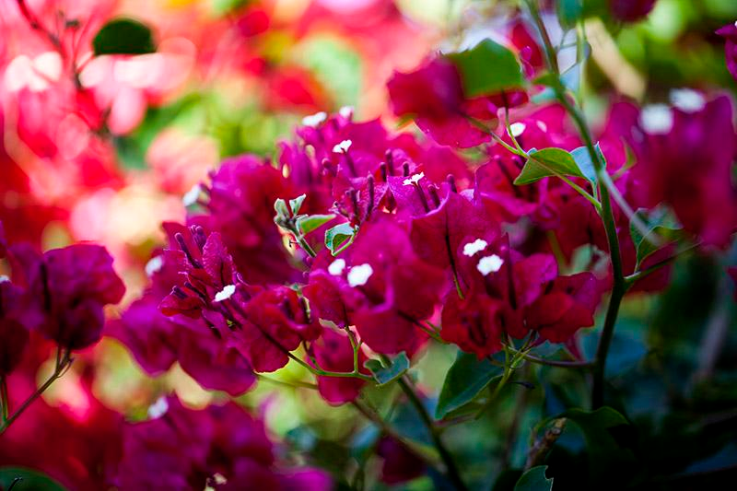

Slide 13
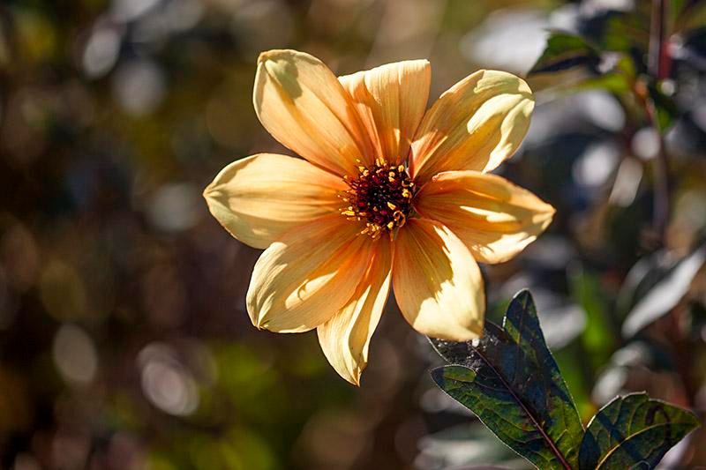

Slide 14
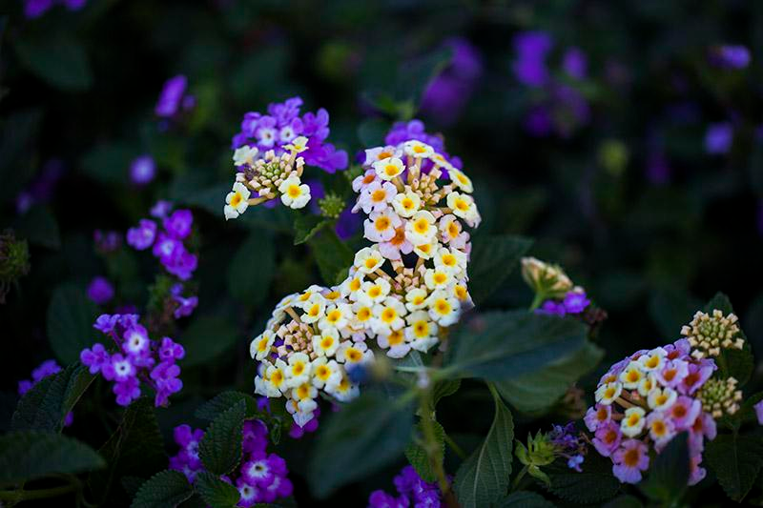

Slide 15
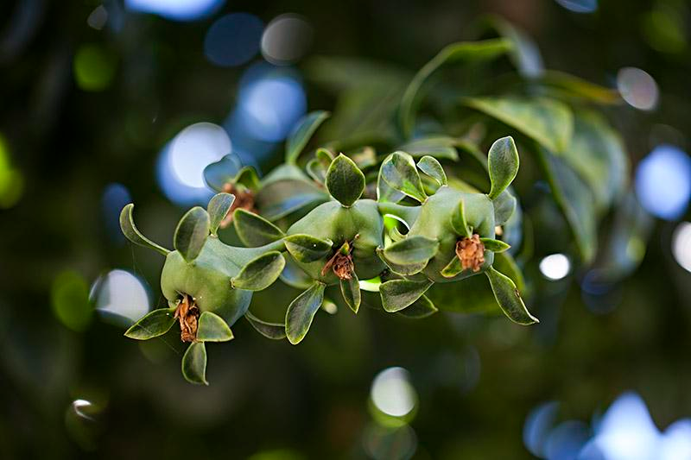

Slide 16
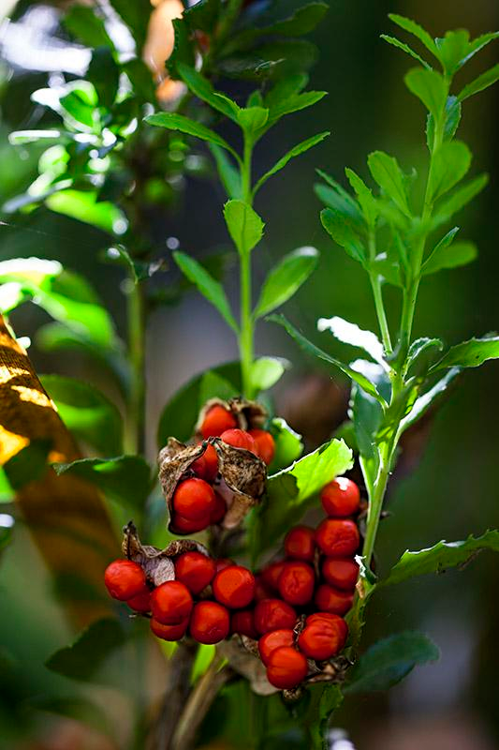
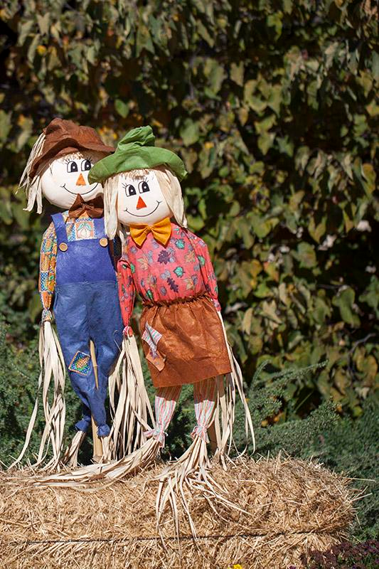

Slide 17
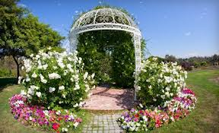

Slide 18
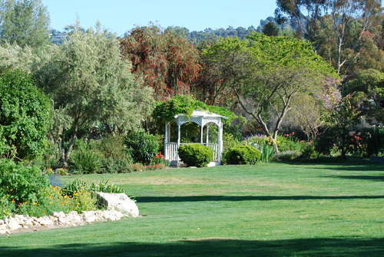

Slide 19
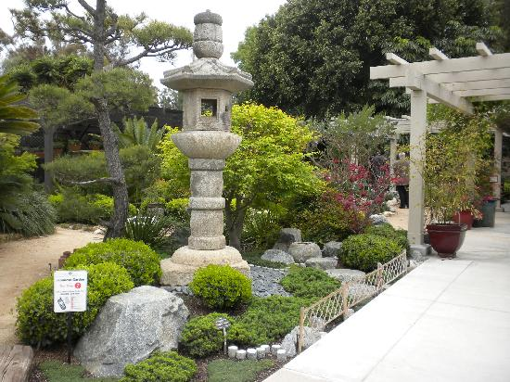

Slide 20
