Slide 1
SWIRLING STAR TRAILS
And the best places for seeing the Milky Way

Slide 2
These are the spectacular snaps of swirling star trails which transform the night sky into a kaleidoscope of color. Keen photographer Evgeniy Zaytsev, 24, captured the stunning shots on trips to Crimea, Altai and Murom, Russia. The pictures of circular star trails are formed by merging multiple photos taken over the course of several hours. Movement of the Earth causes the stars appear in different places in each image. (Caters News/Dan Thomas and Lauren Campbell)
Photography by Evgeniy Zaytsev

Slide 3
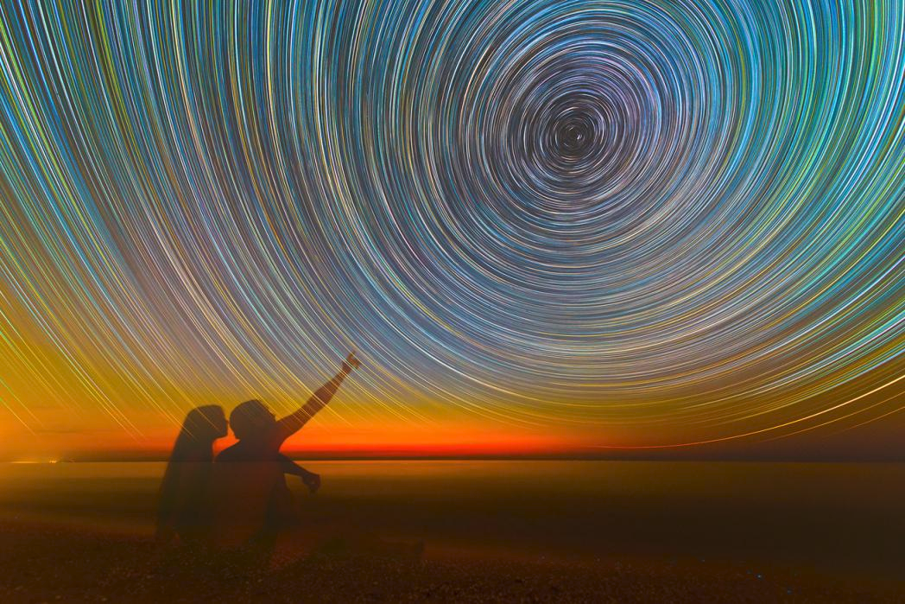
These are the spectacular snaps of swirling star trails which transform the night sky into a kaleidoscope of color.

Slide 5
The pictures of circular star trails are formed by merging multiple photos taken over the course of several hours.

Slide 7
"I will visualize how the star trails and objects along the landscape will look. Then I choose a place for shooting in advance and come before sunset, in order to prepare the camera."

Slide 11
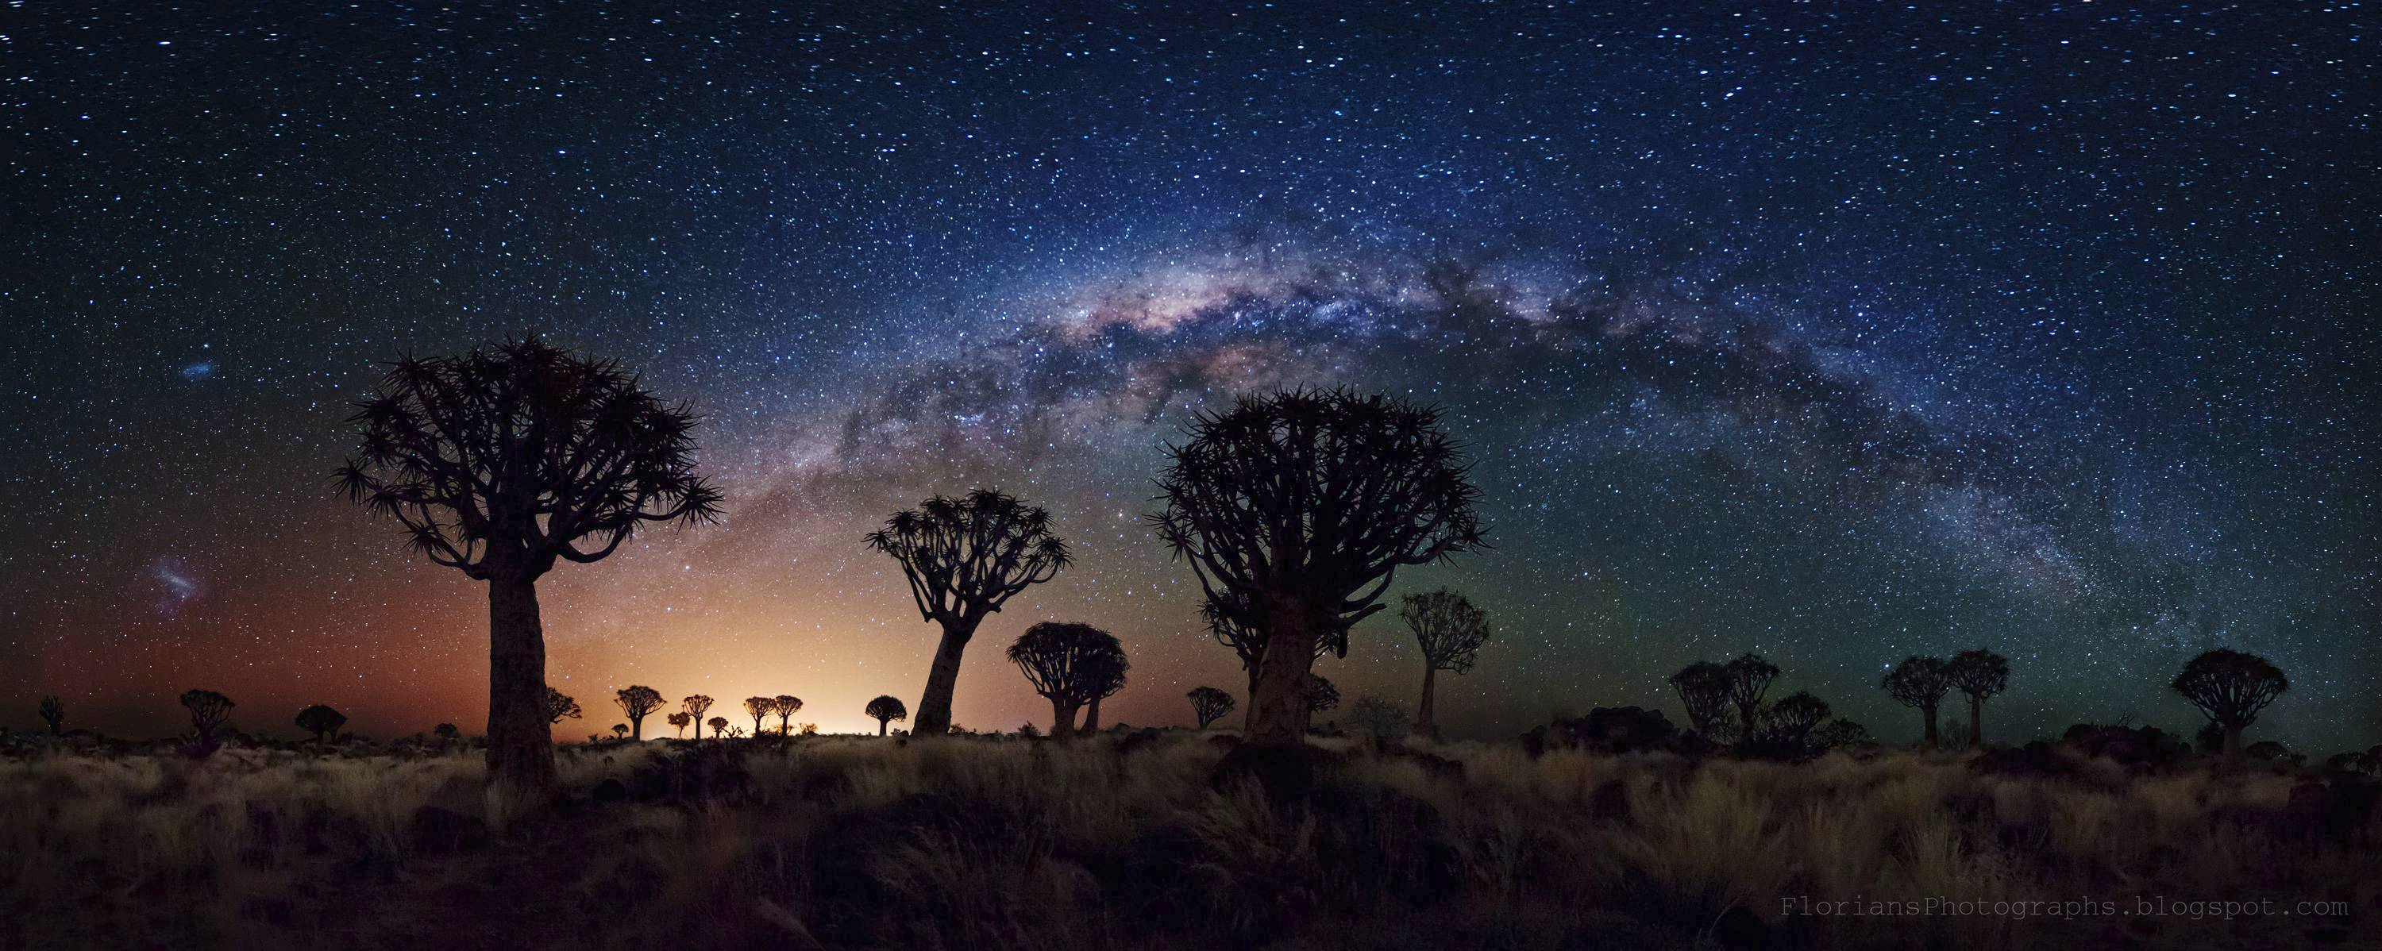
Seeing the Milky Way

Slide 12
Sadly, 99 percent of the population in the continental U.S. still lives in places considered polluted by light, meaning most of us can’t even see the massive spiral galaxy we call home: the Milky Way.
More than 100,000 light years in diameter with more than 100 billion stars and at least as many planets, the Milky Way is arguably the most impressive feature of the night sky you can see with the naked eye. But actually seeing it these days? Well, that requires a little more effort than simply craning your neck.

Slide 13
Outsmart light pollution and catch a glimpse at the galaxy

Slide 15
Where to Go
Death Valley, California
Mayland Community College Blue Ridge Observatory and Star Park, North Carolina
Natural Bridges Monument, Utah
Cherry Springs State Park, Pennsylvania
Big Bend National Park, Texas
Goldendale Observatory, Washington
Chaco Culture National Historical Park, New Mexico

