Slide 1
Photographer captures rare, breathtaking images of recently flipped iceberg
By Max Knoblauch

Slide 2
Icebergs are pretty standard when it comes to appearance: They can be bold and beautiful, sure — but for the most part, they're white, snowy and generally look the same. However, filmmaker Alex Cornell created a new photo series while on vacation in Antarctica last month, which shows a completely different side — literally — to these giant blocks of ice. Heographic expedition with his mother and sister, Cornell's boat encountered an overturned iceberg with amazing coloration in Antarctica's Cierva Cove. "To me, this one looked just as incredible as all of the icebergs," Cornell told Mashable on Saturday. "But the naturalist on board was there to kind of tell us, 'No, this is something different; this is crazy.'"

Slide 4
Icebergs appear blue for the same reasons water does. Because of their chemical makeup, they absorb light in the red end of the spectrum and blue light is reflected more prominently. Snow had recently fallen in the area, so the lack of noticeable snowfall on the iceberg in question means it had recently flipped, according to Cornell. "Its funny — as a photographer and as a person, there's so much there that's all so alien that it's almost overwhelming," he said. "Once you've seen a few penguins, a few icebergs, these crazy jagged mountains, your mind can only comprehend how incredible one or two things are at a time.“ Take a look at more photographs from Cornell's trip.

Slide 11
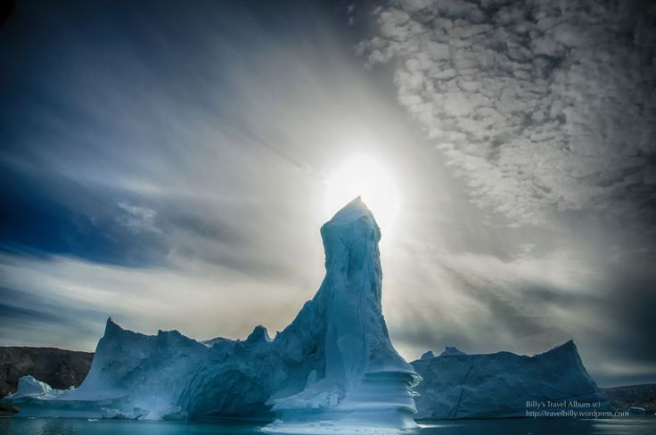
Other beautiful and/or unusual icebergs

Slide 12
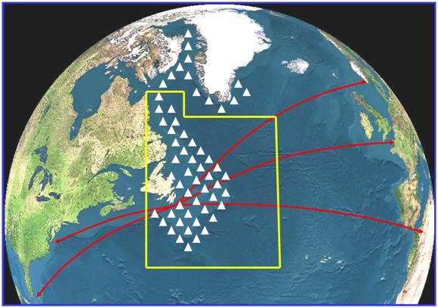
Icebergs enter the North Atlantic shipping lanes

Slide 17
Calving – the birth of an iceberg

Slide 18
Calving

Slide 32
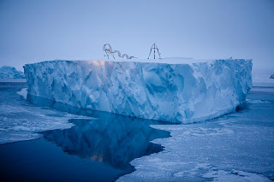

Slide 39
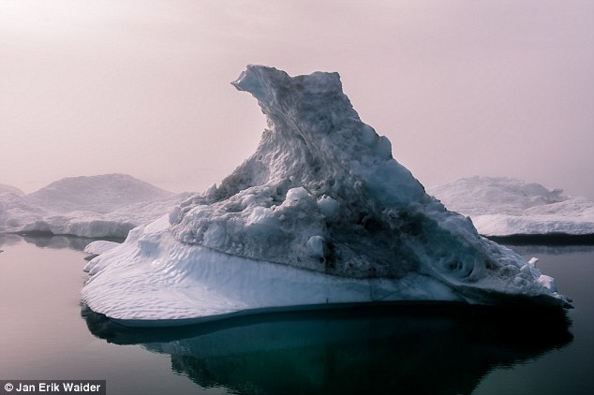

Slide 43
Unusual, rare, red iceberg

Slide 57
