Slide 1
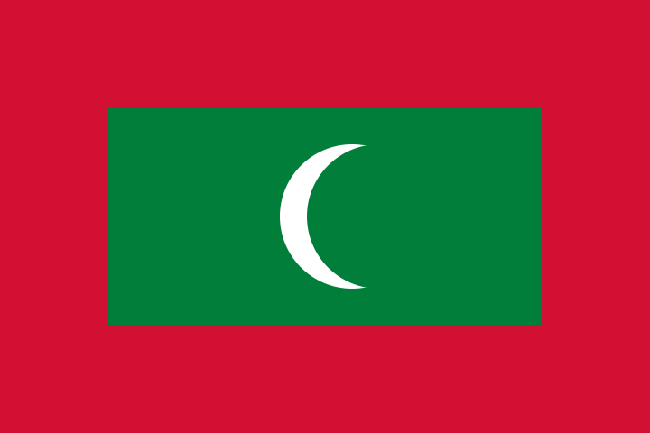
Maldives

Slide 2
Maldives, officially the Republic of Maldives, is an island nation consisting of a group of atolls in the Indian Ocean, south of Lakshadweep group of islands of India, about seven hundred kilometers (435 mi) south-west of Sri Lanka. The twenty-six atolls encompass a territory featuring 1,192 islets, roughly two hundred of which are inhabited by people.
The country's name may stand for "Mountain Islands" (malai in Tamil, meaning "mountain" and teevu in Tamil meaning "island") or it might mean "a thousand islands". Maldives is the smallest Asian country in terms of population, and the smallest Asian country that is a member of the United Nations.
Maldives holds the record for being the flattest country in the world, with a maximum natural ground level of only 2.3 m (7½ ft.), though in areas where construction exists this has been increased to several meters. Over the last century, sea levels have risen about twenty centimeters (8 in). The ocean is likely to continue rising and this threatens the existence of Maldives.

Slide 3
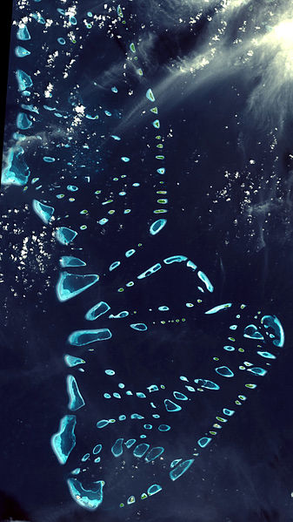
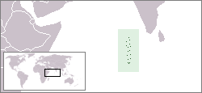

Slide 4
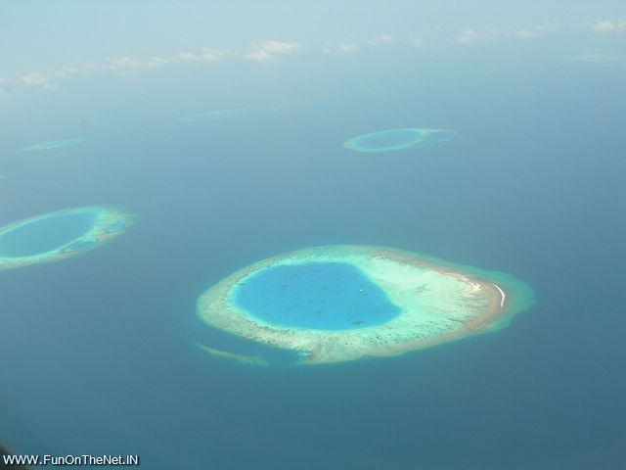

Slide 5
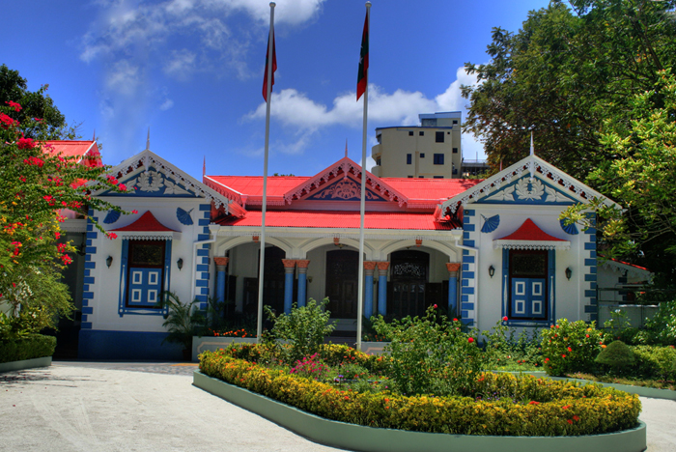
Muliaa'ge: the Presidential Palace of Malé, Maldives

Slide 6
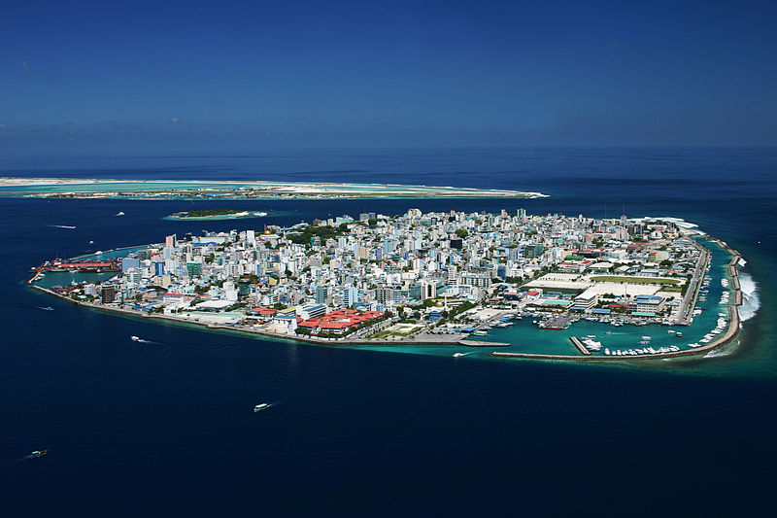
Malé, the capital of the Maldives

Slide 7
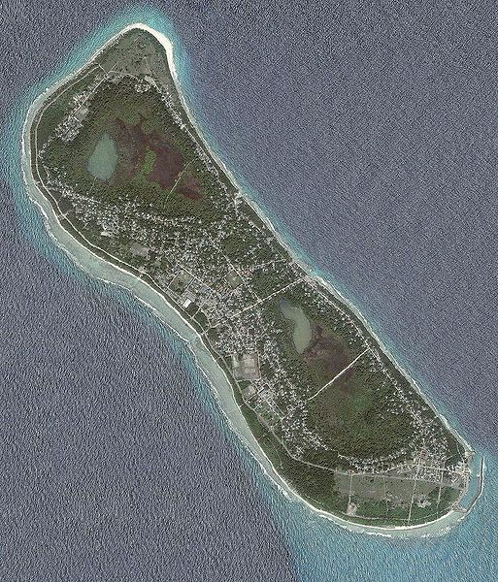
Fuvahmulah

Slide 8
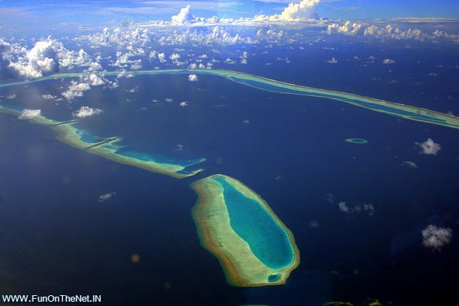

Slide 9
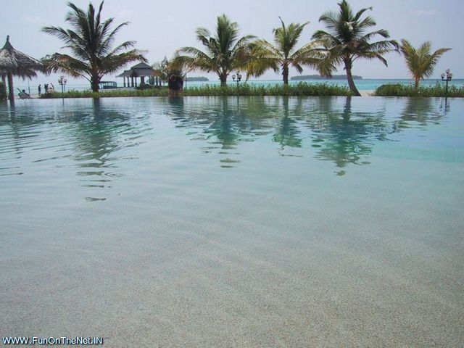

Slide 10
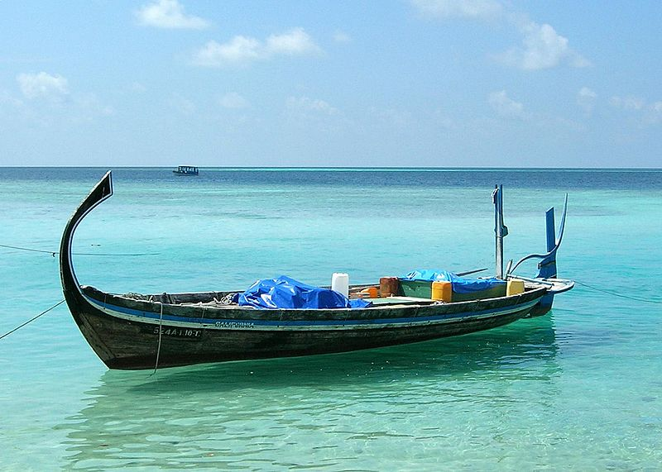

Slide 11
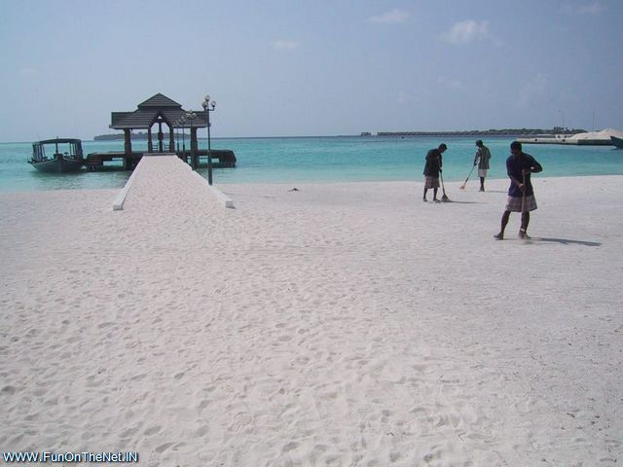

Slide 12
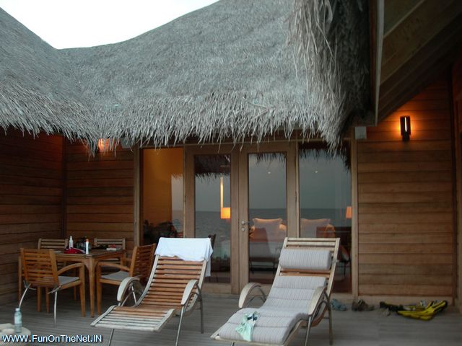

Slide 13
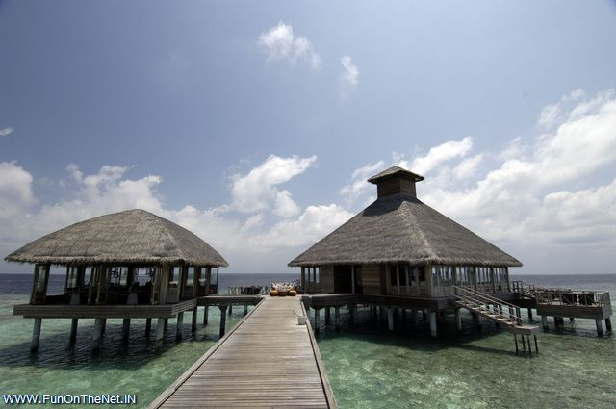

Slide 14
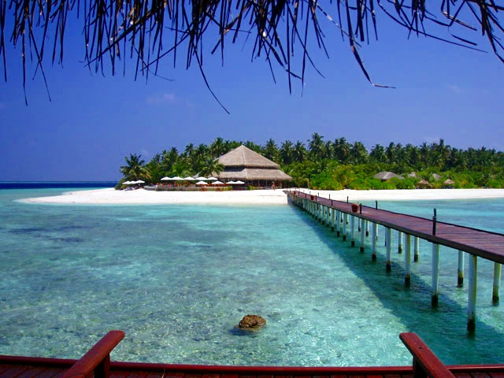

Slide 15
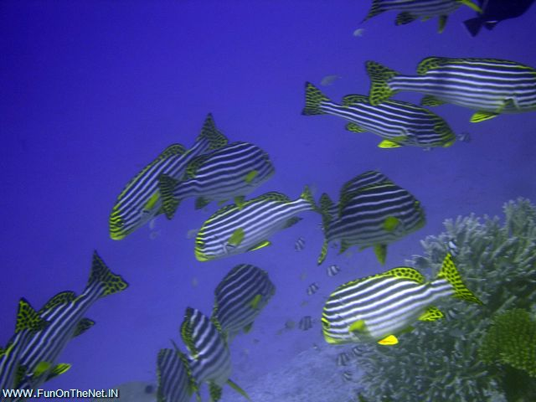

Slide 16
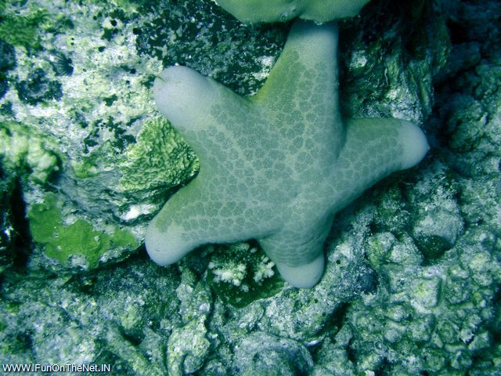

Slide 17
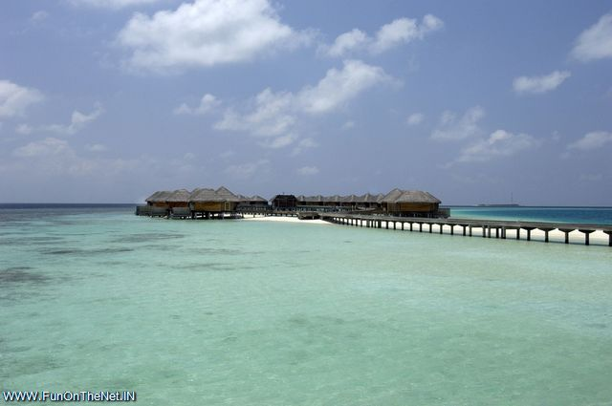

Slide 18
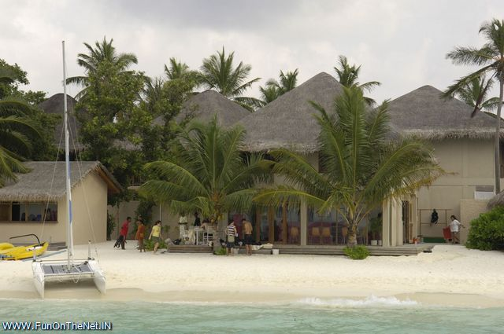

Slide 19
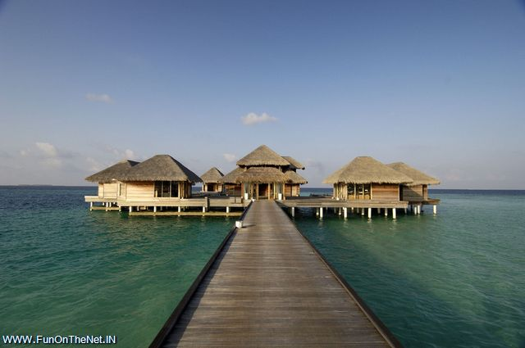

Slide 20
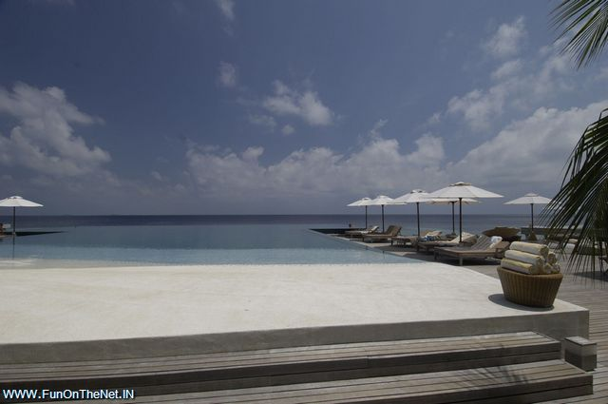

Slide 21
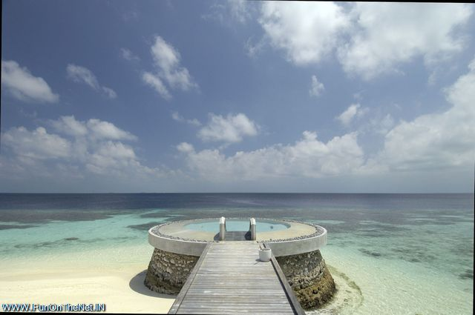

Slide 22
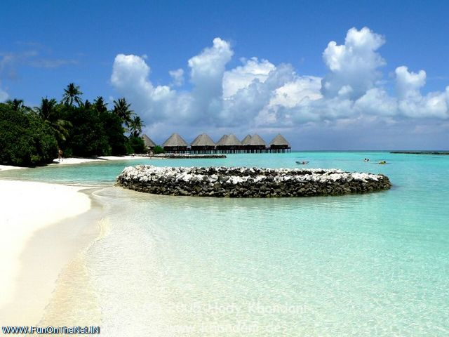
Velidhu Island Maldives

Slide 23
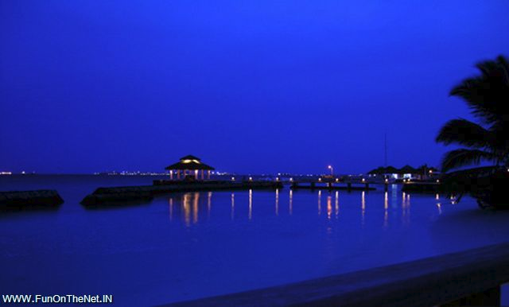

Slide 24
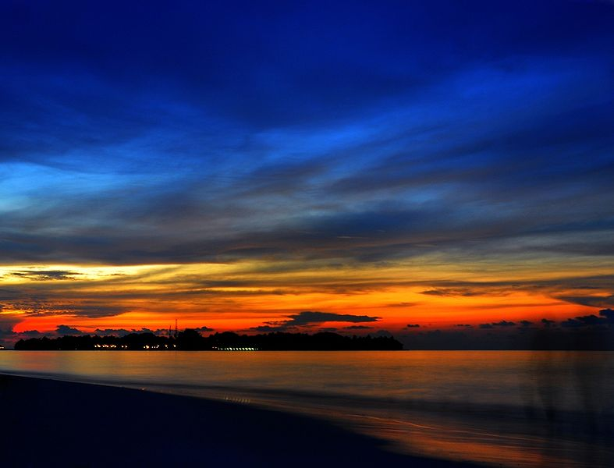

Slide 25
