Slide 1
Hiking the John Muir Trail
Notes:
更多模板、视频教程：http://www.mysoeasy.com

Slide 2
The Beauty of the Earth
Don’t Miss It
Notes:
更多模板、视频教程：http://www.mysoeasy.com

Slide 3
Click here to add your title
The John Muir Trail is 210 miles of breathtaking landscape in California's Sierra Nevadas that begins in Yosemite Valley and ends at the top of Mount Whitney. The record for covering the trail is 3 days, 9 hours, and 5 minutes, set in August by ultrarunners Hal Koerner and Mike Wolfe, but most people take two to three weeks to finish it. The following is a photo gallery of some of the staggering beauty you'll encounter on this trail, arguably one of the most spectacular in the world. Photo by Travis Burke
Notes:
更多模板、视频教程：http://www.mysoeasy.com

Slide 4
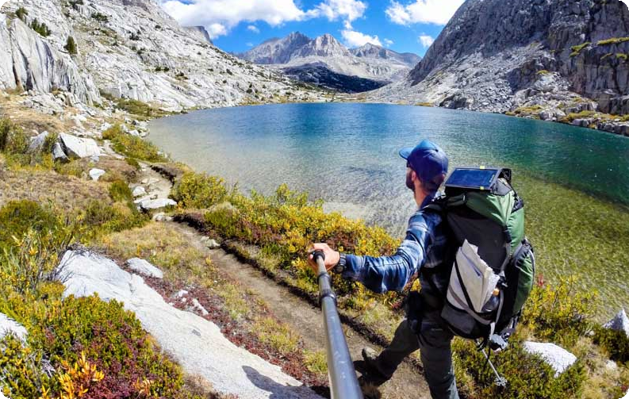

Slide 5
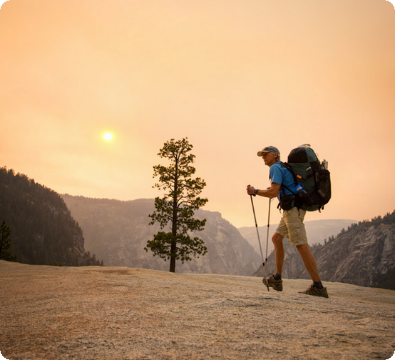
The John Muir Trail winds through Yosemite, Kings Canyon, and Sequoia National Parks, and in late September, raging wildfires in Yosemite tinged the sky orange and left the park smelling of smoke and almost completely deserted, a rarity for one of the world's most popular destination spots.

Slide 6
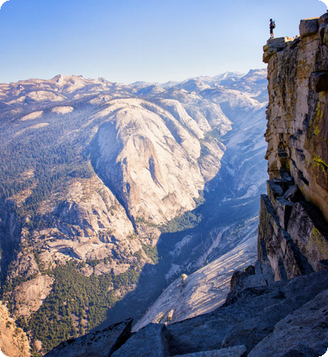
Within Yosemite there is a cavernous granite dome called Half Dome, and generally it is extremely difficult to get a permit to hike to the top of this dome. If you are on a long-distance hike, however, obtaining permits can be a little easier, which is why a side trip to the Half Dome is highly recommended if you happen to be trekking the John Muir Trail.

Slide 7
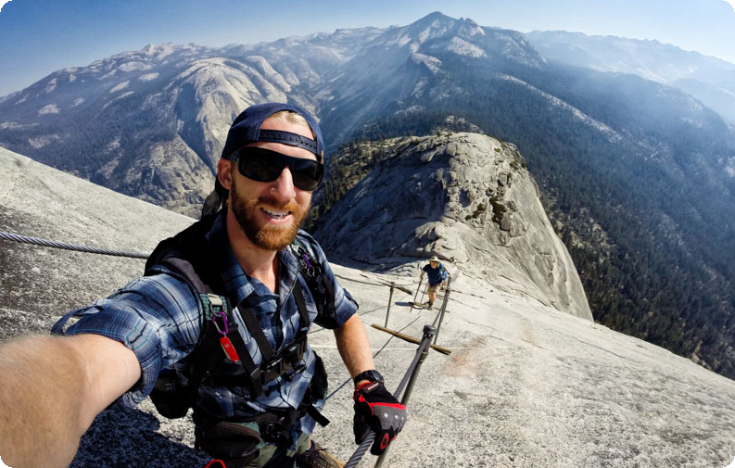
A trek up Half Dome requires that hikers pull themselves up with cables

Slide 8
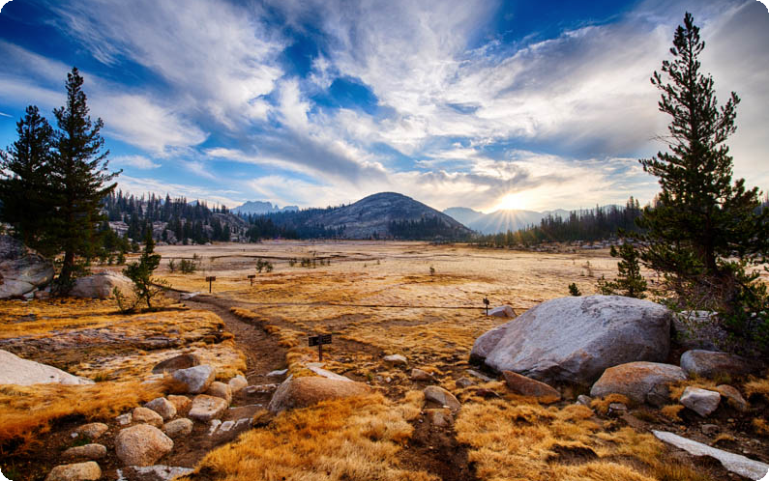
This photo, taken in the morning, is deceivingly peaceful, as a storm raged the night before. The lightning and thunder were less than a second apart, which made setting up camp frightening to say the least.

Slide 9
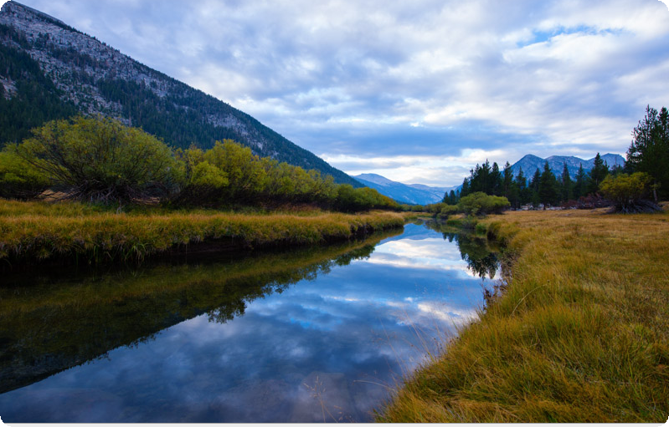
A river reflects the clouds in Yosemite's Lyell Canyon

Slide 10
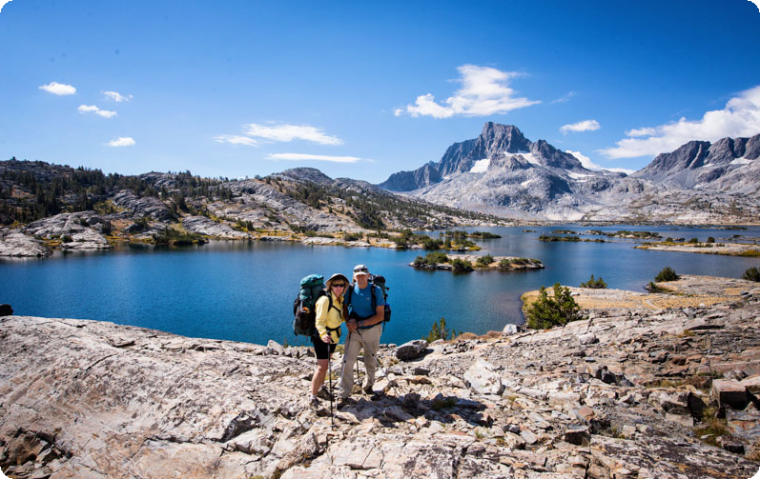
Karen and Ron Burke pose in front of Thousands Islands Lake on a bluebird day. If you look closely, you can see a few glaciers atop Mount Ritter in the distance.

Slide 11
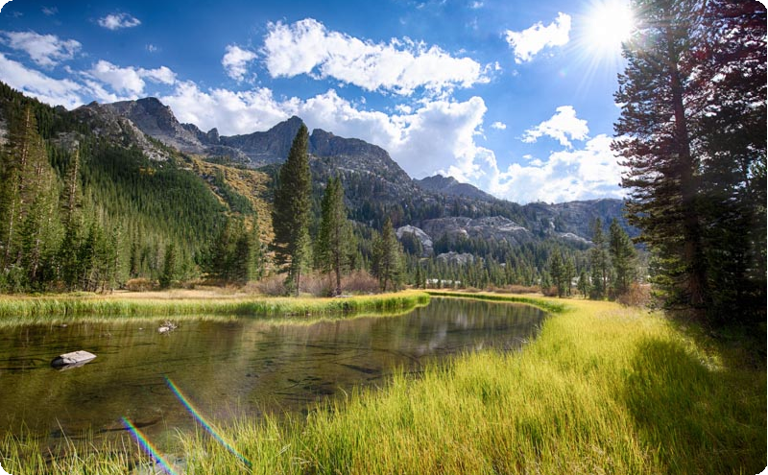
Much of the landscape along the John Muir Trail is so beautiful, it doesn't appear real. It's almost like you're living inside of a painting, or perhaps the "Sound of Music."

Slide 12
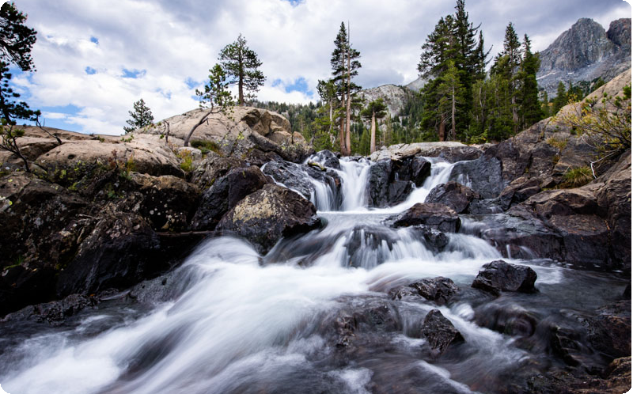
When hiking the trail, waterfalls are also an important source of water, which is very heavy and difficult to carry. Most hikers use filtration systems such as a SteriPen or special tablets to kill any viruses and bacteria in the water

Slide 13
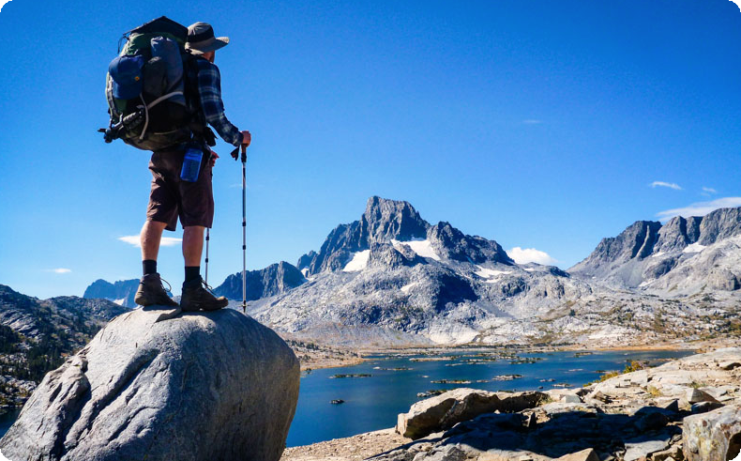
Here, Travis takes a second to soak in the trail's awe-inspiring sights.

Slide 14
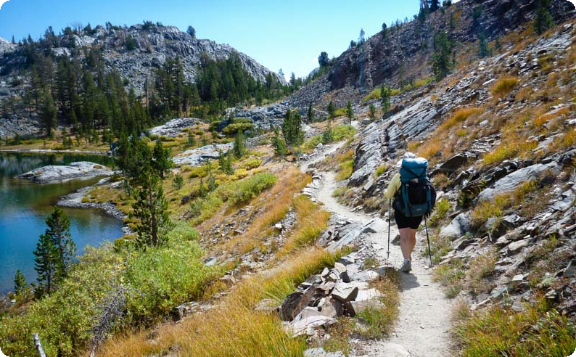
Every bend in the John Muir Trail produces a new yet always majestic sight.

Slide 15
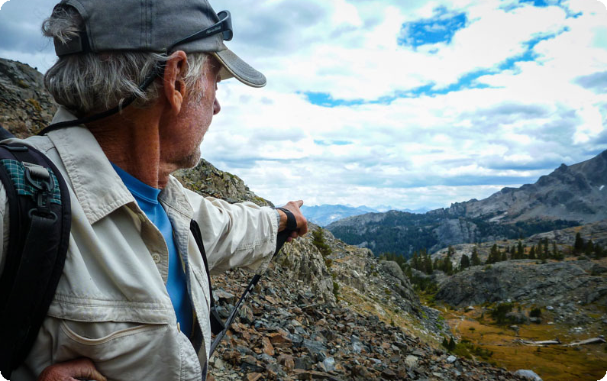
We're hiking much, much farther than those mountains," says Ron Burke after Travis, his son, started asking whether or not they could see Mount Whitney.

Slide 16
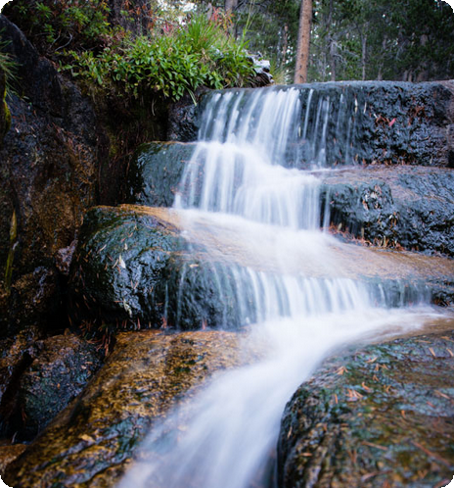

Slide 17
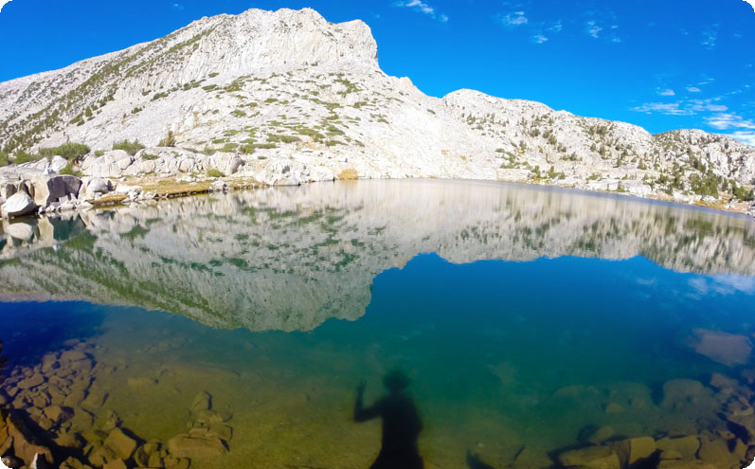
The lake was so clear that not only did it reflect the mountains exactly, but it also allowed Travis Burke to capture a self portrait of sorts

Slide 18
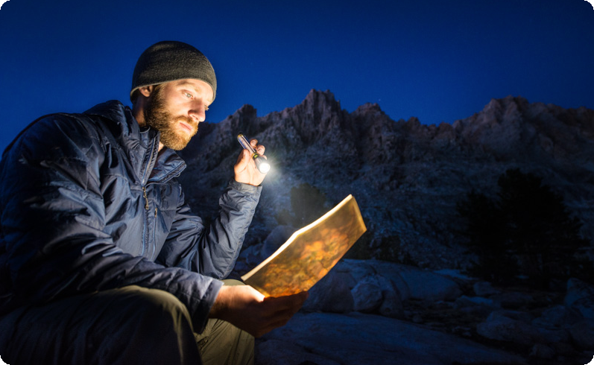
Travis Burke uses his Goal Zero flashlight to plan out the following day. The flashlight is charged using a solar panel, and its battery can be used to charge other electronics.

Slide 19
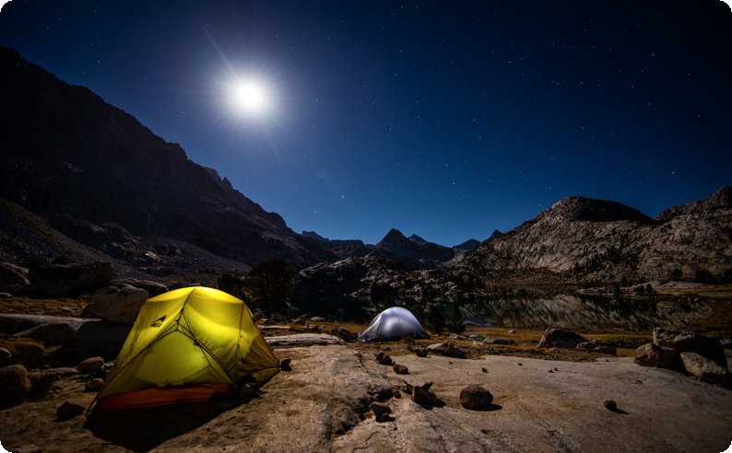
The moon rises over Evolution Lake on the John Muir Trail;

Slide 20
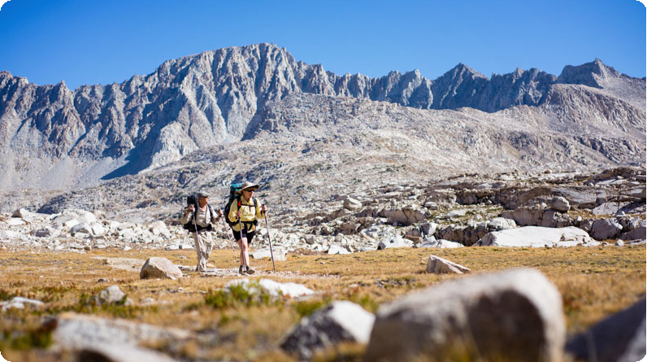
When hiking along the John Muir Trail, the landscape appears to change every 10 minutes or so. Here, at around 10,000 feet, the hikers are above the treeline and could almost be walking on the moon.

Slide 21
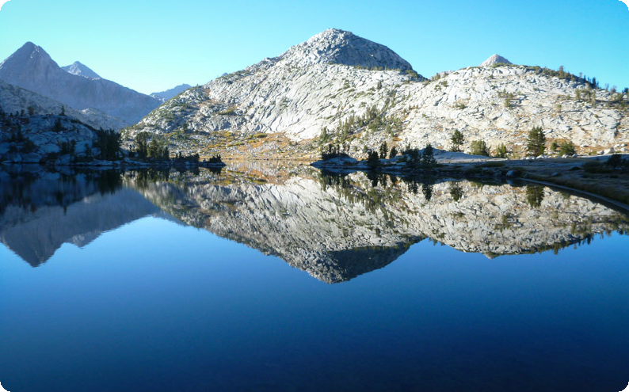
Every morning you wake up along the John Muir Trail, you see mountains in the distance that you must climb over. After those mountains, even more will rise before you in the distance

Slide 22
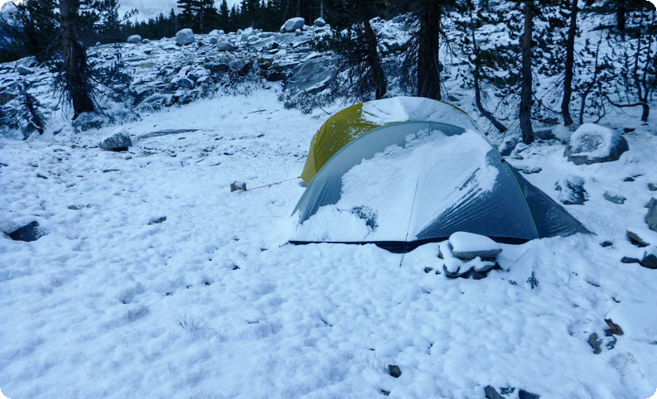
The hikers brought minimal clothing so as to reduce the weight of their packs, so setting up their tents in the snow was cold, to say the least.

Slide 23
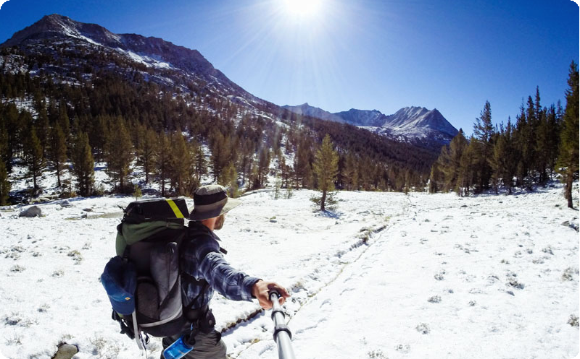
Luckily, the weather was only bad for one night, and the snow wasn't thick enough the next morning to hide the trail.

Slide 24
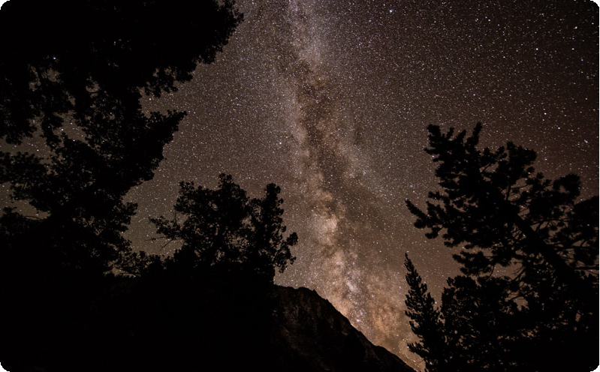
Throughout the entire trip along the John Muir Trail, the moon was extremely bright and thus didn't create promising conditions for night photography, but this shot of the Milky Way rising over the mountains was captured as the moon began to wane.

Slide 25
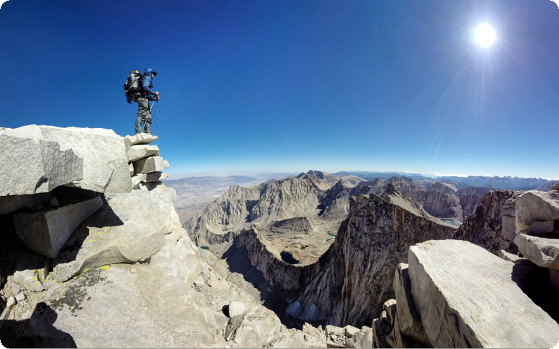
Travis Burke stands atop Mount Whitney, which rises 14,500 feet and marks the end of the John Muir Trail.

Slide 26
Fantastic!
America is such a beautiful place, if people would just slow down and do more than just look - If they take time to really see what is around them, they will truly be blessed with the sight of beauty and majesty. You rarely see that when travelling the interstate highways.

