Slide 1
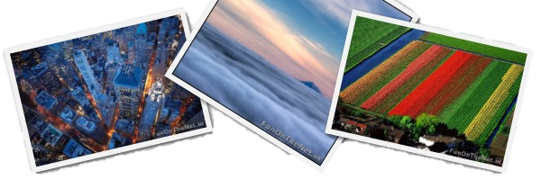
Fantastic Photos

Slide 2
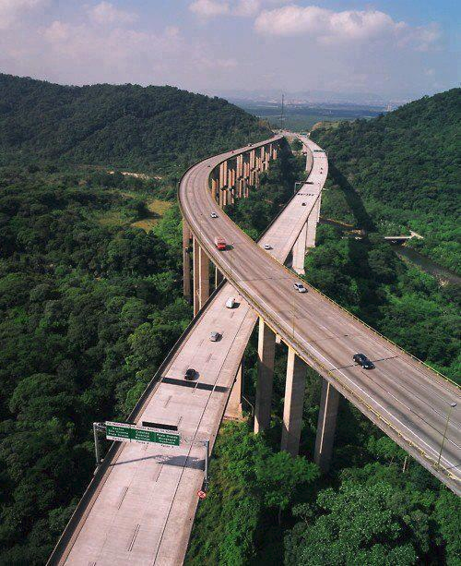
Impressive highway system above the Rainforest in Sao Paolo, Brazil

Slide 3
Dinner in the sky in Brussels, Belgium

Slide 4
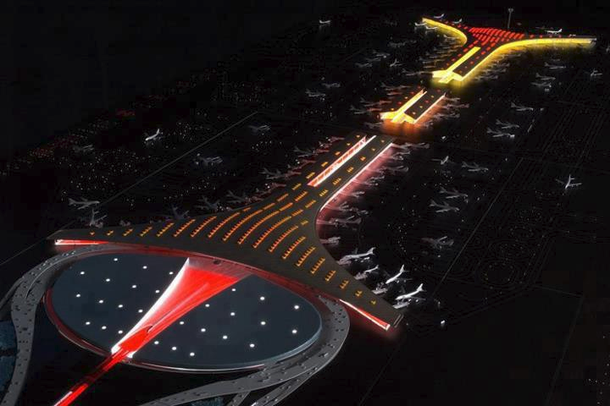
Beijing International Airport, China

Slide 5
Super Moon rising above Sierra Nevada Sequoia National Park, California

Slide 6
The Amazing Stone Mirror in Istanbul, Turkey

Slide 7
Amazing view of Schwerin Castle, Germany

Slide 8
The water is so clear it looks like the boat is hovering! - Bora Pearl Beach

Slide 9
Heart Island in mangrove delta of the Vaza-Barris River, Brazil

Slide 10
Escalator of the New World Trade Center

Slide 11
Airplanes rolling over highway at Leipzig-Halle Airport in Germany

Slide 12
Amazing walk at West Side of Taihang Mountain in Shanxi Province, China

Slide 13
Impressive Swim Pool Balconies at Bandra Ohm Residential Tower in Mumbai, India

Slide 14
Mesmerizing Niagara Falls - Rainbow Bridge, USA

Slide 15
Ferrari World Theme Park in Abu Dhabi

Slide 16
Amazing Corinthos Channel in Greece

Slide 17
Awesome Singapore - Dance of Light

Slide 18
World's Largest Ice Cave in Austria

Slide 19
The Streets of Monaco Yacht

Slide 20
World's first billion dollar house in Mumbai, India - 27 Floors Ambani's Palace

Slide 21
Amazing Landwasser Viaduct Switzerland

Slide 22
Great Aerial Photography
Aerial photography allows us to view the world from a completely new perspective. It is a method of capturing photographs of the land from an elevated location. What makes this technique so unique is that the camera from which these pictures are taken is not supported by a ground-based structure. The camera may be mounted or hand held. Photographers are taken by a photographer, generated either remotely or automatically. Such photographs can be taken from helicopters, rockets, blimps, parachutes etc. Enjoy and be inspired by the following photographs.

Slide 23
Above the Ceiling:

Slide 24
Agricultural landscape near Cognac, Charente, France:

Slide 25
This photographer, Denis Giles has captured the essence of autumn through this beautiful photograph.

Slide 26
A worker rests on bales of cotton in Thonakaha, Korhogo, Ivory Coast. sustainable living.

Slide 27
Mountainous countryside near Maelifellssandue, Myrdalsjokull Region, Iceland.

Slide 28
It is an actual photo of a salt pond taken from an aeroplane.

Slide 29
Taken during a departure from Munich

Slide 30
A glimpse of New York city from the bird's eye view

Slide 31
Paris sunset in gold.

Slide 32
Sarychev valcono in an early stage of eruption

Slide 33
Skyline at sunset by Jeff Bartelt.

Slide 34
Meandering river

Slide 35
London at night

Slide 36
Early morning mists at Stonehenge in the UK

Slide 37
Tulip fields near Lisse, Amsterdam Region, Netherlands

Slide 38
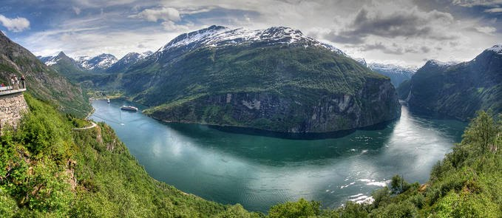
Some great, unlabeled photos

Slide 39
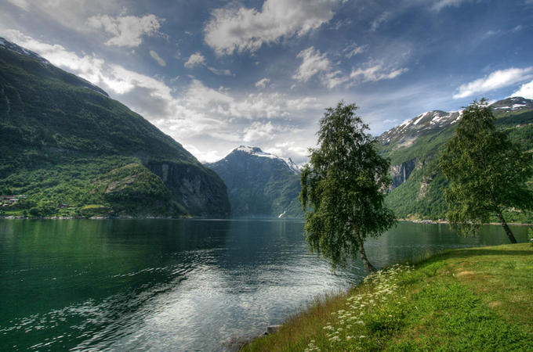

Slide 40
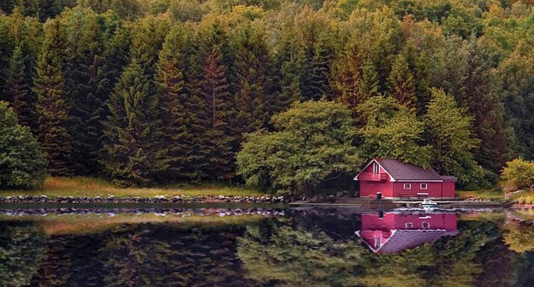

Slide 41
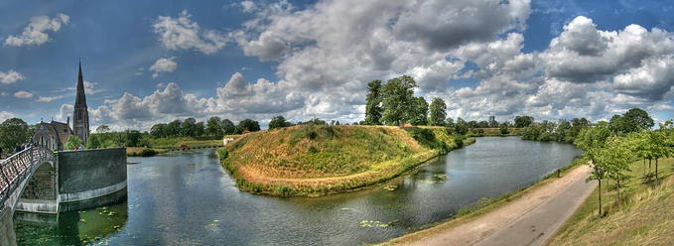

Slide 42
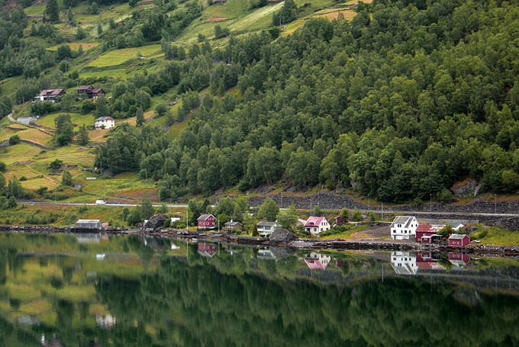

Slide 43
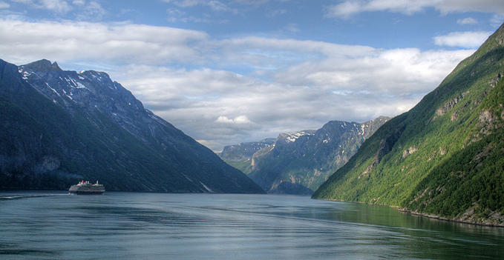

Slide 44
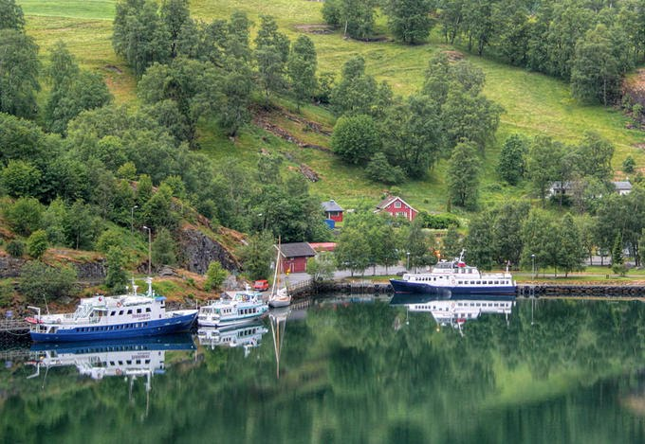

Slide 45
