Slide 1
Beautiful Bougainvillea

Slide 2
Bougainvillea is a genus of flowering plants native to South America from Brazil west to Peru and south to southern Argentina (Chubut Province). Different authors accept between four and 18 species in the genus. They are thorny, woody vines growing anywhere from 3 ft 3 in to 39 ft 4 in tall, scrambling over other plants with their spiky thorns. The thorns are tipped with a black, waxy substance. They are evergreen where rainfall occurs all year, or deciduous if there is a dry season. The leaves are alternate, simple ovate-acuminate, 4–13 cm long and 2–6 cm broad. The actual flower of the plant is small and generally white, but each cluster of three flowers is surrounded by three or six bracts with the bright colors associated with the plant, including pink, magenta, purple, red, orange, white, or yellow. Bougainvillea glabra is sometimes referred to as "paper flower" because the bracts are thin and papery.

Slide 3
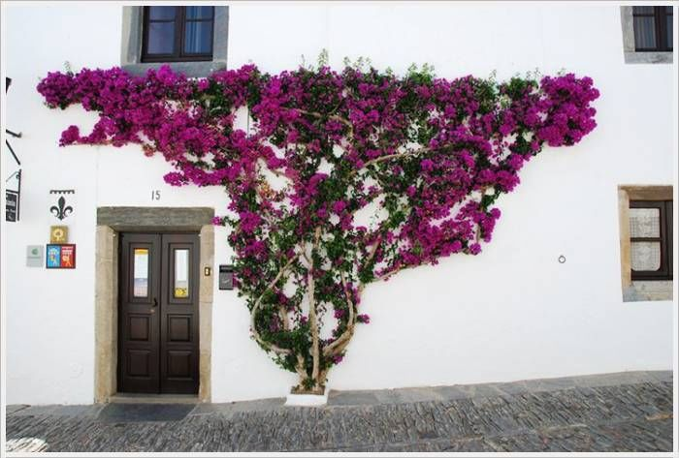

Slide 4
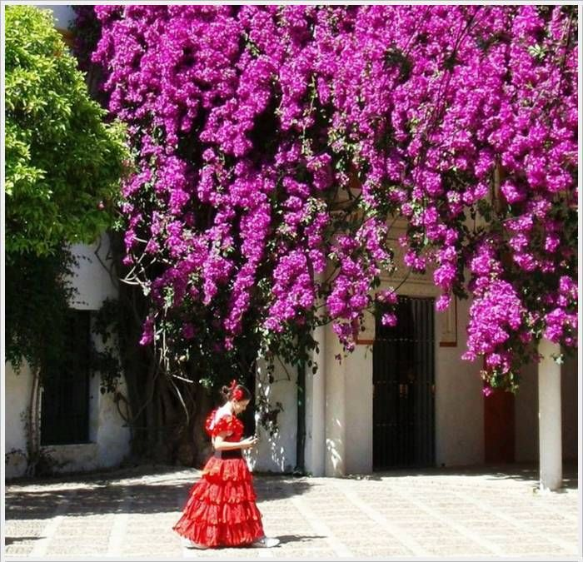

Slide 5
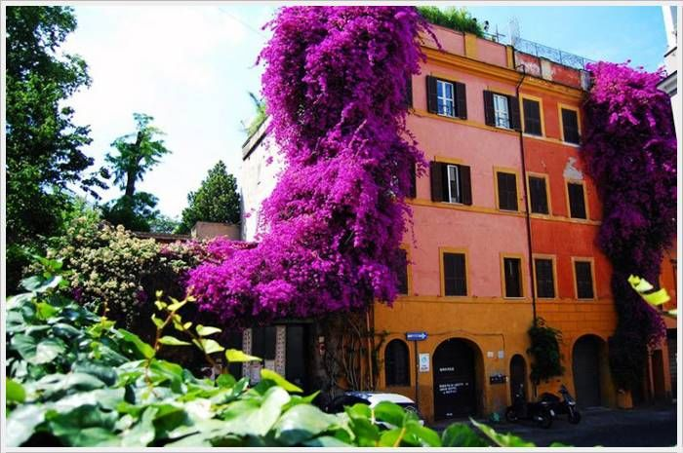

Slide 7
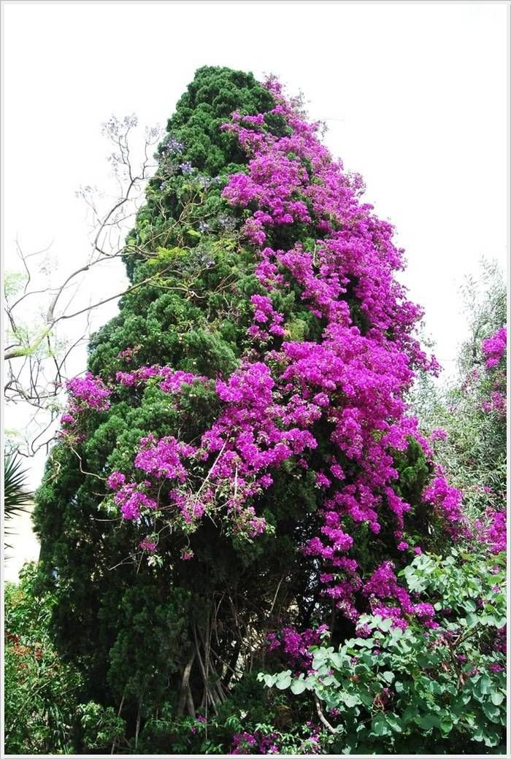

Slide 8
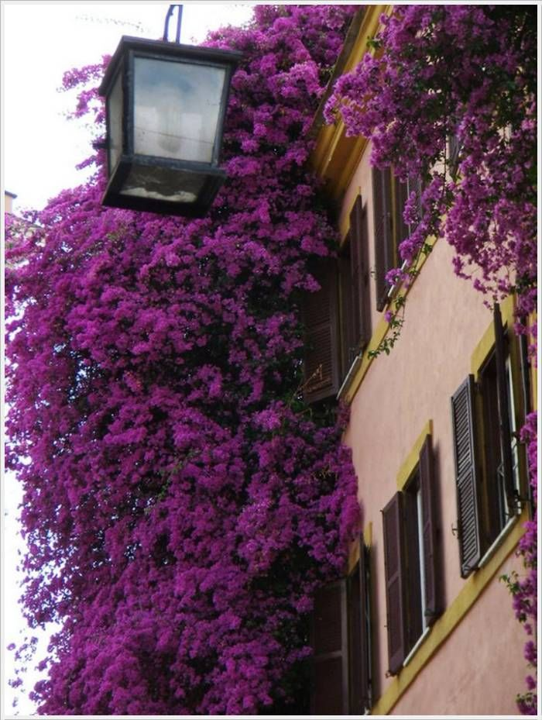

Slide 9
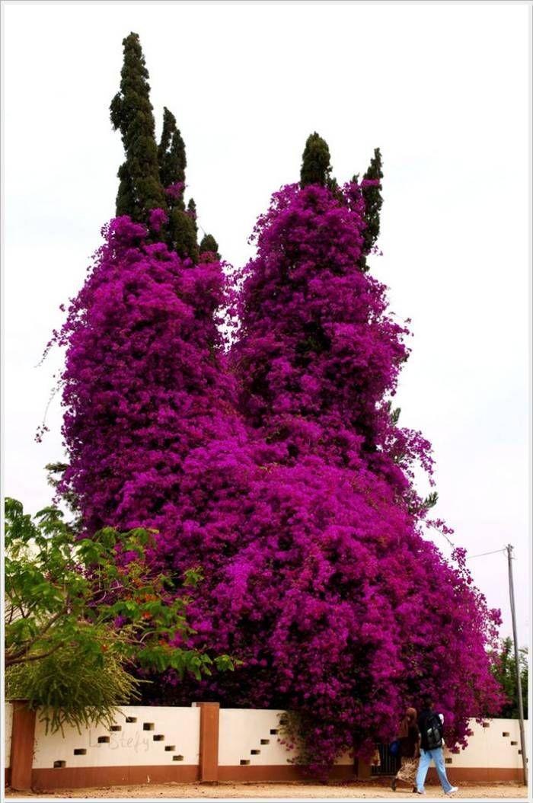

Slide 10
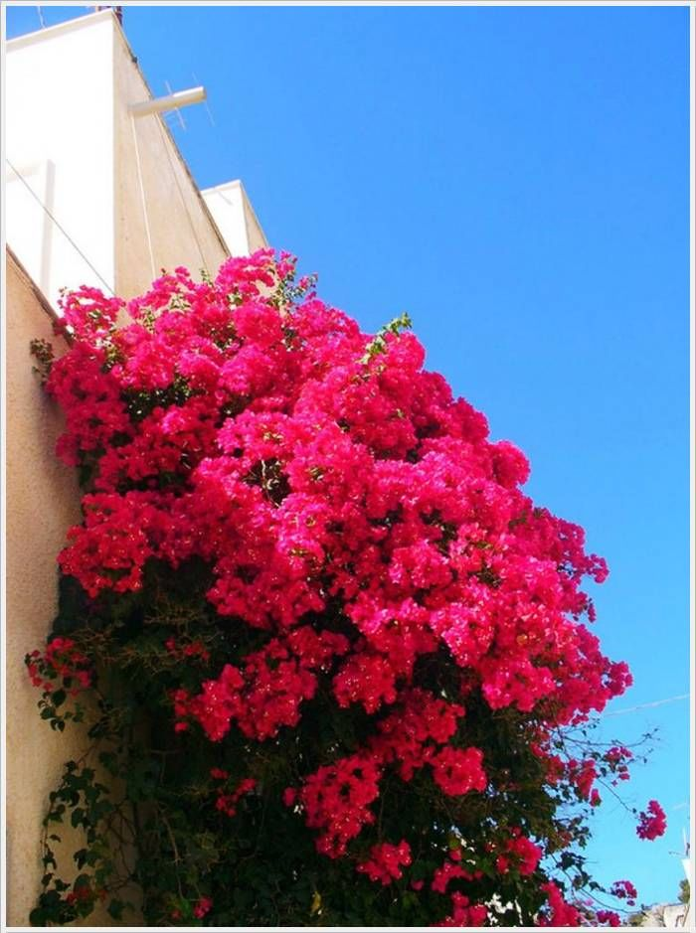

Slide 14
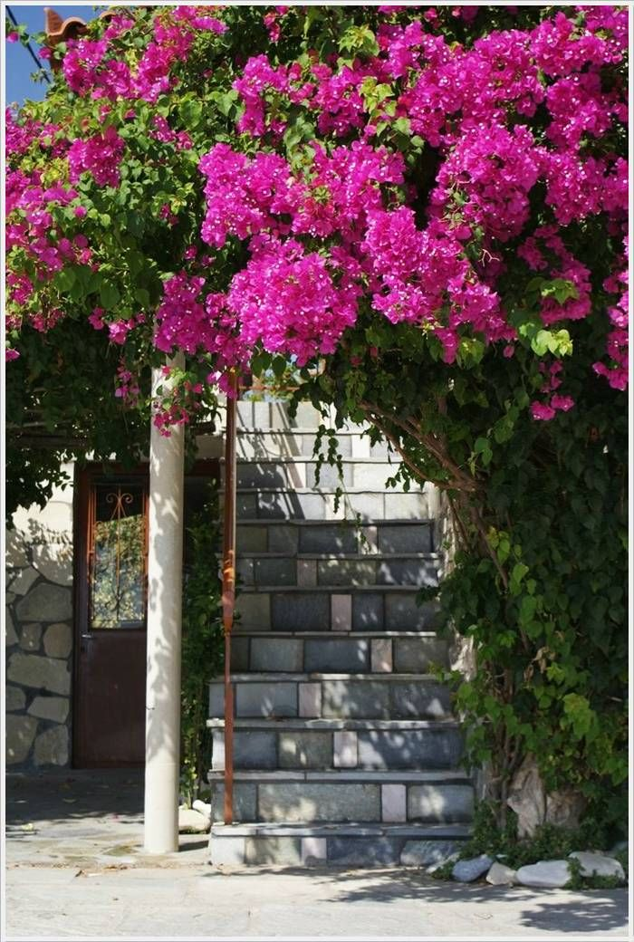

Slide 15
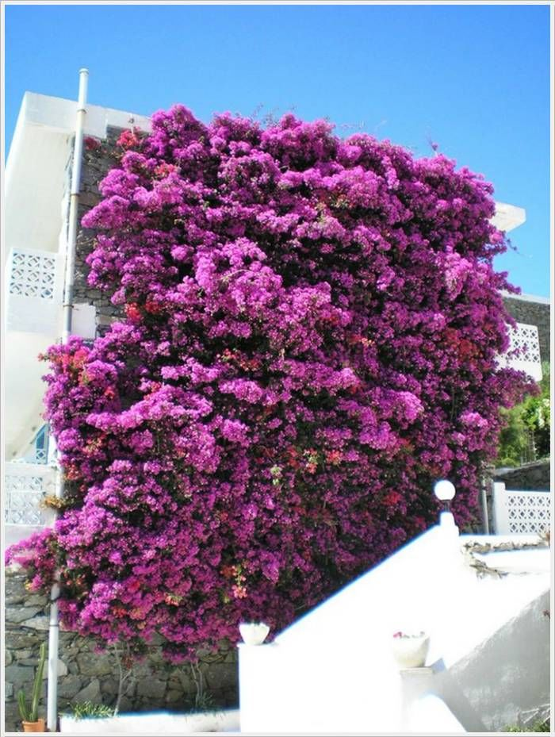

Slide 16
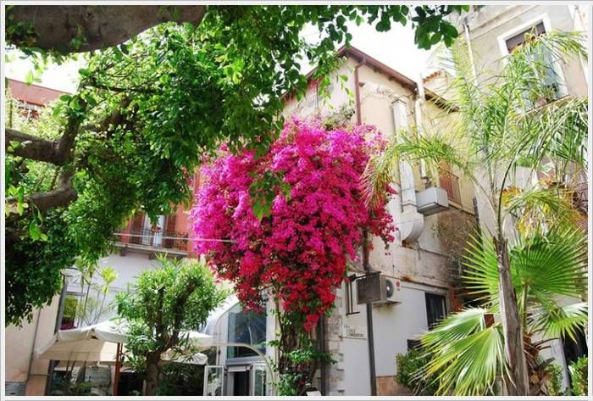

Slide 17
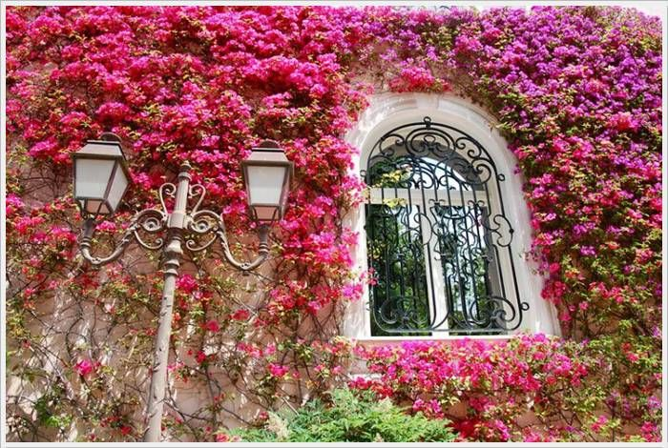

Slide 18
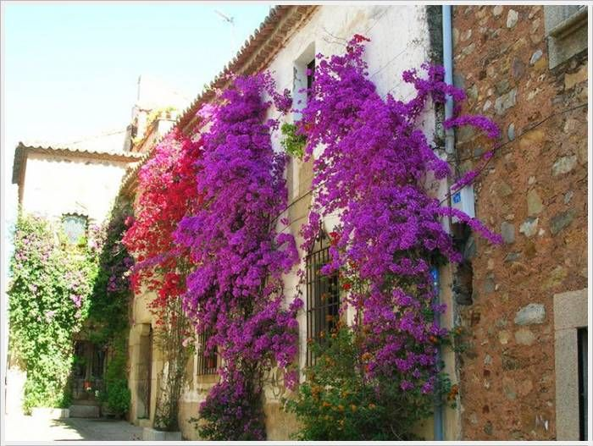

Slide 19
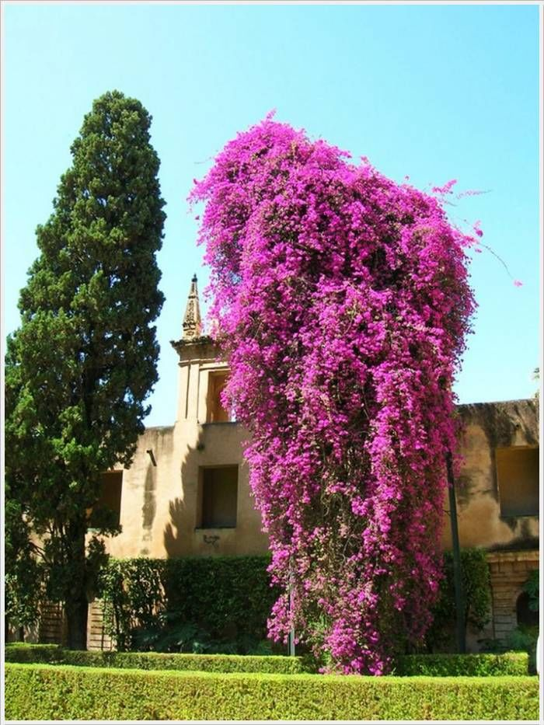

Slide 20
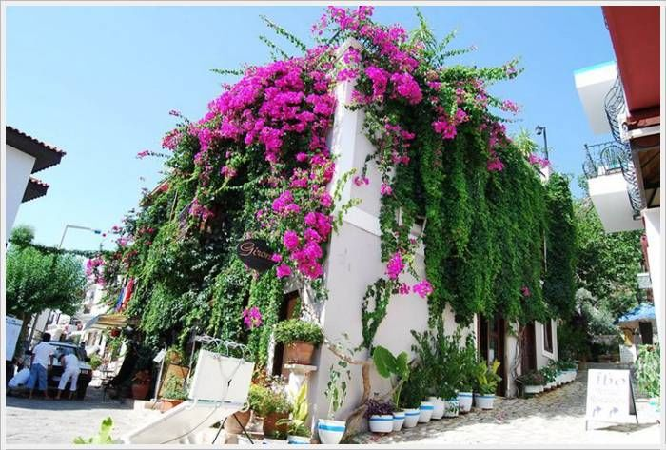

Slide 21
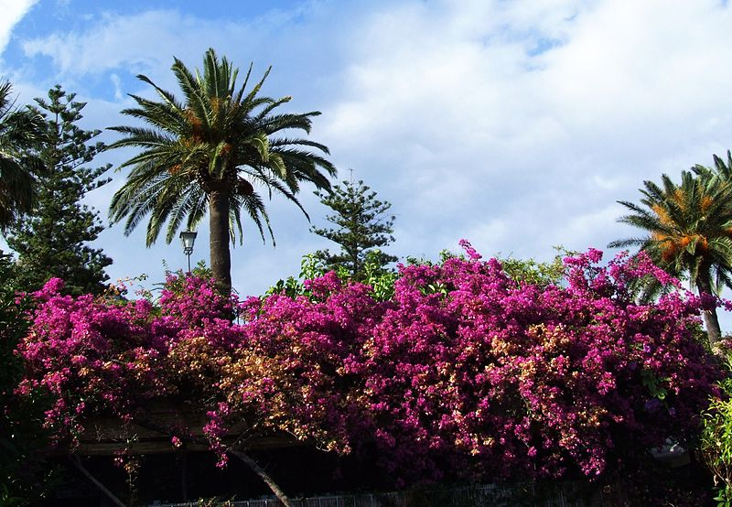

Slide 22
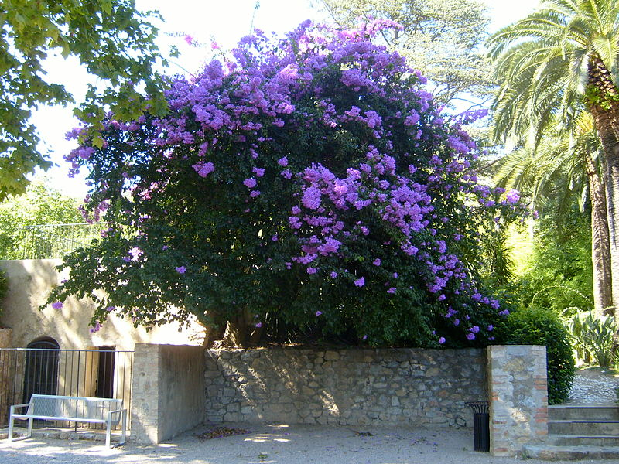

Slide 23
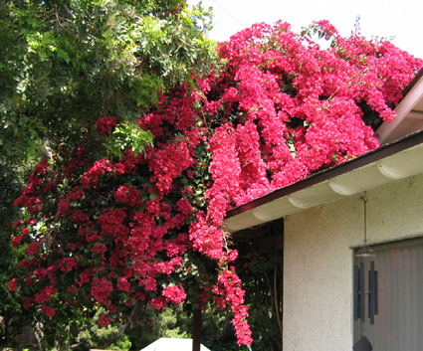

Slide 24
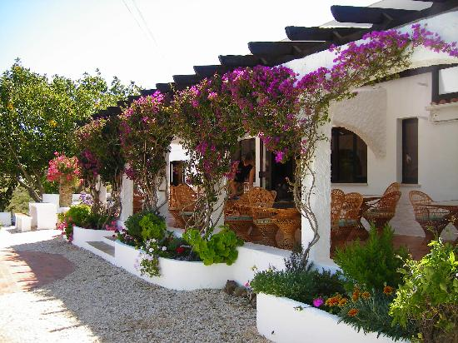

Slide 25
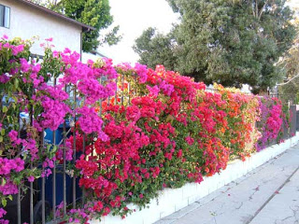

Slide 27
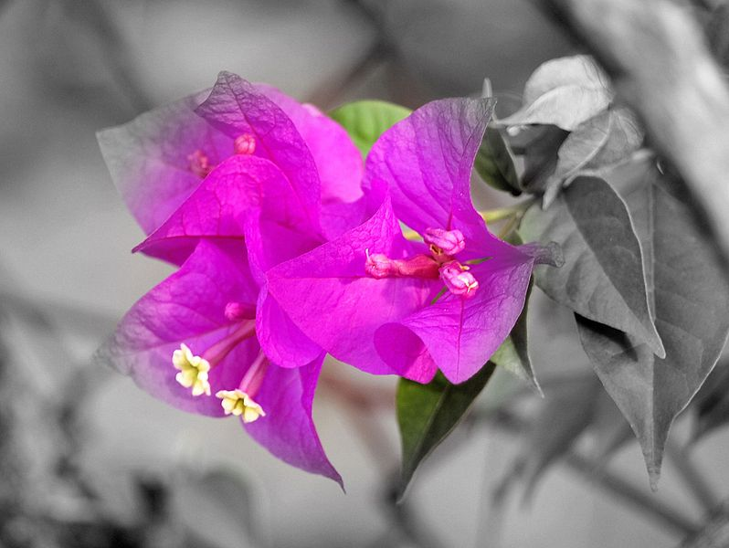
Close-ups of some Varieties

Slide 28
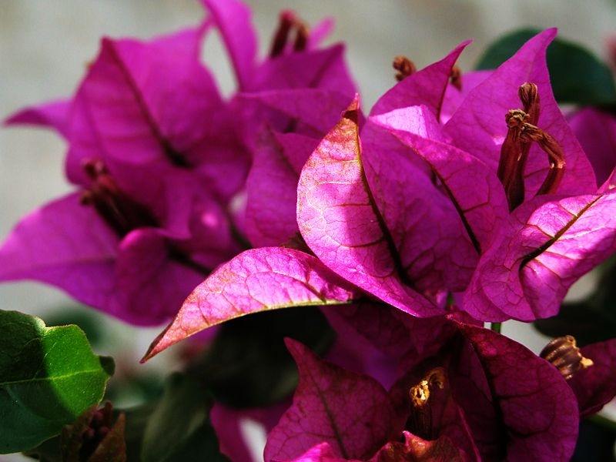

Slide 29
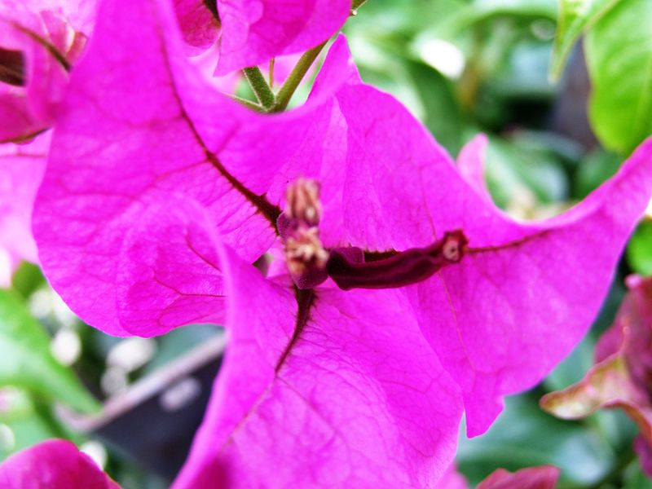

Slide 30
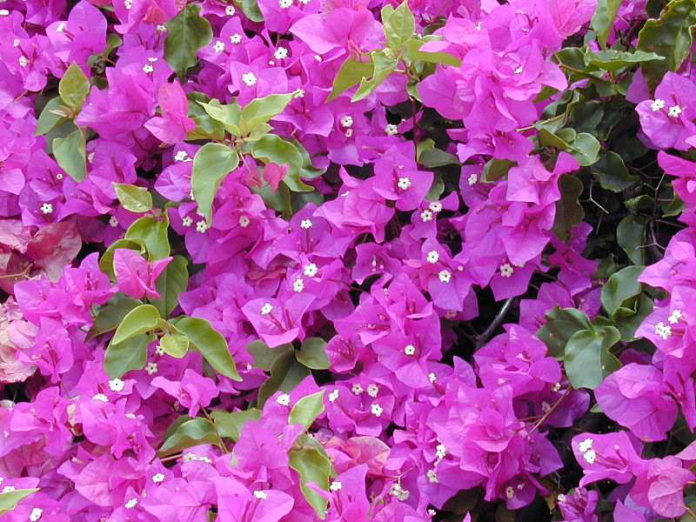

Slide 31
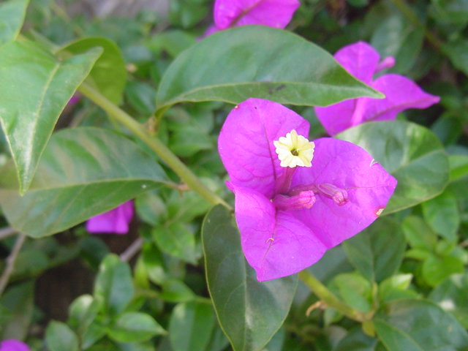

Slide 32
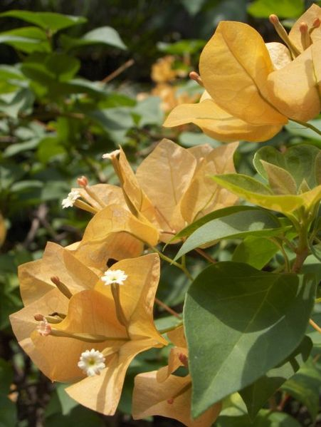

Slide 33
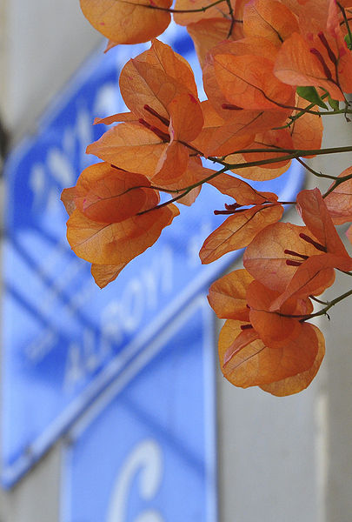

Slide 34
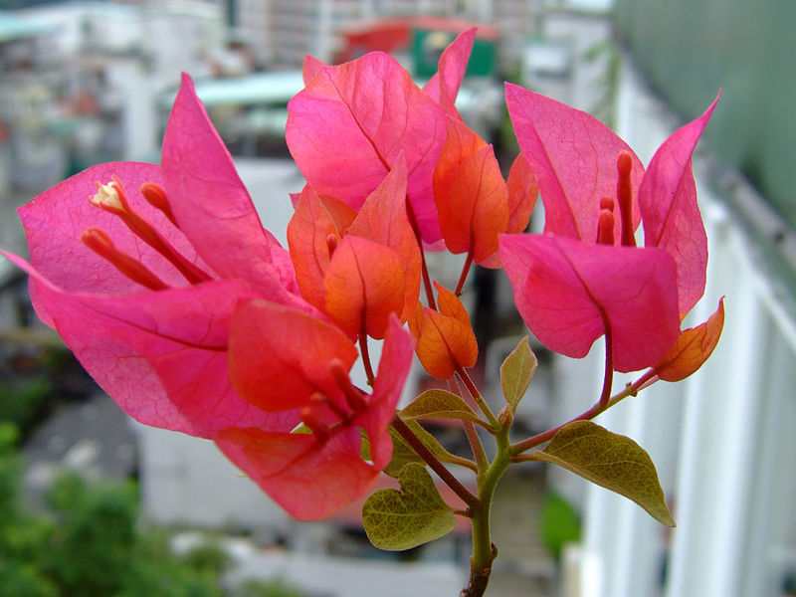

Slide 35
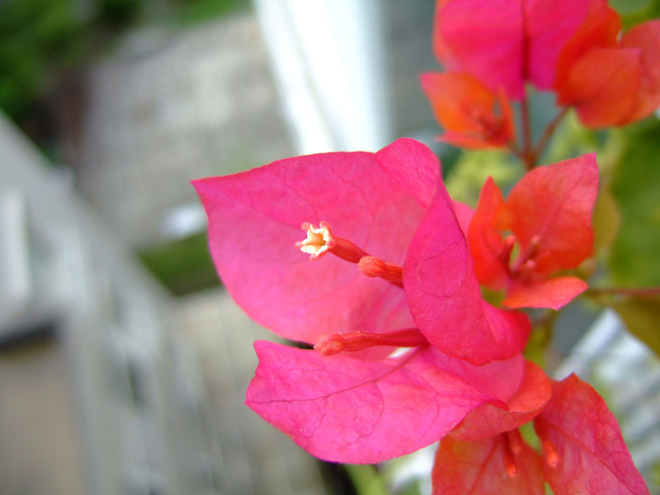

Slide 36
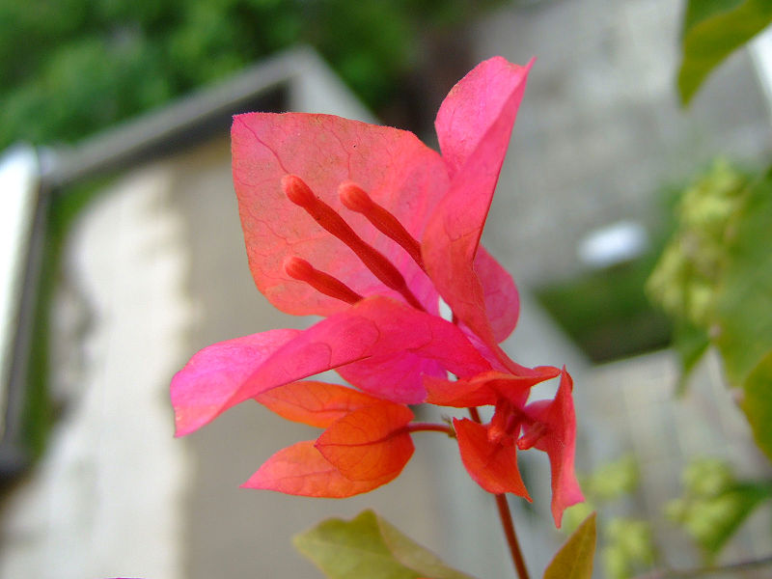

Slide 37
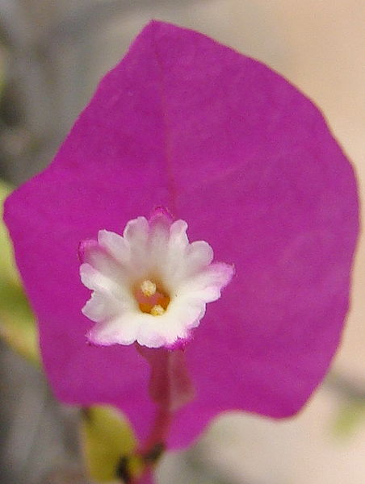

Slide 38
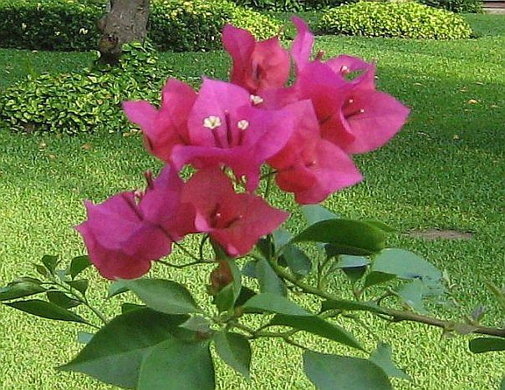

Slide 39
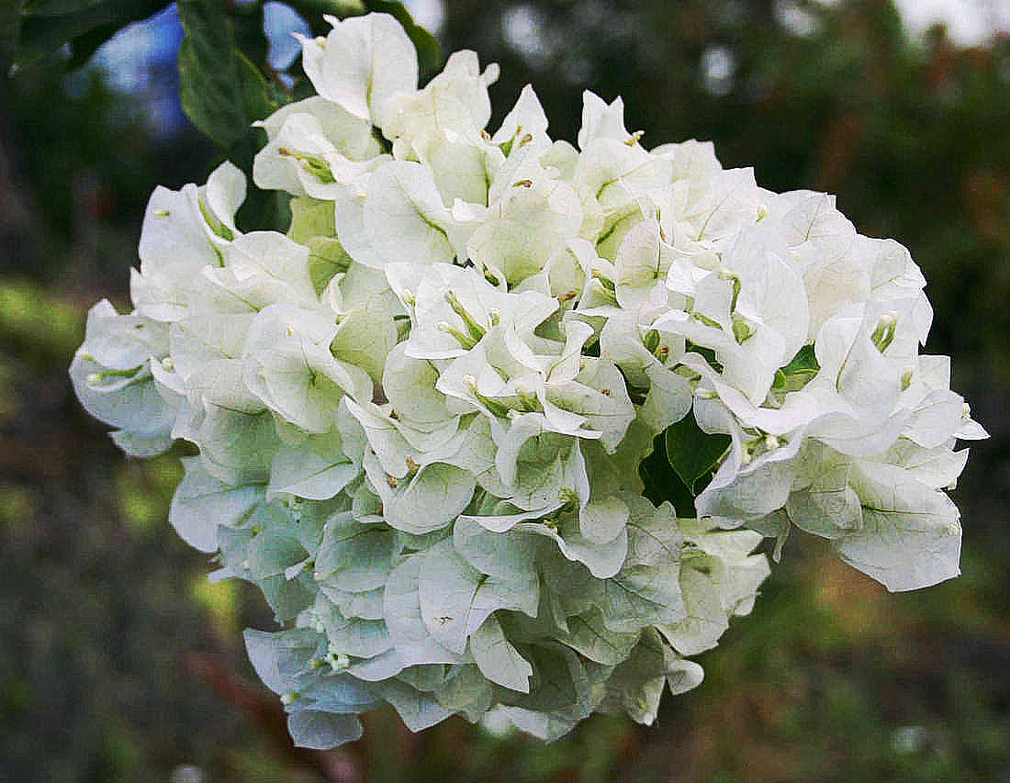

Slide 40
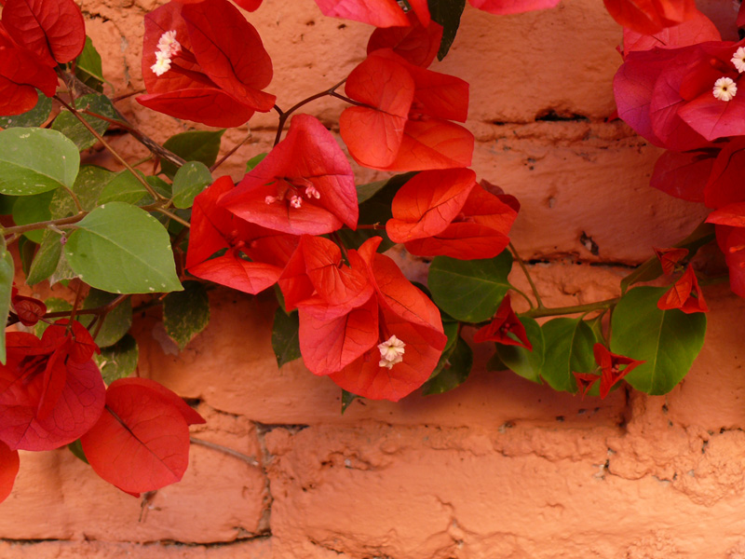

Slide 41
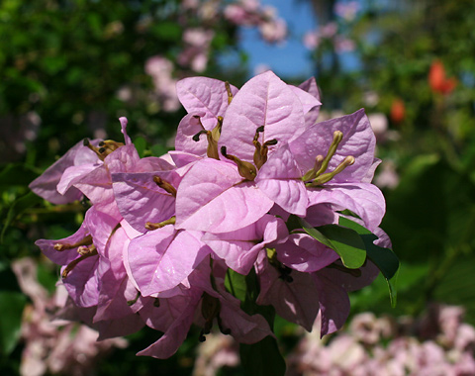

Slide 42
